Slide 1
Trigonometric Equations
Edited by Mr. Francis Hung
Last Updated: 2011-04-23
http:///www.hkedcity.net/ihouse/fh7878/

Slide 2
Trigonometric Equations
sin x = sin α
x = α or 180° - α
sin x = sin 30°
x = 30° or 180° - 30°
x = 30° or 150°
sin x = sin (-120°)
x = -120° or 180°-(-120°) or -120°+360°
x = 300° or 240°
http:///www.hkedcity.net/ihouse/fh7878/

Slide 3
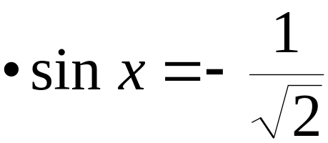
sin x = sin α then x = α or 180° - α
sin x = -1
x = -90° or 180° - (-90°)
x = 270°
http:///www.hkedcity.net/ihouse/fh7878/

Slide 4



sin x = sin α then x = α or π - α
sin x = 1.2
 -1 ≤ sin x ≤ 1
∴ x has no solution
http:///www.hkedcity.net/ihouse/fh7878/

Slide 5
cos x = cos α then x = α or 360° - α
cos x = cos 130°
x = 130° or 360° – 130°
x = 130° or 230°
cos x = –0.9
x = 154° or 360° – 154°
x = 154° or 206°
cos x = –3
 –1 ≤ cos x ≤ 1
∴ x has no solution
http:///www.hkedcity.net/ihouse/fh7878/

Slide 6
cos x = cos α then x = α or 360° - α
cos x = cos (-10°)
x = -10° or 360°-(-10°) or 360° + (– 10°) or 10°
x = 10° or 350°
cos x = cos (– 20°)
cos x = cos 20°
x = 20° or 360° – 20°
x = 20° or 340°
http:///www.hkedcity.net/ihouse/fh7878/

Slide 7
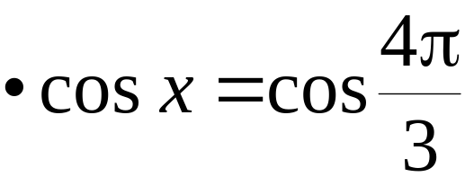
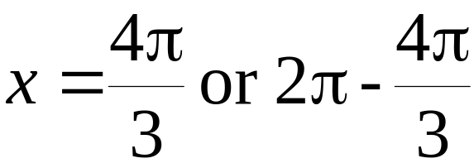
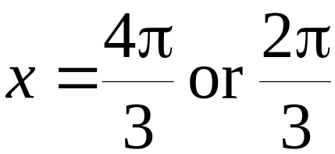
cos x = cos α then x = α or 2π - α
cos x = tan 0.5^{c}
cos x = 0.5463
x = 0.9929 or 2π - 0.9929
x = 0.993 or 5.29
http:///www.hkedcity.net/ihouse/fh7878/

Slide 8
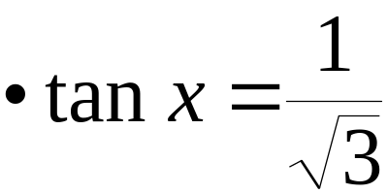

tan x = tan α then x = α or 180°+α
tan x = -1
x = -45° or 180° + (-45°) or 360° + (-45°)
x = 135° or 315°
tan x = 5
x = 78.7° or 259°
http:///www.hkedcity.net/ihouse/fh7878/

Slide 9
tan x = tan α then x = α or 180°+α
sin x = -2 cos x
tan x = -2
x = -63.4° or 180° + (-63.4°) or 360° + (-63.4°)
x = 117° or 297°
tan x = -2 (sin 60° + 1)
tan x = -3.73
x = 105° or 285°
http:///www.hkedcity.net/ihouse/fh7878/

Slide 10
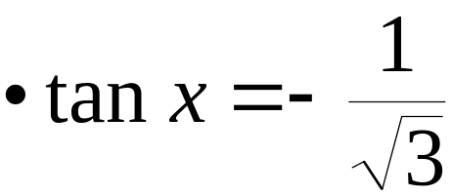
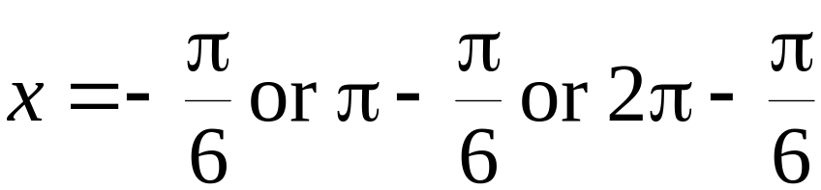
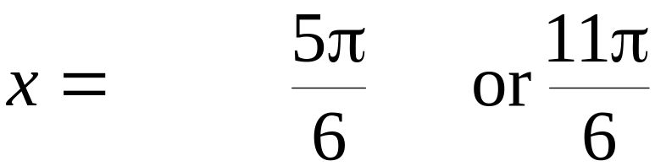
tan x = tan α then x = α or π+α
tan x = -0.5
x = -0.464^{c} or π - 0.464^{c} or 2π - 0.464^{c}
x = 2.68 or 5.82
http:///www.hkedcity.net/ihouse/fh7878/

Slide 11
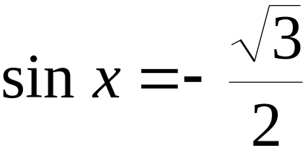
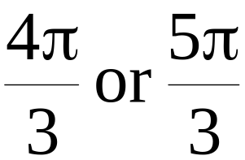
Exercise: solve the trigonometric equations
sin x = sin(-15°)
195° or 345°
Answer in radians: sin x = 0.6
0.644 or 2.50
Answer in terms of π:
sin x = 7
no solution
cos x = cos -330°
30° or 330°
cos x = 0
x = 90° or 270°
Answer in radians: cos x = -1/3
1.91 or 4.37
http:///www.hkedcity.net/ihouse/fh7878/

Slide 12
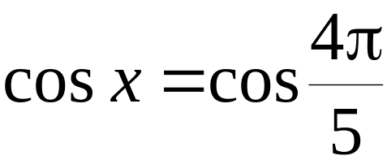
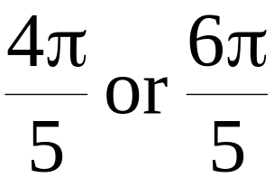
Exercise: solve the trigonometric equations
Answer in terms of π:
cos x = -1
π
Answer in terms of π:
cos x = -sin(3π/4)
3π/4 or 5π/4
Answer in terms of π:
tan x = tan 540°
0°, 180° or 360°
3 sin x = 2 cos x
33.7° or 214°
Answer in terms of π: tan x = -1
x = 3π/4 or 7π/4
Answer in radians: tan x = 3
1.25 or 4.39
http:///www.hkedcity.net/ihouse/fh7878/

Slide 13
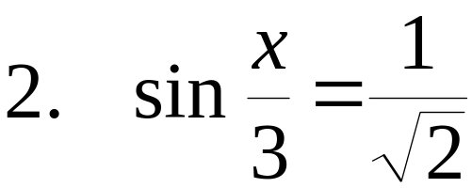
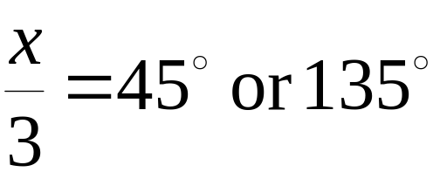
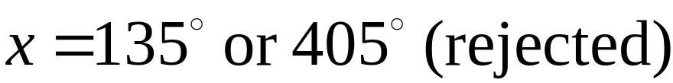
More difficult examples
cos 2x = cos 60°
2x = 60°, 300°, 420°, 660°
x = 30°, 150°, 210°, 330°
http:///www.hkedcity.net/ihouse/fh7878/

Slide 14
More difficult examples
cos 2x = cos (10° + x)
2x = 10° + x or 2x = 360° - (10° + x)
x = 10° or 116.67°
Is there any other solution between 0° and 360°?
236.67°, 356.67°
2 cos² θ - 3 cos θ + 1 = 0
(2 cos θ - 1)(cos θ - 1) = 0
cos θ = 0.5 or cos θ = 1
θ = 60°, 300° or 0°, 360°
http:///www.hkedcity.net/ihouse/fh7878/

Slide 15
More difficult examples
2 tan² θ + tan θ - 1 = 0 (Answer in radians.)
(2 tan θ - 1)(tan θ + 1) = 0
tan θ = 0.5 or tan θ = -1
θ = 0.464^{c}, 3.61^{c} or 3π/4, 7π/4
cos 3x = sin 2x
cos 3x = cos(90° - 2x)
3x = 90° - 2x or 3x = 360° - (90° - 2x)
x = 18° or 270°
Is there any other solution between 0° and 360°?
90°, 162°, 234°, 306°
http:///www.hkedcity.net/ihouse/fh7878/

Slide 16
More difficult examples
2 sin² θ - cos θ - 1 = 0 (Answer in terms of π.)
2(1- cos² θ) - cos θ - 1 = 0
2 cos² θ + cos θ - 1 = 0
(2 cos θ - 1)(cos θ + 1) = 0
cos θ = 0.5 or cos θ = -1
θ = π/3, 5π/3 or π
sin θ tan θ + cos θ = 1 (Answer in terms of π.)
sin θ ( sin θ / cos θ) + cos θ = 1
sin² θ + cos² θ = cos θ
cos θ = 1
θ = 0^{c} or 2π
http:///www.hkedcity.net/ihouse/fh7878/

Slide 17
More difficult examples
3 - 2 sin θ cos θ - 4 sin² θ = 0
3(sin² θ + cos² θ) - 2 sin θ cos θ - 4 sin² θ = 0
3 cos² θ - 2 sin θ cos θ - sin² θ = 0
3 - 2 tan θ - tan² θ = 0
tan² θ + 2 tan θ - 3 = 0
(tan θ + 3)(tan θ - 1) = 0
tan θ = -3 or tan θ = 1
θ = 108°, 288° or 45°, 225°
http:///www.hkedcity.net/ihouse/fh7878/

Slide 18
More difficult examples
12 sin θ - 5 cos θ = 13 (answer in radians.)
(12 sin θ - 5 cos θ)² = 169
144 sin²θ-120sinθcosθ+25cos²θ =169(sin²θ+cos²θ)
25 sin² θ + 120 sin θ cos θ + 144 cos² θ = 0
25 tan² θ + 120 tan θ + 144 = 0
(5 tan θ + 12)² = 0
tan θ = -12/5
θ = 1.97^{c}, 5.11^{c}
Check: when θ = 1.97^{c},
LHS = 12 sin 1.97^{c} - 5 cos 1.97^{c} = 13 = RHS
when θ = 5.11^{c},
LHS = 12 sin 5.11^{c} - 5 cos 5.11^{c} = -13 ≠ RHS
∴ θ = 1.97^{c} only
http:///www.hkedcity.net/ihouse/fh7878/

Slide 19
Summary
In degrees,
sin x = sin α then x = α or 180° - α
cos x = cos α then x = α or 360° - α
tan x = tan α then x = α or 180° + α
In radians,
sin x = sin α then x = α or π - α
cos x = cos α then x = α or 2π - α
tan x = tan α then x = α or π + α
http:///www.hkedcity.net/ihouse/fh7878/

