Slide 1
Trigonometric Equations
Edited by Mr. Francis Hung
Last Updated: 2011-04-23

Slide 2
Trigonometric Equations
sin x = sin α
x = α or 180° – α
sin x = sin 30°
x = 30° or 180° – 30°
x = 30° or 150°
sin x = sin (– 120°)
x = – 120° or 180°–(–120°) or –120°+360°
x = 300° or 240°
Notes:
http://www.hkedcity.net/ihouse/fh7878/

Slide 3
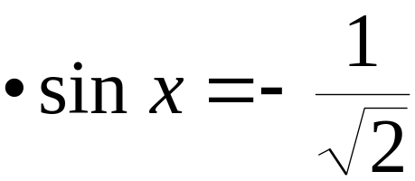
sin x = sin α then x = α or 180° – α
sin x = –1
x = –90° or 180° – (–90°)
x = 270°

Slide 4

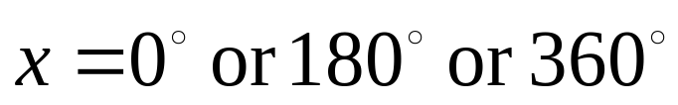

sin x = sin α then x = α or 180° – α
sin x = 1.2
 –1 ≤ sin x ≤ 1
∴ x has no solution

Slide 5
cos x = cos α then x = α or 360° – α
cos x = cos 130°
x = 130° or 360° – (130°)
x = 130° or 230°
cos x = –0.9
x = 154° or 360° – 154°
x = 154° or 206°
cos x = –3
 –1 ≤ cos x ≤ 1
∴ x has no solution

Slide 6
cos x = cos α then x = α or 360° – α
cos x = cos (–10°)
x = –10° or 360°– (–10°) or 360°+(–10°) or 10°
x = 10° or 350°
cos x = cos (–20°)
cos x = cos 20°
x = 20° or 360° – 20°
x = 20° or 340°

Slide 7
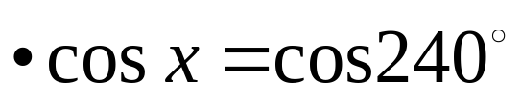
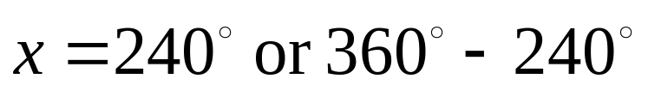
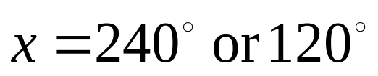
cos x = cos α then x = α or 360° – α
cos x = tan 30°
cos x = 0.5774
x = 54.7° or 360 ° – 54.7°
x = 54.7° or 305.3°

Slide 8
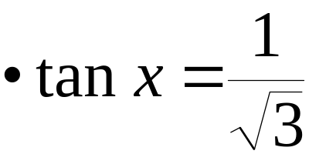

tan x = tan α then x = α or 180°+α
tan x = –1
x = –45° or 180° + (–45°) or 360° + (–45°)
x = 135° or 315°
tan x = 5
x = 78.7° or 259°

Slide 9
tan x = tan α then x = α or 180°+α
sin x = –2 cos x
tan x = –2
x = –63.4° or 180°+(–63.4°) or 360°+(–63.4°)
x = 117° or 297°
tan x = –2 (sin 60° + 1)
tan x = –3.73
x = 105° or 285°

Slide 10
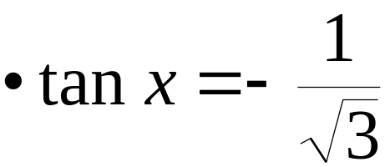
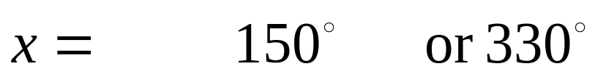
tan x = tan α then x = α or 180°+α
tan x = –0.5
x = –26.6° or 180° – 26.6° or 360° – 26.6°
x = 153.4° or 333.4°

Slide 11
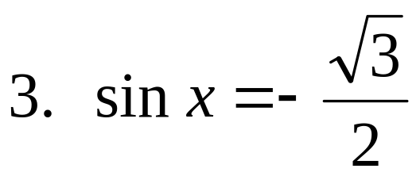
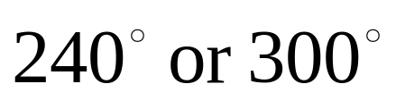
Exercise: solve the trigonometric equations
sin x = sin(–15°)
195° or 345°
sin x = 0.6
36.9° or 143.1°
sin x = 7
no solution
cos x = cos(–330°)
30° or 330°
cos x = 0
x = 90° or 270°
cos x = –1/3
109.5° or 250.5°

Slide 12
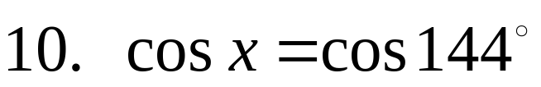
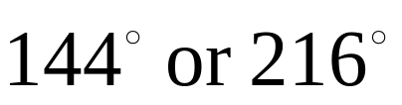
Exercise: solve the trigonometric equations
cos x = –1
180°
cos x = –sin(135°)
135° or 225°
tan x = tan 540°
0°, 180° or 360°
3 sin x = 2 cos x
33.7° or 214°
tan x = –1
x = 135° or 315°
tan x = 3
71.6° or 251.6°

Slide 13
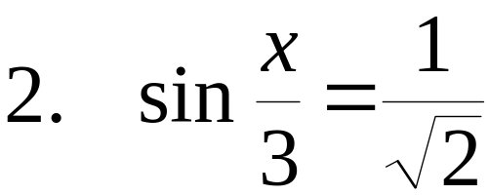
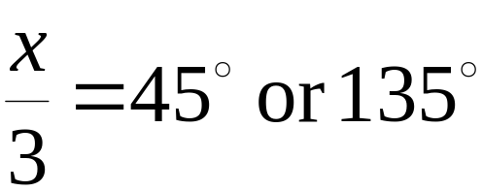
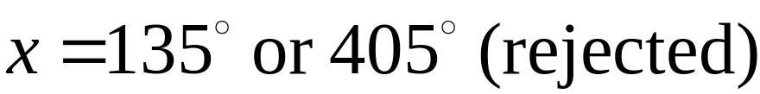
More difficult examples
cos 2x = cos 60°
2x = 60°, 300°, 420°, 660°
x = 30°, 150°, 210°, 330°

Slide 14
More difficult examples
cos 2x = cos (10° + x)
2x = 10° + x or 2x = 360° – (10° + x)
x = 10° or 116.67°
Is there any other solution between 0° and 360°?
236.67°, 356.67°
2 cos² θ – 3 cos θ + 1 = 0
(2 cos θ – 1)(cos θ – 1) = 0
cos θ = 0.5 or cos θ = 1
θ = 60°, 300° or 0°, 360°

Slide 15
More difficult examples
2 tan² θ + tan θ – 1 = 0
(2 tan θ – 1)(tan θ + 1) = 0
tan θ = 0.5 or tan θ = –1
θ = 26.6°, 206.6° or 135°, 315°
cos 3x = sin 2x
cos 3x = cos(90° – 2x)
3x = 90° – 2x or 3x = 360° – (90° – 2x)
x = 18° or 270°
Is there any other solution between 0° and 360°?
90°, 162°, 234°, 306°

Slide 16
More difficult examples
2 sin² θ – cos θ – 1 = 0
2(1 – cos² θ) – cos θ – 1 = 0
2 cos² θ + cos θ – 1 = 0
(2 cos θ – 1)(cos θ + 1) = 0
cos θ = 0.5 or cos θ = – 1
θ = 60°, 300° or 180°
sin θ tan θ + cos θ = 1
sin θ ( sin θ / cos θ) + cos θ = 1
sin² θ + cos² θ = cos θ
cos θ = 1
θ = 0° or 360°

Slide 17
More difficult examples
3 – 2 sin θ cos θ – 4 sin² θ = 0
3(sin² θ + cos² θ) – 2 sin θ cos θ – 4 sin² θ = 0
3 cos² θ – 2 sin θ cos θ – sin² θ = 0
3 – 2 tan θ – tan² θ = 0
tan² θ + 2 tan θ – 3 = 0
(tan θ + 3)(tan θ – 1) = 0
tan θ = –3 or tan θ = 1
θ = 108°, 288° or 45°, 225°

Slide 18
More difficult examples
12 sin θ – 5 cos θ = 13
(12 sin θ – 5 cos θ)² = 169
144 sin²θ – 120sinθcosθ+25cos²θ =169(sin²θ+cos²θ)
25 sin² θ + 120 sin θ cos θ + 144 cos² θ = 0
25 tan² θ + 120 tan θ + 144 = 0
(5 tan θ + 12)² = 0
tan θ = –12/5
θ = 112.6°, 292.6°
Check: when θ = 112.6°,
LHS = 12 sin 112.6° – 5 cos 112.6° = 13 = RHS
when θ = 292.6°,
LHS = 12 sin 292.6° – 5 cos 292.6° = –13 ≠ RHS
∴ θ = 112.6° only

Slide 19
Summary
sin x = sin α then x = α or 180° – α
cos x = cos α then x = α or 360° – α
tan x = tan α then x = α or 180° + α

