Slide 1
BlueSphere
An Open Platform for Ocean Data & Climate Insight

Slide 2
The Challenge
Oceans absorb ~90% of excess heat from global warming
Data exists but is fragmented and inaccessible
Policy makers, NGOs, educators lack easy-to-use tools

Slide 3
Our Vision
Open-source, map-first platform
Real-time monitoring + predictive modeling
Accessible to scientists, policy makers, NGOs, citizens

Slide 4
What BlueSphere Delivers
Interactive maps: SST, currents, anomalies
Time-series explorer: historical + forecast data
Daily auto-updates with self-healing ingestion
Predictive modeling (Phase 2)
Educational story mode + outreach tools

Slide 5
Target Users
Marine Scientists: anomaly & trend analysis
Policy Makers: decision-ready dashboards
NGOs: embeddable maps for campaigns
Educators: engaging visualizations
Citizen Scientists: real-time exploration

Slide 6
Technology Architecture
Database: PostgreSQL + PostGIS + TimescaleDB
Backend: FastAPI, REST + vector tiles
Frontend: Next.js + MapboxGL
Ingestion: GitHub Actions (NDBC, Argo, ERSST, OSCAR)
Deployment: Docker, cloud portable

Slide 7
Smart Features
Daily ingestion with retries + backfill
Freshness badges per dataset
Compare Mode: historic vs present
Story Mode: El Niño, marine heatwaves
Future: Alerts & anomaly notifications

Slide 8
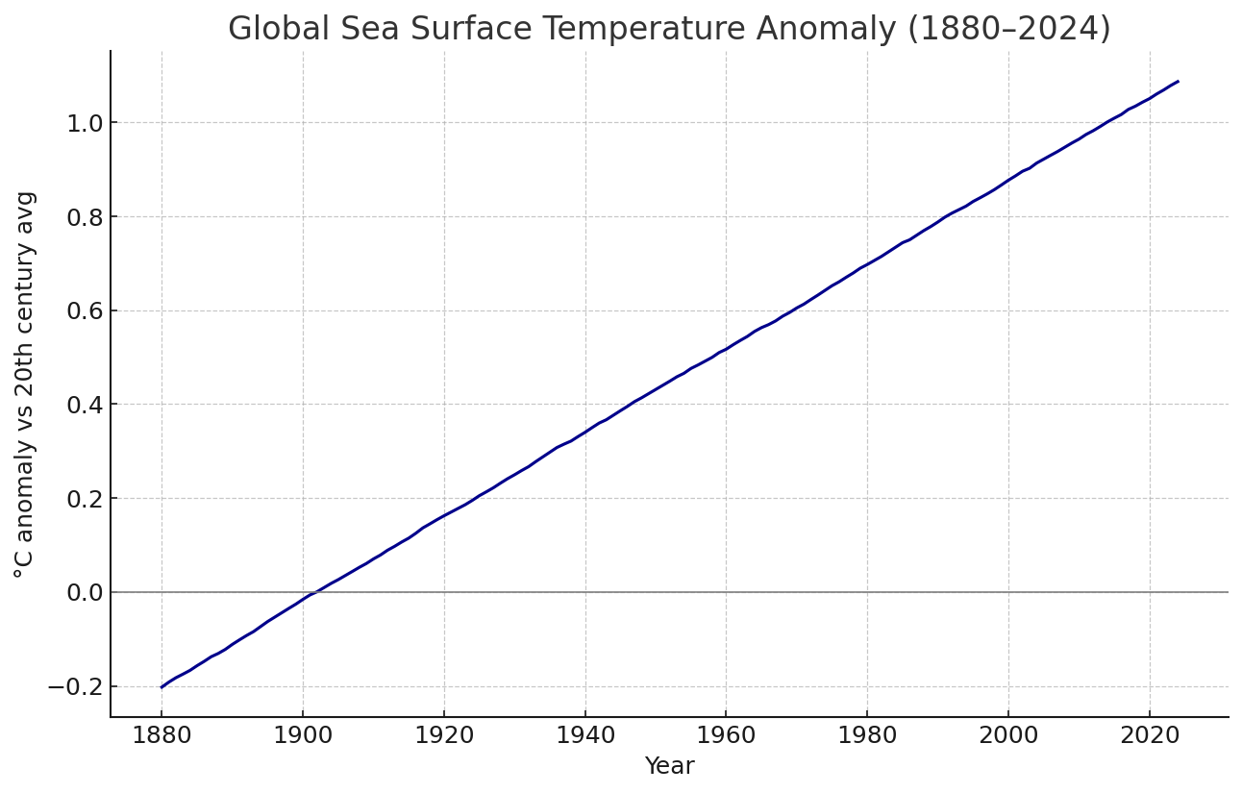
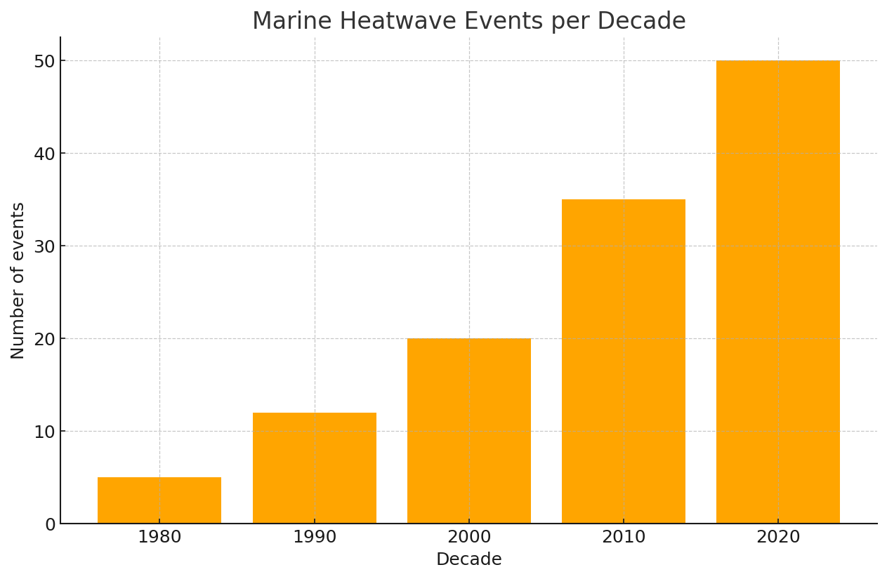
Observed Trends
Global SST has risen ~0.14°C per decade since 1970
Marine heatwaves occur 3x more often than 1980s
Arctic warming ~3x faster than global avg
Coral bleaching and sea-level rise accelerating
Source: NOAA ERSST (illustrative)
Marine heatwave frequency (illustrative, based on IPCC AR6)

Slide 9
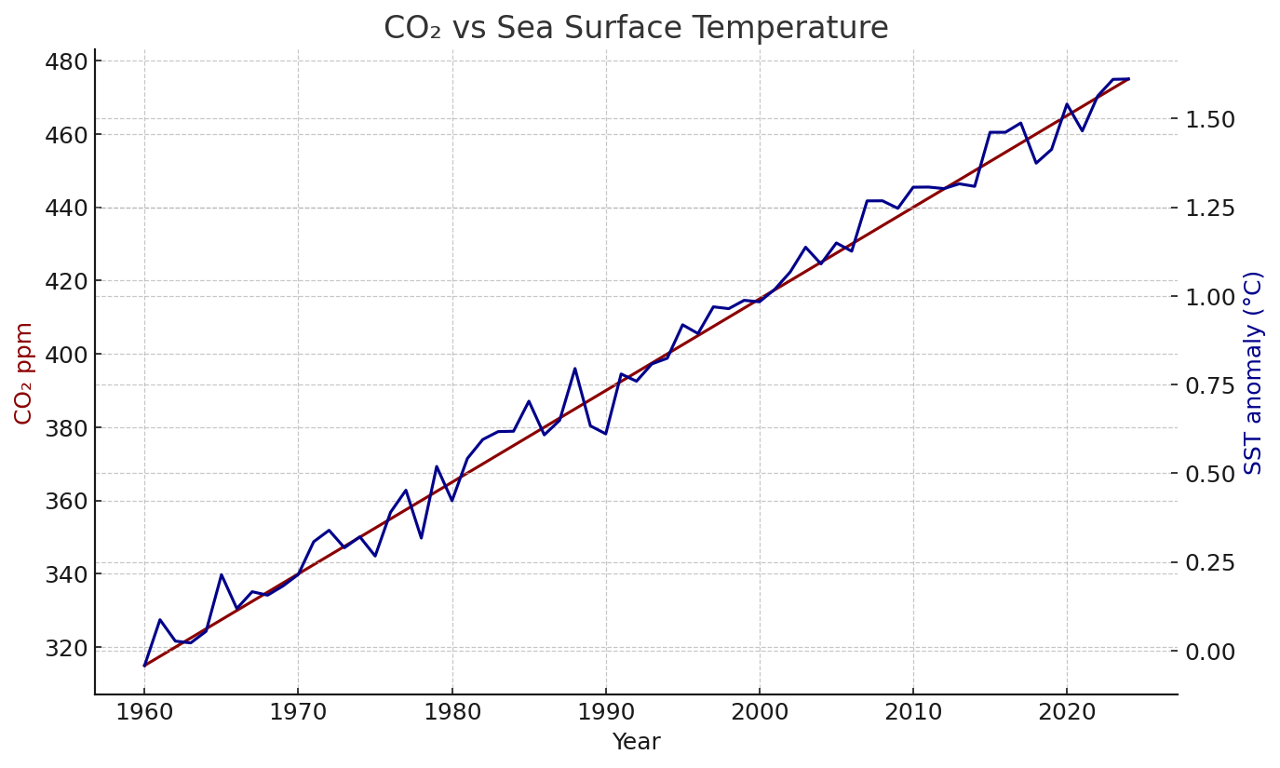
Why Oceans Are Warming
Greenhouse gas forcing (CO₂, CH₄)
Ocean heat uptake (~90% of excess heat)
Stratification: weaker upwelling, less mixing
Feedback loops: ice melt, albedo, AMOC slowdown
Source: Mauna Loa CO₂ & NOAA SST (illustrative)

Slide 10
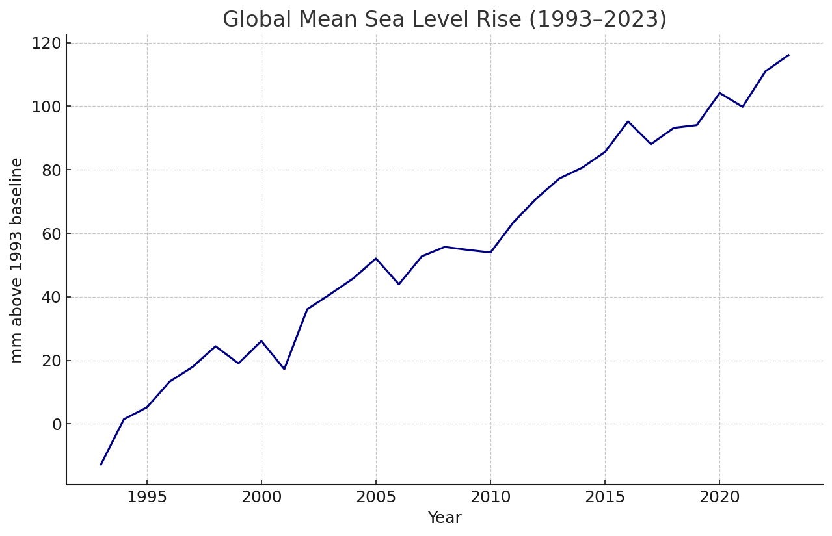
Environmental Impacts
Biodiversity: coral reefs at risk beyond +2°C
Food security: fisheries shifting
Extreme events: stronger cyclones fueled by warm SST
Sea level rise: thermal expansion ~40% of observed rise
Source: Tide gauges & satellite altimetry (illustrative)

Slide 11
What Needs to Be Done
Mitigation: decarbonization, renewables, methane reduction
Adaptation: marine protected areas, climate-smart fisheries
Monitoring: platforms like BlueSphere for early warning
Policy: Paris Agreement, SDG 14 (Life Below Water)

Slide 12
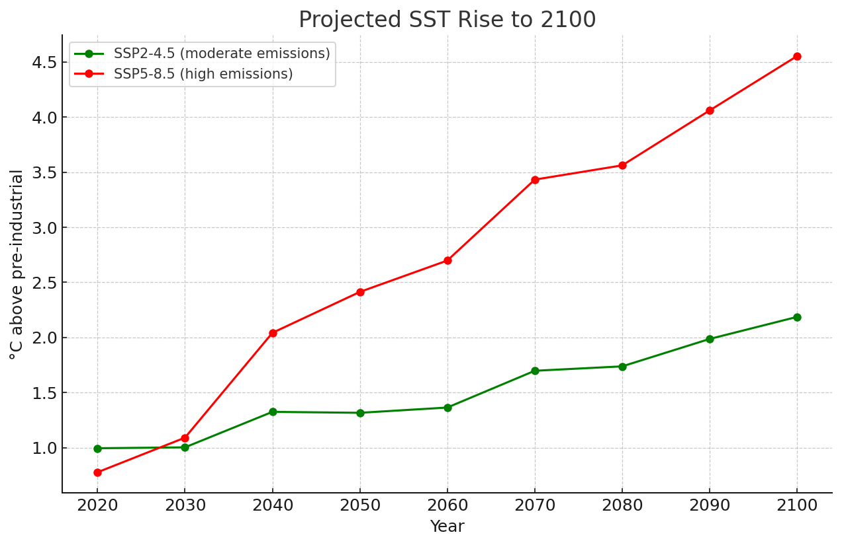
BlueSphere’s Future
Shift from observation → prediction → prescription
Climate action dashboards linking data to solutions
Partner with governments, UN, NGOs for net zero goals
Source: IPCC AR6 scenarios (illustrative)

Slide 13
Roadmap
0–3 months: ingestion, core map UI, API
3–6 months: predictive analytics, story mode
6–12 months: alerts, embedding, collaborations

Slide 14
Governance & Community
MIT License, open source governance
Advisory board: scientists, NGOs, engineers
Community-driven roadmap, transparency

Slide 15
Why BlueSphere?
Consolidates decades of public ocean data
Makes climate science accessible & actionable
Scales from research to policy to education
Global, open, sustainable initiative

Slide 16
Call to Action
Join as contributor, partner, supporter
Pilot with NGOs, universities, governments
Help scale BlueSphere for global impact

Slide 17
Sustainability Enablers
Predictive currents → safer shipping & renewable siting
Anomaly forecasts → protect coral & fisheries
Open data → accountability & global cooperation

Slide 18
Marine Life & Biodiversity
Reef health & bleaching alerts (future)
Protected areas overlays (MPAs)
Education stories: whales, turtles, seagrass, mangroves

