Slide 1
BlueSphere
An Open Platform for Ocean Data & Climate Insight
© 2025 Mark Lindon — BlueSphere — Authored by Mark Lindon

Slide 2
The Challenge
Oceans absorb ~90% of excess heat from global warming
Data exists but is fragmented and inaccessible
Policy makers, NGOs, educators lack easy-to-use tools
© 2025 Mark Lindon — BlueSphere — Authored by Mark Lindon

Slide 3
Our Vision
Open-source, map-first platform
Real-time monitoring + predictive modeling
Accessible to scientists, policy makers, NGOs, citizens
© 2025 Mark Lindon — BlueSphere — Authored by Mark Lindon

Slide 4
What BlueSphere Delivers
Interactive maps: SST, currents, anomalies
Time-series explorer: historical + forecast data
Daily auto-updates with self-healing ingestion
Predictive modeling (Phase 2)
Educational story mode + outreach tools
© 2025 Mark Lindon — BlueSphere — Authored by Mark Lindon

Slide 5
Target Users
Marine Scientists: anomaly & trend analysis
Policy Makers: decision-ready dashboards
NGOs: embeddable maps for campaigns
Educators: engaging visualizations
Citizen Scientists: real-time exploration
© 2025 Mark Lindon — BlueSphere — Authored by Mark Lindon

Slide 6
Technology Architecture
Database: PostgreSQL + PostGIS + TimescaleDB
Backend: FastAPI, REST + vector tiles
Frontend: Next.js + MapboxGL
Ingestion: GitHub Actions (NDBC, Argo, ERSST, OSCAR)
Deployment: Docker, cloud portable
© 2025 Mark Lindon — BlueSphere — Authored by Mark Lindon

Slide 7
Smart Features
Daily ingestion with retries + backfill
Freshness badges per dataset
Compare Mode: historic vs present
Story Mode: El Niño, marine heatwaves
Future: Alerts & anomaly notifications
© 2025 Mark Lindon — BlueSphere — Authored by Mark Lindon

Slide 8
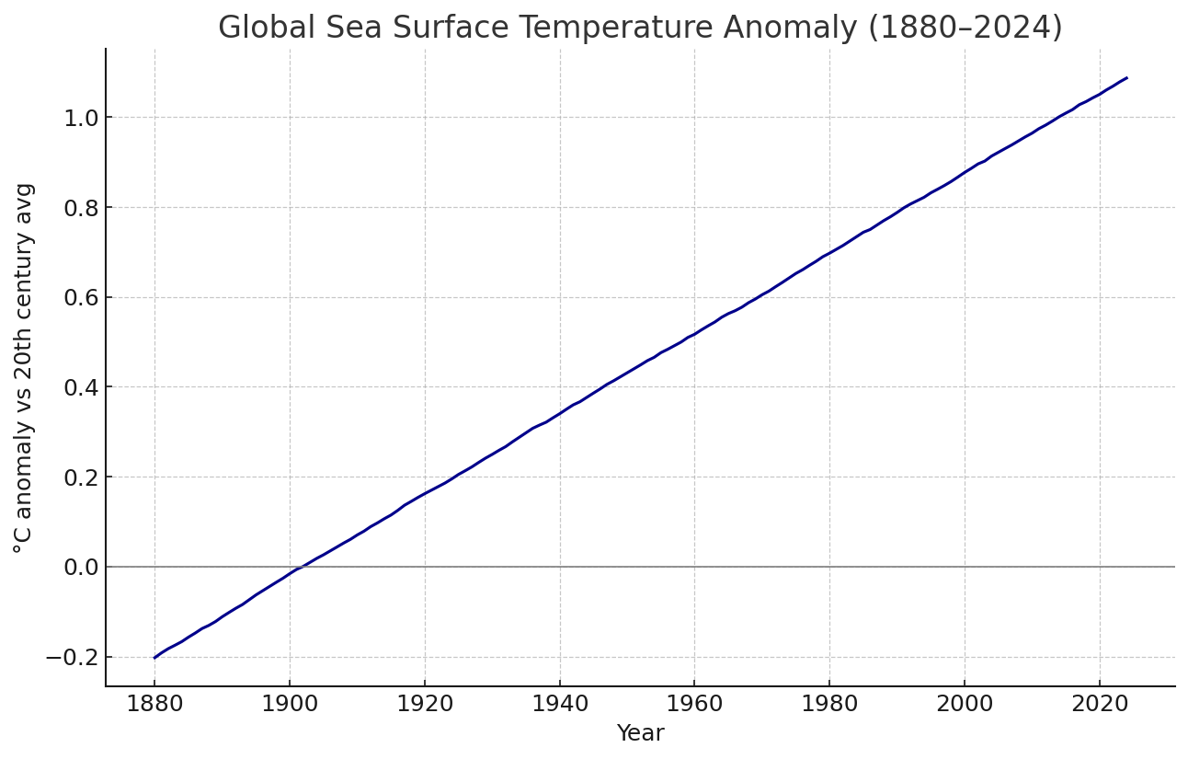
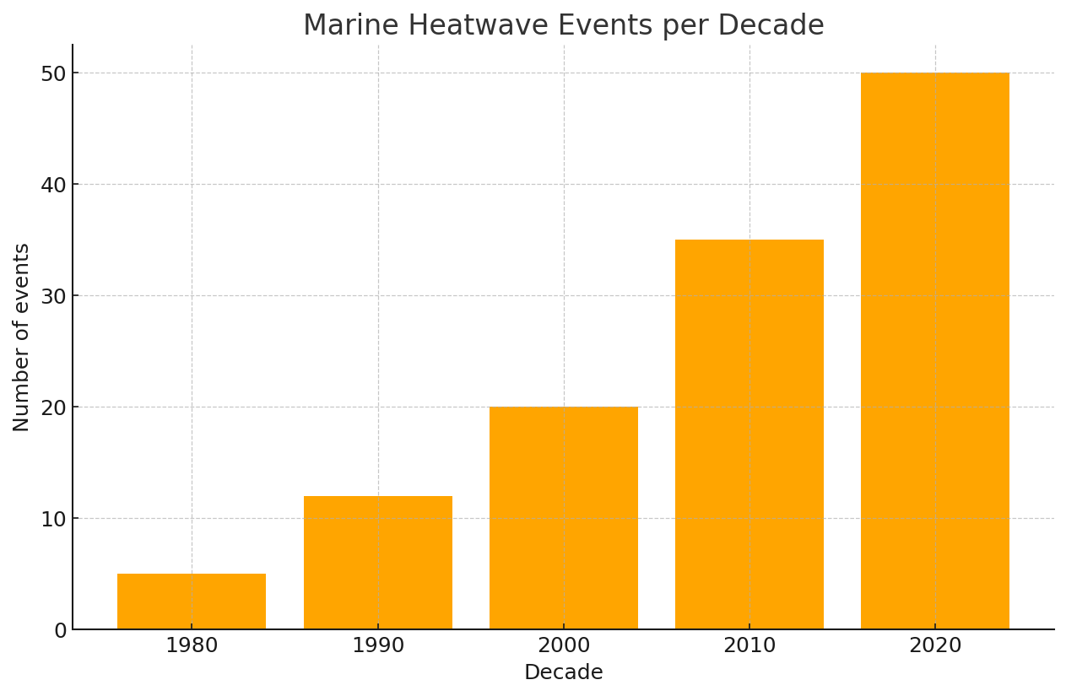
Observed Trends
Global SST has risen ~0.14°C per decade since 1970
Marine heatwaves occur 3x more often than 1980s
Arctic warming ~3x faster than global avg
Coral bleaching and sea-level rise accelerating
Source: NOAA ERSST (illustrative)
Marine heatwave frequency (illustrative, based on IPCC AR6)
© 2025 Mark Lindon — BlueSphere — Authored by Mark Lindon

Slide 9
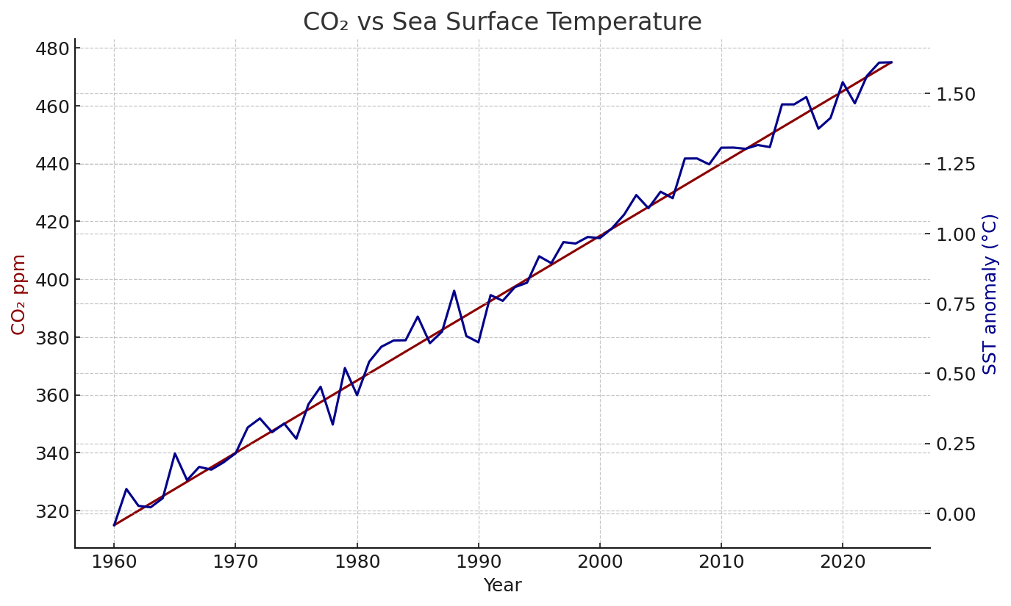
Why Oceans Are Warming
Greenhouse gas forcing (CO₂, CH₄)
Ocean heat uptake (~90% of excess heat)
Stratification: weaker upwelling, less mixing
Feedback loops: ice melt, albedo, AMOC slowdown
Source: Mauna Loa CO₂ & NOAA SST (illustrative)
© 2025 Mark Lindon — BlueSphere — Authored by Mark Lindon

Slide 10
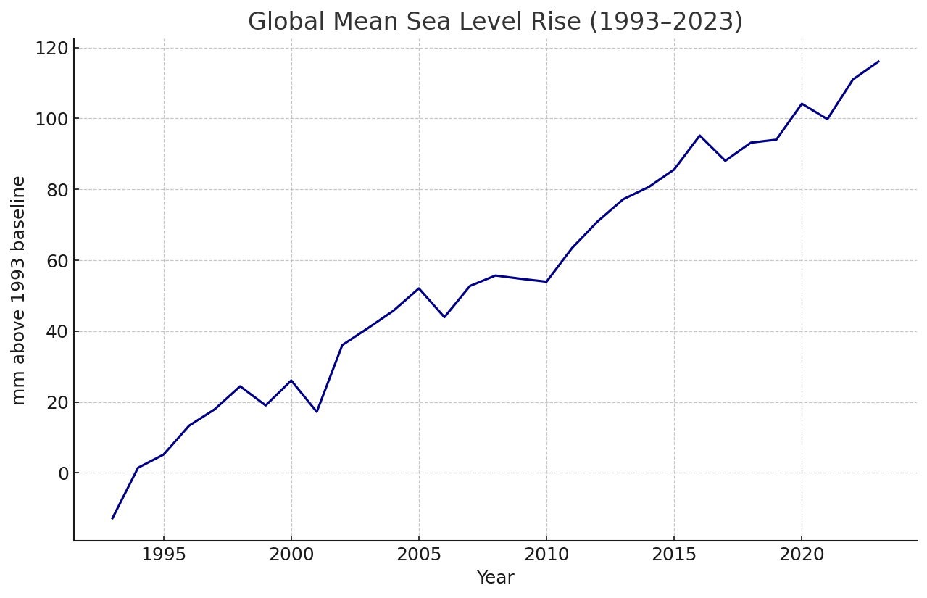
Environmental Impacts
Biodiversity: coral reefs at risk beyond +2°C
Food security: fisheries shifting
Extreme events: stronger cyclones fueled by warm SST
Sea level rise: thermal expansion ~40% of observed rise
Source: Tide gauges & satellite altimetry (illustrative)
© 2025 Mark Lindon — BlueSphere — Authored by Mark Lindon

Slide 11
What Needs to Be Done
Mitigation: decarbonization, renewables, methane reduction
Adaptation: marine protected areas, climate-smart fisheries
Monitoring: platforms like BlueSphere for early warning
Policy: Paris Agreement, SDG 14 (Life Below Water)
© 2025 Mark Lindon — BlueSphere — Authored by Mark Lindon

Slide 12
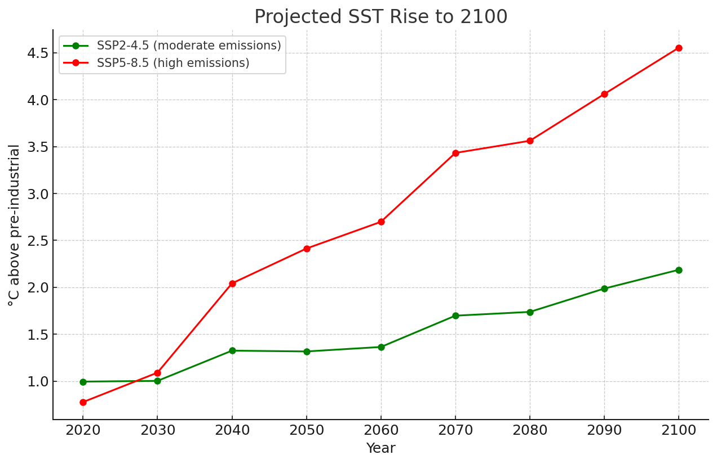
BlueSphere’s Future
Shift from observation → prediction → prescription
Climate action dashboards linking data to solutions
Partner with governments, UN, NGOs for net zero goals
Source: IPCC AR6 scenarios (illustrative)
© 2025 Mark Lindon — BlueSphere — Authored by Mark Lindon

Slide 13
Roadmap
0–3 months: ingestion, core map UI, API
3–6 months: predictive analytics, story mode
6–12 months: alerts, embedding, collaborations
© 2025 Mark Lindon — BlueSphere — Authored by Mark Lindon

Slide 14
Governance & Community
MIT License, open source governance
Advisory board: scientists, NGOs, engineers
Community-driven roadmap, transparency
© 2025 Mark Lindon — BlueSphere — Authored by Mark Lindon

Slide 15
Why BlueSphere?
Consolidates decades of public ocean data
Makes climate science accessible & actionable
Scales from research to policy to education
Global, open, sustainable initiative
© 2025 Mark Lindon — BlueSphere — Authored by Mark Lindon

Slide 16
Call to Action
Join as contributor, partner, supporter
Pilot with NGOs, universities, governments
Help scale BlueSphere for global impact
© 2025 Mark Lindon — BlueSphere — Authored by Mark Lindon

Slide 17
Sustainability Enablers
Predictive currents → safer shipping & renewable siting
Anomaly forecasts → protect coral & fisheries
Open data → accountability & global cooperation
© 2025 Mark Lindon — BlueSphere — Authored by Mark Lindon

Slide 18
Marine Life & Biodiversity
Reef health & bleaching alerts (future)
Protected areas overlays (MPAs)
Education stories: whales, turtles, seagrass, mangroves
© 2025 Mark Lindon — BlueSphere — Authored by Mark Lindon

