Slide 1
Research methodology
Miss Muhoza B Gloria(MScIS, BIT, HCIA)
gmuhoza@kab.ac.ug
+256-750015090

Slide 2
Course Objectives
Students who successfully complete this course will be able to:
To understand the concept of research.
To highlight the importance of research in business.
To format of a research proposal.
To develop skills in problem identification and setting objectives.
To gain skills and knowledge of report writing.

Slide 3
Overview
Overview of research.
Types of research.
Key terms used in research.
Research approaches.
Significance of research.
Research process.
Criteria of good research

Slide 4
Overview of research.
Research: involves “systematic investigation”.
Search again
According to the Advanced Learners Dictionary, Research is defined as “a careful investigation or inquiry specially through search for new facts in any branch of knowledge.”
Oxford Learners Dictionaries defines research as “a careful study of a subject, especially in order to discover new facts or information about it”.

Slide 5
Overview of research cont’
Redman and Mory define research as
“a systematized effort to gain new knowledge”.
It may be a movement from the known to unknown.
It involves inquisitiveness, curiosity into the unknown.
Research is the contributor to the existing stock of knowledge.
A research mind is an inquiring mind, always searching for the unknown, explanations, interventions, causes, outcomes, etc.

Slide 6
Overview of research Cont’
Research has 2 major constituents.
  Discovery (Finding something previously unknown)
  Improvement (producing something better).
Therefore Research can conclusively be defined as “a systematic collection, analysis and interpretation of data to answer a certain question or solve a problem”

Slide 7
Why Research?
New information
Supplement on existing knowledge
Challenge the existing information
Most importantly helps to generate solutions to a problem

Slide 8
Objectives of Research
The main purpose of research is to discover answers to questions through the application of scientific procedures.
To find out the truth which is hidden and which has not been discovered as yet.

Slide 9
Motivation in Research
Desire to get a research degree with its consequential benefits.
Desire to face the challenge in solving the unsolved problems
Desire to get intellectual joy of doing some creative work

Slide 10
Types of Research
Descriptive Research. Includes surveys and fact finding enquiries of different kinds.
The main purpose of this research is “to describe the state of affairs as it exists at present”. It is also termed as Ex Post Facto research.
The main characteristic of this research is that the researcher has no control over the variables, he can only report what has happened or what is happening.

Slide 11
Cont’
In this research, the researcher seeks to measure items like the frequency of shopping, preference of people.
However Analytical research on the other hand, “the researcher has to use facts or information already available and Analyze these facts to make a critical evaluation of the material”

Slide 12
APPLIED VS FUNDAMENTAL
Applied research is also action research and it aims at finding a solution for an immediate problem facing the society, organisation.
Whereas Fundamental research is mainly concerned with generalizations and formulation of a theory or gathering knowledge for knowledge.

Slide 13
Applied Vs Fundamental…..
Research studies, concerning human behaviour carried on with a view to make generalisations about human behaviour, are examples of fundamental research.
But research aimed at certain conclusions (say, a solution) facing a concrete social or business problem is an example of applied research.

Slide 14
Quantitative Vs Qualitative Research
Quantitative research is based on the measurement of quantity or amount, its applicable to a phenomena that can be expressed in terms of quantity or amount.
Qualitative research is specially important in studies where the aim is to discover the underlying motives of human behaviour. This type of research aims at discovering the underlying motives and desires, using in depth interviews for the purpose.

Slide 15
RESEARCH APPROACHES
Quantitative Approach. This involves the generation of data in quantitative form which can be subjected to rigorous quantitative analysis in a formal and rigid fashion.
Qualitative Approach. is concerned with subjective assessment of attitudes, opinions and behaviour. Research in such a situation is a function of researcher’s insights and impressions.

Slide 16
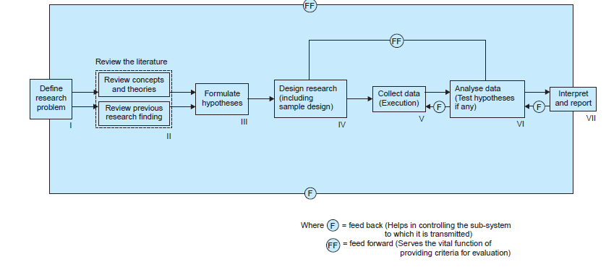
RESEARCH PROCESS

Slide 17
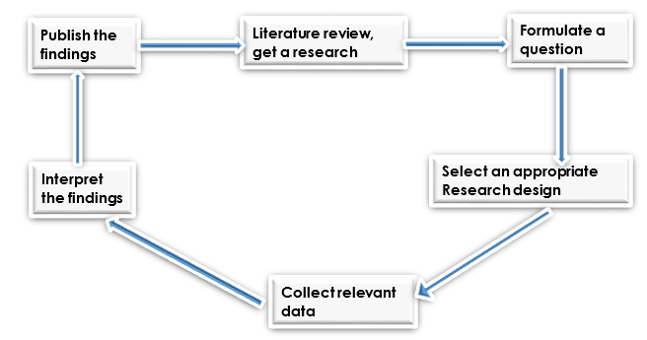
The Research Process

Slide 18
CRITERIA OF GOOD RESEARCH
Good research Must satisfy the following criteria:
The purpose of the research should be clearly defined and common concepts be used.
The research procedure should be clearly described in detail to allow another researcher to repeat the research for further advancement.
The procedural design of the research should be carefully planned to yield results that are as objective as possible

Slide 19
The researcher with complete frankness should report the flaws in the procedural design and estimate their effects on the findings.
The analysis of data should be adequate enough to reveal its significance. The data analysis methods used should be appropriate.
Conclusions should be confined to those justified by the data of the research and limited to those for which data provide an adequate basis.

Slide 20
Greater confidence in research is warranted if the researcher is experienced and has a good reputation in research.

Slide 21
Qualities of a good research
Good research is systematic: Meaning that research is structured with specified steps to be taken in a specified sequence in accordance with the well defined set of rules.
Good research is logical: this implies that research is guided by the rules of logical reasoning and logical process of induction and deduction.

Slide 22
Contd…
Induction is the process of reasoning from a part to the whole whereas deduction is the process of reasoning from some premise to a conclusion which follows from that very premise.
Logical reasoning makes research more meaningful in the context of decision making.

Slide 23
Contd…
Good research is empirical: It implies that research is related basically to one or more aspects of a real situation and deals with concrete data that provides a basis for external validity to research results.
Good research is replicable: This characteristic allows research results to be verified by replicating the study and thereby building a sound basis for decisions.

Slide 24
Thank you

