Slide 1
Mapping-Stations
Aim: create a code library To automate the matching of water quality and streamflow discharge stations
Developed by James Wang

Slide 2
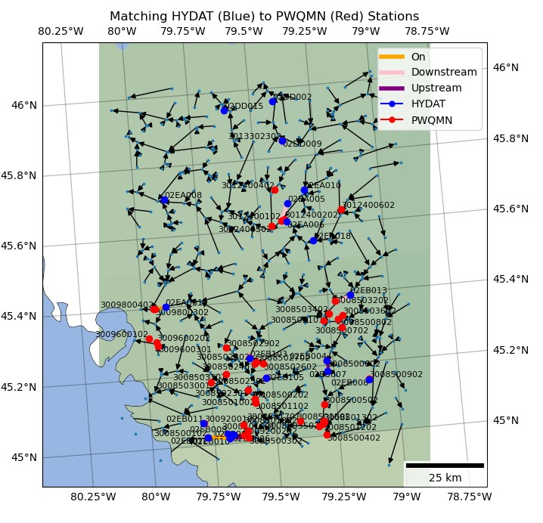
Aim: create a code library that automates the matching of water quality and streamflow discharge stations
Key Functionality
Read in sets of station data
Read in a hydro network dataset
Traverse the river dataset from origin points to candidate points
Measure the distance between co-located stations along the river network
Quantify the number of days of data overlap between matched stations

Slide 3
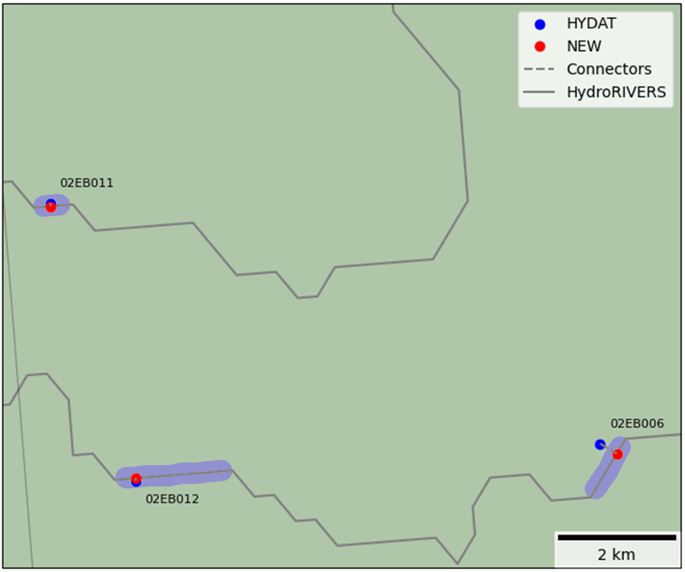
Station Matching
Step 1: Load the origin and candidate stations and river network datasets into memory
Step 2: Assign stations to the river data
Stations are assigned to the nearest river segment (purple)
Station data and position along the river segment are saved to the river dataset loaded in memory
Position is the distance from the head of the river segment to the point on the river closest to the station (blue)
Step 3: Convert the river segment to a directed graph
Maintains the attributes of each segment as edge attributes
Step 4: Iterate through every edge of the graph and match each origin station to a specified number of candidate stations

Slide 4
Station Assignment
Station
Field Value
LENGTH_M: 470
dist_from
Upstream
Downstream
dist_along
River Segment
length
Calculated
Length: 450 m
Dist_along: 200 m
Dist_from: 75 m
Saved
Dist_along: 200/450 *470 m
Dist_from: 75 m
Notes:
The assumption is made that the distance calculations generated by the organizations developing the datasets is more accurate and checked to a greater standard than what is calculated during script runtime. Therefore, the dist_along is calculated relative to the dataset length, IF PROVIDED and present in the line dataset. If not explicitly provided, the runtime calculated distance is used for dist_along. These values and station data are stored in a data container within the line segment attributes.

Slide 5
Alg Inputs: - network - prefix1 - prefix2 alg Parameters: - max depth - max distance - max matches
3
5
2
1
MATCHES
A
4
Hydat ID | PWQMN ID | Info
A | 1 | ~
A | 2 | ~
A | 3 | ~
A | 4 | ~
A | 5 | ~
Yes! Add them to the list of matches.
HYDAT Station
Are there any candidate stations on the highlighted edge?
PWQMN Stations
Ontario Hydro Network
HydroRIVERs
Notes:
For the sake of this example, Hydat stations will be the origin stations, and PWQMN stations the candidate stations

Slide 6
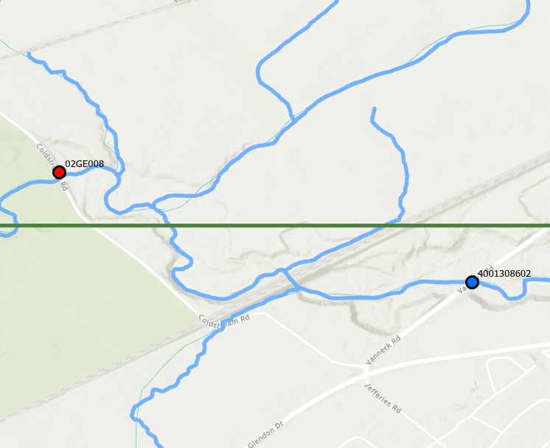
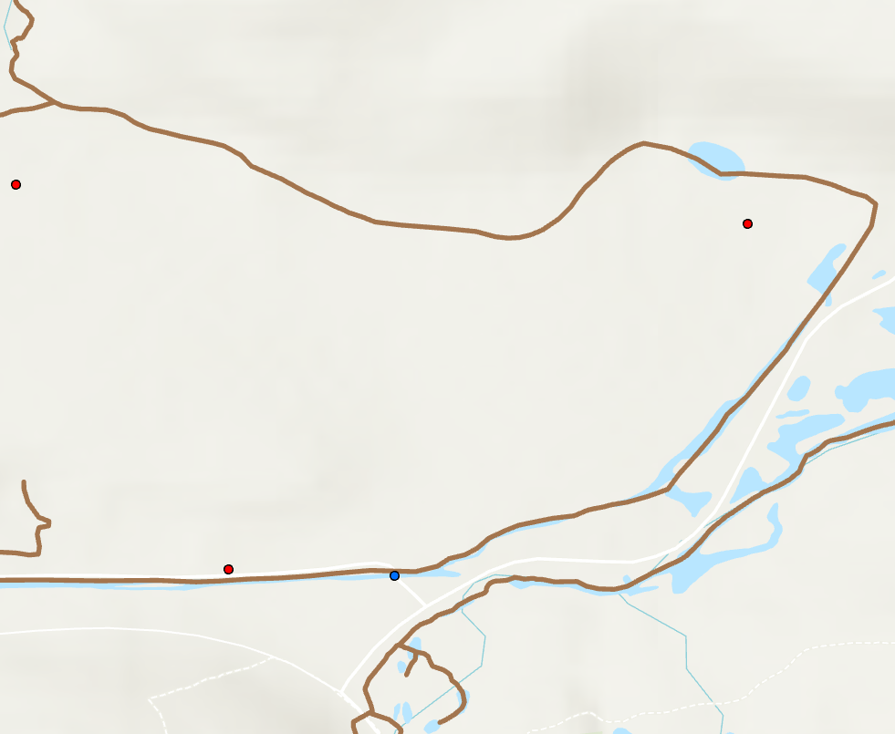
Distance calculation
Always takes the greatest of the following:
direct distance between stations
distance along the network (based on dist_along)
The distance of a station from the network is not incorporated into the distance calculation
Notes:
The direct distance between two points (yellow) is closer to the real world distance along the blue lines than the distance along the network (magenta).

Slide 7
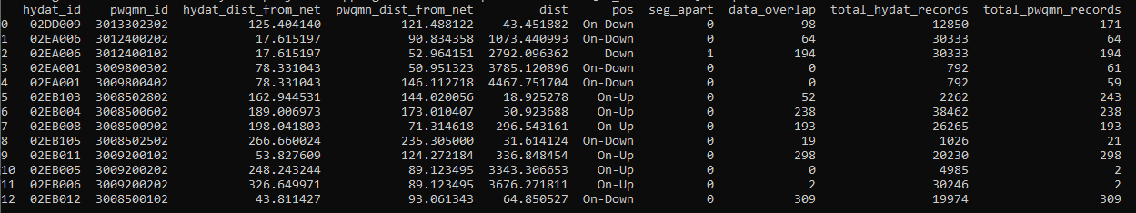
Station Matching (cont)
Step 5: Record data
Save the distance from each station to the network
Save the distance between origin and candidate stations along the network
Save the path taken along the directed graph to reach each candidate station
Calculate the number of days of overlapping data between matched stations
Step 6: Calculate the number of days of overlapping data between matched stations

Slide 8
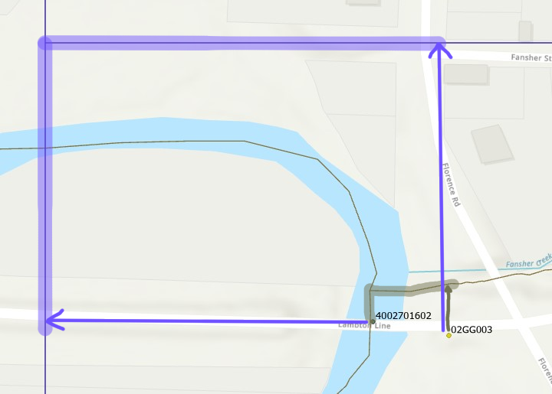
function vs Manual matching
Using manually matched pairs as a comparison for matched stations, and the Ontario Hydro Network dataset for distance, it was found that the function correctly matches all stations in q_c_pairs. The greater the resolution of the river network used, the more accurate station matching is and distance calculations are.

Slide 9
HydroRIVERS vs OHN
Low vs High resolution matching
Notes:
To finish off, I’d like to go through some of the most common errors that occur when matching stations.

Slide 10
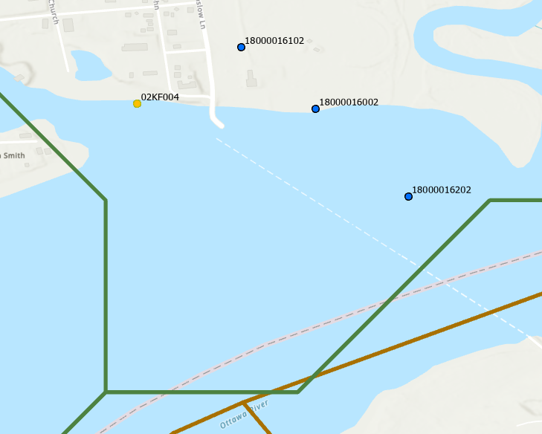
PWQMN Stations
HYDAT Stations
Ontario Hydro Network
Distance incorrect, but matching is functional
HydroRIVERs
Notes:
Distances are not accurate, but the matching of stations is still correct

Slide 11
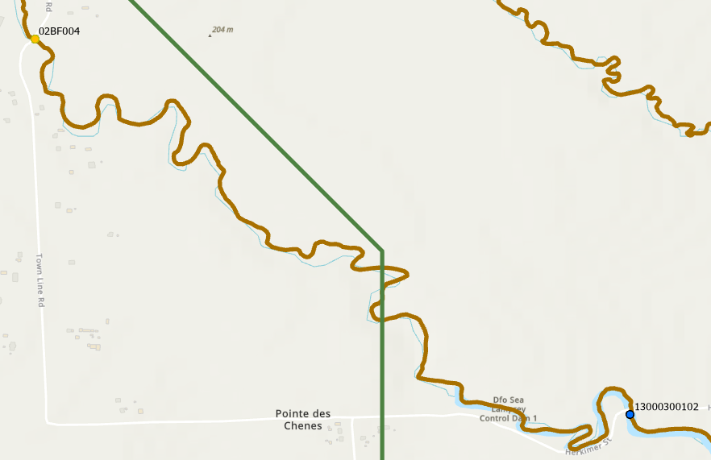
Origin Station
Candidate Stations
Ontario Hydro Network
Meandering not represented in HydroRIVERs – distance incorrect, matching correct
HydroRIVERs

Slide 12
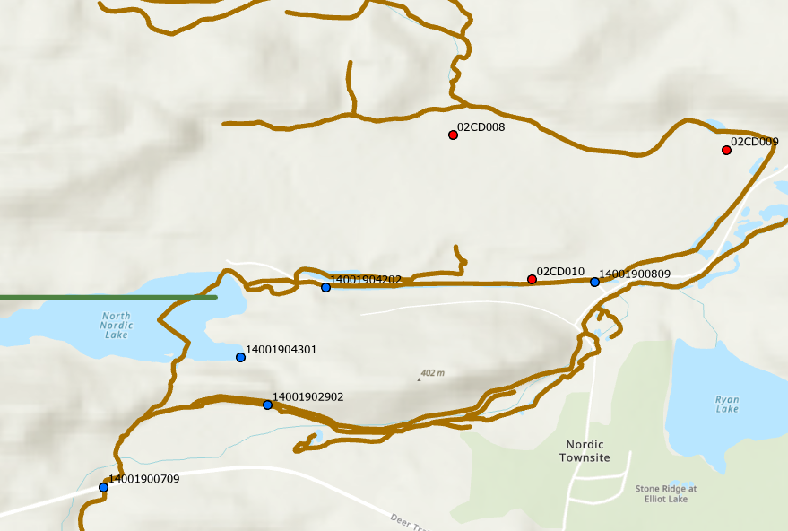
Origin Station
Candidate Stations
Ontario Hydro Network
River segments not captured in HydroRIVERs – distance and matching incorrect
HydroRIVERs
Notes:
Both distance and matching are incorrect.

Slide 13
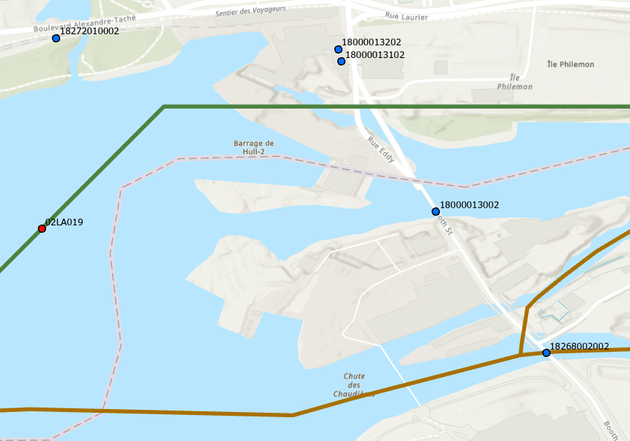
Origin Station
Candidate Stations
Ontario Hydro Network
Station distance from river network and complex river structure
– distances incorrect and matching not ideal
HydroRIVERs

Slide 14
Thank You! Questions?
https://github.com/twilight-goose/Mapping-Stations

Slide 15
Start with the edge the origin station is on
Are there candidate stations on this edge?
Move to the next edge in the direction being travelled
Move to the next origin station
No
Yes
Yes
Depth travelled within algorithm parameters?
Are there more origin stations?
Exit
No
No
Yes
Yes
No
Have the desired number of matches been made?
Sort candidate stations by distance
Yes
Have the stations already been added?
Add stations within distance parameters to matches
No
Notes:
Basic dfs_search() flowchart

