Slide 1
IVI Provisioning Analysis
LIU Chenxi / DSV NKG
Rev01 @ Feb 25,2020
Notes:
Rev01 Feb 25,2020 LIU Chenxi initial verison

Slide 2
System architecture
Feature Description:
IVI provisioning is to register unique information for each dedicated AHU in baidu cloud side.
This feature setup the fundamental base for further service authentication / charging / personalization and etc.

Slide 3
Interaction Sequence
Feature Description:
Suggestions:
AHU connectivity management (WIR connection).
Security management for AHU and Baidu Cloud regarding to Ford specified service.
DuerOS UUID management.
Baidu cloud UUID management.
Use Case Examples:
Suggestions:
AHU ONLY power on internal WIFI post DE00 configured.
Each Ford AHU unit has a Ford specified “birth certificate” which is similar with Ford SupplierFeed metadata. Baidu cloud only provides UUID for AHU units with Ford specified “birth certificate” .
DuerOS issues “Marriage Request” to obtain new UUID if any of the vehicle info changes.
Baidu cloud updates UUID table for new “AHU-VIN marriage”.
Sketch/Picture:
DuerOS Provisioning Happy Path
Provision
AHU
Baidu
UUID Status
State
(
Cloud
DuerOS
)
Factory Mode
VSCS Configured completed
WIR connection
(
DuerOS connects with cloud
)
Null
Unprovisioned
Check Provisioning Trigger
Pre
-
conditions
(
meet
)
(
Issue Provisioning Alert
Check
VehInfo
Waiting for
+
AHU MetaData
)
MetaData
Provisioning Ack
Provisioning Ack
Validity
Provisioning
Started
Waiting for UUID
Generate
Assign UUID
UUID
Stored UUID
Assigning UUID
Provisioning
UUID Ack
Success
Update UUID
–
matrix
Veh
Note
:
AUH follows Ford Power Mode Management in any of Provision State
.
MONETIZATION
In Vehicle / Out of Vehicle Experience? x In □ Out □ Both
Projected Monetization:
Revenue at Point of Sale (of vehicle/service)__________________
Subscription / Pay Per Use Model _________________________
B2B Model (e.g. from data sets) ___________________________
Other _______________________________________________
Business Owner:
Feature Champion:
Feature Owner:
Workstream Source:
Feature Funding Source:
Proposed Implementation Timing: Appl. Ready?

Slide 4
Assumption on current AHU
Feature Description:
This is the work package assumption for current AHU product
There is a dedicated application to control every detailed procedure for provisioning
All the components are from baidu

Slide 5
Analysis for SYNC 4
Feature Description:
This is the work package analysis for the ongoing SYNC 4
Giving the condition that re-use existing system / assets as much as possible

Slide 6
Analysis for SYNC 4 (cntd.)
Feature Description:
It’s estimated that badu provioning app will be kept.
Therefore the interaction between AHU and baidu clode is considered to be ready or almost ready with few adaption to DSV framework and service
In this case, DSV responsibility for provisioning is just providing necessary meta data requested

Slide 7
Meta data
R/O (*) | Name | Attribute | Datatype | Based64 encoded | Length | Sample
R | FESN | 0xF17F | ASCII | No | 8 chars | 1EG004Q6
R | SecurityKeyPackageID | 0xD03D | ASCII | Yes | 40 chars. | EF9FAD62EAD4DA9E635BAFCE8E6B7A50AD0D8B62
R | Hardware/CoreAssembly Part Number | 0xF111 | ASCII | No | 24 chars.
R | Software Part Number | 0xF188 | ASCII | No | 24 chars.
R | Calibration Config Part number | 0xF10A | ASCII | No | 24 chars.
R | Delivery Assembly Number | 0xF113 | ASCII | No | 24 chars.
R | part2Partnumber | 0xF110 | ASCII | No | 20 chars.
R | ECUID | ECU ID is an unique and fixed value for each ECU | Hexadecimal | Yes | 8 chars.
R | ECU_Provisioning State (ECUProvDID) | 0xD021 | Hexadecimal | Yes | Enum 24 chars.
O | Ethernet Mac Address | ECU internal data | ASCII | No | 17 chars.
O | Wi-Fi Mac Address | 0xFD26 | ASCII | No | 17 chars.
O | Bluetooth Mac Address | ECU internal data | ASCII | No | 24 chars.
O | Firmware Version | 0xFD12 and 0xFD15 | ASCII | No | 50 chars.
O | Primary Bootloader Part Number | CCPU: 0x8068 VMCU: 0xD027 | ASCII | No | 24 chars.
O | Recovery load part number | CCPU: 0xEEFF VMCU: 0xEEFE | ASCII | No | 24 chars.
O | Global Configuration Version | Refer to ECU part II spec | ASCII | No | 50 chars.
Feature Description:
Meta data required by baidu provision app (actually from badu cloud) is similar with the data set for peripheral provisioning ( ford cloud)
These are the meta data (which is called ProvOnBoardClient 3 (SYNC)
Ethernet channel is adopted in CVPP

Slide 8
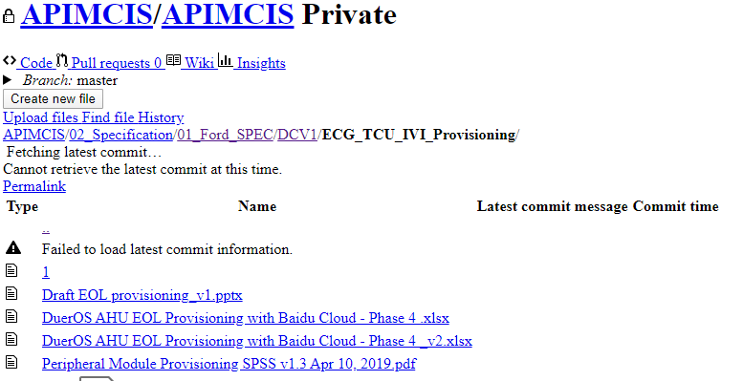
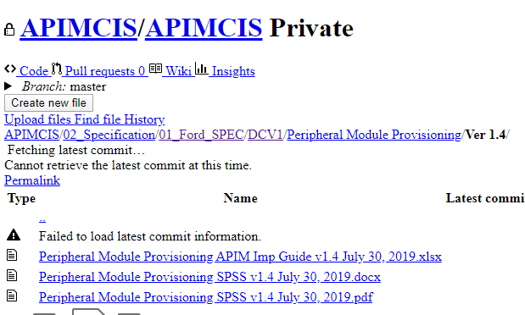
References
Peripheral Module Provisioning SPSS v1.4.pdf
Draft EOL provisioning_v1.pptx
DuerOS AHU EOL Provisioning with Baidu Cloud - Phase 4 _v2.xlsx

