Slide 1
Apex Prediction Markets
Avellaneda–Stoikov market making · Kalshi S&P niche · results & roadmap

Slide 2
Niche: S&P / index prediction on Kalshi
Focused stack for short-dated binary-style contracts tied to realized SPX (or band) outcomes.
Rich local data: archived order-book frames (JSONL), snapshots, Kalshi market-bounds artifacts for replay bands.
External reference: Schwab/minute SPX history scripts to relate spot path to conditional fair value.
Single-market deep dives (tear sheets labeled may01 / may04 / may07) instead of scattering across many unrelated tickers.

Slide 3
Project depth (repository map)
Live + paper paths: Kalshi (and optional Polymarket) WebSockets, discovery, storage.
Strategies package: legacy MM, copy-trading, alt-data — plus MM–AS (`src/strategies/market_making_as.py`).
Simulator layer: historical replay from frames, paper trading, metrics aligned with plotting.
Analysis: `mm_as_tear_sheet.py` (FIFO bucketed realized PnL, inventory/equity charts), Kalshi OB history/live analyzers.
Ops: CLI `scripts/run_strategy.py`, config via Pydantic (`MarketMakingAsSettings`).

Slide 4
Avellaneda–Stoikov: what we implemented
Mid / fair value s: blend of book mid, optional model track; rolling realized σ from price history.
Reservation price r = s − q γ σ² τ (inventory q, risk aversion γ, horizon τ = T−t).
Half-spread from A-S formula, then clipped to [0, 0.49] for valid binary prices in [0,1].
Adaptive γ(ρ): widens risk aversion under regime stress (ρ from reversal-bucket score when enabled).
Regime score currently unwired (`MM_AS_REGIME_SCORE_ENABLED = False`) so ρ = 0 in production path.
Sizing: base fraction of max position, Cauchy/band-based fair value hooks, inventory taper + hard gate + quote skew near limits.

Slide 5
Configuration highlights (MarketMakingAsSettings)
Risk & quotes
γ_base, κ, session_horizon_seconds
quote_update_interval, reprice threshold
max_position (signed cap target)
inventory_hard_gate_fraction, skew coeffs
session_flatten_seconds before EOD
Discovery & sim
Kalshi/Poly discovery filters (spread, volume)
Simulator: enforce_signed_inventory_cap backstop
Historical: bounds JSON → band metadata bootstrap

Slide 6
Measurement: tear-sheet methodology
FIFO pairing per market; realized PnL attributed to closing fill size bucket (0–50, …, 1000+).
Mark-to-market equity: cash from fills + inventory × last print (consistent with plot_backtest_graphics).
Reports: Markdown executive summary + PNG time series (inventory, cash/equity, bucket PnL, fills, VWAP spread).

Slide 7
Results snapshot (single Kalshi markets, ~6.5h sessions)
May 01 — fills 3,767 · MTM equity ~$16.3k vs cash ~$10.6k · max |inv| ~20.8k · max DD ~$4.1k.
May 04 — fills 1,792 · cash ~$4.5k vs MTM ~$3.9k · max |inv| ~60k (extreme directional book) · max DD ~$5.8k.
May 07 — fills 852 · MTM ~−$1.7k vs cash ~−$1.8k · max |inv| ~9.3k · max DD ~$2.6k.
Pattern: small/mid closing sizes often dominated P&L in the “good” days; tail inventory remains the structural risk.

Slide 8
Strengths vs gaps
What looked good
End-to-end path from data → replay → FIFO analytics.
A-S machinery + binary clips + inventory-aware sizing hooks.
Actionable diagnostics (bucketed realized, inventory spikes).
Where it breaks / next work
Inventory explodes relative to “tight MM” — need stronger flattening, caps, or vol/λ calibration.
Regime ρ path off — re-enable or replace with execution-level signal.
Fees, latency tier, partial fills: label sim vs live explicitly.
Fair value: stress-test Cauchy/band model vs pure mid under fast moves.

Slide 9
Roadmap (concrete)
Tighten signed inventory path: lower effective κ or dynamic spread; kill-switch on inventory velocity.
Revisit γ, horizon τ, and max half-spread vs Kalshi tick structure.
Calibrate to arrival rate / queue position if OB data supports it.
Expand SPX-aligned features: joint plots of spot path vs quoted r and inventory.
Automate deck refresh: tie tear_sheet outputs into this script for dated runs.

Slide 10
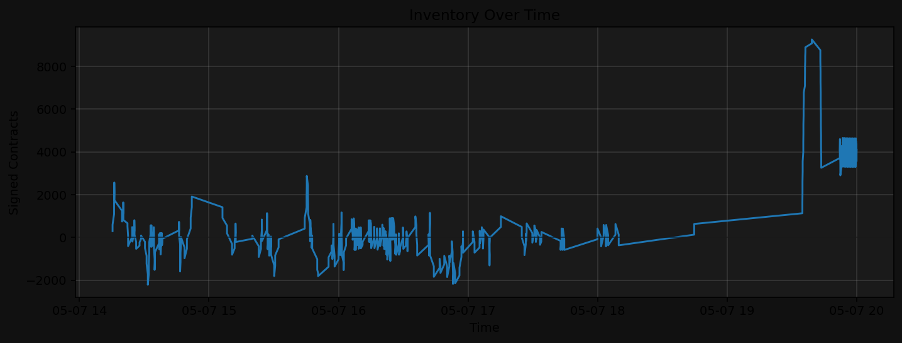
May 07 — inventory (illustrative)

Slide 11
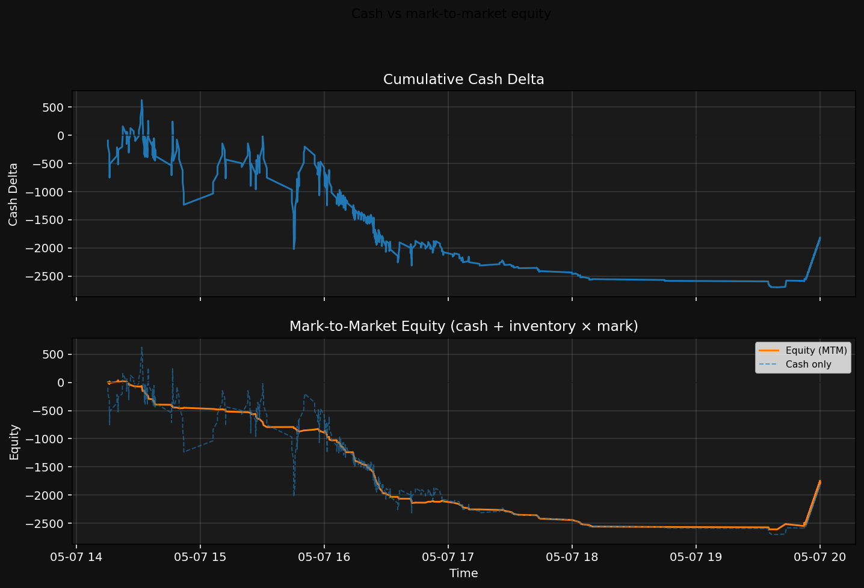
May 07 — cash vs MTM equity

Slide 12
Scripts & entry points
Strategy: `src/strategies/market_making_as.py`
Run: `python scripts/run_strategy.py --strategy market_making …`
Tear sheet: `python scripts/mm_as_tear_sheet.py --db-path … --out-dir reports/tear_*`
This deck: `python scripts/build_mm_as_presentation.py`

