Slide 1
Chapter 17 Binary I/O

Slide 2
Motivations
Data stored in a text file is represented in human-readable form.
Data stored in a binary file is represented in binary form.
You cannot read binary files.
They are designed to be read by programs.

Slide 3
Examples
For example, Java source programs are stored in text files and can be read by a text editor
Machine executable files (such as msword.exe) are stored in binary files and are read by the CPU.
The advantage of binary files is that they are more efficient to process than text files.

Slide 4
How is I/O Handled in Java?
A File object encapsulates the properties of a file or a path, but does not contain the methods for reading/writing data from/to a file. In order to perform I/O, you need to create objects using appropriate Java I/O classes.
Scanner input = new Scanner(new File("temp.txt"));
System.out.println(input.nextLine());
PrintWriter output = new PrintWriter("temp.txt");
output.println("Java 101");
output.close();

Slide 5
Binary I/O
Text I/O requires encoding and decoding.
Binary I/O does not require conversions.
When you write a byte to a file, the original byte is copied into the file. When you read a byte from a file, the exact byte in the file is returned.

Slide 6
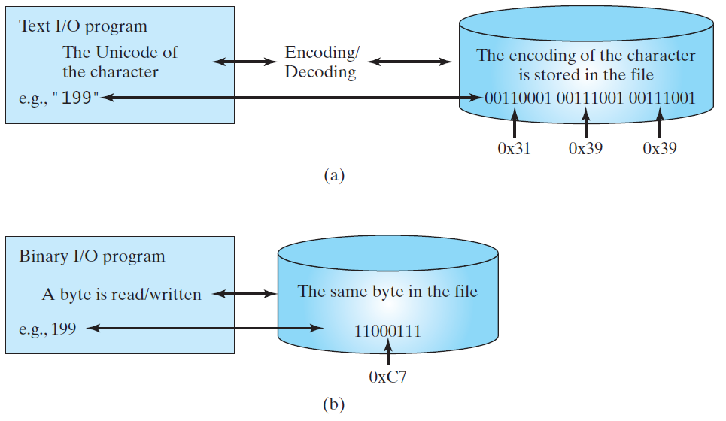
Text I/O vs Binary I/O

Slide 7
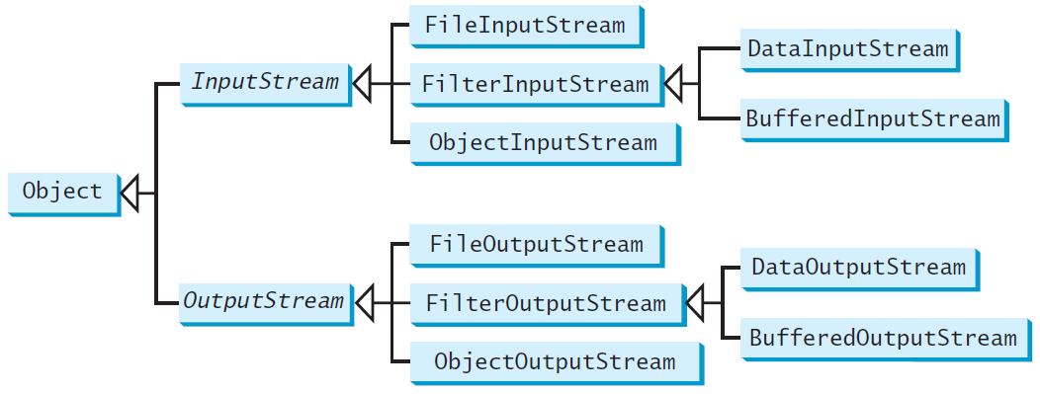
Binary I/O Classes
Abstract class
Abstract class
Notes:
Which method is abstract and why?

Slide 8
InputStream
The value returned is a byte as an int type.
Notes:
Read() is one and only abstract method

Slide 9
OutputStream
The value is a byte as an int type.
Notes:
Write(int b) is one and only abstract method

Slide 10
FileInputStream/FileOutputStream
FileInputStream/FileOutputStream associates a binary input/output stream with an external file.

Slide 11
FileInputStream
To construct a FileInputStream, use the following constructors:
public FileInputStream(String filename)
public FileInputStream(File file)
A java.io.FileNotFoundException would occur if you attempt to create a FileInputStream with a nonexistent file.

Slide 12
FileOutputStream
To construct a FileOutputStream, use the following constructors:
public FileOutputStream(String filename)
public FileOutputStream(File file)
public FileOutputStream(String filename, boolean append)
public FileOutputStream(File file, boolean append)
If the file does not exist, a new file would be created. If the file already exists, the first two constructors would delete the current contents in the file. To retain the current content and append new data into the file, use the last two constructors by passing true to the append parameter.
TestFileStream
Exercise: Make two separate programs,
one for writing and one for reading.

Slide 13
When to use
When you want to read and write bytes only.
Does not allow you to write int, double, String or other types.
Only bytes.

Slide 14
FilterInputStream/FilterOutputStream
Filter streams are streams that filter bytes for some purpose.

Slide 15
Filter Streams
The basic byte input stream provides a read method that can only be used for reading bytes.
If you want to read integers, doubles, or strings, you need a filter class to wrap the byte input stream.
Using a filter class enables you to read integers, doubles, and strings instead of bytes and characters.
FilterInputStream and FilterOutputStream are the base classes for filtering data.
When you need to process primitive numeric types, use DataInputStream and DataOutputStream to filter bytes.

Slide 16
DataInputStream/DataOutputStream
DataInputStream reads bytes from the stream and converts them into appropriate primitive type values or strings.
DataOutputStream converts primitive type values or strings into bytes and output the bytes to the stream.

Slide 17
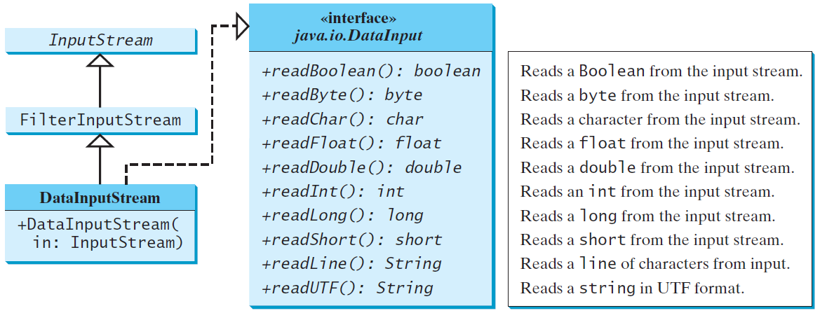
DataInputStream
DataInputStream extends FilterInputStream and implements the DataInput interface.

Slide 18
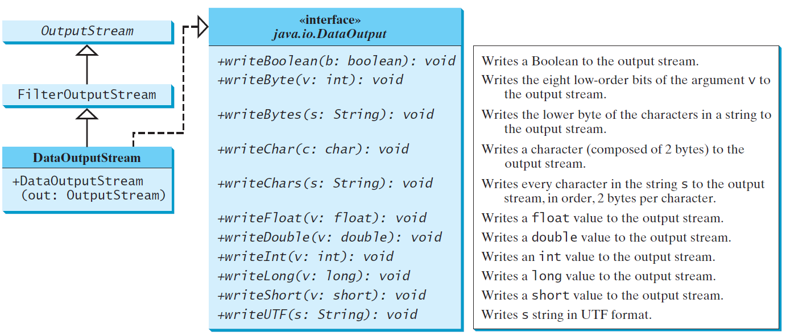
DataOutputStream
DataOutputStream extends FilterOutputStream and implements the DataOutput interface.

Slide 19
Concept of pipe line

Slide 20
Characters and Strings in Binary I/O
A Unicode consists of two bytes.
The writeChar(char c) method writes the Unicode of character c to the output.
The writeChars(String s) method writes the Unicode for each character in the string s to the output.

Slide 21
Using DataInputStream/DataOutputStream
Data streams are used as wrappers on existing input and output streams to filter data in the original stream. They are created using the following constructors:
public DataInputStream(InputStream instream)
public DataOutputStream(OutputStream outstream)
The statements given below create data streams. The first statement creates an input stream for file in.dat; the second statement creates an output stream for file out.dat.
DataInputStream infile =
new DataInputStream(new FileInputStream("in.dat"));
DataOutputStream outfile =
new DataOutputStream(new FileOutputStream("out.dat"));
TestDataStreamRead
TestDataStreamWrite

Slide 22
Checking End of File
Order and Format
CAUTION: You have to read the data in the same order and same format in which they are stored. That is, the reader will need to collaborate with the writer.
TIP: If you keep reading data at the end of a stream, an EOFException would occur. So how do you check the end of a file? You can use input.available() to check it. input.available() == 0 indicates that it is the end of a file.
Exercise:
Save TestDataStreamRead as TestDataStreamRead2. Use a loop in the new program and use checking End of File to control the loop.

Slide 23
Another Way to Detect End of File
See the example DetectEndOfFile.java
Optional exercise: Create TestDataStreamRead3, which uses exception to deal with end of file.
DetectEndOfFile

Slide 24
BufferedInputStream/ BufferedOutputStream
Using buffers to speed up I/O
BufferedInputStream/BufferedOutputStream does not contain new methods. All the methods BufferedInputStream/BufferedOutputStream are inherited from the InputStream/OutputStream classes.

Slide 25
When to use
Buffer File streams allow you to read and write large chunks of bytes to/from file
Minimizes disk access, but not formatted I/O

Slide 26
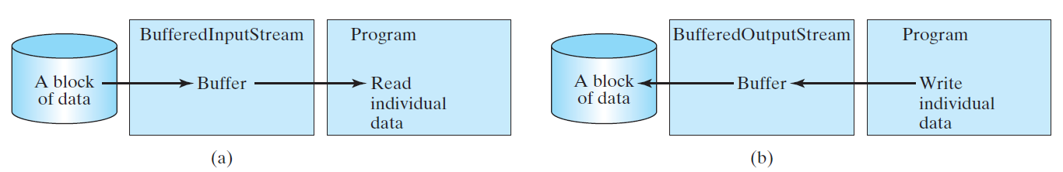
Constructing BufferedInputStream/BufferedOutputStream
// Create a BufferedInputStream
public BufferedInputStream(InputStream in)
public BufferedInputStream(InputStream in, int bufferSize)
// Create a BufferedOutputStream
public BufferedOutputStream(OutputStream out)
public BufferedOutputStream(OutputStreamr out, int bufferSize)

Slide 27
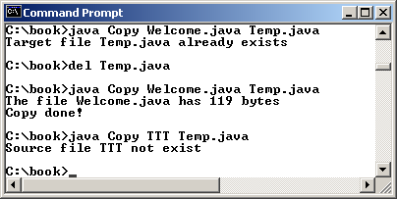
Case Studies: Copy File
This case study develops a program that copies files. The user needs to provide a source file and a target file as command-line arguments using the following command:
java Copy source target
The program copies a source file to a target file and displays the number of bytes in the file. If the source does not exist, tell the user the file is not found. If the target file already exists, tell the user the file already exists.
Copy
(1) Compare the time used for copying.
(2) Why output.close() is necessary for the target file in Copy.java, but not in Copy2.java.
Copy2

Slide 28
Object I/O
DataInputStream/DataOutputStream enables you to perform I/O for primitive type values and strings. ObjectInputStream/ObjectOutputStream enables you to perform I/O for objects in addition for primitive type values and strings.

Slide 29
ObjectInputStream
ObjectInputStream extends InputStream and implements ObjectInput and ObjectStreamConstants.

Slide 30
ObjectOutputStream
ObjectOutputStream extends OutputStream and implements ObjectOutput and ObjectStreamConstants.

Slide 31
Using Object Streams
You may wrap an ObjectInputStream/ObjectOutputStream on any InputStream/OutputStream using the following constructors:
// Create an ObjectInputStream
public ObjectInputStream(InputStream in)
// Create an ObjectOutputStream
public ObjectOutputStream(OutputStream out)
TestObjectOutputStream
TestObjectInputStream

Slide 32
The Serializable Interface
Not all objects can be written to an output stream. Objects that can be written to an object stream is said to be serializable. A serializable object is an instance of the java.io.Serializable interface. So the class of a serializable object must implement Serializable.
The Serializable interface is a marker interface. It has no methods, so you don't need to add additional code in your class that implements Serializable.
Implementing this interface enables the Java serialization mechanism to automate the process of storing the objects and arrays.

Slide 33
The transient Keyword
If an object is an instance of Serializable, but it contains non-serializable instance data fields, can the object be serialized? The answer is no. To enable the object to be serialized, you can use the transient keyword to mark these data fields to tell the JVM to ignore these fields when writing the object to an object stream.

Slide 34
The transient Keyword, cont.
Consider the following class:
public class Foo implements java.io.Serializable {
private int v1;
private static double v2;
private transient A v3 = new A();
}
class A { } // A is not serializable
When an object of the Foo class is serialized, only variable v1 is serialized. Variable v2 is not serialized because it is a static variable, and variable v3 is not serialized because it is marked transient. If v3 were not marked transient, a java.io.NotSerializableException would occur.

Slide 35
Serializing Arrays
An array is serializable if all its elements are serializable. So an entire array can be saved using writeObject into a file and later restored using readObject. Here is an example that stores an array of five int values and an array of three strings, and reads them back to display on the console.
TestObjectStreamForArray

Slide 36
readObject() and writeObject()
Another way to write objects with non-serializable attributes is to provide your own readObject() and writeObject() methods
These methods write and read the object using FileInputStream
This is considered very advanced and should be avoided unless you really understand File I/O completely.

Slide 37
Random Access Files
All of the streams you have used so far are known as read-only or write-only streams.
The external files of these streams are sequential files that cannot be updated without creating a new file.
It is often necessary to modify files or to insert new records into files.
Java provides the RandomAccessFile class to allow a file to be read from and write to at random locations.

Slide 38
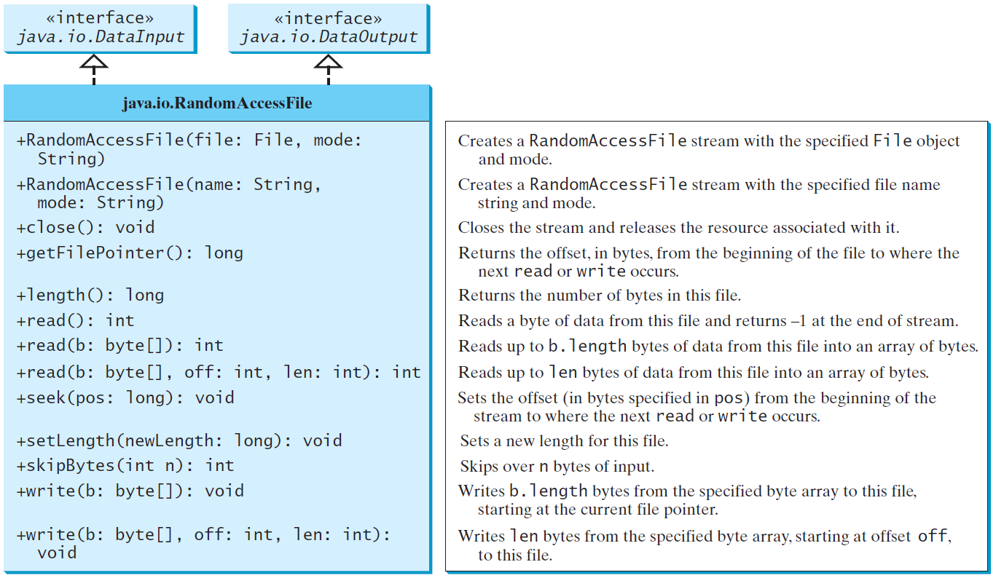
RandomAccessFile

Slide 39
File Pointer
A random access file consists of a sequence of bytes.
There is a special marker called file pointer that is positioned at one of these bytes.
A read or write operation takes place at the location of the file pointer.
When a file is opened, the file pointer sets at the beginning of the file.
When you read or write data to the file, the file pointer moves forward to the next data.
For example, if you read an int value using readInt(), the JVM reads four bytes from the file pointer and now the file pointer is four bytes ahead of the previous location.

Slide 40
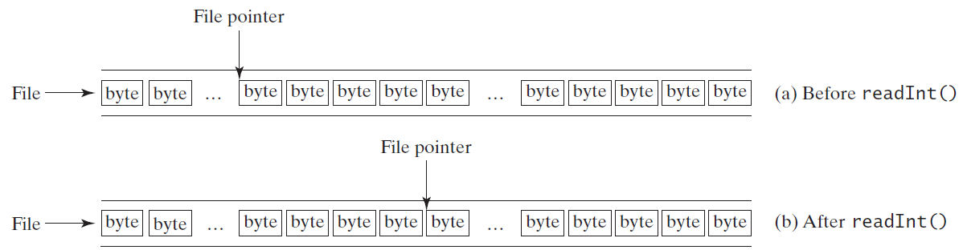
Random Access File Pointer

Slide 41
RandomAccessFile Methods
Many methods in RandomAccessFile are the same as those in DataInputStream and DataOutputStream.
For example, readInt(), readLong(), writeDouble(), readLine(), writeInt(), and writeLong() can be used in data input stream or data output stream as well as in RandomAccessFile streams.

Slide 42
RandomAccessFile Methods, cont.
void seek(long pos) throws IOException;
Sets the offset ( in bytes) from the beginning of the RandomAccessFile stream to where the next read or write occurs.
long getFilePointer() IOException;
Returns the current offset, in bytes, from the beginning of the file to where the next read or write occurs.

Slide 43
RandomAccessFile Methods, cont.
long length()IOException
Returns the length of the file.
final void writeChar(int v) throws IOException
Writes a character to the file as a two-byte Unicode, with the high byte written first.
final void writeChars(String s) throws IOException
Writes a string to the file as a sequence of characters.

Slide 44
RandomAccessFile Constructor
RandomAccessFile raf = new RandomAccessFile("test.dat", "rw"); // allows read and write
RandomAccessFile raf = new RandomAccessFile("test.dat", "r"); // read only

Slide 45
Warning
Random Access File I/O requires a much greater understanding of data representation and size in memory than Text or Object I/O.
Use with extreme care!

Slide 46
A Short Example on RandomAccessFile
TestRandomAccessFile

Slide 47
Fixed Length String I/O
Optional
Random access files are often used to process files of records. For convenience, fixed-length records are used in random access files so that a record can be located easily. A record consists of a fixed number of fields. A field can be a string or a primitive data type. A string in a fixed-length record has a maximum size. If a string is smaller than the maximum size, the rest of the string is padded with blanks.
FixedLengthStringIO

