Slide 1
Java Collection Framework hierarchy
A collection is a container object that holds a group of objects, often referred to as elements. The Java Collections Framework supports three types of collections, named lists, sets, and maps.

Slide 2
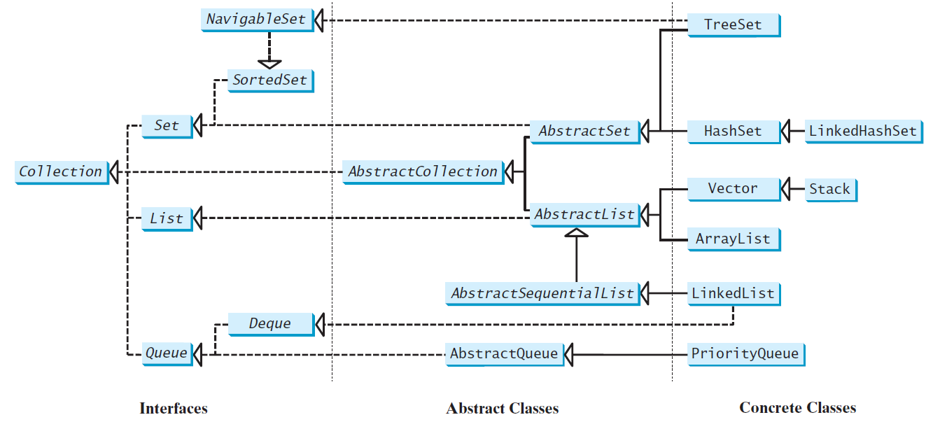
Java Collection Framework hierarchy
The Collection interface is for manipulating a collection of objects.
Set and List are subinterfaces of Collection.

Slide 3
Review 1
List

Slide 4
Lists
A list is a popular data structure to store data in sequential order. For example, a list of students, a list of available rooms, a list of cities, and a list of books, etc. can be stored using lists. The common operations on a list are usually the following:
· Retrieve an element from this list.
· Insert a new element to this list.
· Delete an element from this list.
· Find how many elements are in this list.
· Find if an element is in this list.
· Find if this list is empty.

Slide 5
List vs Array
A list can grow or shrink dynamically.
An array is fixed once it is created. If your application does not require insertion or deletion of elements, the most efficient data structure is the array.

Slide 6
Two Different Lists
The ArrayList class and the LinkedList class are concrete implementations of the List interface.
ArrayList: It uses an array internally to store the elements. The array is dynamically created. If the capacity of the array is exceeded, create a new larger array and copy all the elements from the current array to the new array.
LinkedList: It uses a linked structure. A linked structure consists of nodes. Each node is dynamically created to hold an element. All the nodes are linked together to form a list.

Slide 7
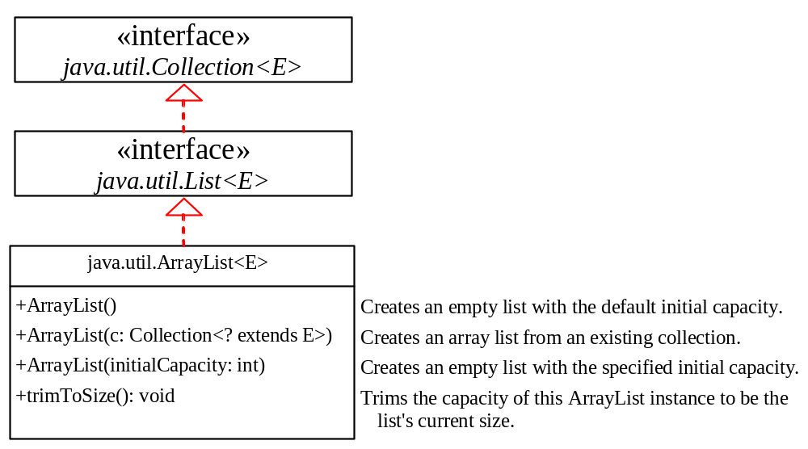
java.util.ArrayList

Slide 8
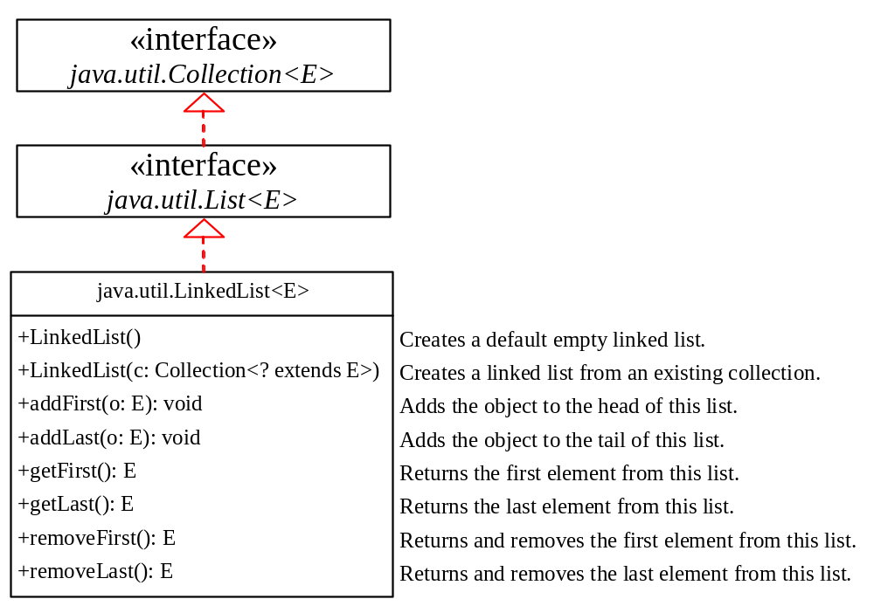
java.util.LinkedList

Slide 9
Example: Using Java’s ArrayList and LinkedList
This example creates an array list filled with numbers, and inserts new elements into the specified location in the list. The example also creates a linked list from the array list, inserts and removes the elements from the list. Finally, the example traverses the list forward and backward.
TestArrayAndLinkedList

Slide 10
ArrayList and LinkedList
You will not be asked to write code implement an array list or a linked list, but you need to know
how they are implemented (conceptually)
the complexity of different operations.

Slide 11
Array Lists
Array is a fixed-size data structure. Once an array is created, its size cannot be changed. An ArrayList is a dynamic data structure based on using an array. The trick is to create a new larger array to replace the current array if the current array cannot hold new elements in the list.
Initially, an array, say data of Object[] type, is created with a default size. When inserting a new element into the array, first ensure there is enough room in the array. If not, create a new array with the size as twice as the current one. Copy the elements from the current array to the new array. The new array now becomes the current array.

Slide 12
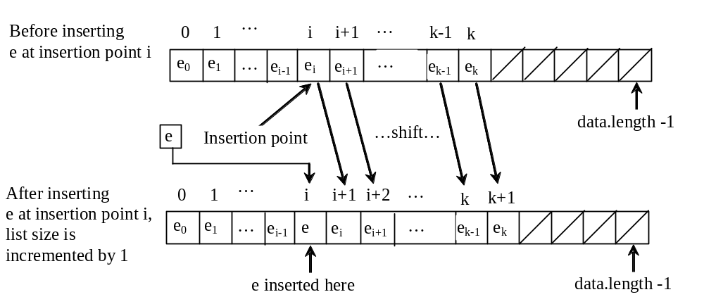
Insertion
Before inserting a new element at a specified index, shift all the elements after the index to the right and increase the list size by 1.

Slide 13
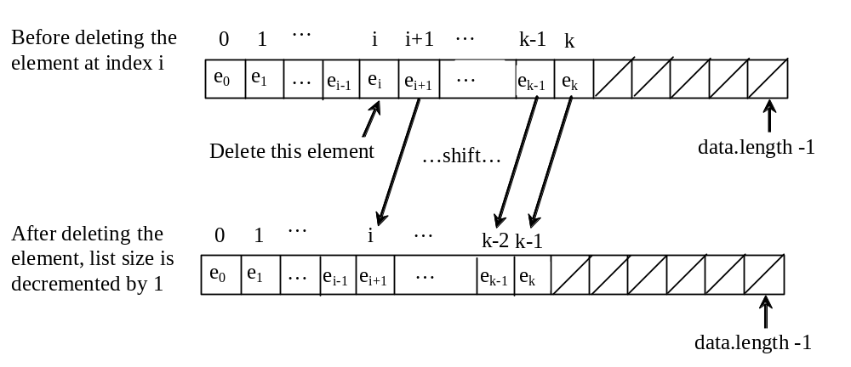
Deletion
To remove an element at a specified index, shift all the elements after the index to the left by one position and decrease the list size by 1.

Slide 14
ArrayList Time Complexity
Accessing using index: O(1)
  get(int index)
  set(int index, Object o)
Adding to the end: O(1)
  add(Object o)
Adding or removing from an Index: O(n)
  add(int index, Object o)
  remove(int index)

Slide 15
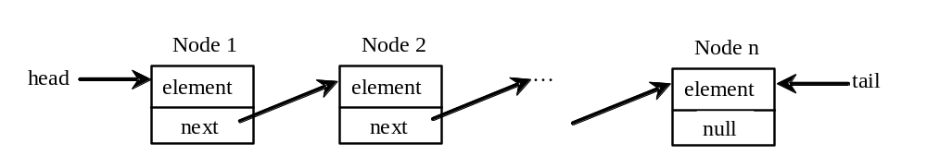
Linked Lists
A linked list consists of nodes. Each node contains an element, and each node is linked to its next neighbor. Thus a node can be defined as a class, as follows:
class Node<E> {
E element;
Node<E> next;
public Node(E o) {
element = o;
}
}

Slide 16
Traversing All Elements in the List
Each node contains the element and a data field named next that points to the next node. If the node is the last in the list, its pointer data field next contains the value null. You can use this property to detect the last node. For example, you may write the following loop to traverse all the nodes in the list.
Node<E> current = head;
while (current != null) {
System.out.println(current.element);
current = current.next;
}

Slide 17
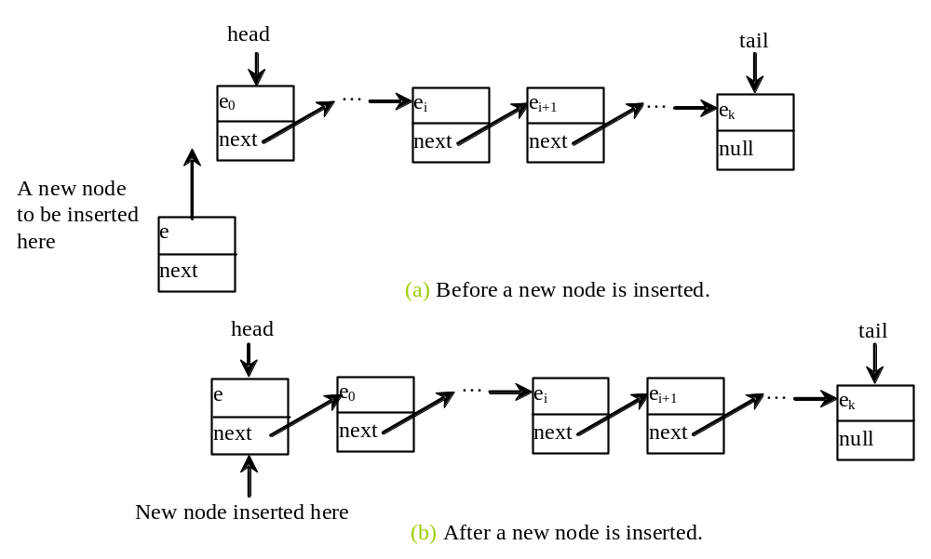
Implementing addFirst(E e) - O(1)
public void addFirst(E e) {
Node<E> newNode = new Node<>(e);
newNode.next = head;
head = newNode;
size++;
if (tail == null)
tail = head;
}

Slide 18
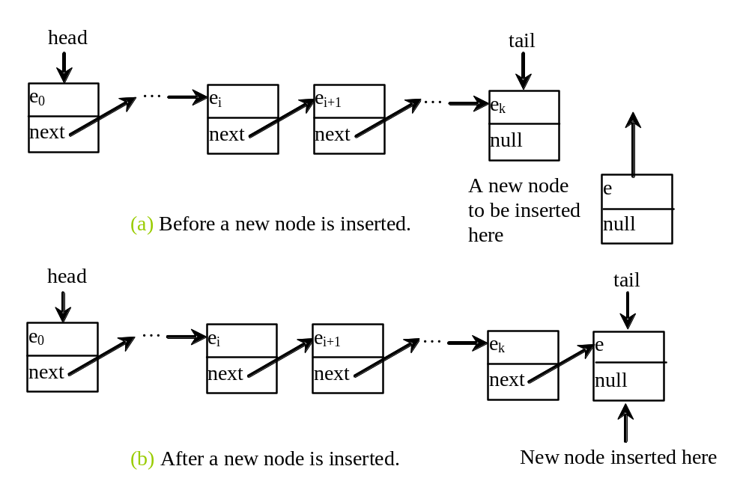
Implementing addLast(E e) – O(1)
public void addLast(E e) {
if (tail == null) {
head = tail = new Node<>(e);
}
else {
tail.next = new Node<>(e);
tail = tail.next;
}
size++;
}

Slide 19
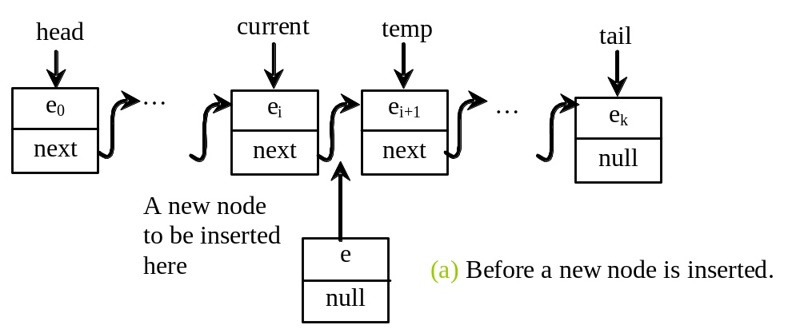
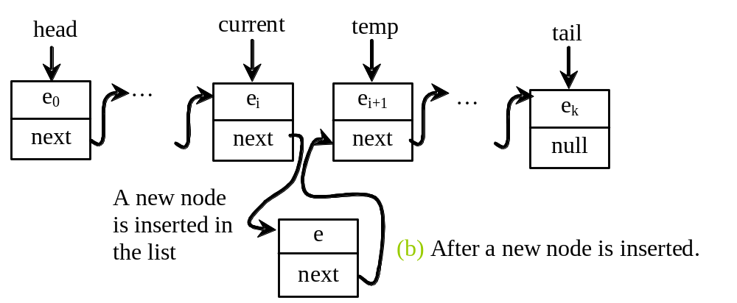
Implementing add(int index, E e) – O(n)
public void add(int index, E e) {
if (index == 0) addFirst(e);
else if (index >= size) addLast(e);
else {
Node<E> current = head;
for (int i = 1; i < index; i++)
current = current.next;
Node<E> temp = current.next;
current.next = new Node<>(e);
(current.next).next = temp;
size++;
}
}
One average, index is n/2, so the loop traverse n/2 nodes to reach indexed location.

Slide 20
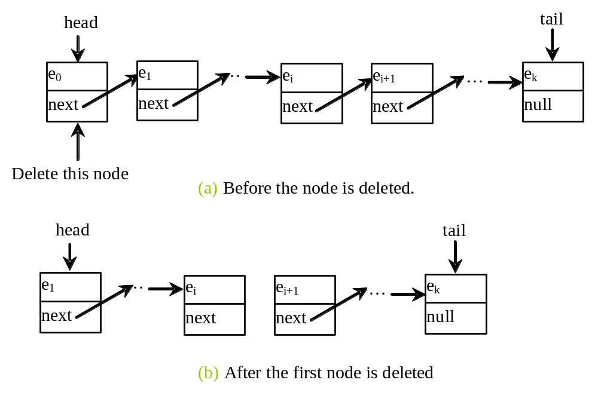
Implementing removeFirst() – O(1)
public E removeFirst() {
if (size == 0) return null;
else {
Node<E> temp = head;
head = head.next;
size--;
if (head == null) tail = null;
return temp.element;
}
}

Slide 21
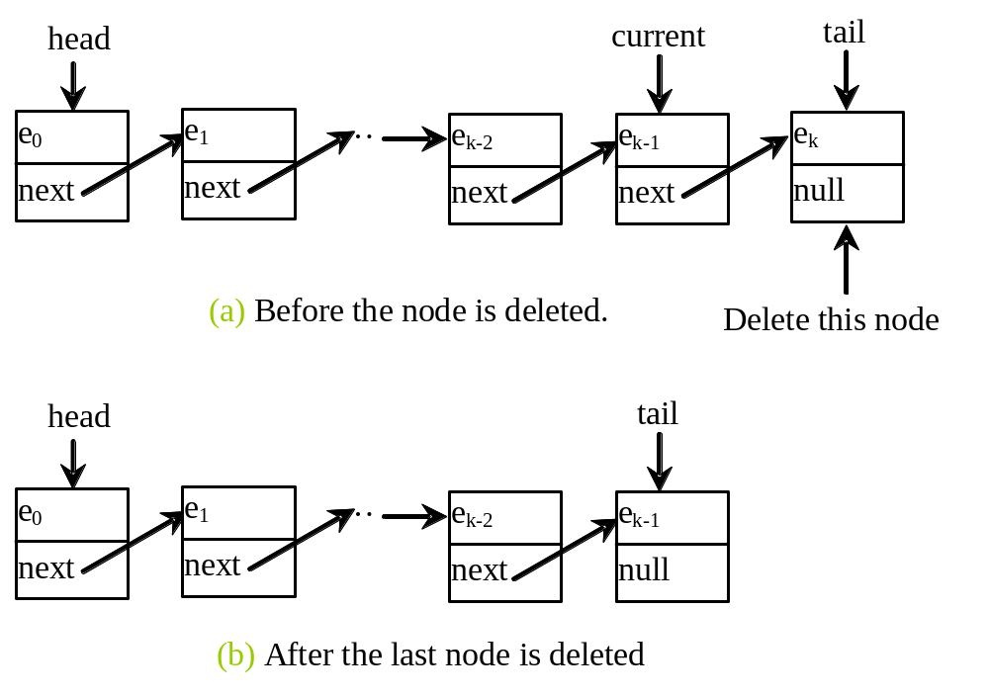
Implementing removeLast()
public E removeLast() {
if (size == 0) return null;
else if (size == 1)
{
Node<E> temp = head;
head = tail = null;
size = 0;
return temp.element;
}
else
{
Node<E> current = head;
for (int i = 0; i < size - 2; i++)
current = current.next;
Node temp = tail;
tail = current;
tail.next = null;
size--;
return temp.element;
}
}
The loop execute O(n) iteration.

Slide 22
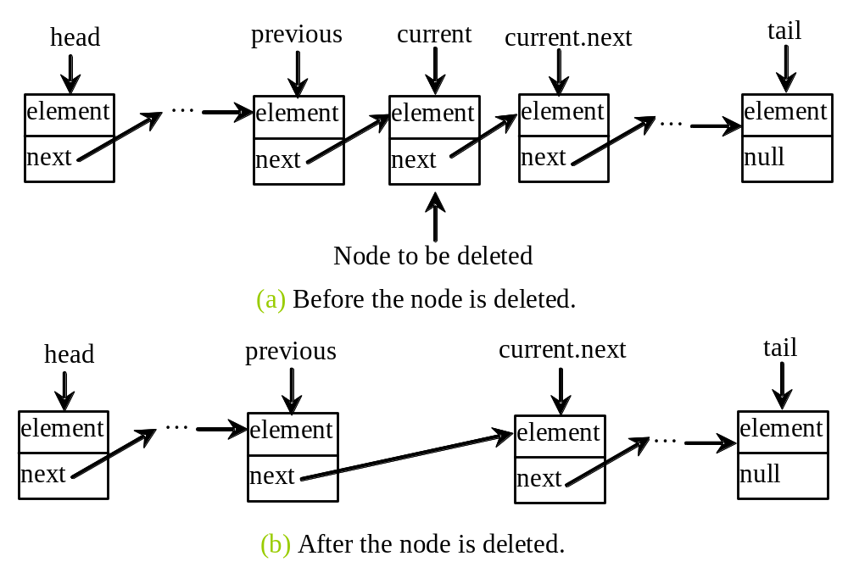
Implementing remove(int index) – O(n)
public E remove(int index) {
if (index < 0 || index >= size) return null;
else if (index == 0) return removeFirst();
else if (index == size - 1) return removeLast();
else {
Node<E> previous = head;
for (int i = 1; i < index; i++) {
previous = previous.next;
}
Node<E> current = previous.next;
previous.next = current.next;
size--;
return current.element;
}
}

Slide 23
Make a Choice: ArrayList or LinkedList
If you need to support random access through an index without inserting or removing elements from any place other than the end, ArrayList offers the most efficient collection.
If, however, your application requires the insertion or deletion of elements from any place in the list, you should choose LinkedList.

