Slide 1
Review 2
Sets and Maps

Slide 2
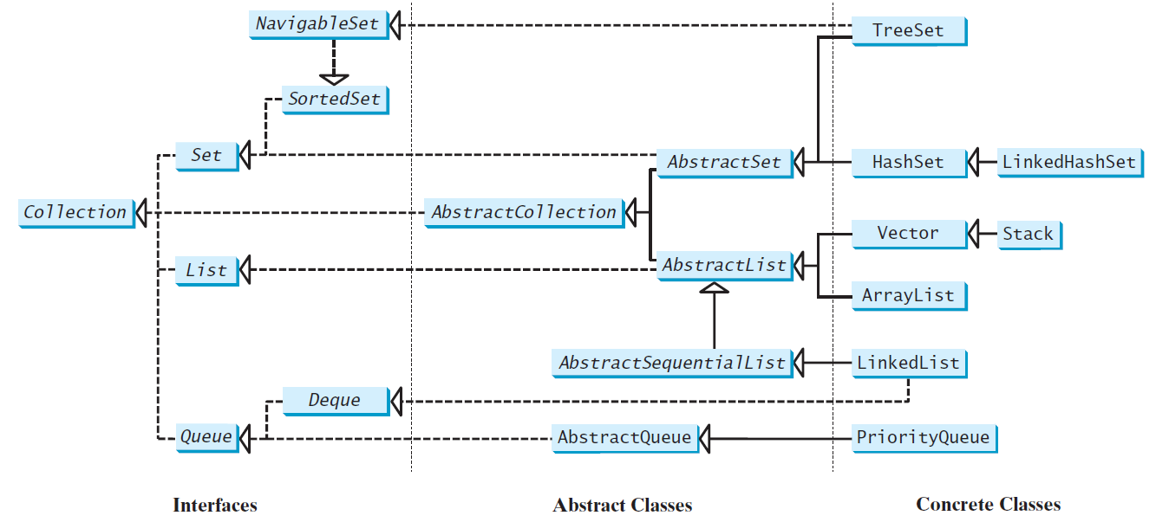
Set and List are subinterfaces of Collection.

Slide 3
The Set Interface
The concrete classes that implement Set must ensure that no duplicate elements can be added to the set. That is no two elements e1 and e2 can be in the set such that e1.equals(e2) is true.

Slide 4
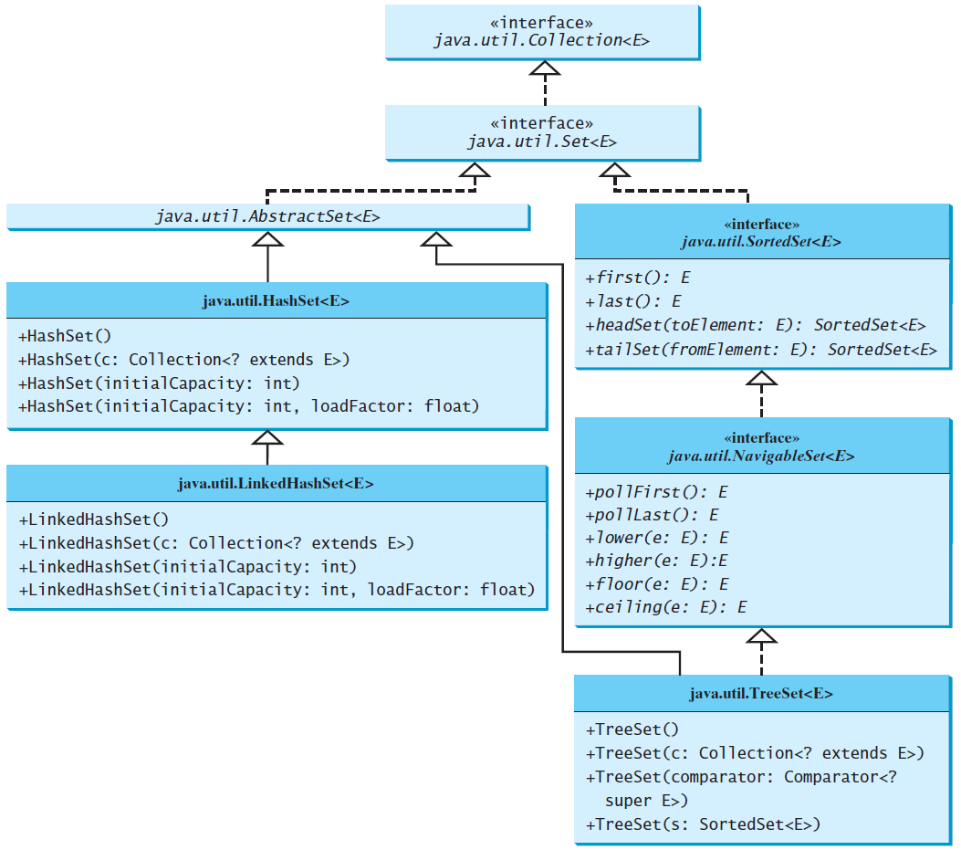
Two Concrete Classes are HashSet and TreeSet

Slide 5
HashSet and TreeSet
HashSet is based on hash table. You will not be asked to implement a HashSet, but you will need to understand its implementation in concept and the time complexity of the operations.
TreeSet is based on self-balancing binary search tree. You will need to know how to implement some operations by recursion (See Review 3).

Slide 6
The HashSet Class
For efficiency, objects added to a hash set need to implement the hashCode method in a manner that properly disperses the hash code.

Slide 7
What is Hashing?
If you know the index of an element in the array, you can retrieve the element using the index in O(1) time. So, can we store the values in an array and use the key as the index to find the value? The answer is yes if you can map a key to an index.
The array that stores the values is called a hash table. The function that maps a key to an index in the hash table is called a hash function.
Hashing is a technique that retrieves the value using the index obtained from key without performing a search.

Slide 8
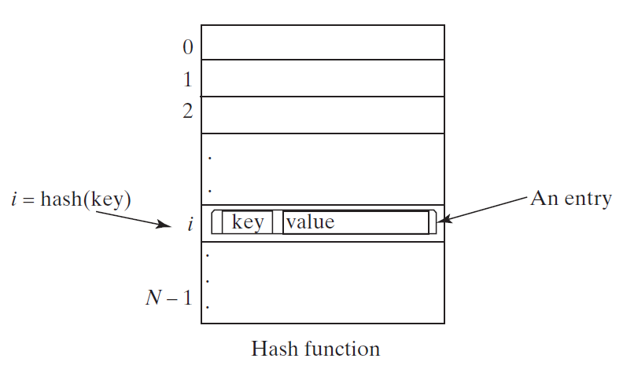
Hash Function and Hash Codes
A typical hash function first converts a search key to an integer value called a hash code, and then compresses the hash code into an index to the hash table.

Slide 9
Collision Handling
If more than one items are mapped to the same index, collision handling is needed.
The following slides shows different ways to handle collisions.

Slide 10
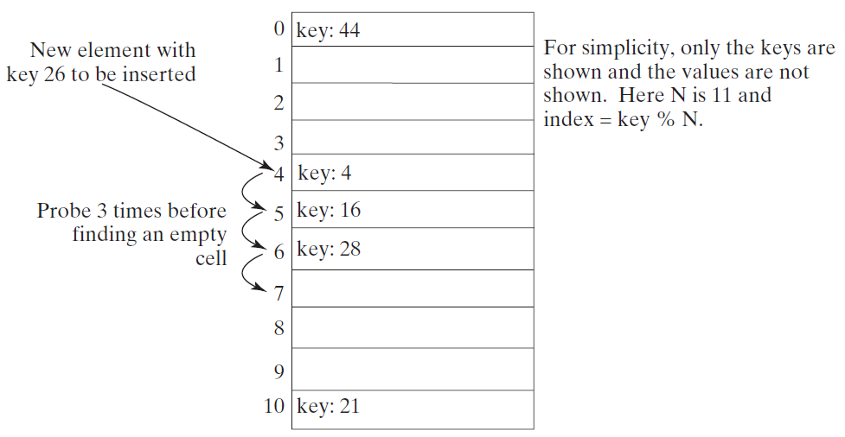
Collision Handling: Linear Probing

Slide 11
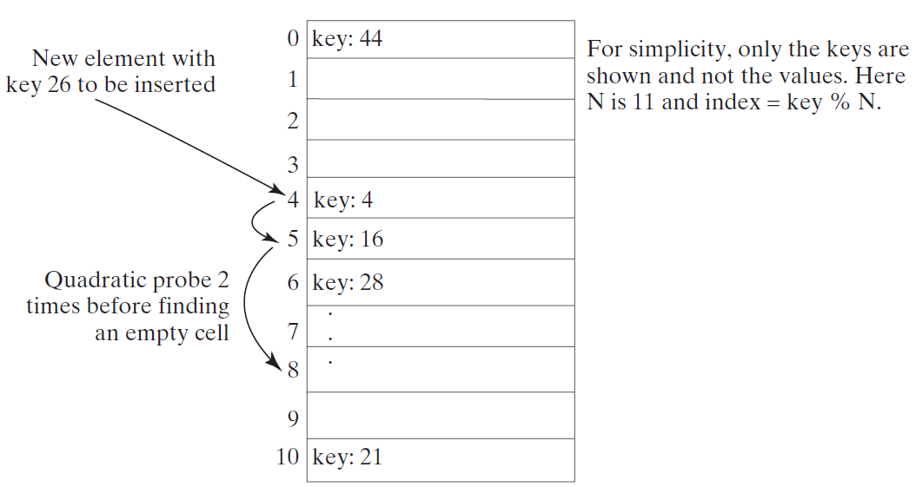
Collision Handling: Quadratic Probing
https://liveexample.pearsoncmg.com/dsanimation/QuadraticProbingeBook.html
Quadratic probing can avoid the clustering problem in linear probing. Linear probing looks at the consecutive cells beginning at index k. Quadratic probing increases the index by j^2 for j = 1, 2, 3, ... The actual index searched are k, k + 1, k + 4, …

Slide 12
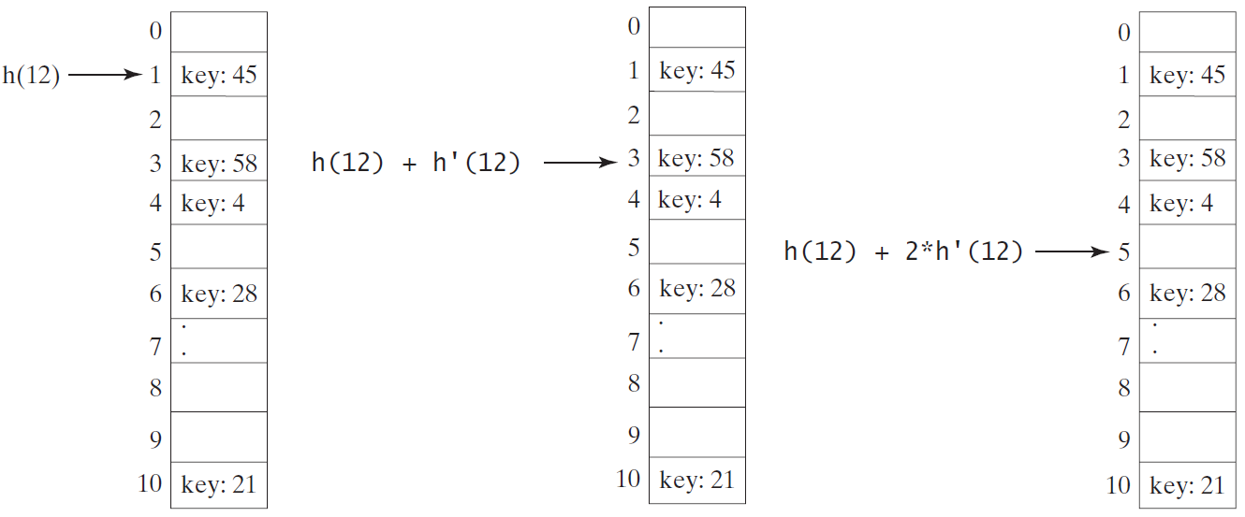
Collision Handling: Double Hashing
https://liveexample.pearsoncmg.com/dsanimation/DoubleHashingeBook.html
Double hashing uses a secondary hash function on the keys to determine the increments to avoid the clustering problem.
h’(k) = 7 – k % 7;

Slide 13
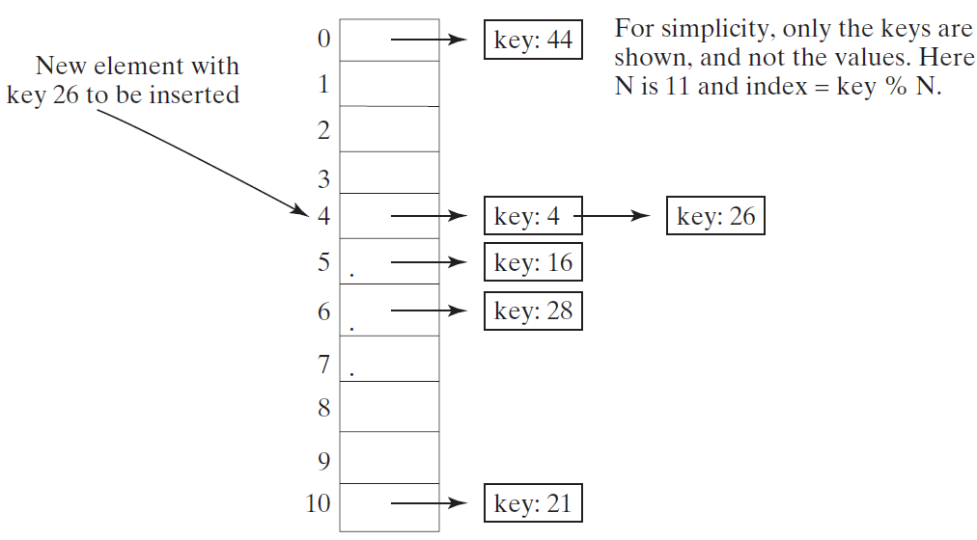
Collision Handling: Using Separate Chaining
https://liveexample.pearsoncmg.com/dsanimation/SeparateChainingeBook.html
The separate chaining scheme places all entries with the same hash index into the same location, rather than finding new locations. Each location in the separate chaining scheme is called a bucket. A bucket is a container that holds multiple entries.

Slide 14
Java HashSet Collision Handling
Similar to previous slide.
Instead of a linked List for each bucket, it uses a balanced tree set.

Slide 15
Using HashSet
TestHashSet
This example creates a hash set filled with strings, and uses an iterator to traverse the elements in the list.
Question: Is the order the same as the order items are entered into the set? No. It doesn’t seem to be any particular order.

Slide 16
Example: Using LinkedHashSet
TestLinkedHashSet
This example creates a hash set filled with strings, and uses an iterator to traverse the elements in the list.
Question: Is the order the same as the order items are entered into the set?: Yes!

Slide 17
The SortedSet Interface and the TreeSet Class
SortedSet is a subinterface of Set, which guarantees that the elements in the set are sorted. TreeSet is a concrete class that implements the SortedSet interface. You can use an iterator to traverse the elements in the sorted order. The elements can be sorted in two ways.

Slide 18
The SortedSet Interface and the TreeSet Class, cont.
One way is to use the Comparable interface.
The other way is to specify a comparator for the elements in the set if the class for the elements does not implement the Comparable interface, or you don’t want to use the compareTo method in the class that implements the Comparable interface. This approach is referred to as order by comparator.

Slide 19
Example: Using TreeSet to Sort Elements in a Set
TestTreeSet
This example creates a hash set filled with strings, and then creates a tree set for the same strings. The strings are sorted in the tree set using the compareTo method in the Comparable interface. The example also creates a tree set of geometric objects. The geometric objects are sorted using the compare method in the Comparator interface.
Question:
(1) Is the order the same as the order items are entered into the set? No
(2) If not, what order? By the order determined by the comparator’s compare method or comparable’s comparedTo method.

Slide 20
Example: The Using Comparator to Sort Elements in a Set
TestTreeSetWithComparator
Write a program that demonstrates how to sort elements in a tree set using the Comparator interface. The example creates a tree set of geometric objects. The geometric objects are sorted using the compare method in the Comparator interface.

Slide 21
CountDistinctWords.java uses a HashSet.
CountDistinctWordsTree.java uses a TreeSet.

Slide 22
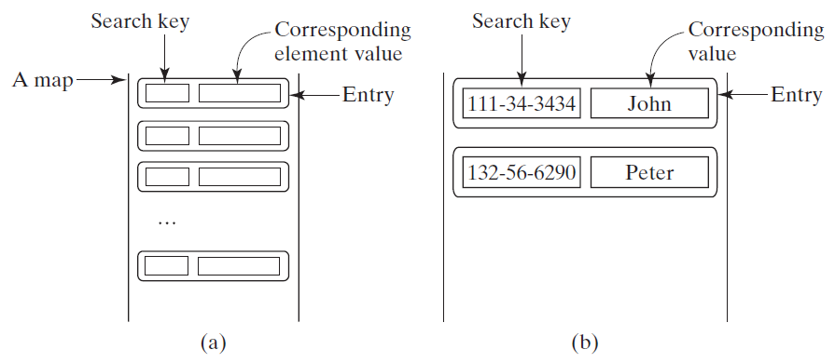
The Map Interface
The Map interface maps keys to the elements. The keys are like indexes. In List, the indexes are integer. In Map, the keys can be any objects.

Slide 23
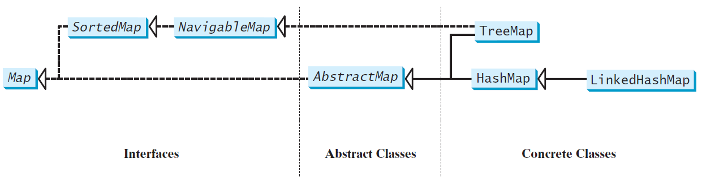
Map Interface and Class Hierarchy
An instance of Map represents a group of objects, each of which is associated with a key. You can get the object from a map using a key, and you have to use a key to put the object into the map.

Slide 24
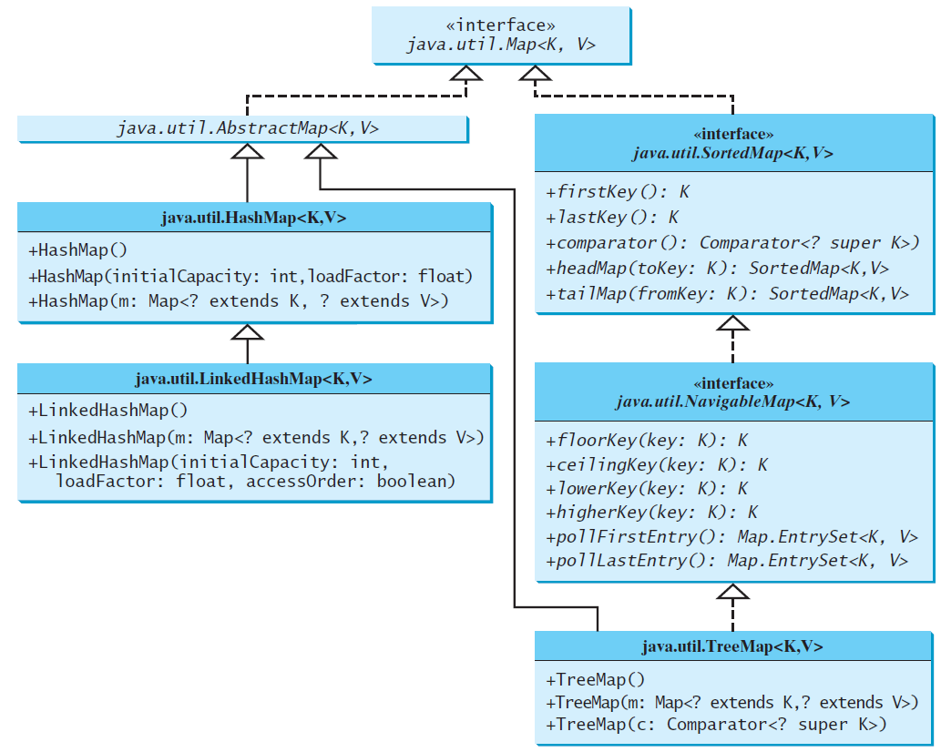
Concrete Map Classes

Slide 25
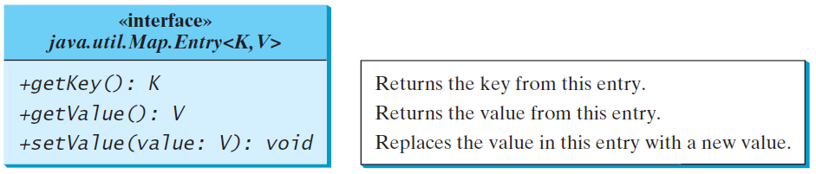
Entry

Slide 26
HashMap and TreeMap
The HashMap and TreeMap classes are two concrete implementations of the Map interface. The HashMap class is efficient for locating a value, inserting a mapping, and deleting a mapping. The TreeMap class, implementing SortedMap, is efficient for traversing the keys in a sorted order.

Slide 27
LinkedHashMap
LinkedHashMap was introduced in JDK 1.4. It extends HashMap with a linked list implementation that supports an ordering of the entries in the map. The entries in a HashMap are not ordered, but the entries in a LinkedHashMap can be retrieved in the order in which they were inserted into the map (known as the insertion order), or the order in which they were last accessed, from least recently accessed to most recently (access order). The no-arg constructor constructs a LinkedHashMap with the insertion order. To construct a LinkedHashMap with the access order, use the LinkedHashMap(initialCapacity, loadFactor, true).

Slide 28
Example: Using HashMap and TreeMap
TestMap
This example creates a hash map that maps borrowers to mortgages. The program first creates a hash map with the borrower’s name as its key and mortgage as its value. The program then creates a tree map from the hash map, and displays the mappings in ascending order of the keys.

Slide 29
Example: Using HashMap and TreeMap
TestMap
Question: What’s order for each different maps?
HashMap: No particular order
TreeMap: Order by compareTo or compare method
LinkedHashMap: by the order of items added to the map.

Slide 30
CountOccurrenceOfWords
This program counts the occurrences of words and displays the words and their occurrences. The program uses a hash map to store a pair consisting of a word and its count. For each word, check whether it is already a key in the map. If not, add the key and value 1 to the map. Otherwise, increase the value for the word (key) by 1 in the map.
CountOccurrenceOfWordsTree
The same program but uses TreeSet. Words are sorted in ascending order.

Slide 31
Time Complexity of
HashSet and HashMap
HashSet:
  Search: O(1)
  Add: O(1)
  Remove: O(1)
HashMap:
  Search for key: O(1)
  Add: O(1)
  Remove: O(1)

Slide 32
Time Complexity of
TreeSet and TreeMap
See Review3.

