Slide 1
Machine to Machine
Secure Transactions

Slide 2
Agenda
Overview of Machine to Machine transactions
API Management Use Case - Proxy - Target
Overview of the JSON Web Token
Introducing ec-auth - ES 512 Key Library
Secure Server to Server walkthrough
Summary
Questions

Slide 3
Machine to Machine Transactions
What is a machine to machine transaction?
Why would you want a machine to machine transaction?
Client
App
🔑
Proxy
🔐
service
Client
App
🔑

Slide 4
API Management
Do you want your service to take advantage of
Access Management
Rate Limiting
Caching
Quota Management
Analytics
Monetization
With one verification step:
Parse Authorization Header
Verify Token
Handle Transaction

Slide 5
JSON Web Token
What is JSON Web Token?
JSON Web Token (JWT) is an open standard (RFC 7519) that defines a compact and self-contained way for securely transmitting information between parties as a JSON object.
https://jwt.io/introduction/
What is the structure of a JWT?
Header
Payload
Signature

Slide 6
JWT Structure
xxxxxxx.yyyyyyy.zzzzzz
Header
Type
Algorithm
Payload (Claims)
iss
aud
sub
Exp
iat
Public Claims
Private Claims
Signature
rsa
hma
ecdsa
Do note that for signed tokens this information, though protected against tampering, is readable by anyone. Do not put secret information in the payload or header elements of a JWT unless it is encrypted.

Slide 7
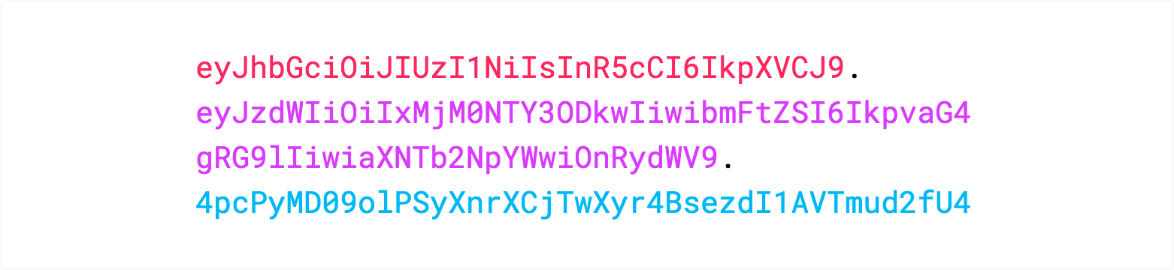
JWT

Slide 8
@twilson63/ec-auth
https://github.com/twilson63/ec-auth
ec-auth is an opensource library that gives you one consolidated library for creating ES512 signed tokens.
Keys - Dynamically generate Public/Private key pair
Sign - Create and Sign JWT
Verify - Verify JWT
Dependencies: jsonwebtoken, jwk-lite, jwk-to-pem

Slide 9
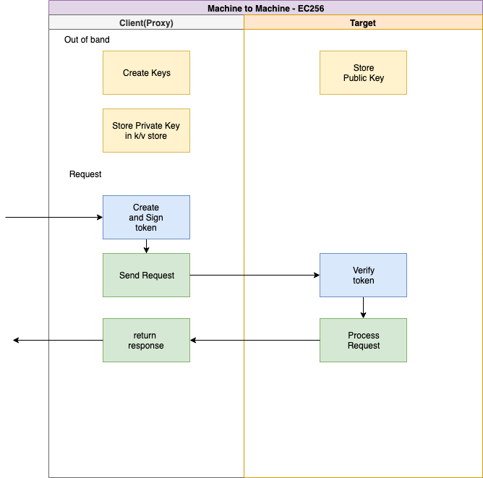
Walkthrough

Slide 10
Workshop Challenge
Lets create a protected target using ES512 keys
I have a dummy proxy setup that will take a get or post request, with a query parameter of target. The proxy will create and sign a JWT and forward the request to the target specified in the target query parameter.
Our challenge will be to create a target service that verifies the token and processes the request.

Slide 11
Summary
The ECDSA signing algorithm leverages the asymmetric security process to allow for secure transactions from on Machine to another.
Standard
No third party dependency
Easy to maintain
Simplifies targets secure trust process
Could be managed dynamically or out of band
Ensures targets are only accessible from proxy no side channels

Slide 12
Questions

Slide 13
Thank you

