Slide 1
AI & Building FDS
Tania Camilla Taarsted Argot
April 29, 2026
Tomas Wind

Slide 2
Debt Collection Management System
Greenfield delivery baseline
DCMS is a greenfield platform for managing DWP debt from identification through recovery, enforcement, and write-off, with compliance, auditability, and business-change control built into the product.
Not COTS
Not Solon Tax
Built for DWP rules

Slide 3
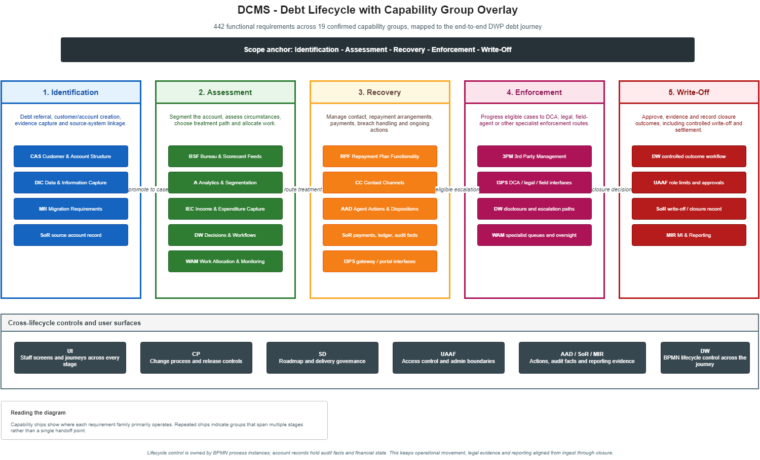
2

Slide 4
WHAT WE ARE BUILDING
What Makes This Different
Statutory guardrails
Business-user strategy authoring
Audit-to-question trail
Legal protections are non-configurable controls, not rule-table preferences.
Decision tables and treatment paths can change through governed authoring without an IT ticket for every rule change.
A regulatory query can be answered from account history, rule versions, suppression decisions, and actor evidence inside DCMS.
3

Slide 5
ARCHITECTURE OVERVIEW
Key Architecture Decisions
Layer | Technology | Version | Notes
Language | Java | 21 (OpenJDK) | LTS, virtual threads
Framework | Spring Boot | 3.4.x | Web, Security, Data, AOP
Process Engine | Flowable | 6.8.x | BPMN + DMN + CMMN, Apache 2.0
Build | Maven | 3.9.6+
Database | PostgreSQL | 16 | public + flowable schemas
Migrations | Flyway Community | 10.x | Two locations: schema + seed
ORM | Spring Data JPA + Hibernate | 6.x
Auth/AuthZ | Keycloak | 24 | OIDC/OAuth2, RBAC
Frontend | React + TypeScript | 18 / 5.x
Design System | GOV.UK Design System | 5.x | WCAG AA
Containers | Docker | 25.x | Multi-stage builds
Orchestration | Docker Compose + Helm 3 | v2 / 3.x | Local + AKS dev
CI/CD | GitHub Actions | —
Logging | Logstash Logback Encoder | 7.x | JSON stdout
Process UI | Flowable Admin UI | 6.8.x | Separate Docker service
4

Slide 6
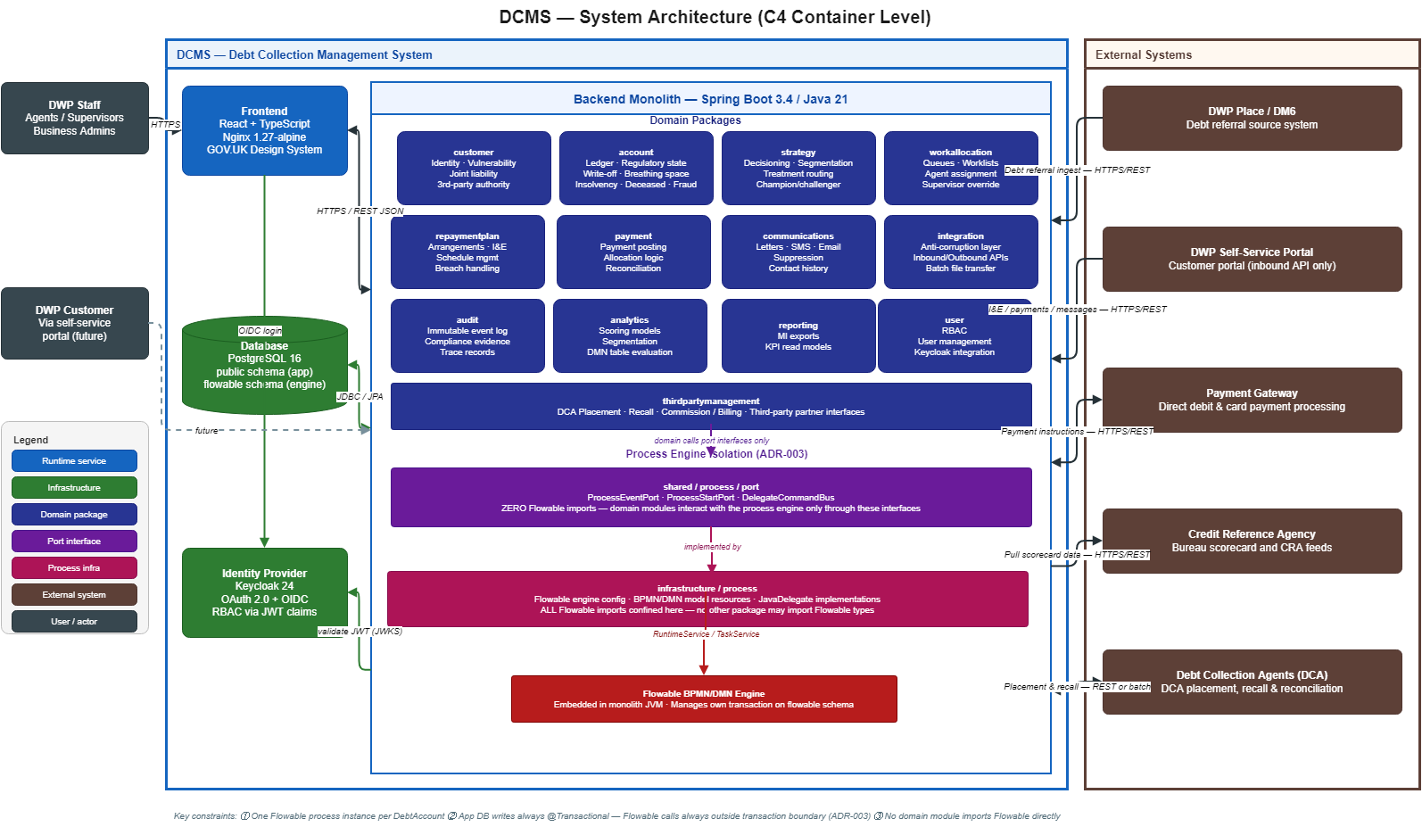
5

Slide 7
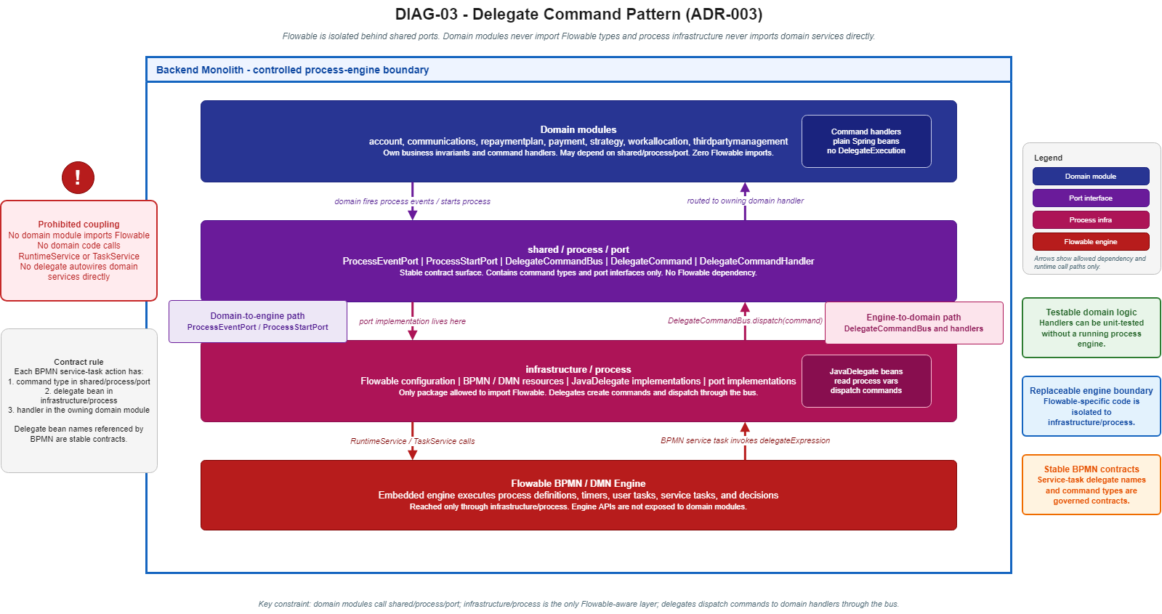
6

Slide 8
REQUIREMENTS AND BUILD SCOPE
Implied Build Scope
Discovered scope | Why it is necessary
Audit trail completeness | Regulatory questions need answerable in-system evidence.
Configuration version snapshot | Policy activation must not silently change live treatment paths.
Exhaustive suppression switch | A missed statutory suppression category must fail at build time.
Three-layer write-off control | Financial-control assurance needs workflow, service, and DB enforcement.
Deceased handler two-phase atomicity | A Flowable failure must not leave active collection against a deceased party.
Champion/challenger is required; the implied build scope is the safety harness around it: measurement, promotion evidence, rollback, and audit. | Without those, we could say we support champion/challenger, but we could not safely prove why a challenger was promoted or what impact it had before touching live accounts.
DCA pre-placement window | GDPR disclosure is enforced by state machine, not operator discretion.
7

Slide 9
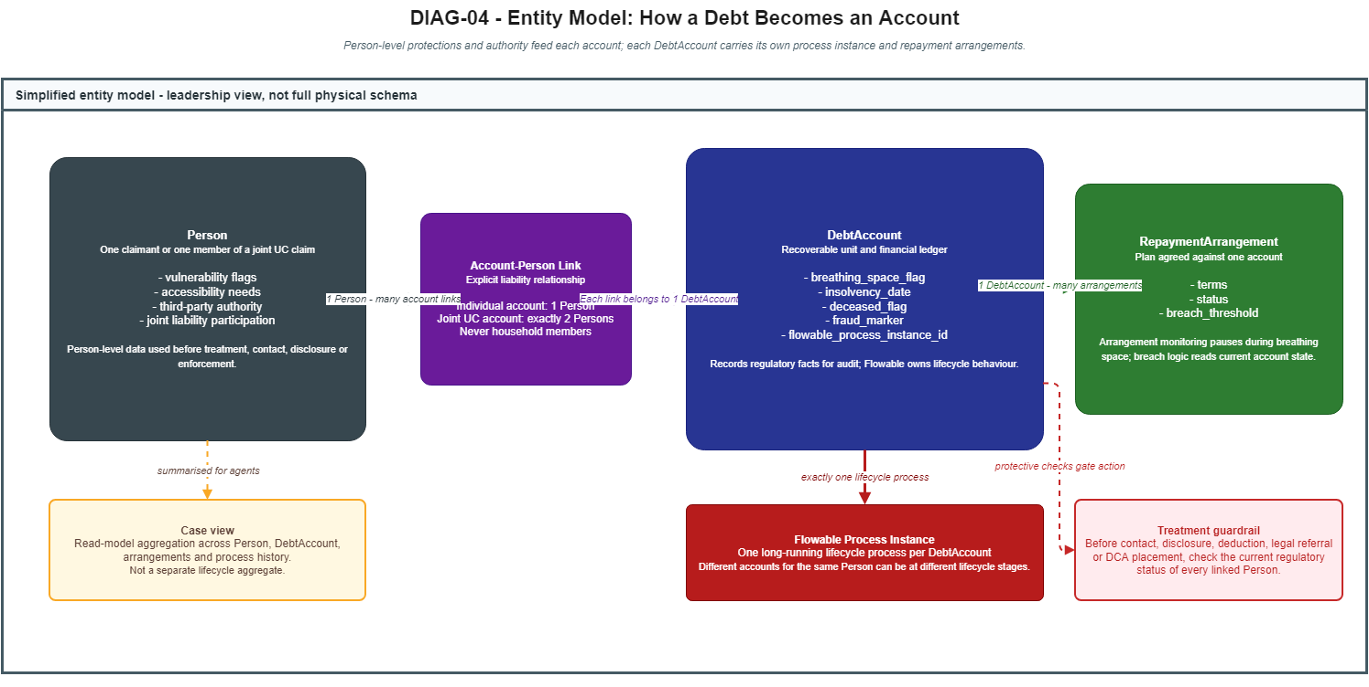
1 arrangement
8

Slide 10
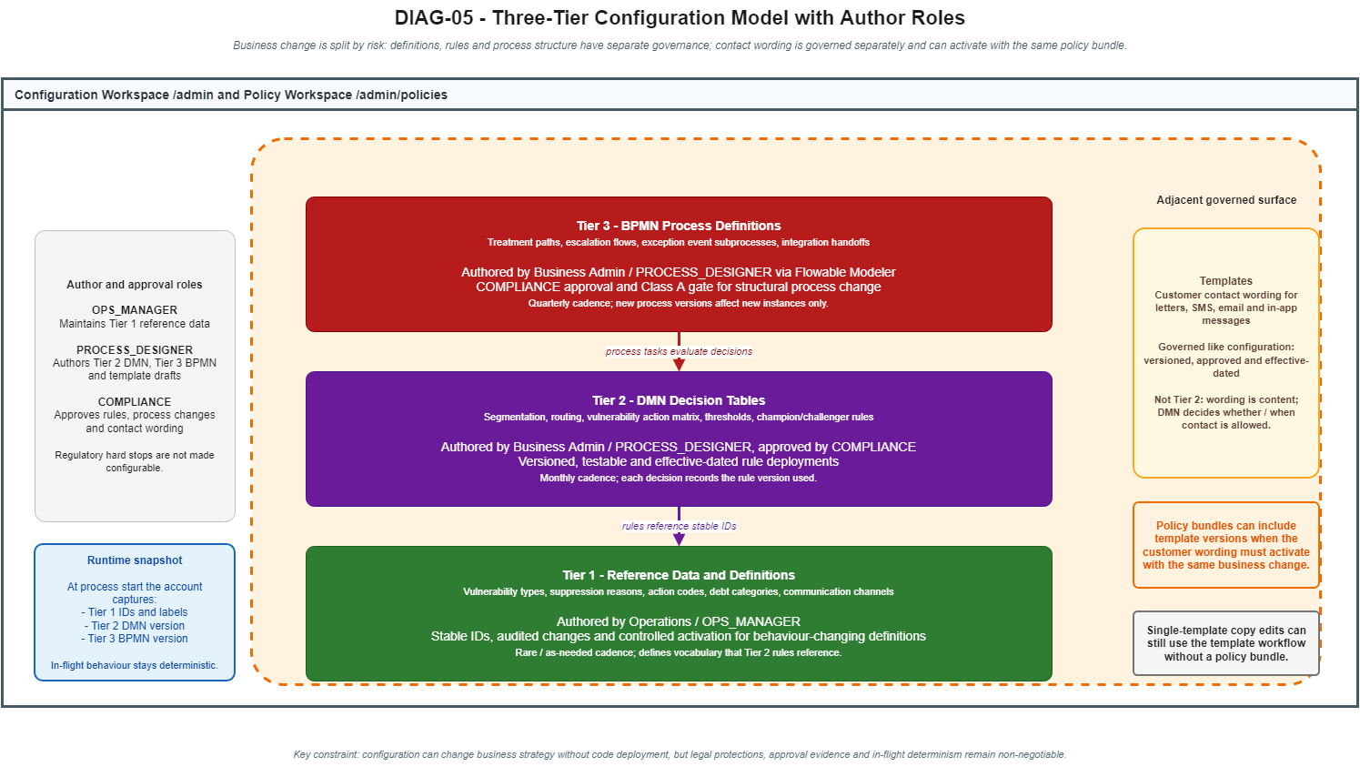
9

Slide 11
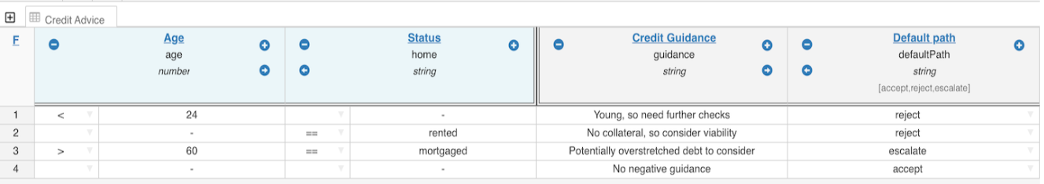
POLICY CONFIGURATOR
DMN Authoring Surface and Tier Summary
Tier | Covers | Who authors | Change frequency
1 | Reference data: vulnerability types, suppression reasons, fee codes | Operations team | Rarely
2 | DMN decision tables: segmentation, routing, thresholds | Business admin - no IT | Monthly
3 | BPMN process definitions: treatment paths, escalation flows | Business admin via Flowable Modeler | Quarterly
Business users change decision rules without raising an IT ticket.
10

Slide 12
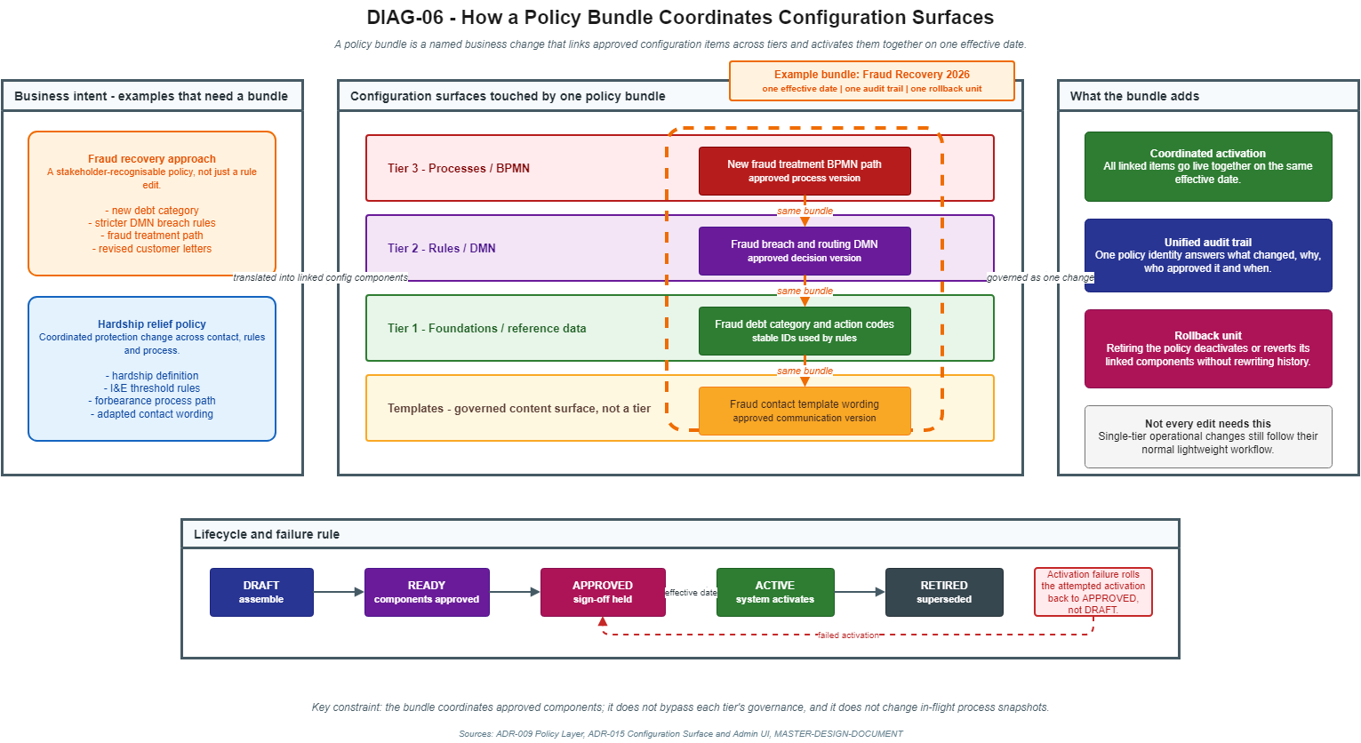
11

Slide 13
NON-CONFIGURABLE COMPLIANCE CONTROLS
Statutory Guardrails
Some protections are system invariants, not business-configurable rules.
Breathing space
Insolvency
Deceased
Vulnerability
Business users can change strategy: thresholds, segmentation, referral rules, treatment paths, and DMN tables.
They cannot configure away statutory protections: contact suppression, moratorium handling, deceased handling, I&E gates, policy floors, or audit evidence
The process engine reads the current DB facts at each decision point so protected status is not dependent on stale process variables.
The intent is deliberate: compliance controls are made impossible to misconfigure.
DCMS separates flexible strategy from non-configurable legal guardrails.
12

Slide 14
OPTIONS, LIMITATIONS, DECISION
Claude’s Identified Options and Recommendations
Option | What it means | How much we'd reuse on paper | Real benefit after problems | Major problems | Decision
A | Build the whole system on top of Solon's tax platform | 30-35% | Only 5-10% | All 7 apply | 7 major problems
B | Use only Solon's billing and payments engine | 20-25% | Only 10-15% | 3 of 7 apply | Savings eaten by integration costs
C | Build our own system, our way | Starting fresh | Baseline | None | No major problems
Solon's latest version (v2.3.0) fixes some of the older issues - but seven serious problems remain.
Claude's recommendation: no part of Solon is used as a foundation or core building block.
Solon Tax's process engine can only stop a workflow, not pause and resume it. Breathing space needs pause-and-resume. Contacting a debtor during breathing space is a criminal offence – Claude is highly against shipping on a platform that makes that mistake possible.

Slide 15
OPTIONS, LIMITATIONS, DECISION
The 7 problems with reusing Solon
Problem | Option A - reuse whole platform | Option B - reuse billing engine only | Option C - build our own
1. Cannot pause a debt case mid-flight when a customer enters Breathing Space (criminal liability under 2020 Debt Respite rules) | Solon's workflow engine cannot do this safely. Every workaround we found puts compliance on developer discipline rather than the system itself. | Solved only by banning Solon's workflow engine outright - a programme commitment, not a technical guarantee. | Our chosen workflow engine supports this natively, by design.
2. Decision rules cannot be edited by non-technical staff | We would have to build a converter between two rule formats - large, risky, and breaks our plan to let business analysts maintain rules. | We use our own decision-rule engine; Solon's rule format never enters our codebase. | Decision tables are editable by non-technical users out of the box.
3. Older Java version, weaker built-in safety | We lose a built-in compile-time check that protects against missing legal categories. We would have to bolt the check on as a test - weaker. | Solon runs in its own process; our Java version is unaffected at the boundary. | Latest Java throughout; the safety check is built in at compile time.
4. Different database change-management tooling | We retire our chosen tool and adopt Solon's, against our own standards. | Two separate databases never share tables, but every cross-system financial flow becomes a sync problem. | Single tool throughout.
5. Different frontend framework | We build a UK government design library for Solon's framework (huge effort) OR run two frontends side by side (inconsistent user experience). | We discard Solon's frontend and build our own anyway. | Standard UK government design system from day one.
6. Many small services vs one application | We accept Solon's many-services design; team grows from 6-7 to 12-15 to operate it; our single-application approach is invalidated. | Our application calls Solon services across the network - extra operational complexity (discovery, retries, fallbacks). | Single application, simpler operations, smaller team.
7. Different way of authorising user actions | We retire our user-claims-based authorisation and adopt Solon's policy-engine approach - rewriting our security model. | Solon accepts our user tokens at its edge; may need a translator. Two security models live side-by-side. | Single authorisation model throughout.
Decision frame: 5–15% net scope reduction does not justify statutory, integration, or platform-coupling risk.

Slide 16
OPTIONS, LIMITATIONS, DECISION
Option A - reuse the whole platform
Solon's workflow engine cannot safely meet UK debt-pause rules. The team must roughly double in size, and every standard Claude have set gets rewritten.
Problem area | What goes wrong
Legal safety (Problem 1) | Solon's workflow engine cannot pause a debt case mid-flight when a customer enters Breathing Space. Every workaround relies on developer discipline rather than the system. Under the 2020 Debt Respite rules that is criminal-liability exposure.
Decision rules (Problem 2) | Business analysts need to be able to update rules. Solon does not support this. We would have to build a converter ourselves - large, risky, and undermines the whole point of giving non-developers control.
Programming language (Problem 3) | Solon runs on an older Java version that lacks a built-in safety check we rely on for legal categories. We would have to bolt the check on ourselves - weaker than the original.
The rest of the stack (Problems 4-7) | Database tooling, frontend framework, system architecture, and security model all differ from ours. Adopting Solon means rewriting every standard we have set and starting from a foreign foundation.
Team size and cost | Operating Solon's many-service design forces the team from 6-7 to ~12-15 people. Once we add the cost of converters and rebuilds, this option costs more than building our own.
Schedule | Weeks of re-evaluation alone. Build start (4 May 2026) slips. Demo (8 July 2026) at risk.

Slide 17
OPTIONS, LIMITATIONS, DECISION
Option B - reuse only the billing engine
Keeps our technology choices, but creates a permanent boundary between two systems - two databases to keep in sync, two security models, and Solon's release schedule still drives ours.
Problem area | What goes wrong
Legal safety still at risk (Problem 1) | Only safe if the programme bans Solon's workflow engine outright. That is a rule we have to enforce ourselves, not a structural protection.
Two databases to keep in sync | Every financial flow crosses a boundary between two databases run by different tools. That means distributed transactions and reconciliation work - hard to get right, expensive to maintain.
Two security models | Our security model on our side, Solon's on theirs. Every cross-boundary call needs review. The vulnerability surface roughly doubles.
Permanent integration cost | We maintain a translation layer between the systems for the life of the programme. Whatever we save by reusing Solon's billing engine is roughly equal to what we spend on the integration.
Operational complexity | Adds service discovery, retries, fallback handling, and remote-call monitoring - all extra operational overhead our team would have to run.
Coupling to Solon's schedule | Whenever Solon releases an upgrade, we have to coordinate. Independent delivery becomes shared delivery.

Slide 18
OPTIONS, LIMITATIONS, DECISION
Option C - build our own
No major problems. Legal safety, security, team size, and schedule all stay as designed. The remaining work is convincing leadership.
Problem area | What goes wrong
Stakeholder framing | Leadership reads '30-35% reuse' as a real saving. The real saving is only 5-15% once the problems are accounted for. We must explain the gap clearly without sounding defensive.
Looks like 'not invented here' | Declining a Netcompany asset (Solon) can read as preference. The truth is structural: Solon was built for tax collection, not debt collection - different domain, different rules.
Senior commitments already made | If a senior person has already publicly committed to Solon, this decision relitigates that commitment. We need a clear paper trail - the architecture decision document and the seven-problem analysis.
Legal framing required | Problem 1 must be presented as criminal-liability exposure under the 2020 Debt Respite rules - not engineering preference. That is the line that ends the debate.
Governance posture | Decision needs a recorded trail: problem matrix, evidence pack, signed-off architecture decision. If we are overruled, we require written acceptance of the legal risk from the accountable executive.
Schedule narrative | Frame 'reuse' honestly: under Solon adoption, build start slips, team grows to 12-15, demo (8 July) at risk. Once leadership sees this clearly, the apparent saving disappears.

Slide 19
OPTIONS, LIMITATIONS, DECISION
Why the Decision Is Locked (According to Claude)
There is no obvious workaround for the legal blocker.
No business-rules engine — every rule change needs a developer and a code release.
Stuck on an older Java version — we lose compiler safety nets that catch whole classes of bugs.
Different database-migration tool — our existing scripts and history wouldn't carry across.
Angular front-end — doesn't fit the GOV.UK Design System we're required to use.
Pre-split into microservices — we deliberately chose one service to keep a small team productive.
Different access-control stack — we'd end up running two auth systems side by side.
17

Slide 20
DEVELOPMENT RELEASES
Release Scope and Roadmap
Release | Scope
Release 1 - Demo Release | Running end-to-end demo proving integration, customer/account view, vulnerability and I&E, repayment arrangement, communications, work allocation, business-owned strategy change, audit trail, RBAC, reporting snapshots, and deployment controls. Uses controlled stubs for external systems.
Release 2 - Post-Demo Completion | Completes operational depth: DCA placement and reconciliation, Direct Debit/DEA, self-service hardening, dispute, deceased, guided-agent, settlement/write-off recovery, finance reconciliation, legal/enforcement, complaints, migration tooling, production/UAT readiness, and full release evidence.
Release 1 exclusions: full DCA/reconciliation, full Direct Debit/DEA and finance depth, public customer portal UI, full dispute/deceased/legal/complaints/settlement recovery lifecycle, legacy migration, production/UAT readiness, and production-scale NFR evidence.
Release 1 is not a partial build; it is the demo-winning operational thread. Release 2 completes production-shaped breadth after the demo.
Two releases only: demo confidence first, post-demo completeness second.
15

Slide 21
Appendix

Slide 22
REQUIREMENTS REFERENCE
Appendix A: Requirement Abbreviation Reference
Abbreviation | Full name | Abbreviation | Full name
3PM | 3rd Party Management | I3PS | Interfaces to 3rd Party Systems
A | Analytics & Segmentation | IEC | Income & Expenditure Capture
AAD | Agent Actions & Dispositions | MIR | MI & Reporting
BSF | Bureau & Scorecard Feeds | MR | Migration Requirements
CAS | Customer & Account Structure | RPF | Repayment Plan Functionality
CC | Contact Channels | SD | System Development & Roadmap
CP | Change Processes | SoR | System of Record
DIC | Data & Information Capture | UAAF | User Access & Admin Functions
DW | Decisions & Workflows | UI | User Interface Screens
WAM | Work Allocation & Monitoring
C

Slide 23
REQUIREMENTS, DEMO FLOW, AND FEATURE DEEP DIVES
Appendix B: 14 Flows Covering 20 Behavioural Requirements
Flow 1: Intake to first contact
x
x
x
x
x
Flow 2: Vulnerability to resolution
x
x
x
x
x
x
x
x
Flow 3: Breach to DCA
x
x
x
x
x
Flow 4: Complex household
x
x
x
x
x
Flow 5: Strategy change without IT
x
x
x
x
x
x
x
x
Flow 6: Executive dashboard
x
x
x
x
x
Flow 7: Self-service handoff
x
x
x
x
x
Flow 8: Dispute
x
x
x
x
x
Flow 9: Deceased protocol
x
x
x
x
x
Flow 10: Write-off and reactivation
x
x
x
x
x
Flow 11: New agent journey
x
x
x
x
x
Flow 12: Regulatory audit
x
x
x
x
x
x
x
x
Flow 13: Month-end surge
x
x
x
x
x
Flow 14: Settlement offer
x
x
x
x
x
All 20 behavioural requirements are covered by at least one flow; headline flows are 2, 5, and 12.
D

Slide 24
REQUIREMENTS, DEMO FLOW, AND FEATURE DEEP DIVES
Appendix C: Three Headline Demo Moments
Flow 5
Flow 2
Flow 12
Strategy change without IT
Vulnerability to resolution
Regulatory audit
Business admin edits DMN, creates a policy bundle, runs simulation, and activates atomically.
Vulnerability flag causes suppression, specialist handling, I&E, and affordable arrangement in under 2 minutes.
Account history, rule versions, actors, and suppression decisions answer a regulatory query in under 10 minutes.
E

Slide 25
REQUIREMENTS, DEMO FLOW, AND FEATURE DEEP DIVES
Appendix D: RBAC - User Roles and Responsibilities
Role group | Roles | Responsibility
Case handling | AGENT SPECIALIST_AGENT ESCALATIONS_AGENT | Work assigned debt cases, record actions, follow guided scripts, and initiate permitted treatment or write-off requests within tier limits.
Supervision and operations | TEAM_LEADER OPS_MANAGER | Manage queues, transfer cases, supervise teams, approve write-offs within delegated authority, and monitor operational performance.
Strategy monitoring | STRATEGY_MANAGER | Monitor champion/challenger performance and trigger approved challenger promotion; cannot author rules or work cases.
Configuration and governance | PROCESS_DESIGNER COMPLIANCE | PROCESS_DESIGNER proposes DMN, BPMN, and template changes; COMPLIANCE approves governed changes and reviews audit evidence.
Senior financial authority | SRO | Named in-system approver for the highest write-off tier; self-approval remains prohibited.
Read-only and technical access | BACKOFFICE FLOWABLE_ADMIN SYSTEM | BACKOFFICE has administrative read access only; FLOWABLE_ADMIN is confined to process-engine operations; SYSTEM is service-to-service only.
M

Slide 26
OPTIONS, LIMITATIONS, DECISION
Appendix E: What each option gives us and costs us
Topic | Option A - reuse whole platform | Option B - reuse billing engine only | Option C - build our own (CONFIRMED)
What we build on | Solon's tax platform with all its tools (workflow engine, decision rules, frontend, security model) | Only Solon's billing/payments API - we replace everything else with our own choices | A single application using standard, well-supported technologies and the UK government design system
Pros | (Rejected - pros not decision-relevant; see Cons) | (Rejected - pros not decision-relevant; see Cons) | - No major problems; the architecture holds up - Workflow engine handles Breathing Space pauses safely - Business analysts can edit decision rules without developer help - Built-in compile-time check for legal categories - Single security model - Team stays at 6-7 people - No dependency on Solon's release schedule
Cons | - Solon's technology differs from ours on every layer - Team must grow from 6-7 to ~12-15 people - Permanently tied to Solon's release schedule - Legal compliance becomes a matter of developer discipline, not built-in safety | - Permanent boundary between two systems - Two databases must stay in sync across every financial flow - Two security models running side-by-side - Translation layer between systems we maintain forever - Savings approximately equal what we spend on the integration | We have to build the most demanding financial features ourselves: the ledger, payment plans, and standard banking message formats.
Major problems | All 7 apply | 3 of 7 apply (1, 4, 7); the rest are sidestepped by replacing those parts | None
Decision frame: 5–15% net scope reduction does not justify statutory, integration, or platform-coupling risk.

Slide 27
Feature Diagrams

Slide 28
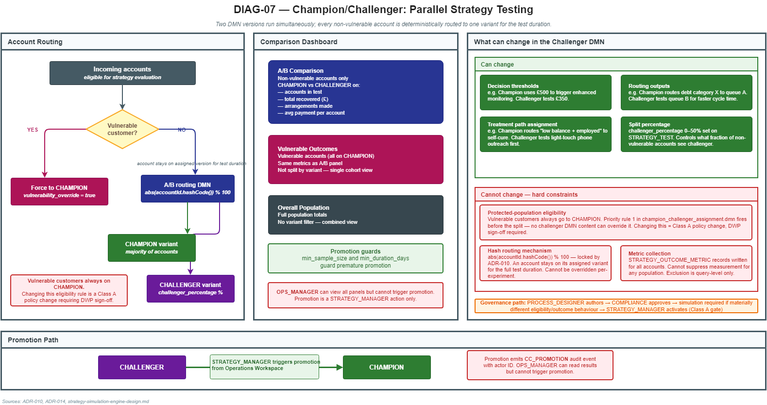
F

Slide 29
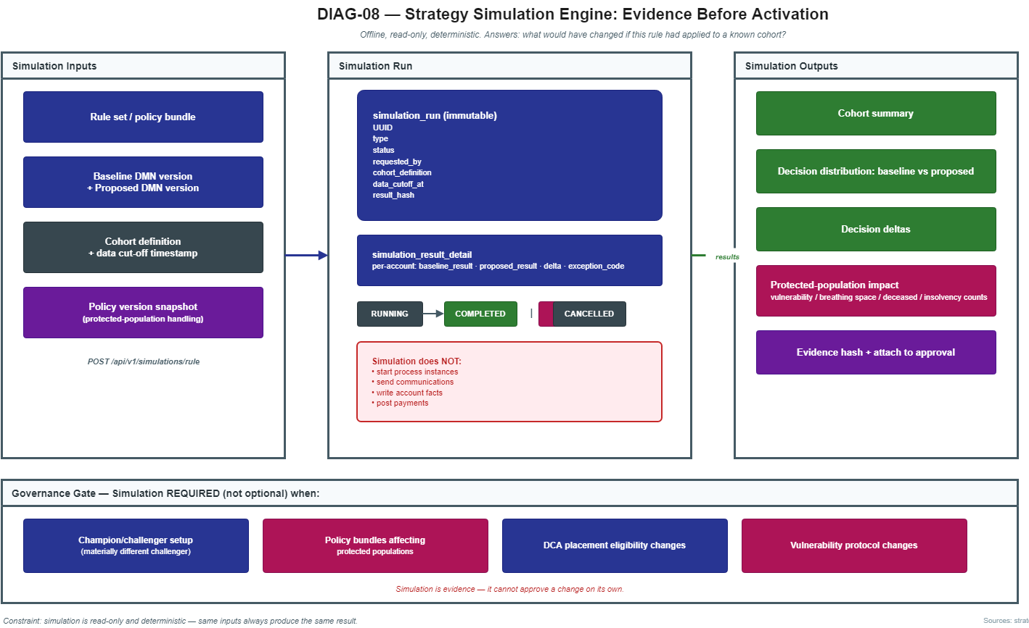
G

Slide 30
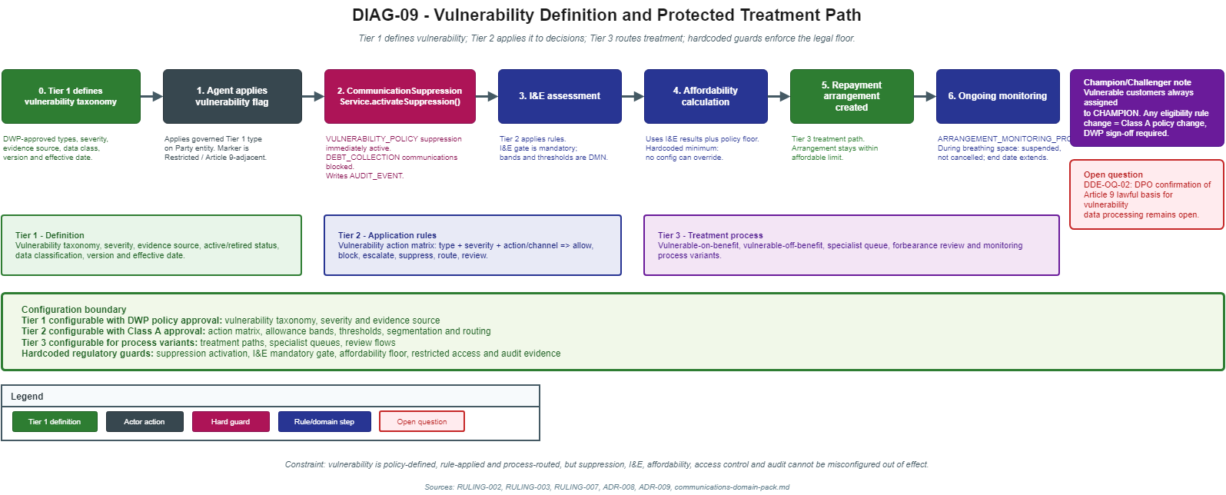
H

Slide 31
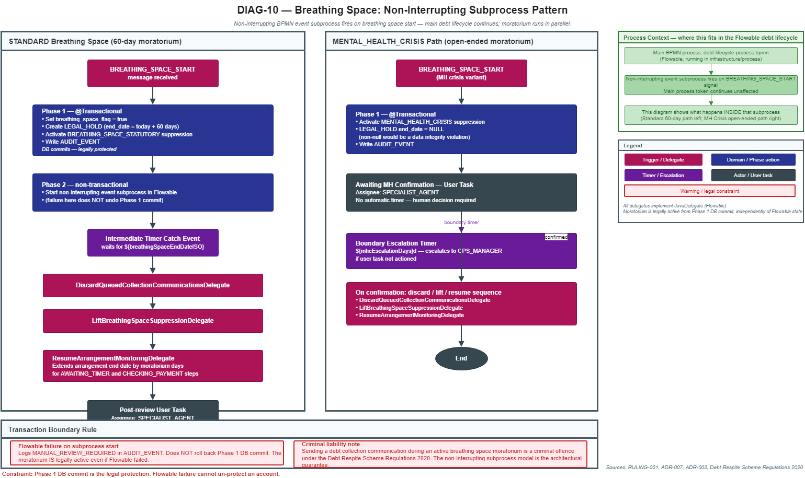
I

Slide 32
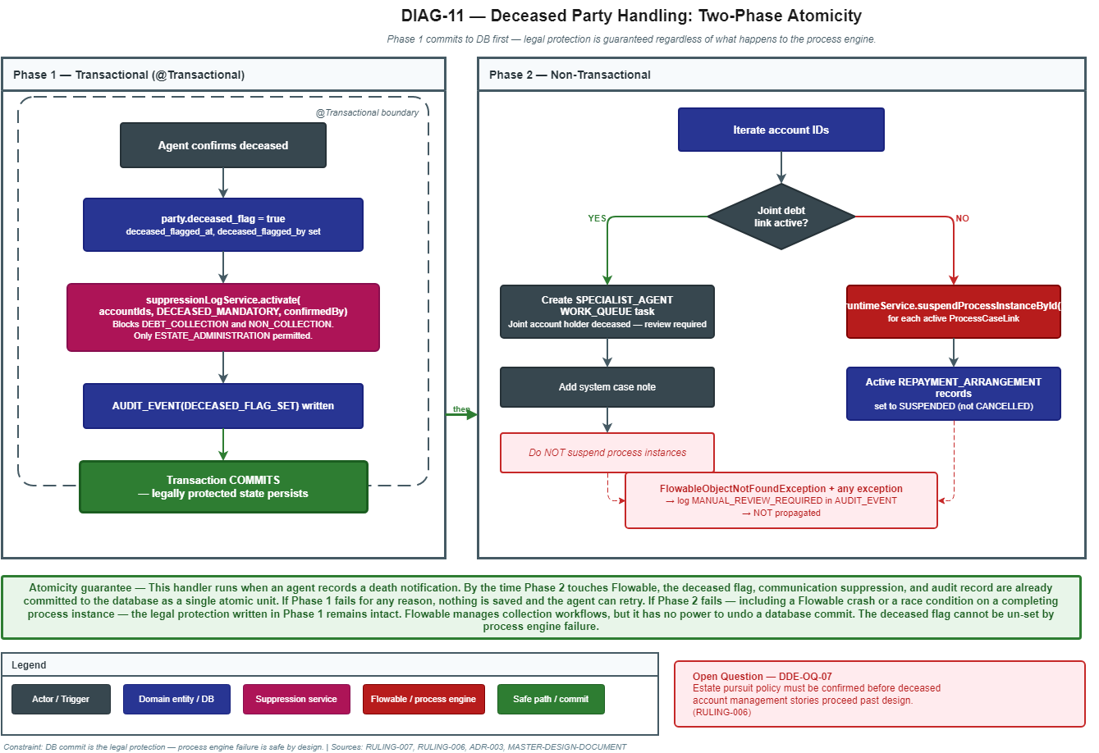
J

Slide 33
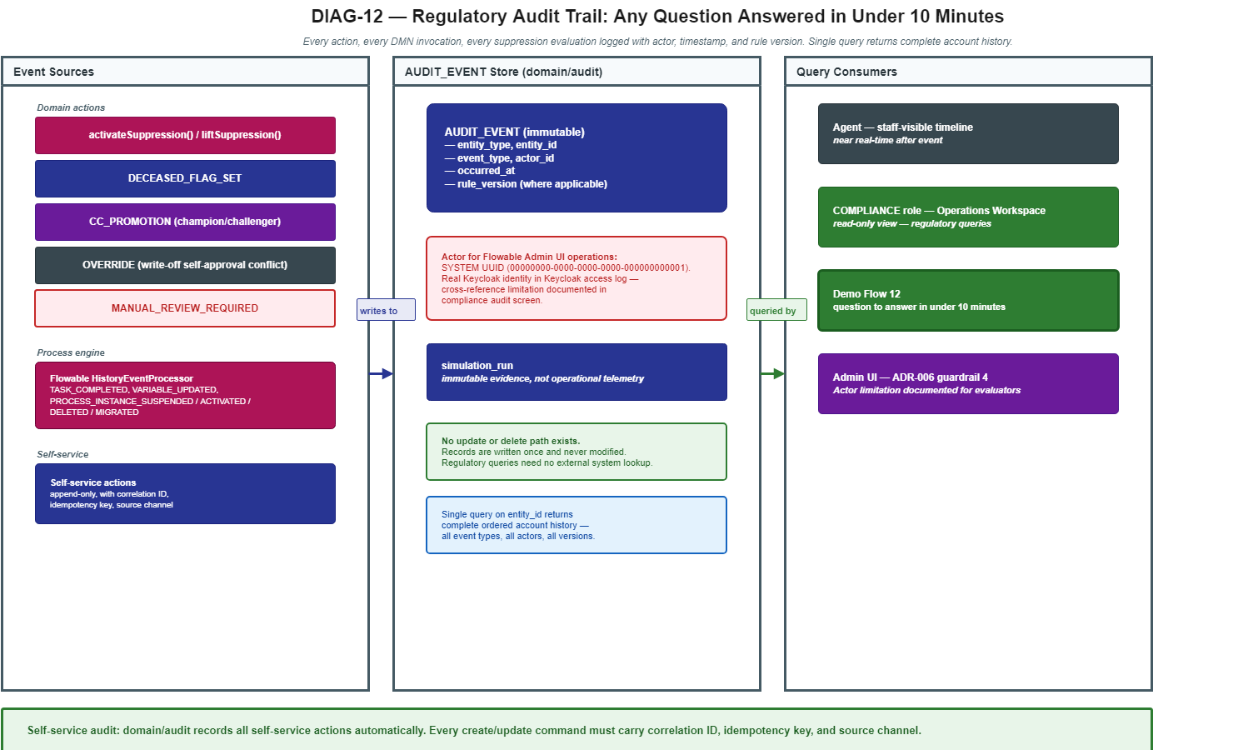
K

Slide 34
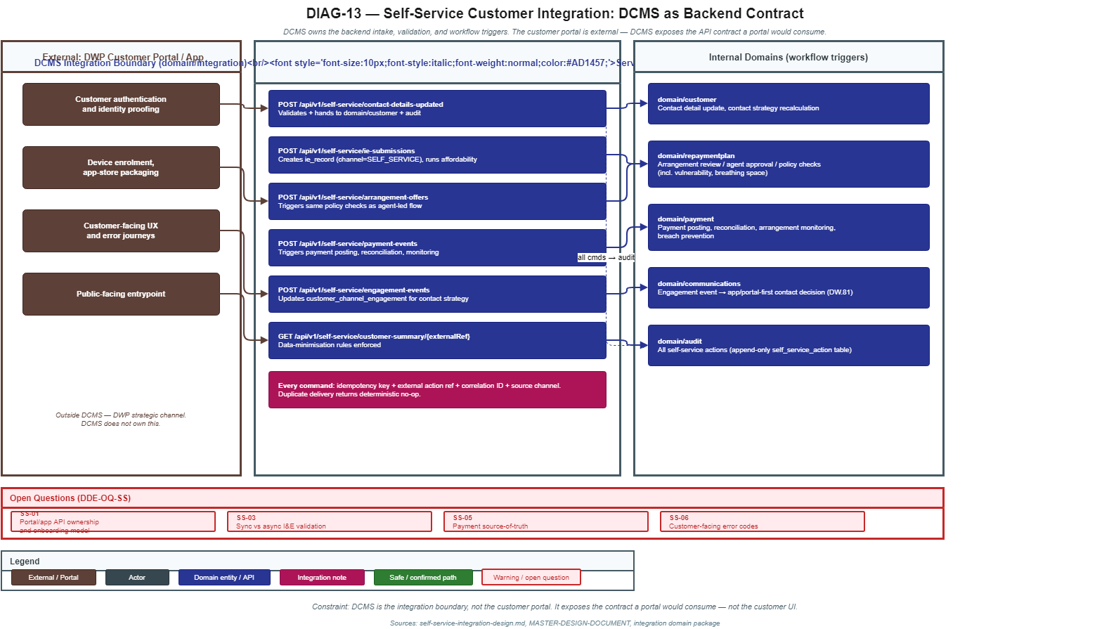
L

