Slide 1
EvacSim overview for leads
Submitted Jan 20, 2008 for internal consideration only.
Mike Johnson (mike.william@gmail.com)
Matthew Bennett (twinbee@gmail.com)
Mike Erwin (significant.bit@gmail.com)

Slide 2
Pathing map structure
Explain map structure
Logical textures

Slide 3
Pathing Map Structure
Consists of convex “regions” connected by shared edges called “portals”
A region cannot have multiple portals leading to the same destination
Portals are automatically detected.

Slide 4
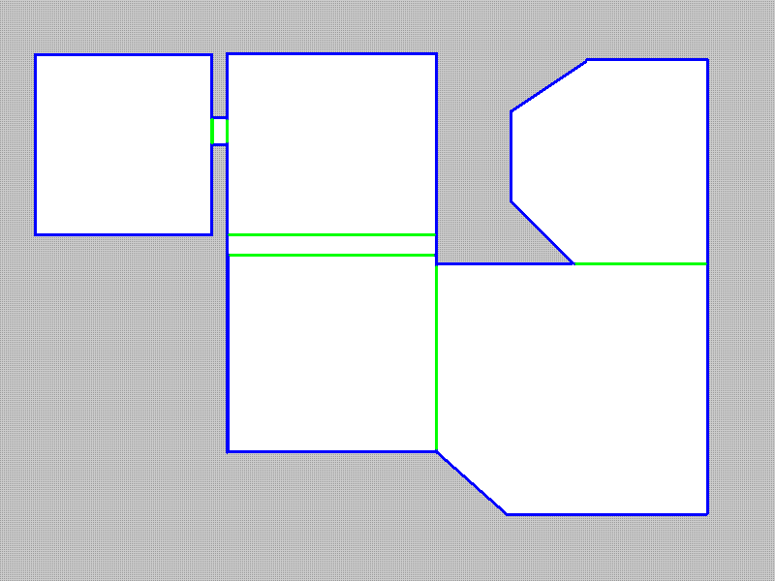
An errorless Pathing Map

Slide 5
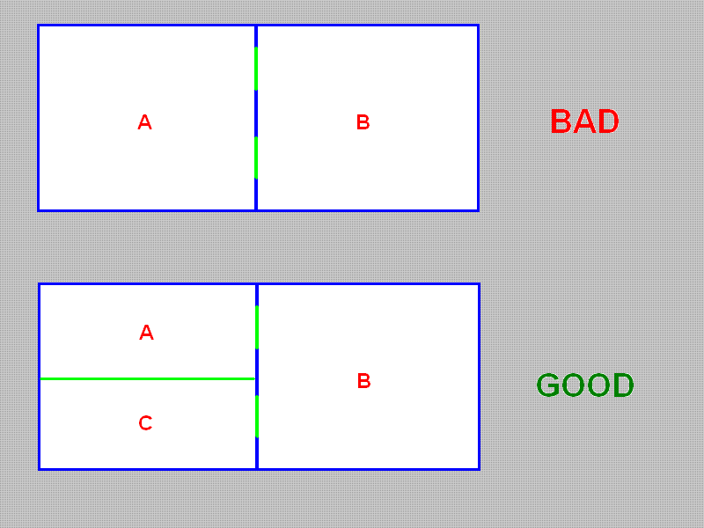
Same-Destination portals

Slide 6
Region Properties
Exit
Stairs
Seating

Slide 7
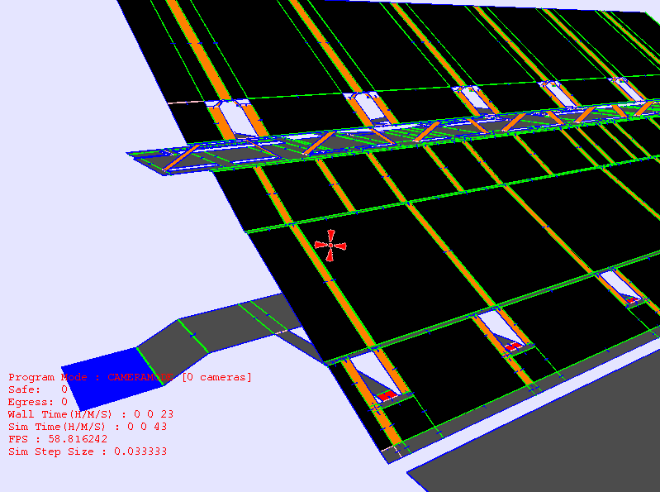

Slide 8
Map Verification and repair
Common errors in Pathing maps
Solutions to these errors

Slide 9
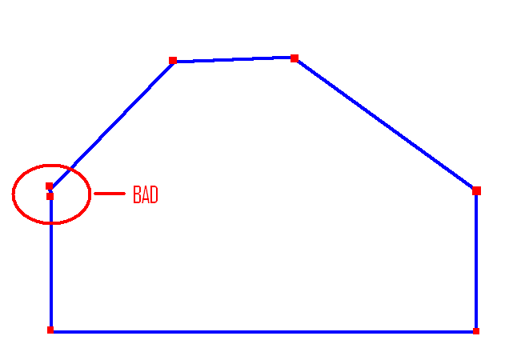
Duplicate or redundant vertices
Solution = vertex snap with threshhold(average the verts)

Slide 10
Incomplete Polygons
Less than 3 vertices, or 3 vertices with 2 duplicates
Solution = Auto delete

Slide 11
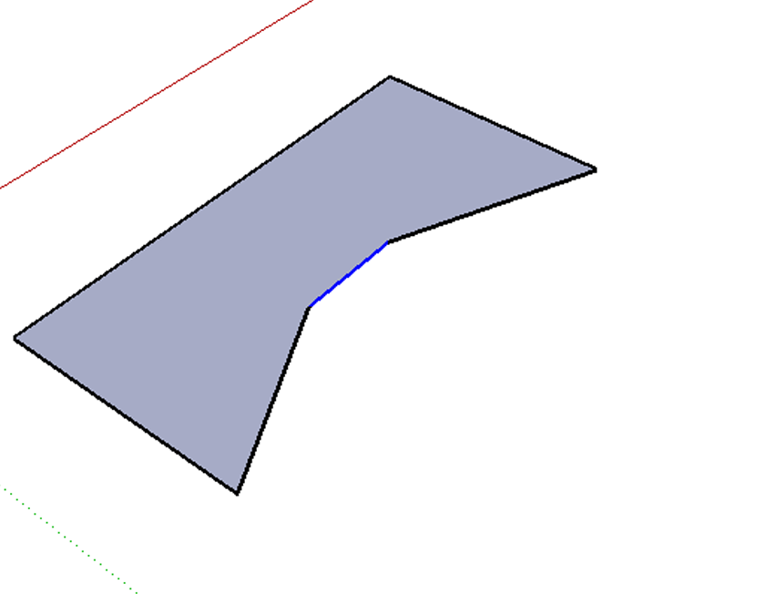
Concave shapes
Solution = highlight poly and rebuild in editor

Slide 12
Reverse Winding
Polygon is “upside down”
Solution = automatically detect and correct winding of polygons

Slide 13
Vertical Polygons
Solution = Detect and automatically delete

Slide 14
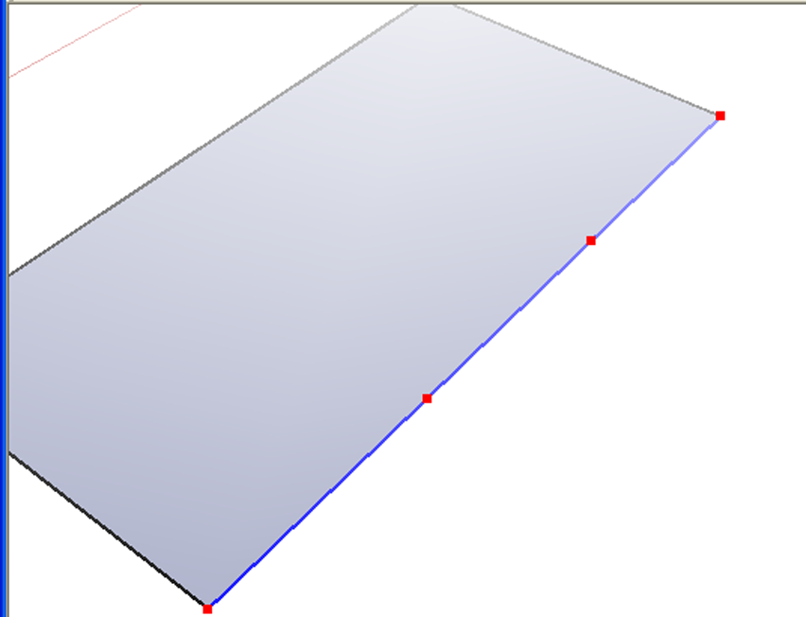
Segmented Walls and Portals
Solution = Autodetect and Cull redundant vertices

Slide 15
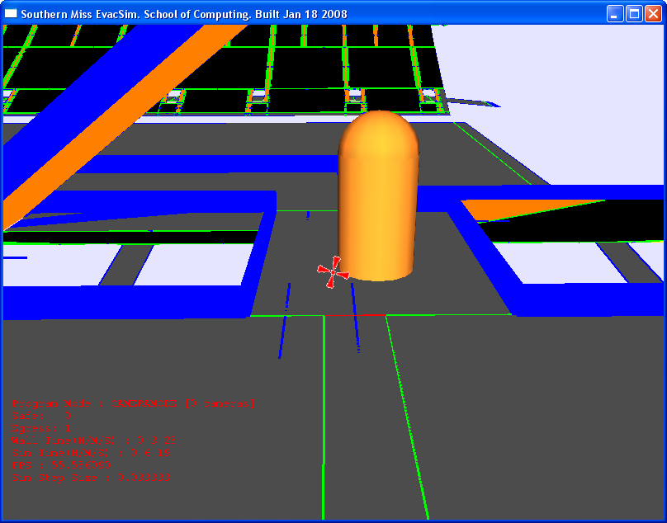
Portals that are too small
Solution = autodetect and exempt from pathing consideration

Slide 16
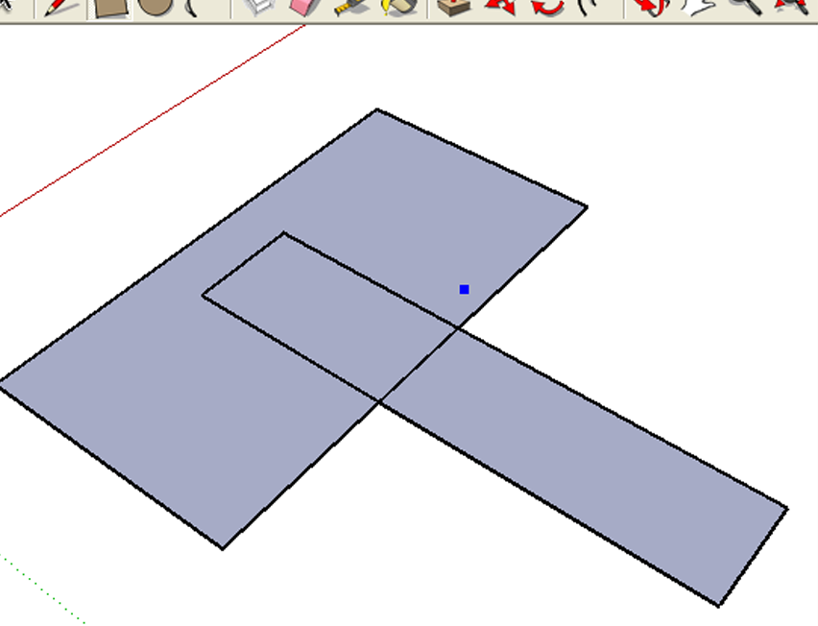
Coplanar overlap

Slide 17
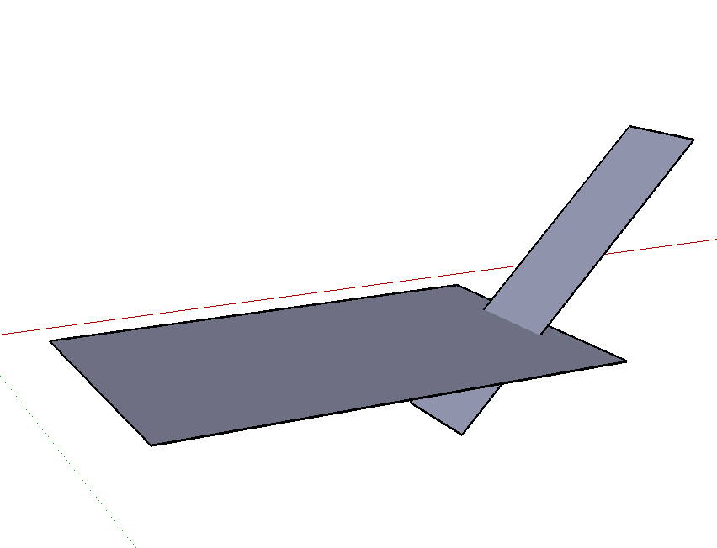
Intersecting Polys

Slide 18
Spawning
Spawn by region given a count
Spawn by region given a percentage

Slide 19
AI
Path selection
Steering Behaviors

Slide 20
High level pathing: Components
Differentiates logical areas of the stadium separated by bottlenecks.
A bottleneck is a portal connecting both a high and low connectivity region. To be considered a bottlenck, the width of a portal cannot exceed a threshhold value.

Slide 21
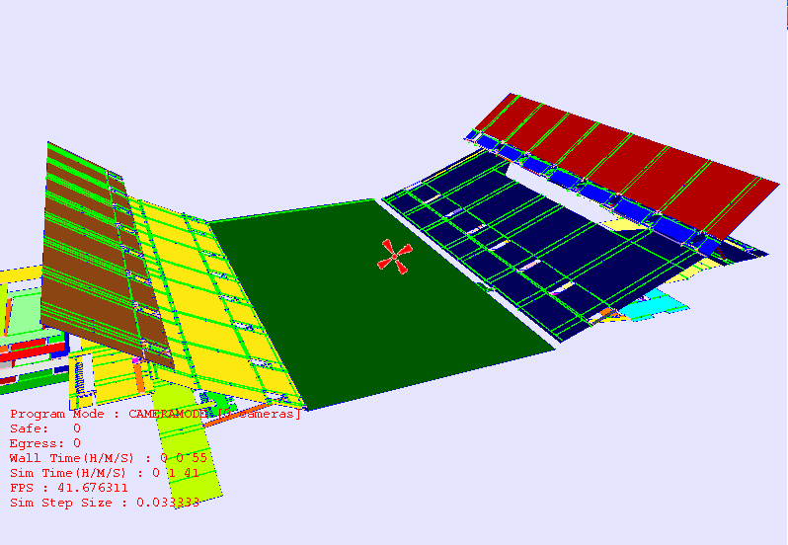
Pathing Map Components

Slide 22
Low level pathing
Mike?

Slide 23
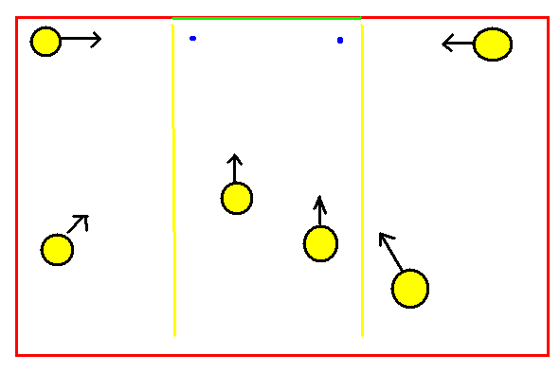
Seek Edge

Slide 24
Physics
ODE
Walls
Anchor to plane
Step size and accuracy and sim time

Slide 25
ODE
Dual purpose library for collision detection and collision response
Only handles entity-entity and entity-wall collisions and responses

Slide 26
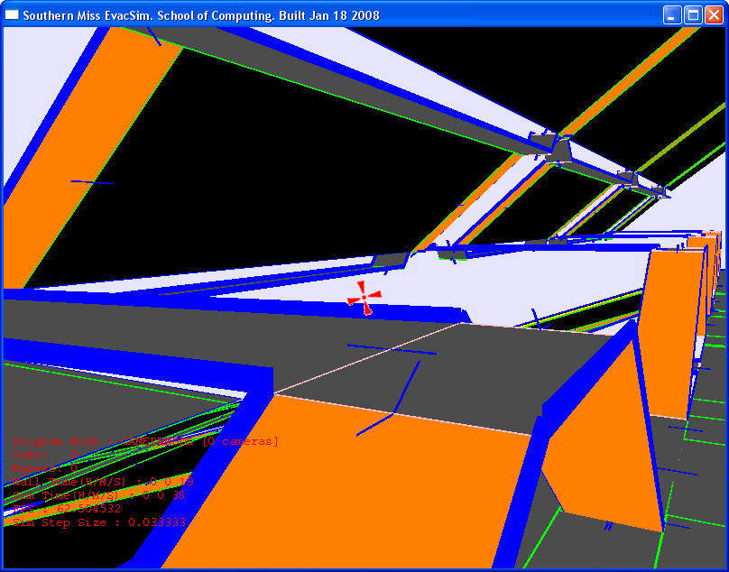
Physical Walls

Slide 27
Anchor to plane
Replaces gravity.
Casts a ray from the position of an entity through it’s associated region and then positions the entity at the collision point.

Slide 28
Simulation timing
Wall time = Real World Time
Simulation World time = Time as perceived by entities in the simulation
Simulation Step size affects accuracy of ODE physical calculations. Smaller step size provides more physical accuracy but heavier overhead.

Slide 29
Graphics
Detail map = “Hi definition model” (optional)
Entity drawing
Labels and such

Slide 30
Console
The console can be accessed at any time using TAB.
Commands typed into the console affect the state of the simulation.
Commands are parsed immediately with one exception.
All commands are lowercase and case sensitive.

Slide 31
Console: loadsim
Generally first command typed in
Loads a “filename.obj” file (pathing map)
If a filename_detail.obj exists it will automatically load that as well.
Third argument is SpawnByCount parameter
Fourth argument ‘noload’ will toggle off loading of the detail map

Slide 32
help
Brings up a list of console commands
F1 hotkey
To get syntax for a specific command, type in that command with no arguments.

Slide 33
Action commands
Sim starts the simulation going in simulation mode
Simcap starts the simulation in non-simulation mode, with image capture via cameras set in camera mode.
Spawn <reg> <num> spawns by count in region reg if num > 1, otherwise it spawns by density. Immediate.

Slide 34
Camera commands
Cam <n:1-9> switches to one of the 9 cameras
The number keys 1-9 will also do this when the text prompt is hidden.
C creates a new camera when in CAMERA MODE and the text prompt hidden.
X resets the currently assigned camera to the current view position.

Slide 35
Camera commands
Loadcams <file>
Savecams <file>
  Allows manipulations of camera files on disk.

Slide 36
Position dump
logpos <file> produces a unique file that has location information for every entity in the simulation. It can take up to a second.
This is used by Jeremy, might have further use later.

Slide 37
Physical Accuracy and Speedup Commands
acc <a> sets the set size to 1/(10*a) of a second per step size (1 btw 1 and 10)
setspeed <min> <max> changes the entities speeds in ft / sec (sim units / sim time)
Physon turns on physics (default)
Physoff turns off physics

Slide 38
Appearance and window behavior
Res <n> accepts the first number n in a 4:3 ratio resolution and resizes the window + openGL scene to that resolution.
Font <face=sans, serif, mono> sets a default font for the text console and heads up display
Font <size> changes the default font size for all text in the sim

Slide 39
Window behavior
Fullscreen toggles fullscreen mode.
F3 will release the mouse for Window resizing, resolution change, movement, recapture mouse
Quit, ESC will close any map currently running, then exit the program if resent
Exit, alt+F4 closes the program immediately

Slide 40
Rendering commands
Pmap
Dmap
Colorcomponents, labelcomponents
Colorregions, labelregionid
Colorerrors
Labelregiondist, etc.

Slide 41
Scripting
Any console command can be scripted.
“Hold” prevents commands being run until “holdoff” is sent (think MATLAB)
The command “makevid” is basically a system call, that places a hold on action until the series of JPGs from the last simulation is compiled into an AVI file and organized. Any holds are released after makevid.

Slide 42
At command
For scripting and scenarios
At <n> min <command>
  Runs <command> when n minutes of simulation time have elapsed.
At <p> per <command>
  Runs <command> when percent of entities have left the simulation or reached a safe region.

Slide 43
Scripts
Script <filename>
  Will load and run a file from the scripts directory as if typed into the simulation environment.
This is an important feature as it takes state out of compile-time and allows better integration with the scenario editor.

Slide 44
Current profile analysis
Show them the profile output and explain which sections need the most work in the near future, along with possible solutions

Slide 45
Installer
Installer is about 50% done as of today.
Simulation depends on
  SDL dll
  ODE dll
  Libjpeg dll
  OBJ files and textures
  Fonts (currently Micro$oft)
Video output (noninteractive) depends on
  Xvid for compression
  VideoDub for compilation
We also need a license, readme, and UNIT TESTS

Slide 46
Repository
Svn+ssh://orca.st.usm.edu/repos/evacsim
  Is our root branch, should allow anonymous checkout. Look at the code.
Website coming with videos, release 1.

Slide 47
Automatic unit testing
Needed! Not well fleshed out yet.
There are some. For example: Type “stresstest” command or press F4 to see if you can bring the machine to its knees. This is to monitor our algorithmic performance.

Slide 48
Questions / comments
Mike J: mike.william at gmail.com
Matthew B: matthew.a.bennett at gmail.com
Mike E: significant.bit at gmail.com
General Discussion Project Mailing list:
usm-simulation-group at googlegroups.com
Website (soon)

