Slide 1
Open Dynamics Engine (ODE)
Matthew Bennett
10-21-03

Slide 2
What is ODE?
The Open Dynamics Engine (ODE) is a free, industrial quality library for simulating articulated rigid body dynamics. For example, it is good for simulating ground vehicles, legged creatures, and moving objects in VR environments. It is fast, flexible and robust, and it has built-in collision detection. ODE is open source under GNU lGPL, and is cross-platform.

Slide 3
What is it good for?
RIGID BODY PHYSICS!
ODE is best for simulating articulated rigid body structures. An articulated structure is created when rigid bodies of various shapes are connected together with joints of various kinds.
COLLISION DETECTION!
ODE has a built-in collision detection system. However you can ignore it and do your own collision detection if you want to.

Slide 4
Features
Here are the features:
* Rigid bodies with arbitrary mass distribution.
* Several Joint types
* Collision primitives: sphere, box, capped cylinder, plane, ray, and triangular mesh.
* Collision spaces: Quad tree, hash space, and simple.
* Simulation method: The equations of motion are derived from a Lagrange multiplier velocity based model due to Trinkle/Stewart and Anitescu/Potra.
* A first order integrator is being used. It's fast, but not accurate enough for quantitative engineering yet. Higher order integrators will come later.
* Choice of time stepping methods: either the standard ``big matrix'' method or the newer iterative StepFast method can be used.
* Contact and friction model: This is based on the Dantzig LCP solver described by Baraff, although ODE implements a faster approximation to the Coloumb friction model.
* Has a native C interface (even though ODE is mostly written in C++).
* Has a C++ interface built on top of the C one.
* Many unit tests, and more being written all the time.
* Platform specific optimizations.

Slide 5
Rigid bodies
Dynamic properties:
* Position vector (x,y,z) of the body's point of reference. The point of reference must correspond to the body's center of mass.
* Linear velocity of the point of reference, a vector (vx,vy,vz).
* Orientation of a body, represented by a quaternion (qs,qx,qy,qz) or a 3x3 rotation matrix.
* Angular velocity vector (wx,wy,wz) which describes how the orientation changes over time.
Static properties:
* Mass of the body.
* Position of the center of mass with respect to the point of reference. In the current implementation the center of mass and the point of reference must coincide.
* Inertia matrix. This is a 3x3 matrix that describes how the body's mass is distributed around the center of mass.
Conceptually each body has an x-y-z coordinate frame embedded in it, that moves and rotates with the body.

Slide 6
Typical Simulation using the ODE
1. Create a dynamics world.
2. Create bodies in the dynamics world.
3. Set the state (position etc) of all bodies.
4. Create joints in the dynamics world.
5. Attach the joints to the bodies.
6. Set the parameters of all joints.
7. Create a collision world and collision geometry objects, as necessary.
8. Create a joint group to hold the contact joints.
9. Loop:
1. Apply forces to the bodies as necessary.
2. Adjust the joint parameters as necessary.
3. Call collision detection.
4. Create a contact joint for every collision point, and put it in the contact joint group.
5. Take a simulation step.
6. Remove all joints in the contact joint group.
10. Destroy the dynamics and collision worlds.

Slide 7
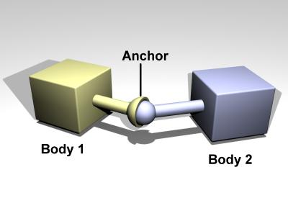
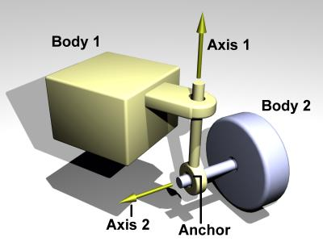
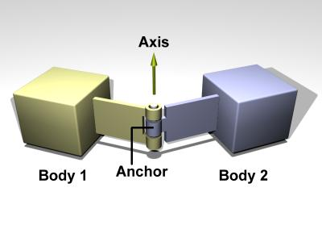
Joints
Hinges are used to constrain the way bodies can move in relation to one another. They are the essential way to redirect forces.

Slide 8
Collision handling: Detection AND Response
1. Before each simulation step, the user calls collision detection functions to determine what is touching what. These functions return a list of contact points. Each contact point specifies a position in space, a surface normal vector, and a penetration depth.
(This step is optional. User can write his/her own collision detection).
2. A special contact joint is created for each contact point. The contact joint is given extra information about the contact, for example the friction present at the contact surface, how bouncy or soft it is, and various other properties.
3. The contact joints are put in a joint "group", which allows them to be added to and removed from the system very quickly.
4. A “step” is taken.
5. All contact joints are removed from the system.

Slide 9
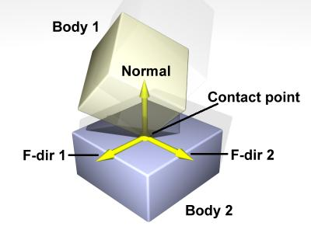
Contact Joint
The contact joint is the primary method of reacting to a collision. It only allows velocities of bodies to be moving away from each other when they are arbitrarily close (impacted, for instance). When a contact joint is applied, some arbitrary change of net forces can be applied to the two bodies to simulate a reaction.

Slide 10
Forces
The process of simulating the rigid body system through time is called integration. Each integration step advances the current time by a given step size, adjusting the state of all the rigid bodies for the new time value. There are two main issues to consider when working with any integrator:
ODE's current integrator is very stable, but not particularly accurate unless the step size is small. For most uses of ODE this is not a problem -- ODE's behavior still looks perfectly physical in almost all cases. However ODE should NOT be used for engineering apps.
Between each integrator step the user can call functions to apply forces to the rigid body. These forces are added to "force accumulators" in the rigid body object. When the next integrator step happens, the sum of all the applied forces will be used to push the body around. The forces accumulators are set to zero after each integrator step.

Slide 11
Local Application?
Good for any simulation of rigid body physics (games, physical system simulations) where speed is important and arbitrary level of precision is not needed.
Also good for collision detection. The collision detection and rigid-body physics engines work separately
No graphics: implement that yourself with any graphics API (OpenGL)
Plan to develop some elementary demos and a document on how they were written. “Phy Sims for dummies?”

Slide 12
Questions
Email: maaronbe@orca.st.usm.edu

