Slide 1


Blog Portal
Sakshi Katiyar,
Aishwary Singh
Team Members:
Aradhya,Anchal,Twinkle,Gunjan,
Naveen
2023 NucleusTeq. All Rights Reserved | Confidential and Proprietary
2020 NucleusTeq. All Rights Reserves | Confidential and Proprietary

Slide 2
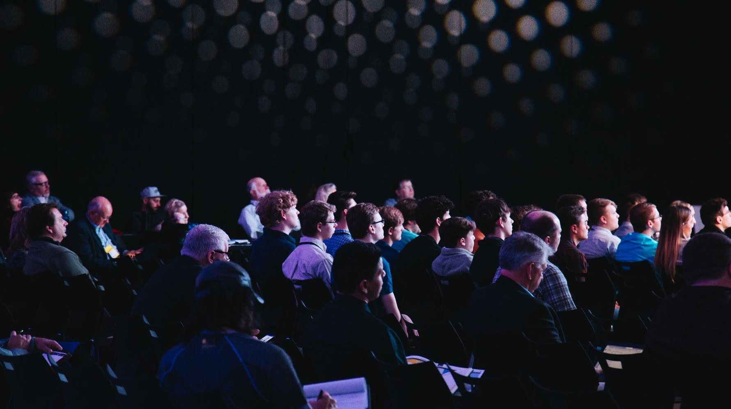
Agenda
Project Overview
Use Case Diagram
Sequence Diagram
ER Diagram
Project Screenshots
2023 NucleusTeq. All Rights Reserved | Confidential and Proprietary

Slide 3
BLOG PORTAL
Basic Idea:-
To develop a blog portal that allows users to publish and explore a wide
range of blogs on different technologies.
Technologies And Tools Used:-
SpringBoot
React
VSCode
Eclipse IDE

Slide 4
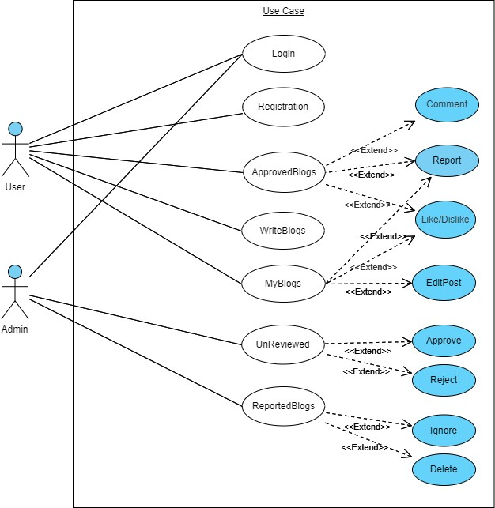
2023 NucleusTeq. All Rights Reserved | Confidential and Proprietary

Slide 5
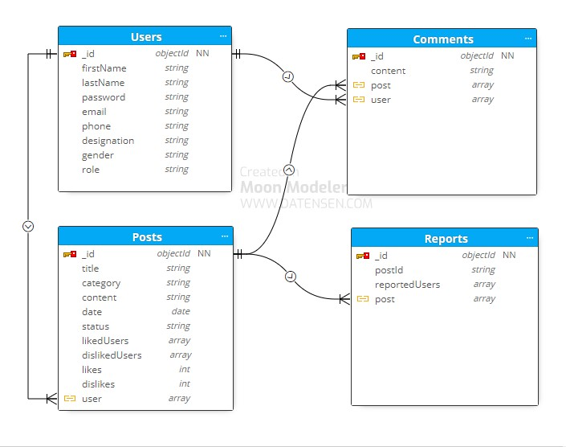
DataBase Desgin

Slide 6
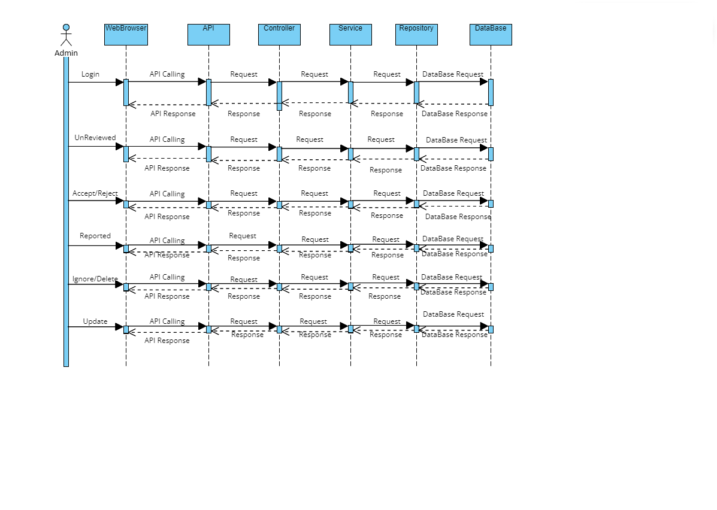
Sequence Diagram

Slide 7
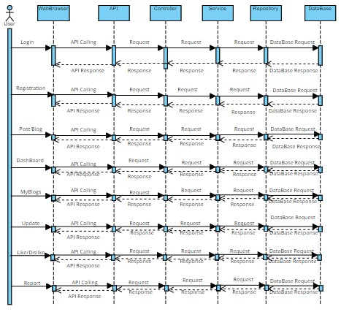

Slide 8
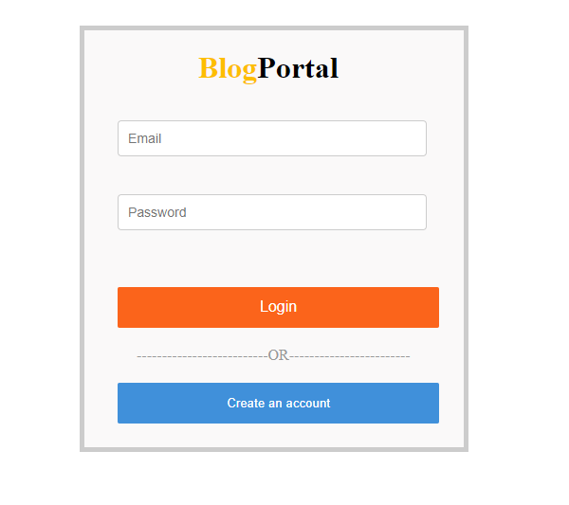
ScreenShots

Slide 9
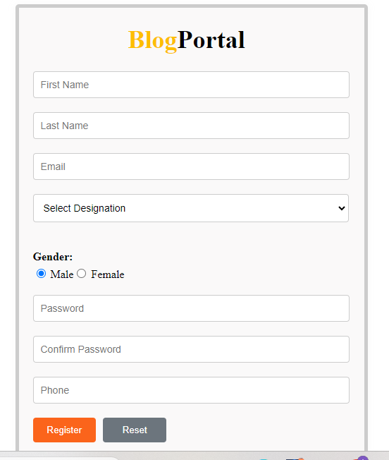

Slide 10
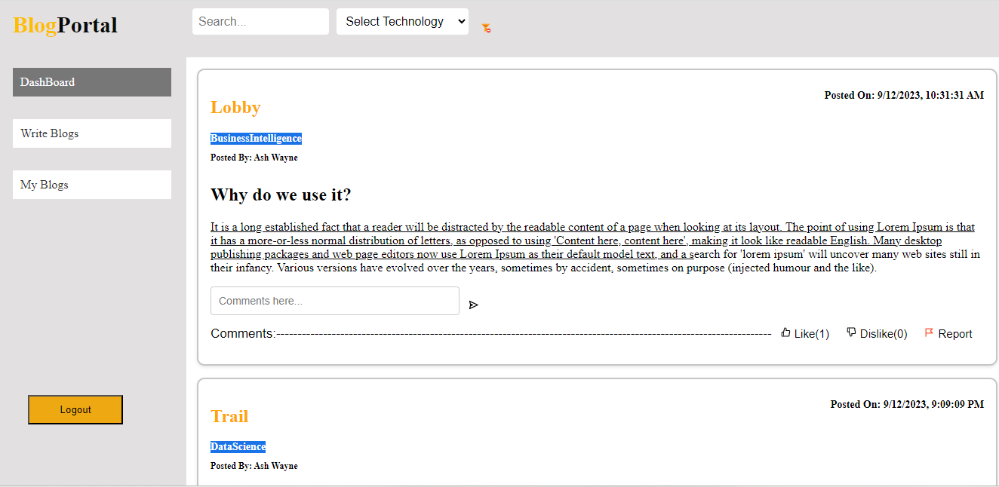

Slide 11
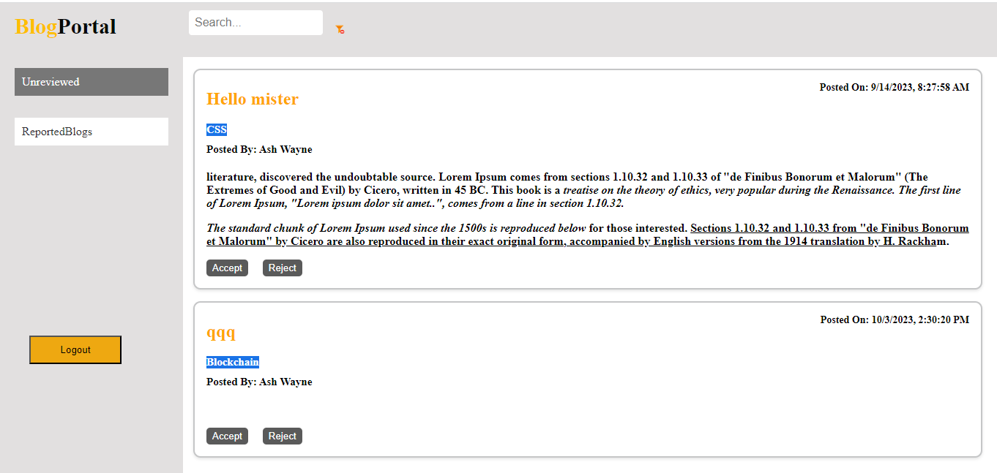

Slide 12
THANK YOU

