Slide 1
HOME AUTOMATION · VOICE UX · ON-DEVICE PRIVACY
Hearth
A local, privacy-first voice dashboard for the smart home
STAGE 2 · FUNCTIONAL PROTOTYPE
TEAM NAME
Apex
TEAM MEMBERS
Twinkle Soni
Kashish Yadav

Slide 2
01 · PROBLEM STATEMENT
Smart homes talk back — but never show their work
Voice assistants execute commands on faith. When they mishear, misfire, or silently do nothing, the only feedback is a beep — and every raw utterance is typically shipped to a cloud server first.
?
☁
▤
No visual confirmation
Cloud-first processing
Fragmented interfaces
Users can't tell what a command was understood as until the light does (or doesn't) turn on — there's no readable intermediate step.
Most commercial assistants route raw audio off-device by default, raising real privacy concerns for something inside the home.
Each vendor ships its own app; there's no single, unified, glanceable dashboard that reflects what the whole home is doing right now.
HEARTH
02 / 10

Slide 3
02 · PROPOSED SOLUTION
One glanceable dashboard, everything processed at home
ON THIS DEVICE ONLY
1
Mic input
Hearth listens for a command, parses it into a structured intent using a fully local NLU engine, and instantly renders the result — the parsed intent, its confidence, and the live device state — in one screen. No audio or command text ever leaves the device.
↓
2
Local speech-to-text
Instant visual feedback
↓
Every command renders a parse card: intent, device, room, value and a confidence score — in under a second.
3
Local intent parser
↓
Local-only pipeline
4
Confidence score
Speech-to-text, intent parsing and device-state logic all run in-browser / on-device — zero network calls for the core loop.
↓
Unified control surface
5
Dashboard render + device update
Every room and device sits on one dashboard instead of being scattered across vendor apps.
HEARTH
03 / 10

Slide 4
03 · TARGET USERS & USE CASE
Built for households that want control, not a black box
◆
✓
◐
⌂
Everyday households
Privacy-conscious users
Elderly & accessibility needs
Renters & tinkerers
Families running multiple rooms and devices who want one dashboard instead of five apps.
People uncomfortable with always-on mics streaming audio to third-party clouds.
Users who benefit from large, instant visual confirmation alongside voice, not instead of it.
Anyone who wants a lightweight, self-hosted layer over existing smart-home hardware.
USE CASE WALKTHROUGH
It's 9pm. Priya says, “dim the living room lights to 30 percent and lock the front door.” Hearth's dashboard instantly shows two parsed commands with 90%+ confidence, updates the Living Room and Front Door cards live, and logs both actions to a session-only history — all without a single request leaving her router.
HEARTH
04 / 10

Slide 5
04 · KEY FEATURES
What the prototype actually demonstrates
1
2
3
Voice + text command input
Local natural-language parser
Live parse card
Browser-native speech recognition with a live waveform indicator, plus a typed-command fallback for reliable demoing.
A rule-based intent engine extracts intent, device, room and value from free-form phrasing entirely in client-side JS.
Every command instantly shows its recognized intent, target device/room, value and a confidence score — before any device changes.
4
5
6
Unified device dashboard
Session-only history log
Privacy meter
All rooms and devices — lights, thermostat, fan, TV, lock — sit on one grid with real-time state and animated updates.
A running, timestamped log of every command and its confidence — kept in memory, never written to a server.
A persistent “bytes sent to the cloud” counter stays at zero, making the local-only claim visibly verifiable.
Every feature above runs with the device offline — disconnect the network and Hearth keeps working exactly the same.
HEARTH
05 / 10

Slide 6
05 · TECHNOLOGY STACK
Deliberately lightweight — the intelligence lives client-side
Input layer
Processing layer
Interface layer
Integration layer
• Web Speech API (browser ASR)
• Custom rule-based NLU (JavaScript)
• HTML5 / CSS3 dashboard, responsive grid
• Simulated device layer (this prototype)
• Typed-command fallback UI
• Intent + entity + confidence scoring
• Vanilla JS state manager & live re-render
• Production path: local hub via MQTT / Matter / Zigbee2MQTT
• Production path: on-device engines (Vosk / whisper.cpp)
• Extensible to a local intent-classification model
• Session-scoped history (in-memory, no persistence)
• No cloud API calls in the core command loop
HEARTH
06 / 10

Slide 7
06 · SYSTEM ARCHITECTURE
From spoken word to device state, without leaving the room
DEVICE / LOCAL-NETWORK BOUNDARY — NOTHING BELOW THIS LINE CROSSES THE INTERNET
Voice / text
input
→
Local ASR
(speech-to-text)
→
Local NLU
intent parser
→
Intent + entities
+ confidence
→
State manager
(device model)
→
Dashboard render
+ device action
KEY DESIGN CHOICE
The parse output (intent, entities, confidence) is rendered on screen the same tick it's computed — the dashboard is a direct view into the parser's state, not a delayed confirmation.
Optional cloud sync (future scope) is strictly opt-in and out-of-band from the command loop above — the core experience never depends on it.
HEARTH
07 / 10

Slide 8
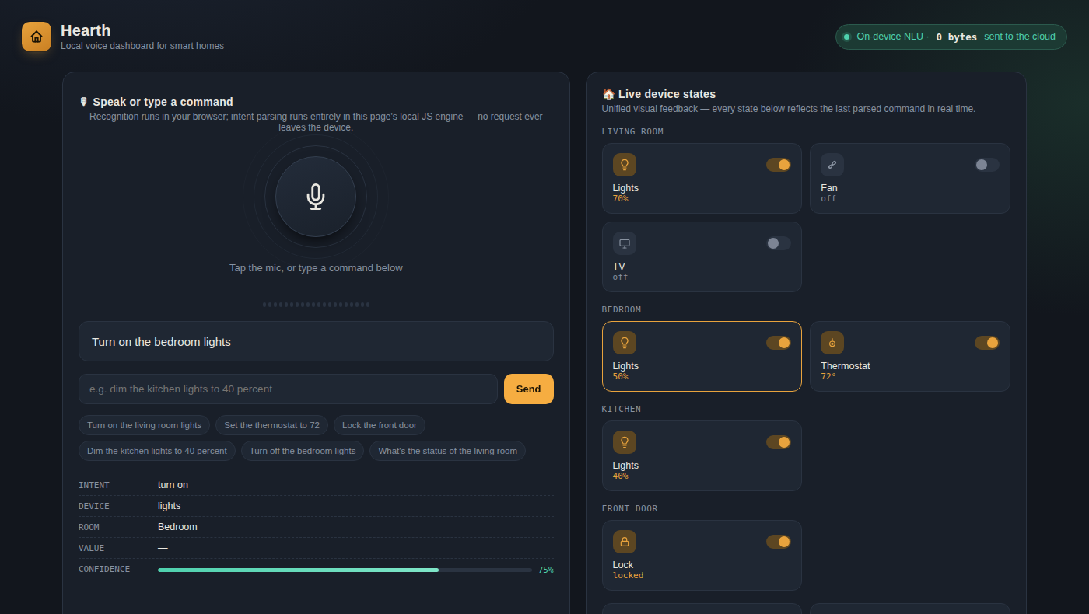
07 · PROTOTYPE & DEMO
Live, working dashboard — not a mockup
TRY IT LIVE
Open hearth-prototype.html (submitted alongside this deck) in any modern browser — no install, no server.
SAMPLE COMMANDS
“turn on the living room lights” · “set the thermostat to 72” · “lock the front door” · “dim the kitchen lights to 40 percent”
WHAT TO LOOK FOR
The parse card and device grid update in the same instant, and the cloud-bytes counter stays at zero throughout.
HEARTH
08 / 10

Slide 9
08 · INNOVATION, IMPACT & SCALABILITY
Why this is different, and why it holds up at scale
◆
Innovation
▲
Impact
◈
Scalability
Feedback-first design: the parse result is the primary UI, not an afterthought toast
Reduces silent command failures by showing exactly what was understood
NLU rules are data-driven — new devices/rooms are config, not code changes
Verifiable privacy — a live zero-byte network counter, not just a policy claim
Lowers the privacy barrier to smart-home adoption for cautious households
Local-only core scales per-home with zero added cloud infrastructure cost
Confidence scoring surfaced to the user, not hidden inside the model
One dashboard replaces several vendor apps for daily control
Swappable ASR/NLU backends (on-device ML models) without UI changes
HEARTH
09 / 10

Slide 10
09 · FUTURE SCOPE
From hackathon prototype to a daily-driver dashboard
Near term
Mid term
Long term
• Swap rule-based NLU for a small on-device intent-classification model
• Wake-word detection for hands-free activation, fully on-device
• Optional, end-to-end encrypted cross-device sync (strictly opt-in)
• Real device integration via Matter / Zigbee2MQTT / MQTT bridge
• Per-user voice profiles processed and stored locally only
• Offline-first mobile companion app mirroring the same dashboard
• Multi-turn commands: “turn off the lights” → “in the bedroom too”
• Routine builder: chain multiple intents into one saved scene
• Open device-plugin format so any hardware vendor can integrate
Thank you — questions welcome.
HEARTH
10 / 10

