Slide 1


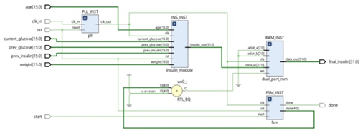
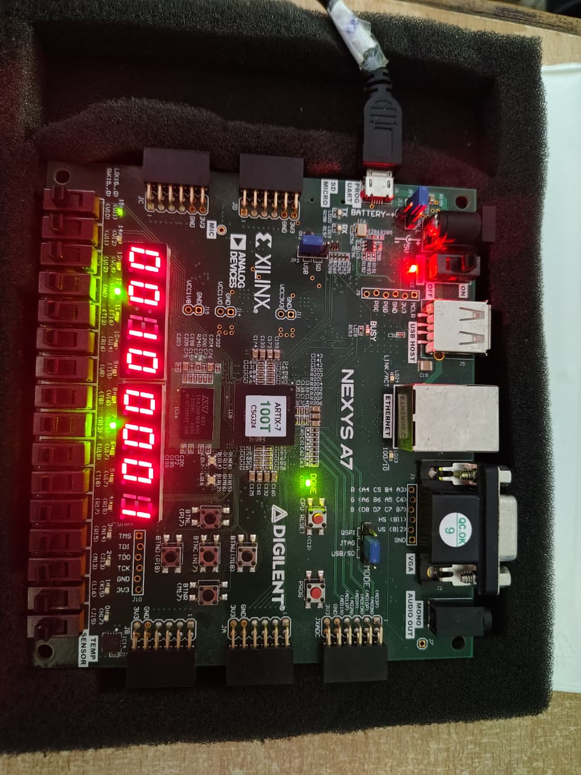
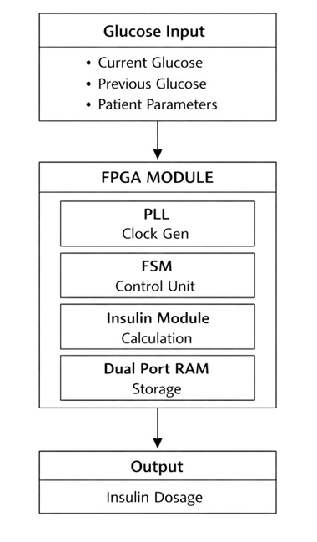
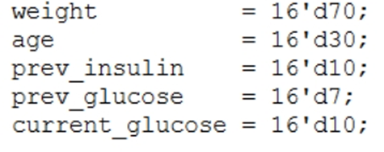
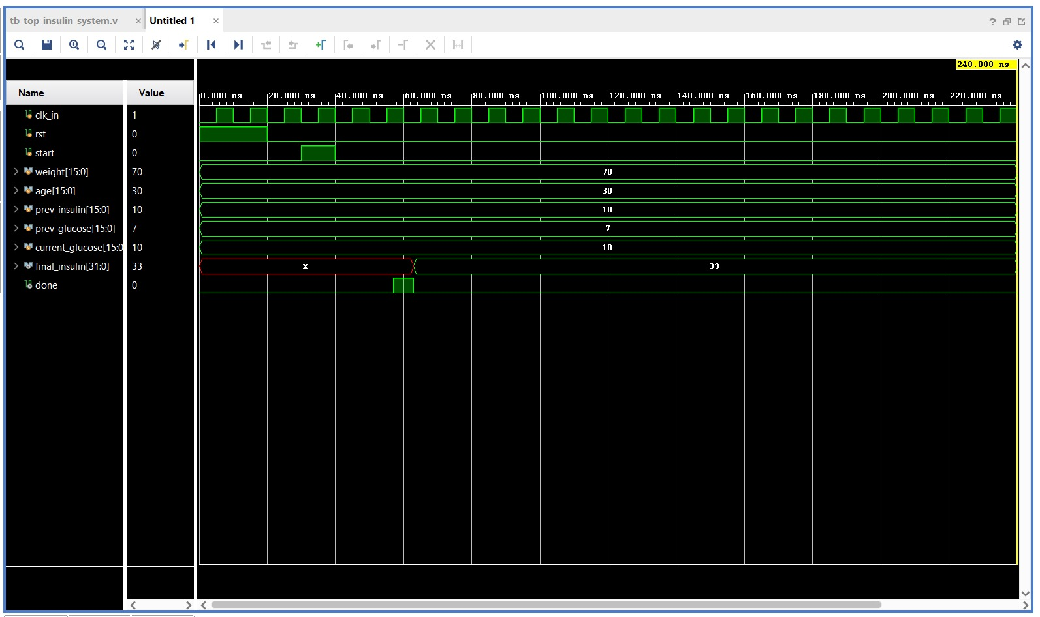
FPGA - BASED INSULIN DOSAGE COMPUTATION SYSTEM FOR DIABETES MANAGEMENT
Introduction
Software Used
Results
Diabetes is a chronic disease which involves constant check on the amount of glucose in the blood. This means that the correct amount of insulin should be given to sustain normal body functions. Administration of insulin in wrong ways can cause crucial health conditions. Hence, proper estimation of insulin is of paramount importance to treat diabetes properly. In the presented project, an insulin control system is offered automatized with the assistance of FPGA.
Methodology
It shows the flow of input parameters such as glucose levels and patient data into the FPGA module, where different units like PLL, FSM, insulin calculation module, and memory perform processing. The final output is the calculated insulin dosage.
Results
The Nexys A7 FPGA board used for implementing the insulin dosage computation system. The computed insulin value is displayed using the on-board seven-segment display and LEDs. Since the FPGA design operates using integer representation, the displayed value “63” corresponds to 6.3 IU of insulin. This confirms the successful hardware realization and output visualization of the system.
Conclusion
The project shows that an insulin dosage control system can work well using a kind of computer chip called an FPGA. This system takes in information about glucose. Produces insulin output using a specific type of logic. When we tested the system, it worked correctly which means it is an example of how this can be done with hardware.
Under the Guidance
Ms. P. Roopa Ranjani
Asst. Prof.
Affiliate: K. Naga Teja Sri, M. Twinkle Durga, S. Vaishnavi

