Slide 1
CLEAN MY CITY
Mobile APPLICATION

Slide 2
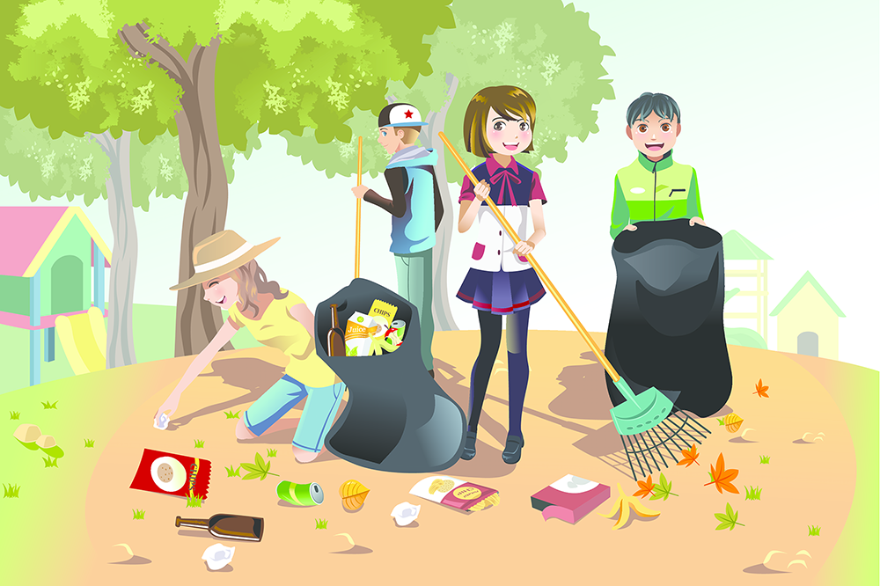
Cleanliness in the cat World, is usually a virtue put above godliness

Slide 3
Introduction
The Clean My city app is complaint associated app which gives garbage checking and solving the problem of the city garbage.
This is when a person registers in the app and clicks and posts a photo of the garbage in the particular area. Then the officers will solve the problem and remove the photo, from the complaint section.
Through this app, the problem of garbage can be solved easily and with well proofs.
The community work gets recognized by this app and gives awareness to the whole country.

Slide 4
Mobile Features and framework
WEB SERVICES : The web services should be operating so that data could be sent and through which the complaint gets registered.
AUTHENTICIATED MOBILE NUMBER : The user should have a authenticated mobile number. Also each and every user own their individual identity.
PHOTO UPLOAD : After the users registers , it uploads the photograph of the garbage area after which the officers solve the issue. This photograph is taken from the user’s phone gallery, therefore user has to capture the photo by phone’s camera.

Slide 5
WORK FLOW
The community officer logins
The removal of the garbage from a specific place, takes place.
The complaint is solved and hence removed from complaints, thus leading to the cleaned area
The complaint added in the complaint list
Comes across the number of complaints
User
Area with garbage
Clicks photograph
Logins in clean my app
Uploads the image and provides location and submit .

Slide 6
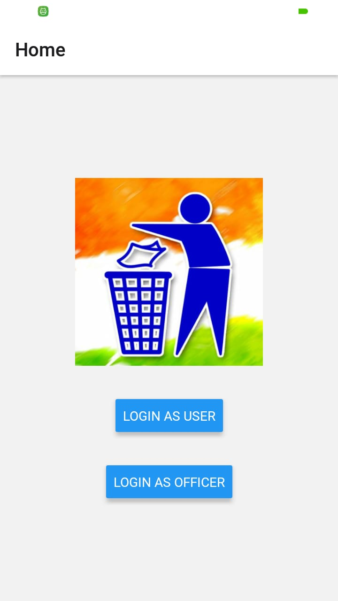
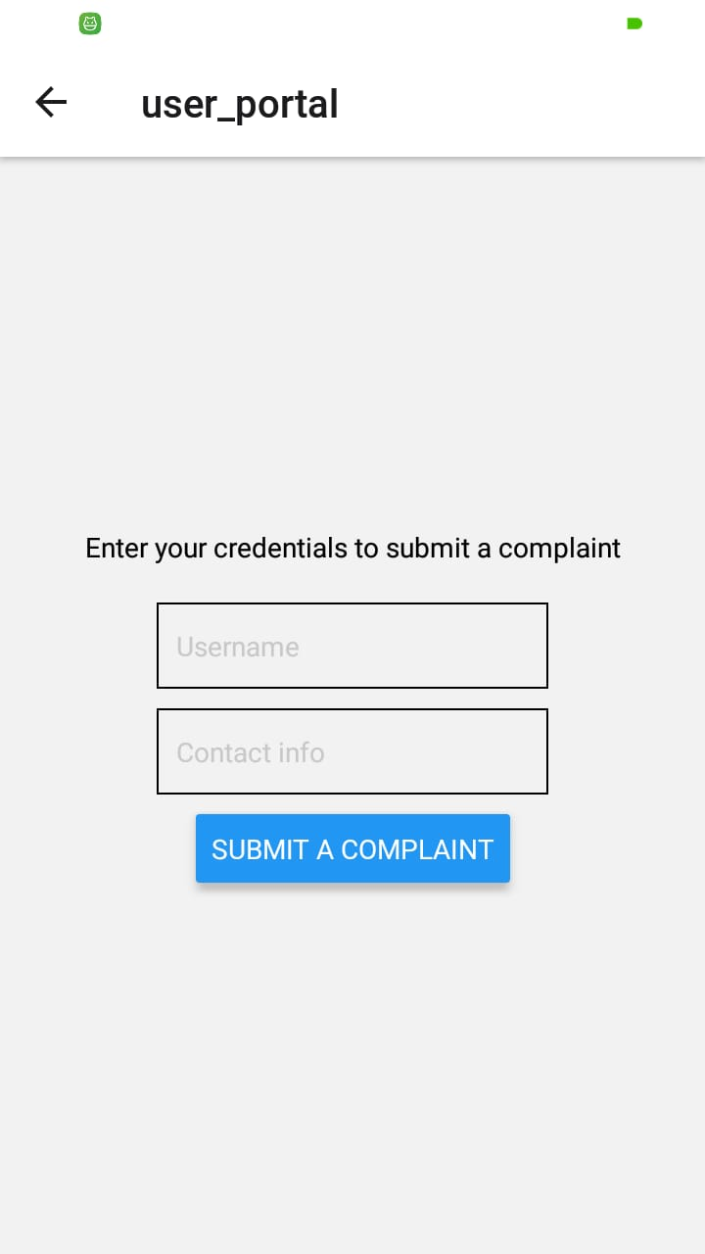
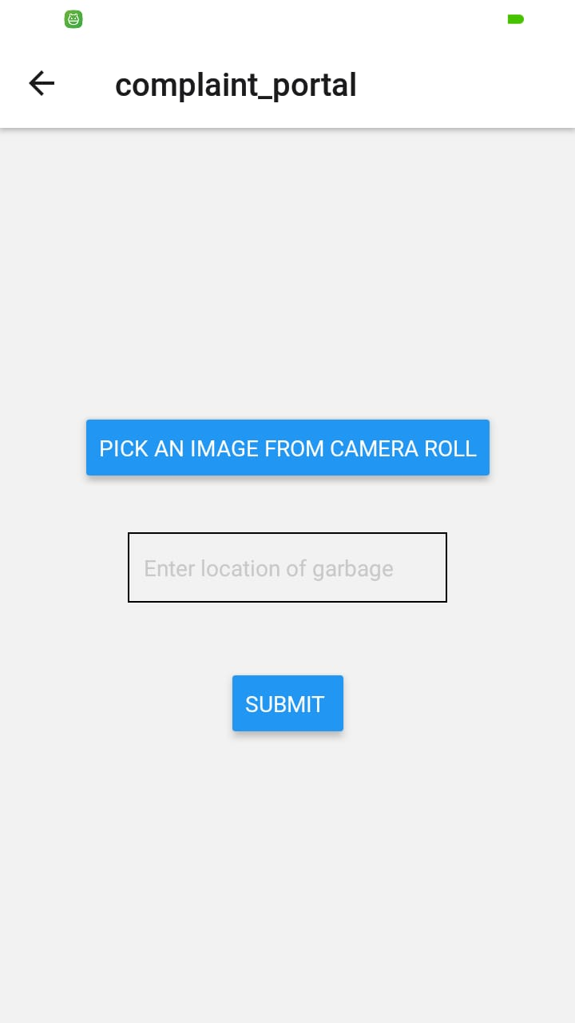

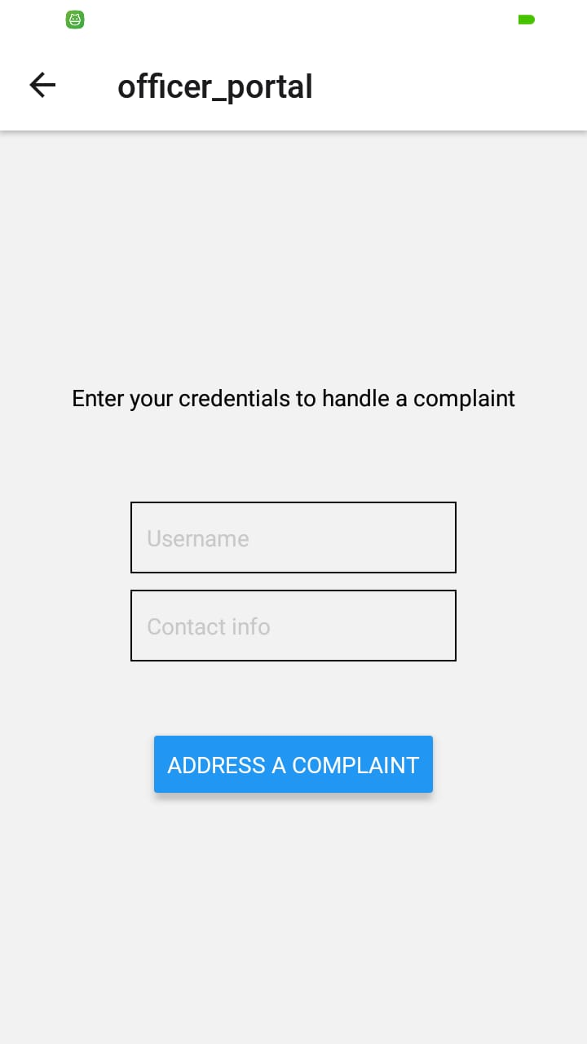
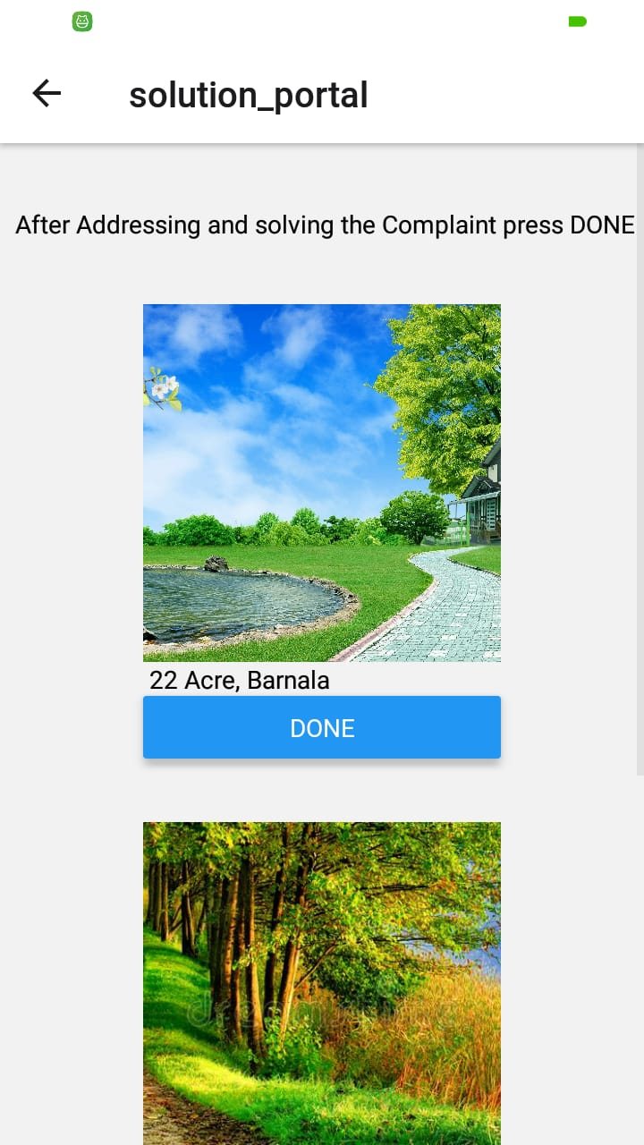
WORKING OF THE APPLICATION
HOME SCREEN

Slide 7
APP ARCHITECTURE
Multi-platform Application: In order to make the application runnable for android, ios and web browser, the expo SDK has been used.
User-friendly: As the app, should be easily, used by the user, the input text is used for taking the information from the user, the buttons with wide area are used to be pressed easily.
Image upload: Image picker component of react-native has been used to upload the image from the gallery, for this permissions have to be taken from the device, which are granted by the user only.
Language used: The language used in the deployment of the app is react-native. And various components like react-navigation, button, input-text, text etc are used.

Slide 8
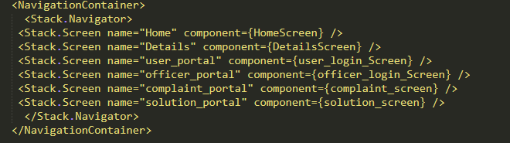
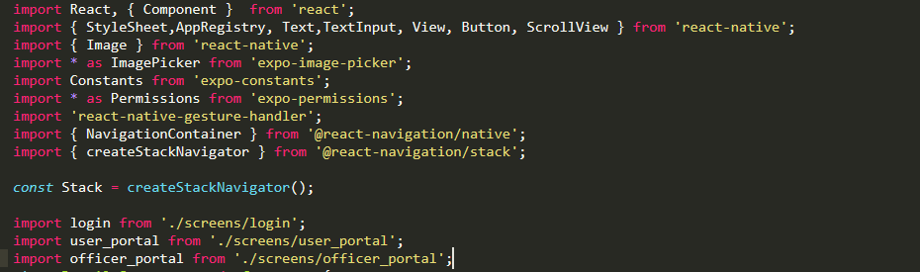
CODE
Navigation-control
Libraries imported

Slide 9
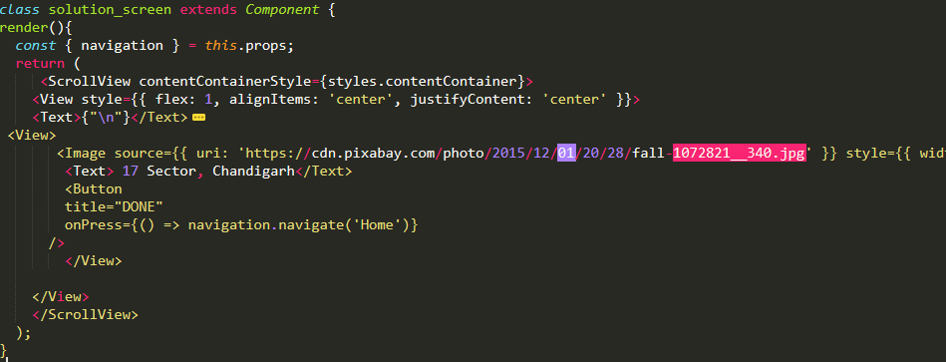
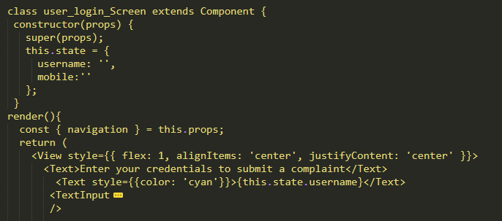
Solution Screen
User Screen

Slide 10
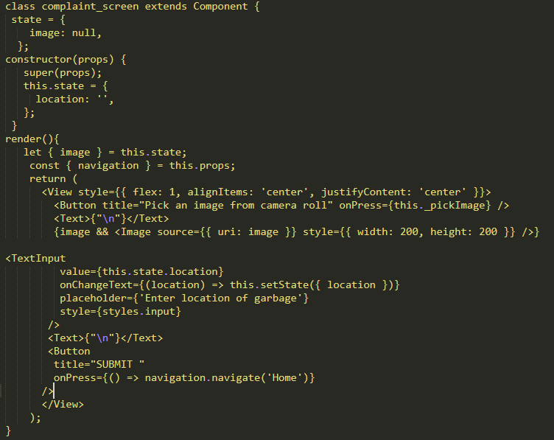
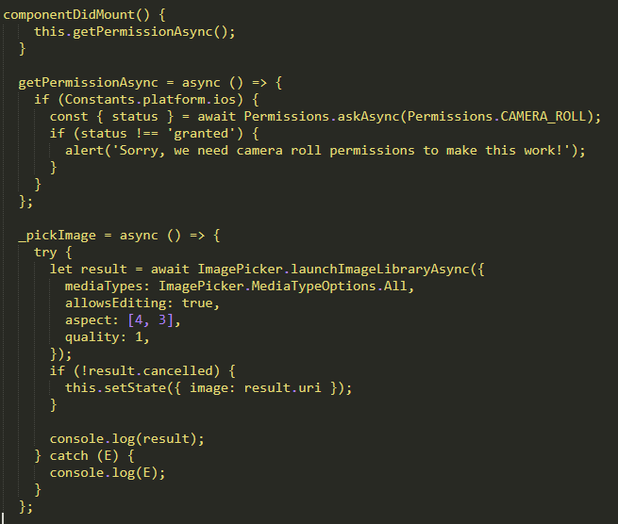
Complaint-Portal
Image upload

Slide 11
APP framework
Complaints registering: Complaints being added by the user, are stored in the form of JSON data having the information of user, ie, the name of user, mobile number of user, the complaint registered, the location, the url of the image uploaded by the user.
Complaint Addressing: The JSON data stored earlier with the addition of the complaints, the list is extracted in the complaint list, with the image of garbage area, along with location of area, with a done button. As the complaint is resolved the officer will press the done button, and return back to home page.
Image removal: As the complaint is solved, the complaint is deleted from the complaints list, this is because in the complaint table the complaint is no more as unsolved, but has been given a solved status, this leads to not showing in the complaint portal.

Slide 12
Data undertaken
Solution_id
Officer_name
Mobile_no
Complaint_id
Location
Complaint_id
User_name
Mobile_no
Image_path
Location
Status

Slide 13
CONCLUSION AND FACED CHALLENGES
Application has been developed, with an aim to help larger part of society.
The major challenges faced during the application deployment were uploading image from user phone and identifying each user uniquely with unique mobile number.
Associating officer with the location they addressed, thus adding onto their portfolio.

Slide 14
THANK YOU

