Slide 1
Bootstrap
All blue are from Bootstrap documents

Slide 2
bootstrap
Instead of using your own css and js files we use bootstraps files
Large screens – 1200px+ [col-lg-*]
Medium screens – 992px+ [col-md-*]
Small screens – 768px+ [col-sm-*]
Extra small screens – 0px+ [col-xs-*]

Slide 3
Bootstrap
most popular HTML, CSS, and JavaScript framework for developing responsive, mobile-first web sites. front-end framework for faster and easier web development. It includes HTML and CSS based design templates for typography, forms, buttons, tables, navigation, modals, image carousels and many other, as well as optional JavaScript plugins
Advantages of Bootstrap: Easy to use: Anybody with just basic knowledge of HTML and CSS can start using Bootstrap Responsive features: Bootstrap's responsive CSS adjusts to phones, tablets, and desktops Mobile-first approach: In Bootstrap 3, mobile-first styles are part of the core framework Browser compatibility: Bootstrap is compatible with all modern browsers (Chrome, Firefox, Internet Explorer, Safari, and Opera)
Adv of CDN: Many users already have downloaded Bootstrap from MaxCDN when visiting another site. As a result, it will be loaded from cache when they visit your site, which leads to faster loading time. Also, most CDN's will make sure that once a user requests a file from it, it will be served from the server closest to them, which also leads to faster loading time.
One framework, every device. Bootstrap easily and efficiently scales your websites and applications with a single code base, from phones to tablets to desktops with CSS media queries.
Full of features. With Bootstrap, you get extensive and beautiful documentation for common HTML elements, dozens of custom HTML and CSS components, and awesome jQuery plugins.
Preprocessors: Bootstrap ships with vanilla CSS, but its source code utilizes the two most popular CSS preprocessors, Less and Sass. Quickly get started with precompiled CSS or build on the source.
Please note that all JavaScript plugins require jQuery to be included

Slide 4
Tools
Bootlint is the official Bootstrap HTML linter tool. It automatically checks for several common HTML mistakes in webpages that are using Bootstrap in a fairly "vanilla" way. Vanilla Bootstrap's components/widgets require their parts of the DOM to conform to certain structures. Bootlint checks that instances of Bootstrap components have correctly-structured HTML. Consider adding Bootlint to your Bootstrap web development toolchain so that none of the common mistakes slow down your project's development. [lint or a linter is any tool that flags suspicious usage in software written in any computer language]
Bootstrap automatically adapts your pages for various screen sizes. Here's how to disable this feature so your page works like this non-responsive example.
Steps to disable page responsiveness. Check EX: http://getbootstrap.com/examples/non-responsive/
Omit the viewport <meta> mentioned in the CSS docs
Override the width on the .container for each grid tier with a single width, for example width: 970px !important; Be sure that this comes after the default Bootstrap CSS. You can optionally avoid the !important with media queries or some selector-fu.
If using navbars, remove all navbar collapsing and expanding behavior.
For grid layouts, use .col-xs-* classes in addition to, or in place of, the medium/large ones. Don't worry, the extra-small device grid scales to all resolutions.
Browser and device support Bootstrap is built to work best in the latest desktop and mobile browsers, meaning older browsers might display differently styled, though fully functional, renderings of certain components.

Slide 5
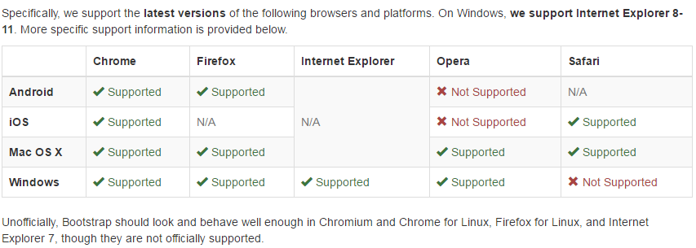
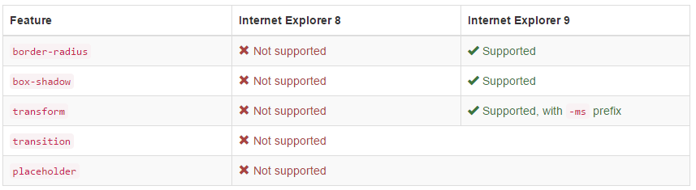
Supported versions
Internet Explorer 8 and 9 are also supported, however, please be aware that some CSS3 properties and HTML5 elements are not fully supported by these browsers. In addition, Internet Explorer 8 requires the use of Respond.js to enable media query support.
Visit Can I use... for details on browser support of CSS3 and HTML5 features.

Slide 6
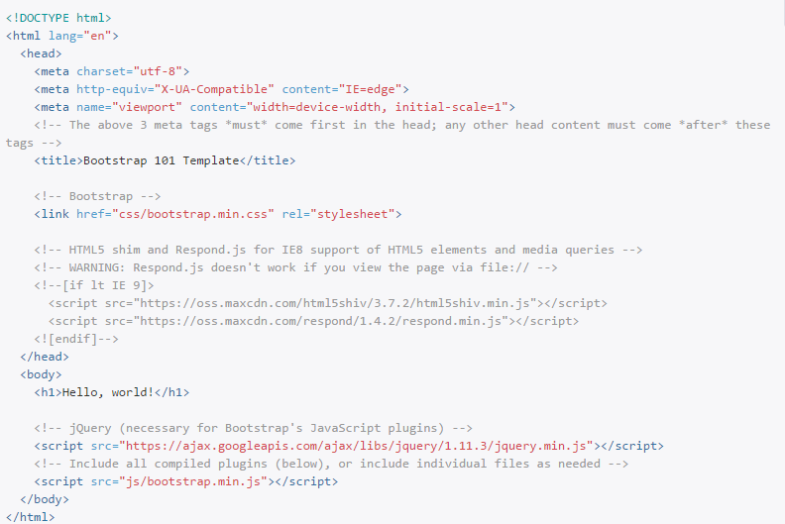
<meta name="viewport" content="width=device-width, initial-scale=1"> To ensure proper rendering and touch zooming, add the following <meta> tag inside the <head> The width=device-width part sets the width of the page to follow the screen-width of the device (which will vary depending on the device). The initial-scale=1 part sets the initial zoom level when the page is first loaded by the browser.
You can disable zooming capabilities on mobile devices by adding user-scalable=no to the viewport meta tag. This disables zooming, meaning users are only able to scroll, and results in your site feeling a bit more like a native application. Overall, we don't recommend this on every site, so use caution! <meta name="viewport" content="width=device-width, initial-scale=1, maximum-scale=1, user-scalable=no">
This is how a page should look to start with Bootstraps

Slide 7
Mobile first With Bootstrap 2, we added optional mobile friendly styles for key aspects of the framework. With Bootstrap 3, we've rewritten the project to be mobile friendly from the start. Instead of adding on optional mobile styles, they're baked right into the core. In fact, Bootstrap is mobile first. Mobile first styles can be found throughout the entire library instead of in separate files.
To ensure proper rendering and touch zooming, add the viewport meta tag to your <head>. <meta name="viewport" content="width=device-width, initial-scale=1"> You can disable zooming capabilities on mobile devices by adding user-scalable=no to the viewport meta tag. This disables zooming, meaning users are only able to scroll, and results in your site feeling a bit more like a native application. Overall, we don't recommend this on every site, so use caution! <meta name="viewport" content="width=device-width, initial-scale=1, maximum-scale=1, user-scalable=no">
Containers: Bootstrap requires a containing element to wrap site contents and house our grid system. You may choose one of two containers to use in your projects. Note that, due to padding and more, neither container is nestable. Use .container for a responsive fixed width container. Use .container-fluid for a full width container, spanning the entire width of your viewport.
Grid system: Bootstrap includes a responsive, mobile first fluid grid system that appropriately scales up to 12 columns as the device or viewport size increases. It includes predefined classes for easy layout options, as well as powerful mixins for generating more semantic layouts.
Rows must be placed within a .container (fixed-width) or .container-fluid (full-width) for proper alignment and padding.
Use rows to create horizontal groups of columns.
Content should be placed within columns, and only columns may be immediate children of rows.
Predefined grid classes like .row and .col-xs-4 are available for quickly making grid layouts.
Columns create gutters (gaps between column content) via padding. That padding is offset in rows for the first and last column via negative margin on .rows.
The negative margin is why the examples below are out dented. It's so that content within grid columns is lined up with non-grid content.
Grid columns are created by specifying the number of twelve available columns you wish to span. For example, three equal columns would use three .col-xs-4.
If more than 12 columns are placed within a single row, each group of extra columns will, as one unit, wrap onto a new line.
Grid classes apply to devices with screen widths greater than or equal to the breakpoint sizes, and override grid classes targeted at smaller devices. Therefore, e.g. applying any .col-md-* class to an element will not only affect its styling on medium devices but also on large devices if a .col-lg-* class is not present.

Slide 8
Containers
To wrap contents we use containers: *The .container class provides a responsive fixed width container *The .container-fluid class provides a full width container, spanning the entire width of the viewport
you cannot put a container inside another container. They aren’t nestable

Slide 9
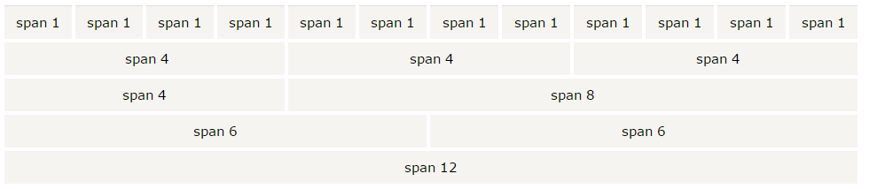
Bootstrap Grid
We have 12 columns across the pg. you can also group the columns together to create wider columns:
Bootstrap's grid system is responsive, and the columns will re-arrange automatically depending on the screen size. On a big screen it might look better with the content organized in three columns, but on a small screen it would be better if the content items were stacked on top of each other.
We have four GRID CLASSES: xs (for phones) sm (for tablets) md (for desktops) lg (for larger desktops)
Each class scales up, so if you wish to set the same widths for xs and sm, you only need to specify xs.

Slide 10
STEPS: 1.Create a container (<div class="container">) 2. First; create a row (<div class="row">) 3. Then, add the desired number of columns (tags with appropriate .col-*-* classes).

Slide 11
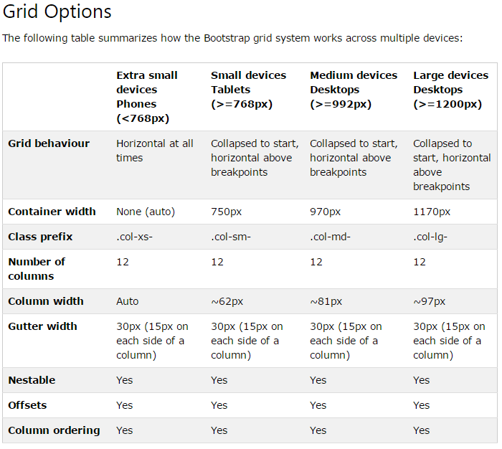
Grid

Slide 12
GRID
Bootstrap Grid - Stacked-to-horizontal We will create a basic grid system that starts out stacked on mobiles/tablets (small devices), before becoming horizontal on desktops (medium/large devices).
Then gradually talk abt small medium large.
If medium has 2 divs with each 6 and 6(which is 50 50) then for smaller devices it takes the entire width (if nothing mentioned for)
If large splits into 50-50, then for smaller and extra smaller it will stack vertically by 100%
Ex : if v have three divs with col-sm-4 then we get a three equal-width columns starting at tablets and scaling to large desktops. On mobile phones, the columns will automatically stack

Slide 13
Under typography
Browser's default settings
Bootstrap's way of styling elements:
h1-h6
<small>
<mark>
<abbr>
<blockquote>
<dl>
<code>
<kbd>
<pre>
Contextual Colors :.text-muted, .text-primary, .text-success, .text-info, .text-warning, and .text-danger
and Backgrounds: .bg-primary, .bg-success, bg-info, bg-warning, and .bg-danger
Diff classes to style the elements such as: .lead.small.text-left.text-center.text-right.text-justify.text-nowrap.text-lowercase.text-uppercase.text-capitalize.initialism.list-unstyled.list-inline.dl-horizontal.pre-scrollable

Slide 14
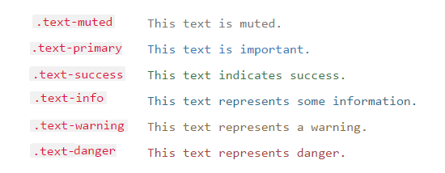
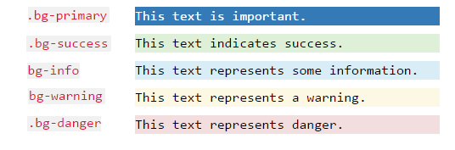
Bootstrap Text/Typography
global default font-size is 14px, with a line-height of 1.428. applied to the <body> and all paragraphs. In addition, all <p> elements have a bottom margin that equals half their computed line-height (10px by default).
There is a diff way how bootstrap styles HTML elements when compared to the browser . CHECK http://www.w3schools.com/bootstrap/bootstrap_typography.asp h1(36px),h2(30px),h3(24px),h4(18px),h5(14px),h6(12px)
Contextual Colors
Contextual backgrounds

Slide 15
Bootstrap Text/Typography
.lead Makes a paragraph stand out
.small Indicates smaller text (set to 85% of the size of the parent)
.text-left Indicates left-aligned text
.text-center Indicates center-aligned text
.text-right Indicates right-aligned text
.text-justify Indicates justified text
.text-nowrap Indicates no wrap text
.text-lowercase Indicates lowercased text
.text-uppercase Indicates uppercased text
.text-capitalize Indicates capitalized text
.initialism Displays the text inside an <abbr> element in a slightly smaller font size
.list-unstyled Removes the default list-style and left margin on list items (works on both <ul> and <ol>). This class only applies to immediate children list items (to remove the default list-style from any nested lists, apply this class to any nested lists as well)
.list-inline Places all list items on a single line
.dl-horizontal Lines up the terms (<dt>) and descriptions (<dd>) in <dl> elements side-by-side. Starts off like default <dl>s, but when the browser window expands, it will line up side-by-side
.pre-scrollable Makes a <pre> element scrollable

Slide 16
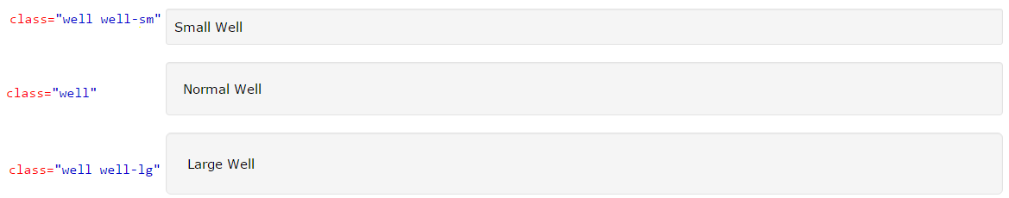
Few Bootstrap classes
Bootstrap tables: classes such as .table, .table-striped, .table-bordered, .table-hover, .table-condensed, .table-responsive, <tr class="success">, <tr class=“info">, <tr class="active">, <tr class="warning">, <tr class="danger">
Bootstrap Images: .img-rounded, .img-circle, .img-thumbnail, .img-responsive - Responsive images automatically adjust to fit the size of the screen. The .img-responsive class applies display: block; and max-width: 100%; and height: auto; to the image
For videos or slideshows: Classes can be applied directly to <iframe>, <embed>, <video>, and <object> elements. .embed-responsive-item - responsive video by adding class to an <iframe> tag
Bootstrap Jumbotron: .jumbotron indicates a big box for calling extra attention to some special content or information(a grey box with rounded corners also enlarges the font sizes of the text inside it)
Page Header: is like a section divider, .page-header class adds a horizontal line under the heading (+ adds some extra space around the element)
Well: .well class adds a rounded border around an element with a gray background color and some padding
<div class="embed-responsive embed-responsive-16by9"> <iframe class="embed-responsive-item" src="..."></iframe> </div>

Slide 17
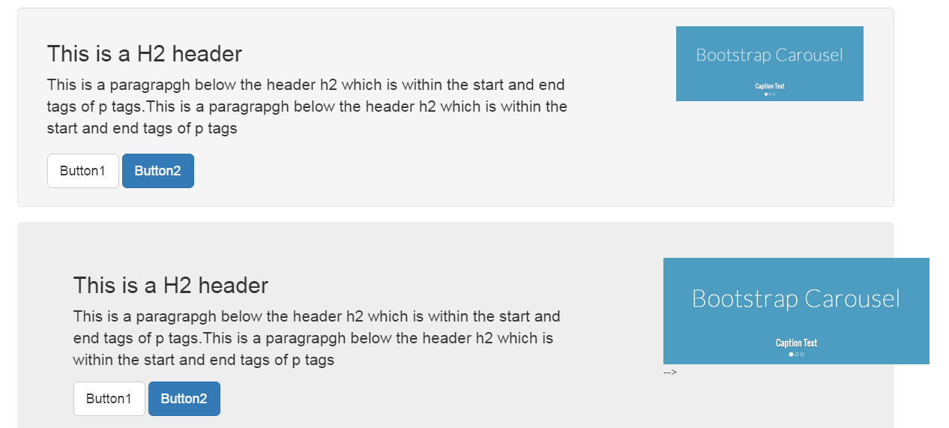
Image Responsive
First choose an img which is of bigger size. (1) with img-responsive (2)widout img-responsive

Slide 18
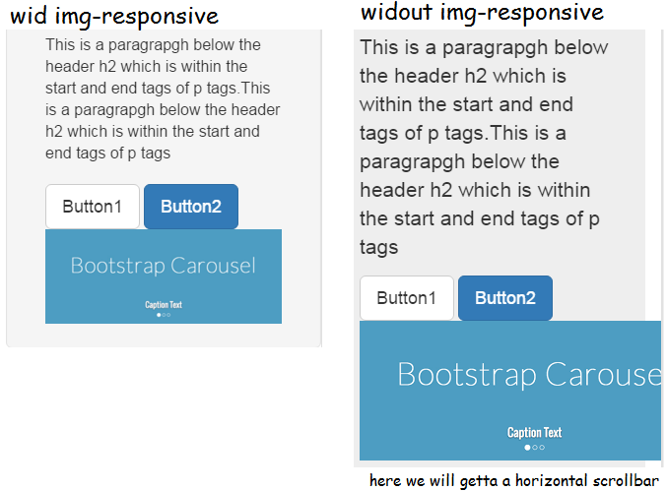

Slide 19
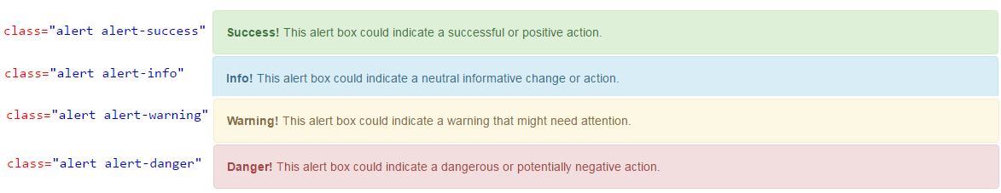
Few Bootstrap classes
Alerts - .alert class, followed by one of the four contextual classes .alert-success, .alert-info, .alert-warning or .alert-danger
To close the alert add both “close” and data-dismiss=“alert” close if for styling the button so that It is in corner and so on. And data-dismiss fa the js part that is to remove. (1) link widin the div: to help improve accessibility for people using screen readers, you should include the aria-label="close" attribute, when creating a close button. &times; (×) is an HTML entity that is the preferred icon for close buttons, rather than the letter "x" (2)button widin the div
The .fade and .in classes adds a fading effect when closing the alert message
<div class="alert alert-success fade in">

Slide 20

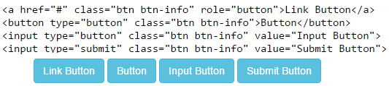




Few Bootstrap classes
Buttons: 7 styles of buttons
The button class can be used on <a>, <button>, or <input> element
Four button sizes:
Block level buttons: .btn-block class EX: class="btn btn-primary btn-block“
Active/Disabled Buttons: .active makes a button appear pressed, and the class .disabled makes a button unclickable

Slide 21

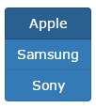
Few Bootstrap classes
Button Groups: group a series of buttons together (on a single line). Use a <div> element with class .btn-group to create a button group
Instead of applying button sizes to every button in a group, use class .btn-group-* to size all buttons in the group
Vertical Buttons:
Justified button groups: span the entire width of the screen, use the .btn-group-justified justified works for anchor tags but for button we must wrap each button into an div with class btn-group
<div class="btn-group"> <button type="button" class="btn btn-primary">Apple</button> <button type="button" class="btn btn-primary">Samsung</button> <button type="button" class="btn btn-primary">Sony</button> </div>
<div class="btn-group btn-group-lg">
<div class="btn-group-vertical">
<div class="btn-group btn-group-justified">

Slide 22


Few Bootstrap classes
Dropdown button groups Here wateva has to come down widin sony shud be under <ul> with class dropdown-menu(this class is needed to hide the ul elements and display oly when clicked) and the button shud have data-toggle=dropdown. Class dropdown-toggle is unwanted, it is jus fa styling
To split button dropdowns: Just make the sony and the caret as two different buttons
<div class="btn-group"> <button type="button" class="btn btn-primary">Apple</button> <button type="button" class="btn btn-primary">Samsung</button> <div class="btn-group"> <button type="button" class="btn btn-primary dropdown-toggle" data-toggle="dropdown"> Sony <span class="caret"></span>
</button> <ul class="dropdown-menu" role="menu"> <li><a href="#">Tablet</a></li> <li><a href="#">Smartphone</a></li> </ul> </div> </div>
<div class="btn-group"> <button type="button" class="btn btn-primary">Sony</button> <button type="button" class="btn btn-primary dropdown-toggle" data-toggle="dropdown"> <span class="caret"></span> </button> <ul class="dropdown-menu" role="menu"> <li><a href="#">Tablet</a></li> <li><a href="#">Smartphone</a></li> </ul> </div>

Slide 23
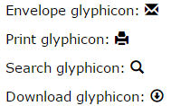
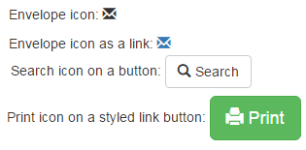
Few Bootstrap classes
Bootstrap Glyphicons: 260 glyphicons from the Glyphicons Halflings set. It can be used in text, buttons, toolbars, navigation, forms, etc.
Ex:
Syntax: Name must be replaced wid glyphicons name
<span class="glyphicon glyphicon-name"></span>
<div class="container">
<p>Envelope icon: <span class="glyphicon glyphicon-envelope"></span></p>
<p>Envelope icon as a link:
<a href="#"><span class="glyphicon glyphicon-envelope"></span></a>
</p>
<p>Search icon on a button:
<button type="button" class="btn btn-default">
<span class="glyphicon glyphicon-search"></span> Search
</button>
</p>
<p>Print icon on a styled link button:
<a href="#" class="btn btn-success btn-lg">
<span class="glyphicon glyphicon-print"></span> Print
</a>
</p>
</div>

Slide 24


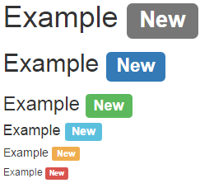
Few Bootstrap classes
Bootstrap Badges: Badges are numerical indicators of how many items are associated with a link. Use the .badge class within <span> elements
Inside buttons:
Bootstrap Labels: to provide additional information about something
<a href="#">News <span class="badge">5</span></a><br>
<a href="#">Comments <span class="badge">10</span></a><br>
<a href="#">Updates <span class="badge">2</span></a>
<button type="button" class="btn btn-primary">Primary <span class="badge">7</span></button>
<button type="button" class="btn btn-success">Success <span class="badge">3</span></button>
<button type="button" class="btn btn-danger">Danger <span class="badge">5</span></button>
<h1>Example <span class="label label-default">New</span></h1>
<h2>Example <span class="label label-primary">New</span></h2>
<h3>Example <span class="label label-success">New</span></h3>
<h4>Example <span class="label label-info">New</span></h4>
<h5>Example <span class="label label-warning">New</span></h5>
<h6>Example <span class="label label-danger">New</span></h6>

Slide 25
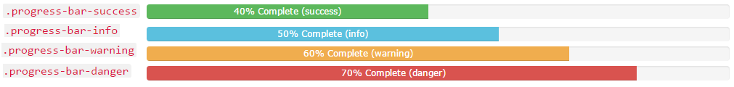
Few Bootstrap classes
Progress Bar: Here main is the progress class. Aria attributes is for screen readers and style:width gives the length of the color
To show the value 70% on it. Remove the span completely and jus put 70 %
Progress Bar stripped:
Animated Progress bar : moving - add class active.
<div class="progress">
<div class="progress-bar" role="progressbar" aria-valuenow="70" aria-valuemin="0" aria-valuemax="100" style="width:70%">
<span class="sr-only">70% Complete</span>
</div>
</div>

Slide 26
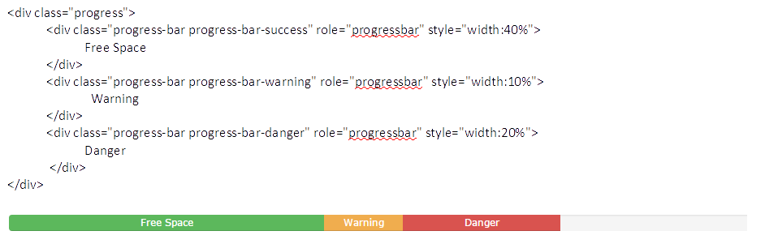
Few Bootstrap classes
Stacked progress bar: by placing multiple bars into the same <div class="progress">

Slide 27
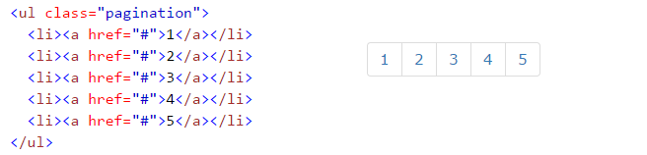

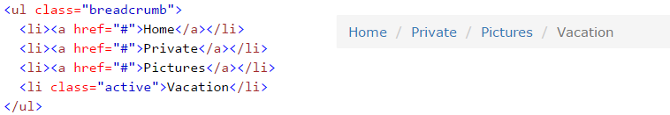
Few Bootstrap classes
Bootstrap Pagination: add the .pagination class to an <ul> element
To make it into active state:
Disable state
Pagination sizing : pagination-lg and pagination-sm
Breadcrumbs: Another form of pagination.

Slide 28
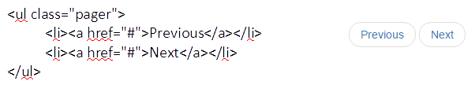
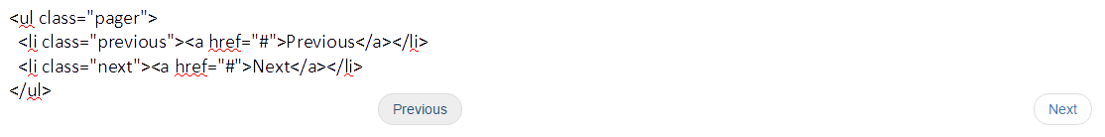
Few Bootstrap classes
Pager is also a form of pagination. Pager provides previous and next buttons (links). Class “.pager”
Align Buttons: Use the .previous and .next classes to align each button to the sides of the page

Slide 29
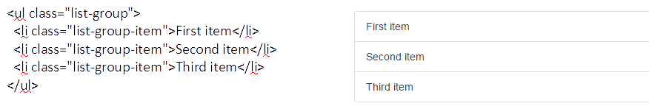
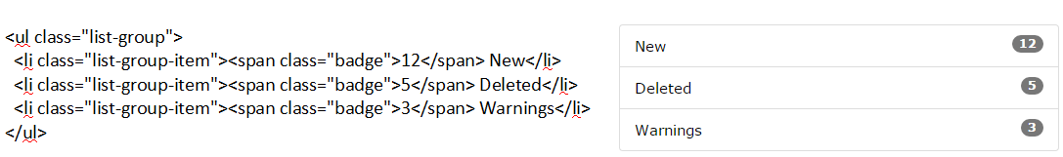
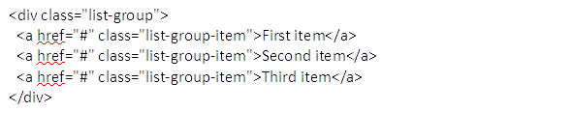
Few Bootstrap classes
List Groups: use an <ul> element with class .list-group, and <li> elements with class .list-group-item
List group with badges: The badges will automatically be positioned on the right
List group with links: The items in a list group can also be hyperlinks. This will add a grey background color on hover

Slide 30
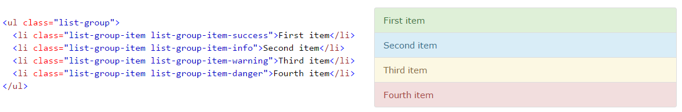
Few Bootstrap classes
Active fa the prev: use .active class
Disabled item:
Contextual Classes

Slide 31
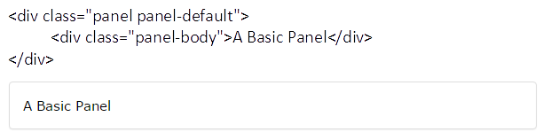
Few Bootstrap classes
Panel: is a bordered box with some padding around its content. .panel class, and content inside the panel has a .panel-body class
We have different classes for panel such as : panel-heading, panel-body, panel-footer and to group many panels together we have panel-group and also .panel-default, .panel-primary, .panel-success, .panel-info, .panel-warning, or .panel-danger

Slide 32
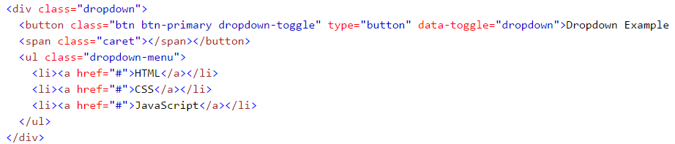


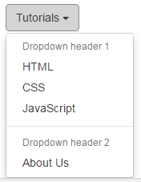
Few Bootstrap classes
Dropdowns: is a toggleable menu that allows the user to choose one value from a predefined list
The .dropdown class indicates a dropdown menu. To open the dropdown menu, use a button or a link with a class of .dropdown-toggle and the data-toggle="dropdown" attribute. The .caret class creates a caret arrow icon (), which indicates that the button is a dropdown. Add the .dropdown-menu class to a <ul> element to actually build the dropdown menu.
Dropdown divider:
Dropdown-header: .dropdown-header class is used to add headers inside the dropdown menu:

Slide 33
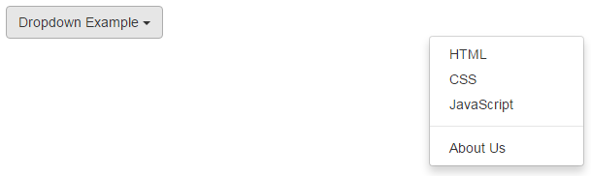
Few Bootstrap classes
Disable an Item: To disable an item in the dropdown menu, use the .disabled class <li class="disabled"><a href="#">CSS</a></li>
Position the drop-down: To right-align the dropdown, add the .dropdown-menu-right
<ul class="dropdown-menu dropdown-menu-right">
dropdown menu to expand upwards instead of downwards, change the <div> element with class="dropdown" to "dropup"
To help improve accessibility for people using screen readers, you should include the following role and aria-* attributes

Slide 34

Few Bootstrap classes
Basic Collapsible: when you want to hide and show large amount of content
The .collapse class indicates a collapsible element, this is the content that will be shown or hidden with a click of a button
To control (show/hide) the collapsible content, add the data-toggle="collapse" attribute to an <a> or a <button> element. Then add the data-target="#id" attribute to connect the button with the collapsible content (<div id="demo">).
For <a> elements, you can use the href attribute instead of the data-target attribute
For the above example use: <a href="#demo" data-toggle="collapse">Collapsible</a>
By default, the collapsible content is hidden. However, you can add the .in class to show the content by default:
<div id="demo" class="collapse in">
Check w3schools for Different examples using collapse.
Accordion: refer w3schools. Vry Impt

Slide 35
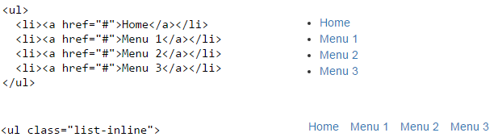
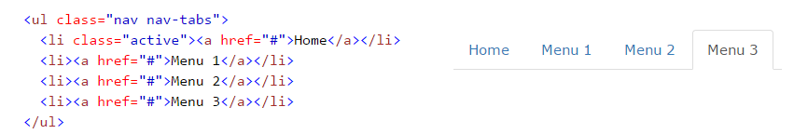
Tabs and pills
Tabs are created with <ul class="nav nav-tabs"> Tip: Also mark the current page with <li class="active">

Slide 36
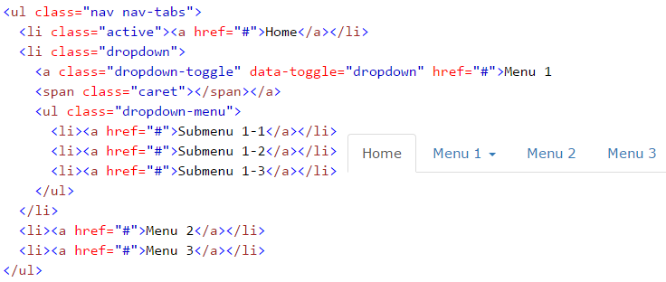
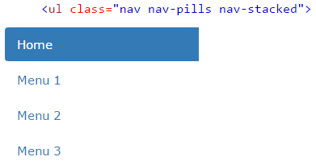
Few Bootstrap classes
Tabs with dropdown(same applies with pills- jus replace nav-tabs with nav-pills)
Pills. Instead of nav-bars replace with nav-pills
Vertical pills:

Slide 37
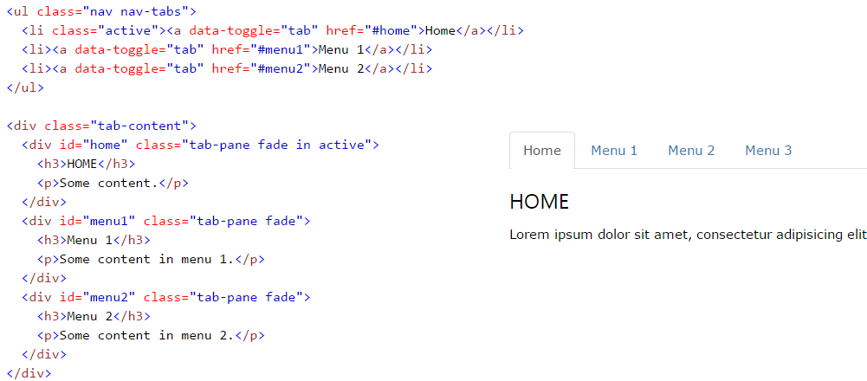
Few Bootstrap classes
To centre/justify the tabs use:
Toggleable/dynamic tabs: add the data-toggle="tab" attribute to each link. Then add a .tab-pane class with a unique ID for every tab and wrap them inside a <div> element with class .tab-content. If you want the tabs to fade in and out when clicking on them, add the .fade class to .tab-pane
Same applies to pills. Jus change data-toggle= “tab” to data-toggle= “pill”

Slide 38
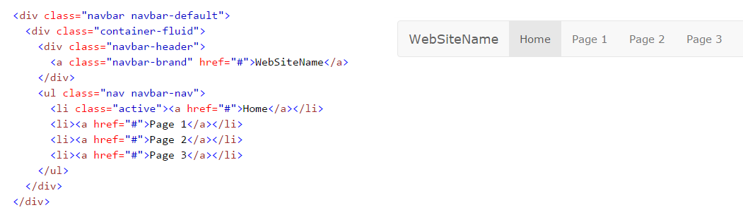

Navigation Bar
With Bootstrap, a navigation bar can extend or collapse, depending on the screen size.
To get black navbar Just change the .navbar-default class into .navbar-inverse
To fix navbar at the top or bottom of the page

Slide 39
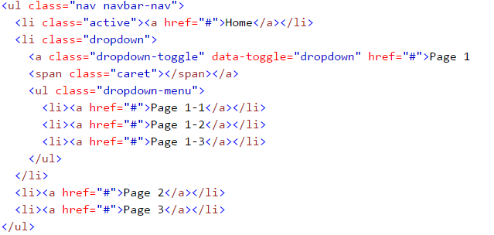
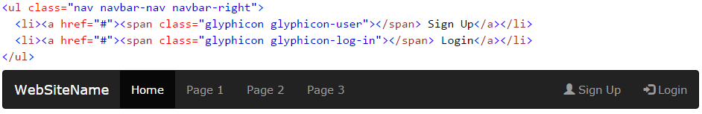
To add a drop-down to the navbar. For the above example:
Right-aligned nav bar - .navbar-right class is used to right-align navigation bar buttons. For the above example jus add another ul element

Slide 40
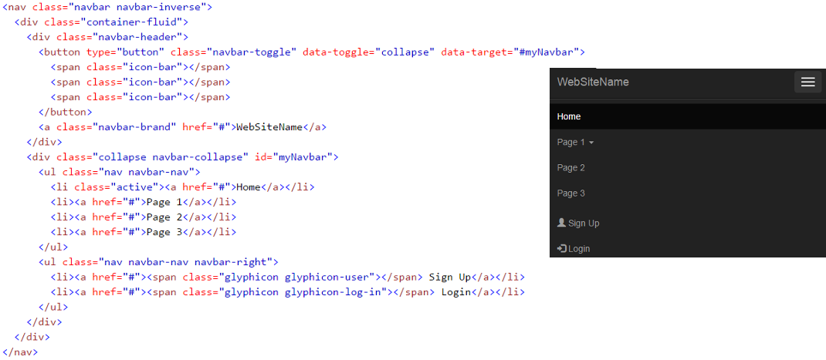
Collapsible navigation bar
On small screens hide the navigation bar; and only show it when it is needed

Slide 41
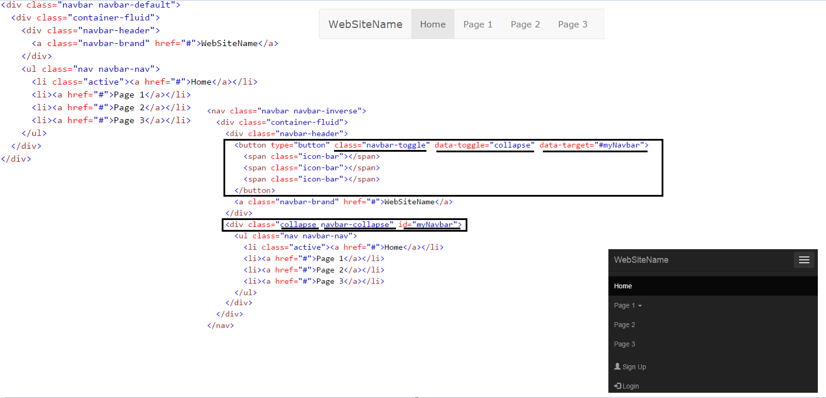

Slide 42
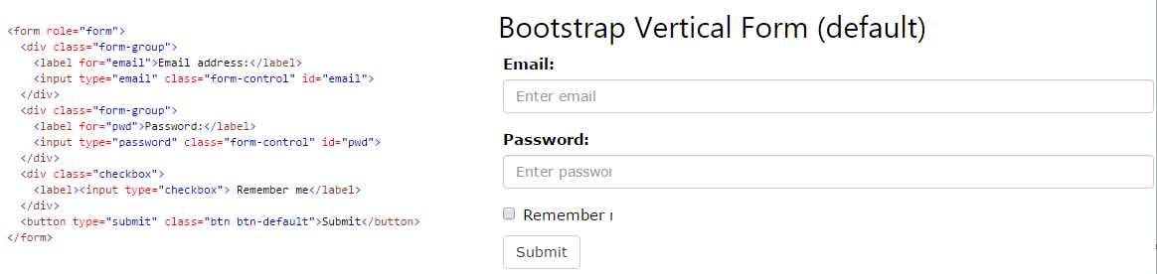
Bootstrap Forms
Form controls automatically receive some global styling with Bootstrap. All textual <input>, <textarea>, and <select> elements with class .form-control have a width of 100%
3 types of form layouts: vertical (default), horizontal and inline form
Rules for the form layouts: Always use <form role="form"> (helps improve accessibility for people using screen readers) Wrap labels and form controls in <div class="form-group"> (needed for optimum spacing) Add class .form-control to all textual <input>, <textarea>, and <select> elements

Slide 43
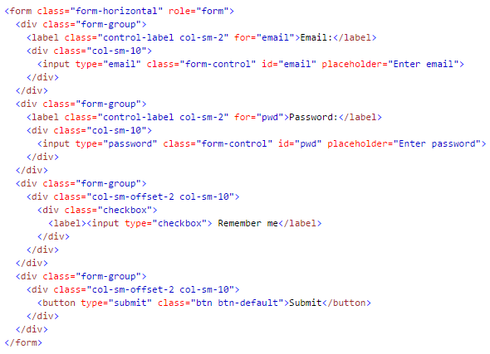
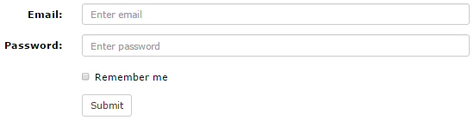
Inline forms: all of the elements are inline, left-aligned, and the labels are alongside. Note: This only applies to forms within viewports that are at least 768px wide! Additional rule for an inline form: Add class .form-inline to the <form> element
Tip: If you don't include a label for every input, screen readers will have trouble with your forms. You can hide the labels for all devices, except screen readers, by using the .sr-only class
Horizontal forms: stands apart from the other forms both in the amount of markup, and in the presentation of the form.
Additional rules for a horizontal form: Add class .form-horizontal to the <form> element Add class .control-label to all <label> elements
Tip: Use Bootstrap's predefined grid classes to align labels and groups of form controls in a horizontal layout.

Slide 44

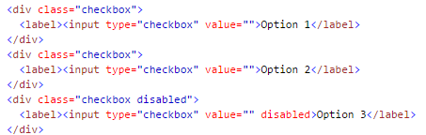



Bootstrap Form Inputs
Form controls: Bootstrap supports the following form controls: input, textarea, checkbox, radio, select
Input types: Bootstrap supports all the HTML5 input types: text, password, datetime, datetime-local, date, month, time, week, number, email, url, search, tel, and color.
EX:
Checkboxes:
Use the .checkbox-inline class if you want the checkboxes to appear on the same line

Slide 45
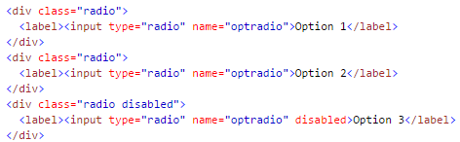

Radio Buttons: and for inline
More on form input controls: (Not necessary though) http://www.w3schools.com/bootstrap/bootstrap_forms_inputs2.asp
Input sizing in forms: Set the heights of input elements using classes like .input-lg and .input-sm. Set the widths of elements using grid column classes like .col-lg-*and .col-sm-*
Help Text (not necessary) http://www.w3schools.com/bootstrap/bootstrap_forms_sizing.asp diff examples are der, not necessary though.

Slide 46
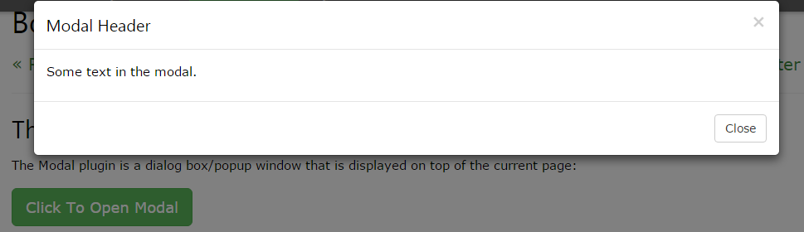
Bootstrap Carousel Plugin
It is a component for cycling through elements, like a carousel (slideshow). Plugins can be included individually (using Bootstrap's individual "carousel.js" file), or all at once (using "bootstrap.js" or "bootstrap.min.js"). [Carousels are not supported properly in Internet Explorer 9 and earlier (because they use CSS3 transitions and animations to achieve the slide effect]
http://www.w3schools.com/bootstrap/bootstrap_carousel.asp Refer through the code and explanation
Modal: The Modal Plugin is a dialog box/popup window that is displayed on top of the current page Check the explanation and the code-MUST.
Tooltip: The Tooltip plugin is small pop-up box that appears when the user moves the mouse pointer over an element. Requires jquery to attach tooltip to that element http://www.w3schools.com/bootstrap/bootstrap_tooltip.asp [even widout jquery it worked for me in w3schools platform.]
Bootstrap Popover Plugin:The Popover plugin is similar to tooltips; it is a pop-up box that appears when the user clicks on an element. The difference is that the popover can contain much more content. . Requires jquery to attach popover to that element http://www.w3schools.com/bootstrap/bootstrap_popover.asp

Slide 47
Bootstrap Scrollspy Plugin (Advanced): The Scrollspy plugin is used to automatically update links in a navigation list based on scroll position
The element with data-spy="scroll" requires the CSS position property, with a value of "relative" to work properly.
http://www.w3schools.com/bootstrap/bootstrap_scrollspy.asp check for the code and explanation
Data Affix: dint go thru.

Slide 48
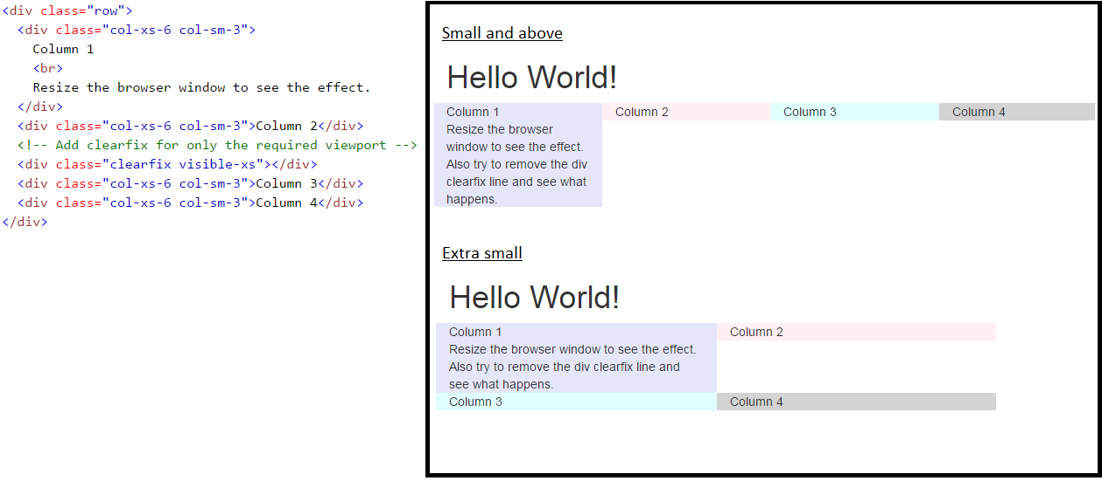
Clear Floats
Clear floats (with the .clearfix class) at specific breakpoints to prevent strange wrapping with uneven content

Slide 49
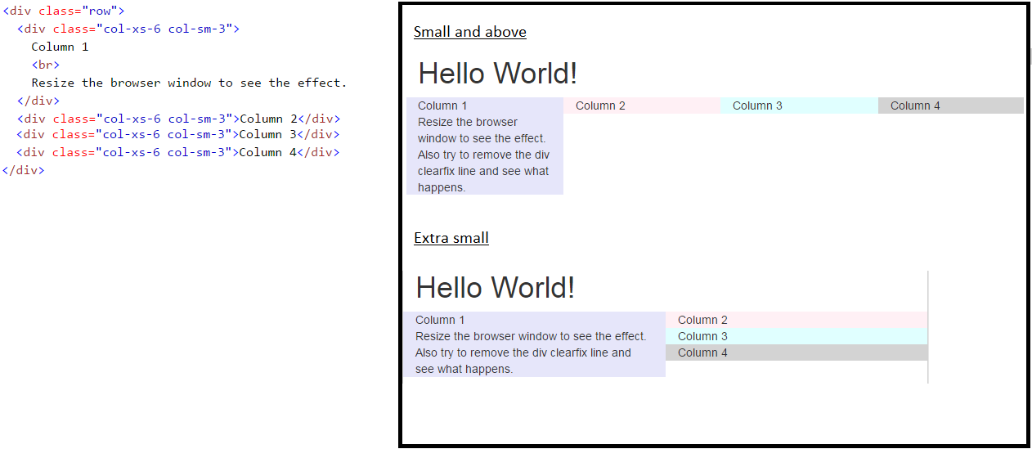
Without Clear Floats

Slide 50


Push and pull – change column ordering

Slide 52
Impt point
<link href=“ ” rel=“stylesheet”> wat is rel - rel attribute specifies the relationship between the current document and the linked document/resource.
Positon
STATIC: keeps the element in a normal flow of the pg . top, right, bottom, left and z-index properties do not apply
RELATIVE: is positioned relative to its normal position. Setting the top, right, bottom, and left properties of a relatively-positioned element will cause it to be adjusted away from its normal position. Other content will not be adjusted to fit into any gap left by the element.(that space will be visible and nothing can be put widin it)
ABSOLUTE: is positioned relative to the nearest positioned ancestor. Elements that are positioned relatively are still considered to be in the normal flow of elements in the document. In contrast, an element that is positioned absolutely is taken out of the flow and thus takes up no space when placing other elements.
FIXED: is positioned relative to the viewport, which means it always stays in the same place even if the page is scrolled. The top, right, bottom, and left properties are used to position the element.
[z-index property specifies the stack order of an element (which element should be placed in front of, or behind, the others). An element with greater stack order is always in front of an element with a lower stack order.]
[Bootstrap ported from Less to Sass for easy inclusion in Rails, Compass, or Sass-only projects.]
Precompiled means LESS files and compiled means the LESS files being converted into CSS files

Slide 53
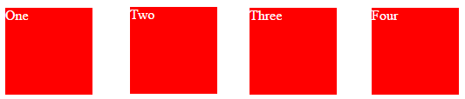
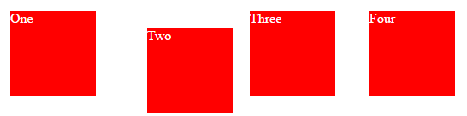

<div class="box" id="one">One</div>
<div class="box" id="two">Two</div>
<div class="box" id="three">Three</div>
<div class="box" id="four">Four</div>
RELATIVE
#two {
position: relative;
top: 20px;
left: 20px;
}
ABSOLUTE
#three {
position: absolute;
top: 20px;
left: 20px;
}

Slide 54
Impt contd
Add IE8 support for HTML5 and media queries
Your document should start with this: <!DOCTYPE html>
If it doesn't declare the doctype then the browser is meant to assume Quirks Mode, which is a compatibility mode for websites built when standards written and not implemented. It somewhat emulates how IE5 would render the page. This particular declaration above will trigger Standards Mode (so do most). It will also indicate a HTML5-compliant page, but that's far less important.
I don't know why Chrome would have displayed the site correctly without it, unless there is a way for the user to disable Quirks Mode in the browser. In any case, this is a simple change that will save you lots of headaches, and if it's still bad after declaring the doctype we can investigate other problems.
To use “standards” mode, simply specify one of the doctypes we mentioned before. When the browser encounters these doctypes it will enter standards mode and render according to the specified DTD(Document Type Definition) . If we omit the doctype entirely – and many existing pages on the web do not contain one – or specify an invalid one, then the browser will enter “quirks” mode and render the page in the traditional fashion
<!--[if lt IE 9]>
<script src=""></script>
<script src=""></script>
<![endif]-->

Slide 55

What is @media?
The @media rule is used to define different style rules for different media types/devices. In CSS2 this was called media types, while in CSS3 it is called media queries.
Media queries look at the capability of the device, and can be used to check many things, such as: width and height of the viewport width and height of the device orientation (is the tablet/phone in landscape or portrait mode?) resolution and much more Change the background-color if the viewport is 480 pixels wide or wider

Slide 56


Impt contd
.footer {
color: #7CB2E2;
background-color: black;
position: absolute;
width: 1440px;
bottom: 0px;
}
For footer I did :
In Collapse we have navbar-fixed-top, then we click on the expand button the content behind that is not pushed down rather it is overridden. To remove that functionality take out the class and then it works as expected. It basically pushes the content down.
Device width and viewport width

Slide 57
Impt contd
Handle mobile devices:
Not doing anything and let mobile users zoom in to read your website
Create a second website, like m.facebook.com, and redirect mobile devices to that website
Use responsive web design
http://marksheet.io/css-responsiveness.html VRY VRY VRY IMPT LINK AND MUST GO THROUGH
http://marksheet.io/ WHICH HAS MANY LESSONS
http://getbootstrap.com/getting-started/ REFER FOR MORE ON RESPOND JS AND IE-WINDOWS8 (later-not necessary and understandable though)

Slide 58

Questions
Check what shim and respond js can do
Why is bootstrap called a framework?
What is CSS source maps?
What is EDGE? Microsoft Edge (codename "Spartan") is a web browser developed by Microsoft and included in the company's Windows 10 operating systems, replacing Internet Explorer as the default web browser on all device classes.
In browsers we have diff modes like EDGE mode and document mode
What is <meta http-equiv="X-UA-Compatible" content="IE=edge"> . Something to do with getting the latest Edge mode in older versions of IE(8 and above I GUESS).
<!-- HTML5 Shim and Respond.js IE8 support of HTML5 elements and media queries -->
<!-- WARNING: Respond.js doesn't work if you view the page via file:// --> <!--[if lt IE 9] /home/Savitha/bootstrap-3.3.5-dist/css /home/Savitha/bootstrap-3.3.5-dist/js>
<script src = "https://oss.maxcdn.com/libs/html5shiv/3.7.0/html5shiv.js"></script>
<script src = "https://oss.maxcdn.com/libs/respond.js/1.3.0/respond.min.js"></script>
<![endif]-->

Slide 59
Questions
What is before after shown in the DOM?
20) Explain what media object in Bootstrap is and what are their types?Media objects in Bootstrap enables to put media object like image, video or audio to the left or right of the content blocks. Media element can be created using the class .media and the source is specified in using the class .media-object. Media-objects are of two types,They are of two types.media.media-list
Some of the standard carousel includes.carousel (options).carousel (‘cycle’).carousel (‘pause’).carousel (‘number’).carousel (‘prev’).carousel (‘next’)

Slide 60

Links
http://getbootstrap.com/getting-started/#download entire page and also all the other tabs such as css, js, components
http://www.sitepoint.com/twitter-bootstrap-tutorial-handling-complex-designs/
W3schools and tutorials point

Slide 61
To Do
Build a website similar to amazon or flipkart.
Check the themes/templates at w3schools for reference
Put all functionalities wid a sample syntax and keep the print out of the syntax ready
Build a website similar to amazon or flipkart.
Check the themes/templates at w3schools for reference
https://cleartax.in/save/rent

Slide 62
All new CS talk

Slide 63
Build a Website
Structure(HTML) element style(CSS) page behaviour(JS) – Building a page 1
Jumping btw html css js to build a page. All these movements btw files shows how much work a good website requires. Framework can help us with this process. Framwork is a set of tools that can assist us in building our website. Here Framework is a downloadable library of tools that assist with adding style and functionality to your website.
Most popular framework for styling and organizing the website – Bootstrap. Bootstrap is the most popular HTML, CSS, and JS framework for developing responsive, mobile first projects on the web. Bootstrap is an open-source Javascript framework developed by the team at Twitter for faster creation of device responsive web applications.Bootstrap was also programmed to support both HTML5 and CSS3
It can help us in – skip writing our css and js and lets us focus primarily on HTML and the structure of our site. Instead of using our own css/js files we use Bootstrap's files
To Get the Bootstrap framework go to link and download the bootstrap library 2: http://getbootstrap.com/Bootstrap – which contains the js and the css files we need Source codeSass
Under downloaded file talk abt CSS folder and the two files widin them : bootstrap.css and bootstrap.min.cssunder fonts: Bootstrap provides fonts that can be used as icons. Entire library of icons.under js – js file to add behaviour
Show to add Bootstrap into the HTML pg – link .
To add behaviour we need to add js to our pg and BS framework uses jquery framework(add jquery library) [now show the same HTML page wid BS]

Slide 64

We will b using classes to improve our HTML visually, but widout writing a single line of CSS
To centre our contents and pair of side margins we use BS's container class. BS's container class will responsively add margins, centre and wrap our content. If we drag the edge of our browser window(resizing the browser) we see that the margin will periodically reset when the width of the window crosses S,M,L boundary lines.
Widout container yo content might get into vry vry edge of the pg. To overcome we can use container-fluid class which adds a lil padding but still allows stretch it to the entire width of the pg. BS's container-fluid class allows fa stretching if it is desired on larger screens.
Basically it container will keep the content in the middle of the page
Till now we have added some structure to our content but it d pg luks so vertical n evry elem shows as a new row on our pg.Every elem shows as a new row on our pg. How can v use BS to use more of our horizintal space cuz We have oly 1 column which occupies a lot of horizontal space(here we will not talk abt the rows class yet. jus dat each elem is like a row n v ve oly one column yet) printscreen the pg on paint n explain. Bootstrap helps us solve the problem by dividing d pg into 12 columns
ROWS 3 – Horizontal grouping of dataCOLUMNS – vertical grouping of dataBS divides our pg into 12 columnsElement can span the columns in gridIf v add the no of columns in evry rowit equals to 12

Slide 65

then show the print screened img on paint

Slide 66

Wireframes:
To denote the no of columns each of the elements take up we can BS's col-*-* classes

Slide 67
After adding the columns it is difficult to tel which column is in which row thus we use BS row class. We can use math to calculate but we can use the class row
Using rows uses 15px more of the screen
Generally popular proportion fa columns is 9 columns + 3 columns
To add more space btw 2 elements we can use empty columns . But always use offset class to offset elements by given no of coulmns col-md-offset-1. This adds a column of padding to the left side of the second element.
But the md we have used wont work if we shrink the page. Cuz none of the columns that we r using will work below 992 px
The “small” grid size is used fa smaller resolutions, often tablets or compact laptop screens.
BS fits elements wer space is avaliable
Visibility hidden – hidden-sm,hidden-md. visible-md, visible-lg
For visible n hidden the inheritance dosn come into picture. If u say visible-sm den it shows oly in sm mode

Slide 68
Typography: The art and technique of arranging text on the pg to make written language most appealing. This is abt wat font, the size, the position, the color
pg dosn use browser's default font but uses BS's default font which can b seen in bootstrap.css . This is applied to the entire pg but can be overriden in two ways : 1.using tags 2.using typography css classes. using tags like h1,h2using classes like lead -increases the font size n d weight n also lil more space aron the elem(adds importance,margin and more emphasis)[well is sumthg not related to typography]using well classes – gives the element a gray background and a rounded gray border(this gives a mine inset effect)to add more padding we can use well-lg which makes it slightly largerto decrease the padding we can use well-sm
Another characteristic in typography involves text allignment. There r few classes which can help us in that
Allignment classes: BS has number of alignment classes fa txt: text-* text-centertext-justifytext-right/text-lefttext-nowrap
Icons- in downloaded lib we have fonts folder which has the 200 icons cald glyphicons. A font is mapping from a character code to some font img.[ex: code 41 maps to capital A]. BS has CSS classes dat we need to add to use icons. But under fonts folder there are many fonts thats cuz of web browsers. The .woff(web open font format) file is being used in many modern web-browsers. Other files r used fa older version of IE o other old browsersIcons shud oly be used on elems which has no text content and have no child elementsex:<i class=”glyphicon></i> [I is generally used for italic texts but it has become a std practice to use it for icons]add a class of glyphicon which use glyphicons font rather than the default font being applied to the entire pg.
<I class= “glyphicon glyphicon-briefcase”></i> here we use two classes to accomplish a single task(in BS in many places we can find that). glyphicon-briefcase says which icon to use and glyphicon class sets what font family we will usecheck http://getbootstrap.com/components/ for many glyphicons
To set the size of icons we cant use height and width as we do fa images. By default since BS sets body font size to 14px that also sets the size of the icons. To override use yo own css file. These icons r basically fonts

Slide 69
Footer
To get rid of bullet icons change the style of ul elem. To do that add class like:list-unstyled : this removes the bullet icons and also removes the marginlist-inline : same as above but also makes the li elems to show up horizontally n not vertically
To encourage ppl to click on them
Well gives an inset effect. Also border wid rounded corners. To add more padding well-lg. Wen shrinked it removes the border[dats gud]
Buttons:<button type=“button”>Button1</button> luks diff on diff browsers thus add BS class “btn” which will make it look same on diff browsers. This also adds padding around them and nice gray background but nothing happens wen you move over them and also small.To increase size we can add btn-lg – this will result in larger font and lil more padding . Similarly we have btn-xs btn-sm btn-lgdefault is btn-md . If u don’t specify nethg den it is assumed as btn-mdTo specify color :btn-default normal button wid white background, btn-primary,btn-danger.

Slide 70
Header
Widin container we will b using navigation bar using BS. Diff in navigation we will no longer be using grid sys(remove row n col-mds). Width will b determined by our content rather than our grid system .
Try the header with h1 itself instead of anchor. To this anchor we add navbar-brand. The ul elements will b next to the a elems.navbar-brand will float the text left and increase the font-size. This is place wer we can also put our websites’s logos(img o txt).
To clean the list of links i.e. the ul elems we can add a class of nav which tells that the list items i.e. li elems widin dis entire elems r links.it adds padding fa all of the navigation links.nav class is similar to btn o glyphicon which is used as the starting point to say that we r going to use a nav hea. We still need to add another class to tel wat type of navigation we wanna use.
Few nav modifiers: nav-pills – causes links to appear horizontallynav-tabs – causes tab nav barnavbar-nav – whixh causes the unordered list of links to appear inline horizontally. Similar to pills but widout rounded borders
To have our nav to b on d right separate from brand position we can add a class to the above two classes “navbar-right”<ul class=“nav navbar-nav navbar-right”></ul>
But to have nice background navigation bar which spreads to the entire pg. The major change hea is changin the div into navigation bar using BS’s navigation component. For this add a class called navbar to the div that contains the brand and the list of links. This class is sumthg lik btn. Inorder to add color jus add navbar-default to it which changes the links colors in the header and adds padding.Navbar-inverse for darker color schemes
In simple words the navbar is for the entire header and nav is for links within them)
But our navbar is stil not spread to the entire page that’s because it is widin n container. Replace dat wid placing the container div widin the div containing navbar navbar-default
We can have navbar ne-wer in the pg (in d middle, in d top, or bottom) we have class like navbar-static-top to position the navbar at the top of our pg. and also we have navbar-static-bottom to position at the bottom. We also have navbar-fixed-top n bottom which means that it is fixed even wen the pg is scrolled
PLUGINS – last 2 videos

Slide 71
Diff btw responsive and adaptive web designs
https://cdn.css-tricks.com/wp-content/uploads/2015/11/rwd-vs-adapt-example.gif pictorial diff
https://css-tricks.com/the-difference-between-responsive-and-adaptive-design/
Responsive websites respond to the size of the browser at any given point. No matter what the browser width may be, the site adjusts its layout (and perhaps functionality) in a way that is optimized to the screen. Is the browser 300px wide or 30000px wide? It doesn't matter because the layout will respond accordingly. Well, at least if it's done correctly!
Adaptive websites adapt to the width of the browser at a specific points. In other words, the website is only concerned about the browser being a specific width, at which point it adapts the layout.

Slide 72
slideshare
Bootstrap 3 - Sleek, intuitive, and powerful mobile first front-end framework for faster and easier web development. Bootstrap 3.
Bootstrap includes a responsive, mobile first fluid grid system that appropriately scales up to 12 columns as the device or viewport size increases
Features ● CSS resetting for cross browser compatibility ● Grid scaffolding for design ● Multi-screen support (responsive design) ● “Mobile first”, like jQuery Mobile ● And a really good looking UI framework

Slide 73
questions
Check if the img gets responsive or what class to be added to make it responsive? - It is not responsive
More abt Mobile-first in BS3. Diff btw BS2 and BS3 on the same. Wer in BS2 we had to write diff files fa mobiles
BS uses CSS media queries. More on that
Preprocessors: Bootstrap ships with vanilla CSS, but its source code utilizes the two most popular CSS preprocessors, Less and Sass. Quickly get started with precompiled CSS or build on the source.
More on shims for older browsers
More on HTML5 and CCS3
More on BS fluid grid systems
Is it a must that we need a container to wrap rows? The .row class is not required inside a .container, but it is a good idea to include it anyways when you start incase you want multiple rows later on. All that .row really does is make sure that all of the divs inside of it appear on their own line, separated from the previous and the following .rows. In short: .row defines a row of divs, like the name implies. Each one indicates a new line of divs, no matter if the above line is full or not.You should use wrap row in container or you'll have a problem with the negative margins that BS 3 uses for the row element. Basically the row is designed to be within a container. You can however use col-* alone w/o any container. Without the container it kind a works - but it shows a horizontal scroll bar at the bottom of the page. In all grid systems, there are gutters between each column. Bootstrap's system sets a 15px padding on both the left and the right of each column to create this gutter. The issue is that the first column should not have half a gutter on the left, and the last should not have half a gutter on the right. Rather than use some sort of .first or .last class on those columns as some grid systems do, they instead set the .row class to have negative margins that match the padding of the columns. This "pulls" the gutters off of the first and last columns, while at the same time making it wider.
Check how Classes can be applied directly to <iframe>, <embed>, <video>, and <object> element
text-justify dint work. If your text doesn't span more than one line, justifying doesn't do anything. Your text has to wrap to the next line, and then the FIRST line will be justified, but not the second.
More on role and aria-* attributes
How to include the plugins individually
What is quirks mode
How to talk Bootstrap wrt relative and adaptive
Bootstrap in landscape and Portrait. And is everythg wrt the viewport or the device [or browser]?

Slide 74

questions
Check what shim and respond js can do
Why is bootstrap called a framework?
What is CSS source maps?
What is EDGE? Microsoft Edge (codename "Spartan") is a web browser developed by Microsoft and included in the company's Windows 10 operating systems, replacing Internet Explorer as the default web browser on all device classes.
In browsers we have diff modes like EDGE mode and document mode
What is <meta http-equiv="X-UA-Compatible" content="IE=edge"> . Something to do with getting the latest Edge mode in older versions of IE(8 and above I GUESS).
<!-- HTML5 Shim and Respond.js IE8 support of HTML5 elements and media queries -->
<!-- WARNING: Respond.js doesn't work if you view the page via file:// --> <!--[if lt IE 9] /home/Savitha/bootstrap-3.3.5-dist/css /home/Savitha/bootstrap-3.3.5-dist/js>
<script src = "https://oss.maxcdn.com/libs/html5shiv/3.7.0/html5shiv.js"></script>
<script src = "https://oss.maxcdn.com/libs/respond.js/1.3.0/respond.min.js"></script>
<![endif]-->

Slide 75


Slide 76


Slide 77


Slide 78


Slide 79


Slide 80


Slide 81


Slide 82


Slide 83


Slide 84


Slide 85


Slide 86


Slide 87


Slide 88


Slide 89
Condensed notes

Slide 90
web
Web isn limited to one particular device or one environment. Web is universal. It must work with any form on info. It must also be accesible from any device. Our designs must work on universal web.
Web Design:Adaptive DesignResponsive Design
. Desktop optimize sites work on mobile device but u have to zoom in a lot and swipe a lot
If u have a website built fa desktop u can either 1. separate mobile site - using separate markup, separate style and separate content.2.Adaptive design - to adapt the site from desktop to mobile envi 3.Responsive design

Slide 91
Adaptive
Adaptive web design is for controlled adaptation i.e. If u know the device o the design context dat u need to design for and then design accordingly
Adaptive design dosn means it covers al of the web . It jus means that yo designing fa specific context like device o screen size o resolution. Wat it basically means u know wat it is n yo specifically targetting that context
BREAKPOINTS: wer yo design breaks down. It is typically the height and width of the target viewport. We have iphone, andriod, kindles , ipads (iphones height 480px and width 320px)
Responsive designs are fluid sites wid series of break points weras adaptive designs are selectively optimized fa d context yo targetting.

Slide 92
Responsive
layout adapts itself to different browser window sizes : all the values used are calculated proportionally to the viewport size, so when resizing, all the columns are resized, but the general layout stays the same.
Relative length units specify a length relative to another length property. Relative length units scales better between different rendering mediums
if u resize the element it wud b proportional o relative to its containing element. The site scales based on the size of the viewport
Responsive design provide continuity btw context. Optimal design experience whether u look in desktop environment o mobile environment
They r portable n accesible
All responsive r adaptive but all adaptive r not
BREAKPOINTS: context defines break points

Slide 93
Media queries
Media query is a CSS technique introduced in CSS3. The @media rule is used to define different style rules for different media types/devices.
It uses the @media rule to include a block of CSS properties only if a certain condition is true.
ou write additional CSS rules that are only applied in certain cases.

Slide 94
Mobile first
Mobile first focuses on:simplify contentprioritize layoutoptimize user experience
Yo space is much more valuable in a mobile design. You cant have filler materials , random photos o random materials, You have to prioritize
Mobile first gives you a great foundation fa responsive design.
In Bootstrap 3, mobile-first styles are part of the core framework
Mobile first styles can be found throughout the entire library instead of in separate files.

Slide 95
What is Bootstrap?
Jumping btw html css js to build a page. All these movements btw files shows how much work a good website requires. Framework can help us with this process. Framwork is a set of tools that can assist us in building our website. Here Framework is a downloadable library of tools that assist with adding style and functionality to your website.
most popular HTML, CSS, and JavaScript framework for developing responsive, mobile-first web sites.
One framework, every device. Bootstrap easily and efficiently scales your websites and applications with a single code base, from phones to tablets to desktops with CSS media queries. Bootstrap automatically adapts your pages for various screen sizes
Full of features , dozens of custom HTML and CSS components, and awesome jQuery plugins
Most popular framework for styling and organizing the website – Bootstrap. Bootstrap is the most popular HTML, CSS, and JS framework for developing responsive, mobile first projects on the web. Bootstrap is an open-source Javascript framework developed by the team at Twitter for faster creation of device responsive web applications.Bootstrap was also programmed to support both HTML5 and CSS3

Slide 96
What can Bootstrap do?
It can help us in – skip writing our css and js and lets us focus primarily on HTML and the structure of our site. Instead of using our own css/js files we use Bootstrap's files which will provide some pg styling n behaviour fa our site

Slide 97
Wat we will be building?
This includes thgs lik navigation bar n dropdown fa additional links. Also we will b designing the responsive websites in many devices. One code base which works on a desktop, tablet o phone wid minimal added work rqd
Talk abt the downloaded library.

Slide 98
Responsive
Responsive features: Bootstrap's responsive CSS adjusts to phones, tablets, and desktopsMobile-first approach: In Bootstrap 3, mobile-first styles are part of the core frameworkBrowser compatibility: Bootstrap is compatible with all modern browsers (Chrome, Firefox, Internet Explorer, Safari, and Opera)

Slide 99
Grid systems
Grids make the design more legible and better organized from design stand point
Bootstrap includes a responsive, mobile first fluid grid system that appropriately scales up to 12 columns as the device or viewport size increases. It includes predefined classes for easy layout options, as well as powerful mixins for generating more semantic layouts.
We have 12 columns across the pg. you can also group the columns together to create wider columns
Bootstrap's grid system is responsive, and the columns will re-arrange automatically depending on the screen size. On a big screen it might look better with the content organized in three columns, but on a small screen it would be better if the content items were stacked on top of each other.
We have four GRID CLASSES: xs (for phones)sm (for tablets)md (for desktops)lg (for larger desktops)
If medium has 2 divs with each 6 and 6(which is 50 50) then for smaller devices it takes the entire width (if nothing mentioned for). If large splits into 50-50, then for smaller and extra smaller it will stack vertically by 100%

Slide 100
Containers
To centre our contents and pair of side margins we use BS's container class. BS's container class will responsively add margins, centre and wrap our content. If we drag the edge of our browser window we see that the margin will periodically reset when the width of the window crosses S,M,L boundary lines
Bootstrap requires a containing element to wrap site contents and house our grid system. You may choose one of two containers to use in your projects. Note that, due to padding and more, neither container is nestable. Use .container for a responsive fixed width container. Use .container-fluid for a full width container, spanning the entire width of your viewport
For this show example widout the width set to some value
Widout container yo content might get into vry vry edge of the pg. To overcome we can use container-fluid class which adds a lil padding but still allows stretch it to the entire width of the pg. BS's container-fluid class allows fa stretching if it is desired on larger screens.
Basically it container will keep the content in the middle of the page
After adding the columns it is difficult to tel which column is in which row thus we use BS row class.

Slide 101
Rows n columns
Rows must be placed within a .container (fixed-width) or .container-fluid (full-width) for proper alignment and padding.
Use rows to create horizontal groups of columns.
Content should be placed within columns, and only columns may be immediate children of rows.
Predefined grid classes like .row and .col-xs-4 are available for quickly making grid layouts.
Columns create gutters (gaps between column content) via padding. That padding is offset in rows for the first and last column via negative margin on .rows.
The negative margin is why the examples below are out dented. It's so that content within grid columns is lined up with non-grid content.
Grid columns are created by specifying the number of twelve available columns you wish to span. For example, three equal columns would use three .col-xs-4.
If more than 12 columns are placed within a single row, each group of extra columns will, as one unit, wrap onto a new line.
Grid classes apply to devices with screen widths greater than or equal to the breakpoint sizes, and override grid classes targeted at smaller devices. Therefore, e.g. applying any .col-md-* class to an element will not only affect its styling on medium devices but also on large devices if a .col-lg-* class is not present.

Slide 102
Typography
The art and technique of arranging text on the pg to make written language most appealing. This is abt wat font, the size, the position, the color
pg dosn use browser's default font but uses BS's default font which can b seen in bootstrap.css . This is applied to the entire pg but can be overriden in two ways : 1.using tags 2.using typography css classes.

Slide 103
Navigation
<div class="row"> <div class="col-md-12"> <h1>This is the main header</h1> </div>
</div>
1.We will b replacing this entire row wid a navigation bar – we will no longer b using a grid sys thus we can remove the class row n col-md alltogether. Why not using grid? We want width in our navigation to be determined by our content rather than our grid system.
2.Wen v add ul – we get the default bullet icons n unstyled unordered lists
Wen v add navbar-brand we say that the the txt o img in it is a brand n will b positioned to the left side of the pg. Using navbar-brand is the best place to put the site logo
Add class nav to the ul elems which specifies that the list items widin this entire elems r links(adds more padding). Nav is similar to btn o glyphicon wer we get to add many classes after . To tel wat type of navigation we wanna use nav modifiers .
Remove nav-tabs from the ppt
Add class navbar-nav which is similar to nav-pills except it removes the rounded corners
To place our link towards right side separate from our brand position – navbar-right
To let the navigation to have nice background n to stretch across the pg . To do this change the div into a navigation bar using Bootstraps navigation component. For this add class navbar which contains our brand n our links. But ths dosn do much(it is juslik btn). Thus add another class cald navbar-default which gives us a vry nice grey background which is one of the theme. Thers is anther theme cald navbar-inverse.
But it dosn stretch acorss the pg , instead it has been centered thats cuz of the container. But we need to separate our navigation from our container .

Slide 104
Navigation
Thus move the container class to a new div. Which still will centre the content. Navbar static n fixed dont do
To make our navigation collapsible. Show the icon(samplepg). To do this we need to add some behaviour to our website. Css is for styling. Fa behaviour we need js(like responding in some way wen an element in clicked). To switch the ul elements btw seeing the links and seeing the icons, we need to add a class called collapse which will completely hide the navigation in all screen sizes. To make it hide oly in extra small screen we have a class called navbar-collapse which makes it show in small screens n above
To create the icon first create a button above the links.
To position the button twds the right add navbar-toggle to the button. To pull the buttons we have many classes such as pull-left pull-right(dont do)
To get the icons add class: <span class="icon-bar"></span> 3 times
The button dosn work n to make to functional we need to add behaviour using js. Collapse is for hiding n showing n thus wen the button is clicked we need to remove the collapse class to make the links visible n wen clicked again we need to add the collapse class again so that it hides the links. To do that we need bootstraps js collapse plugin. To use bootstrap js plugin we shud additional data attributes. Thus we need to specify which class to toggle we have data-toggle= “collapse” which means that this will add n remove the “collapse” class to some element in the pg. We need to add another attr data-target which is a css selector to select the elem on pg
To make the brand n button in one row n ul in another row we need to wrap them in new elems. Wrap the brand n button in a div wid the class navbar-header

