Slide 1
Creational Design Patterns
by
Tenneti Venkata Suresh(159231)
Foundation TEG
02/12/13

Slide 2
Design Patterns
Creational Design Patterns
Abstract Factory
Builder
Factory Method
Protoype
Singleton

Slide 3
Creational Design Patterns
Objects created in a normal way may not be well suited for a problem at hand.
Creational design patterns focus on handling object creation mechanisms where objects are created in a manner suitable (i.e., controlling the creation process) for the requirement we're working in.
Some of the patterns under this category are : Prototype, Factory method, Abstract factory, Singleton and Builder.

Slide 4
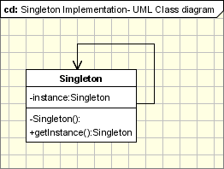
Singleton
Singleton
  Ensure that only one instance of a class is created and provide a global access point to the object.
When to use
  Should be used when we must ensure that only one instance of a class is created and when the instance must be available through all the code.
Common Usage
  Log class objects
  Configuration classes
  Accessing resources in shared mode

Slide 5
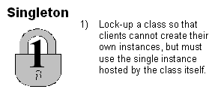
Singleton

Slide 6
Singleton
Make the class responsible for controlling the object creation.
  Define a private static attribute in the 'singleton' class
  Define a public static accessor function in the class
  Do “lazy initialization” (creation on demand) in the accessor function.
  Define copy constructor, assignment operator to be private or protected if necessary.
  Clients may now only use the accessor function to refer to the single object.
Singletons does not remove away the problem of global variables; in fact they are the same with a different name.

Slide 7
Factory method
Factory method
  Defines an interface for creating objects, but lets subclasses to decide which class to instantiate. &
  Refers to the newly created object through a common interface.
When to use
  The client need not be aware of the classes responsible for the objects it needs.
  Instead the client simply knows that it can address the object it needs with a generic name.

Slide 8
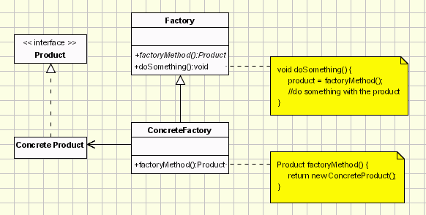
Factory method

Slide 9
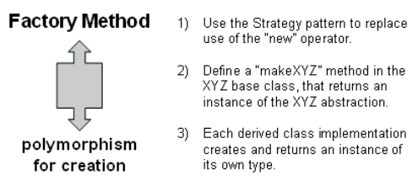
Factory method

Slide 10
Abstract Factory
Provides an interface for creating families of related or dependent objects without specifying their concrete classes.
Abstract Factory pattern lets a class defer instantiation to subclasses.
The client asks the abstract factory for creation of an object and gets a pointer of type superclass (thus the client being completely ignorant of the object creation process).
Should be used when the client should not know about the implementation of the concrete classes.
Commonly used in creation of the frameworks in a library.

Slide 11
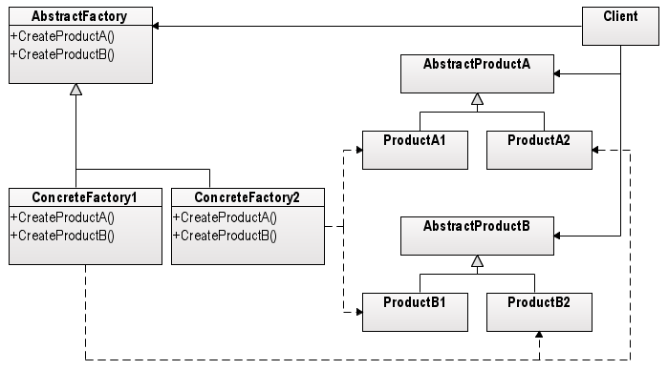
Abstract Factory

Slide 12
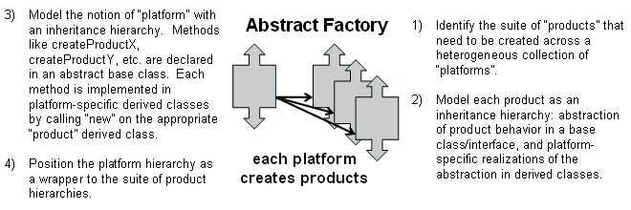
Abstract Factory

Slide 13
Builder
Complex objects are made of parts produced by other objects that need special care when being built.
An application might need a mechanism for building complex objects that is independent from the ones that make up the object.
When to use
  We want to construct a complex object, however we do not want to have a complex constructor member or one that would need many arguments.

Slide 14
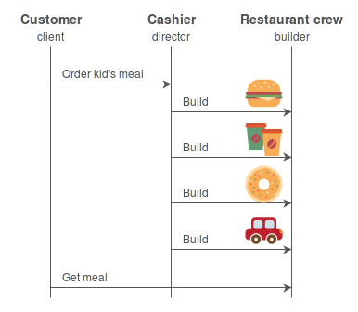
Builder

Slide 15
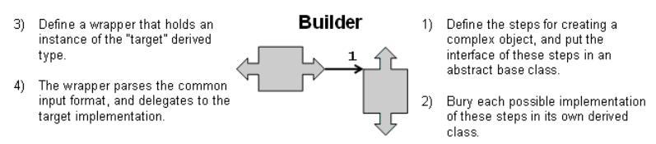
Builder
Solution
  Define an intermediate object whose member functions define the desired object part by part before the object is available to the client.
  Builder pattern lets us defer the construction of the object until all the options for creation have been specified.

Slide 16
Prototype
Prototype
  A prototype pattern is used when the type of objects to create is determined by a prototypical instance, which is cloned to produce new objects.
  The pattern is used, for example, when the inherent cost of creating a new object in the standard way i.e., using the new operator is very expensive for the application.
When to use
  Say you wanted to copy/replicate a set of objects to a different disk/storage location you can go for a prototype

Slide 17
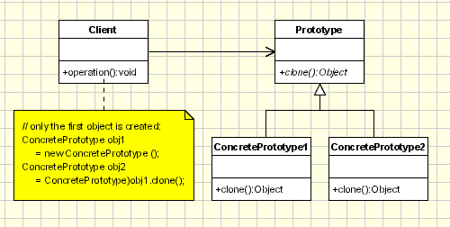
Prototype

Slide 18
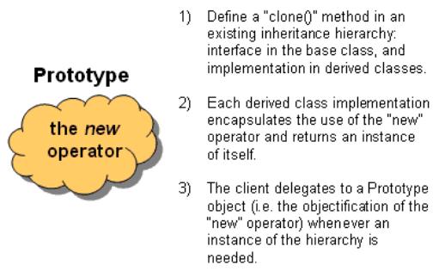
Prototype

