Slide 1
Behavioral Design Patterns
by
Tenneti Venkata Suresh(159231)
Foundation TEG
02/12/13

Slide 2
Behavioral Design Patterns
Behavioral Design Patterns
Command
Iterator
Mediator
Observer

Slide 3
Behavioral Design Patterns
The behavioral design patterns are the ones that identify common communication patterns between objects and realize these patterns.
They focus on improving or streamlining the communication between the disparate objects in a system.
By doing so, these patterns increase flexibility in carrying out this communication.
Behavioral patterns are concerned with the assignment of responsibilities between objects, or, encapsulating behavior in an object and delegating requests to it.

Slide 4
Command Pattern
Command pattern encapsulates a request as an object.
Objectification of an invocation of a method on an object.
An object-oriented callback.
Command pattern decouples the object that invokes the operation from the one that knows how to perform it.
To achieve this separation, the designer creates an abstract base class that maps the receiver and the action (a pointer to a member function).
The clients treat the command objects as a “black box” and simply call the execute() method when they need the object's service.

Slide 5
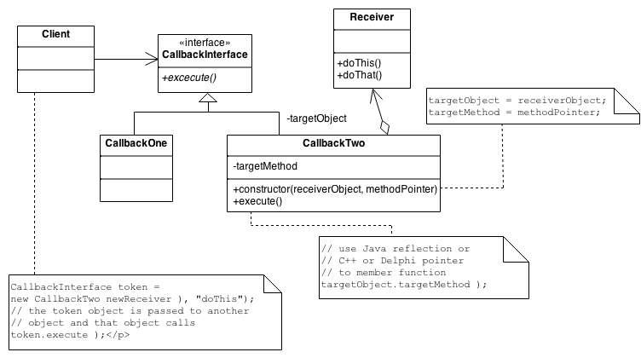
Command Pattern

Slide 6
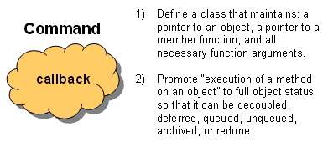
Command Pattern

Slide 7
Iterator Pattern
Iterator design pattern provides a way to access the elements of an aggregate object sequentially without exposing its underlying representation.
Promotes the traversal of a collection to “full object status”.
When to use
  Need to “abstract” the traversal of different data structures so that algorithms can be defined that are capable of interfacing with each transparently.
  A way to access elements without exposing its internal structure.

Slide 8
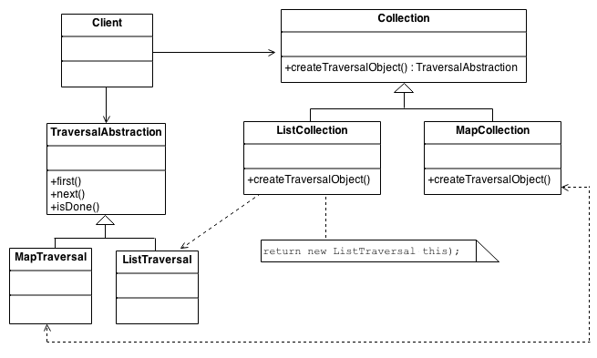
Iterator Pattern

Slide 9
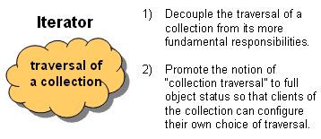
Iterator Pattern

Slide 10
Mediator Pattern
Mediator design pattern defines an object that encapsulates how a set of objects interact.
Mediator promotes loose coupling by keeping objects from referring each other explicitly, and lets you vary their interaction independently.
Design an intermediary to decouple the relationships between peers.
When to use : We want to design reusable components, but dependencies between the potentially reusable pieces demonstrate the “spaghetti code”

Slide 11
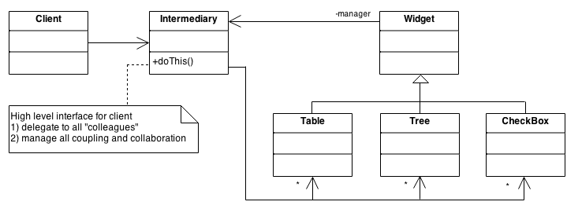
Mediator Pattern

Slide 12
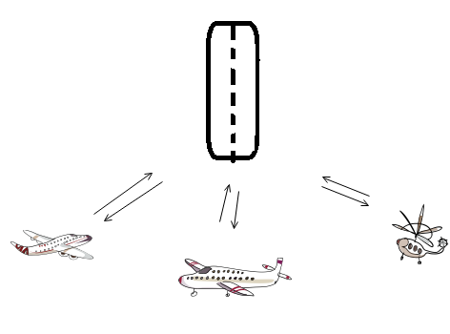
Mediator Pattern

Slide 13
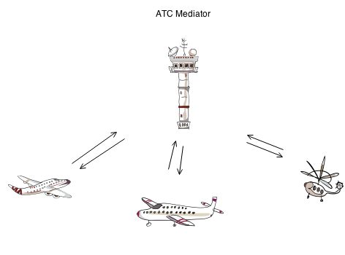
Mediator Pattern

Slide 14
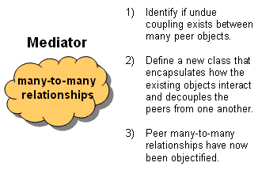
Mediator Pattern

Slide 15
Observer Pattern
Observer design pattern defines a one-to-many dependency between objects so that when one object changes state, all its dependents are notified and updated automatically.
Two components are involved – Subject and Observers.
The subject holds the data/business logic and the observers are interested in the changes in the data/business logic.
Observers register themselves with the Subject as they are created.
Whenever the Subject changes, it broadcasts to all registered Observers that it has changed.

Slide 16
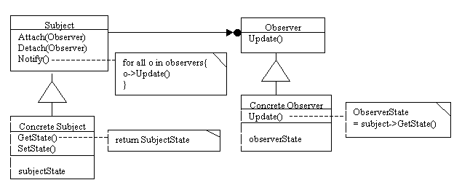
Observer Pattern

Slide 17
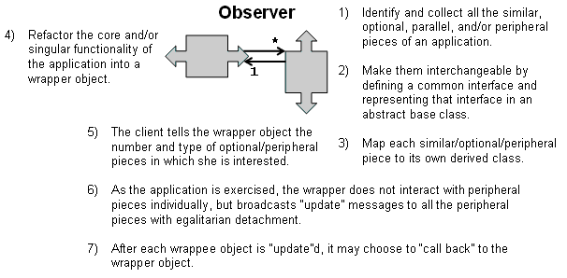
Observer Pattern

