Slide 1
Structural Design Patterns
by
Tenneti Venkata Suresh(159231)
Foundation TEG
02/12/13

Slide 2
Structural Design Patterns
Structural Design Patterns
Adapter
Bridge
Proxy
Composite

Slide 3
Structural Design Patterns
Structural patterns are concerned with object composition and typically identify simple ways to realize relationships between different objects.
They help ensure that when one part of a system changes, the entire structure of the system doesn't need to do the same.
Patterns that fall under this category include : Adapter, Bridge, Composite and Proxy.

Slide 4
Adapter Pattern
To convert the interface of a class into another interface clients expect.
Adapter lets classes work together that could not otherwise because of incompatible interfaces.
Adapter is about creating an intermediary abstraction that translates, or maps, the old component to the new system.
Clients call methods on the Adapter object which redirects them into calls to the old component.
This strategy can be implemented either with inheritance or with aggregation.

Slide 5
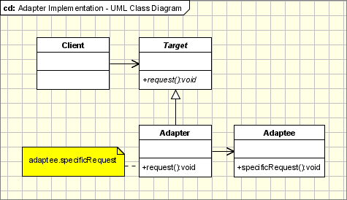
Adapter Pattern

Slide 6
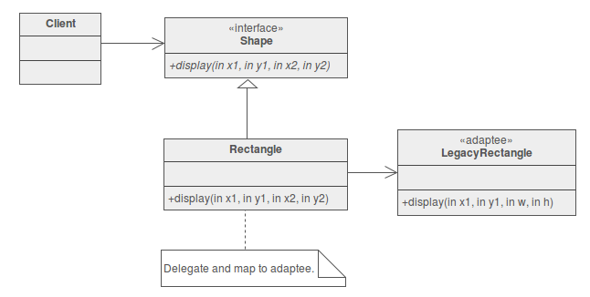
Adapter Pattern

Slide 7
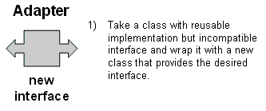
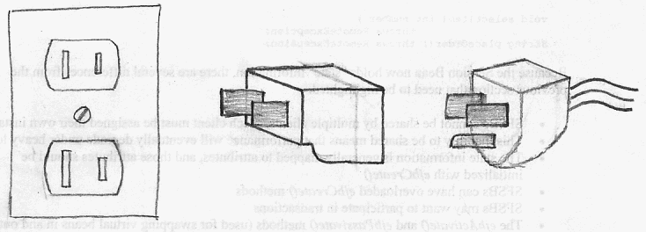
Adapter Pattern

Slide 8
Bridge Pattern
Decouple an abstraction from its implementation so that the two can vary independently.
Decompose the component's interface and implementation into orthogonal class hierarchies.
Publish the interfaces through an inheritance hierarchy, i.e., have a specialization of the interfaces.
Let implementation have its own inheritance hierarchy.
Use the Bridge pattern when you have a proliferation of classes on the scale of m x n where m represents a list of features and n represents a list of platforms.

Slide 9
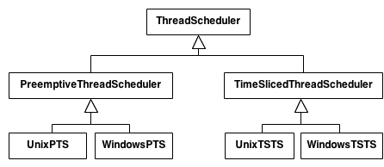
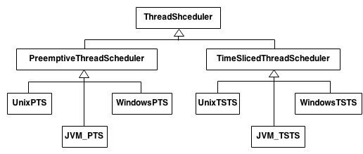
Bridge Pattern

Slide 10
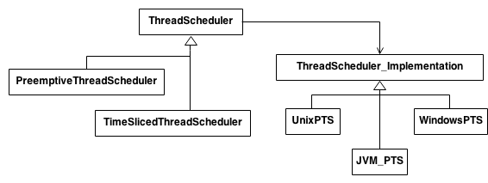
Bridge Pattern

Slide 11
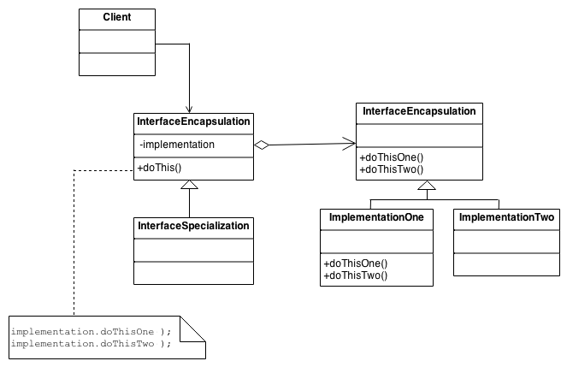
Bridge Pattern

Slide 12
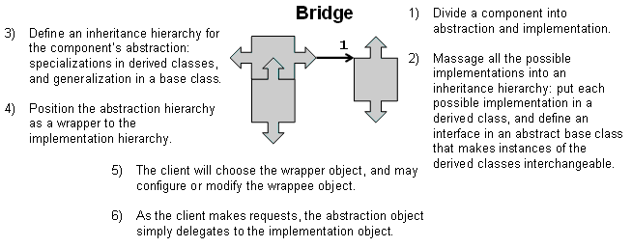
Bridge Pattern

Slide 13
Composite Pattern
Composite Pattern treats the elements alike whether they are individual units or themselves a collection of individual units.
Examples:
  Taking a parlance from the Unix/Linux file system where everthing is treated as a file. The directory too is treated as a file though it is a collection of few files.
  Menu is a collection of menu items, and some menu items may hold a menu again.
Compose objects into tree structures to represent individual/collection hierarchies.

Slide 14
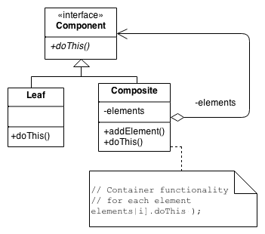
Composite Pattern

Slide 15
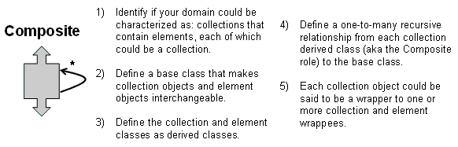
Composite Pattern

Slide 16
Proxy Pattern
Proxy Pattern adds an extra level of indirection to support distributed or controlled access.
Example :
  Application has objects which are resource hungry.
  Would like to design the application such that the objects are instantiated only when they are actually required/requested by the client.
  A well developed library of functions is available. However we want to have a controlled way of calling the functions/restrict calling the functions with invalid parameters.

Slide 17
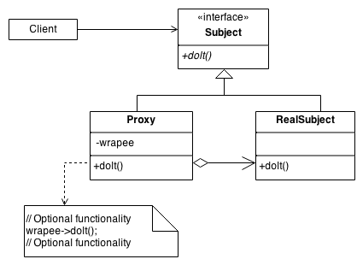
Proxy Pattern

Slide 18
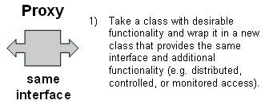
Proxy Pattern

