Slide 1
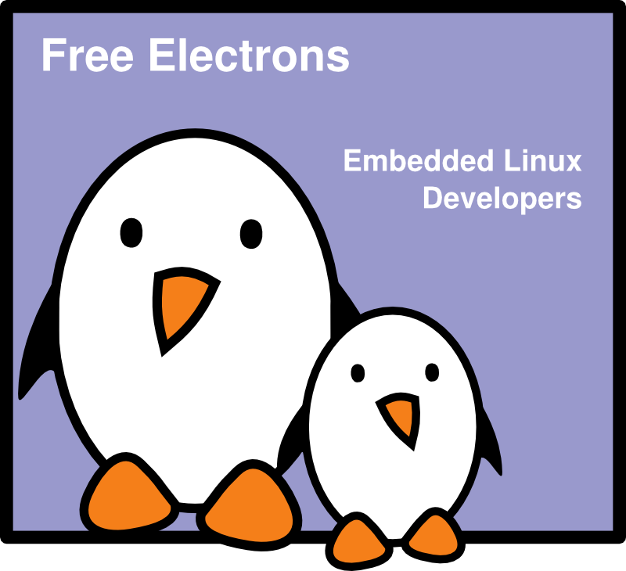
SSH
SSH
Thomas Petazzoni
Free Electrons

Slide 2




Rights to copy
© Copyright 2008-2009, Free Electrons
feedback@free-electrons.com
Document sources, updates and translations: http://free-electrons.com/docs/ssh
Corrections, suggestions, contributions and translations are welcome!
Latest update: Sep 14, 2009
Attribution – ShareAlike 3.0
You are free
to copy, distribute, display, and perform the work
to make derivative works
to make commercial use of the work
Under the following conditions
Attribution. You must give the original author credit.
Share Alike. If you alter, transform, or build upon this work, you may distribute the resulting work only under a license identical to this one.
For any reuse or distribution, you must make clear to others the license terms of this work.
Any of these conditions can be waived if you get permission from the copyright holder.
Your fair use and other rights are in no way affected by the above.
License text: http://creativecommons.org/licenses/by-sa/3.0/legalcode

Slide 3
Introduction
SSH stands for Secure SHell
SSH is a secure communication protocol that allows remote login, file transfer and port tunneling, normalized by RFC 4251, 4252, 4253 and 4254.
Replacement for telnet, rlogin, rsh, etc.
On Linux, the main implementation is OpenSSH, with both the server and client programs
A smaller implementation for embedded systems called Dropbear is also available
On Windows, Putty is one of the free SSH client available.

Slide 4
Installation and basic usage
OpenSSH is available as a package in all GNU/Linux distributions
On Ubuntu, two packages are available
  openssh-client, the client programs
  openssh-server, the server program
Connecting to an SSH server is as simple as
ssh username@hostname
ssh will prompt for the user password and log in to the remote system.

Slide 5
File transfer and X forwarding
Files can be transferred using the scp client program
scp myfile1 myfile2 \ username@hostname:~/dest/directory/
scp -r mydirectory user@host:~/dest/
With ssh -X option, one can tell ssh to enable X11 forwarding
  It allows graphical applications run on the remote host to be displayed on the local screen
  On the server, X11Forwarding must be enabled in the configuration file /etc/ssh/sshd_config.

Slide 6
Remote execution
ssh not only allows to connect to a remote host, but also allows remote execution of commands
  ssh user@host ls
  This is very useful in shell scripts, for example
ssh is also used by other programs as a transport layer
  rsync, the synchronisation tool, can work over ssh
  rsync -e ssh ~/work user@workhost:~/work
  CVS, Subversion and most of the version control tools can work over SSH

Slide 7
Skipping the password with keys
An interesting feature of SSH is that you can bypass the password step by using cryptographic keys
First, generate a private and public SSH key using
ssh-keygen -t dsa
It will prompt you for a passphrase, which will be required to «unlock» your private key everytime you use time
The key has been generated in
  ~/.ssh/id_dsa, the private key, that no one should have access to
  ~/.ssh/id_dsa.pub, the public key, that you can transfer publicly to everybody

Slide 8
Skipping the password with keys (2)
Now, you need to transfer the public key to the hosts you want to connect to
  ssh-copy-id user@host
The public key has been transferred to the remote host, and you should see it in ~/.ssh/authorized_keys on the remote host
Trying to login to the remote host should ask you the passphrase of the private key
This allows to replace our dozens of different passwords by a single passphrase, which is easier to remember.

Slide 9
Skipping the password with keys (3)
ssh-agent allows to avoid giving the passphrase at every login. It keeps the passphrase in memory, either forever or for a limited time
Run the agent: $(eval ssh-agent)
  Will run the ssh-agent program
  Will set a few environment variables so that the other ssh programs can connect to the agent
Give the passphrase to the agent: ssh-add
The other ssh programs can now login to remote hosts that know about your public key without entering the password

Slide 10
Skipping the password with keys (4)
The environment variables set by ssh-agent disappear when you exit the current shell
The best solution is to start the ssh-agent before starting the X server so that all your applications will have access to these environment variables
This is usually done by default on most distributions, including Ubuntu
  The file /etc/X11/Xsession.options sets the use-ssh-agent option
  A script in /etc/X11/Xsession.d/ starts the agent if the use-ssh-agent option is set

Slide 11
Skipping the password with keys (5)
The process of telling the agent your passphrase can be further improved by
  Installing a graphical ssh-add program: ssh-askpass-gnome for Gnome or ksshaskpass for KDE (only available in the next Ubuntu version)
  Running ssh-add automatically when the graphical environment starts. The exact configuration depends on your window manager.

Slide 12
Port tunneling
SSH can also be used to tunnel ports
Create a local port that connects to a remote host through a SSH connection to another host
  ssh -L 12345:localhost:25 user@host
  Any connection on the local port 12345 will in fact reach port 25 on the destination, through an encrypted tunnel
Create a remote port that connects to a host through a SSH connection to localhost
  ssh -R 4242:kernel.org:80 user@host
  Any connection on the remote host port 4242 will in fact reach port 80 of kernel.org through an encrypted tunnel

Slide 13
Configuration file
SSH stores a configuration file in ~/.ssh/config
It can be used to set global options, but also per-host options, like
  Host openmoko
  HostName 192.168.0.202
  User root
Using these options, running “ssh openmoko” will connect automatically to IP 192.168.0.202 with the root login.

Slide 14


Practical lab – Using SSH
Time to start Lab !
Ask your neighbor to create an account for you
Login to your neighbor system using ssh
Set up the keys to login without entering any password

Slide 15
Thanks
To people who sent corrections, suggestions or improvements
Guillaume Lelarge

