Slide 1
E-COMMERCE
SALES & CUSTOMER ANALYTICS
Data-driven analysis of sales, profitability, returns and customer patterns
Python • Pandas • Matplotlib • Seaborn • Power BI • Git & GitHub
Internship Final Project
Twisha Thakkar

Slide 2
1. Project Overview
Understanding the business question and analytical approach
DATASET
PROJECT TYPE
OUTPUT
34,500 records
E-commerce analytics
Dashboard + insights
17 columns covering orders, products, customers and delivery.
Sales, customer, profitability and returns analysis.
Python EDA, five visualizations and an interactive Power BI dashboard.
Project Objectives
Workflow
• Prepare and validate a real-world e-commerce transaction dataset
• Identify sales, profitability, return and customer patterns
• Build meaningful visualizations and an interactive dashboard
• Convert findings into actionable business recommendations
• Data collection → inspection → cleaning
• Exploratory data analysis and correlation analysis
• Visualization and KPI development
• Power BI dashboard → business insights → recommendations
E-Commerce Sales & Customer Analytics • 2

Slide 3
2. Problem Statement
What the analysis is designed to solve
Business Challenge
Key Questions
• E-commerce transactions contain multiple dimensions such as category, region, payment method, returns and customer attributes.
• Raw transaction data alone makes it difficult to quickly identify strong and weak business areas.
• The project converts raw records into clear metrics, trends and visual evidence for decision-making.
• Which product categories generate the most sales and profit?
• How do sales change across regions and months?
• Which categories have weaker profitability?
• What is the overall and category-wise return rate?
• What actions can improve revenue and profitability?
E-Commerce Sales & Customer Analytics • 3

Slide 4
3. Tools & Methodology
From raw transactions to business-ready insights
01 Data
02 Prepare
03 Analyze
04 Visualize
05 Dashboard
Kaggle dataset
34,500 × 17
Validate types
Check quality
EDA + statistics
Correlation + outliers
5 meaningful charts
Trend & comparisons
Power BI KPIs
Filters & visuals
Python
Pandas
Matplotlib / Seaborn
Power BI
Git & GitHub
Data Quality Checks
• No missing values • No duplicate rows • Date converted to datetime • Invalid numeric values checked • Genuine negative profit margins retained
E-Commerce Sales & Customer Analytics • 4

Slide 5
4. EDA Findings
Key patterns discovered during exploratory analysis
TOTAL SALES
TOTAL ORDERS
AVG. PROFIT MARGIN
RETURN RATE
≈ 5.87M
≈ 35k
28.12
0.06%
Major Findings
Trends & Data Behavior
• Electronics is the strongest sales category with approximately 3.32M in sales.
• Electronics also has a high average profit margin of approximately 55.72.
• Grocery sales are much lower, at approximately 82K.
• Grocery has a negative average profit margin of approximately -2.26.
• Sales fluctuate over time, with December 2024 reaching roughly 278K.
• Profit margin contains outliers; these were retained because they may represent genuine business losses.
E-Commerce Sales & Customer Analytics • 5

Slide 6
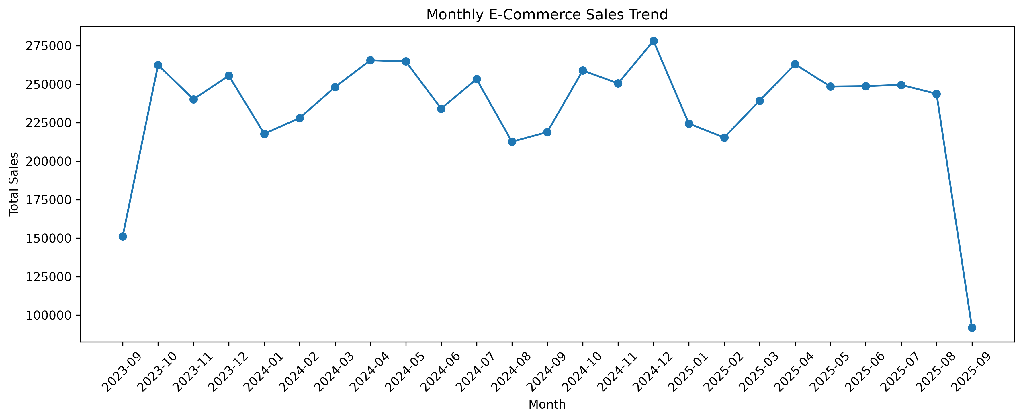
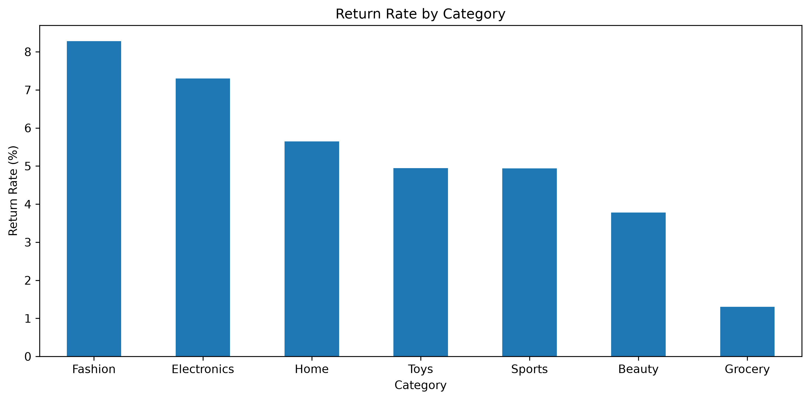
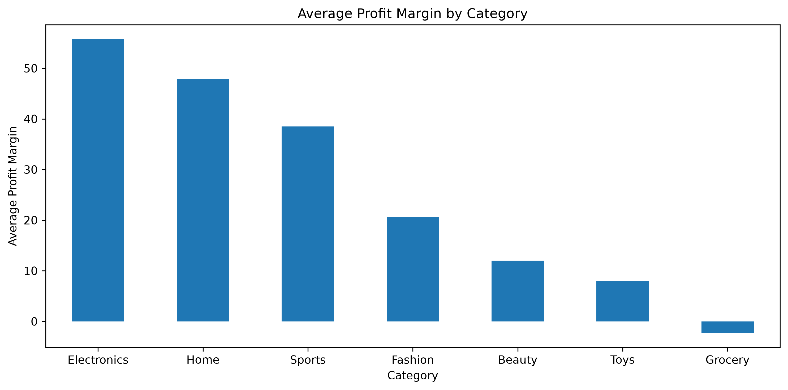
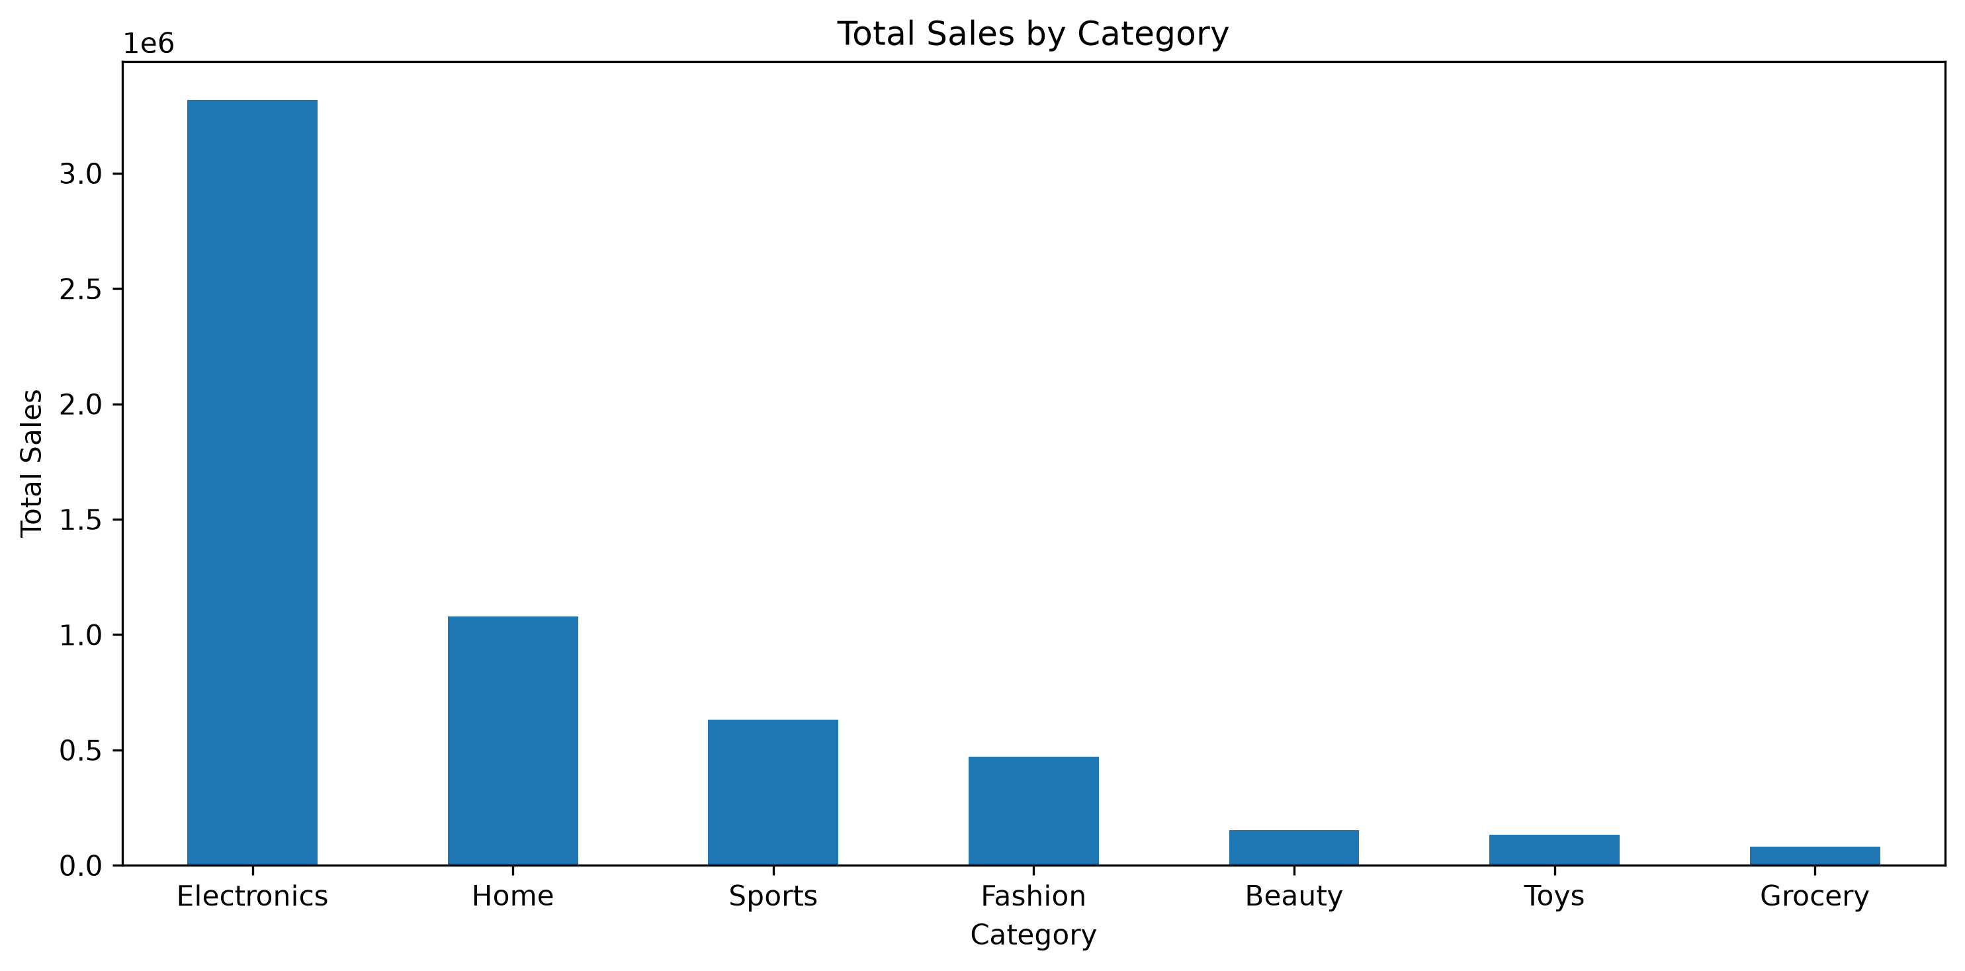
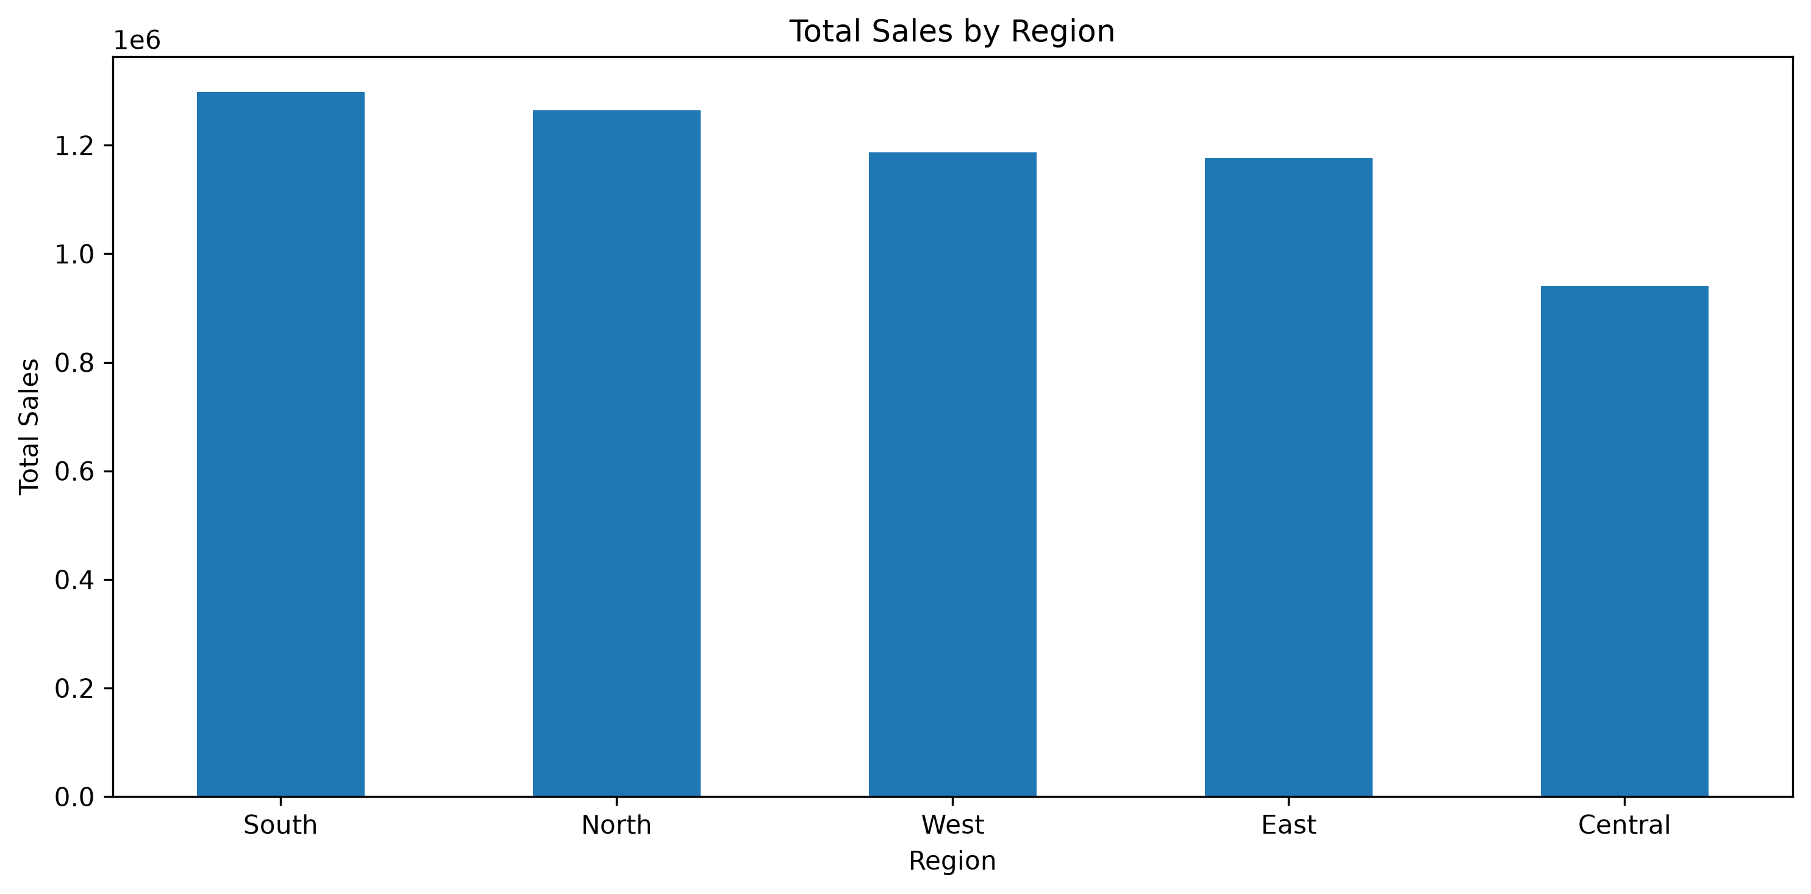
5. Visualizations
Five charts used to communicate the most important patterns
E-Commerce Sales & Customer Analytics • 6

Slide 7
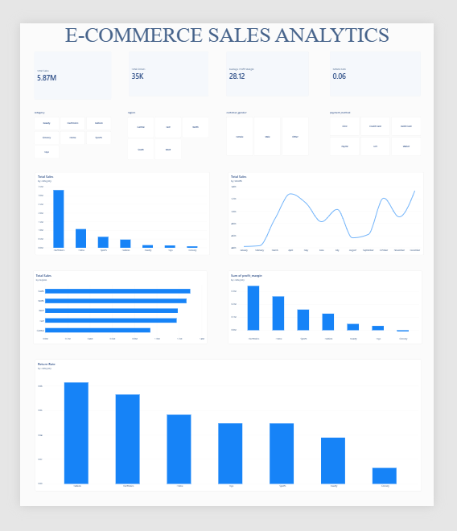
6. Power BI Dashboard
Interactive executive view of sales performance and profitability
E-Commerce Sales & Customer Analytics • 7

Slide 8
7. Business Insights & Recommendations
Turning analysis into practical actions
Business Insights
Recommendations
• Electronics is the main revenue driver.
• Electronics combines strong sales with high profitability.
• Grocery contributes comparatively low sales and negative average margin.
• Overall return rate is approximately 5.52%.
• Sales show monthly fluctuations, with a December 2024 peak of roughly 278K.
• Profitability differs substantially across categories.
• Prioritize inventory and marketing for high-performing Electronics products.
• Review Grocery pricing, supplier costs, discounts and shipping economics.
• Prepare inventory and campaigns ahead of seasonal sales peaks.
• Monitor return rates by category and investigate frequent-return products.
• Track sales, profit margin and returns together rather than revenue alone.
Thank you
E-Commerce Sales & Customer Analytics • 8

