Slide 1
Movie Recommendation System
Group 2:
Prakruti Joshi (phj15)
Twisha Naik (tn268)
Hari Priya Ponnakanti (hp467)
Dhruv Mundhra (dm1396)

Slide 2
Problem Statement
Aim: Build a movie recommendation system based on ‘MovieLens’ dataset.
We wish to integrate the aspects of personalization of user with the overall features of movie such as genre, popularity etc.
Notes:
Implemented popularity model, content based model, collaborative filtering model and latent factor based model and combining the above to form a hybrid model.
Hyperparameter tuning, testing accuracy and evaluation of recommendations of each model

Slide 3
DataSet
MovieLens review dataset (ml-latest-small)
Ratings: 100k
Movies: 9k
Users: 600
Integrated the dataset with IMDB and TMDB data set publically available.
Split the dataset into 80% training and 20% testing based on the User ID.
Notes:
The primary dataset used for this project is the movielens review dataset. consisting of 27,753,444 reviews over 58,098 different movies by 283,228 users.

Slide 4
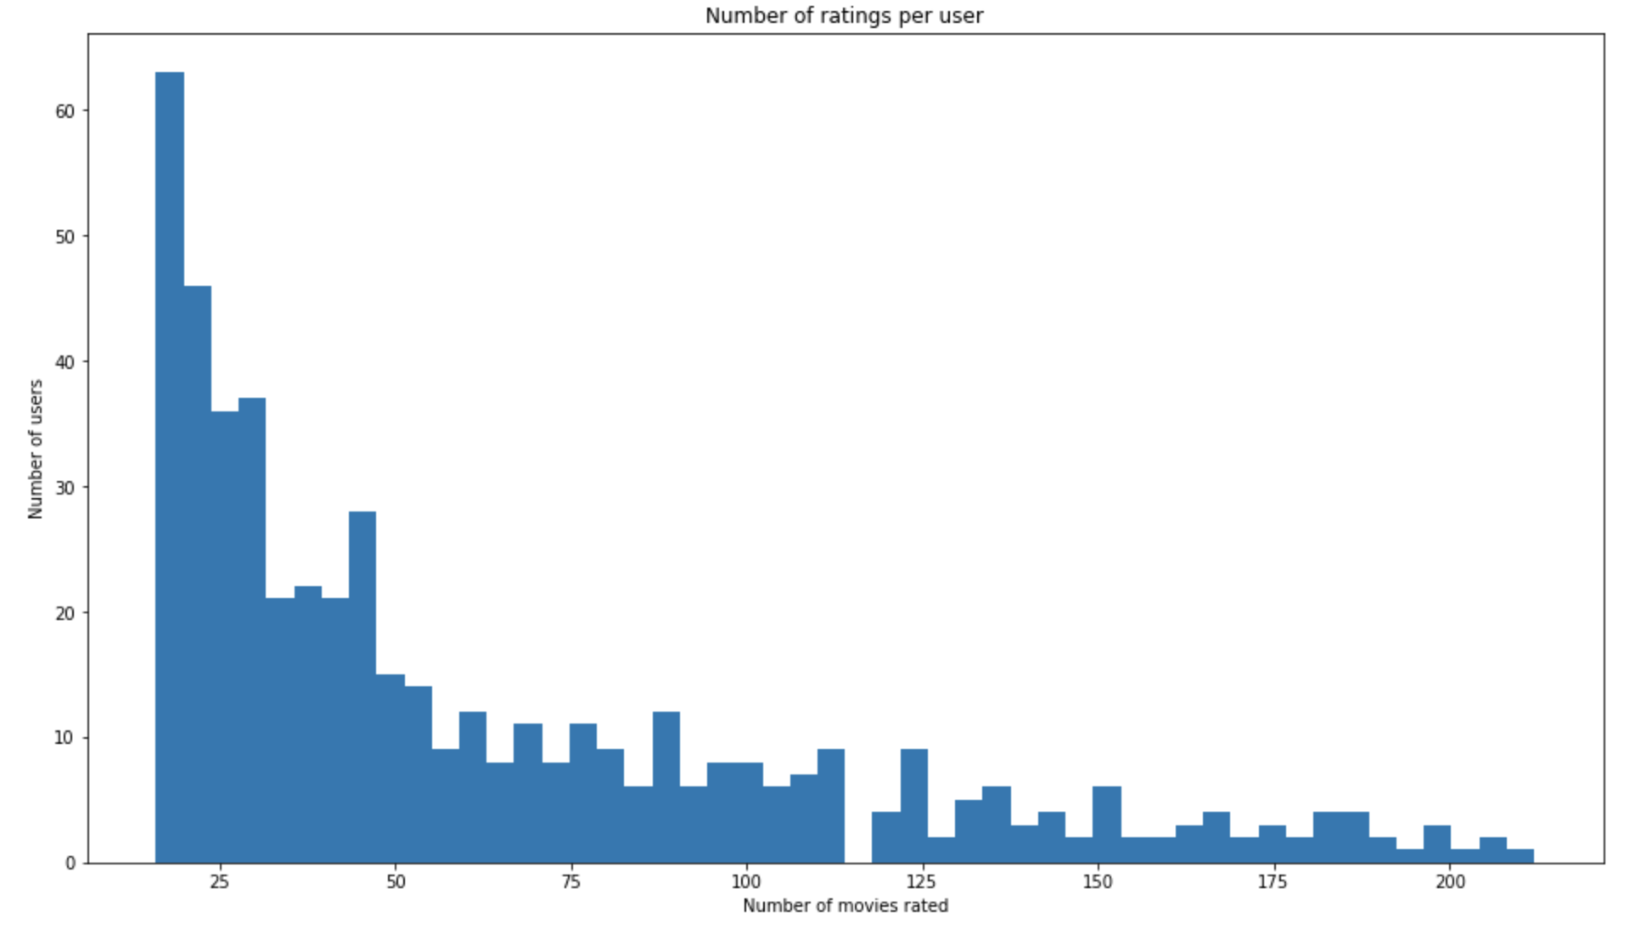
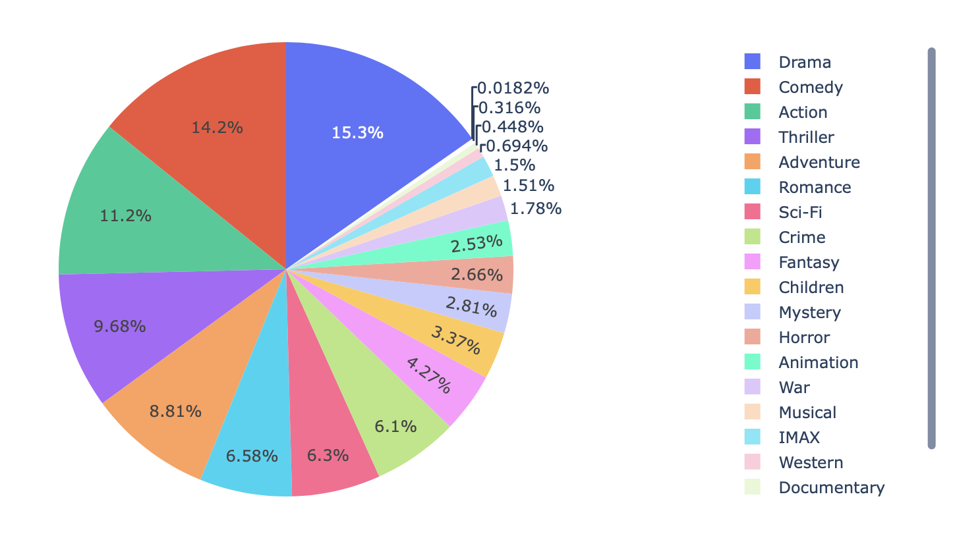
Data Analysis
Genre Distribution:
Number of ratings per user:

Slide 5
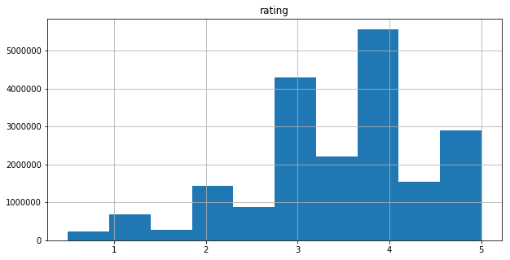
Histogram of Ratings:

Slide 6
Models
Popularity based model
Content based model
Collaborative Filtering
Matrix Factorization method
Combined model ( SVD + CF)
Hybrid model

Slide 7
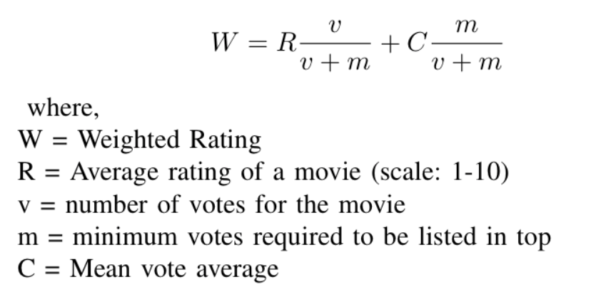
Popularity Model
Genre wise popular movies
Computed on:
Popularity metric from TMDB data
Weighted Rating from IMDB

Slide 8
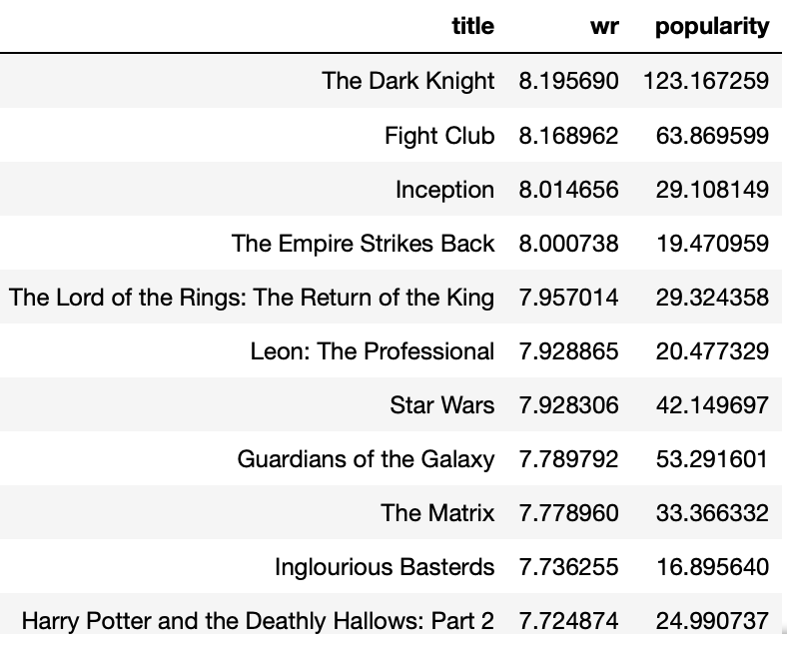
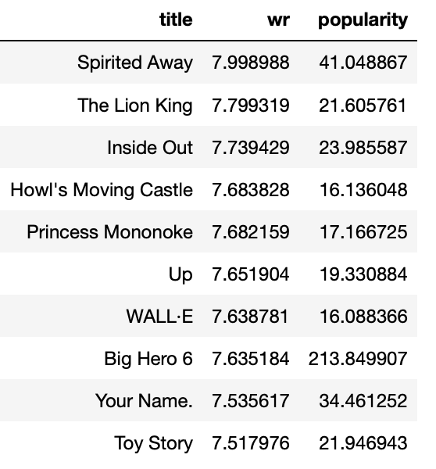
Action Movies
Animated Movies

Slide 9
Content-Based Recommendation
User profile based on item profiles
Genre
Year of release of movie
Movie - Movie similarity

Slide 10
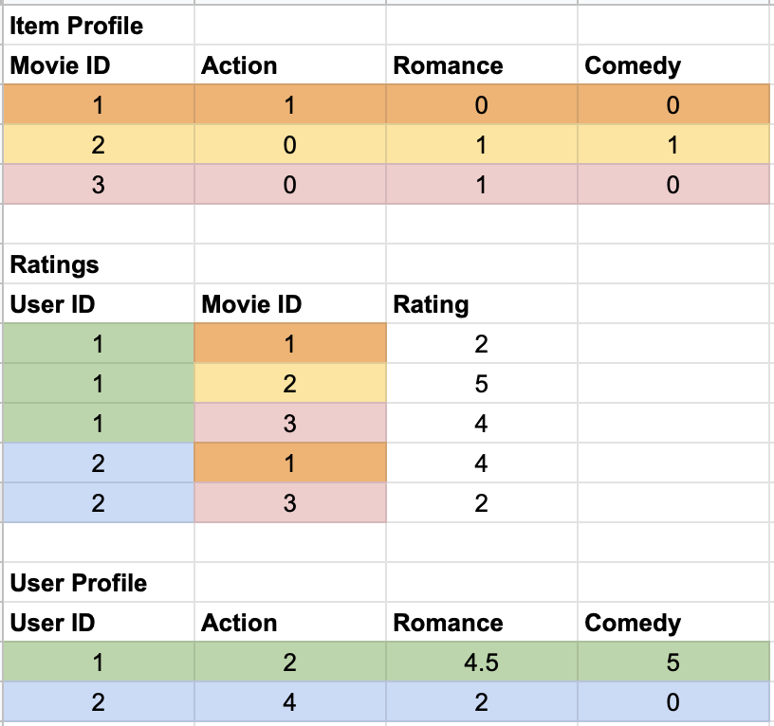
User and Item Vectors
Item Vector:
Vector of length total genres with 1 at relevant indices
User Vector:
Vector of length total genres with the value of average rating for each genre based on ratings in train set
Notes:
Item profile = Based on the the genre list for each movie, we build a movie profile. Example movie 1 belongs to genre [“Action”],movie 2 is a RomCom movie, and so on.
Using the ratings data, which has ratings for a movie by the user, we build a user profile.
Each entry in the user profile vector depicts the affinity of the user for that specific genre.

Slide 11
Evaluation metrics
Metric | Content based (Genre)
RMSE | 0.9185
MAE | 0.7095
Metric | Content based (Genre)
Precision | 0.800932214
Recall | 0.495168862
F-Measure | 0.6119842046
NDCG | 0.945576877

Slide 12
Movie-Movie Similarity
TF-IDF using overview and tagline of movies (from TMDb)
Issue: This just gives movies having similar description.
Notes:
As it is clearly seen from the movie title, movies with Christmas and Santa Claus are returned

Slide 13
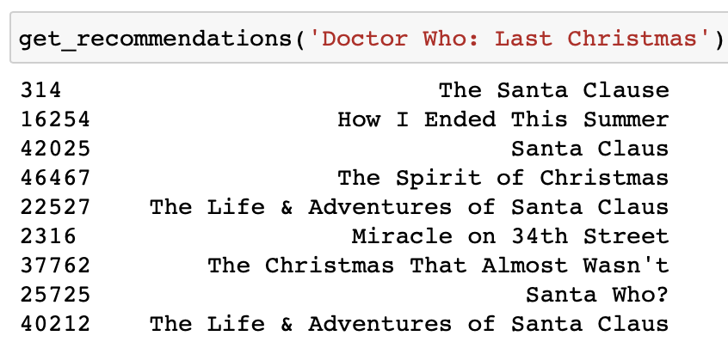
Movie-Movie Similarity (Cont.)
Overview of ‘Doctor Who: Last Christmas’
'The Doctor and Clara face their Last Christmas. Trapped on an Arctic base, under attack from terrifying creatures, who are you going to call? Santa Claus!'

Slide 14
Improvement
Adding the genre two times to give more weightage
Changing TF-IDF to Count Vector
TF-IDF gives lesser weight to frequently occurring terms across documents

Slide 15
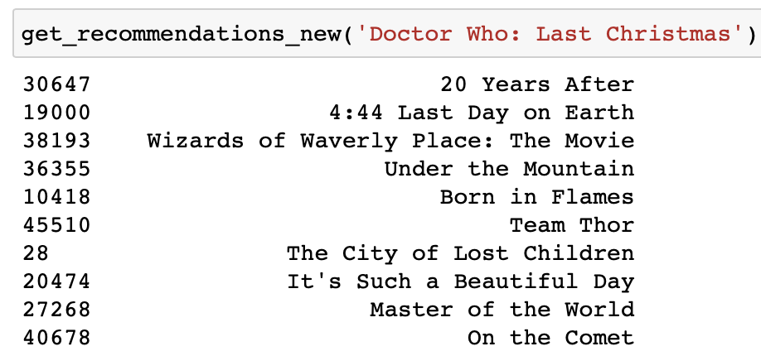
Movie 1: '20 Years After'
“In the middle of nowhere, 20 years after an apocalyptic terrorist event that obliterated the face of the world!”
Genre: ['Drama', 'Fantasy', 'Sci-Fi']
Movie 2: '4:44 Last Day on Earth'
Overview:
'A look at how a painter and a successful actor spend their last day together before the world comes to an end.'
Genre: ['Drama', 'Fantasy', 'Sci-Fi']
Doctor Who:
'The Doctor and Clara face their Last Christmas. Trapped on an Arctic base, under attack from terrifying creatures, who are you going to call? Santa Claus!'
['Adventure', 'Drama', 'Fantasy', 'Sci-Fi']

Slide 16
Collaborative Filtering
KNN (k- nearest neighbors) algorithm using Surprise library
Variations of KNN based approaches:
KNNBasic
KNNwithMeans
KNNWithZScore
KNNBaseline : integrates the baseline estimate ratings
Similarity metrics:
Cosine similarity
Mean square difference based similarity
Pearson coefficient (mean-centered cosine similarity)
Pearson Baseline (uses global baselines for centering instead of means)
Notes:
Pearson Baseline: This method computes the Pearson correlation coefficient between all pairs of users (or items) using baselines for centering instead of means.

Slide 17
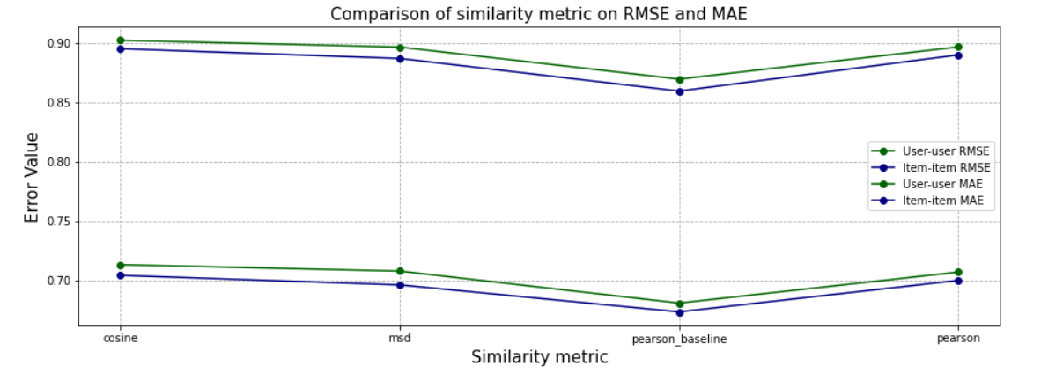
User-User and Item-Item comparison

Slide 18
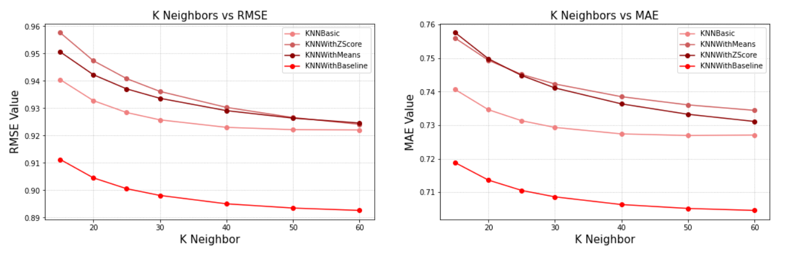
RMSE vs MAE for different k

Slide 19
Latent Factor Methods
Matrix Factorisation algorithms using Surprise library
SVD : baseline estimates + latent factor predictions
SVDpp : SVD + considers implicit ratings
Hyperparameter tuning using GridsearchCV
Number of epochs, number of factors, regularization parameter

Slide 20
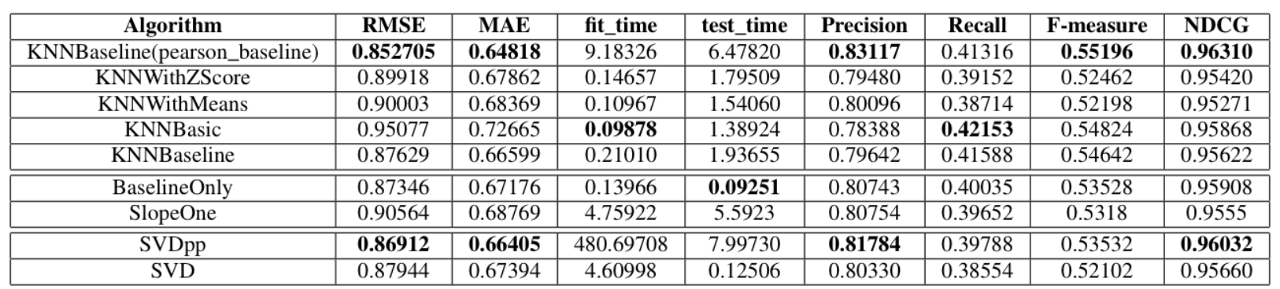
Evaluation of various algorithms:
Precision and Recall @ 5
Relevant : rating >=3.75
Notes:
SVD++

Slide 21
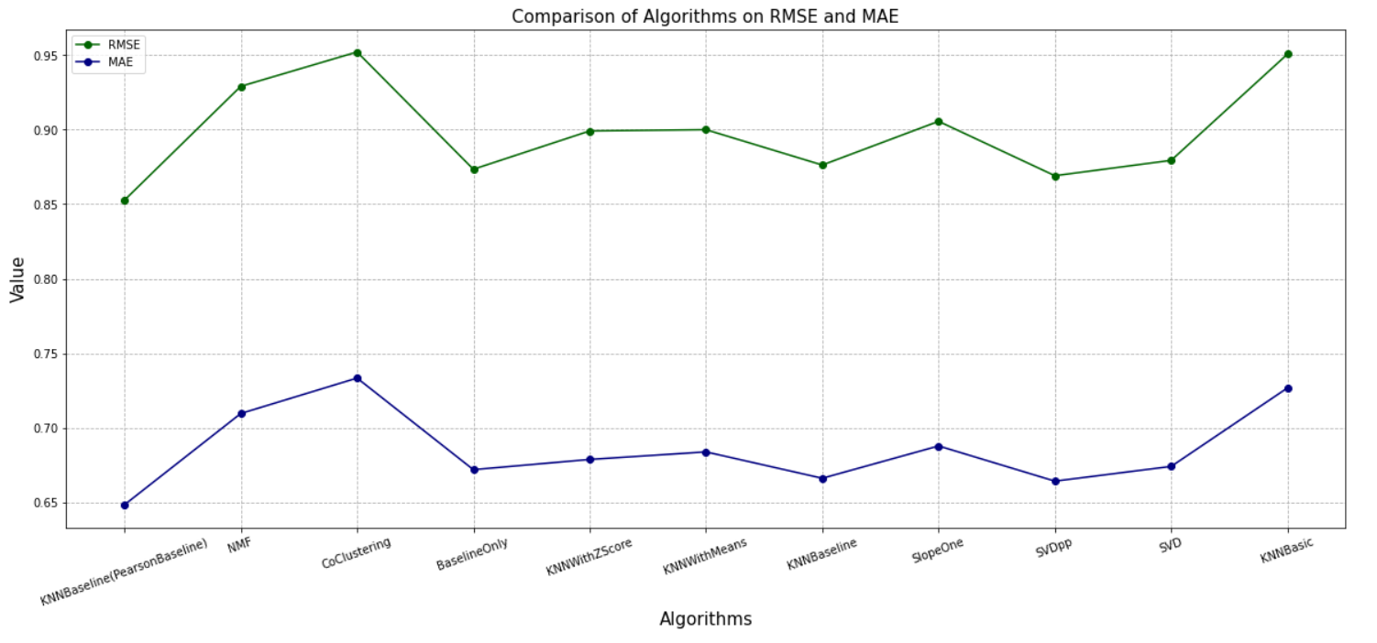
RMSE vs MAE for different algorithms

Slide 22
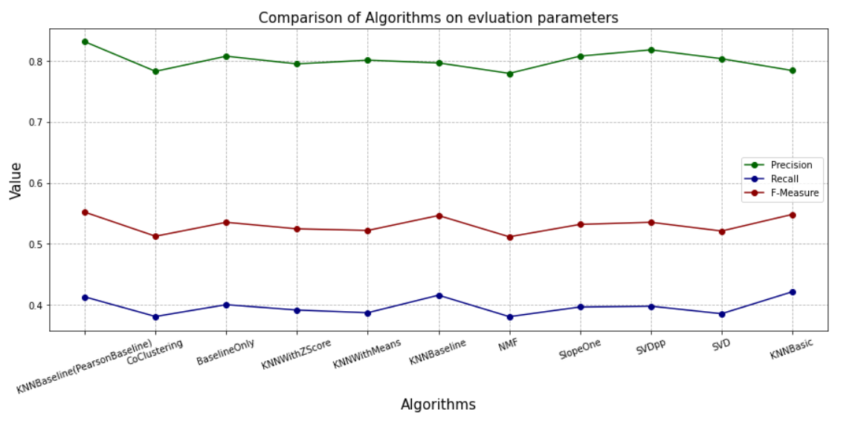
Evaluation of different algorithms

Slide 23
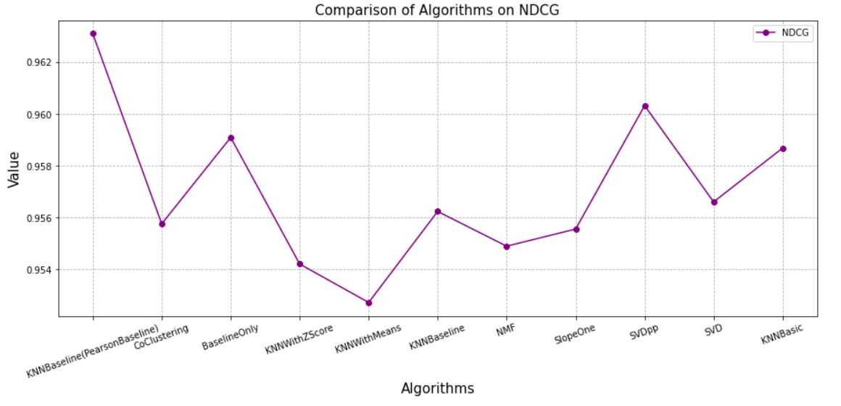
NDCG scores for different algorithms

Slide 24
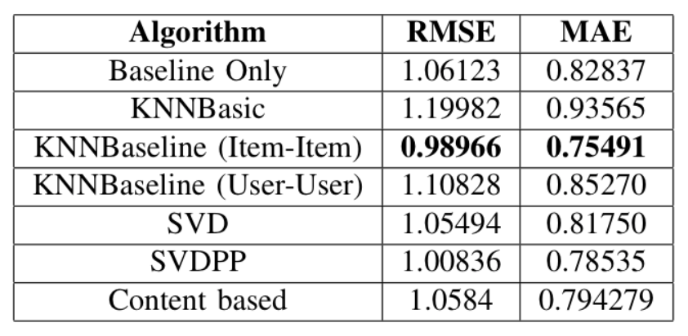
Which model is best for less ratings in training data?
(Less than 18 ratings per user)

Slide 25
Combined Model
Matrix Factorization + CF
Weighted linear combination of prediction ratings
Combined:
KNNBaseline (with pearson baseline similarity)
SVDpp
SVD
BaselineOnly

Slide 26
Weighted Combination of the best Algorithms
SVD | KNNBaseline (PearsonBaseline) | SVDPP | Baseline | RMSE | MAE | Precision | Recall | F-Measure | NDCG
0 | 0 | 1 | 0 | 0.8626 | 0.6735 | 0.79921 | 0.33642 | 0.47352 | 0.95872
0 | 1 | 0 | 0 | 0.8527 | 0.6482 | 0.81984 | 0.36242 | 0.50264 | 0.96310
0 | 0.6 | 0.4 | 0 | 0.844 | 0.6427 | 0.82732 | 0.35428 | 0.49611 | 0.96637
0.05 | 0.6 | 0.35 | 0 | 0.84405 | 0.6427 | 0.82836 | 0.35424 | 0.49626 | 0.96731
0.1 | 0.5 | 0.3 | 0.1 | 0.84405 | 0.6433 | 0.83139 | 0.35040 | 0.49301 | 0.96614

Slide 27
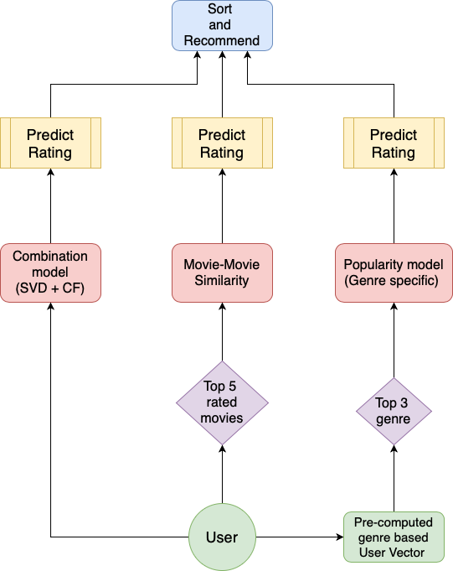
Hybrid Model
Combination of recommendations using:
Combined model ( SVD + CF)
Content Based Movie-Movie Similarity
Popularity model
+
User Profile (Genre Based)

Slide 28
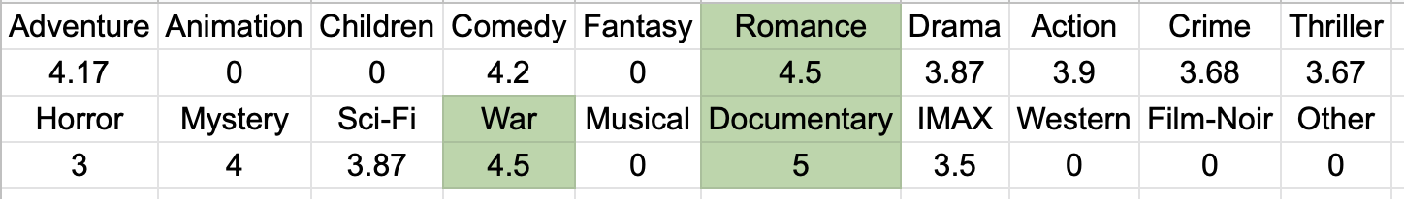
Results when enough information of User
User Id = 2
User top genre list from User vector:
['Documentary', 'Romance', 'War']:

Slide 29
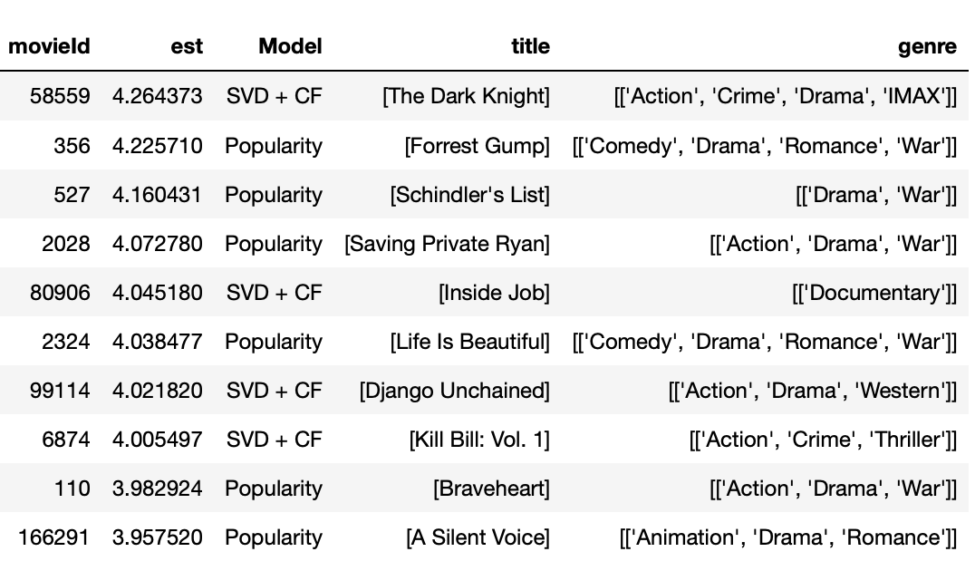

Slide 30
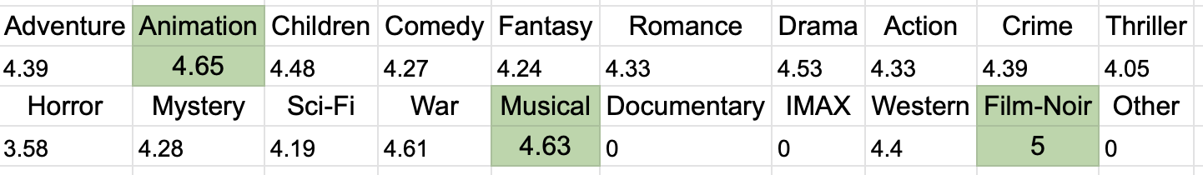
Results when enough information of User
User Id = 1
User top genre list from User vector:
[‘Film-Noir’, ‘Animation’, ‘Musical’]:

Slide 31
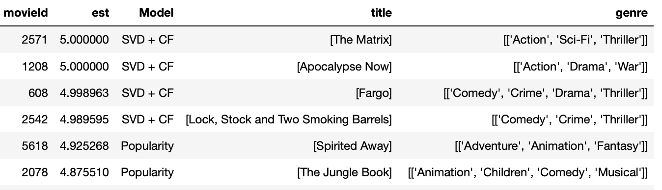

Slide 32
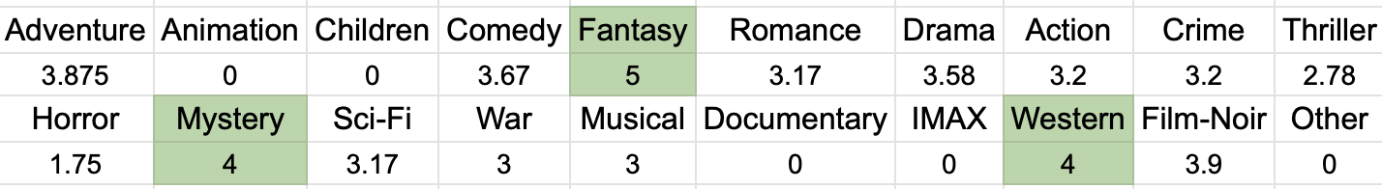
Results when less information about user
User Id = 9
User top genre from User Vector:
[‘Fantasy’, ‘Western’, ‘Mystery’]

Slide 33
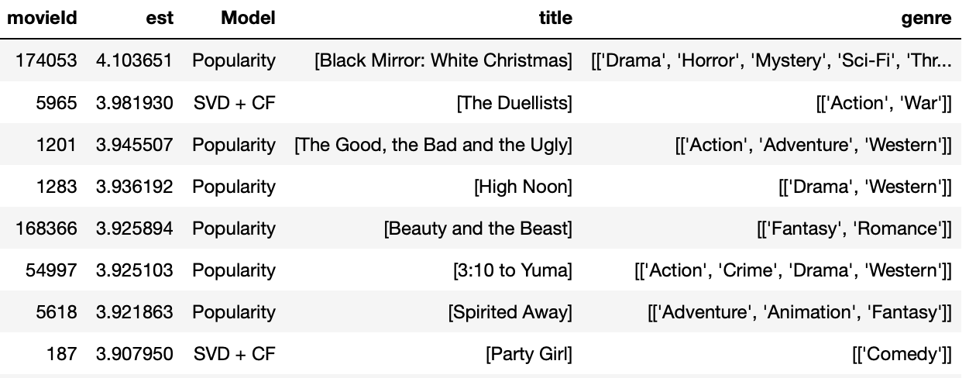

Slide 34
Takeaways:
Content based with genre is good when a user has less ratings.
Movie similarity metric based on features like overview, taglines and genre.
Item-item collaborative filtering works better than user-user collaborative filtering.
KNN based and SVD algorithms improve when global baselines are added.
Combining the predictions and recommendations of different models gives better results in terms of accuracy and quality of recommendations.

Slide 35
References:
Surprise library: https://surprise.readthedocs.io/en/stable/
Hybrid recommendation system: https://arxiv.org/pdf/1901.03888.pdf
Evaluating recommendation system: http://fastml.com/evaluating-recommender-systems/

Slide 36
Thank you!
Questions?

