Slide 1
PROBLEM 15 | MT-AIML | NLP PREPROCESSING & LANGUAGE MODELING
WordNet Similarity Measures for Legal Speech Analysis
Student photograph
(insert here)
Taxonomic vs information-theoretic closeness between courtroom transcript terms and statute definitions
Name | [Your full name]
Enrollment no. | [Enrollment number]
Programme | B.Tech IT (AI & ML Honors), SCET, Sarvajanik University
Academic year | 2026-27, Semester 6
Email / Mobile | [email] / [mobile]
Submission | Final submission: 7 Oct 2026
Notes:
Fill in name, enrollment number, email, mobile and insert the photograph before submitting.

Slide 2
The problem: linking speech to statute terms
Courtroom speech reaches software as ASR transcripts; statutes use fixed, formal terms.
Speakers vary their words: agreement for contract, theft for larceny, penalty for fine.
Exact keyword match misses these links; a number for conceptual closeness is needed.
Task: build a tool that scores term-to-term closeness using the WordNet hierarchy and compare two families of measures.
Closeness should look like this
contract - agreement
high
crime - larceny
high
judge - dog
near zero
Notes:
Motivation: legal retrieval and transcript-to-statute linking.

Slide 3
Understanding: WordNet is a tree of is-a links
Words are grouped into synsets. Each synset points to a more general parent (hypernym) up to one root, entity.n.01. Closeness depends on where two synsets meet.
Close: crime and larceny share a specific parent
Distant: court and judge meet only at the root
crime.n.01 (shared parent)
entity.n.01 (shared parent)
felony.n.01
court.n.01 (institution)
larceny.n.01
judge.n.01 (person)
Verified with NLTK WordNet on this project's data: lowest common hypernym of crime/larceny = crime.n.01; court/judge = entity.n.01.
Notes:
Hypernym paths come from the prototype output. Depth of larceny.n.01 is 10; crime.n.01 is 8.

Slide 4
Understanding: two families of measures
Family | Measure | Formula | What it rewards
Taxonomic | Path | 1 / (len + 1) | Short route between synsets
 | Wu-Palmer | 2·depth(LCS) / (depth a + depth b) | A deep shared ancestor
 | Leacock-Chodorow | -log((len + 1) / 2D) | Log-scaled path length
Information-theoretic | Resnik | IC(LCS) | A specific shared ancestor
 | Lin | 2·IC(LCS) / (IC a + IC b) | Resnik, normalised to 0-1
LCS = lowest common subsumer. IC(c) = -log P(c), estimated from a corpus (Genesis or Brown). D = max taxonomy depth.
Key question: do tree-distance measures and corpus-specificity measures agree on legal terms?

Slide 5
Scope of the solution
In scope
Out of scope (stated limits)
Five WordNet measures: Path, Wu-Palmer, LCH, Resnik, Lin
Noun pairs; one verified sense per legal term
Pairwise matrices, correlations between metrics
Transcript-to-statute matching with a confidence threshold
Streamlit web app and two PDF reports
Automatic sense disambiguation (covered by Problems 13, 14, 19)
Multi-word terms and verbs
Training on a legal corpus; IC uses Genesis or Brown
Claims of benchmark accuracy: gold ratings are small and author-assigned

Slide 6
Existing solutions (1/2): the research measures
Wu & Palmer (1994). Verb semantics and lexical selection. ACL.
Leacock & Chodorow (1998). Combining local context and WordNet similarity for word sense identification. In WordNet: An Electronic Lexical Database, MIT Press.
Resnik (1995). Using information content to evaluate semantic similarity in a taxonomy. IJCAI. arXiv:cmp-lg/9511007.
Lin (1998). An information-theoretic definition of similarity. ICML.
Pedersen, Patwardhan & Michelizzi (2004). WordNet::Similarity: measuring the relatedness of concepts. NAACL (Demonstrations).
Budanitsky & Hirst (2006). Evaluating WordNet-based measures of lexical semantic relatedness. Computational Linguistics 32(1).
These define the five measures this project implements and the similarity-versus-relatedness distinction it tests.

Slide 7
Existing solutions (2/2): tools, and the gap
Existing tool | What it offers | Limit for legal speech
NLTK WordNet interface nltk.org/howto/wordnet.html | All five measures; Brown and other IC files | General English; no legal relations
Princeton WordNet wordnet.princeton.edu | Synsets and hypernym hierarchy | Court and judge meet only at the root
LEGAL-BERT Chalkidis et al., 2020 (Findings of EMNLP) | Contextual embeddings pre-trained on legal text | Needs compute; scores are not interpretable as tree distance
Gap this project addresses
A small, interpretable tool that compares the measures side by side on legal terms, shows where they disagree, and documents the failure cases.
Notes:
Verify the links and citations against the originals before final submission.

Slide 8
System architecture and data flow
Transcript
raw text
Preprocessing
clean, split, tokenise, lemmatise
Legal lexicon
term to hand-checked synset
Similarity engine
Path, WuP, LCH, Resnik, Lin
Outputs
tables, charts, app, reports
preprocessing.py cleaning, loaders, term extraction
models.py five measures, IC tables, matrices, correlations, statute matching
pipeline.py evaluation runner; app.py Streamlit interface
One verified synset per term, so errors are not caused by sense disambiguation.
Statute matching uses a normalised-score threshold (0.6); below it the tool reports no confident match.
Two IC corpora supported (Genesis with add-1 smoothing, Brown).

Slide 9
Data and evaluation setup
28
23
5
term pairs scored
related legal pairs
unrelated control pairs
10
40
30
transcript sentences
legal-term occurrences
distinct legal terms
Each pair has a relatedness rating from 0 (unrelated) to 4 (closely related).
Caveat: ratings were assigned by the project author, and the transcript is a short synthetic excerpt. Results show behaviour on this set, not a benchmark.

Slide 10
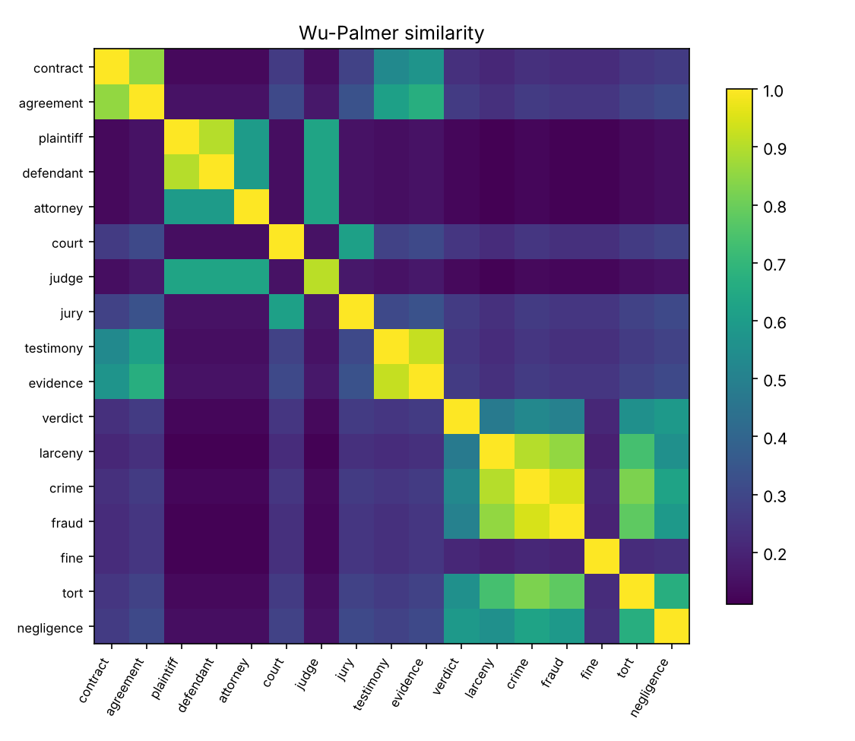
Web application and reports
Four tabs in the web app
Compare two terms: pick senses, see all five scores and the hierarchy path
Similarity matrix: choose terms and metric, heat-map table
Transcript to statutes: paste text, set threshold, see best statute match
Evaluation: agreement with gold ratings, metric correlations, all pair scores
Reports (docs/)
Architecture & Methodology: formulas, design, limits
Evaluation Report: tables, charts, failure analysis
Sample output: Wu-Palmer matrix, 17 legal terms

Slide 11
Result 1: agreement with gold ratings
All five measures reach Spearman 0.54 to 0.61 (Genesis IC).
Lin is highest, by a small margin.
With 28 pairs, 95% bootstrap intervals overlap heavily (for example Lin 0.30 to 0.80).
Conclusion: all measures capture a moderate monotone link with the gold ratings; none clearly beats the others.
Notes:
Bootstrap intervals are in the Evaluation Report, section 2.

Slide 12
Result 2: related versus unrelated pairs
Every measure scores related pairs well above controls (gap 0.28 to 0.39).
Lin has the largest gap (0.39); Path the smallest (0.28).
Path scores are low overall, because shortest paths between specific legal concepts are long.
Wu-Palmer has the highest control score, a warning sign (see failure cases).

Slide 13
Where the two families disagree
Pair | Wu-Palmer | Resnik | WuP rank | Resnik rank
lawyer - prosecutor | 0.952 | 4.119 | 1 | 10
judge - prosecutor | 0.909 | 4.102 | 3 | 11
oath - testimony | 0.615 | 5.373 | 14.5 | 9
damages - fine | 0.762 | 7.984 | 10 | 5
Path and LCH: correlation 1.00, identical rankings (LCH is a monotone function of path length).
Resnik and Lin: correlation 0.97.
Path versus Resnik 0.83, Path versus Lin 0.85: the weakest links, where the families truly differ.
Central contrast. Taxonomic measures reward proximity in the tree: lawyer, prosecutor and judge are close in the person branch. Information-theoretic measures reward the specificity of what is shared: damages and fine share a specific money concept.
Notes:
Spearman correlations from outputs/metric_correlations_spearman.csv.

Slide 14
Transcript-to-statute matching
Each distinct term is matched to the closest of 10 statute terms; threshold 0.6 on a 0-1 scale.
Terms identical to a statute term score the maximum under every measure.
Person terms (plaintiff, defendant, judge, attorney) get no confident match: the statute list has no person terms, and the threshold refuses to force one.
Good matches: damages to Fine, trial and appeal to Verdict.

Slide 15
Failure cases found
Similarity is not relatedness
Path scores compress
judge and dog score 0.67 on Wu-Palmer: both are organisms and meet at organism.n.01 (depth 5). Court and judge, strongly related, score 0.15: they meet only at the root.
contract and agreement, a near-synonym pair, score 0.33 on Path but 0.86 on Wu-Palmer. Absolute Path values are hard to threshold.
Negative information content
Hierarchy coverage
Genesis with add-1 smoothing gives the root a slightly negative IC (about -0.083), so Resnik and Lin can dip just below zero. Brown gives exactly 0.
statute resolves to legislative_act.n.01, far from law.n.01, so law and statute score low although a lawyer treats them as close.

Slide 16
Limitations and future work
Limitations
Future work
28 pairs and author-assigned ratings: correlations are imprecise.
Synthetic transcript; 10 statute terms.
WordNet is general English; legal relations are not hypernym links.
Genesis (biblical text) is a poor IC proxy for legal usage.
Nouns and single words only.
Ratings from several independent annotators.
IC estimated from a legal corpus.
Multi-word terms and sense disambiguation.
Combine taxonomic and IC scores in one ranking.
Test on real court transcripts.

Slide 17
Conclusion
All five measures separate related legal pairs from unrelated ones and correlate moderately with gold ratings. None clearly dominates on 28 pairs.
1
Path and Leacock-Chodorow are rank-equivalent; Resnik and Lin behave alike. The real comparison is path family versus information-content family.
2
Taxonomic measures judge closeness in the hierarchy; IC measures judge the specificity of what is shared. For legal text, use both, with a legal IC corpus and expert ratings.
3

