Slide 1
AI Approach: Behavioral & Alternative Credit Signals
No reliance on traditional credit history
Uses behavioral, financial, and stability signals
Key inputs:
Bill payment consistency
Transaction & spending patterns
Location stability
Bank balance & cash flow
Seasonal income modeling for informal workers
User Data
Feature Engineering
AI Model
Credit Risk Score
“Creditworthiness is inferred from behavior, not history.”

Slide 2
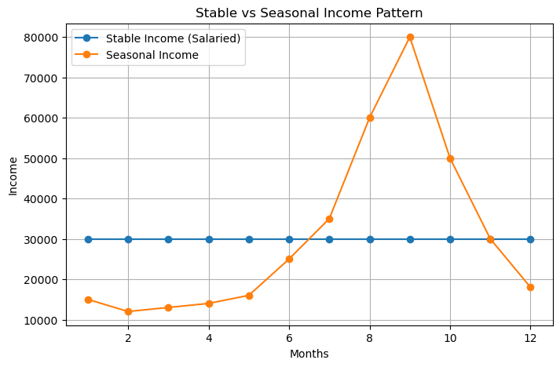
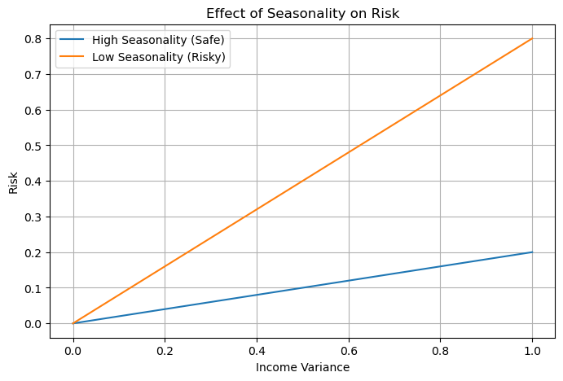
🤖 Feature Engineering & Key Innovation
Feature | Meaning | Importance
bill_payment_score | Repayment discipline | High
ecommerce_spend_ratio | Spending behavior pattern | Medium
location_stability | User traceability & fraud risk | High
balance_norm | Financial strength & liquidity | High
job_stability_score | Income consistency | High
avg_transaction_value | Financial activity level | Medium
transaction_frequency | Banking engagement | Medium
account_age | Long-term financial reliability | Low–Medium
cash_vs_digital_ratio | Financial transparency | Medium
loan_history_score | Past credit behavior | High
🚀 Key Innovation:
Seasonality-aware modeling
Differentiates:
❌ random income fluctuations
✅ predictable seasonal spikes
👉 This prevents unfair rejection of seasonal earners like vendors and artisans.

Slide 3
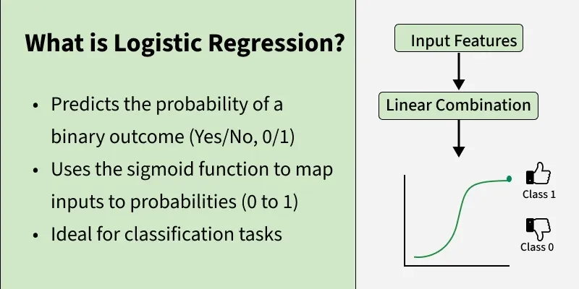
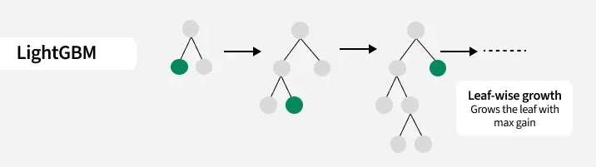
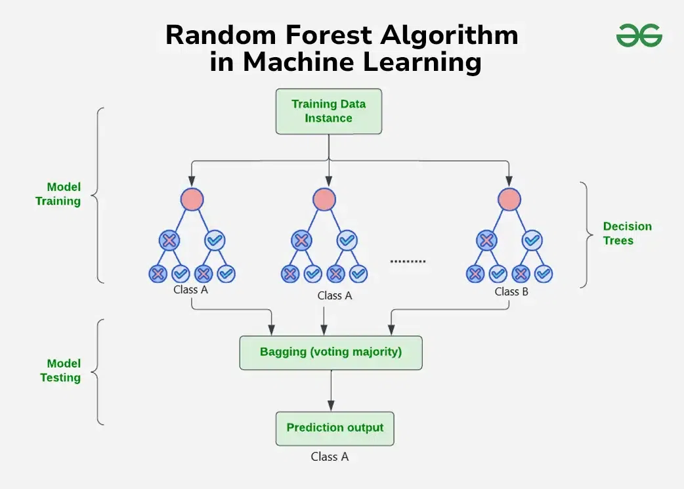
⚙️ Model Architecture & Training
Training Data
Models Used:
Random Forest
LightGBM
Logistic Regression
Subset 1
Subset 2
Subset 3
Random Forest
LightGBM
Logistic Regression
Ensemble Learning (Voting Classifier)
Combines:
accuracy (tree models)
interpretability (logistic regression)
Prediction (Yes/NO)
Prediction (Yes/NO)
Prediction (Yes/NO)
Key Design Choices:
Class imbalance handled (important)
Focus on minimizing false negatives
Explainable feature importance
Ensemble Prediction
Ultimate Prediction

Slide 4
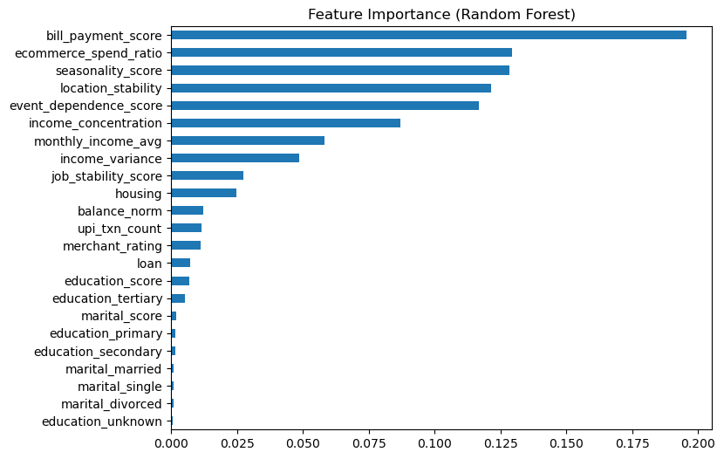
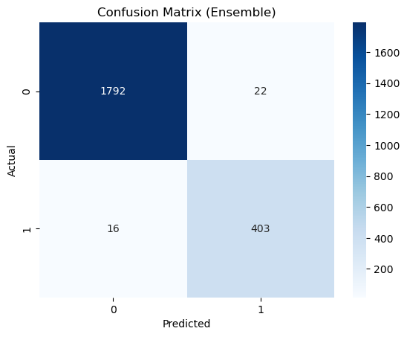
📊 Performance & Impact
📊 Model Performance:
Accuracy: 98%
Recall (risky users): 96%
High precision & reliability
📈 Key Insights:
Behavioral features dominate
Seasonal modeling improves fairness
Strong performance on imbalanced data
🌍 Impact:
Enables credit access for underserved users
Reduces NPA risk for banks
Supports financial inclusion

