Slide 1
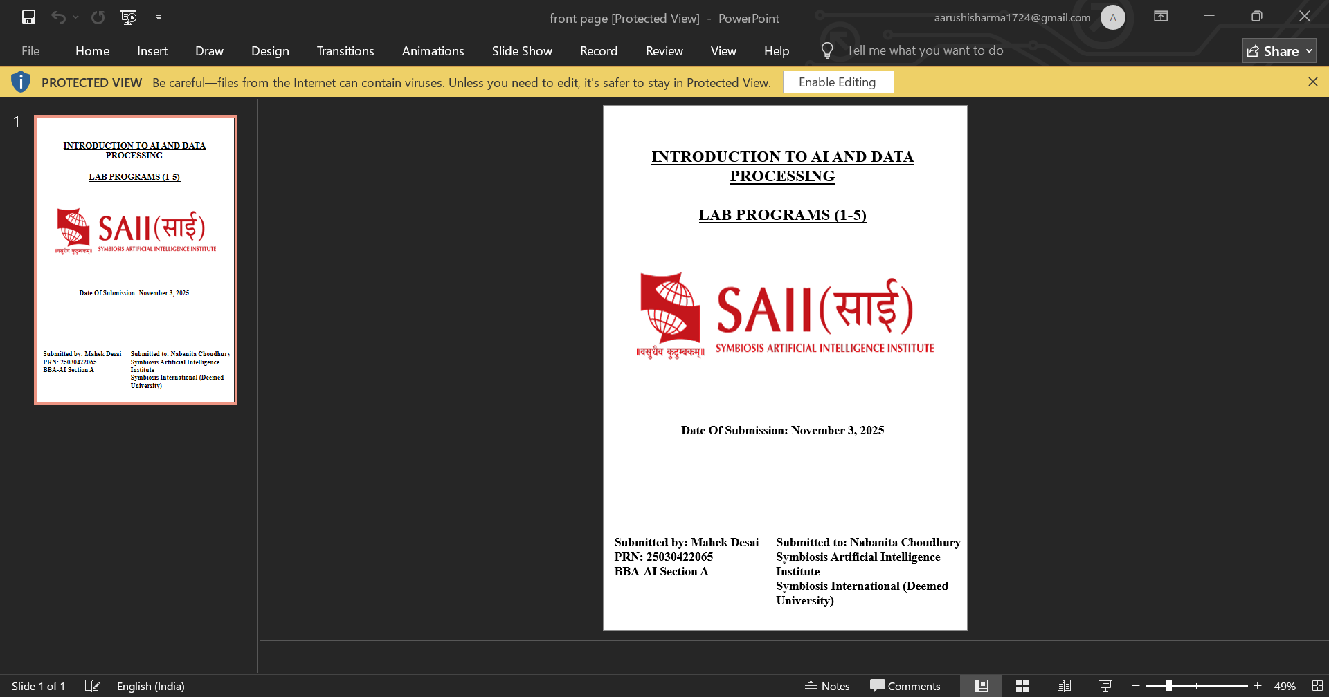
Python Programming
Mini Python Application
Submitted By –
Aarushi Sharma
Prisha Vora
Gurnaaz Kaur
Twisha Shukla
Submitted to-
Dr. Dawa Chyopel Lepcha

Slide 2
Guess the Number

Slide 3
Introduction
This Python project is a simple yet engaging game called 'Guess the Number'. In this game, the computer randomly selects a number between 1 and 20, and the player has to guess it. The program provides hints like 'Too high' or 'Too low' until the player finds the correct number.

Slide 4
Objective
To create an interactive guessing game.
To understand loops, conditionals, and random number generation.
To strengthen logic and problem-solving skills using Python.

Slide 5
How the game works
The computer randomly chooses a secret number within a range (1 to 20).
The player then tries to guess the number.
After each guess, the computer gives a hint — whether the guess is too high, too low, or correct.
The game continues until the player guesses the correct number, and then the program displays how many attempts it took.

Slide 6
Code Explanation
Import random → allows using random numbers.
Number = random.randint(1, 20) → computer selects a random number.
Print('Guess a number between 1 and 20') → instructs the player.
While True → runs continuously until the correct guess.

Slide 7
Code Explanation
Guess = int(input('Your guess: ')) → takes input from user.
If guess == number → checks if the guess is correct.
elif guess < number → shows 'Too low, try again!'.
else → shows 'Too high, try again!'.

Slide 8
Output
When the program runs:
The computer picks a number between 1 and 20.
The user guesses until they find the correct number.
The program displays helpful feedback for each guess.

Slide 9
Conclusion & Learnings
Learned how to use loops, conditionals, and random module in Python.
Improved logical thinking and debugging skills.
Future Improvements: Add a scoring system, GUI interface, or attempt limits.

