Slide 1
October 6, 2017 – Oct 31, 2018

Slide 2
Hello!
John McColman
john@infrontmarketing.ca
403.861.9727
Dave Taylor
dave@infrontmarketing.ca
403.891.9295

Slide 3
ASSETS / CREATIVE

Slide 4
Assets
Skyscraper
160x600
Tall Block
300x600
Leaderboard – 728x90
Big Box
300x250
Mobile
320x50

Slide 5
Assets
Remarketing Creative
Mobile
320x50
Leaderboard – 728x90
Big Box
300x250

Slide 6
OVERALL PERFORMANCE

Slide 7
100,000 Foot View
Oct 2017 – Oct 2018
We will get into more detail throughout this report, but currently here is what we’re seeing.
Ads have been delivered 5.6 million times.
We’ve generated 2,697 clicks and it usually takes 1.75 times viewing the ad before clicking on this
We have reached over 3.2 million unique devices/people over the course of the year.
Your ad has been interacted with 0.53% (meaning people moving the mouse over the ads/interacting with it)
1,743 Total Non-Unique Conversions (meaning people seeing the ad and coming to the website)

Slide 8
Creative Breakdown By creative unit
Creative Size Name | Creative Size Format | Impressions | Clicks | CTR | Total Conversions | Conversion Rate | Total Non-Unique Conversions | Non-unique Conversion Rate | Interaction Rate
MAIN CREATIVE
LEADERBOARD | 728x90 | 670,753 | 232 | 0.03% | 307 | 0.05% | 394 | 0.06% | 1.69%
TALL BLOCK | 300x600 | 399,708 | 312 | 0.12% | 295 | 0.37% | 367 | 0.39% | 3.42%
SKYSCRAPER | 160x600 | 135,353 | 37 | 0.03% | 132 | 0.10% | 197 | 0.15% | 2.22%
BIG BOX | 300x250 | 2,074,160 | 910 | 0.04% | 621 | 0.06% | 698 | 0.07% | 0.76%
MOBILE | 320x50 | 2,312,574 | 1181 | 0.05% | 610 | 0.03% | 727 | 0.04% | 0.10%
SUBTOTALS |  | 5,592,548 | 2,672 | 0.06% | 1,965 | 0.12% | 2,383 | 0.14% | 1.64%
REMARKETING CREATIVE
LEADERBOARD | 728x90 | 2,688 | 8 | 0.30% | 43 | 1.60% | 71 | 2.64% | 7.33%
BIG BOX | 300x250 | 5,224 | 6 | 0.11% | 59 | 1.13% | 102 | 1.95% | 4.31%
MOBILE | 320x50 | 2,234 | 6 | 0.27% | 29 | 1.30% | 38 | 1.70% | 5.37%
SUBTOTALS |  | 10,146 | 20 | 0.23% | 131 | 1.34% | 211 | 2.10% | 5.67%
TOTALS
TOTALS |  | 5,602,694 | 2,692 | 0.14% | 2,096 | 0.73% | 2,594 | 1.12% | 3.65%
The following report is showing each creative size, delivery of ads performance and conversion metrics.
Format is the size (in pixels) of the ad – Examples of creative that are used are on page 4.
Impressions are each time an ad is delivered/shown.
Clicks – When someone clicks on an ad.
CTR (Click Through Rate)
Total Conversions – If someone sees your ad but does not click, but returns to the site afterwards. This helps show reach/performance other than clicks & CTR.
Conversion Rate in % - another way to show conversion.
Total Non-Unique Conversions – Showing all (including duplication) conversions.
Non-Unique Conversion Rate in %

Slide 9
CONVERSION DATA / BREAKDOWN

Slide 10
Overall Conversions
CONVERSION ANALYSIS |  |  | BRAND INQUIRY
NAME | TOTAL |  | ABOUT US | CONTACT US | HOME PAGE | LINKS | SERVICES | TESTIMONIALS
MAIN CREATIVE
LEADERBOARD | 394 |  | 1 | 2 | 282 | 0 | 108 | 1
TALL BLOCK | 367 |  | 1 | 1 | 257 | 0 | 108 | 0
SKYSCRAPER | 197 |  | 2 | 0 | 97 | 0 | 98 | 0
BIG BOX | 698 |  | 13 | 1 | 384 | 1 | 298 | 1
MOBILE | 727 |  | 20 | 4 | 539 | 2 | 161 | 1
SUBTOTAL |  |  | 37 | 8 | 1,559 | 3 | 773 | 3
REMARKETING CREATIVE
LEADERBOARD | 71 |  | 3 | 3 | 2 | 0 | 63 | 0
BIG BOX | 102 |  | 1 | 1 | 8 | 0 | 92 | 0
MOBILE | 38 |  | 1 | 1 | 3 | 0 | 33 | 0
SUBTOTAL |  |  | 5 | 5 | 13 | 0 | 188 | 0
TOTALS | 2,594 |  |  |  |  |  |  | 2,594

Slide 11
BEHAVIOR & AUDIENCE

Slide 12
Category
Behavior Audience
Category | Impressions | Clicks | CTR | Impression Performance (%) | Clicks (%) | Click Performance (%)
Lifestyle | 548,593 | 249 | 0.05% | 103.74% | 21.43% | 112.38%
Entertainment and Hobbies | 505,088 | 189 | 0.04% | 95.30% | 16.27% | 88.16%
Food | 423,554 | 160 | 0.04% | 107.80% | 13.77% | 94.07%
Auto | 383,943 | 152 | 0.04% | 173.14% | 13.08% | 122.03%
Music | 328,439 | 120 | 0.04% | 111.85% | 10.33% | 137.21%
Finance | 125,885 | 69 | 0.05% | 76.54% | 5.94% | 92.36%
Technology | 79,798 | 56 | 0.07% | 82.62% | 4.82% | 90.67%
Movie/TV | 121,200 | 46 | 0.04% | 86.36% | 3.96% | 71.41%
Shopping | 55,561 | 34 | 0.06% | 64.54% | 2.93% | 73.23%
Travel | 48,871 | 32 | 0.07% | 53.26% | 2.75% | 96.07%
Home | 111,164 | 27 | 0.02% | 65.19% | 2.32% | 73.00%
News | 11,538 | 15 | 0.13% | 116.63% | 1.29% | 345.26%
Health and Wellness | 19,364 | 9 | 0.05% | 65.40% | 0.77% | 61.25%
Region | 10,047 | 2 | 0.02% | 59.63% | 0.17% | 28.88%
Students | 1,122 | 1 | 0.09% | 120.60% | 0.09% | 269.15%
Book Lover | 7 | 1 | 14.29% | 52.70% | 0.09% | 269.33%
This report is showing the categories view.
This is the full ’50,000’ foot view of the categories of behaviors (bSegs) shown on the next slide.

Slide 13
Name | Impressions | Clicks | CTR
Canadian Affairs | 358,557 | 143 | 0.04%
Metropolitan | 280,106 | 91 | 0.03%
International News | 201,400 | 83 | 0.04%
Greater Metropolitan Area | 129,923 | 62 | 0.05%
Women's Clothing | 210,757 | 57 | 0.03%
Music Lover | 110,758 | 46 | 0.04%
Government | 48,125 | 32 | 0.07%
Foreign Car Brands | 103,921 | 30 | 0.03%
Moviegoer - Now Playing | 60,619 | 26 | 0.04%
IT Corporate Tech Intender | 43,355 | 25 | 0.06%
Celebrity News and Gossip Reader | 103,169 | 24 | 0.02%
Online Shopping Enthusiast | 30,283 | 21 | 0.07%
Finance News Reader | 75,634 | 21 | 0.03%
Auto Intender | 24,317 | 21 | 0.09%
TV Watcher | 60,581 | 20 | 0.03%
Men's Interest | 50,929 | 20 | 0.04%
Outdoor Clothing | 105,040 | 18 | 0.02%
Lifestyle Enthusiast | 38,753 | 16 | 0.04%
Sports Fan | 60,482 | 15 | 0.02%
Hockey Fan | 39,387 | 15 | 0.04%
Fine Art Enthusiast | 1,418 | 15 | 1.06%
Women's Interest | 58,477 | 14 | 0.02%
Personal and Home Electronics Intender | 11,221 | 14 | 0.12%
Legal Issues | 22,259 | 14 | 0.06%
Vacation Travel Intender | 6,562 | 13 | 0.20%
New Auto Intender | 17,015 | 12 | 0.07%
Men's Clothing | 47,720 | 12 | 0.03%
Discount and Deal Seeker | 23,125 | 12 | 0.05%
Video Gamer | 53,207 | 11 | 0.02%
Theatre & Performing Arts Fan | 10,485 | 11 | 0.10%
Social Media Fan | 51,870 | 11 | 0.02%
Parenting and Family | 3,579 | 11 | 0.31%
Car Purchasing Sites | 6,635 | 11 | 0.17%
Wine and Spirits Drinker | 12,132 | 10 | 0.08%
Real Estate & Mortgage Intender | 5,117 | 10 | 0.20%
Behavior / Audience
bSegs (Behavioral Segments) View
Top 35 view sorted by clicks.
Over 250 total Bsegs that are targeted during this campaign. As bSegs don’t perform we will optimize towards bSegs that provide value for the campaign.
We are adjusting and optimizing for the top 75-100 behaviors we are seeing results on. We will continue to target and optimize moving forward with this campaign.
If there are questions about this data, please let us know.

Slide 14
SITE BREAKDOWN

Slide 15
URL | Impressions | Clicks | CTR
bbc.co.uk | 345,223 | 259 | 0.08
unknown | 57,501 | 202 | 0.35
diply.com | 235,461 | 161 | 0.07
ads.mopub.com | 191,858 | 153 | 0.08
bbc.com | 185,565 | 124 | 0.07
quizzes.howstuffworks.com | 437,186 | 114 | 0.03
ctvnews.ca | 37,919 | 88 | 0.23
washingtonpost.com | 66,308 | 60 | 0.09
dailymail.co.uk | 62,916 | 56 | 0.09
cpaxrtb.ca | 20,522 | 55 | 0.27
thespec.com | 11,034 | 49 | 0.44
espn.com | 51,112 | 35 | 0.07
globalnews.ca | 45,739 | 34 | 0.07
cracked.com | 24,621 | 34 | 0.14
fashionbeans.com | 78,450 | 33 | 0.04
itunes.apple.com | 23,268 | 30 | 0.13
microsoft.com | 77,182 | 27 | 0.03
weather.com | 4,495 | 25 | 0.56
newsweek.com | 38,922 | 23 | 0.06
calgary.ctvnews.ca | 14,091 | 23 | 0.16
nhl.com | 71,508 | 21 | 0.03
everydayhealth.com | 3,607 | 21 | 0.58
varagesale.com | 21,063 | 20 | 0.09
worldation.com | 4,116 | 19 | 0.46
allrecipes.com | 79,234 | 16 | 0.02
tpc.googlesyndication.com | 84,024 | 15 | 0.02
play.howstuffworks.com | 20,506 | 15 | 0.07
bhaskar.com | 7,820 | 13 | 0.17
xxlmag.com | 23,074 | 12 | 0.05
medicinehatnews.com | 4,113 | 12 | 0.29
theladders.com | 9,727 | 11 | 0.11
kissasian.ch | 6,964 | 11 | 0.16
cp24.com | 1,971 | 11 | 0.56
maduradas.com | 19,035 | 10 | 0.05
Site Lists – Impression Delivery (Top 35
Site Lists will only paint a part of the picture.
There are many things to consider when looking at the site list.
Something with a lot of success like cpaxrtb.ca or googleads.g.doubleclick.net is actually a Canadian Network of premium inventory along with a premium Google Network. We unfortunately can’t breakdown these networks but they tend to have premium inventory we use along with generate great results.
BBC.com is also a premium network which is great to see results and impressions being delivered on.
Any questions on sites/site lists or a larger list please don’t hesitate to ask.
This will be an ongoing site delivery list for the entire season.

Slide 16
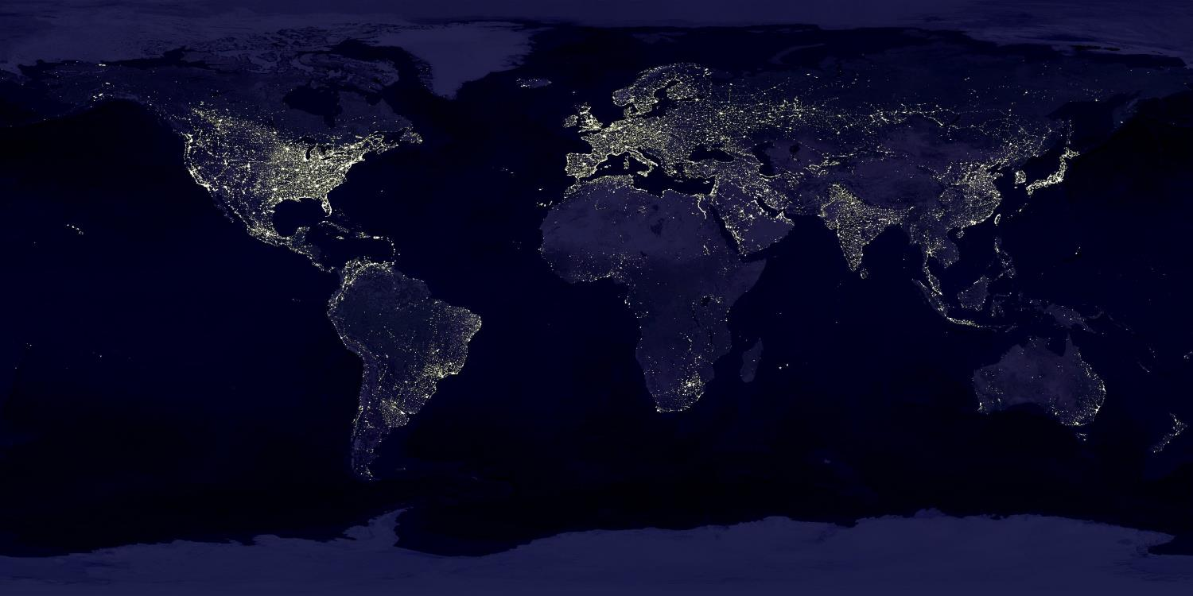
GEOGRAPHY

Slide 17
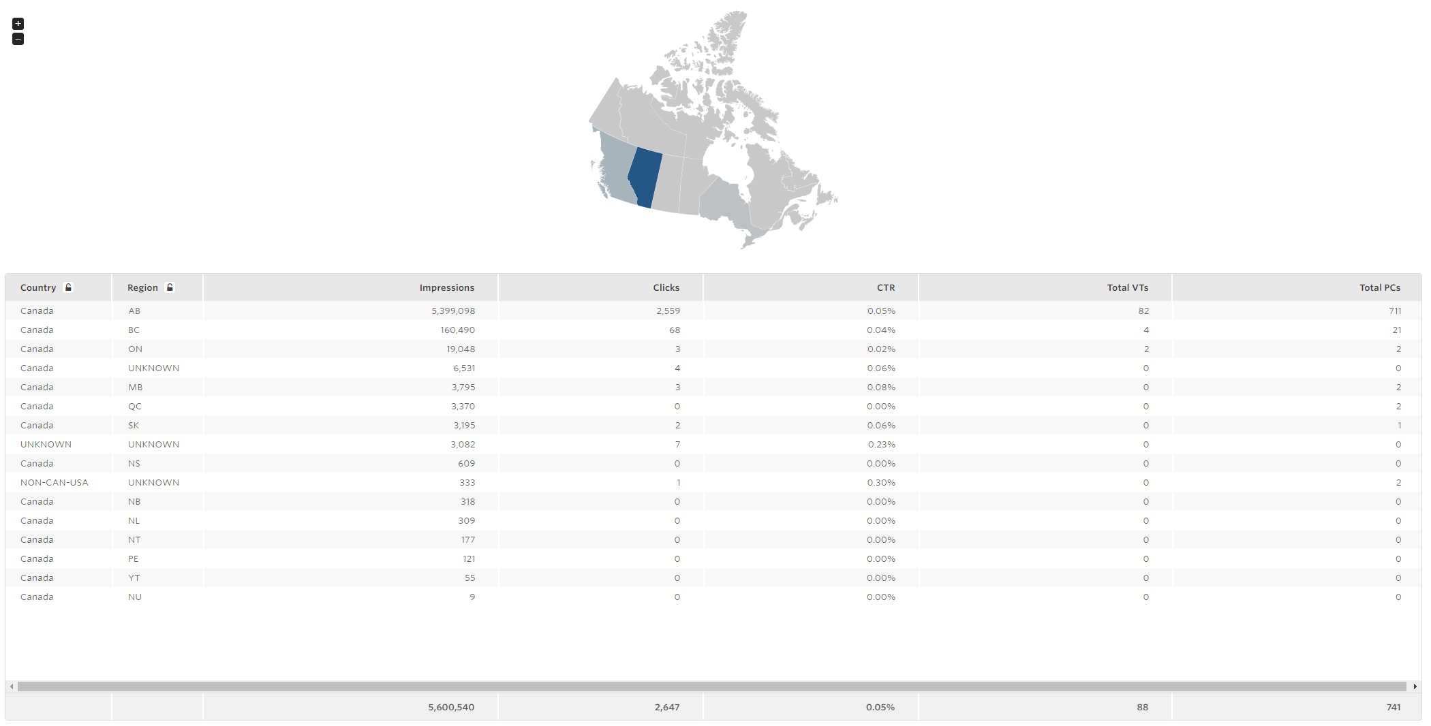
Geography

Slide 18
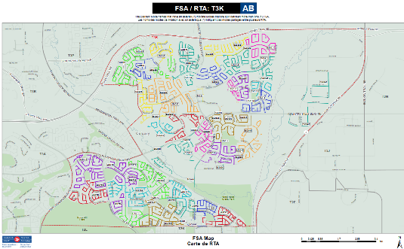
Zip/Postal Code | Country | Region | Impressions | Clicks | CTR
T3H | CA | AB | 443,636 | 208 | 0.05%
T2L | CA | AB | 281,775 | 169 | 0.06%
T3J | CA | AB | 299,382 | 147 | 0.05%
T3G | CA | AB | 261,902 | 143 | 0.05%
T3K | CA | AB | 332,843 | 139 | 0.04%
T2Z | CA | AB | 247,609 | 113 | 0.05%
T2Y | CA | AB | 267,991 | 111 | 0.04%
T2T | CA | AB | 239,918 | 103 | 0.04%
T2A | CA | AB | 185,303 | 98 | 0.05%
T3B | CA | AB | 163,942 | 94 | 0.06%
T2E | CA | AB | 226,769 | 93 | 0.04%
T2J | CA | AB | 176,485 | 92 | 0.05%
T2W | CA | AB | 167,534 | 89 | 0.05%
T2N | CA | AB | 174,000 | 82 | 0.05%
T1Y | CA | AB | 136,758 | 73 | 0.05%
T2V | CA | AB | 150,669 | 72 | 0.05%
T2K | CA | AB | 124,185 | 60 | 0.05%
T3M | CA | AB | 146,079 | 57 | 0.04%
T2X | CA | AB | 120,179 | 57 | 0.05%
T3L | CA | AB | 91,357 | 47 | 0.05%
T3E | CA | AB | 104,263 | 46 | 0.04%
T3A | CA | AB | 83,290 | 43 | 0.05%
T2C | CA | AB | 110,737 | 40 | 0.04%
T2S | CA | AB | 67,790 | 32 | 0.05%
T3R | CA | AB | 93,096 | 30 | 0.03%
T5H | CA | AB | 44,956 | 26 | 0.06%
T2G | CA | AB | 74,828 | 25 | 0.03%
T2R | CA | AB | 74,100 | 24 | 0.03%
T1K | CA | AB | 35,448 | 24 | 0.07%
UNKNOWN | CA | AB | 48,200 | 20 | 0.04%
T4B | CA | AB | 35,197 | 20 | 0.06%
T2P | CA | AB | 53,153 | 20 | 0.04%
UNKNOWN | CA | BC | 48,099 | 17 | 0.04%
T2M | CA | AB | 41,021 | 16 | 0.04%
T3C | CA | AB | 33,358 | 15 | 0.04%
Geography – Top 40
Here is a greater look at the Alberta breakdown specific to postal codes to show performance.
More information on view through from FSA along with clicks, CTR & Post Clicks.
Canada Post offers a great mapping service for further insight.
https://maps.canadapost.ca/RouteFinder/Maps/Current/CPC_SCP_AB_T3K.pdf (Can replace T3K with any 3 digit postal code (T2K, T2T for lookup).

Slide 19
GOOGLE ANALYTICS BREAKDOWN

Slide 20
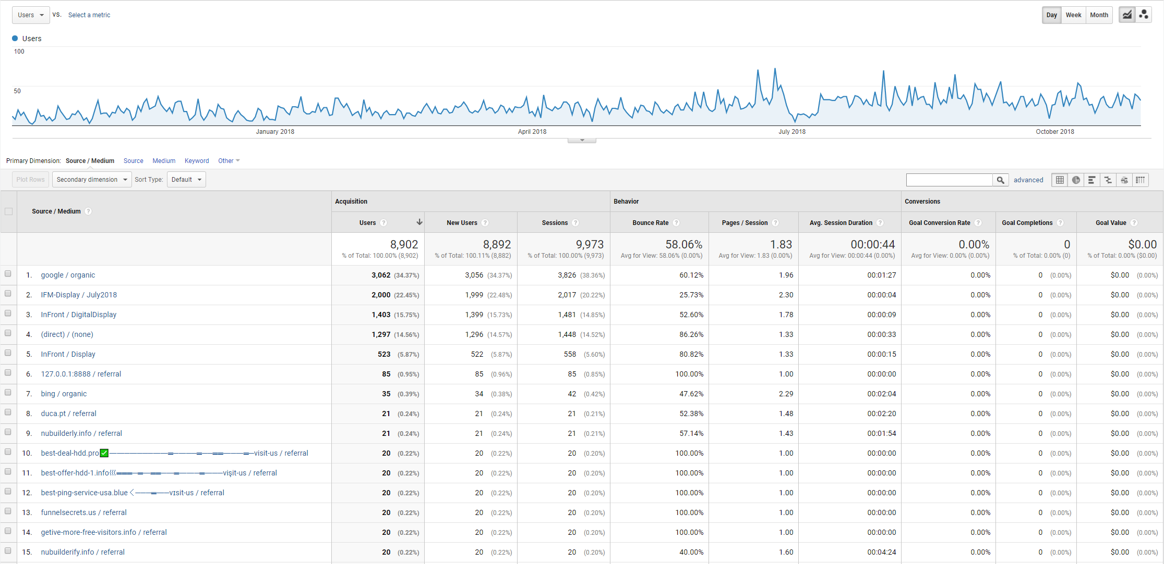
Google Analytics – 1 Full Year
Oct 1, 2017 – Oct 31, 2018

Slide 21
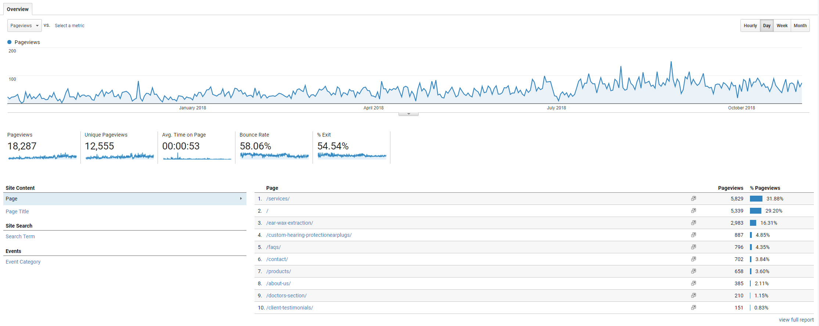
Google Analytics – 1 Full Year
Oct 1, 2017 – Oct 31, 2018

Slide 22
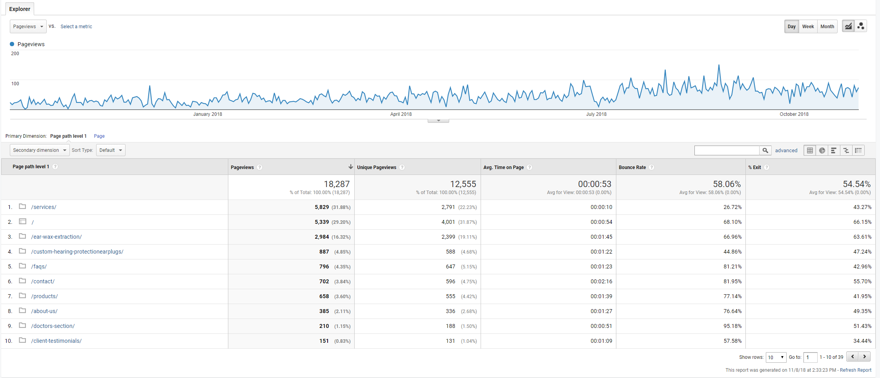
Google Analytics – 1 Full Year
Oct 1, 2017 – Oct 31, 2018

Slide 23
Thank You!
Any questions ?
You can find us at:
john@infrontmarketing.ca
403.861.9727
dave@infrontmarketing.ca
403.891.9295

