Slide 1
Term Project Progress Presentation

Slide 2
Meet the Team “TWIT”
JINWOO JEON
Seungyeop seon
HYUNJAE LEE
BACKEND DEVELOPER
Jeongmin kim
Jane Doe
Jane Doe
Jane Doe
Jane Doe
Team leader
Data Preprocessing,
Collecting chatlogs,
Additional features
Data Preprocessing,
Collecting follows,
Additional features
Query calculation,
Evaluation Function
Presentation,
Evaluation Function
zinuzian@gmail.com
minn951120@naver.com
tjstmdduq94@naver.com
leehj8687@email.com
Notes:
© Copyright Showeet.com – Creative & Free PowerPoint Templates

Slide 3
Contents
3r^{d} week progress
Trouble Shooting
Schedule
Q&A

Slide 4
3nd week progress - Lee
Projectizing all components
IR
App.py
api
Data
downloading

Slide 5
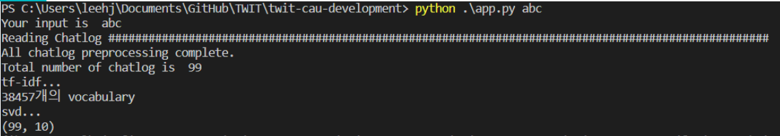
3rd week progress - Lee
2. Test

Slide 6
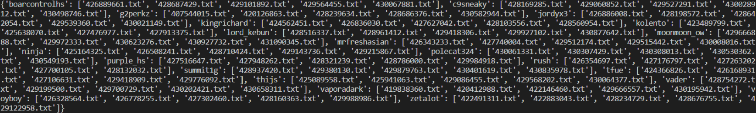
3rd week progress - Lee
Test
Steamers’ infos = { ‘streamer’ name’ : [chatlog1, chatlog2, … ], …}

Slide 7
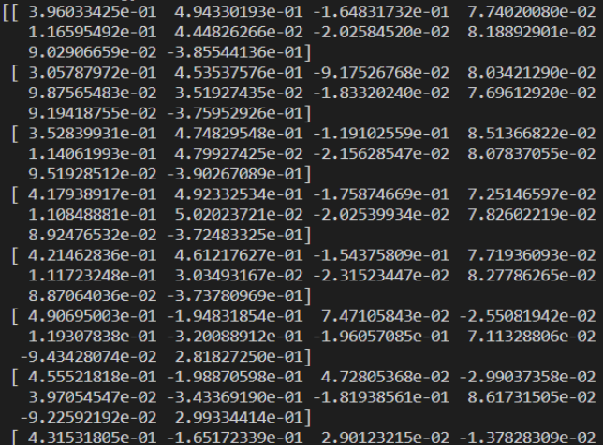
3rd week progress - Lee
Test
SVD result (99,10)

Slide 8
3rd week progress - Jeon
Average SVD result for each streamer
Corpus is given in order of streamer name and videoID.
Corpus
Streamer A
Streamer B
Streamer C
Streamer D
Notes:
문서 읽어오는 순서랑

Slide 9
3rd week progress - Jeon
Average SVD result for each streamer
TF-IDF matrix still has the same order
TF-IDF
Streamer A
Streamer B
Streamer C
Streamer D
Notes:
Tf-idf 생성되는 순서랑 똑같고

Slide 10
3rd week progress - Jeon
Average SVD result for each streamer
Average result : Dictionary with 20 keys, items are list with length 10
SVD
Streamer A
Streamer B
Streamer C
Streamer D
Notes:
Svd 해도 순서는 유지되어서 svd 결과만으로 평균내기가 가능했다.

Slide 11
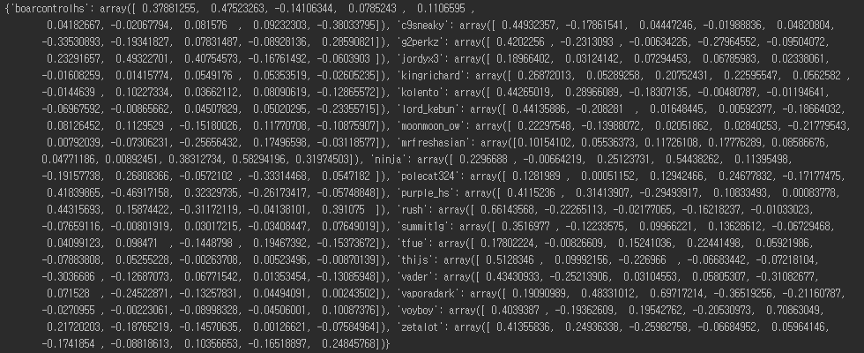
3rd week progress - Jeon
Average SVD result for each streamer
Average result : Dictionary with 20 keys, items are list with length 10

Slide 12
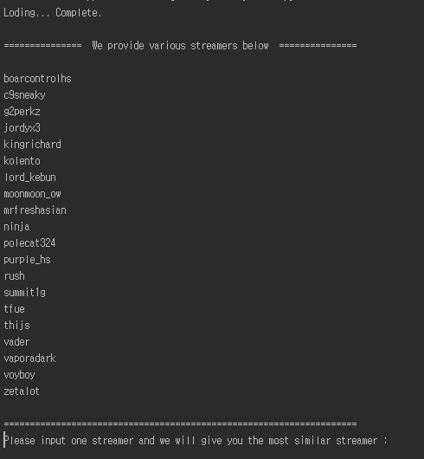
3rd week progress - Jeon
2. Save it as a binary file and load it when program runs.
If StreamerVector.dat doesn’t exist,
we make file
using previous algorithm.
Otherwise, load the file
to eliminate
meaningless calculation.
Notes:
스트리머 벡터 (평균낸거)를 바이너리로 저장하고 로드함
왜? 매 실행마다 계산 무의미

Slide 13
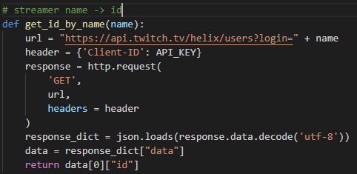
3rd week progress - Kim
Implement function: streamer name -> id

Slide 14
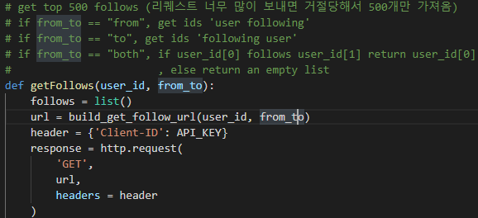
3rd week progress - Kim
Improve getFollows function
Add “both” mode
to implement
evaluation function

Slide 15

3rd week progress - Kim
Make evaluation function how many followers follow other streamer
$$f(one, other)=\frac{followers(other|one)}{followers(one)}$$

Slide 16
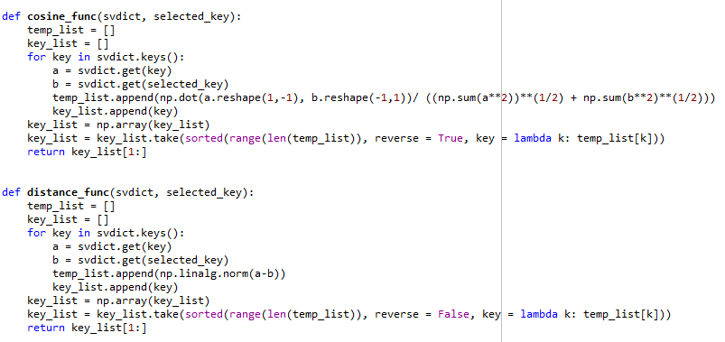
3rd week progress - Seon
Make a evaluation function.
Using cosine similarity
And Euclidian distances.
Notes:
스트리머 벡터 (평균낸거)를 바이너리로 저장하고 로드함
왜? 매 실행마다 계산 무의미

Slide 17
3rd week progress - Seon
When input is voyboy
Cosine Similarity
Euclidian Distance
1 | rush
2 | c9sneaky
3 | summit1g
4 | kingrichard
5 | lord_kebun
6 | boarcontrolhs
1 | jordyx3
2 | rush
3 | tfue
4 | kingrichard
5 | summit1g
6 | c9sneaky
Notes:
스트리머 벡터 (평균낸거)를 바이너리로 저장하고 로드함
왜? 매 실행마다 계산 무의미

Slide 18
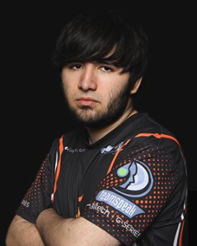
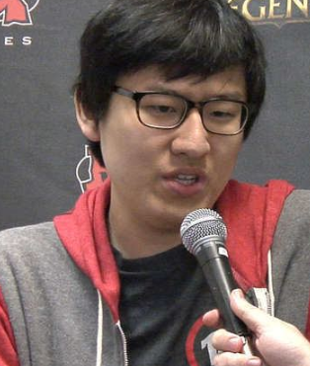
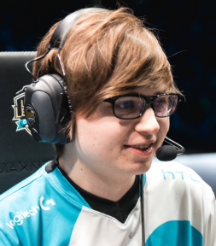
3rd week progress - Seon
A point of sameness
<Voyboy>
<C9sneaky>
<Rush>
- Professional gamer of league of legends
Notes:
스트리머 벡터 (평균낸거)를 바이너리로 저장하고 로드함
왜? 매 실행마다 계산 무의미

Slide 19
3rd week progress - Seon
As a result,
- The recommendation of streamers through chat logs shows reasonable results.
- The method of Cosine Similarity shows better performance than Euclidian Distance one.
Notes:
스트리머 벡터 (평균낸거)를 바이너리로 저장하고 로드함
왜? 매 실행마다 계산 무의미

Slide 20
Development plans
Week | Plan
1st | Collecting chat logs and follows
2nd | Data preprocessing and query calculation
3rd | Developing evaluation function
4th | Additional features

Slide 21
Thank you!
Merci!

