Slide 1
Term Project Proposal Presentation

Slide 2

Hello!
We are “TWIT”

Slide 3
Meet the Team
JINWOO JEON
Seungyeop seon
HYUNJAE LEE
BACKEND DEVELOPER
Jeongmin kim
Jane Doe
Jane Doe
Jane Doe
Jane Doe
Team leader
Data Preprocessing,
Collecting chatlogs,
Additional features
Data Preprocessing,
Collecting tags,
Additional features
Query calculation,
Evaluation Function
Presentation,
Evaluation Function
zinuzian@gmail.com
minn951120@naver.com
tjstmdduq94@naver.com
leehj8687@email.com
Notes:
© Copyright Showeet.com – Creative & Free PowerPoint Templates

Slide 4
Contents
1st week progress
Trouble Shooting
Schedule
Q&A

Slide 5
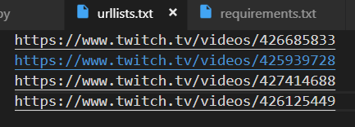

1st week progress
Collecting Chatlog
Video URL List

Slide 6
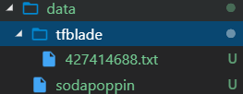
1st week progress
Collecting Chatlog
Saved under
{%home%}\data\Streamer_Name\

Slide 7
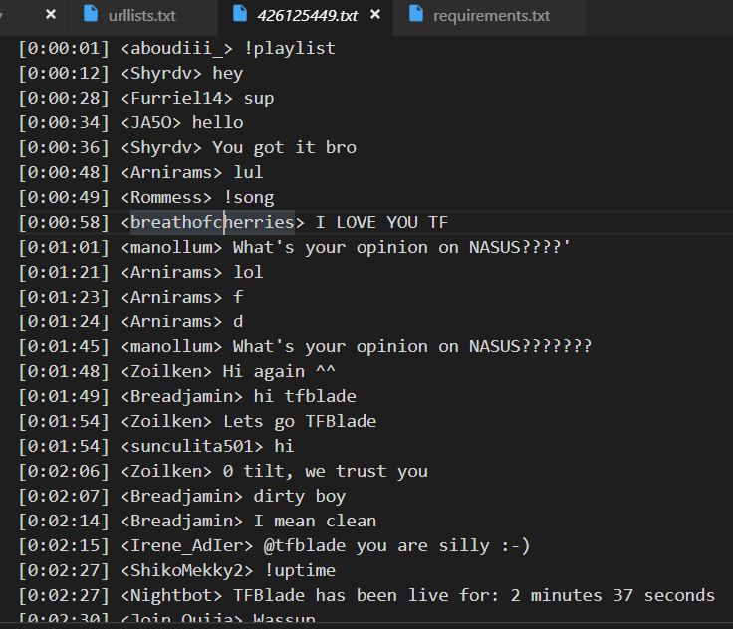
1st week progress
Collecting Chatlog
[timestamp] <user_name> chat

Slide 8
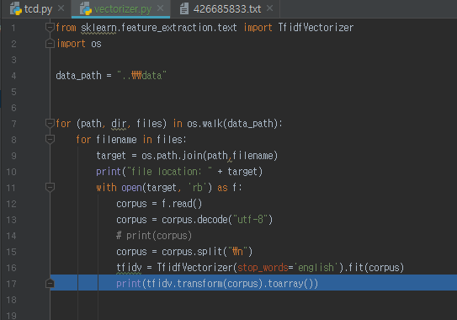
1st week progress
Data Preprocessing (Ongoing)
Using scikit-learn
TF-IDF Vectorizer
Emojis are all around the chatlog.
-> solved using UTF-8 encoding
Remove stop words

Slide 9
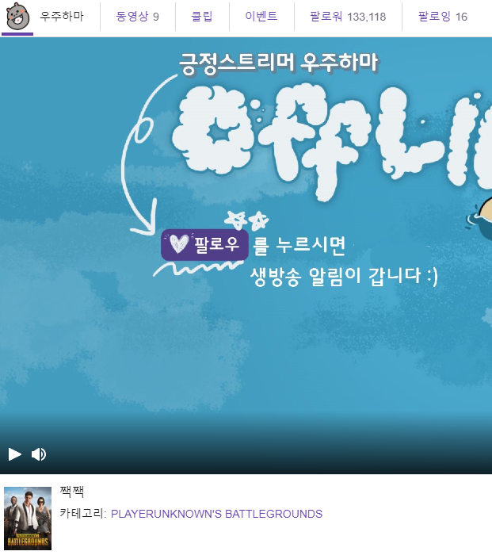
Trouble Shooting
Tags
Most of the streamers don’t use tags
Use followers (or category)

Slide 10

Trouble Shooting
Similarity between two streamers (Evaluation)
$$sim\left(q,r\right)=\frac{followers\left(q\right)∩followers(r) }{followers(q)}$$

Slide 11
Development plans
Week | Plan
1st | Collecting chat logs and tags
2nd | Data preprocessing and query calculation
3rd | Developing evaluation function
4th | Additional features

Slide 12
Thank you!
Merci!

