Slide 1


Scrum 3 Team Project
CRUD AJAJ-PHP-MySQL Web Service

Slide 2

Team Members
Devon Leedy
Tristan Lake
Jeremy Kirkpatrick

Slide 3
Assignment Goals
- Build a CRUD Web Service
- Use PHP (OOP)
- Connect to MySQL
- Return JSON via API
- Use AJAJ (AJAX + JSON)

Slide 4

Technologies Used
- PHP (OOP)
- MySQL
- JavaScript (AJAX)
- HTML/CSS
- JSON APIs

Slide 5

Project Structure
Scrum3_Team_3
- Provider_3 (Backend)
- Client_3 (Frontend)
- Classes, API, Testers, SQL, Diagrams

Slide 6
Database Design
3 Tables:
- Directors
- Movies
- Reviews
Each table has 5+ fields and 7+ records

Slide 7
Backend (Provider_3)
- DB class (connection)
- CRUD functions (Insert, Read, Update, Delete)
- Separate classes per table

Slide 8
API Layer
API_3.php returns JSON
Handles:
- GET (Read)
- POST (Insert)
- PUT (Update)
- DELETE

Slide 9

Frontend (Client_3)
- index.html
- Uses JavaScript (AJAX)
- Calls API
- Displays results using innerHTML

Slide 10
Testers
- Located in Provider_3/Testers
- Test all CRUD operations
- Display JSON outputs

Slide 11
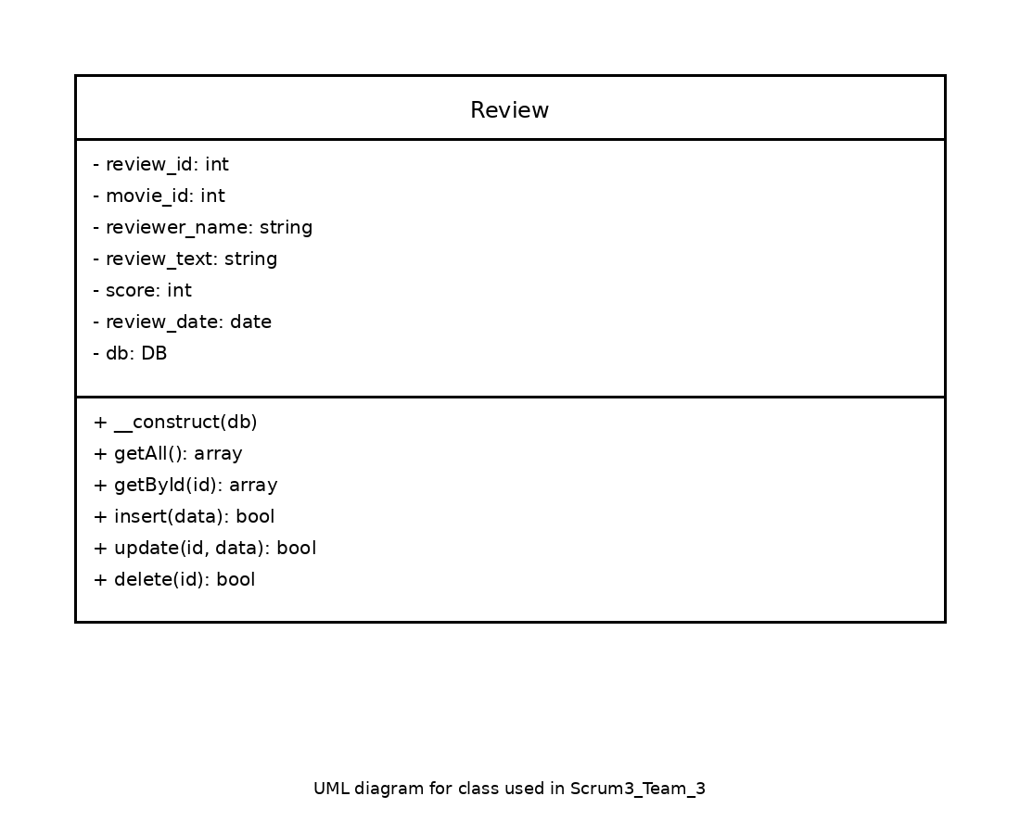
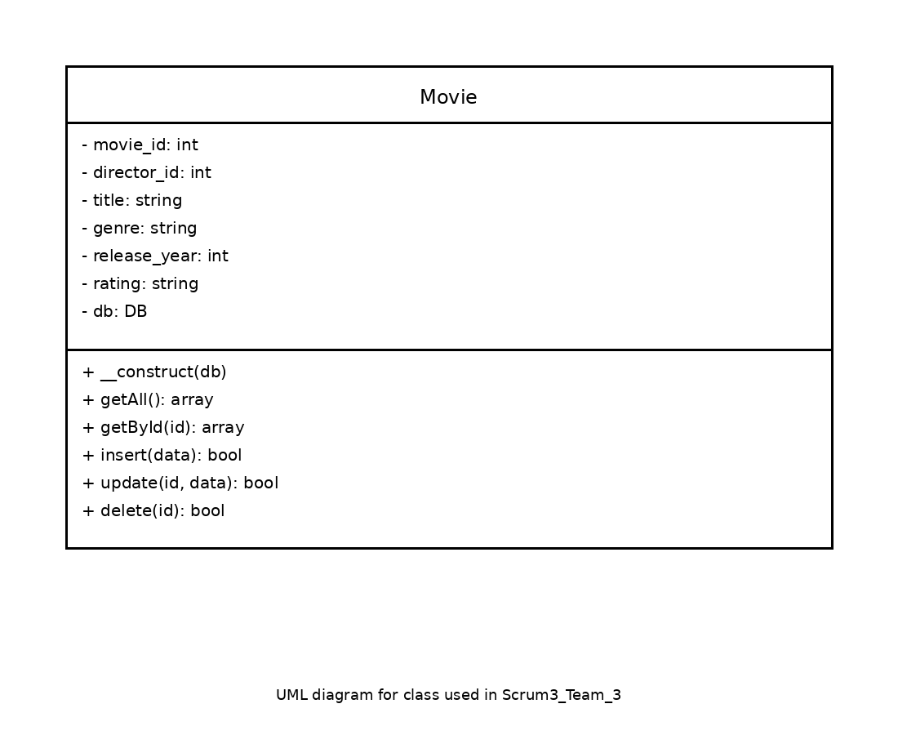

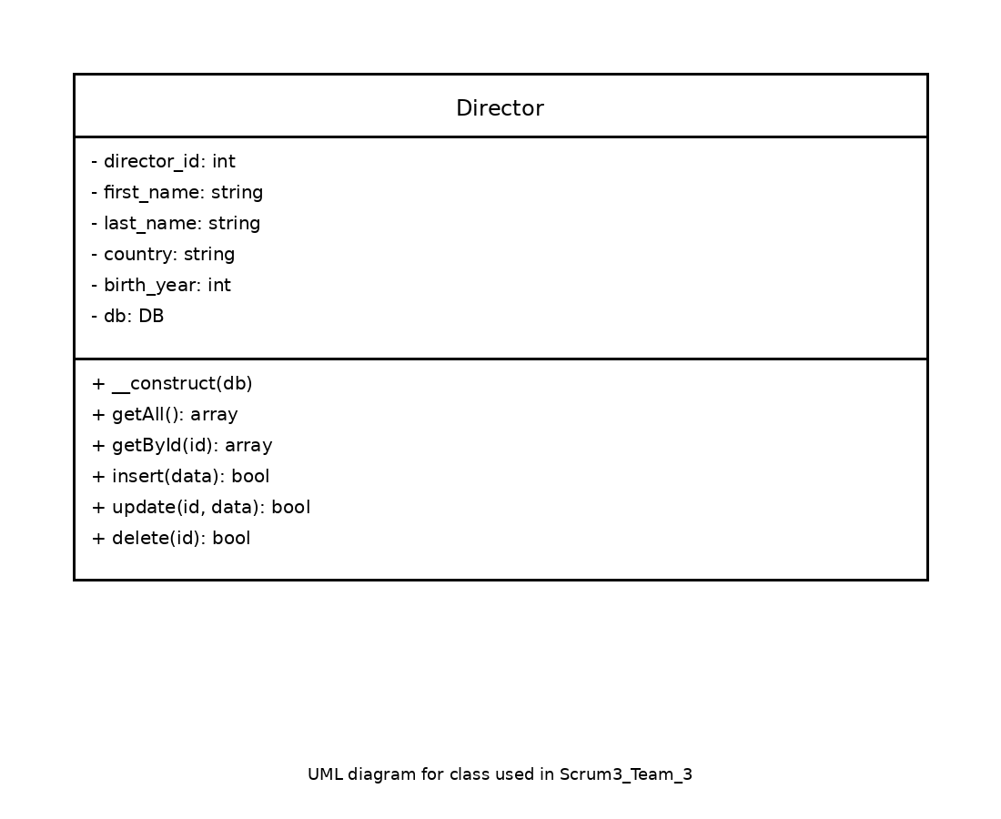
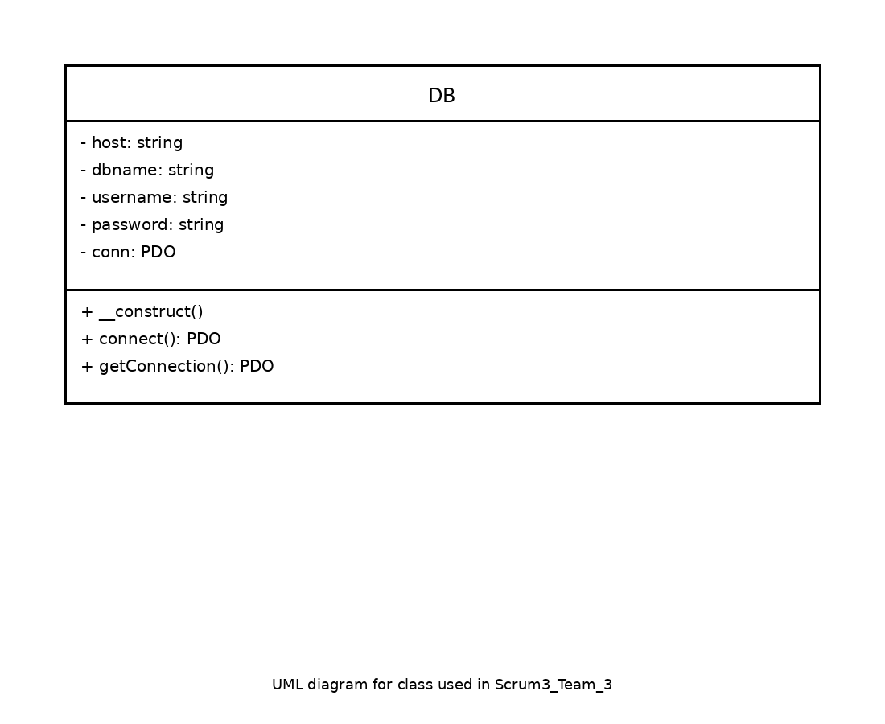
UML Diagrams
- DB class
- Director class
- Movie class
- Review class
- Shows relationships

Slide 12
How to Test the System
Open
Open Client index.html
Perform
Perform CRUD operations
Run
Run Testers
View
View JSON/API output

Slide 13

Debugging Methods
Check
- Check browser console
Use
- Use echo/print in PHP
Validate
- Validate JSON output
Test
- Test endpoints directly

Slide 14
Challenges & Solutions
- Connecting frontend to API
- Fixing JSON formatting
- Handling CRUD properly
Solution: Step-by-step testing

Slide 15
Conclusion
Successfully built a full CRUD Web Service
Learned backend + frontend integration

