Slide 1
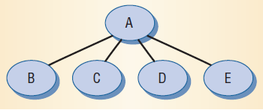
Leveraging Social Networks to Fight Spam
P. Boykin and V. Roychowdhury, Computer (April 2005).
A particular scenario: For an individual user, create her contacts’ interaction network.
Star subnetwork per email: Subgraph represents e-mail interaction generated by a message sent from A to B and C and cc’d to D and E. These networks are then aggregated.
Notes:
1. there's this little harmless looking insect called a locust, but, outbreaks of locust swarms are big threats to our food security;
2. (state the data source of the plot); from the plot, we see that locust outbreak is very bursty (we see a devastating outbreak every ... years approximately)
3. a locust outbreak is similar in concept fundamentally to any other outbreak we observe in life, such as outbreaks of flu; basically, each locust has x number of offsprings, or each flu-infected person can pass the flu onto x number of other individuals; if x surpasses one, epidemic outbreaks are likely;
4. now, for the locust, rainfall is important: heavy rains -> locust eggs absorb moisture and hatch (i.e. greatly increase number of offsprings per locust) -> Locust Plague!

Slide 2
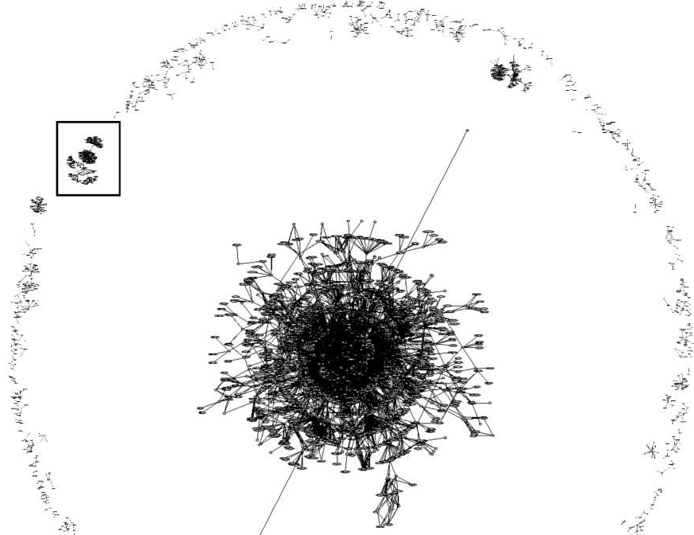
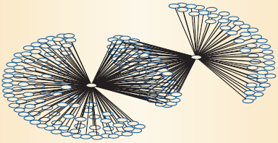
Structure of the Network
A Subgraph of the giant connected component: no node shares a neighbor with any of its neighbors.
What is happening? Two
spammers share many co-recipients
(middle nodes).
Notes:
1. there's this little harmless looking insect called a locust, but, outbreaks of locust swarms are big threats to our food security;
2. (state the data source of the plot); from the plot, we see that locust outbreak is very bursty (we see a devastating outbreak every ... years approximately)
3. a locust outbreak is similar in concept fundamentally to any other outbreak we observe in life, such as outbreaks of flu; basically, each locust has x number of offsprings, or each flu-infected person can pass the flu onto x number of other individuals; if x surpasses one, epidemic outbreaks are likely;
4. now, for the locust, rainfall is important: heavy rains -> locust eggs absorb moisture and hatch (i.e. greatly increase number of offsprings per locust) -> Locust Plague!

Slide 3
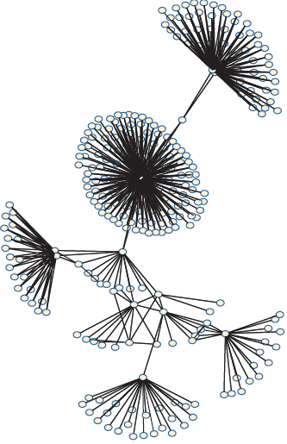
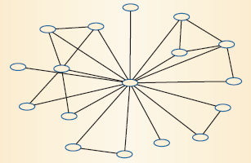
Friends’ subnetworks
Subgraph of a nonspam component: Shows a higher incidence of triangle structures (neighbors sharing neighbors) than the spam subgraph. In this component, around 67 percent of the nodes are connected to each other.
Notes:
1. there's this little harmless looking insect called a locust, but, outbreaks of locust swarms are big threats to our food security;
2. (state the data source of the plot); from the plot, we see that locust outbreak is very bursty (we see a devastating outbreak every ... years approximately)
3. a locust outbreak is similar in concept fundamentally to any other outbreak we observe in life, such as outbreaks of flu; basically, each locust has x number of offsprings, or each flu-infected person can pass the flu onto x number of other individuals; if x surpasses one, epidemic outbreaks are likely;
4. now, for the locust, rainfall is important: heavy rains -> locust eggs absorb moisture and hatch (i.e. greatly increase number of offsprings per locust) -> Locust Plague!

Slide 4
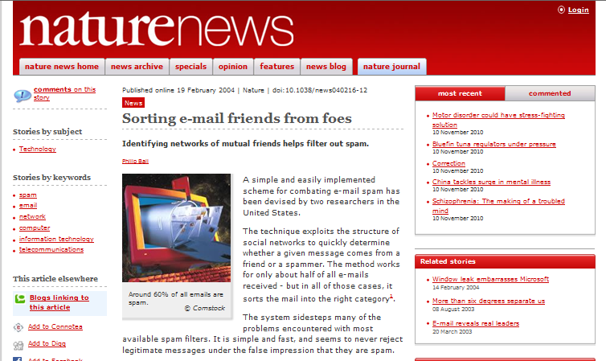
Putting Structure to Work

Slide 5
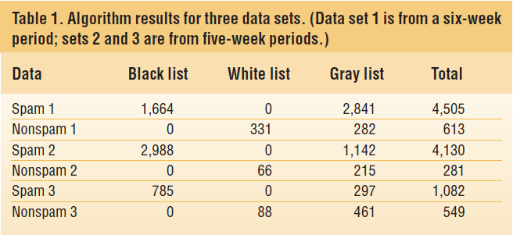
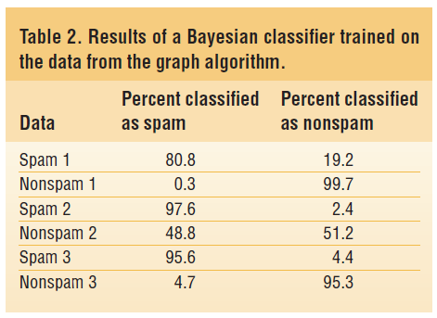
Sorting Email Friends from Foes
We break the complete network into components and then use a number of metrics including, clustering coefficient, degree distribution, and classify nodes as in (i) White List, (ii) Black List, or (iii) Gray list.
Notes:
1. there's this little harmless looking insect called a locust, but, outbreaks of locust swarms are big threats to our food security;
2. (state the data source of the plot); from the plot, we see that locust outbreak is very bursty (we see a devastating outbreak every ... years approximately)
3. a locust outbreak is similar in concept fundamentally to any other outbreak we observe in life, such as outbreaks of flu; basically, each locust has x number of offsprings, or each flu-infected person can pass the flu onto x number of other individuals; if x surpasses one, epidemic outbreaks are likely;
4. now, for the locust, rainfall is important: heavy rains -> locust eggs absorb moisture and hatch (i.e. greatly increase number of offsprings per locust) -> Locust Plague!

Slide 6
Spam Filtering and
Global Social Email Networks
  Vwani Roychowdhury
  Department of Electrical Engineering, UCLA
  Joint work with:
  Joseph S. Kong, Oscar Boykin, Behnam Rezaei, Nima Sarshar

Slide 7
Motivation
In the previous presentation, we see that the personal email network can be harnessed to filter spam.
This naturally begs the question: can the global social email network, which reaches hundreds of millions of users worldwide, be harnessed to help fight spam?

Slide 8
Presentation Overview
Collaborative Spam Filter Design
Related Work
Email Network as a Distributed Platform
Scalable Percolation Search
System Implementation and Design
Simulation Results
Malicious Infiltration and Trust Schemes

Slide 9
Collaborative Spam Filter Design
A collaborative spam filter uses the collective memory of, and feedback from, the users to reliably identify spams.
There are three main challenges facing collaborative spam filter design:
  How to find and connect users?:
  How to make the search scalable?:
  Who to trust?

Slide 10
Existing Design and Solutions
SpamNet: central server design, server-based search, seniority trust scheme.
Vipul's Razor (open source version of SpamNet).
SpamWatch: distributed hash table (DHT) P2P network design, approximate text addressing (ATA) search scheme. [Zhou03]

Slide 11
Harnessing the Email Network
The basic idea: instead of using dedicated central servers or P2P systems, we use our latent social email network as the distributed spam filter platform.
All queries and communications are exchanged via background email through personal contacts.
Motivation: we should exploit our existing network to find and connect users.

Slide 12
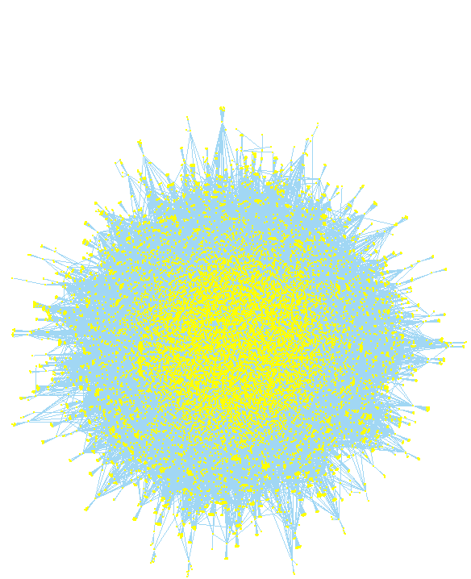
Topology of Email Networks
Email network:
nodes = email addresses;
edges = email exchanges in
either direction.
Email network data [Ebel02]:
56,969 nodes, 84,190 edges
PL degree distribution:
P(k) / k^{-1.81}
We can utilize the scalable percolation search algorithm on this naturally power-law network to search.
Real-world email network [Ebel02]

Slide 13
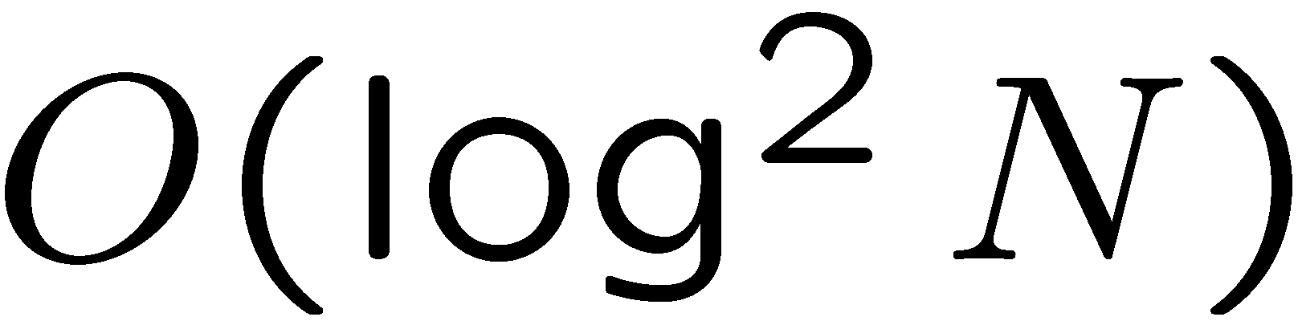
Percolation Search [Sarshar04]
N. Sarshar, P. Boykin, and V. Roychowdhury. Percolation search in power law networks: Making unstructured peer-to-peer networks scalable. In Proceedings of the 4th IEEE international conference on peer-to-peer computing, 2004.
Developed in the UCLA Complex Networks Lab led by Prof. Roychowdhury.
Provably solves the search scalability problem in unstructured P2P networks.
Even rare items can be found with probability 1, while keeping the traffic scalable ( for the optimal network topology).
Offers comparable performance to Distributed Hash Table (DHT) object location schemes but in an unstructured network.

Slide 14
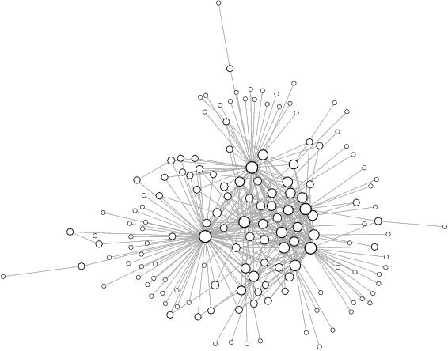
Bond Percolation Theory
Consider the random network below (153 nodes, 366 edges).

Slide 15
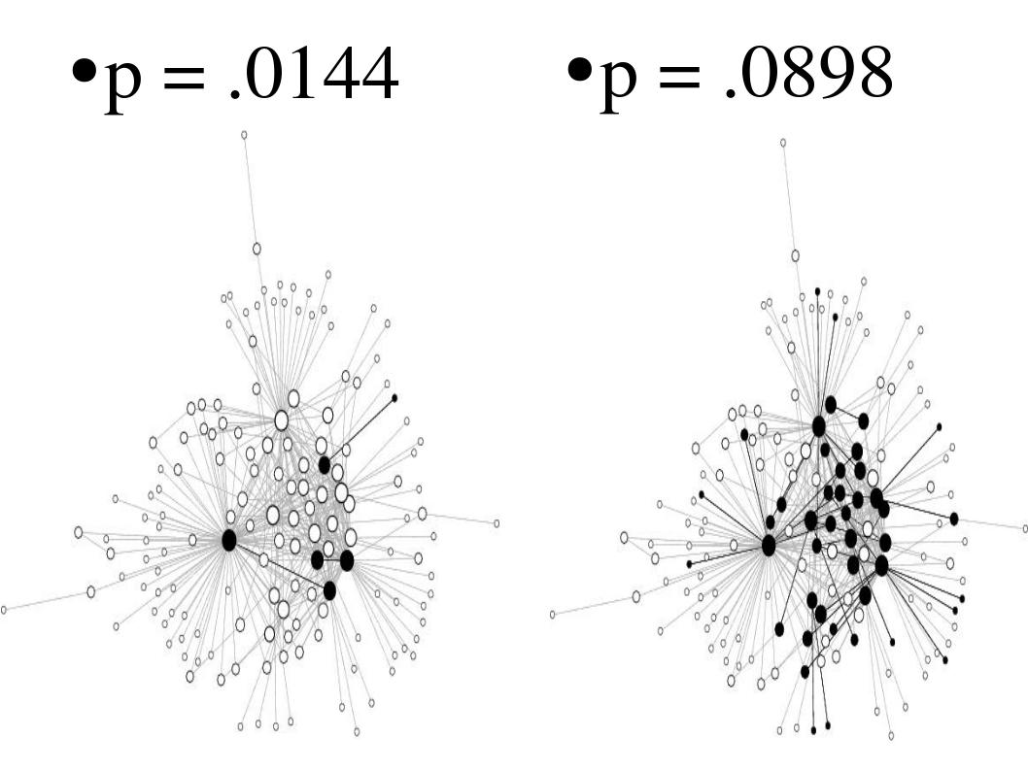
Bond Percolation Theory
Bond percolating with probability p means to keep each edge with probability p.

Slide 16
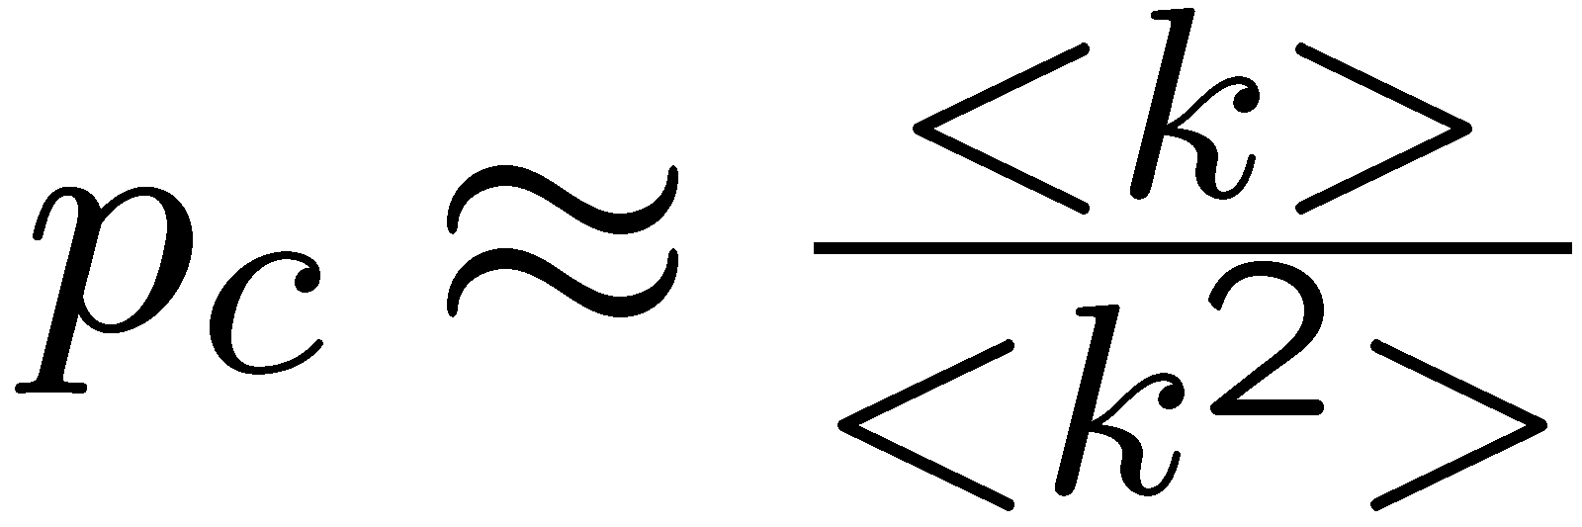
Percolation Threshold
The percolation threshold p_{c} of a network is defined as followed:
for a network , p_{c} ¼.0359 for our sample network.
if p < p_{c}, the percolated network consists of small and disconnected components;
if p > p_{c}, a giant connected component (GCC) emerges.

Slide 17
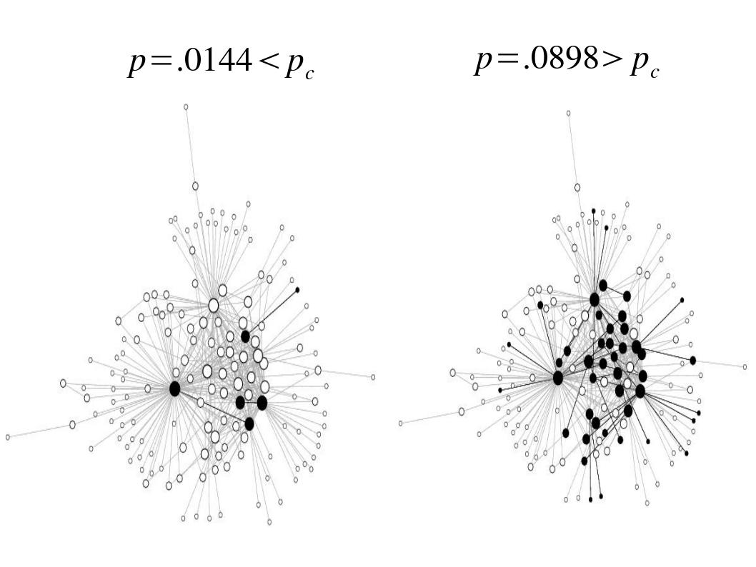
Percolation Threshold

Slide 18
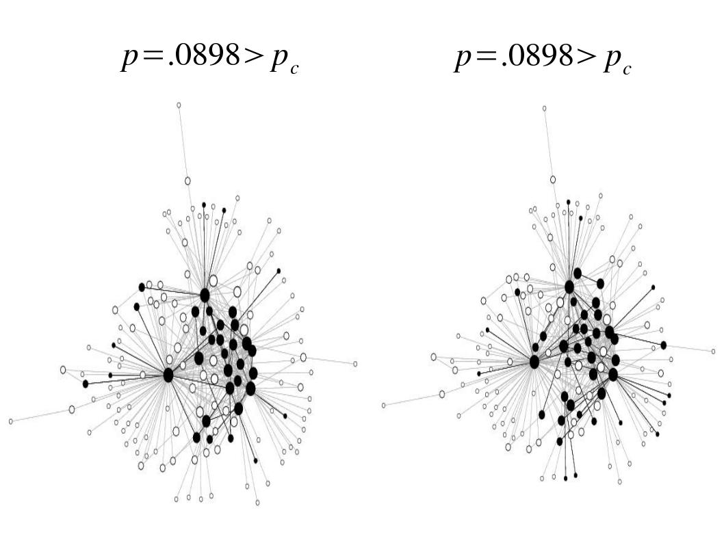
Percolation Search
For p > p_{c}, the high degree nodes almost suredly remain in the giant connected component of the percolated network.
Realization 1
Realization 2

Slide 19
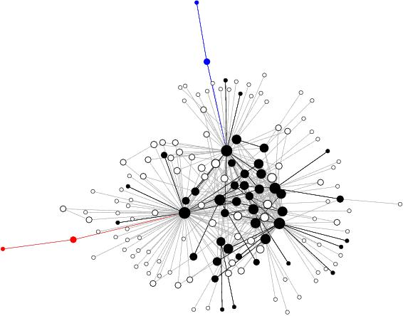
Percolation Search
The idea: start queries from high degree nodes AND cache contents at high degree nodes; high degree nodes can find each other by percolation.
To find high degree nodes,
do a random walk with
log(N) hops.
1. Content caching
3. Bond percolation
2. Query implantation

Slide 20
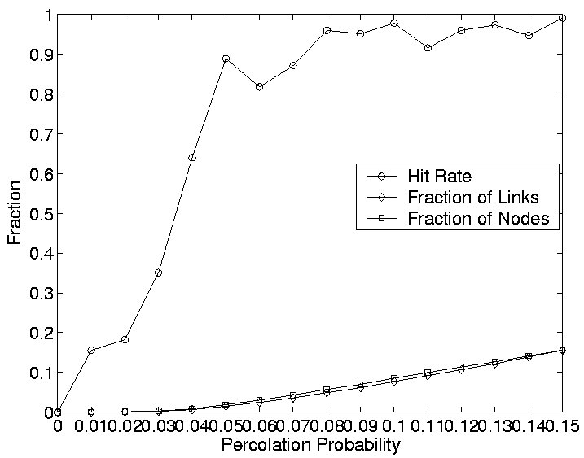
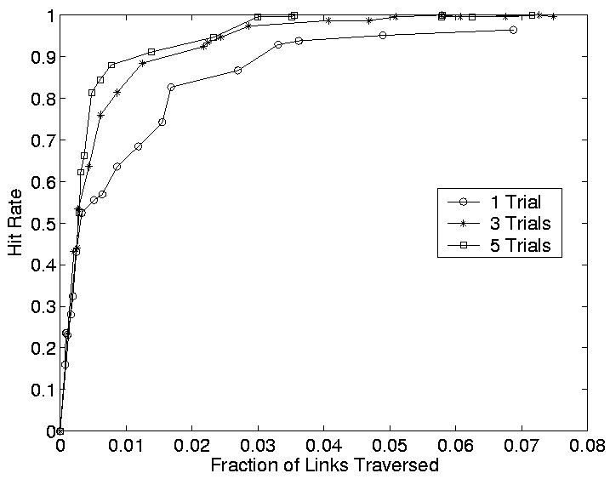
Percolation Search on Email Net
Simulating percolation search on real-world email network: only one unique copy of the desired content exists on the network of 56,969 nodes. A node is chosen uniformly randomly to search for this unique content.

Slide 21
Build a Distributed Spam Filter!
Use the digest-based mechanisms to index spams.
Use our latent social email network as the distributed platform.
Use the efficient percolation search protocol to query for suspected spam messages indexed by digests.

Slide 22
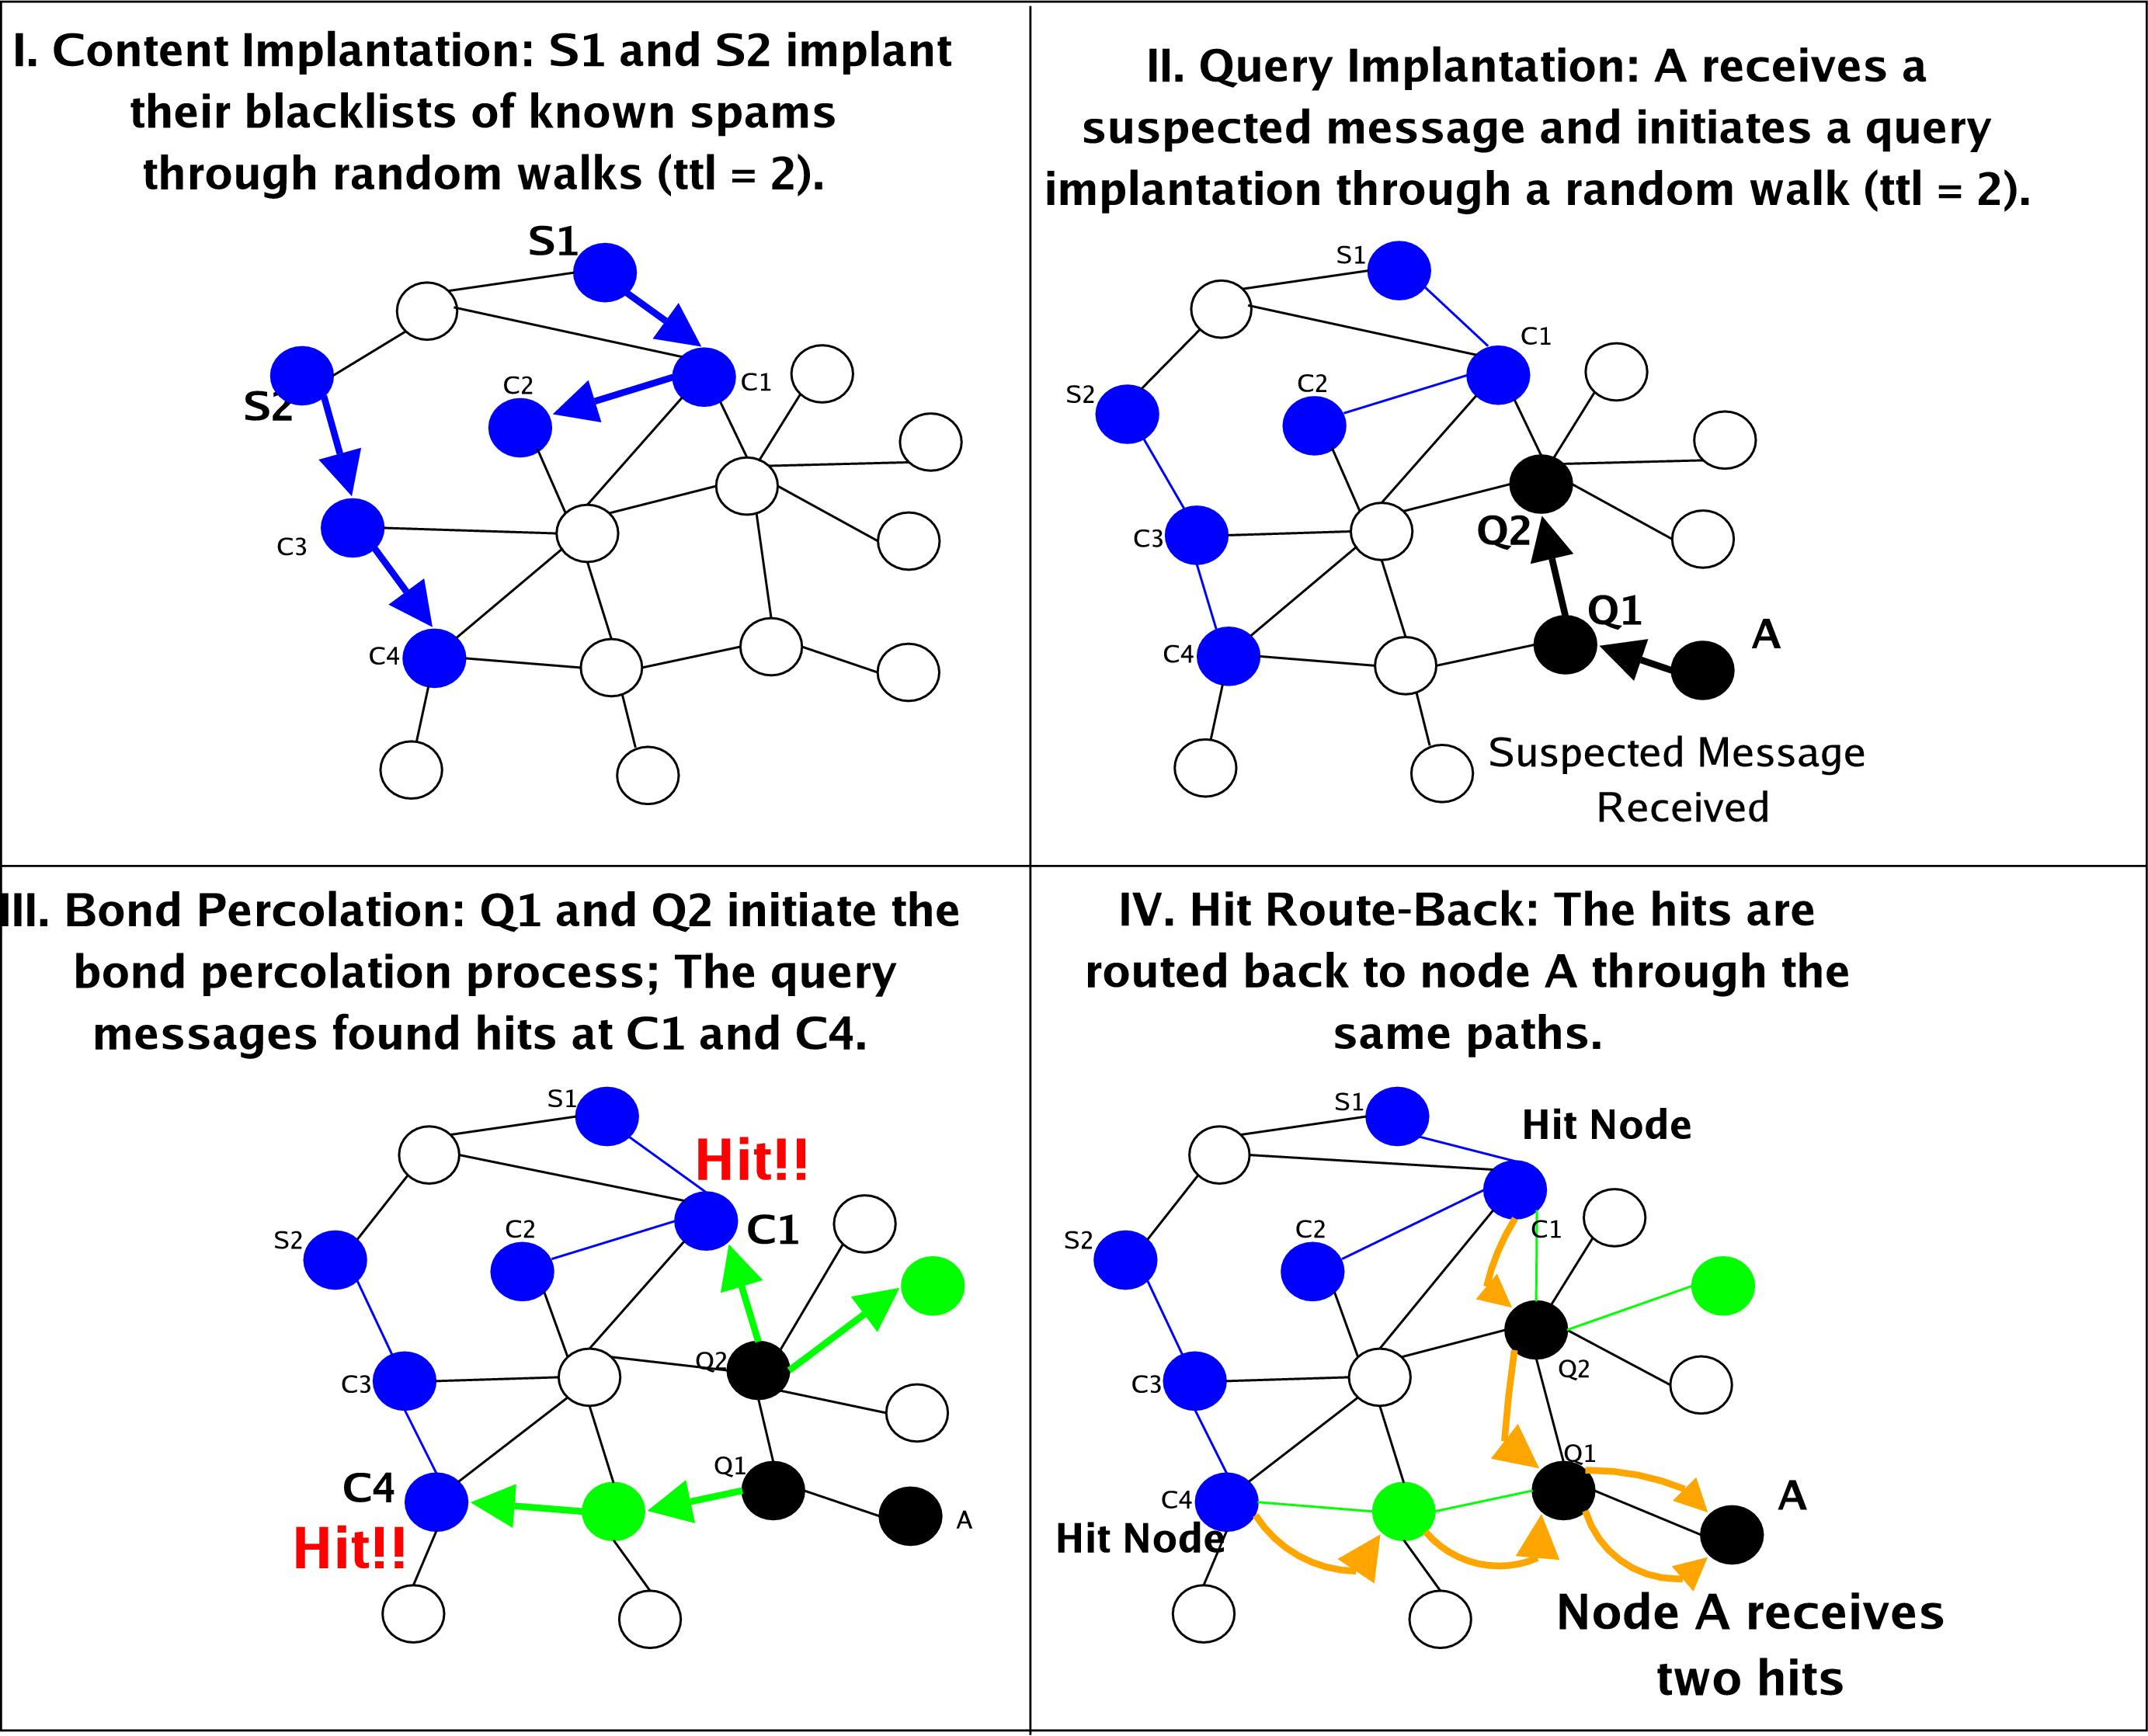
System Protocol

Slide 23
Spam rec’vd
Hit!!
Content caching
Bond percolationation at p = 0.2
No
No
Yes
No
No
Yes
No
No
Yes
No
Suspected message rec’vd
Query implantation
No
No

Slide 24
Distributed Client Implementation
Implement the system as a plug-in to any email client such as Sendmail.
Any other existing spam filter can be used to do initial filtering.
All system messages (e.g. queries, hit returns and content caching) can be done via background email exchanges.

Slide 25
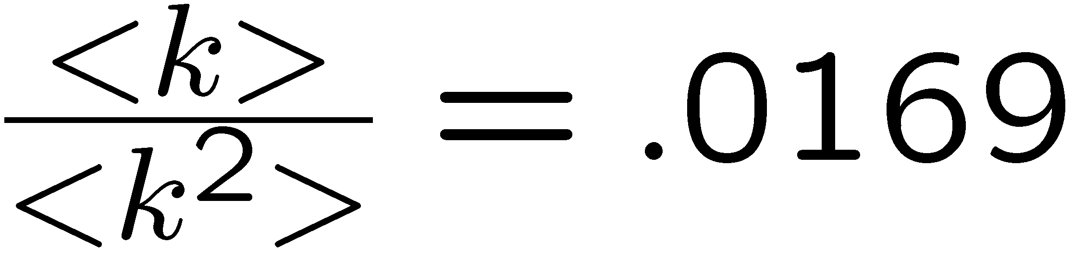
Simulation on Real Email Net
Number of Nodes | 56,969
Number of Edges | 84,190
Node Degree Distribution | Power-Law (exp = 1.8)
Bond Percolation Threshold
Time-to-Live (TTL) | 50
# of arrivals of the same spam | 500
# of hits needed to id spam | 2
# of runs | 30

Slide 26
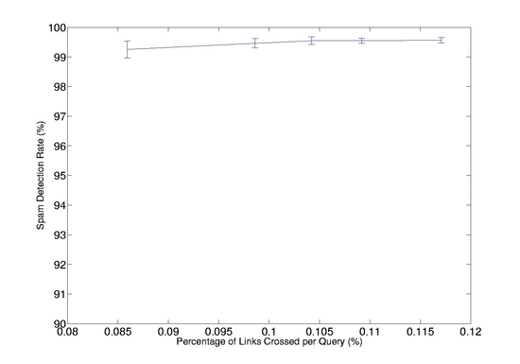
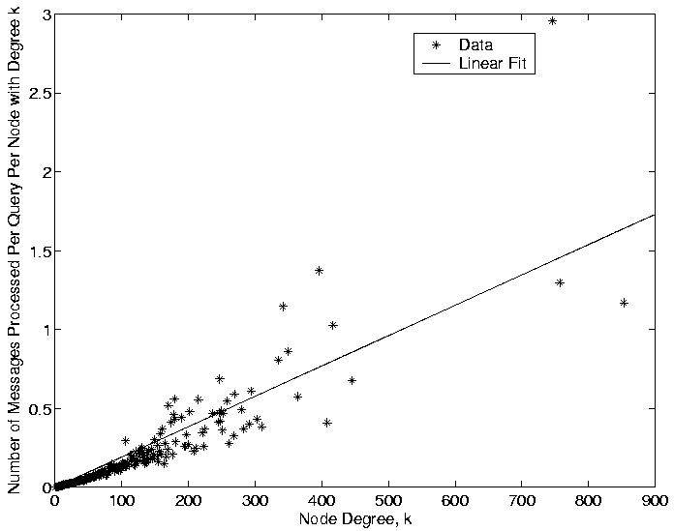
Simulation Results
Detection rate vs. traffic.
Traffic vs. node degree.

Slide 27
Infiltration and MailTrust
Malicious users will attempt to subvert the system.
We propose an eigen-based trust scheme.
The topological structure of the social email networks can be used to assign trust or reputation to individual users (just like PageRank).
Model each email contact as placing a unit of trust on the recipient.
Model the whole graph as a discrete time Markov chain.

Slide 28
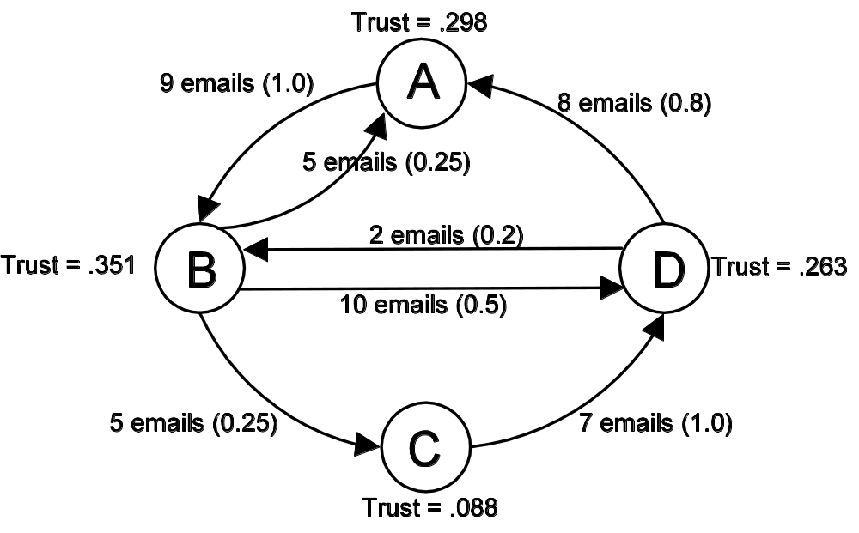
Simple Illustration of MailTrust

Slide 29
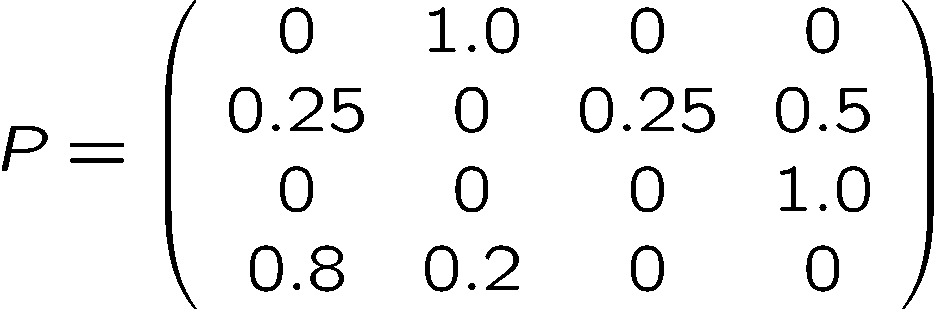
Markov Chain (Cont’d)
Using the example on the previous slide, we can construct the following transition matrix:

Slide 30
Markov Chain (Cont’d)
In addition, we must ensure that the Markov Chain is ergodic.
In email network, this means that nodes must out-links.
This can be achieved by having nodes with zero out-degree assign uniform trust to a set of pre-trusted nodes who have been carefully picked.

Slide 31
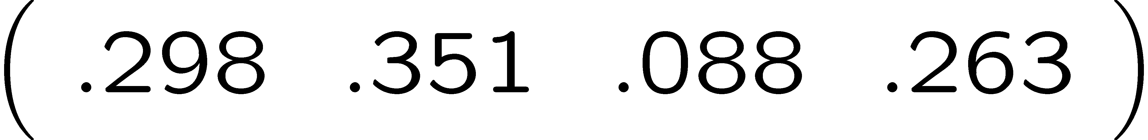
Markov Chain (Cont’d)
In order to find the MailTrust score, compute the steady state probability distribution, which corresponds to the principal eigenvector of P.
Can be done efficiently using the Power Iteration method.
Using this method, the MailTrust score vector for our example are found to be: .
The MailTrust scores are computed in a distributed fashion (see a paper by Kamvar et al. ACM WWW 03).

Slide 32
MailTrust Simulation Setup
A malicious node can subvert the system by introducing blacklists of well-known valid messages into the network.
Note that this form of attack will only raise the false positive rate of the system and it has no impact on the spam detection rate.
a small fraction of nodes in the network (250 nodes) will be labelled as malicious nodes and these malicious nodes will blacklist nonspams from popular mailing lists;

Slide 33
MailTrust Simulation Setup (Cont’d)
The malicious nodes will follow all specifications of the protocol such as forwarding and routing queries and storing cache implants for other nodes.
The MailTrust scheme results in about 50% improvement in lowering the false positive rate.

Slide 34
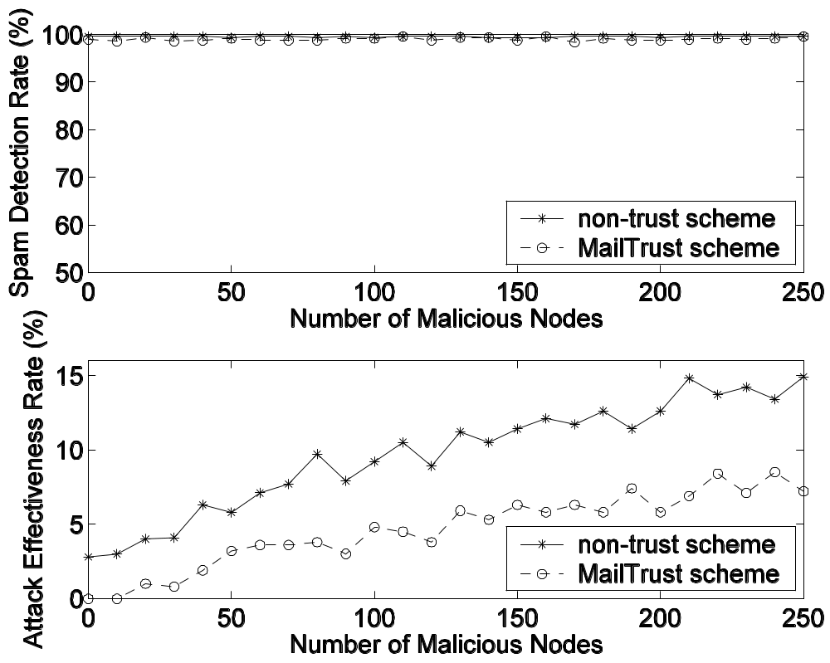
MailTrust Simulation Results

Slide 35
Summary
We presented a distributed collaborative anti-spam system.
Can be implemented as a simple plug-in.
Delivers superior performance while keeping bandwidth cost on the internet extremely low.
MailTrust scheme is effective in deterring malicious users.
A more comprehensive version is available on: http://arxiv.org/abs/physics/0504026
Journal version will soon appear on IEEE Computer.

Slide 36
Case Study
Information Resonance on Twitter: Watching Iran
The so-called Green Revolution/Movement that followed a highly controversial election in Iran.
Notes:
Hi everyone, my name is Zicong. Thank you all for coming to my thesis talk. The title of my thesis is Information dynamics in social interactions: hidden structure discovery and empirical case studies.

Slide 37
Twitter’s Features as Social Medium
A 140-character limit on each user's message (tweet), which plays a role in shaping the types of messages that are posted and shared.
A directed social network of friends and followers, where a user’s message is sent to all its followers. This provides a viral or point-to-point channel for information transmission via Retweet (RT).
The public timeline, which provides real time access to tweets on specific topics for everyone. This provides a broadcast channel for information transfer, which can then feed into the point-to-point channel.

Slide 38
Measurement Methodology
We collected tweets of more than 20 million publicly accessible users on Twitter and analyzed over three million tweets related to the Iranian election posted by around 500K users during June and July of 2009.
Based on our coverage estimation, our dataset covers 89.6% of users and 96.9% of tweets relevant to the subject of Iranian Election on Twitter.
We only consider the tweets that have related keywords. [J.Beilin et al, Web Ecology Project, 2010]
We use digests technique to infer the link.
[E.Damiani et al, IEEE P2P, 2004]

Slide 39
Questions we Ask
How does a message resonate and spread widely among the users on Twitter? That is, how do the information cascades form and propagate?
Is there a pattern to the types of messages that find large resonance and spread through the network?
Are the resulting cascade dynamics different from those reported in the literature (for example, in the context of links to posts in the blogosphere), due to the unique features of Twitter?
Given the existence of both broadcast and point-to-point channels of communication in Twitter, what relative roles do they play in the cascades?

Slide 40
Our Approach
We study information cascades dealing with specific events, such as the Iranian Election, Death of Michael Jackson and the Swine Flu outbreak.
The cascades, their distributions, shapes and frequency are studied within the same event space.
Toward this, we determine the set of all active users for a topic, and analyze their status messages to build the Tweet networks.
We also study the underlying event-based Friends -Followers (F-F) network comprising only the active users, and investigate its role.

Slide 41
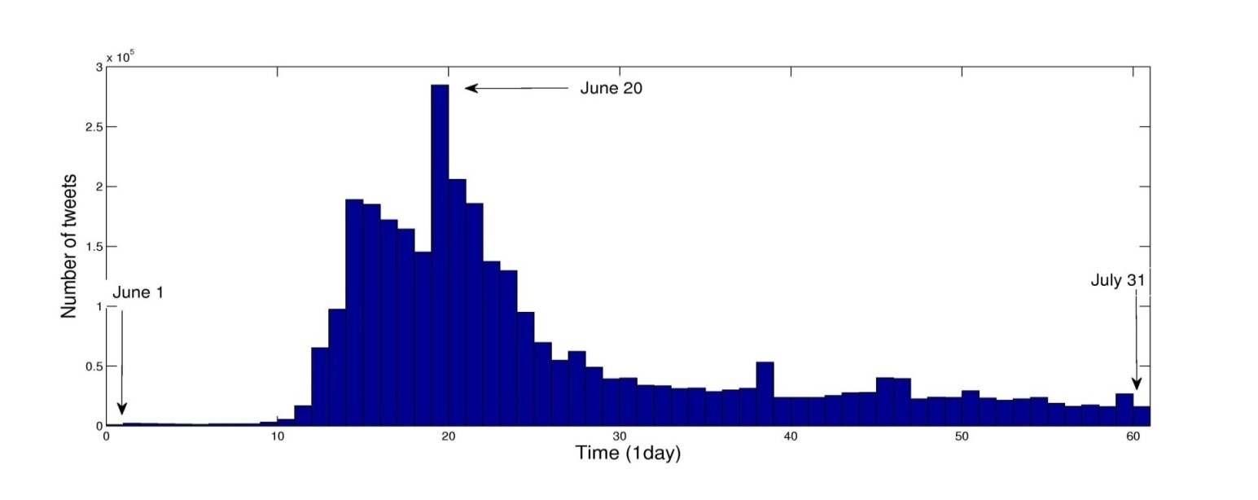
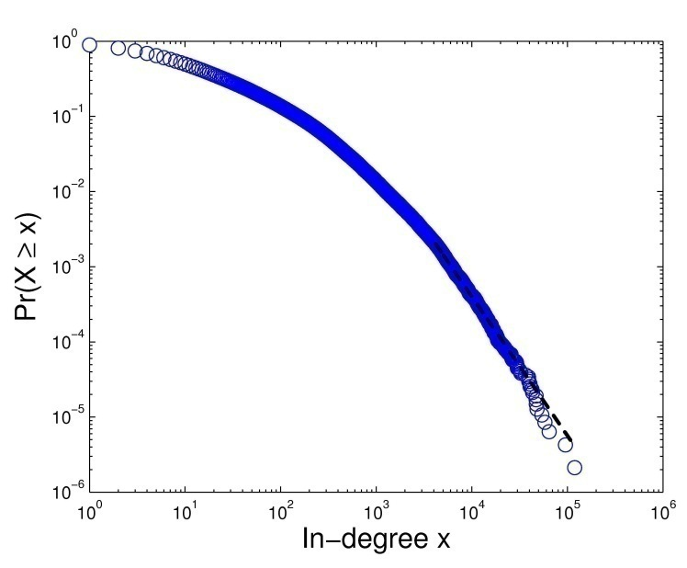
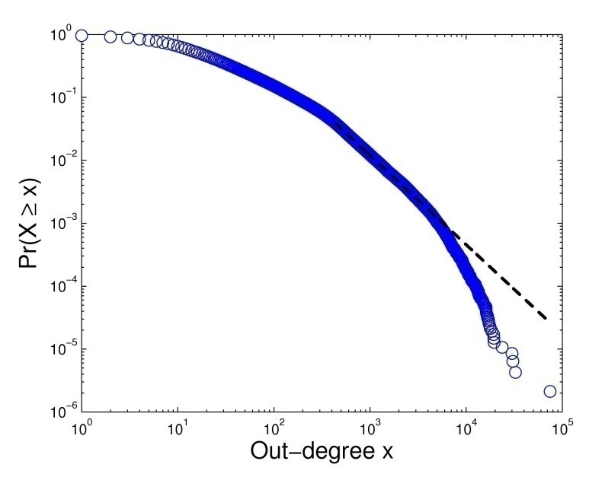


Iranian Election on Twitter
The activity on Twitter matches political events inside as well as outside Iran
Event-based F-F network: power-law degree distribution

Slide 42
Summary of Results
The event-specific cascade size distribution is a power-law with exponent equal to -2.5 and more than 99% of the cascades have depth less than three, and hence shallow.
63.7% of the RTs in Iranian Election (78% for the other two topics) are along the F-F network edges. Thus the friendship network plays a major role.
Surprisingly, more than 34% of RTs for Iranian elections (around 20% for the other topics) are from the public timeline or the broadcast channel.
The event-based F-F networks have common characteristics across the three topics we studied, and its structure can explain the cascade size distribution.

Slide 43
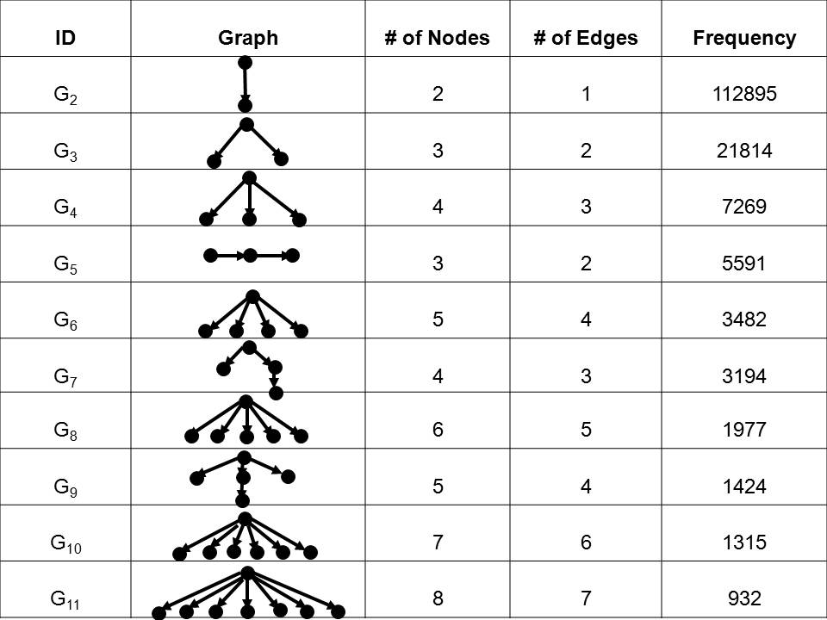
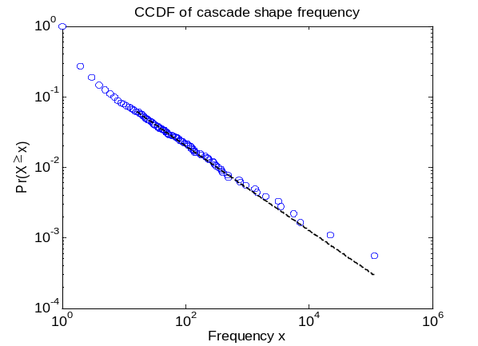

Common Cascade Shapes
Frequency distribution is also a power-law

Slide 44
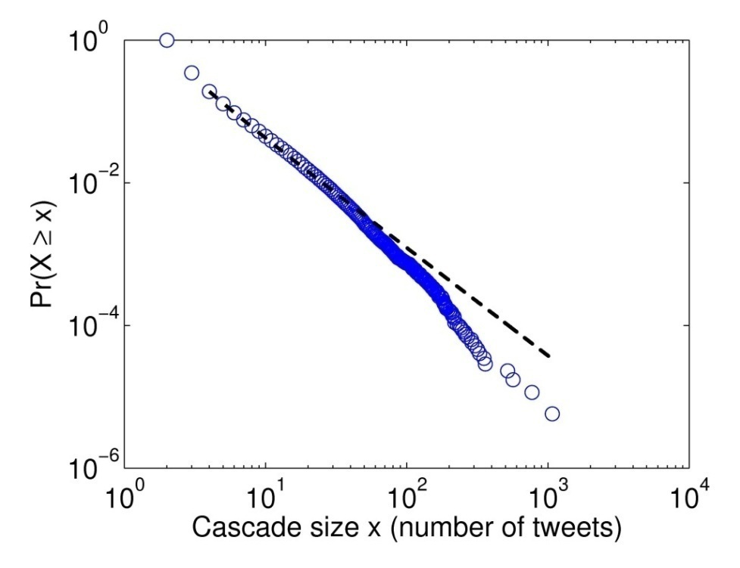
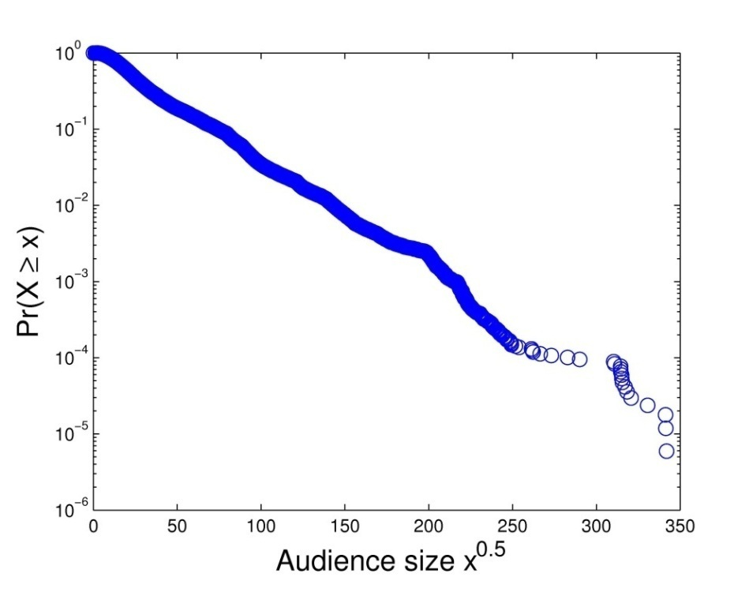


More about Cascade Topology
The cascade size distribution is a power-law
The audience size distribution is a stretched exponential distribution

Slide 45
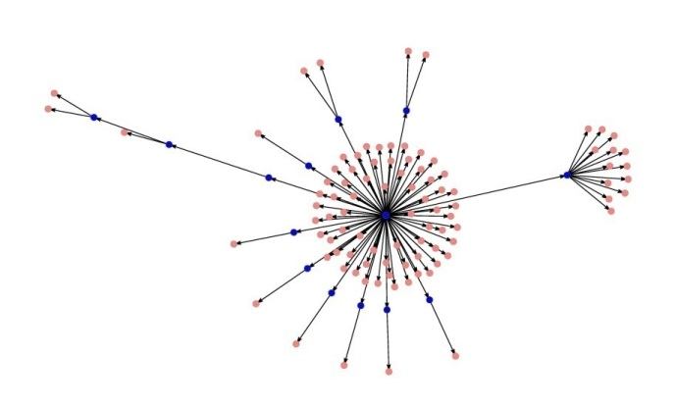
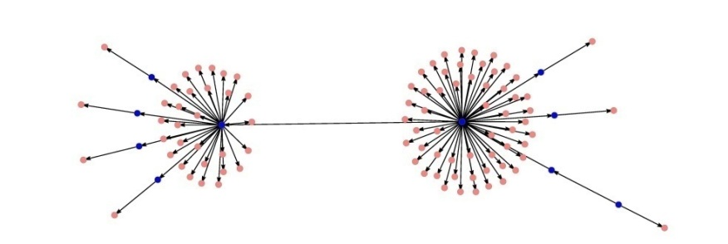
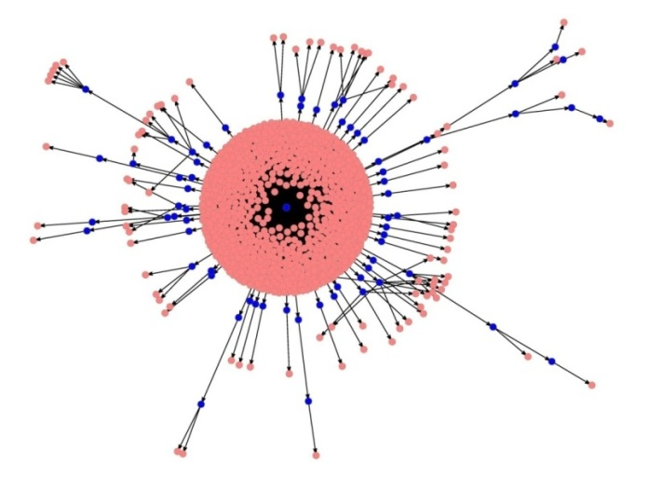
How do Cascades Look like?
Central hub cascade
‘StopAhmadi’ : Please @Twitter and @ev don’t take down twitter, for the iranian ppl #iranelection
Two central hub cascade
‘RealTalibKweli’: Pray for the protesters in Iran. Regardless of your politics
Largest cascade
‘Stephenfry’ : Functioning Iran proxies 218.128.112.18:8080 218.206.94.132:808 218.253.65.99:808 219.50.16.70:8080 #iranelection - feel free to RT

Slide 46
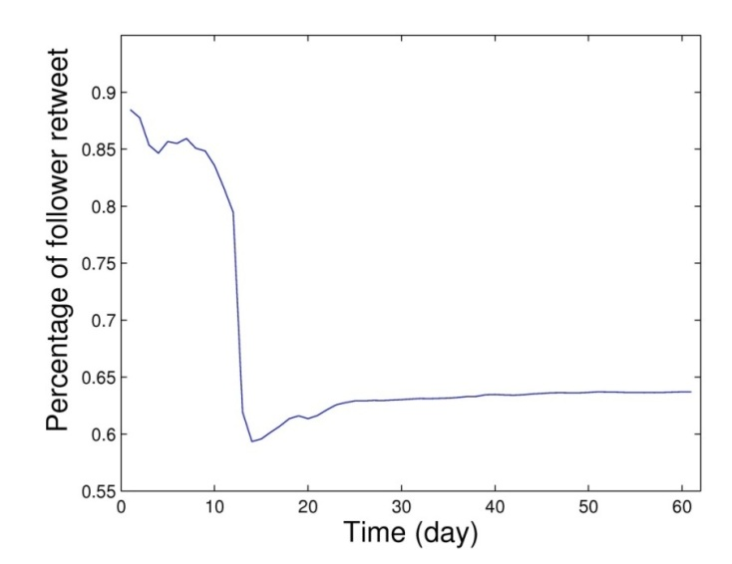
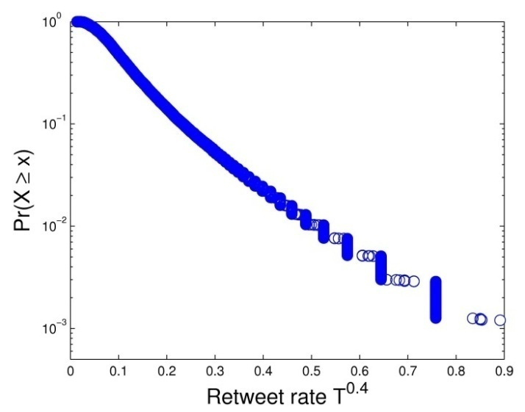
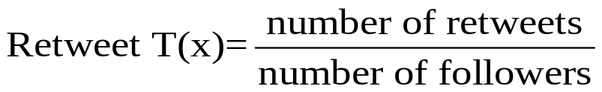
Information Propagation via F-F Network
63.7% of the retweets happen within F-F network.
Retweet rate is highly content dependent.
In a cascade, retweet rate decays exponentially as the cascades spread away from the source.

Slide 47
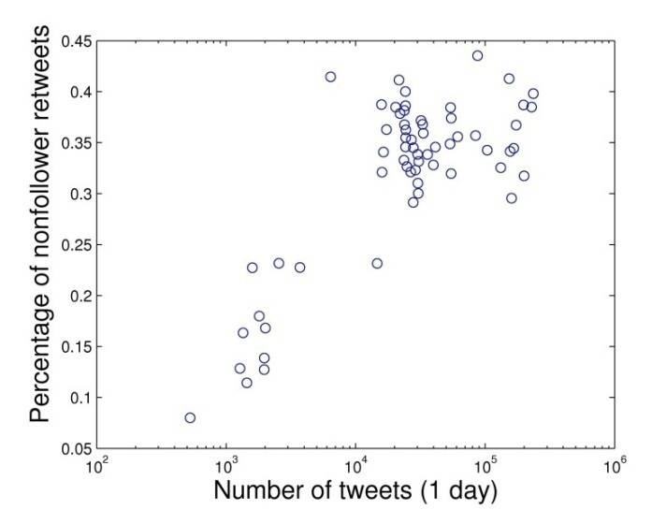
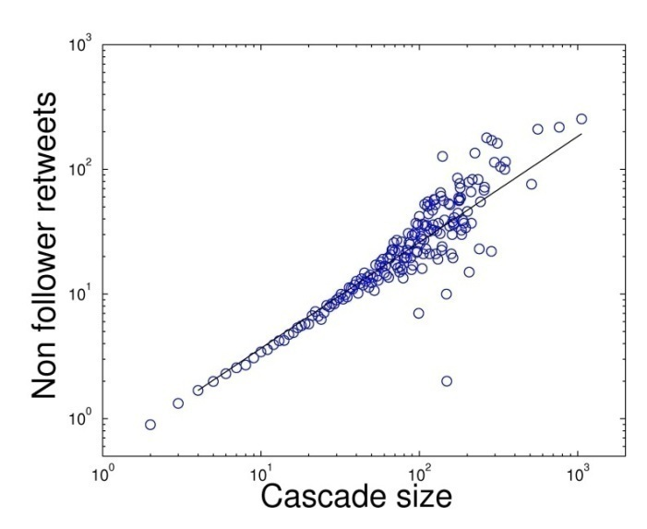
Information Propagation via Public Timeline
At least 34% of retweets are from the public timeline.
As Iranian election becomes a more popular trend on Twitter, more retweets are from the public timeline.
Larger cascades include more retweets from the public timeline.

Slide 48
What do People Retweet?
Breaking news: real-time reports of events in Iran
Non-time-sensitive material: sharing photos and videos, political analysis, personal accounts of protests in blogs and instructions on how to get involved
Rumors and misinformation: Rumor that tanks had appeared on the streets in Tehran spreaded easily
Spam: spammers tried to use the hashtag #IranElection to advertise their own product (eg. Habitat took advantage of the protests to market its spring collection)
Others: about Twitter itself, jokes, encouraging words and funny slogans

Slide 49
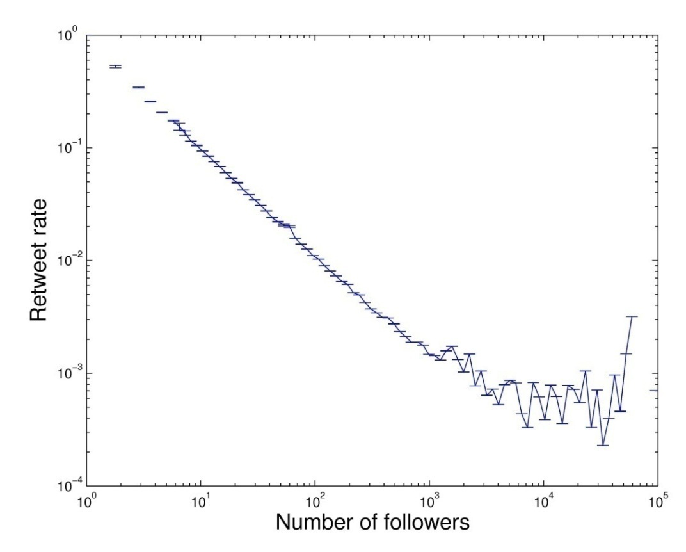
Who do People Retweet?
Official news media: cnnbrk, anncurry, breakingnews
Alternative media: Mashable ,Tehranbureau
Iranian Tweeters: persiankiwi, oxfordgirl
Celebrities: Stephen Fry, Barack Obama

Slide 50
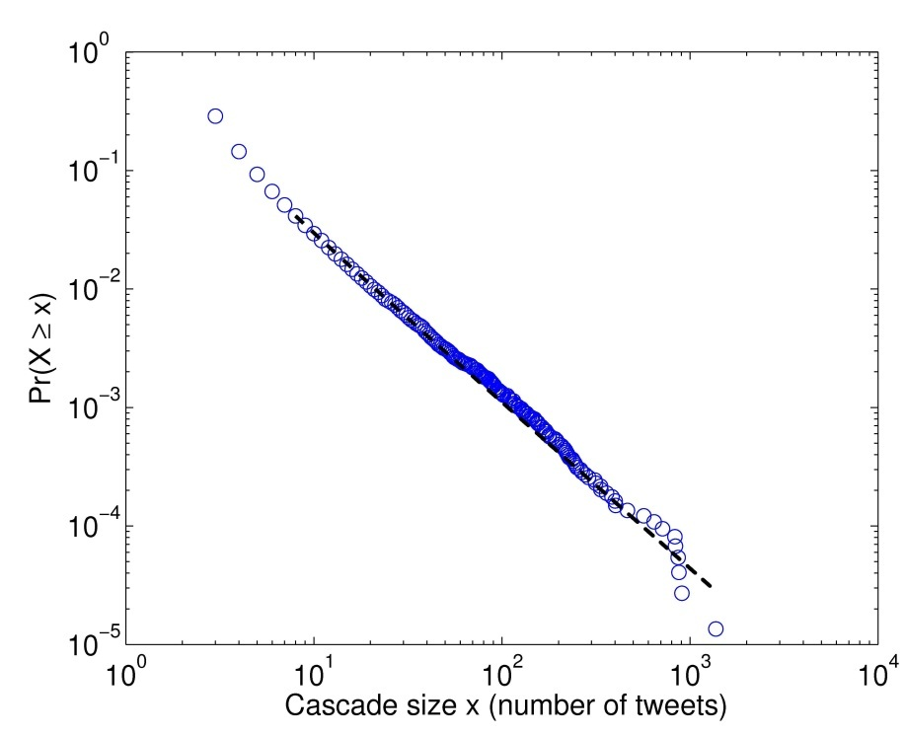
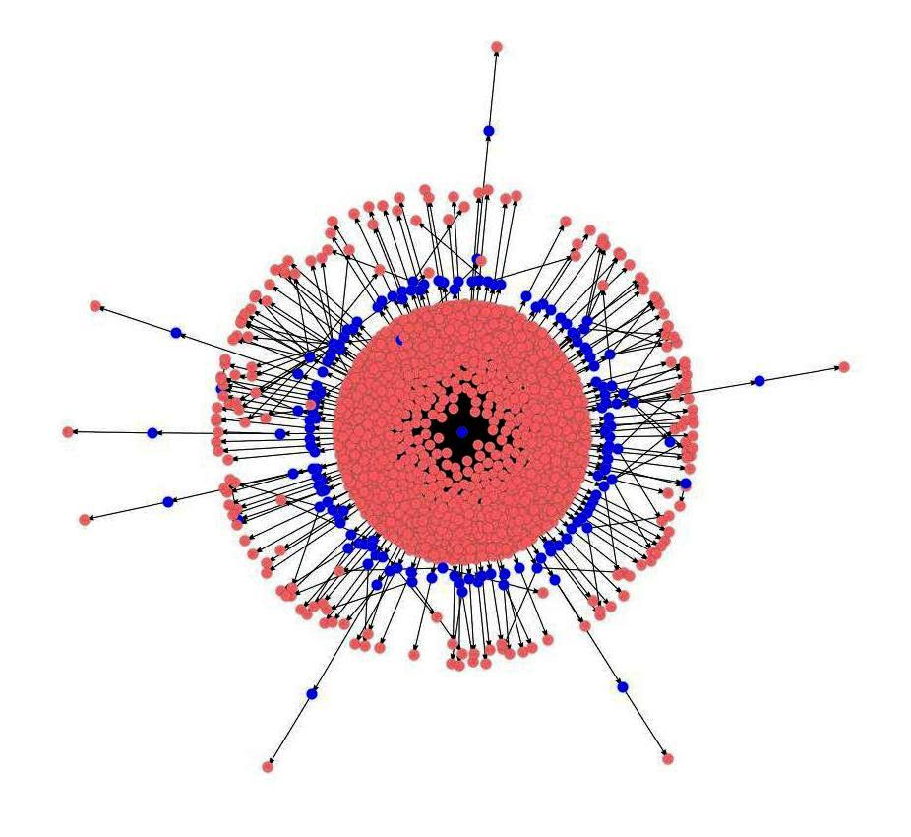

Other Topic: Death of Michael Jackson
Largest cascade
The cascade size distribution is a power-law
78.5% of the retweets happen within F-F network

Slide 51
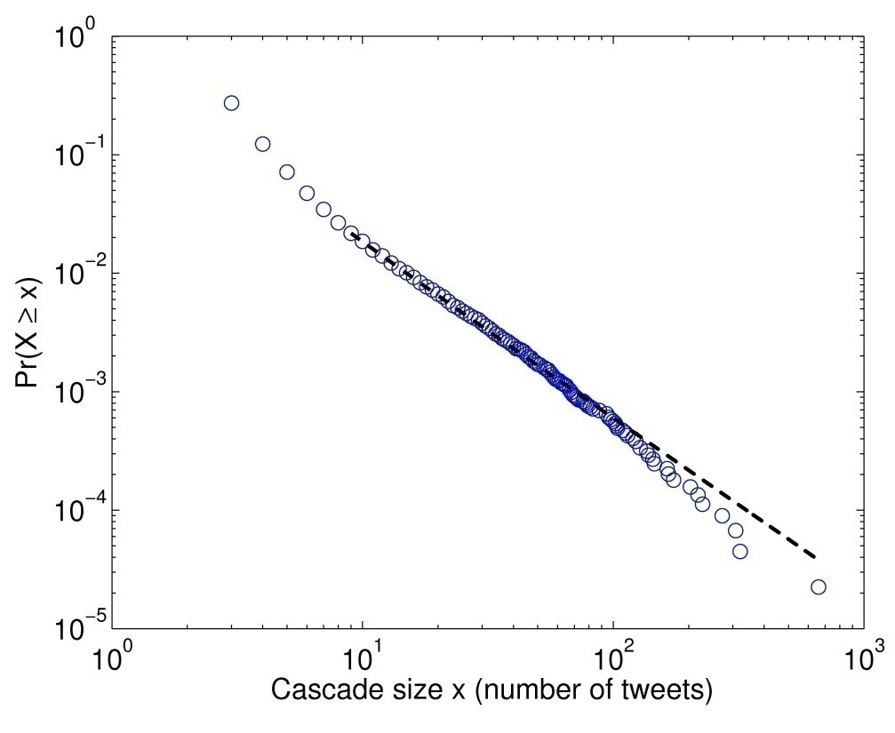
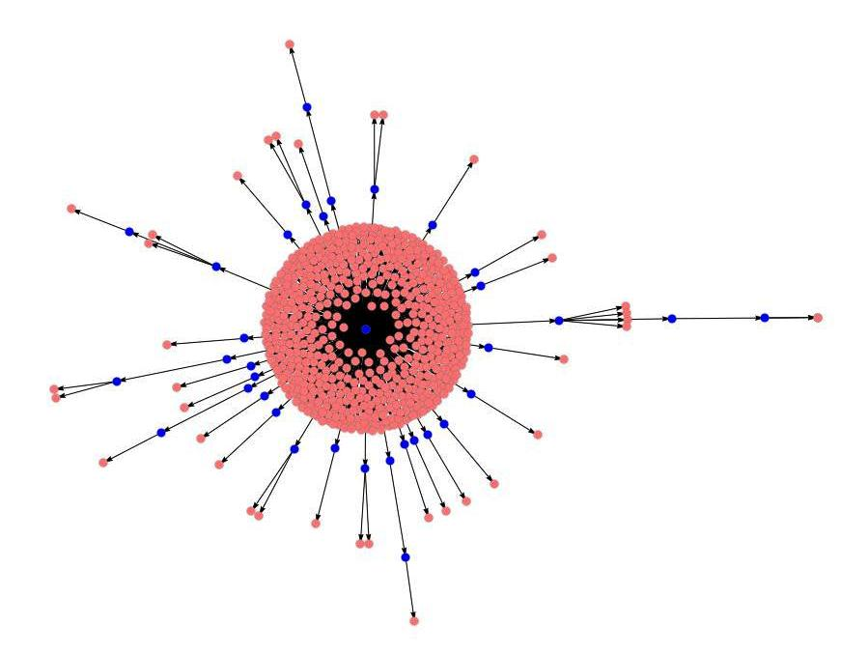

Other Topic: Swine Flu Outbreak
Largest cascade
The cascade size distribution is a power-law
77.3% of the retweets happen within F-F network

Slide 52
Modeling
The cascade size distribution of F-F network edges is a power-law with exponent equal to -3, which is different from what one expects from a branching process -1.5
w/ prob p
…
…
…
w/ prob cp
…
…
…
…
…
…
…
w/ prob c²p
…
…
Event-based follower size:
PL with exponent of -2.85
Cascade size:
PL with exponent of -3

