Slide 1
Homework Assignment #1

Slide 2
Outline
Shell
Unix variables
PATH
Related Functions
Fork() and Wait()
Exec
Internal command
External command
Background execution
Output redirection
Command
Exercise

Slide 3
Shell Introduction(1/3)
A shell is a program that acts as an interface between a
user and the operating system.
user
shell
OS

Slide 4
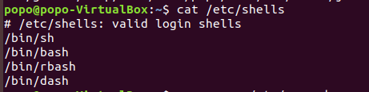
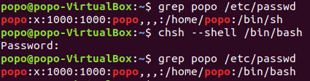
Shell Introduction(2/3)
The shells that are available in your system
You can change the shell
To know which shell you use
change shell

Slide 5
Shell Introduction(3/3)
A shell command can be
Internal (built-in): the code to be executed is part of the shell.
Running these commands does not require searching their path by the system.
Example: cd, pwd, echo, export…
External: the code to be executed resides in a separate binary file.
Running these commands requires searching their path by the system.
Example: ls, cp…

Slide 6
Outline
Shell
Unix variables
PATH
Related Functions
Fork() and Wait()
Exec
Internal command
External command
Background execution
Output redirection
Command History
Exercise

Slide 7
Unix variables(1/3)
A Unix variable allows passing information from the shell to programs.
Standard Unix variables are split into two categories
Shell variables
Environment variables

Slide 8
Unix variables(2/3)
Example of environment (global) variables
OSTYPE: the name of the current operating system
USER: your login name
LOGNAME: the login-name of the user
HOME: the path name of your home directory
MAIL: the path to your mail inbox
HOST: the name of the computer you are using
DISPLAY: the name of the computer screen display
PRINTER: the default printer
EDITOR: the default text editor
PATH: the directories the shell should search to find a command
SHELL: the full pathname of the login shell

Slide 9
Unix variables(3/3)
Example of shell (local) variables
argv: an array of command/program arguments
cwd: the full pathname of the current directory
gid: the user’s real group ID
history: indicates the number of history events to save.
home: initialized to the home directory of the invoker.
owd: the old (pr previous) working directory
path: a list of directories to look for executable commands
prompt: the string printed before reading a command
shell: the full pathname of the running shell
term: the terminal type
tty: the name of the tty (TeleTYpe) terminal
uid: the user’s real user ID
user: the user’s login name

Slide 10
Outline
Shell
Unix variables
PATH
Related Functions
Fork() and Wait()
Exec
Internal command
External command
Background execution
Output redirection
Command History
Exercise

Slide 11
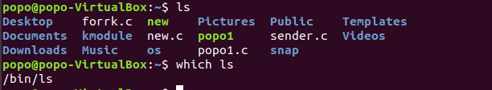
PATH(1/5)
The directories the shell should search to find an executable file
By PATH variable, user don’t need to enter complete path to execute the external command (eq.ls cp..)
To know PATH(echo $PATH)
ls is the external command
ls is in the /bin
To know where is ls

Slide 12
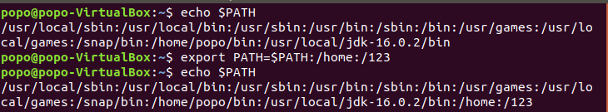
PATH(2/5)
Add path in PATH
Temporary (close terminal will disappear)

Slide 13

PATH(3/5)
Add path in PATH
Permanent (PATH is changed even if you close terminal or reboot.)
Modify /etc/profile
Modify profile need the permission of root
change to root identity

Slide 14
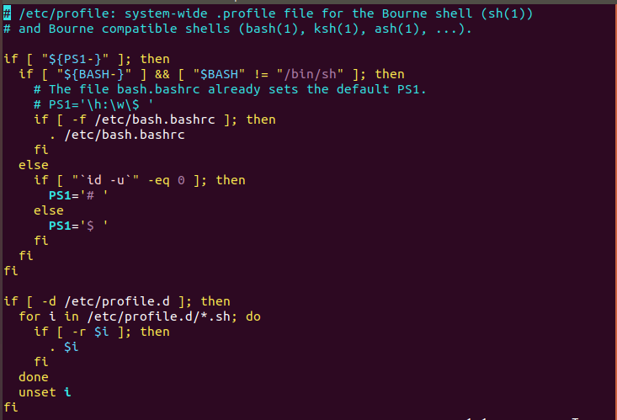

PATH(4/5)
vim /etc/profile
add :/hello

Slide 15
PATH(5/5)
After modify /etc/profile
After reboot

Slide 16
Outline
Shell
Unix variables
PATH
Related Functions
Fork() and Wait()
Exec
Internal command
External command
Background execution
Output redirection
Command History
Exercise

Slide 17
Fork(1/3)
The fork() system call creates new process
The fork() copies the parent's memory image so that the new process receives a copy of the address space of the parent.
Both processes continue at the instruction after the fork statement (executing in their respective memory images).
#include <unistd.h>
pid_t fork(void);

Slide 18
Fork(2/3)
Copy of memory
image
Original memory
image
Parent process
fork()
Child process

Slide 19
Fork(3/3)
process
Fork()
Return 0
Return a
new PID(> 0)
New
process
Original
process
continues

Slide 20
Wait (1/1)
The wait() Function
The parent can execute wait() to block until the child finishes
If wait() returns because the status of a child is reported, it returns the process ID of that child.
Else if an error occurs, it returns –1.
#include <sys/wait.h>
pid_t wait(int *stat_loc);
EX: wait(NULL);

Slide 21
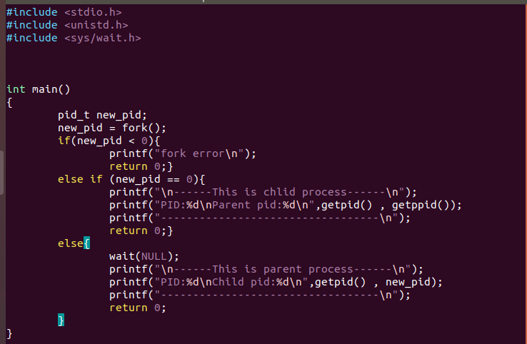
Fork()-Wait() Example (1/2)
fork()-wait() example

Slide 22
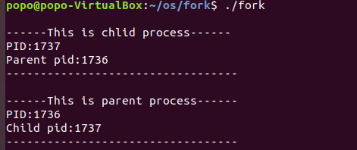
Fork()-Wait() Example (2/2)
Execution Result
Parent process always waits for child process and execute

Slide 23
Outline
Shell
Unix variables
PATH
Related Functions
Fork() and Wait()
Exec
Internal command
External command
Background execution
Output redirection
Command History
Exercise

Slide 24
Exec Family (1/5)
The fork() function creates a copy of the calling process, but many applications require the child process to execute code that is different from that of the parent.
The exec() family provides a facility for overlaying the process image of the calling process with a new image.
Use the fork()–exec() combination for the child to execute the new program while the parent continues to execute the original code.

Slide 25
Exec Family (2/5)
Copy of memory
image
Original memory
image
Parent process
fork()
Load another image
exec()
Child process

Slide 26
Exec Family (3/5)
The exec() Family (cont.)
passes the command-line arguments in an explicit list and are useful if you know the number of command-line arguments at compile time.
#include <unistd.h>
int execlp(const char *filename,const char *arg0, … /*(char *)NULL*/);

Slide 27

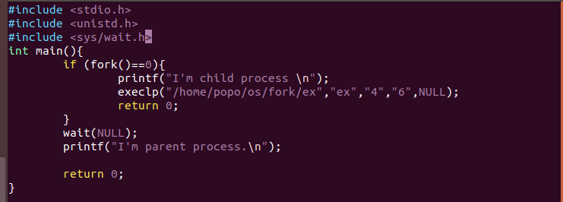
Exec Family (4/5)
Execlp() execute program defined by yourself

Slide 28

Exec Family (5/5)
Result

Slide 29
Outline
Shell
Unix variables
PATH
Related Functions
Fork() and Wait()
Exec
Internal command
External command
Background execution
Output redirection
Command History
Exercise

Slide 30
Internal command (1/8)
執行內建command時不得使用fork-exec函式
cd: change the current working directory
chdir() changes the current working directory of the calling process to the directory specified in path.
#include <unistd.h>
int chdir(const char *path);
EX: chdir(“/home”);

Slide 31
Internal command(2/8)
pwd: to know the current working directory
The getcwd() function copies an absolute pathname of the current working directory to the array pointed to by buf, which is of length size.
#include <unistd.h>
char *getcwd(char *buf, size_t size);

Slide 32
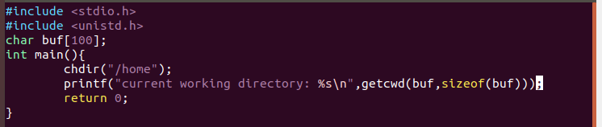
Internal command(3/8)
Example

Slide 33
Internal command(4/8)
Result

Slide 34
Internal command(5/8)
Export 命令用來設置環境變量
The getenv() function searches the environment list to find the environment variable name, and returns a pointer to the corresponding value string.
#include <stdlib.h>
char *getenv(const char *name);

Slide 35
Internal command(6/8)
The setenv() function adds the variable name to the environment with the value value, if name does not already exist.
#include <stdlib.h>
int setenv(const char *name, const char *value, int overwrite);

Slide 36
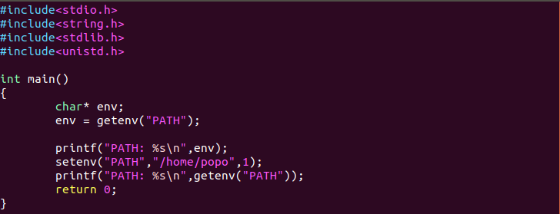
Internal command(7/8)
Example

Slide 37
Internal command(8/8)
Result

Slide 38
Outline
Shell
Unix variables
PATH
Related Functions
Fork() and Wait()
Exec
Internal command
External command
Background execution
Output redirection
Command History
Exercise

Slide 39
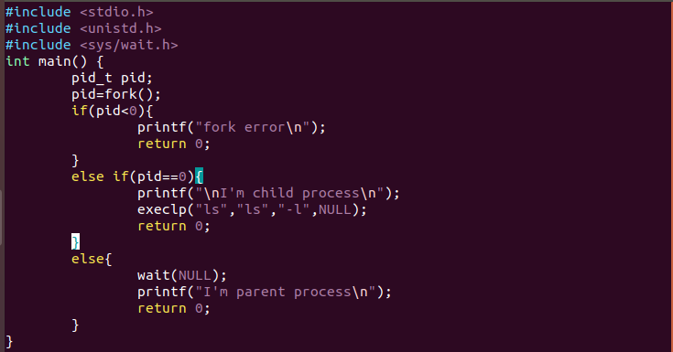
External command(1/2)
執行External commands：fork child process後，再用exec-like函數執行外部command

Slide 40
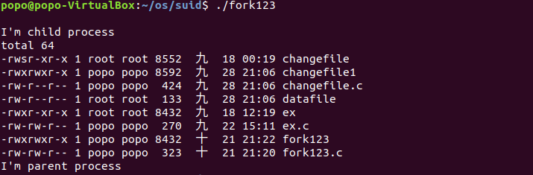
External command(2/2)
Result

Slide 41
Outline
Shell
Unix variables
PATH
Related Functions
Fork() and Wait()
Exec
Internal command
External command
Background execution
Output redirection
Command History
Exercise

Slide 42

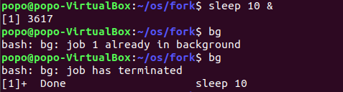
Background execution(1/2)
當你需要在背景執行程式時，在你要執行的指令後面加“&”
Example

Slide 43
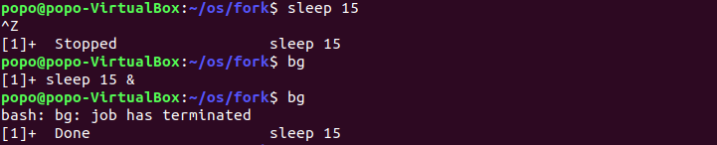
Background execution(2/2)
當執行一個指令時，按Ctrl+Z會暫停，再輸入bg，則會把該指令再放到background執行。
Example

Slide 44
Outline
Shell
Unix variables
PATH
Related Functions
Fork() and Wait()
Exec
Internal command
External command
Background execution
Output redirection
Command History
Exercise

Slide 45
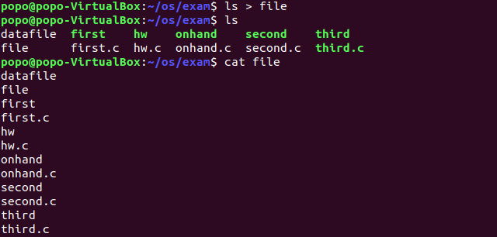
Output redirection(1/2)
Output direction is a feature in Linux such that when executing a command, you can change the standard output devices.當你執行指令要輸出到某個檔案時，利用“>”符號
Example
Command > target file

Slide 46
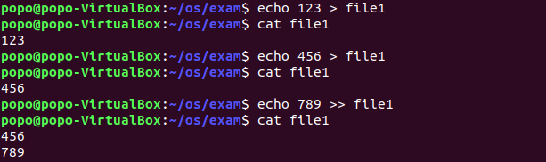
Output redirection(2/2)
使用“>”會改變輸出檔案內容，檔案內容變成剛剛輸入指令的結果。如果使用“>>”，則是原本的檔案內容追加剛剛輸入指令的結果
Example

Slide 47
Outline
Shell
Unix variables
PATH
Related Functions
Fork() and Wait()
Exec
Internal command
External command
Background execution
Output redirection
Command History
Exercise

Slide 48
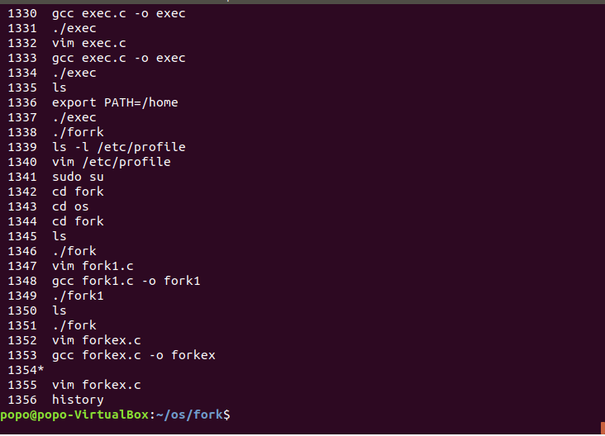
Command History(1/7)
It’s an external commmand that you can check commmands you typed before.

Slide 49
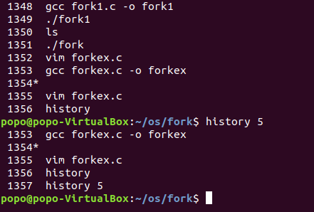
Command History(2/7)
To check most recently 5 command line which you type

Slide 50

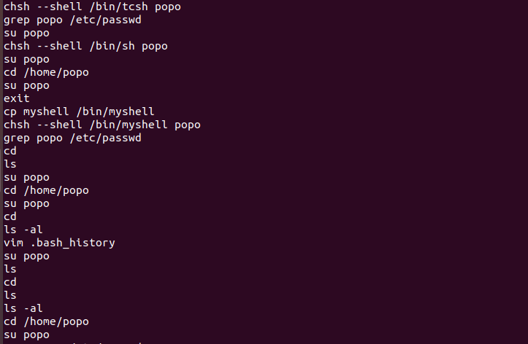
Command History(3/7)
.bash_history records what you typed before

Slide 51
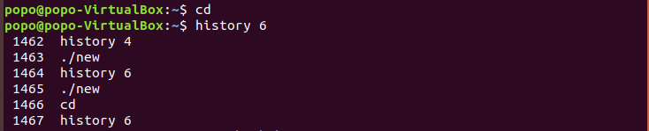
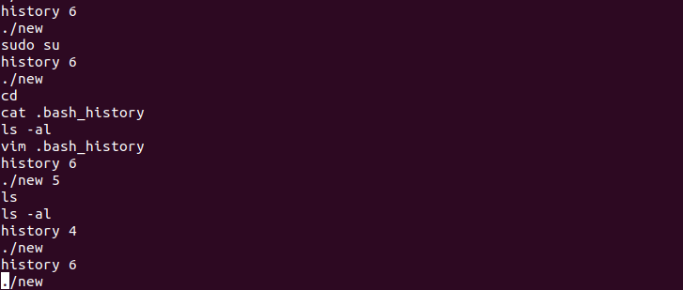
Command History(4/7)
Command history will get data from buffer. After you turn off the terminal, the data will be sent to .bash_history
Because you haven’t close terminal yet , so these data are not in .bash_history
.bash_history
same

Slide 52
Command History(5/7)
Useful function: readline()
readline() will read a line from the terminal and return it
When you compile your program , you need to link the library(-lreadline)
#include <stdio.h>
#include <readline/readline.h>
#include <readline/history.h>
char *;
readline (const char *prompt);
gcc Source.c –o executable file –lreadline
EX:gcc hw.c –o hw -lreadline

Slide 53
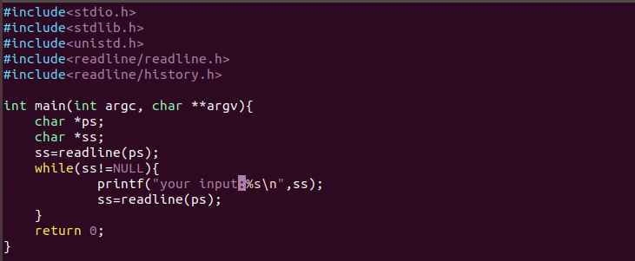
Command History(6/7)
Example

Slide 54
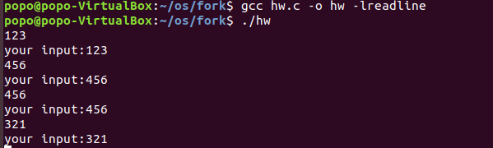
Command History(7/7)
Result

Slide 55
Outline
Shell
Unix variables
PATH
Related Functions
Fork() and Wait()
Exec
Internal command
External command
Background execution
Output redirection
Command History
Exercise

Slide 56
A Simple Linux Shell
基本功能(70%)
1. 印出prompt，例如“目前目錄$ ”(可以自行定義)，接受command
2. 接受command並執行command
Build-in commands：包含export 、 echo 、pwd、cd。內建command時不得使用fork-exec函式
其中export可以設定PATH環境變數
外部commands：fork child process後，再用exec-like函數執行外部command，執行結果直接output到console上即可
3. command執行結束後，再回到1.

Slide 57
A Simple Linux Shell (Cont.)
進階功能
查詢歷史command(10%)
按上/下鍵時，印出prompt及上/下一筆歷史command。
歷史command印出後，按enter鍵可執行該歷史command.
支援background execution (&)(10%)
支援Output redirection (>)(10%)

Slide 58
Turn in
Deadline
2021/12/8 PM.11:59:59
Upload to iLearning
File name
HW1_ID.zip (e.g. HW1_4106056000.zip)
Source code
.c file
Word(explain your code and post a screenshot of the result)
If you don’t hand in your homework on time, your score will be deducted 10 points every day.

Slide 59
Turn in
請勿抄襲
助教會使用程式抄襲軟體檢查，如有發現抄襲者，以零分計算。

Slide 60
TA
Name：Yu –Chen Jheng
Email：eric5211.kzps@gmail.com
Lab：OSLab (1001)

