Slide 1
Agenda
OpenAI Overview
How Large Language Model (LLM) work
Configuration parameters
OpenAI API Access
NLP to SQL
Python Docstring generation
Retrieval Augmented Generation (RAG) and Text Embeddings

Slide 2
OpenAI Overview
December 2015 – OpenAI as a Non-Profit. Elon Musk and Sam Altman announced the creation of a new non-profit organization, called OpenAI.
Musk and Altman were influenced by Google acquiring DeepMind in 2014, concerned that A.I. technology would only be developed and controlled by just a few of the world’s largest technology companies.
2018 - OpenAI announced the first version of GPT (Generative Pre-Training Transformer).
Elon Musk resigned his board seat at OpenAI, due to “potential future conflict of interest” due to Tesla’s own development of AI systems
2019 - OpenAI transitioned from a non-profit organization to a “capped” for-profit organization, in order to accept an investment of $1 billion dollars, partnering with Microsoft in the process (who was also the lead investor).
Notes:
this capped for-profit organization, the idea behind it is basically after a certain amount of profit,
OpenAI will then have to either like donate that money or do something with it in a way that isn't just recording it as profit in the books.

Slide 3
OpenAI Overview
2019
OpenAI announces a new model called GPT-2.
GPT-2 was not initially released to the public due to safety concerns regarding the ability to possibly create false misinformation at a large scale.
2020 - GPT-3 was announced
In June of 2020 OpenAI would announced the creation of an API to access its new AI Models.
Initial users had to apply to be accepted to have access to the API.
2021 - OpenAI announced the creation of DALL-E, a model capable of producing images from text.
The model is not open-sourced or available via an API.
Notes:
Concerned because of the upcoming 2020 election

Slide 4
OpenAI Overview
2022 - DALLE-2 is announced, creating images of significantly better quality from text prompts. ChatGPT is announced, which is an optimized version of GPT for dialogue, trained on human feedback.
2023 - OpenAI announced that Microsoft made a new $10 billion investment for OpenAI.
As part of this investment, Azure became the exclusive cloud provider of OpenAI model API calls. Note that the API is still available directly from OpenAI.
On March 14, 2023, OpenAI released GPT-4, both as an API (with a waitlist) and as a feature of ChatGPT Plus.
In September 2023, OpenAI announced DALL-E 3, a more powerful model better able to generate images from complex descriptions without manual prompt engineering and render complex details.
Notes:
And in order to train this much model size or this much data, it costs about $4.6 million in GPU costs.
And so previously we discussed Microsoft's investment into OpenAI, and it should be noted that a lot of that money actually comes back to Microsoft in the form of Azure GPU Cloud credits.
So essentially Microsoft gives money to OpenAI, and then OpenAI then spends that money on Azure Cloud services in order to rent GPU to actually train the model.

Slide 5
How Large Language Model (LLM) work
Fundamentally, when we’re dealing with any large language model, we’re providing some text to the large language model, and then we get some output.
Notes:
Take note, this is a very high level overview. We are not discussing how to train the model. OpenAI already trained the GPT model for us.
Having this basic understanding of how the model works is really going to help you understand the generation configuration parameters that we’ll discuss later.

Slide 6
How Large Language Model (LLM) work
What is the capital of France?
Notes:
Fundamentally, when we’re dealing with GPT model or any other large language model, we’re providing some text to the large language model, and then we get some output text.

Slide 7
How Large Language Model (LLM) work
GPT LLM
What is the capital of France?
Notes:
Fundamentally, when we’re dealing with GPT model or any other large language model, we’re providing some text to the large language model, and then we get some output text.

Slide 8
How Large Language Model (LLM) work
GPT LLM
What is the capital of France?
Paris
Notes:
Fundamentally, when we’re dealing with GPT model or any other large language model, we’re providing some text to the large language model, and then we get some output text.
So what is happening inside this LLM?

Slide 9
How Large Language Model (LLM) work
What is the capital of France?
Paris
Notes:
First thing is to understand model does not think of words like you and I do.

Slide 10
How Large Language Model (LLM) work
Tokenization
“what”
“is”
“cap”
“ital”
“of”
“france”
What is the capital of France?
Paris
Notes:
Instead, it takes input words and breaks them up into tokens. This process is known as tokenization.
Note that 1 token doesn’t equal 1 word. You'll see here that larger words are broken down into smaller tokens.
This will help with different things like prefixes or suffixes or just understanding different parts of languages.

Slide 11
How Large Language Model (LLM) work
Vector
Embeddings
“what”
“is”
“cap”
“ital”
“of”
“france”
[0,1,3]
[4,1,3]
[5,3,6]
[8,4,1]
[9,1,3]
[0,5,1]
What is the capital of France?
Paris
Notes:
Next, the train model is going to convert token into vector embeddings. Clearly there is a lot of mathematical going on inside the LLM, and you can’t multiply or divide words.
For example, you can’t say something like what is France divided by Paris. So in that case, we're going to need to have a mathematical representation of the tokens.
So, we’re converting from words to tokens and then tokens to mathematical vector embeddings.
The creation of these vector embeddings is part of the training process.

Slide 12
How Large Language Model (LLM) work
Transformer
Model
“what”
“is”
“cap”
“ital”
“of”
“france”
[0,1,3]
[4,1,3]
[5,3,6]
[8,4,1]
[9,1,3]
[0,5,1]
[0,1,3]
[4,1,3]
[5,3,6]
[8,4,1]
[9,1,3]
[0,5,1]
[?]
What is the capital of France?
Paris
Notes:
Now, in terms of text generation, once we have the vector embeddings, we're really asking the transformer model what is the next most likely vector given this sequence of vectors.
So, we are asking the model if I gave you this series of vectors, what is the next most likely vector to occur?
And then I could just work backwards from the vector to the token, and then the tokens to the words.

Slide 13
How Large Language Model (LLM) work
Most Likely
Tokens
“what”
“is”
“cap”
“ital”
“of”
“france”
[0,1,3]
[4,1,3]
[5,3,6]
[8,4,1]
[9,1,3]
[0,5,1]
[0,1,3]
[4,1,3]
[5,3,6]
[8,4,1]
[9,1,3]
[0,5,1]
[?]
95%
What is the capital of France?
Paris
2%
1%
0.5%
0.2%
0.1%
Notes:
However, the transformer model does not just think in a deterministic way that there’s only a single vector that will show up here.
Instead, it creates a probability distribution of the next most likely tokens.

Slide 14
How Large Language Model (LLM) work
Most Likely
Tokens
“what”
“is”
“cap”
“ital”
“of”
“france”
[0,1,3]
[4,1,3]
[5,3,6]
[8,4,1]
[9,1,3]
[0,5,1]
[0,1,3]
[4,1,3]
[5,3,6]
[8,4,1]
[9,1,3]
[0,5,1]
[?]
95%
What is the capital of France?
Paris
2%
1%
0.5%
0.2%
0.1%
[5,2,2]
[5,1,6]
[8,2,1]
[7,3,9]
[2,9,8]
[3,7,4]
Notes:
Technically, all it’s just vectors, so after performing some mathematical operations internally, at the end you're getting a probability distribution.
And then we're going to sample from that probability distribution to get the vectors.

Slide 15
How Large Language Model (LLM) work
Most Likely
Tokens
“what”
“is”
“cap”
“ital”
“of”
“france”
[0,1,3]
[4,1,3]
[5,3,6]
[8,4,1]
[9,1,3]
[0,5,1]
[0,1,3]
[4,1,3]
[5,3,6]
[8,4,1]
[9,1,3]
[0,5,1]
[?]
95%
What is the capital of France?
Paris
2%
1%
0.5%
0.2%
0.1%
[5,2,2]
[5,1,6]
[8,2,1]
[7,3,9]
[2,9,8]
[3,7,4]
Paris
Tours
Laon
Troyes
Versailles
Orleans
Notes:
And remember the vectors are actually just tokens that can always be transformed back into words.

Slide 16
How Large Language Model (LLM) work
Most Likely
Tokens
“what”
“is”
“cap”
“ital”
“of”
“france”
[0,1,3]
[4,1,3]
[5,3,6]
[8,4,1]
[9,1,3]
[0,5,1]
[0,1,3]
[4,1,3]
[5,3,6]
[8,4,1]
[9,1,3]
[0,5,1]
[?]
95%
What is the capital of France?
Paris
2%
1%
0.5%
0.2%
0.1%
[5,2,2]
[5,1,6]
[8,2,1]
[7,3,9]
[2,9,8]
[3,7,4]
Paris
Tours
Laon
Troyes
Versailles
Orleans
Notes:
So we can see here that I would maybe have a 95% chance of choosing the token vector embedding that was connected to the word Paris.

Slide 17
How Large Language Model (LLM) work
Most Likely
Tokens
“what”
“is”
“cap”
“ital”
“of”
“france”
[0,1,3]
[4,1,3]
[5,3,6]
[8,4,1]
[9,1,3]
[0,5,1]
[0,1,3]
[4,1,3]
[5,3,6]
[8,4,1]
[9,1,3]
[0,5,1]
[?]
95%
What is the capital of France?
Paris
2%
1%
0.5%
0.2%
0.1%
[5,2,2]
[5,1,6]
[8,2,1]
[7,3,9]
[2,9,8]
[3,7,4]
Paris
Tours
Laon
Troyes
Versailles
Orleans
Notes:
And then I would get the output of Paris. This is kind of just a made up extreme example.
But if you're doing something more creative, like asking for a poem, then there's going to be a kind of flatter distribution and you're going to get more creative outputs.
Because remember, you're not necessarily choosing the most likely token you are sampling from this distribution.
Later on, we'll see that there's configuration parameters we can set to actually change and play around with this distribution, because maybe you want to pick less likely tokens to get a more creative output. Or maybe you always want to pick the next most likely token.
Key idea here is that you're creating a distribution that you sample from, and then you can work backwards to the vector embeddings, to the tokens, to the words to get back text generation that we as humans can understand.

Slide 18
How Large Language Model (LLM) work
Key Takeaways:

Slide 19
How Large Language Model (LLM) work
Key Takeaways:
Model uses tokens, not words.
Model has its own internal vector embedding representation of tokens.
The next most probable token is chosen from a distribution, allowing for stochastic results (next token is not deterministic, even for the exact same input).
Notes:
That is to say, the next token is not guaranteed to 100% always be the same, even for the exact same input, you can expect to get different results

Slide 20
Configuration Parameters
OpenAI Completion Call Parameters
Model
Prompt
Max Tokens
Stop
N
Temperature
Top P
Frequency Penalty
Presence Penalty
https://platform.openai.com/docs/guides/text-generation/parameter-details

Slide 21
Max Tokens
The maximum number of tokens to generate in the completion.
The token count of your prompt plus max_tokens cannot exceed the model's context length.

Slide 22
Stop
You can specify a list of stop sequence values to stop the text generation
For example, if you are asking for a SQL query, you may set a semicolon as the stop sequence, to make sure GPT doesn’t continue pass the query with an additional explanation.

Slide 23
N
How many completions to generate for each prompt.
Keep in mind that this is essentially the same thing as running the same prompt multiple times, so this could consume your token quota quickly, which costs money!
We will pretty much always set this to 1, indicating we only want 1 completion.
You should really only be doing this when your temperature is set to something above zero, otherwise you'll just get repetitive results.

Slide 24
Temperature
Higher Temperature (~1.0)
More “creative” results, could sometimes go off topic or random.
Lower Temperature (~0.0)
Less “creative” results, should be used in situations where you expect a singular correct answer.

Slide 25
Top P
This considers the cumulative probability of the tokens, allowing you to cut-off at a certain cumulative probability.
For example, a P = 0.97 would stop considering any tokens once the cumulative probability reaches 97%.
Alter Top P or Temperature but not both.
95%
95%
2%
2%
1%
0.5%
0.2%
0.1%
[5,2,2]
[5,2,2]
[5,1,6]
[8,2,1]
[8,2,1]
[7,3,9]
[2,9,8]
[3,7,4]
Paris
Tours
Laon
Paris
Troyes
Versailles
Versailles
Orleans

Slide 26
Frequency Penalty
As you play more and more of OpenAI completion text, you'll notice that sometimes it does start to repeat itself. It will write a paragraph, write a sentence, and then suddenly starts falling into this loop where it keeps saying the same thing over and over again. If you wanna break out of that, you can induce a frequency penalty.
Number between -2.0 and 2.0.
Positive values penalize new tokens based on their existing frequency in the text so far, decreasing the model's likelihood to repeat the same line verbatim.
Notes:
You can start playing around with these if you notice your model ends up repeating stuff over and over and over again.

Slide 27
Presence Penalty
Number between -2.0 and 2.0.
Positive values penalize new tokens based on whether they appear in the text so far, increasing the model's likelihood to talk about new topics.

Slide 28
OpenAI
The main types of models we use:
GPT - text generation
text-embedding-3-small – text embedding
DALLE - image generation

Slide 29
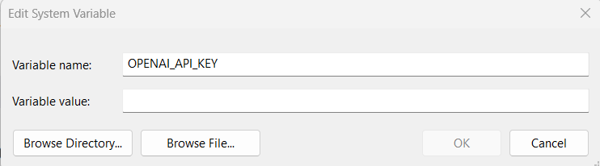
OpenAI API Access

Slide 30
OpenAI API Access
pip install openai
from openai import OpenAI
client = OpenAI()
response = client.chat.completions.create(
model="gpt-3.5-turbo",
messages=[
{"role": "user", "content": "Write a rap about Donald Trump, make sure it rhymes"}
]
)
print(response.choices[0].message.content)

Slide 31
NLP to SQL
Build a simple application that would allow a non-technical person to directly interact with a database and retrieve information without knowing SQL.

Slide 32


NLP to SQL
Notes:
Often at company, you’ll have someone who’s like executive or marketing person who’s not exactly technical, but they need information from a database.

Slide 33
NLP to SQL
Notes:
And they want to send the request to the database.

Slide 34
NLP to SQL
Notes:
And that means they need to actually ask a human developer to develop some sort of SQL query. Then that person will actually perform the query and then return the results in some sort of report.

Slide 35

NLP to SQL
Notes:
With OpenAI API, we can actually automate this process. We can actually swap out developer time for a computer time.
Essentially, having a non-technical person ask in natural language, convert that to SQL using OpenAI, conduct the actual query and then return results.
For example, “How much sales in this quarter?”, then this would converted into a SQL query, like “Select blank from where this table, bla bla” and then return result

Slide 36
NLP to SQL
Take tabular data and convert to SQL database.
Take natural language request.
Convert NLP to SQL via OpenAI API
Send SQL request to database
Return results.

Slide 37
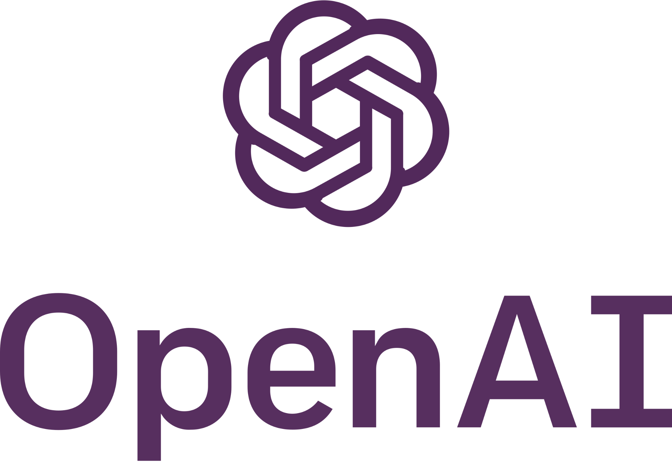
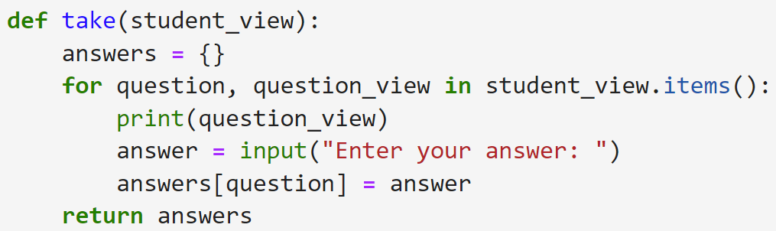
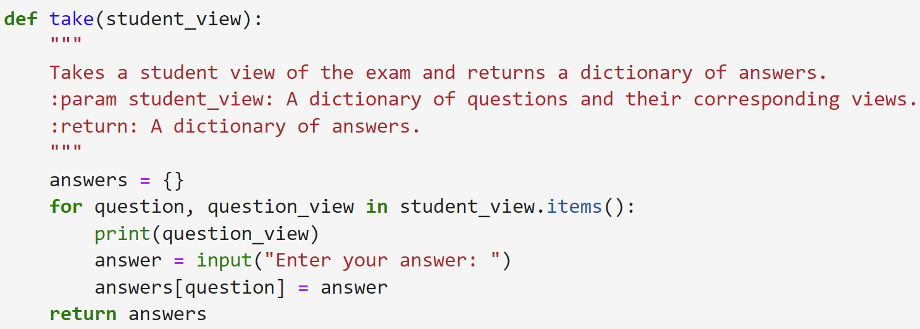
Python Docstring generation
Take any .py file with functions in it and return the same .py file with docstrings for each function

Slide 38
Python Docstring generation
Grab python code (use Inspect library)
Send to completion API with some additional instructions to create doc string.
Combine docstring with original python function.

Slide 39
RAG and Text Embeddings
RAG stands for Retrieval Augmented Generation and make great use of the model’s ability to generate vector embeddings of text.
GPT is a very powerful model, but there will be content it does not know about.
For example, GPT probably does not know about the vacation policies at a specific company. So how could we leverage AI to build a corporate HR assistant?
What we need is the ability to “augment” GPT by providing the model with extra context when asking a question.
For example, if we could provide the text about a corporate vacation policy along with our query, then GPT could read the text and give us a reasonable answer.

Slide 40
RAG and Text Embeddings
How many weeks off do employees of Intel get?

Slide 41
RAG and Text Embeddings
How many weeks off do employees of Intel get?
GPT

Slide 42
RAG and Text Embeddings
I'm sorry, I can't answer your question about how many weeks off employees of Intel get. I don't have access to internal HR information for specific companies.
However, I can offer some general information about vacation policies in the United States.
How many weeks off do employees of Intel get?
GPT

Slide 43
RAG and Text Embeddings
How many weeks off do employees of Intel get?
Intel HR
3 Weeks Vacation per year. With one additional day per year with the company.

Slide 44
RAG and Text Embeddings
How many weeks off do employees of Intel get?
Intel HR
3 Weeks Vacation per year. With one additional day per year with the company.
GPT

Slide 45
RAG and Text Embeddings
According to the Intel HR vacation policy documents, employees receive 3 weeks of vacation per year, with one additional day per year with the company.
How many weeks off do employees of Intel get?
Intel HR
3 Weeks Vacation per year. With one additional day per year with the company.
GPT

Slide 46
RAG and Text Embeddings
Now we can see that LLMs can answer any question if they have the correct and appropriate context and documents for an answer, this is “augmented generation” because we augmented the original query with the context of the ACME HR policy documents.
But how can we retrieve this context?
Recall our models ability to embed text into vectors.
If we had all our text documents stored as vectors and matched to the original text, we could perform vector similarity searches to find the most relevant documents.

Slide 47

RAG Process

Slide 48
RAG Process
Notes:
we're actually going to take that query and embed it into a vector representation.

Slide 49
RAG Process
Notes:
Before we send it to GPT model, we send it to an embedding model to get the vector. Now, I have both the original query text and the embedded vector representation.

Slide 50

RAG Process
Notes:
Similarly, we also taken set of documents, such as all my internal documentation about HR, and I vectorized those as well. This is known as a vector store.
Basically I have the embedded vector representation of every relevant document.
If you wanted to, maybe you have a vector embedding of all of Wikipedia because you're trying to answer questions related to the fact.

Slide 51
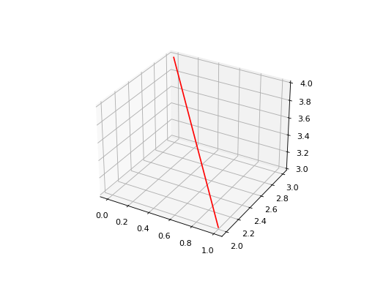
RAG Process
Notes:
So now that I have these vector embeddings, both of my query and of my related documents, what I can do is perform a similarity search.
Remember, these vectors are just essentially lines in space. In this case it's going to be like 10k+ dimensions. So it's hard to visualize that.
But if you think about it in terms of like a two dimensional vector or a three dimensional vector, you can understand that there's actually certain vectors that are closer in the space or more similar to each other than other vectors, and I can perform what's known as a cosine similarity search between these vectors to figure out the vector that is most similar to my query vector

Slide 52
RAG Process
Notes:
Basically, what I'm doing here is I'm figuring out which document is most similar to the query that’s being asked.

Slide 53
RAG Process
Notes:
And then once I perform this cosine similarity search, I'm going to isolate that document.

Slide 54
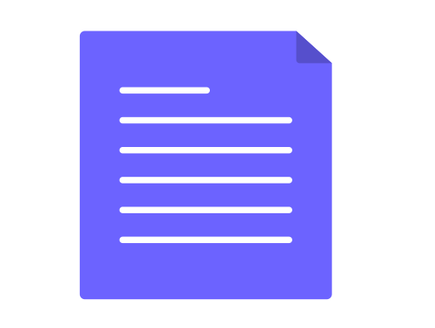
RAG Process
Notes:
And really what I need is not the vector embedding representation but the document itself.
And so now what I have here is the document that has the most similar content to my original query.

Slide 55

RAG Process
Notes:
And so I'm going to pass in my original query with an additional context and then pass it into GPT model.

Slide 56
RAG Process
Prompt:
“What can you tell me about vacation policy?”
Context below:
{Insert Document}

Slide 57
RAG Process

Slide 58
RAG Process
Embed new query.
Read in Documents (text, PDF, etc.)
Embed Documents as Vectors
Store Vector Embeddings (Vector Store)
Perform Similarity Search
Augment text generation with original document

