Slide 1
SQL with MySQL

Slide 2



What is Database?
A collection of information organized in such a way that a computer program can quickly select desired pieces of data.
Stores data at the Back end database in MYSQL/SQL Server / Oracle or any other DBMS
Front End: done in PHP / .Net / JSP or
any server side scripting languages

Slide 3
Database Types
Flat-file
Hierarchical
Network
Relational
Object-oriented
Object-relational

Slide 4








Database management system (DBMS)
“Simply DBMS helps you to create and manage databases- same like MSWord helps you to create or manage word documents.”

Slide 5
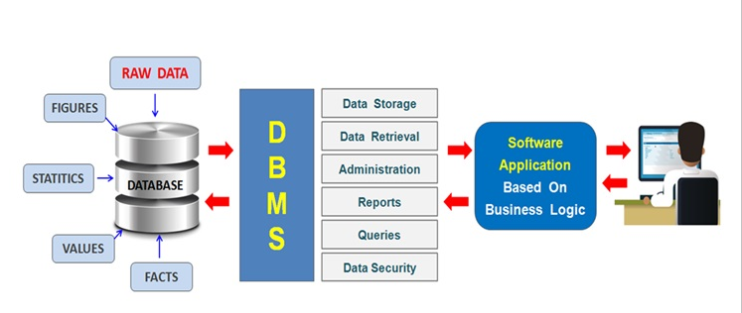
DBMS

Slide 6
DBMS continued..
DBMS is a computer software providing the interface between users and a database (or databases)
It is a software system designed to allow the definition, creation, querying, update, and administration of databases
Different types of DBMS are RDBMS, Object Oriented DBMS, Network DBMS, Hierarchical DBMS

Slide 7
DBMS Software Components
Database Definition
Language and graphical tools to define entities, relationships, integrity constraints and authorization rights
Application Development
Graphical tools to develop menus, data entry forms, and reports
Transaction Processing
Controls to prevent interference from simultaneous users and
Controls to recover lost data after a failure
Database Tuning
Tools to monitor and improve database performance

Slide 8
Database Interrogation
Definition: Capability of a DBMS to report information from the database in response to end users’ requests
Query Language - allows easy, immediate access to ad hoc data requests
Report Generator - allows quick, easy specification of a report format for information users have requested

Slide 9
Relational Database Concept
Dr. E. F. Codd proposed the relational model for database systems in 1970.
It is the basis for the relational database management system (RDBMS).
The relational model consists of the following:
Collection of objects or relations
Set of operators to act on the relations
Data integrity for accuracy and consistency
I - 18

Slide 10


Definition of a Relational Database
A relational database is a collection of relations or two-dimensional tables.
MySQL server
Table name: EMPLOYEES
Table name: DEPARTMENTS
…
…
I - 19

Slide 11
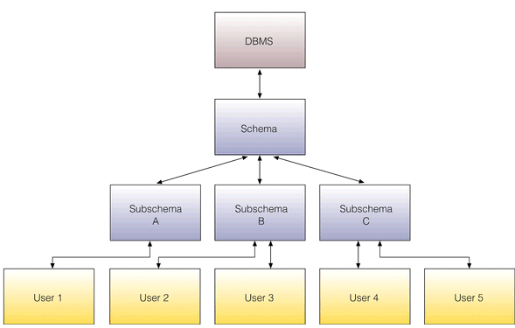
Schemas
Schema - A description of the database
Subschema – describes a subset of the database and which users have access to this subset

Slide 12

Data Models
Data Models
Model of system
in client’s mind
Entity model of client’s model
Table model of entity model
MySQL server
Tables on disk
I - 20

Slide 13
Data Objects
A database object in a relational database is a data structure used to either store or reference data.
Table – Basic unit of storage; composed rows and columns
View – Logically represents subsets of data from one or more tables
Sequence – Generates primary key values
Index – Improves the performance of some queries
Synonym – Alternative name for an object
- All of them use “Create” command
I - 20

Slide 14
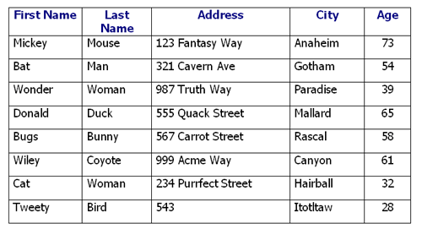
MySQL Concepts
MySQL Database groups related information into logical structures called schemas.
The logical structures contain schema objects.
Tables –
The basic units of data storage in MySQL Database.
Tables hold all user-accessible data.
Each table contains rows that
represent individual data records.
Rows are composed of columns
that represent the fields of the records.

Slide 15
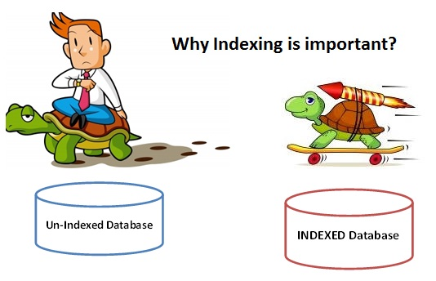
MySQL Concepts
Indexes –
Optional objects that improve the performance
of data retrieval from tables.
Indexes are created on one or more columns
of a table, and are automatically maintained in the database.
Views -
Combine information from several different tables into a single presentation.
A view can rely on information from both tables and other views.
Other objects: sequences, synonyms, procedures, functions, triggers, packages

Slide 16
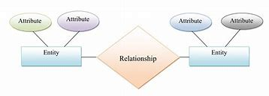
The RDBMS follows “Entity- Relationship model ”

Slide 17
What is Entity – Relationship (ER) Data Model ?
In ER model all the data will be viewed as Entities, Attributes and different relations that can be defined between entities
Entities
Is an object in the real world that is distinguishable from other objects
Ex. Employees, Places
Attributes
An entity is described in the database using a set of attributes
Ex. Employee_Name, Employee_Age, Gender

Slide 18
ER Data Model ? Continued..
Relationships
So a relation means simply a two dimensional table
Entities will be data with in a table
And attributes will be the columns of that table
Entity - An entity is a business object that represents a group, or category of data.
Instance (Record, Tuple) - A single, specific occurrence of an entity is an instance. Other terms for an instance are record and tuple.
Attribute- An attribute is a sub-group of information within an entity.
A relationship is a link that relates two entities that share one or more attributes.

Slide 19
Data Types & Relationship Types
Data Types
Alphanumeric (Text, Memo, Varchar)
Numeric (Number, Currency, etc.)
Date/Time
Boolean (Yes/No)
Relationship Types
One-to-one
One-to-many
Many-to-many

Slide 20
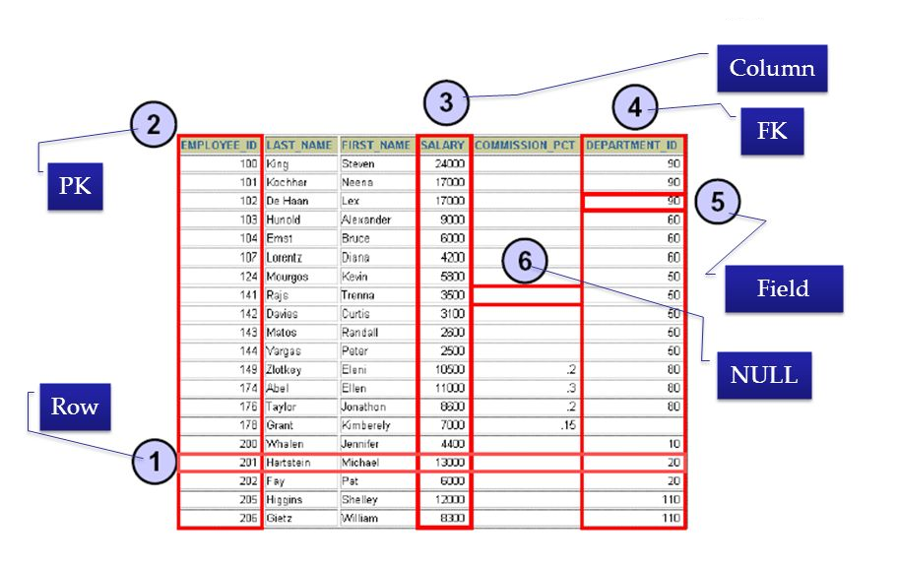
Relational Database Terminology
I - 27

Slide 21
MySQL
It is the world's most used open source relational database management system (RDBMS). It is named after cofounder Michael Widenius' daughter, My. The SQL phrase stands for Structured Query Language
In January 2008, Sun Microsystems bought MySQL for $1 billion

Slide 22
3 Types Of SQL Statements
Data Definition Language (DDL)
Are used to define the database structure or schema.
Create
Alter
Drop
Truncate

Slide 23
DML & DCL
Data Manipulation Language (DML)
Are used for managing data within schema objects.
Insert
Update
Delete
SELECT

Slide 24
DML & DCL
Data Control Language (DCL) statements.
Used to create roles, permissions, and referential integrity as well it is used to control access to database by securing it.
Grant
Revoke
Commit
Rollback

Slide 25
DDL Statements
Create – Database
To create a Database
Syntax : CREATE DATABASE dbname;
Example : CREATE DATABASE my_db;
To Use a database
Syntax : Use dbname;
Example: Use my_db;

Slide 26
Creating a table
Syntax
CREATE
TABLE table_name
(
column_name1 data_type(size), column_name2 data_type(size), column_name3 data_type(size), PRIMARY
KEY(column_name1)
);
Example
CREATE TABLE Person (
PersonID int auto_increment,
FirstName varchar(2),
Address varchar(255),
City varchar(255),
Primary key(PersonID)
);

Slide 27
DDL - Altering a table
ALTER TABLE Persons ADD email VARCHAR(60);
ALTER TABLE Persons DROP COLUMN city;
ALTER TABLE Persons CHANGE FirstName FullName VARCHAR(20);
DDL - Deleting a Table
DROP TABLE table_name ;

Slide 28
DML Statements
DML - Insert Data into a table
Syntax :
INSERT INTO table_name VALUES (value1,value2,value3,...);
Example:
INSERT INTO Customers (CustomerName, City, Country)
VALUES ('base', 'Chicago', 'USA');
Note : String and date values are specified as quoted string.

Slide 29
DML - Retrieving information from a table
“The SELECT statement is used to pull data from a table”
Syntax:
SELECT what_to_select FROM table_name Where conditions_to_satisfy ;
What_to_select indicates what you want to see. This can be a list of columns or * to
The Where clause is optional. If it is present, conditions_to_satisfy specifies one or more conditions that rows must satisfy to qualify for

Slide 30
DML- Example
Select * from person;
Select id, firstname from person;
Select * from person where city="New York‟
SELECT columnlist
FROM tablelist
WHERE condition
GROUP BY columnlist
HAVING condition
ORDER BY columnlist

Slide 31
DML - Update Query
Syntax:
UPDATE table_name
SET column1=value1,column2=value 2,...
WHERE some_column=some_value;
Example:
UPDATE Customers
SET ContactName="Alex', City="Chicago'
WHERE CustomerName=“boss”;

Slide 32
DML - Delete Query
Syntax:
DELETE FROM table_name
WHERE some_column=some_value;
Example:
DELETE FROM Customers
WHERE CustomerName=‘boss' AND ContactName='Maria';

Slide 33
DCL Statements
DCL – Setting Privilege
Example:
GRANT ALL ON boss.user TO 'someuser'@'somehost';
REVOKE ALL ON boss.user FROM
What privileges to be given
All -> will set all the privileges SELECT-> will set only to select privilege
Table name Username

Slide 34
SQL Functions
SQL has many built-in functions for performing calculations on data. It can be broadly classified into:
Aggregate Functions
Scalar functions

Slide 35
SQL Functions (cont.)
Aggregate Function
SQL aggregate functions return a single value, calculate from all the
values in a column.
Select AVG(int_price) from tbl_stock; // returns 8
Select SUM(int_price) from tbl_stock; // returns 33
Select MIN(int_price) from tbl_stock; // returns 2
Select COUNT(vchr_product) from tbl_stock; // returns 10
SUM(int_price)
Pk_Item | Var_prod | Int_price
1 | Pen | 10
2 | Book | 15 | Returns a single value
3 | Eraser | 2
4 | Pencil | 6

Slide 36
SQL Functions (cont.)
Scalar Functions
SQL scalar functions return a single value for each values of a particular column given as input.
Select UCASE(vchr_product) from tbl_stock; // returns each column value in capital letter
Select LCASE(vchr_product) from tbl_stock; // returns each column value in small letter
Select ROUND(int_price) from tbl_stock; // returns each value rounded
Select FORMAT(int_price,decimal) from tbl_stock; // returns each value formatted to the decimal
Pk_int_id | Vchr_product | Int_price
1 | Pen | 10
2 | Book | 15
3 | Eraser | 2
4 | Pencil | 6
Returns a single value
Returns a single value
Returns a single value
Returns a single value

Slide 37
SQL Functions (cont.)
Date and Time Formats
Examples:
SELECT CURRENT_DATE(); // returns current date
SELECT NOW(); // returns timestamp
SELECT DATE_ADD("2000-04-30 08:30:20", INTERVAL -2 HOUR); // 2000-04-30 06:30:20
SELECT DATE_FORMAT("2000-03-25", "%M %D %Y"); //March 25th 2000
SELECT DATEDIFF ("2000-04-15 06:10:30", "2000-04-11") //4
String Functions
Examples:
SELECT concat (firstname,' ',lastname) FROM customers; // firstname lastname
SELECT LENGTH(‘Hello'); // 5
SELECT SUBSTRING(‘HelloWorld',5,6); // oWorld
SELECT LTRIM(' Hello'); //Hello
SELECT REPLACE(‘HelloWorld', ‘Hello', ‘Hi'); //HiWorld

Slide 38
SQL Functions (cont.)
Numeric Functions
Examples:
SELECT 3*5; // 15
SELECT ROUND(-1.23); // -1
SELECT TRUNCATE(1.234,1); // 1.2
SELECT SQRT(64); //8
SELECT DEGREES(PI() / 2); // 90

Slide 39
Grouping Data
GROUP BY allows you to take your result set, group it into logical groups and then run aggregate queries on the groups.
You could for instance select all employees, group them by their workplace location and calculate the average salary. This would give you result on average salary of an employee at a given location
Tbl_employee
Emp_id | Emp_name | Emp_age | Emp_email | Salary | Place
1000 | Samantha | 45 | sm@gmail.com | 10000 | Toronto
1001 | Anna | 23 | an@gmail.com | 20000 | Chicago
1002 | Norman | 25 | nn@gmail.com | 15000 | Toronto
1003 | Samantha | 25 | sam@gmail.com | 13000 | Chicago
Avg = 12500
Avg = 11500

Slide 40


Example
Select vchr_place, avg(int_salary) from tbl_employee group by vchr_place;
Results:
Tbl_employee
Emp_id | Emp_name | Emp_age | Emp_email | Int_salary | vchr_place
1000 | Samantha | 45 | sm@gmail.com | 10000 | Toronto
1001 | Anna | 23 | an@gmail.com | 20000 | Chicago
1002 | Norman | 25 | nn@gmail.com | 15000 | Toronto
1003 | Samantha | 25 | sam@gmail.com | 13000 | Chicago
Vchr_place
Avg(int_salary)
Toronto
12500
Chicago
11500

Slide 41



The HAVING Clause
The HAVING clause was added to SQL because the WHERE keyword could not be used with aggregate functions.
An Sql statement can have both “where‟ clause and “having‟ clause. Where filters data before grouping. Having filters data after grouping
Syntax:
SELECT column_name, aggregate_function(column_name) FROM table_name WHERE column_name operator value
Select vchr_place, avg(int_salary) from tbl_employee group by vchr_place having avg(int_salary)>12000;
Vchr_place
Avg(int_salary)
Vchr_place
Avg(int_salary)
Toronto
12500
Toronto
12500
Chicago
11500

Slide 42
Sorting Data
ORDER BY
To sort the result set, you add the ORDER BY clause to the SELECT statement.
SELECT
select_list
FROM
table_name
ORDER BY
column1 [ASC|DESC],
column2 [ASC|DESC],
...;

Slide 43
Example
Select vchr_place, avg(int_salary)
from tbl_employee
group by vchr_place
having avg(int_salary)>10000
order by vchr_place asc;
Vchr_place
Vchr_place
Avg(int_salary)
Chicago
11500
Toronto
12500

Slide 44
SQL Commands (contd)
DISTINCT
When querying data from a table, you may get duplicate rows.
In order to remove these duplicate rows, you use the DISTINCT clause in the SELECT statement.
SELECT DISTINCT
select_list
FROM
table_name;

Slide 45
SQL Commands
AND
The AND operator is often used in the WHERE clause of the SELECT, UPDATE, DELETE statement to form a condition. The AND operator is also used in join conditions of the INNER JOIN and LEFT JOIN clauses.
SELECT
column1,
column2,
column3
FROM
tablename
WHERE
column1 = ‘ABC' AND column2 = ‘XYZ';

Slide 46
SQL Commands
OR
The MySQL OR operator combines two Boolean expressions and returns true when either condition is true.
SELECT
column1,
column2,
column3
FROM
tablename
WHERE
column1 = ‘ABC' OR column2 = ‘XYZ';

Slide 47
SQL Commands
LIKE
The LIKE operator is a logical operator that tests whether a string contains a specified pattern or not.
SELECT
column1,
column2,
column3
FROM
tablename
WHERE
column3 LIKE '%ab%';

Slide 48
SQL Commands
BETWEEN
The BETWEEN operator is a logical operator that allows you to specify whether a value in a range or not.
The BETWEEN operator is often used in the WHERE clause of the SELECT, UPDATE, and DELETE statements.
SELECT
column1,
column2,
column3
FROM
tablename
WHERE
column3 BETWEEN 90 AND 100;

Slide 49
SQL Sub-Queries
A subquery is a SELECT statement within another statement.
A subquery can return a scalar (a single value), a single row, a single column, or a table (one or more rows of one or more columns).
These are called scalar, row, column, and table subqueries respectively
SELECT * FROM t1 WHERE column1 = (SELECT column1 FROM t2);

Slide 50
SQL Sub-Queries
The main advantages of subqueries are:
They allow queries that are structured so that it is possible to isolate each part of a statement.
They provide alternative ways to perform operations that would otherwise require complex joins and unions.
Subqueries are more readable than complex joins or unions.

Slide 51
Sub-Query as Scalar Operand
A subquery is a scalar subquery that returns a single value
SELECT UPPER((SELECT s1 FROM t1)) FROM t2;
Example:
SELECT distinct UPPER((SELECT DEPT_NAME FROM Department where dept_id=10)) FROM Employee;

Slide 52
Sub-Query – Row Queries
A row subquery is a subquery variant that returns a single row and can thus return more than one column value.
SELECT
column1,column2,column3
FROM
table1
WHERE
(column1,column2,column3) IN
(SELECT column1,column2,column3
FROM table2);

Slide 53
Sub-Query – Row Queries
If a returns any rows at all, EXISTS subquery is TRUE and NOT EXISTS subquery is FALSE.
Example:
SELECT DISTINCT emp_dept_id FROM Employee WHERE EXISTS (SELECT * FROM Department WHERE Department.dept_id = Employee.Emp_dept_id);
SELECT DISTINCT dept_id FROM Department WHERE NOT EXISTS (SELECT * FROM Employee WHERE Department.dept_id = Employee.Emp_dept_id);

Slide 54
Correlated Subqueries
A correlated subquery is a subquery that contains a reference to a table that also appears in the outer query.
They can be inefficient because the subquery executes for each row of the driving query.
Many times, correlated subqueries can be replaced by equivalent straight joins.
Example:
SELECT * FROM Employee
WHERE Emp_dept_id = ANY
(SELECT Dept_id FROM Department
WHERE Department.Dept_id = Employee.Emp_Dept_id);

Slide 55
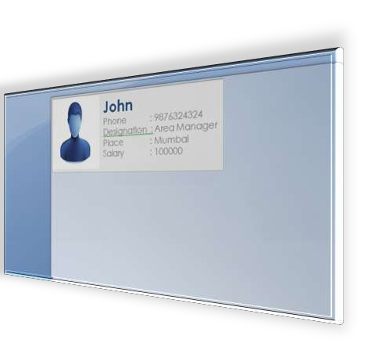
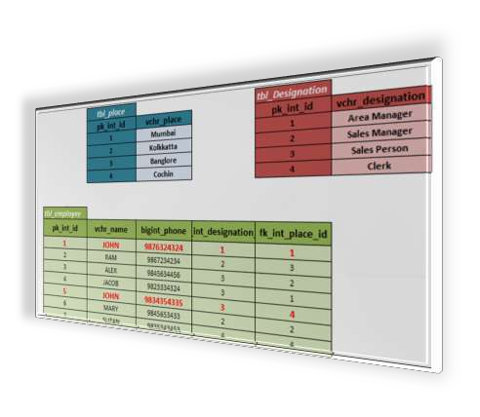
Joins
An SQL JOIN clause is used to combine rows from two or more tables, based on a common field between them.
Join helps to write single query to fetch data from multiple tables so as to meet the business requirement/generate reports

Slide 56
Types Of joins
Inner join
Outer Join
Left Outer Join
Right outer Join
Cross Join

Slide 57
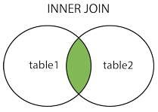
Inner Join
The INNER JOIN keyword selects all rows from both tables as long as there is a match between the columns in both tables.
Syntax
SELECT column_name(s) FROM table1
INNER JOIN table2 ON table1.column_name=table2.column_name
SELECT column_name(s) FROM table1 INNER JOIN table2 USING (column_name)

Slide 58






Inner Join
SELECT emp_id,emp_name, vchr_place from tbl_employee Join tbl_place on fk_int_place_id=pk_int_id
Emp_id | Emp_name | Fk_int_place_id
1000 | Samantha | 1
1001 | Anna | 3
1002 | Norman | 2
1003 | Mike | NULL
Pk_int_id
Vchr_place
1
Washington
Inner Join
2
Dallas
3
New York
4
Raleigh
Emp_id | Emp_name | Vchr_place
1000 | Samantha | Washington
1001 | Anna | New York
1002 | Norman | Dallas

Slide 59
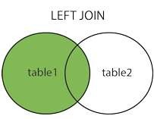
Left Join
Left Join
The LEFT JOIN keyword returns all rows from the left table (table1), with the matching rows in the right table (table2). The result is NULL in the right side when there is no match.
Syntax
SELECT column_name(s) FROM table1 LEFT JOIN table2 ON table1.column_name=table2.column_name;
SELECT column_name(s) FROM table1 LEFT JOIN table2 USING (column_name);

Slide 60


Left Join
SELECT emp_id,emp_name, vchr_place from tbl_employee Left Join tbl_place on fk_int_plac_id=pk_int_id
Emp_id | Emp_name | fk_int_place_id
1000 | Samantha | 1
1001 | Anna | 4
1002 | Norman | 2
1003 | Mike | 5
1004 | Alex | 6
pk_int_id | Vchr_place
1 | Washington
2 | Dallas
3 | New York
4 | Raleigh
Left Join
Emp_id | Emp_name | Vchr_place
1000 | Samantha | Washington
1001 | Anna | Raleigh
1002 | Norman | Dallas
1003 | Mike | NULL
1004 | Alex | NULL

Slide 61
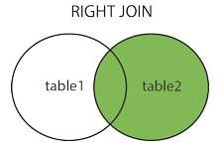
Right Join
The RIGHT JOIN keyword returns all rows from the right table (table2), with the matching rows in the left table (table1). The result is NULL in the left side when there is no match.
Syntax
SELECT column_name(s) FROM table1 RIGHT JOIN table2 ON table1.column_name=table2.column_name;
SELECT column_name(s) FROM table1 RIGHT JOIN table2 USING (column_name);

Slide 62
Right Join
SELECT emp_id,emp_name, vchr_place from tbl_place Right Join on tbl_employee fk_int_place_id=pk_int_id
Emp_id | Emp_name | fk_int_place_id
1000 | Samantha | 1
1001 | Anna | 4
1002 | Norman | 2
1003 | Mike | 5
1004 | Alex | 6
pk_int_id | Vchr_place
1 | Washington
2 | Dallas
3 | New York
4 | Raleigh
Right Join
Emp_id | Emp_name | Vchr_place
1000 | Samantha | Washington
1001 | Anna | Raleigh
1002 | Norman | Dallas
NULL | NULL | New York

Slide 63
Cross Join
Cross Join clause returns a Cartesian product of rows from the joined tables.
If each table has n and m rows respectively, the result set will have nxm rows.
It does not have a join predicate i.e. ON or USING clause cannot be used.

Slide 64
Cross Join
SELECT emp_id,emp_name, vchr_place from tbl_place Cross Join on tbl_employee;
Emp_id | Emp_name | fk_int_place_id
1000 | Samantha | 1
1001 | Anna | 2
1002 | Norman | 2
1003 | Mike | 1
pk_int_id | Vchr_place
1 | Washington
2 | Dallas
Right Join
Emp_id | Emp_name | Vchr_place
1000 | Samantha | Washington
1000 | Samantha | Dallas
1001 | Anna | Washington
1001 | Anna | Dallas
1002 | Norman | Washington
1002 | Norman | Dallas
1003 | Mike | Washington
1003 | Mike | Dallas

Slide 65
Rollup
The ROLLUP generates multiple grouping sets based on the columns or expression specified in the group by clause.
SELECT select_list
FROM table_name
GROUP BY c1, c2, c3 WITH ROLLUP;

Slide 66
Rollup
ROLLUP creates subtotals at each level in hierarchical structure
Country | Warehouse | Quantity
Canada | Toronto | 12969
Canada |  | 12969
United States of America | New Jersey | 7252
United States of America | San Francisco | 28613
United States of America | Seattle, Washington | 14860
United States of America | Southlake, Texas | 5483
United States of America |  | 56208
 |  | 69177

Slide 67
Rollup Example
SELECT country, warehouse, GROUPING(country, warehouse), avg(Quantity)
FROM inventory
GROUP BY country, warehouse WITH ROLLUP
To check whether NULL in the result set represents the subtotals or grand totals, GROUPING() function is used.
The GROUPING() function returns a 1 if the aggregated number is a subtotal row over the specified column.
It also returns 1 when NULL occurs in a super-aggregate row, otherwise, it returns 0.
Country | Warehouse | Grouping (COUNTRY) | Grouping (WAREHOUSE) | Quantity
Canada | Toronto | 0 | 0 | 12969
Canada |  | 0 | 1 | 12969
United States of America | New Jersey | 0 | 0 | 7252
United States of America | San Francisco | 0 | 0 | 28613
United States of America | Seattle, Washington | 0 | 0 | 14860
United States of America | Southlake, Texas | 0 | 0 | 5483
United States of America |  | 0 | 1 | 56208
 |  | 1 | 1 | 69177

Slide 68
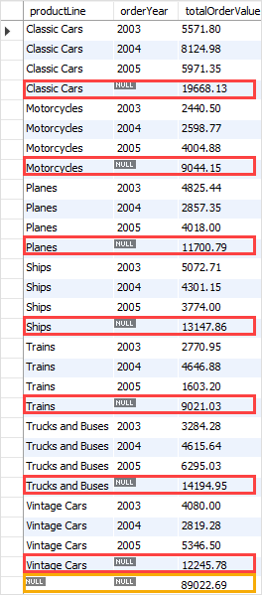
Example 2:
SELECT productLine, orderYear, SUM(orderValue) totalOrderValue
FROM sales
GROUP BY productline, orderYear WITH ROLLUP;
The ROLLUP generates the subtotal row every time the product line changes and the grand total at the end of the result

Slide 69
CUBE
SELECT columnlist, aggregate function
FROM tablelist
GROUP BY CUBE (columnlist)
CUBE is an extension of the GROUP BY clause.
CUBE allows you to generate subtotals like the ROLLUP extension.
CUBE extension will generate subtotals for all combinations(2^n)of grouping columns(n)
specified in the GROUP BY clause.
The GROUPING() function returns a 1 if the aggregated
number is a subtotal row over the specified column.
MYSQL: Group By Modifiers
Customer | Category | Year | Total units
AECOM | CPU | 2016 | 51
AECOM | CPU |  | 51
AECOM | Mother Board | 2016 | 144
AECOM | Mother Board |  | 144
AECOM | Storage | 2016 | 287
AECOM | Storage |  | 287
AECOM |  | 2016 | 482
AECOM |  |  | 482

Slide 70
www.cognixia.com

