Slide 1


Git and GitHub
www.cognixia.com

Slide 2

What is Version Control System?
A system that keeps records of your changes
Allows for collaborative development
Allows you to know who made what changes and when
Allows you to revert any changes and go back to a previous state
+91 898-002-4735 (973) 598-3969 44 203-808-4216 +973 1619-8549
www.cognixia.com

Slide 3
What is Version Control System?
git
SVN
Clearcase
Mercury
Popular Version Control System
+91 898-002-4735 (973) 598-3969 44 203-808-4216 +973 1619-8549
www.cognixia.com

Slide 4
What is Git?
Distributed version control
Users keep entire code and history on their location machines
Users can make any changes without internet access
(Except pushing and pulling changes from a remote server)
Created by Author of Linux
+91 898-002-4735 (973) 598-3969 44 203-808-4216 +973 1619-8549
www.cognixia.com

Slide 5
What is GitHub?
Is a Cloud Provider for git services
Other vendors such as: bitbucket, gitorious etc
+91 898-002-4735 (973) 598-3969 44 203-808-4216 +973 1619-8549
www.cognixia.com

Slide 6
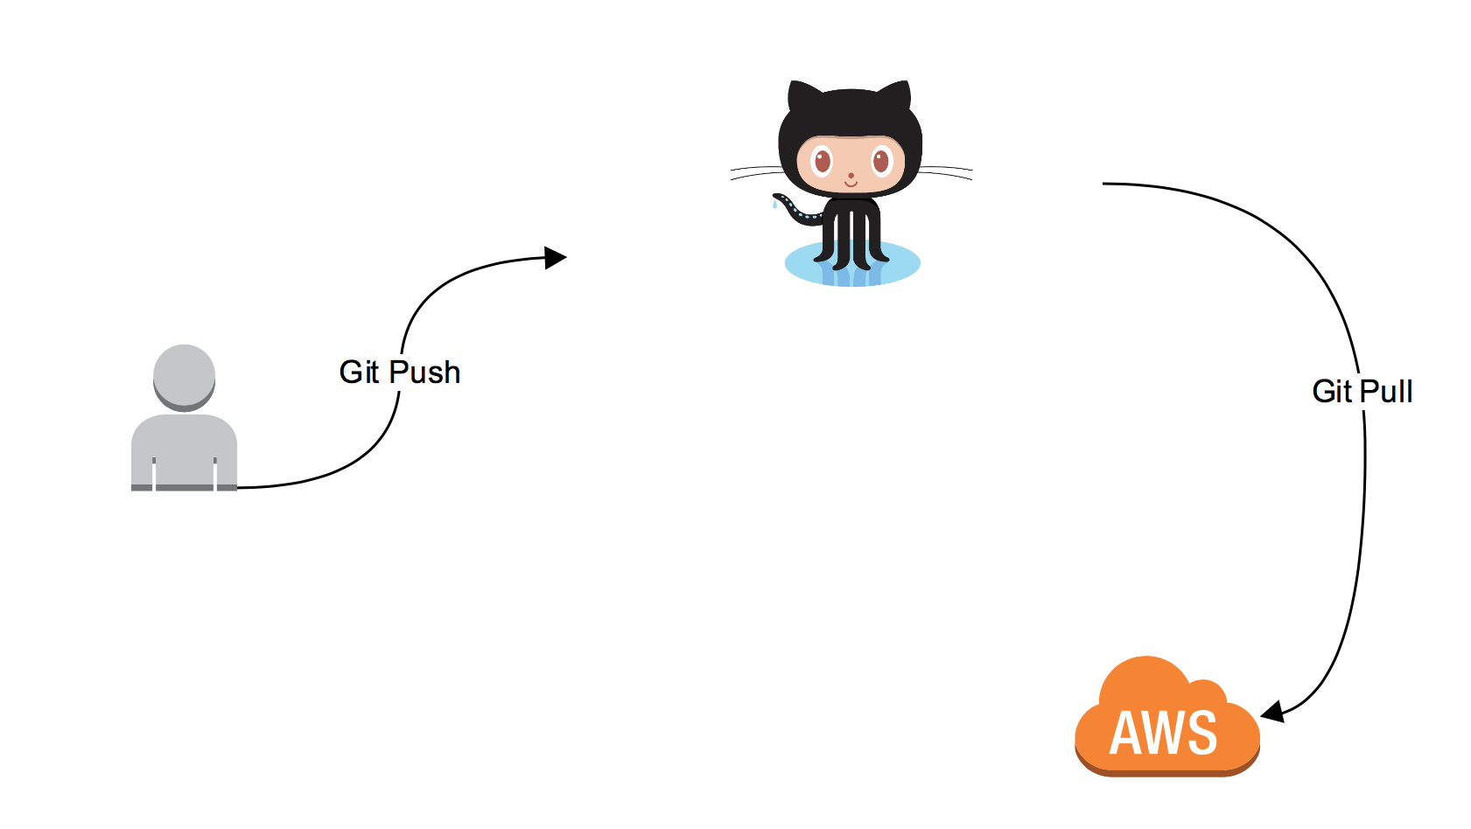
Basic Git WorkFLow(Simplified)
+91 898-002-4735 (973) 598-3969 44 203-808-4216 +973 1619-8549
www.cognixia.com

Slide 7
Installation:
OS | Commands/sites
Linux (Debian) | Command: sudo apt-get install git
Linux (Redhat) | Command: sudo yum install git
Mac | http://git-scm.com/download/mac
Windows | http://git-scm.com/download/win
+91 898-002-4735 (973) 598-3969 44 203-808-4216 +973 1619-8549
www.cognixia.com

Slide 8
Key Concepts: Snapshots
The way git keeps track of your code history
Essentially records what all your files look like at a given point in time
You decide when to take a snapshot, and of what files
Have the ability to go back to visit any snapshot
Your snapshots from later on will stay around, too
+91 898-002-4735 (973) 598-3969 44 203-808-4216 +973 1619-8549
www.cognixia.com

Slide 9
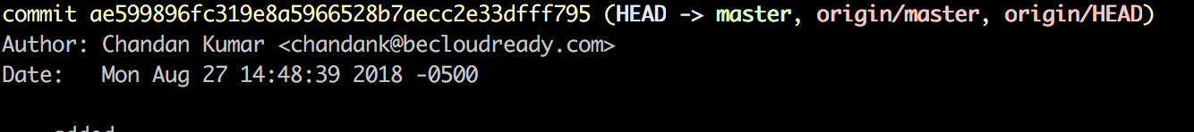
Key Concepts: Commits
The act of creating a snapshot
Essentially, a project is made up of a bunch of commits
Commits contain three pieces of information:
Information about how the files changed from previously
A reference to the commit that came before it
A hash code name
+91 898-002-4735 (973) 598-3969 44 203-808-4216 +973 1619-8549
www.cognixia.com

Slide 10
Key Concepts:Repositories
Often shortened to ‘repo’.
A collection of all the files and the history of those files.
Consists of all your commits.
Place where all your hard work is stored.
+91 898-002-4735 (973) 598-3969 44 203-808-4216 +973 1619-8549
www.cognixia.com

Slide 11
Key Concepts: Cloning
Can live on a local machine or on a remote server (GitHub!).
The act of copying a repository from a remote server is called cloning.
Cloning from a remote server allows teams to work together.
+91 898-002-4735 (973) 598-3969 44 203-808-4216 +973 1619-8549
www.cognixia.com

Slide 12
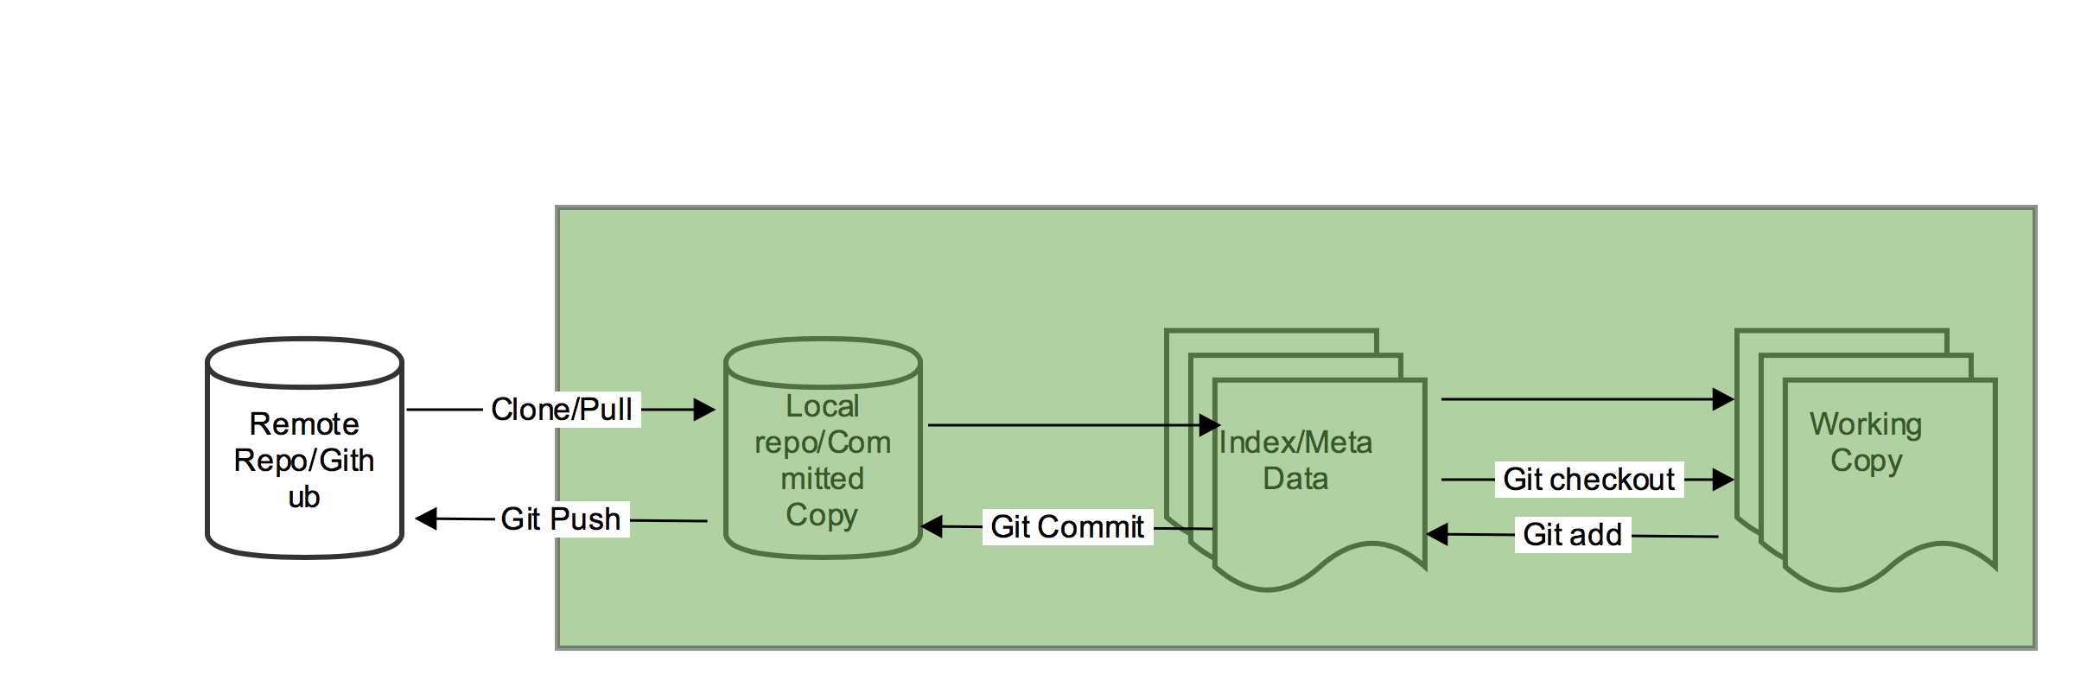
Git Work Flow
+91 898-002-4735 (973) 598-3969 44 203-808-4216 +973 1619-8549
www.cognixia.com

Slide 13
Working example
Open cmd or terminal
git clone https://github.com/becloudready/git-tutorials.git
cd git-tutorials
<Do some changes>
touch <Yourname> or create a .txt file
git add <yourname>
git commit -m ‘Added my file’
git push origin master
No passwords after 13-Aug-2021: Creating a personal access token - GitHub Docs
+91 898-002-4735 (973) 598-3969 44 203-808-4216 +973 1619-8549
www.cognixia.com
Notes:
Echo “Hello World” > Test.txt

Slide 14
Incremental Changes
On Local box
git add
git status
git commit
git push
On AWS
git clone
git pull
+91 898-002-4735 (973) 598-3969 44 203-808-4216 +973 1619-8549
www.cognixia.com

Slide 15
Assignment:
Create your own repo on github
Push the first code (any random file) from your PC
Push it to the github from PC
Pull it to AWS
+91 898-002-4735 (973) 598-3969 44 203-808-4216 +973 1619-8549
www.cognixia.com

Slide 16
Push and Pull :
The process of downloading commits that don’t exist on your machine from a remote repository is called pulling changes
The process of adding your local changes to the remote repository is called pushing changes
+91 898-002-4735 (973) 598-3969 44 203-808-4216 +973 1619-8549
www.cognixia.com

Slide 17
Quick Recap :
Command | Usage
Git log | Check the history of the whole repo
Git add | Add the file into staging area
Git commit | Commit the file to local repo
Git push | Push to remote repo
Git blame <file-name> | Find the history of changes done on that file
Git status | Checking current staging area
Git checkout –b <branch> | Create a new branch off existing branch
Git merge <branch name> | Merge the branch with existing
Git reset | Reset all changes
Git stash | Stash changes to local staging area
Git pull | Pull from remote to local
+91 898-002-4735 (973) 598-3969 44 203-808-4216 +973 1619-8549
www.cognixia.com

Slide 18
Complete Git Work Flow:
+91 898-002-4735 (973) 598-3969 44 203-808-4216 +973 1619-8549
www.cognixia.com

Slide 19
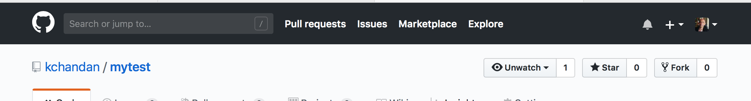
Forking is easy:
Step 1
https://github.com/kchandan/bash
Click on the Fork Icon
+91 898-002-4735 (973) 598-3969 44 203-808-4216 +973 1619-8549
www.cognixia.com

Slide 20
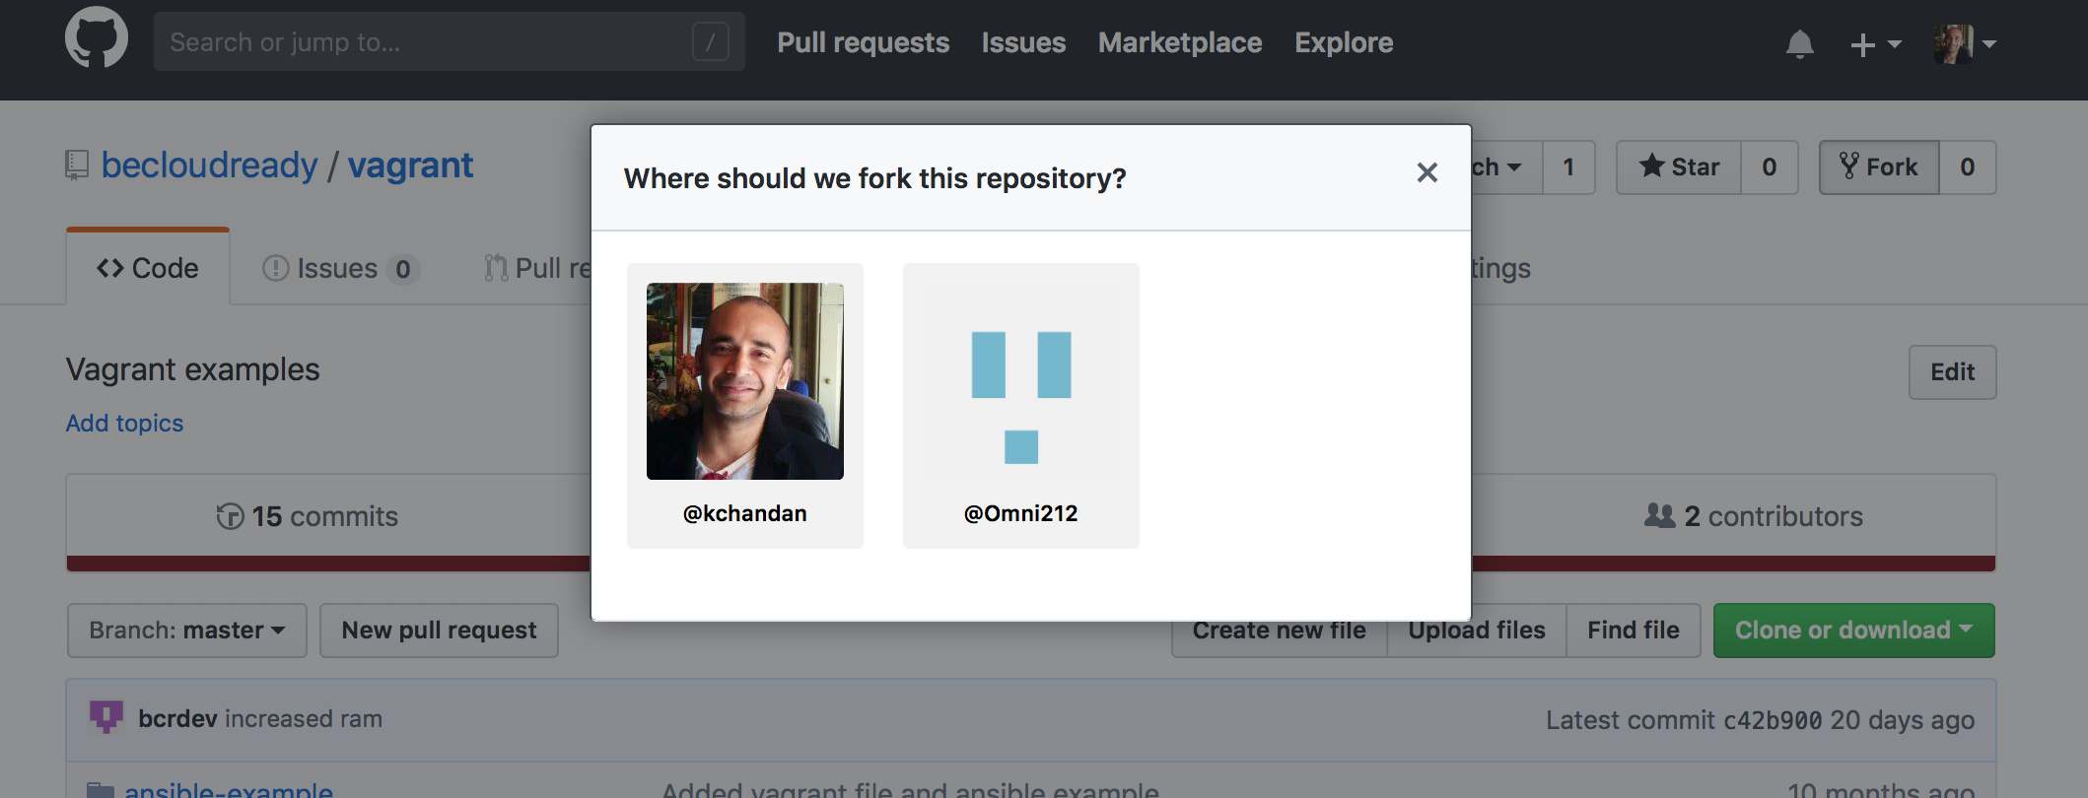
Forking is easy:
Step 2
Select your github profile where you want to fork it.
+91 898-002-4735 (973) 598-3969 44 203-808-4216 +973 1619-8549
www.cognixia.com

Slide 21
Editor Settings for Git Work Flow: VS Code
Download : https://code.visualstudio.com/download
Install on Local PC/MAC
+91 898-002-4735 (973) 598-3969 44 203-808-4216 +973 1619-8549
www.cognixia.com

Slide 22
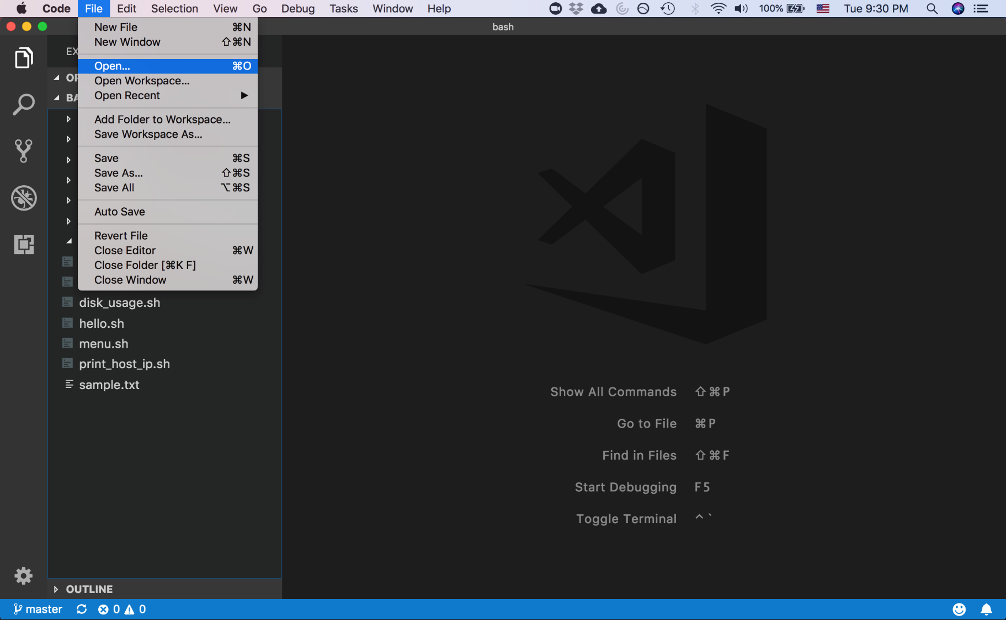
Editor Settings for Git Work Flow: VS Code
Open the Git repository
+91 898-002-4735 (973) 598-3969 44 203-808-4216 +973 1619-8549
www.cognixia.com

Slide 23
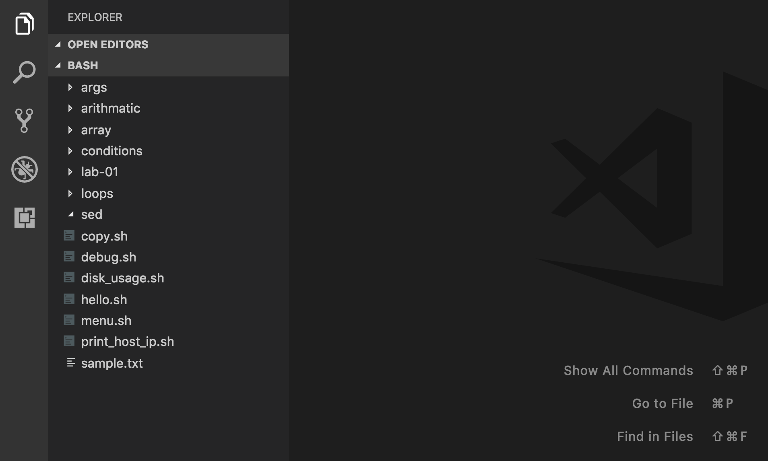
Editor Settings for Git Work Flow: VS Code
Git Plugin of VS Code
Git Plugin
+91 898-002-4735 (973) 598-3969 44 203-808-4216 +973 1619-8549
www.cognixia.com

Slide 24
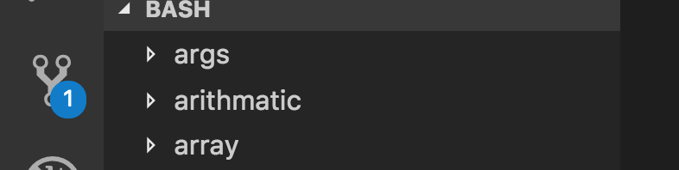
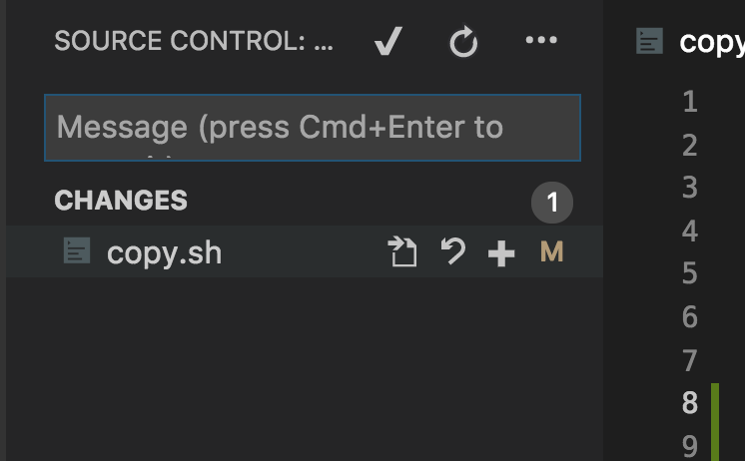
Git Plugin in Action
Once to modify any file, it will show up the number of files modified.
Click on + sign to add the file.
+91 898-002-4735 (973) 598-3969 44 203-808-4216 +973 1619-8549
www.cognixia.com

Slide 25
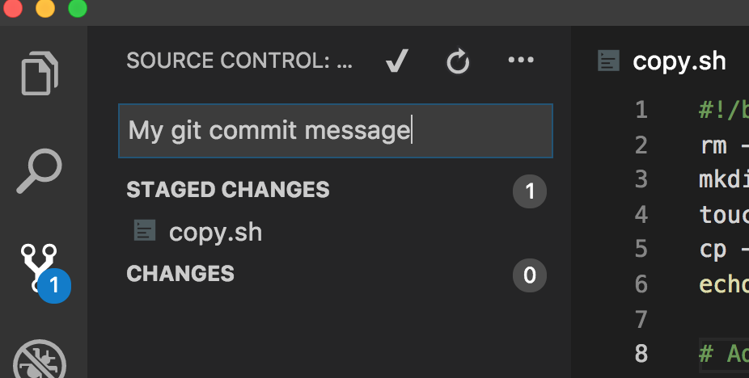

Git Plugin in Action
Enter the git commit message and click on check mark icon to commit the changes.
Once the code is committed, the bottom left corner shows files to be committed, click on the circle icon to trigger pull/push.
+91 898-002-4735 (973) 598-3969 44 203-808-4216 +973 1619-8549
www.cognixia.com

Slide 26
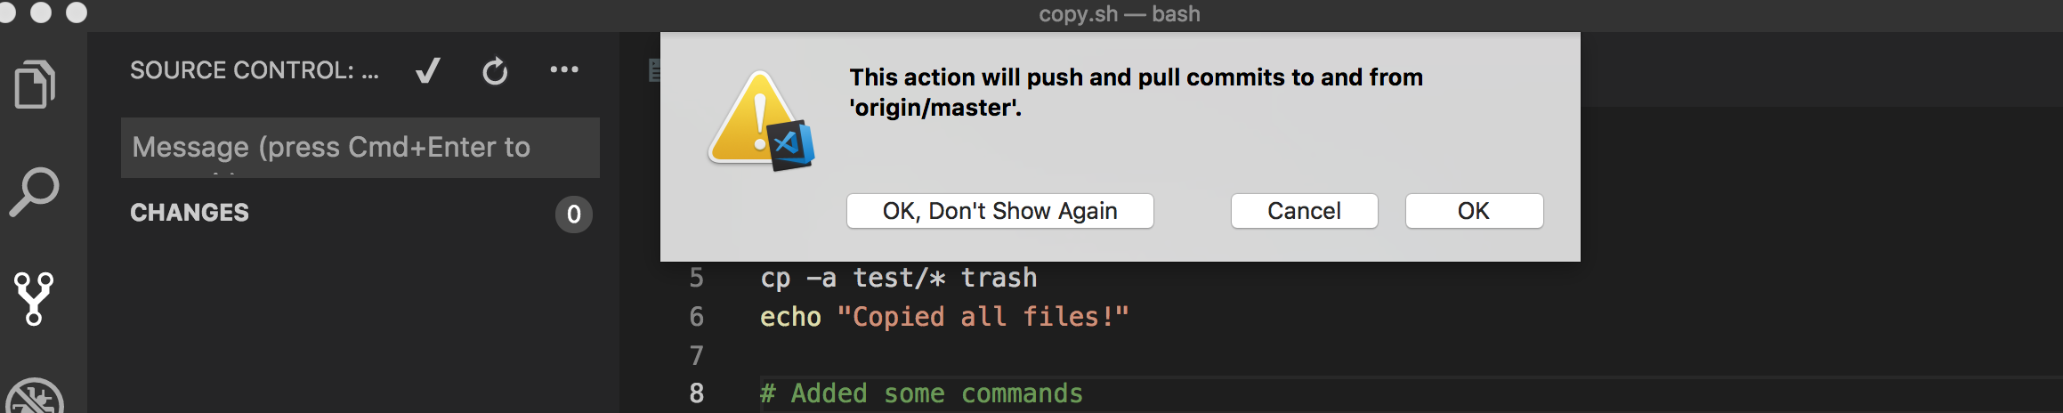
Git Plugin in Action
It will pop up this warning sign. Just click Ok to proceed with pull/push operation.
Once aforesaid operation is finished, go and check github web portal to ensure your changes are pushed.
+91 898-002-4735 (973) 598-3969 44 203-808-4216 +973 1619-8549
www.cognixia.com

Slide 27
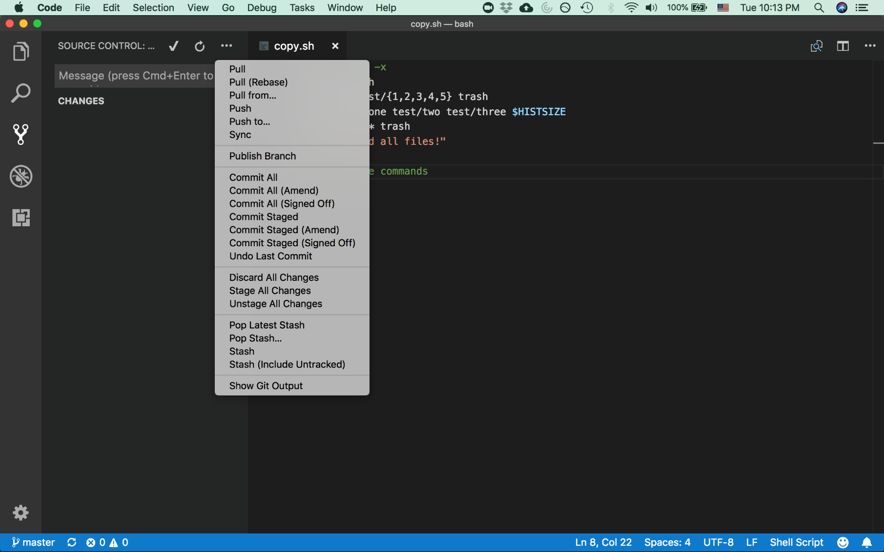
Git Plugin : More Actions
+91 898-002-4735 (973) 598-3969 44 203-808-4216 +973 1619-8549
www.cognixia.com

Slide 28
More Tips
https://code.visualstudio.com/docs/introvideos/versioncontrol
Resolving Git Merge Conflict: https://docs.github.com/en/free-pro-team@latest/github/collaborating-with-issues-and-pull-requests/resolving-a-merge-conflict-using-the-command-line

Slide 29
Git - Scenarios
Consider the following scenario involving Git.
Jack and Jill are both working on a shared project MyProj that is stored in a remote Git repo.
Jack does a clone on the remote repo.
What two things does Git create when Jack issues the clone command?
When Jack issues the clone command, Git creates:
a local copy of the MyProj repository and
a working directory that contains the latest snapshot of the project files.
+91 898-002-4735 (973) 598-3969 44 203-808-4216 +973 1619-8549
www.cognixia.com

Slide 30
Git – Scenario – Step 2
Next, Jack edits the MyProj file test.rb
Then, he executes an add, a commit and a push.
What does Git do when Jack issues these commands?
The add command “stages” the file test.rb
The commit command updates Jack’s local repository to reflect the changes.
The push command updates the remote repository to reflect the changes in Jack’s local repository.
+91 898-002-4735 (973) 598-3969 44 203-808-4216 +973 1619-8549
www.cognixia.com

Slide 31
Git – Scenario – Step 3
Next, Jill does a clone on MyProj.
Then, Jill and Jack both edit test.rb in parallel. test.rb has over 100 lines of code.
Jill edits a couple lines at the top of the file, and Jack edits a couple lines at the bottom of the file.
Then, Jack does an add/commit/push. Finally, Jill does a add/commit/push.
What does Git do when Jill issues the push command?
When Jill issues the push command, Git rejects her push.
Because the remote branch has changed since the last time Jill pulled from it.
+91 898-002-4735 (973) 598-3969 44 203-808-4216 +973 1619-8549
www.cognixia.com

Slide 32
Git – Scenario – Step 4
What Git commands should Jill issue next and what would the result of the command be?
Jill should do a pull on the remote repository.
That will update her current branch in her local repository as well as her working directory.
The update will both download the changes in the remote repository and merge them into her current branch.
Then upload the merged changes, she would need to do an add/commit/push.
+91 898-002-4735 (973) 598-3969 44 203-808-4216 +973 1619-8549
www.cognixia.com

Slide 33
Thank You
+91 898-002-4735 (973) 598-3969 44 203-808-4216 +973 1619-8549
www.cognixia.com

