Slide 1
HFES Student Chapter
🎃🦇👻TRIVIA NIGHT👻🦇🎃

Slide 2
How this will work
6 rounds
  Assign 1/3/5 pts for first half, 2/4/6 second half
Bonus round
  2 pts each, 2 pt bonus for all 10
Final question 7 pt
Honor code: keep phones away, grade yourself

Slide 3
Let's do this!
Split into groups of 2-4
+1 point per unique PhD, Master, Undergrad
Come up with funny team name

Slide 4
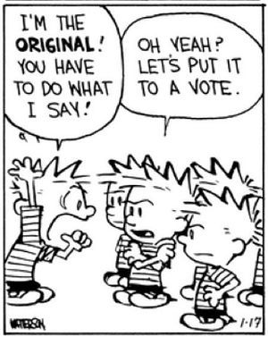
Round 1: Individual Differences
People are not all the same
People are not all like a designer
Even designing for the average can exclude most
Trivia!

Slide 5
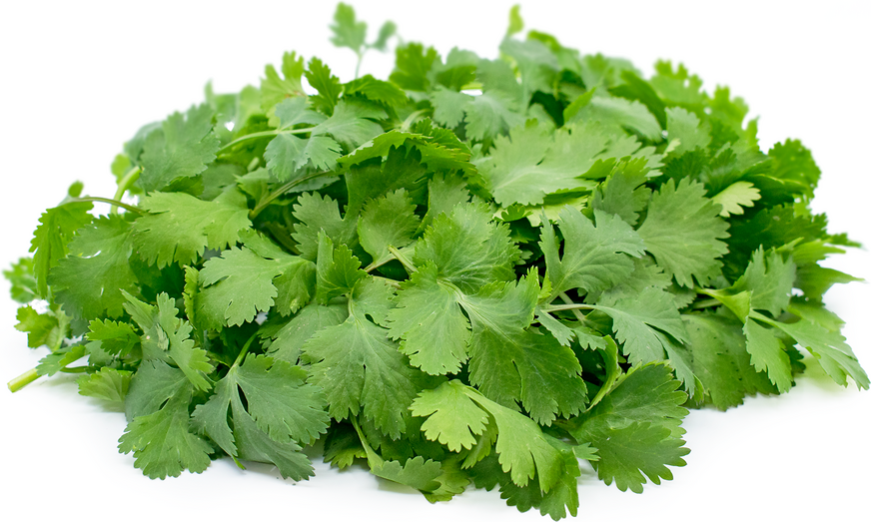
Genetic differences make some people perceive cilantro to taste like what?

Slide 6
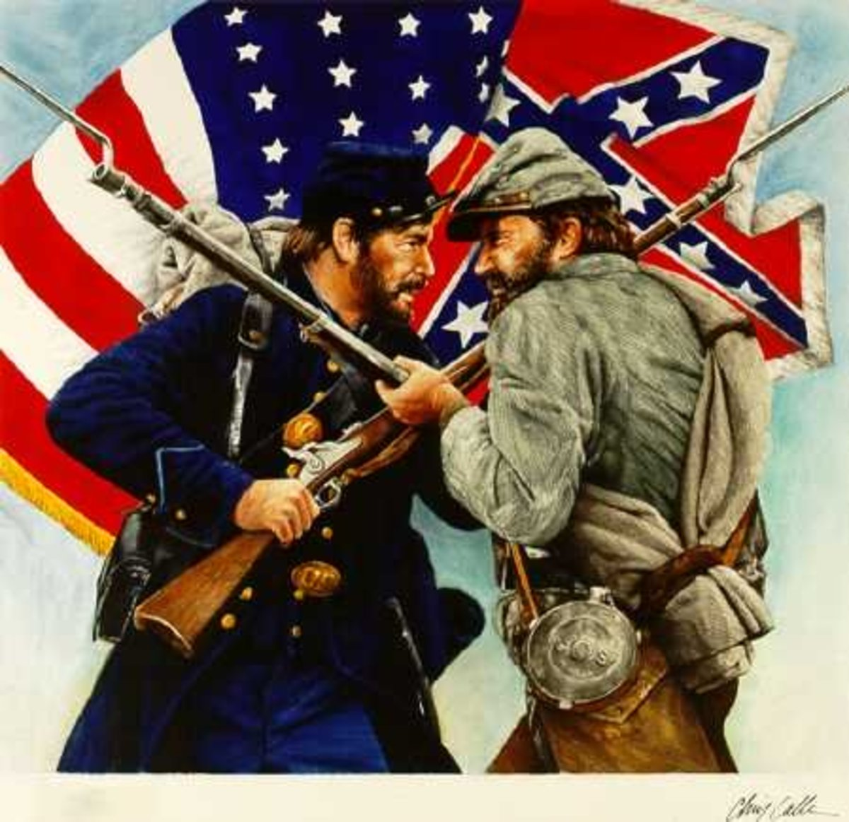
Slop-workers, slop-shops, and slop-sellers were names for producers of what individualized good, which began mass production during the War of 1812 and saw further growth in popularity during and after the Civil War?

Slide 7
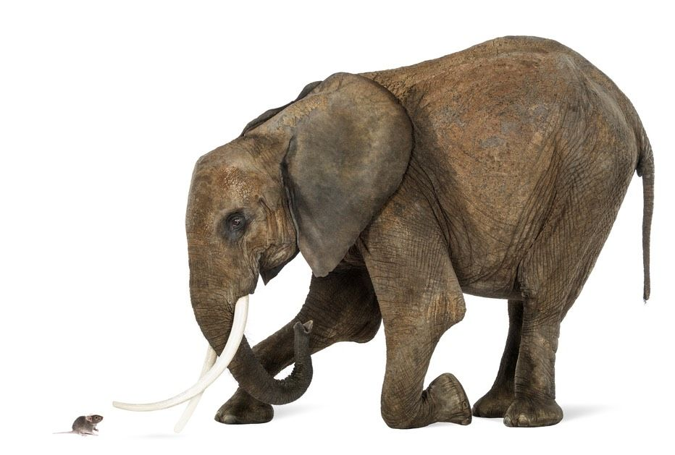
About how many times as tall is the tallest person ever compared to the shortest person ever? (+/- 0.5 times)

Slide 8
Round 1: Individual Differences
Write down your answers!
Ready?

Slide 9
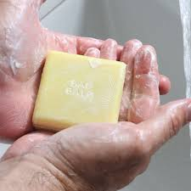
Genetic differences make some people perceive cilantro to taste like soap!
OR6A2 gene
~10% of US population

Slide 10
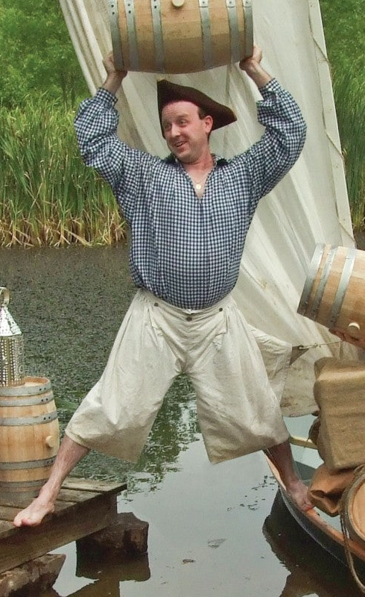
Slop-workers, slop-shops, and slop-sellers produced clothes!
Standardization and ready-to-wear sizes slowly replaced tailors
  Originally a sailing term
  Early clothes ill-fitting (“Slops”)
Important in Civil War
  Identification, protection from elements, morale
  Union advantage early in the war

Slide 11
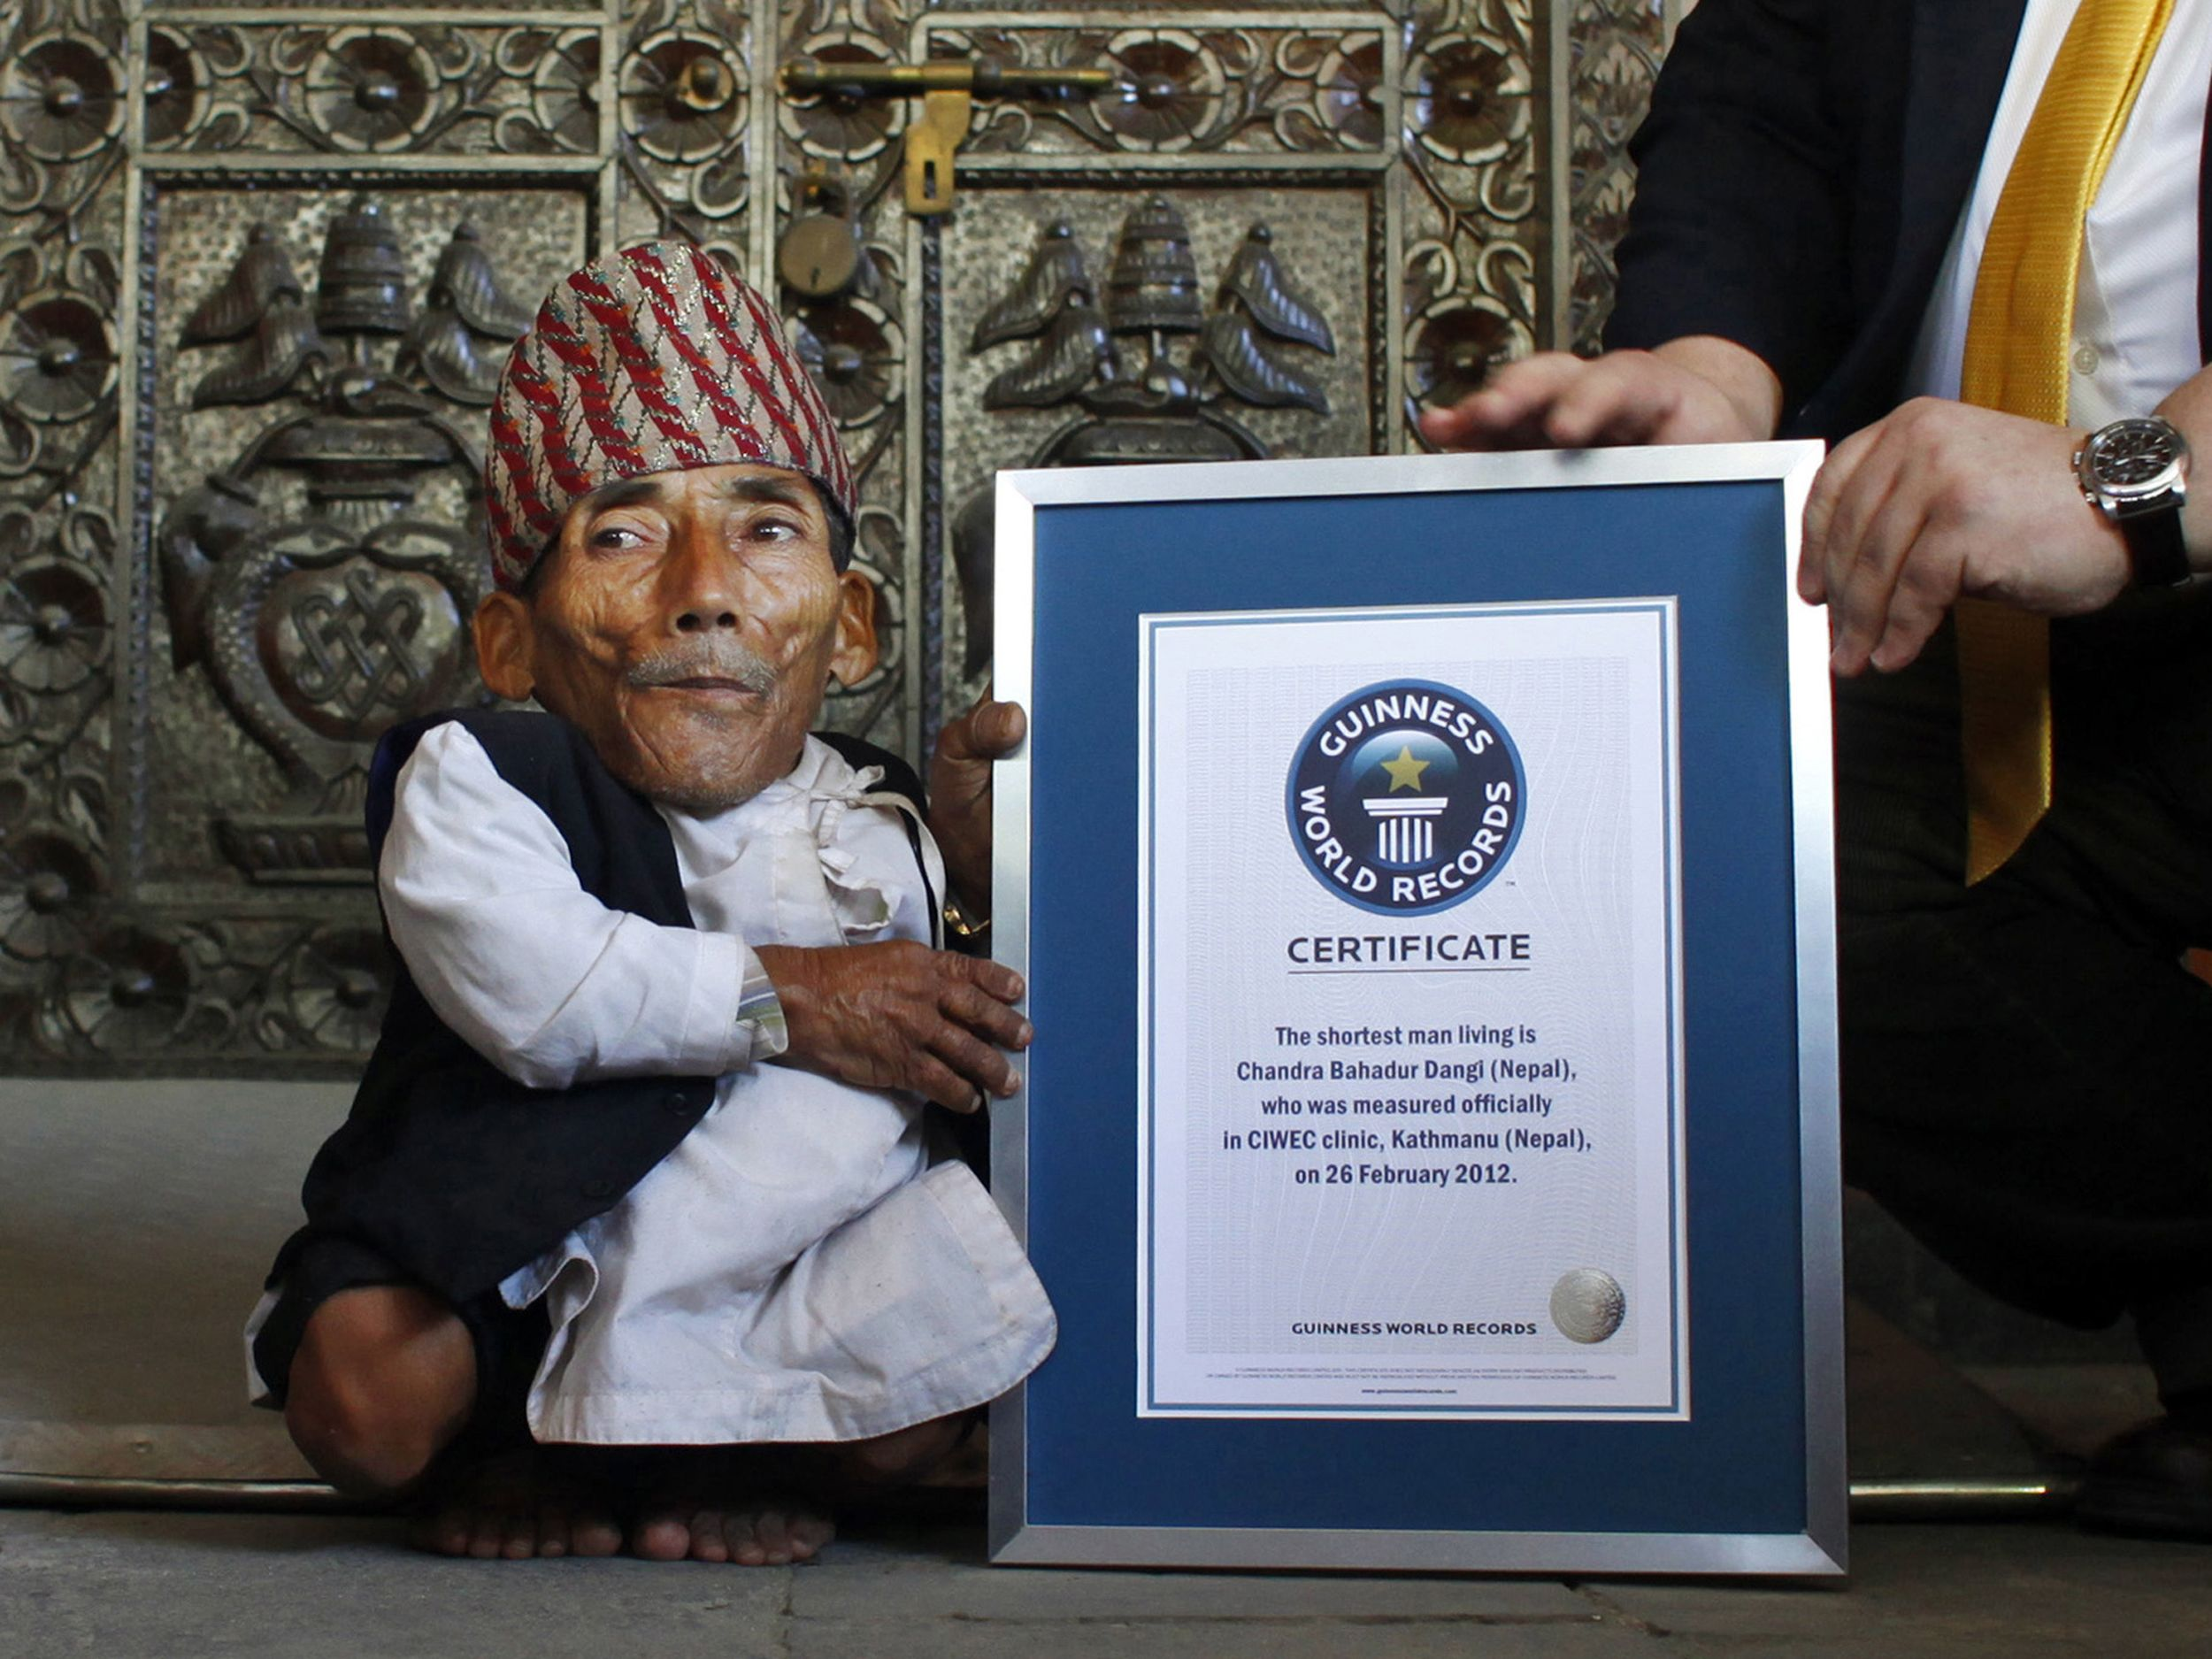
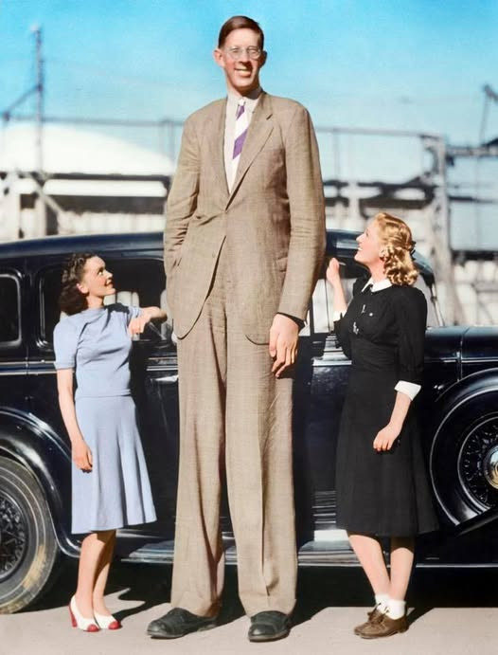
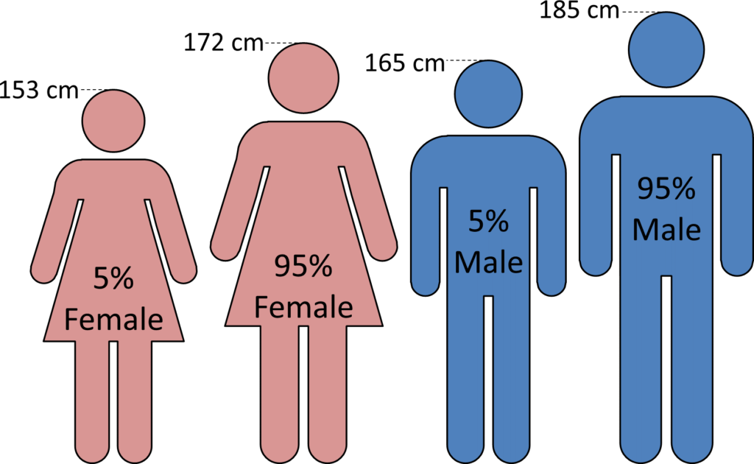
The tallest person ever is about 5 times as tall as the shortest person ever!
1’9.5”
About 12” difference (20%) between 5% Female and 95% Male
8’11”

Slide 12
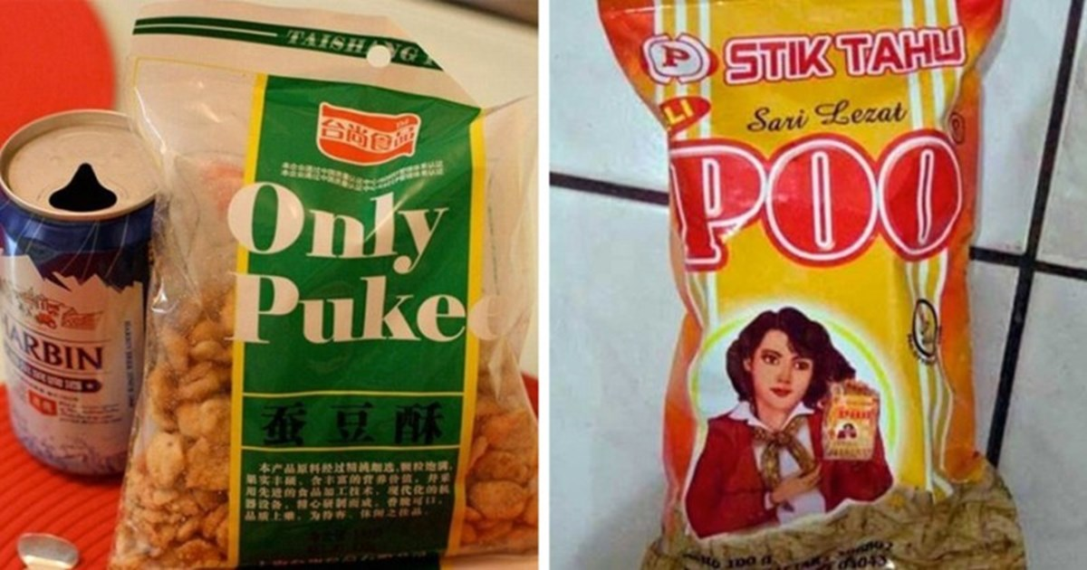
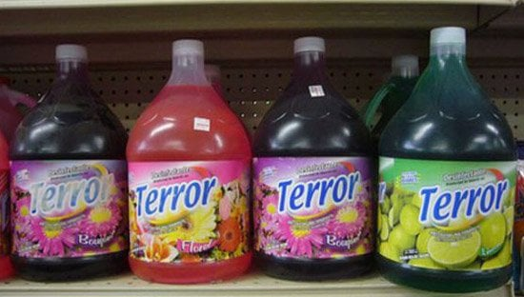
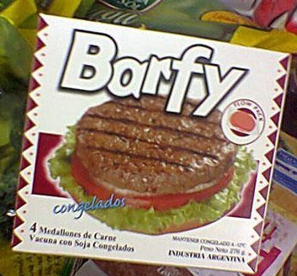
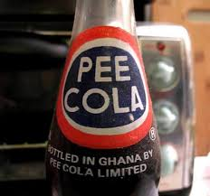
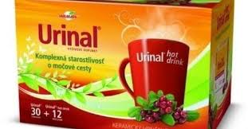
Round 2: You Give Product a Bad Name
Names matter
  Purchasing intent
  Communicate function
When bad, obscure the product

Slide 13
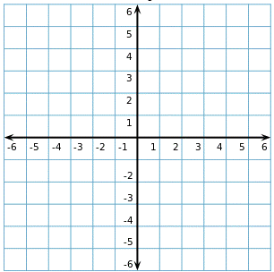
What household object was patented by 1970 as an “X-Y Position Indicator”?

Slide 14

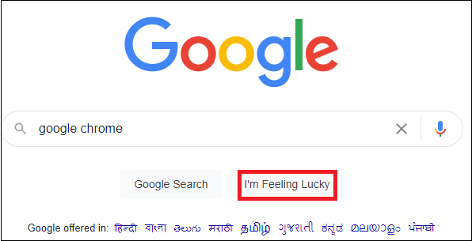
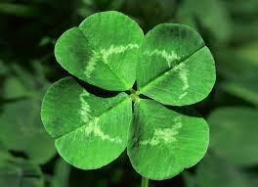
What does Google's "I'm feeling lucky" do?

Slide 15
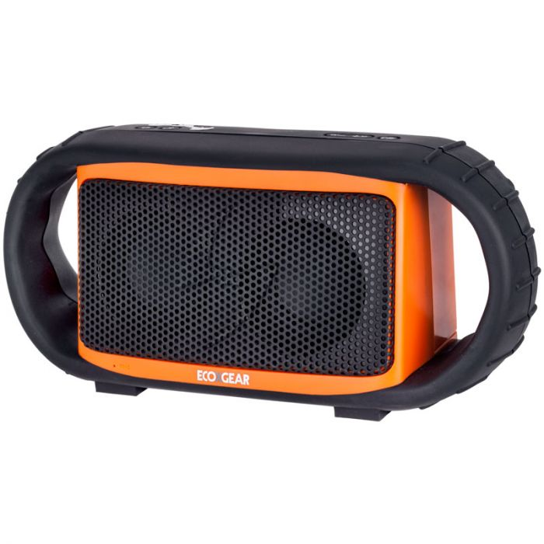

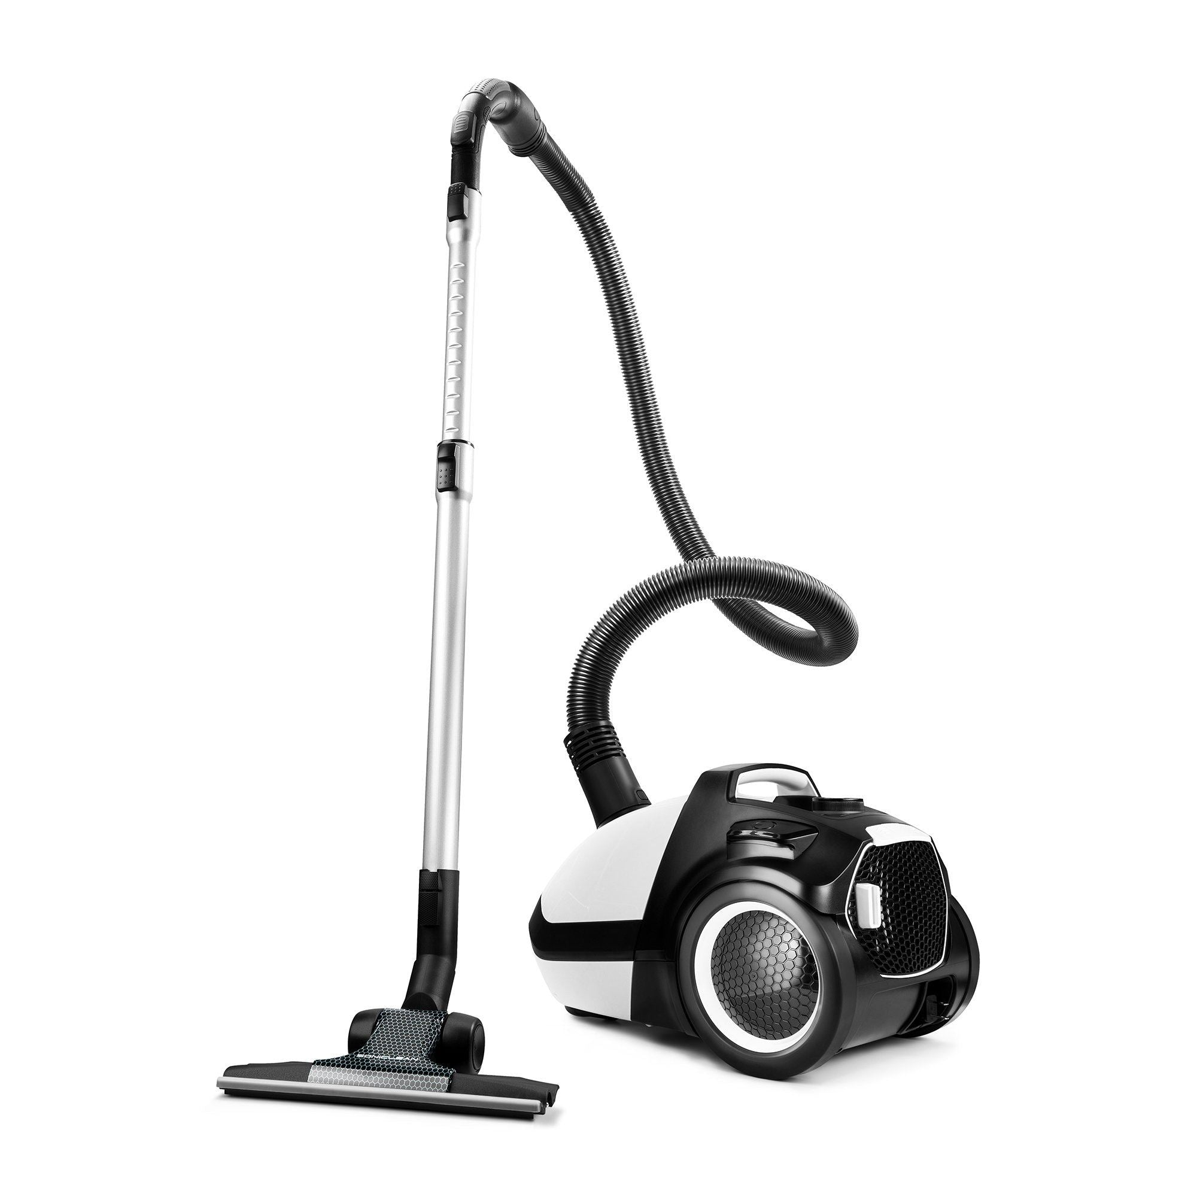
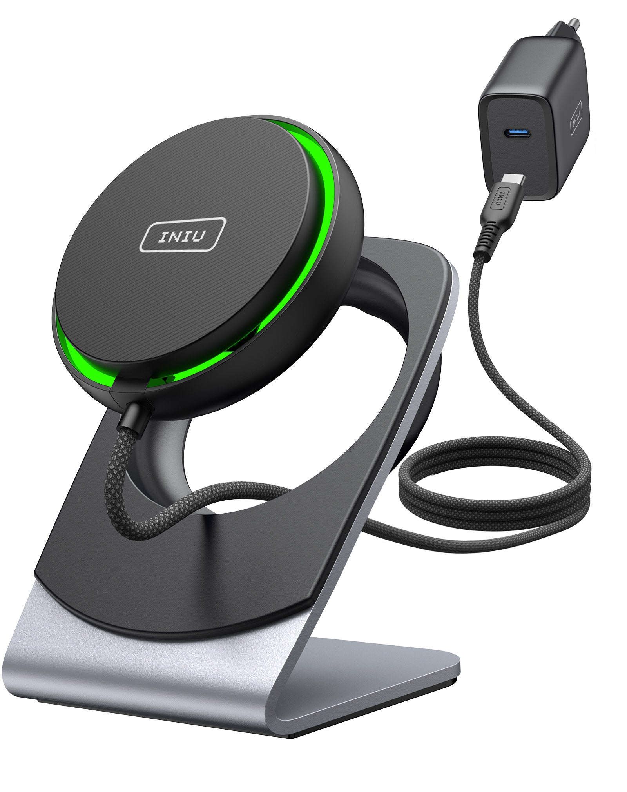
What kind of consumer tech is the "Grace Digital Ecoxgear Ecoxbt"?
B) Shower Head
A) Speaker
C) Vacuum Cleaner
D) Phone Charger

Slide 16
Round 2: You Give Product a Bad Name
Write down your answers!
Ready?

Slide 17
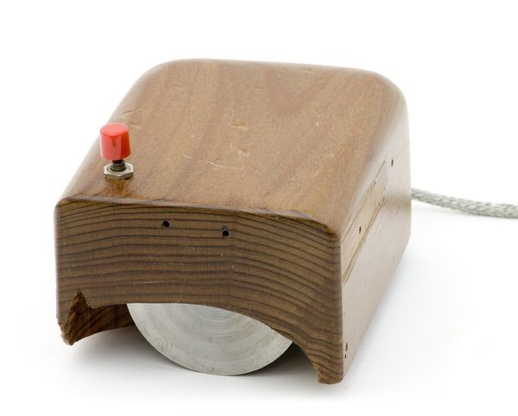

The mouse was patented as an “X-Y Position Indicator for a Display System”!
Invented by Douglas Engelbart in 1963 at Stanford, built by Bill English in 1964
  Quickly referred to as “mouse” because of tail (cursor may have been called CAT)
  “Mother of all demos”
Two wheels and one button
Replaced text commands
Lots of mice now don’t have a “tail”, but the name sticks (see Skeuomorphism)

Slide 18
Google's "I'm feeling lucky" takes you to the page of the first result!
Or… something else?
  If nothing typed, easter eggs
Originally to show off efficiency, confidence
Not clear to novices
On and off prevalence
  Costs ad revenue
Bad name?

Slide 19
The “Grace Digital Ecoxgear Ecoxbt” is a bluetooth speaker (A)!
Of course it is…

Slide 20

Round 3: Famous Effects
People who noticed and explained phenomena have things named after them sometimes
Observations about behavior offer insights into how the brain works

Slide 21
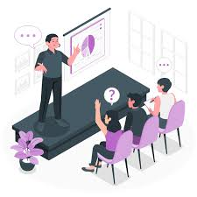

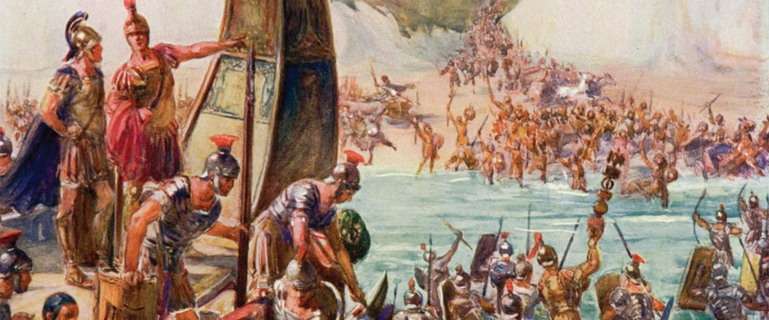
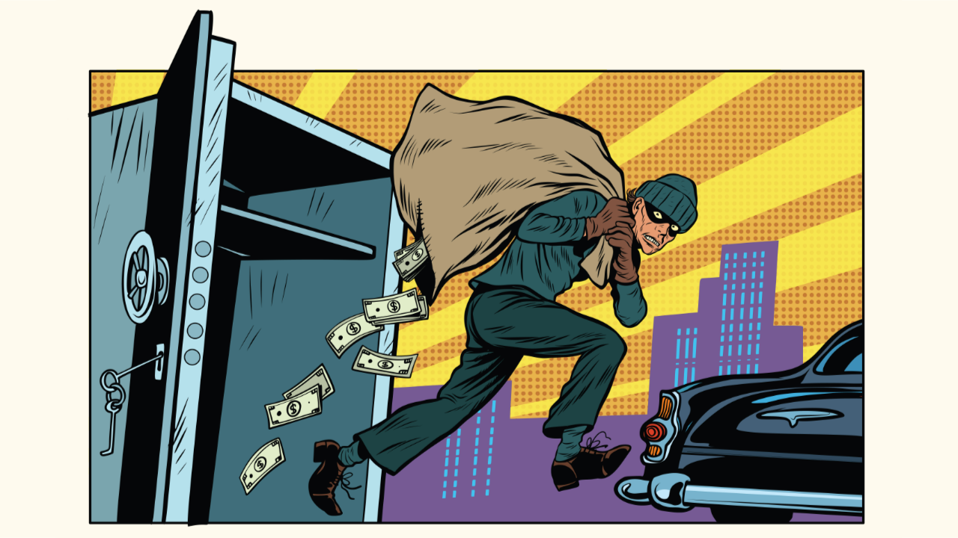
The Dunning-Kruger Effect, where people with low expertise overestimate their confidence, was inspired by a what?
B) Disappointing Valentine’s gift
A) Terrible senior capstone project
D) Failed bank robbery
C) Catastrophic Roman invasion

Slide 22

The Cocktail Party Effect was inspired by the observation that people easily notice what?

Slide 23
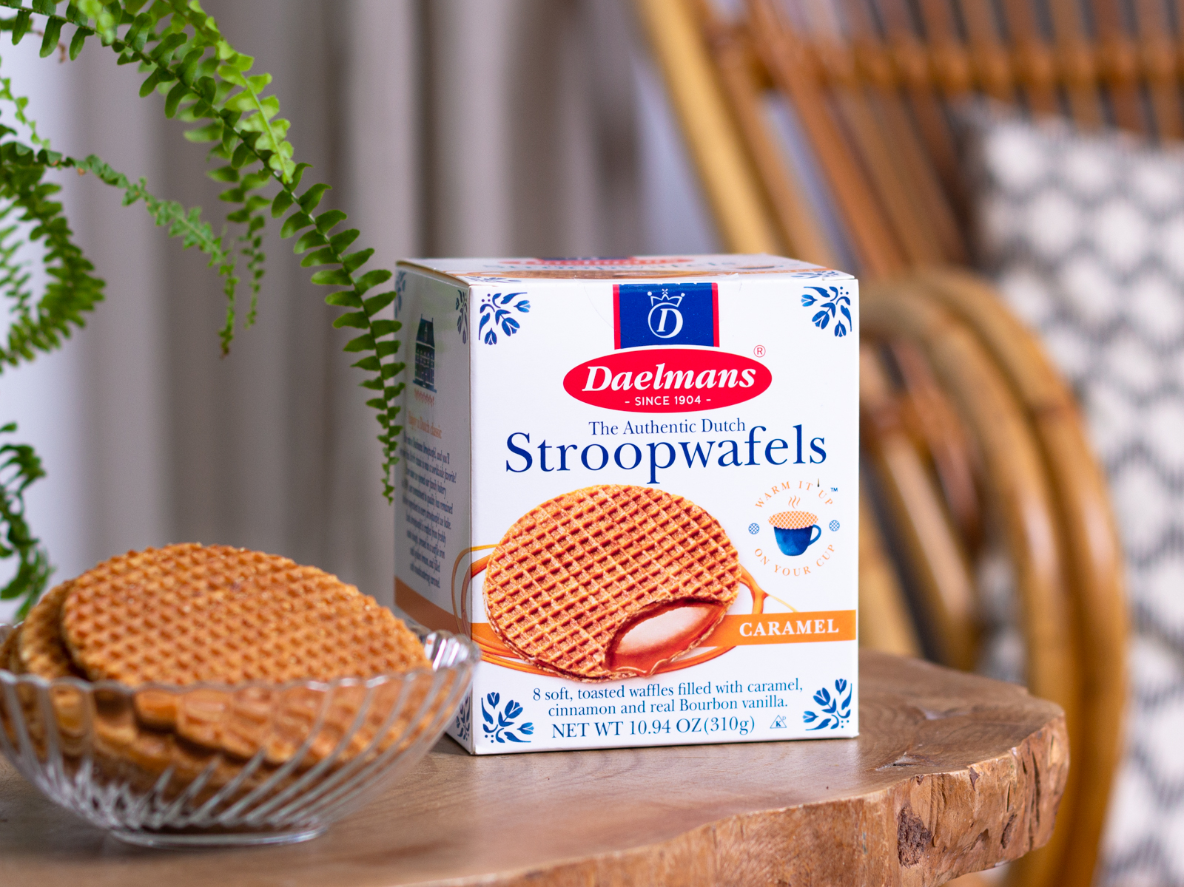
The Stroop Effect describes the phenomenon where categorization time is slower when what two features of a displayed word are incongruous? (half credit each)
Stroopwafels are unrelated to this question

Slide 24
Round 3: Famous Effects
Write down your answers!
Ready?

Slide 25
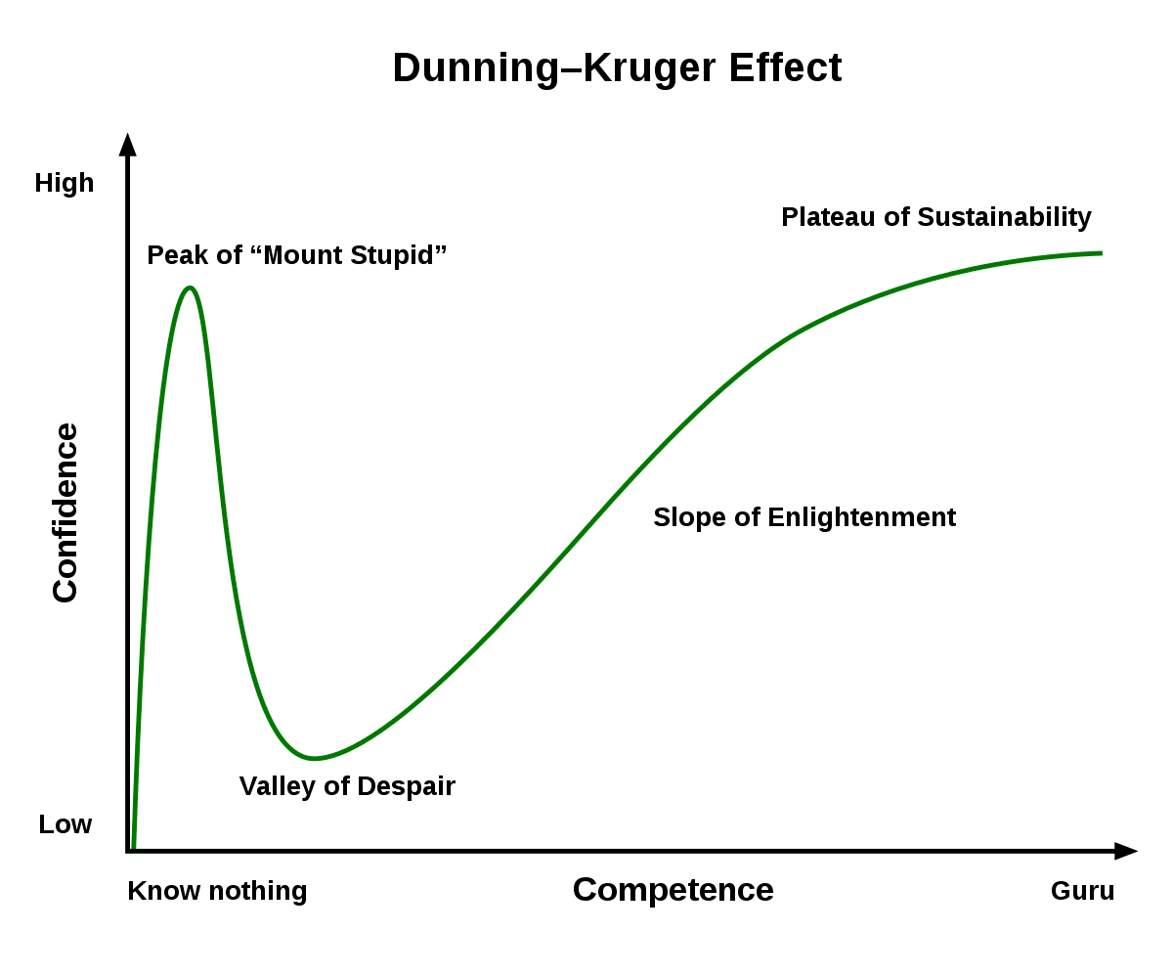
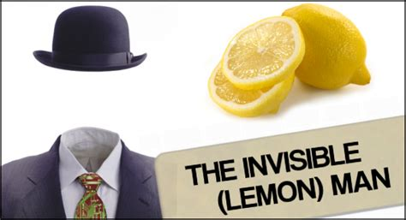
The Dunning-Kruger effect research was inspired by a failed bank robbery (D)!
In 1995, McArthur Wheeler and Clifton Earl Johnson robbed two banks
How to evade security cams? Lemon juice on their faces.
  It works as invisible ink!
  Wheeler took a picture of himself to verify, and didn’t see himself in it
They were arrested: “But I wore the lemon juice! I wore the lemon juice!”
Inspired Cornell psychologists David Dunning and Justin Kruger
  “Unskilled and Unaware of It: How Difficulties in Recognizing One's Own Incompetence Lead to Inflated Self-Assessments” (1999)

Slide 26
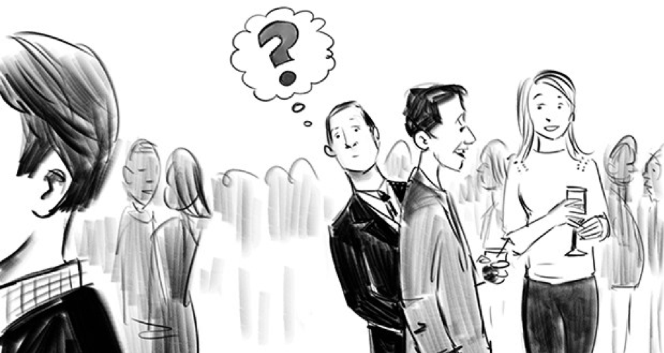
The Cocktail Party Effect was inspired by the observation that people easily notice their name!
Attention is both a filter and a fuel
Cognitive effort is spent to filter erroneous stimuli
Semantic meaning is still processed in unattended stimuli
Similar research shows people tend to follow stimuli from one ear to another, and maintain stimuli in sensory register briefly
  Echoic memory
  Iconic memory
  Other senses

Slide 27
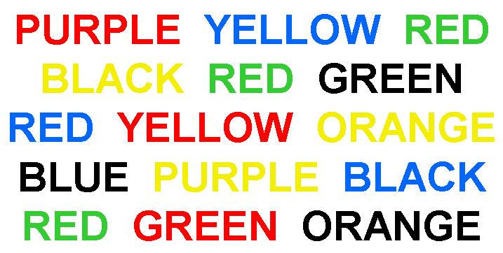
The Stroop Effect describes the phenomenon where categorization time is slower when the meaning and color of a displayed word are incongruous!
Harder to name the color of a word than to read the word
Reading is a more automatic process than naming color
Slower reaction time when they don’t match
Used to assess cognitive control

Slide 28
Bonus Round!!!
2 pt per correct response, 2 pt bonus for all 10
Name as many of Jakob Nielsen’s 10 Usability Heuristics as you can!
Wrong guesses don’t count against you.

Slide 29
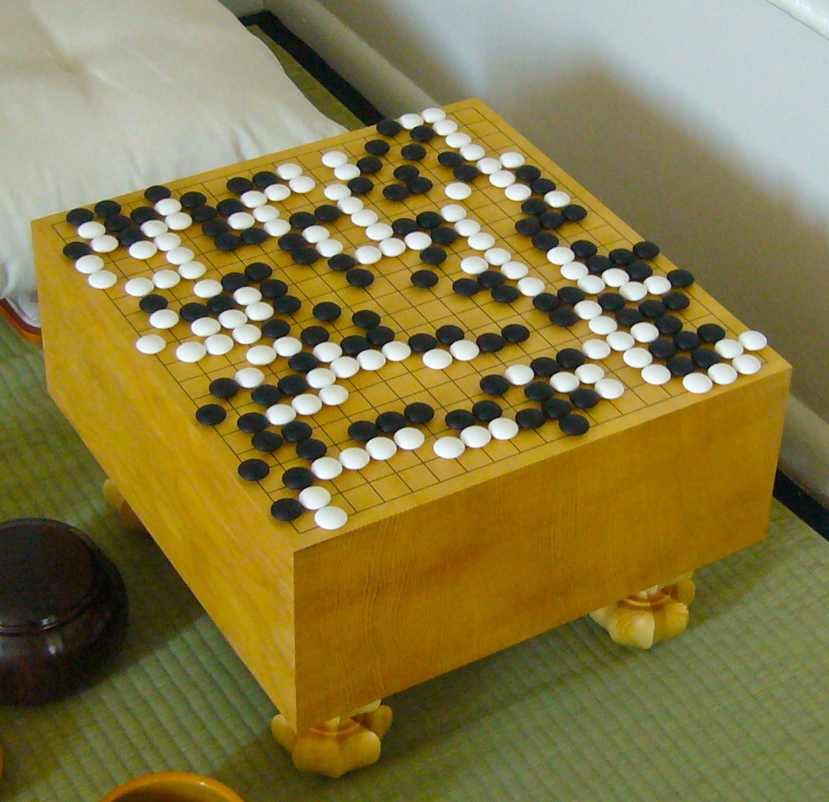
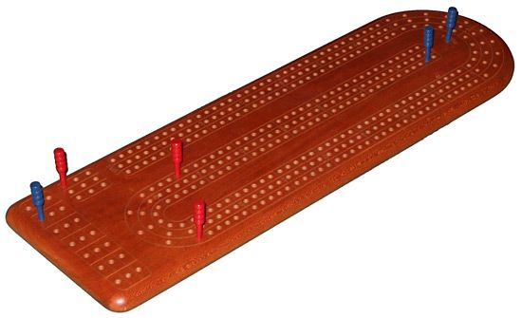
Go!
This slide is so that Tommy doesn’t go to the answers accidentally

Slide 30
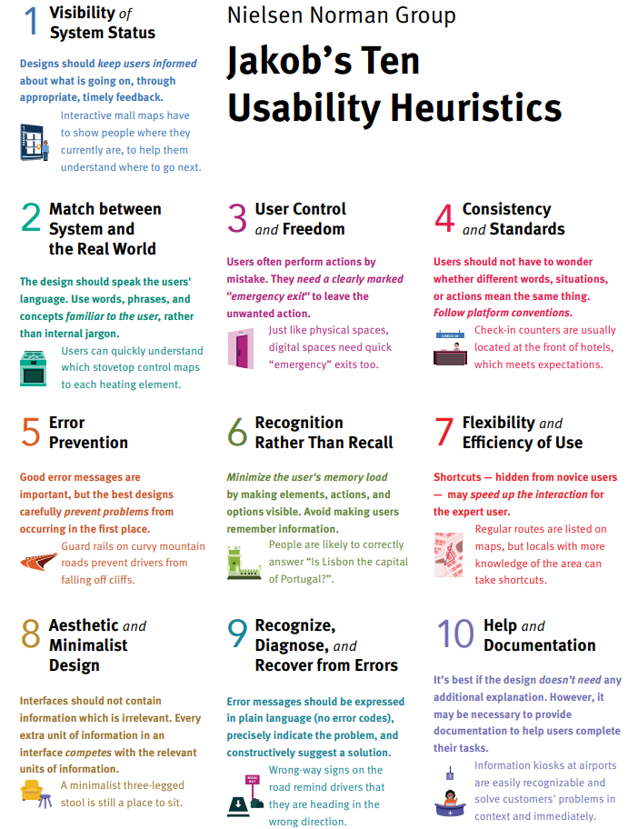
Bonus Round Answers
Grade yourselves
Synonyms OK within reason
2 pt each, 2 pt bonus for all 10

Slide 31
Round 4: Inciting Incidents
When things go bad, people want to know why
Leads to better understanding
Prevents future disasters

Slide 32
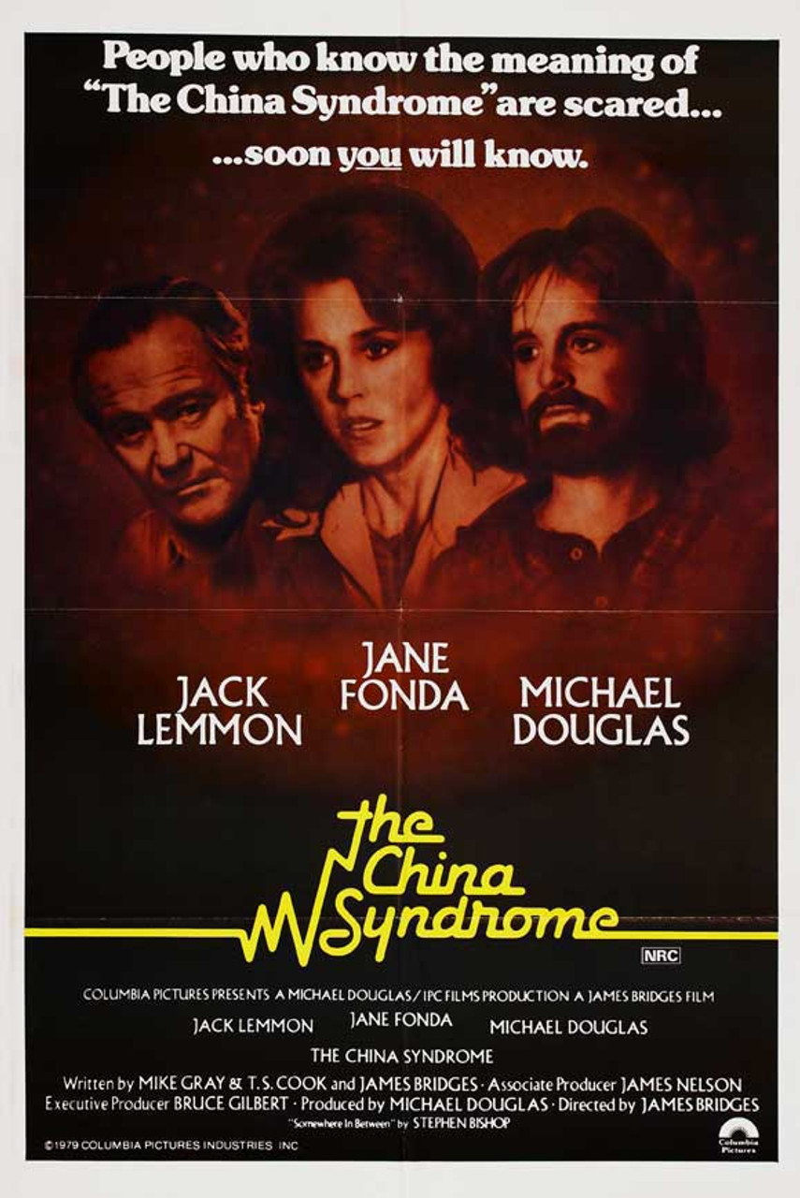
What 1979 energy accident was influenced by poor control design and led to research in fields like cognitive engineering and decision making?

Slide 33
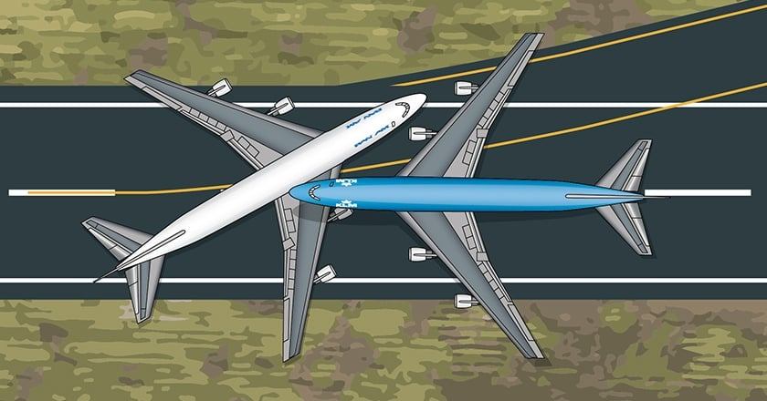
What 1977 air traffic disaster was the worst air accident in history, and led to the study of Crew Resource Management?

Slide 34
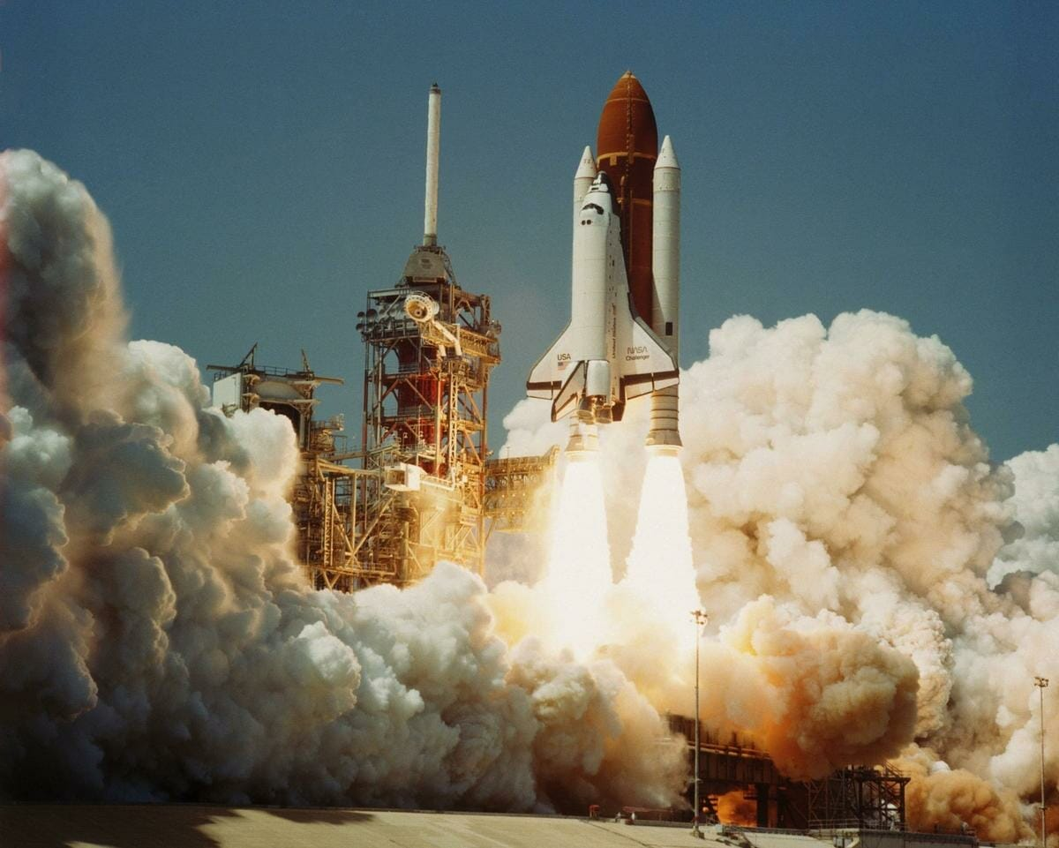
What 1986 space disaster caused by faulty O-rings led to research on organizational error and culture of safety?

Slide 35
Round 4: Inciting Incidents
Write down your answers!
Ready?

Slide 36
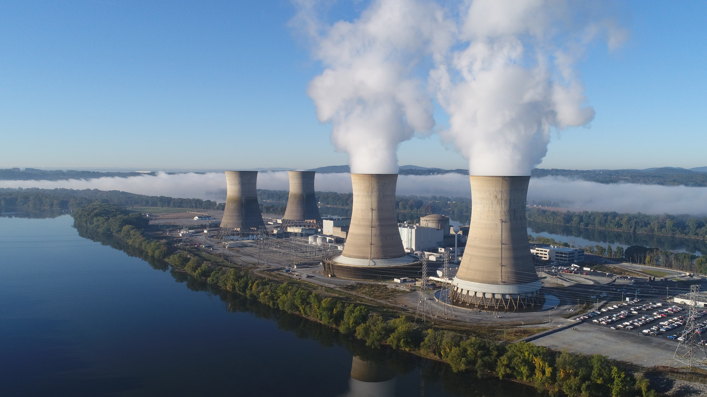
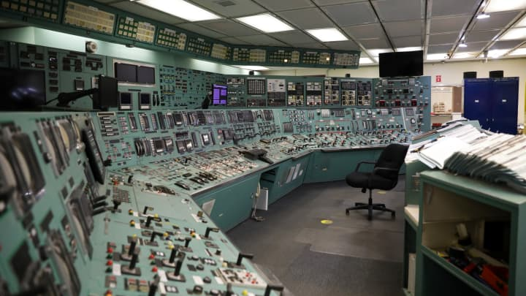
The 1979 Three Mile Island accident was influenced by poor control design and led to the field of Cognitive Engineering and Decision Making
In 1979, 3 Mile Island nuclear plant lost coolant from a stuck-open valve
  Operators were unable to recognize the failure
  Bad controls, alarms, and indicators contributed
“The control room and computer interfaces at Three Mile Island could not have been more confusing if they had tried” – Don Norman
Accident studied by Norman, Rasmussen, Reason, Sheridan, Salas, Woods, Leveson, Hollnagel, and others
Led to research into controls and decision making
Also made the public wary of nuclear (and came right after release of disaster movie “The China Syndrome”)

Slide 37
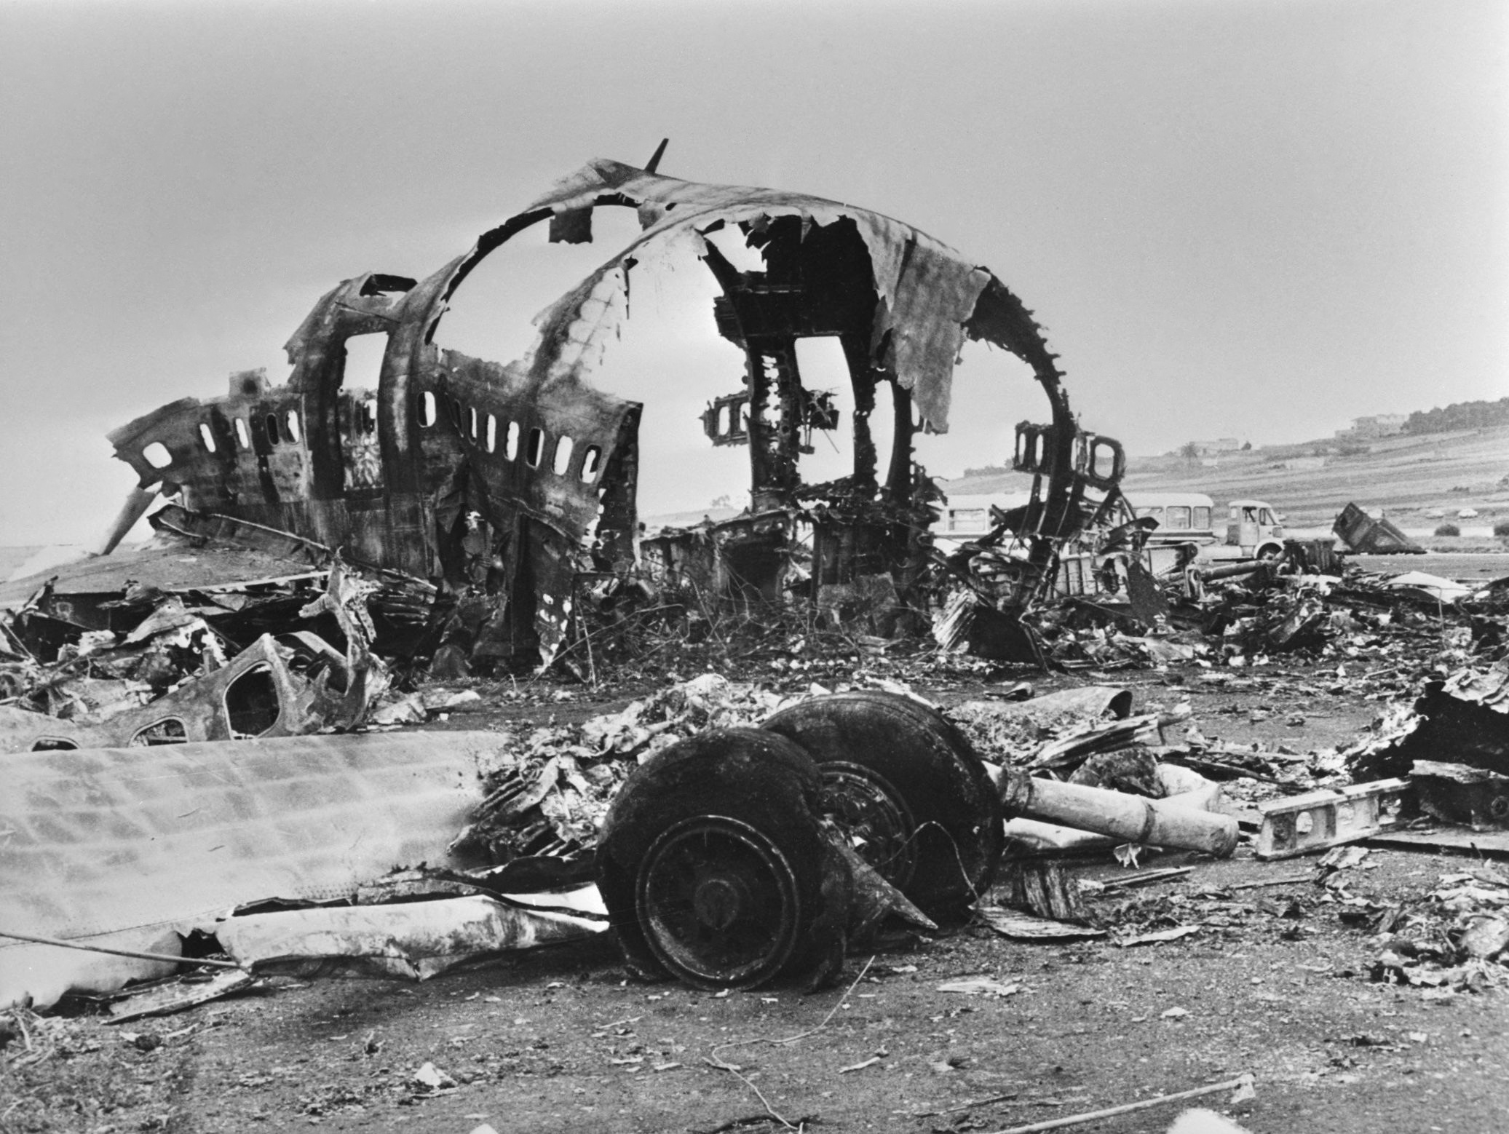
The Tenerife Airport Disaster led to the development of Crew Resource Management
In 1977 in the Canary Islands, two Boeing 747s collided on a foggy runway
Worst accident in aviation history
Caused by congestion, weather, and misinterpreted radio communication
  Both tower and other plane told leaving plane to stop, but resulted in interference
  Power dynamics contributed
  “We are at takeoff” “OK”
Led to standardized communication procedures
  Standard phrases
  Readback instead of “roger” or “ok”
  Careful use of “takeoff”
Crew Resource Management: pilots should contradict when unsafe

Slide 38
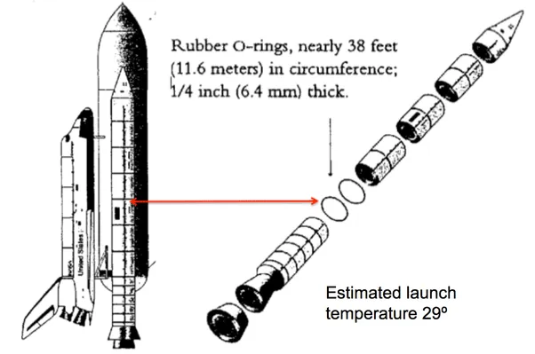
The Challenger Explosion led to research on organizational error and culture of safety
Cold weather
  Fuel tank O-rings got cold, brittle
  Explosion
Engineers warned management about risks
  Went ahead anyway
Led to research about how organizations handle risk and how cultures of safety can be developed

Slide 39

Round 5: Common Surveys
You want to know something and you can’t easily measure it. What do you do?
Ask someone and hope they can answer!
I’ll give you the survey, you give me what it measures!

Slide 40

NASA TLX

Slide 41
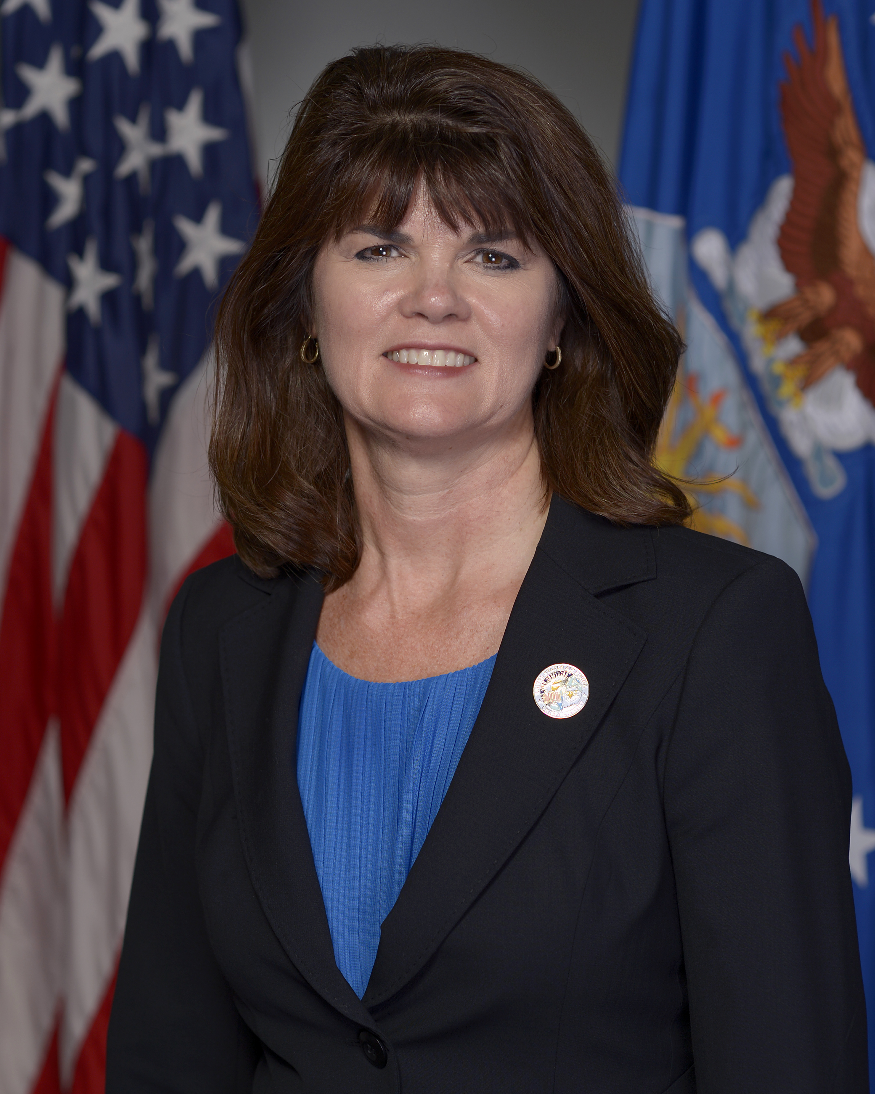
SAGAT and SART

Slide 42

S.U.S.

Slide 43
Round 5: Common Surveys
Write down your answers!
Ready?

Slide 44
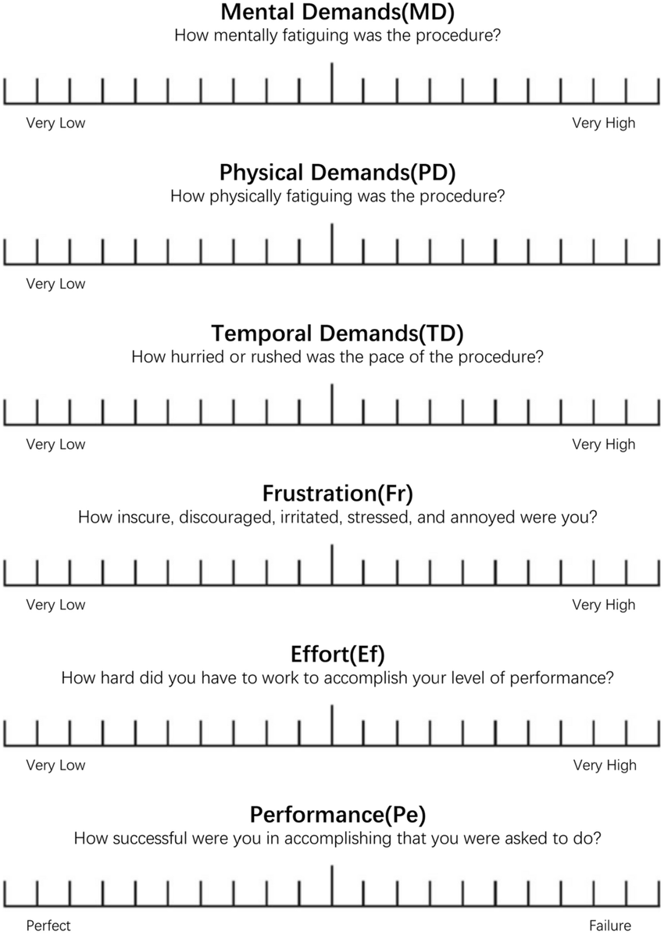

NASA Task Load Index
Workload!
In 6 subscales
  Mental
  Physical
  Temporal
  Frustration
  Effort
  Performance

Slide 45
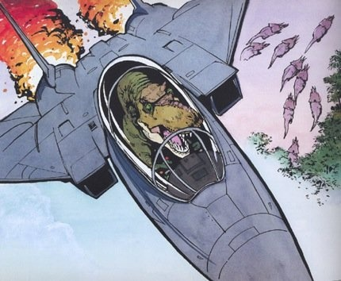
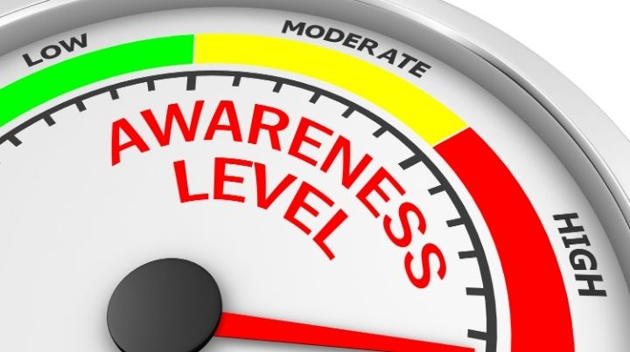
Situation Awareness Global Assessment Technique and SART
Situation Awareness!
Three levels
  Perception (what)
  Comprehension (so what)
  Projection (what next)
SAGAT – freeze randomly and ask what they know
SART – subjective self-assessment

Slide 46
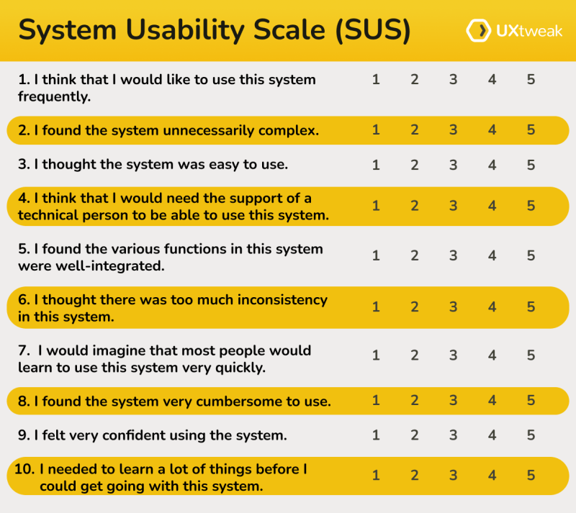
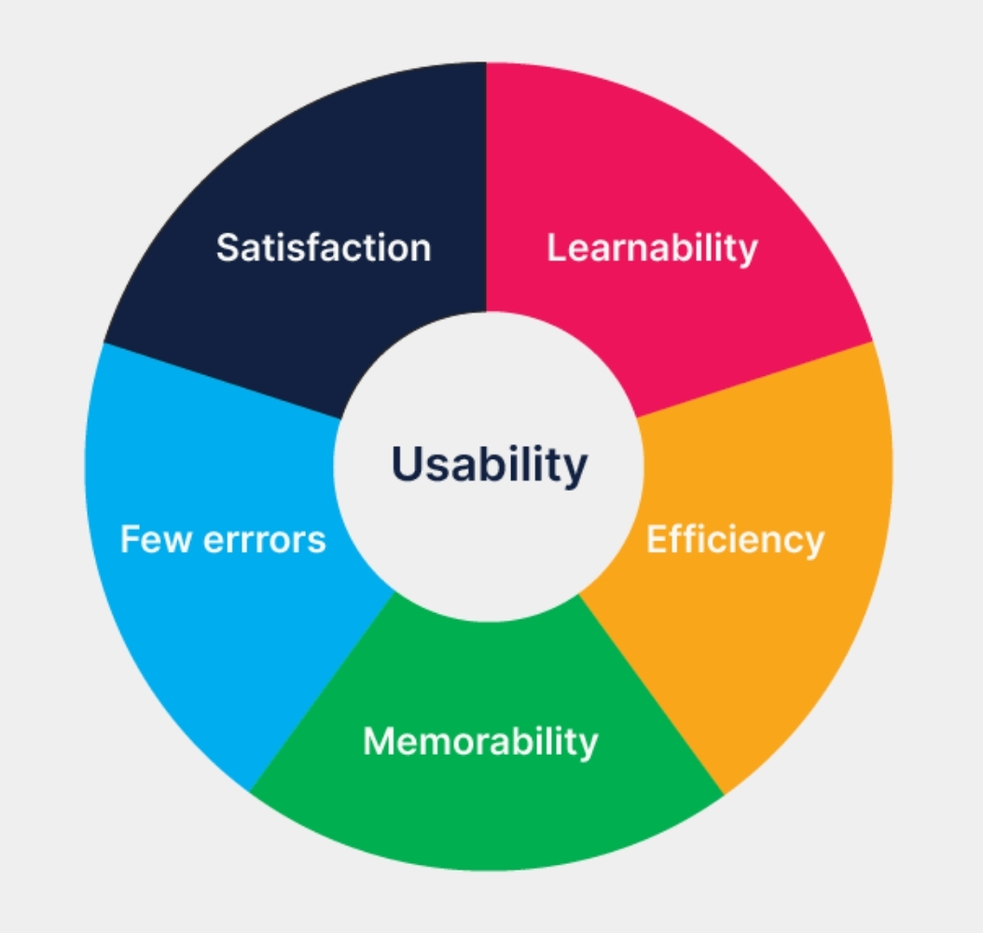
System Usability Scale
Usability!
10 items
Subjective assessment
EZ peasy

Slide 47
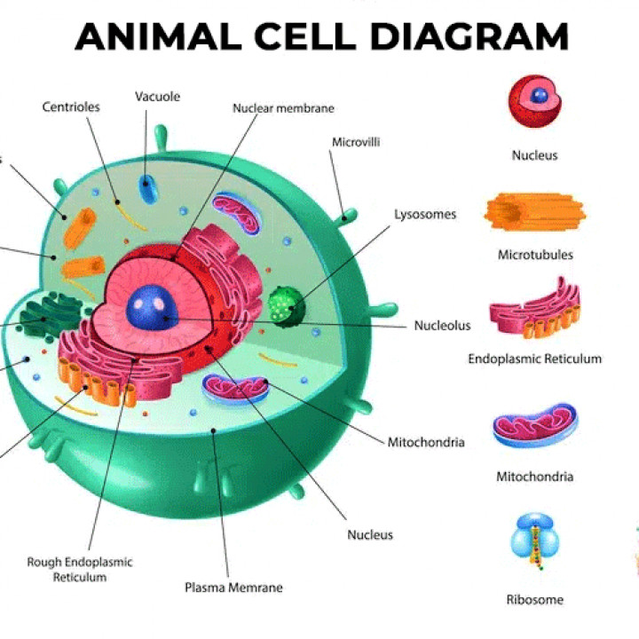
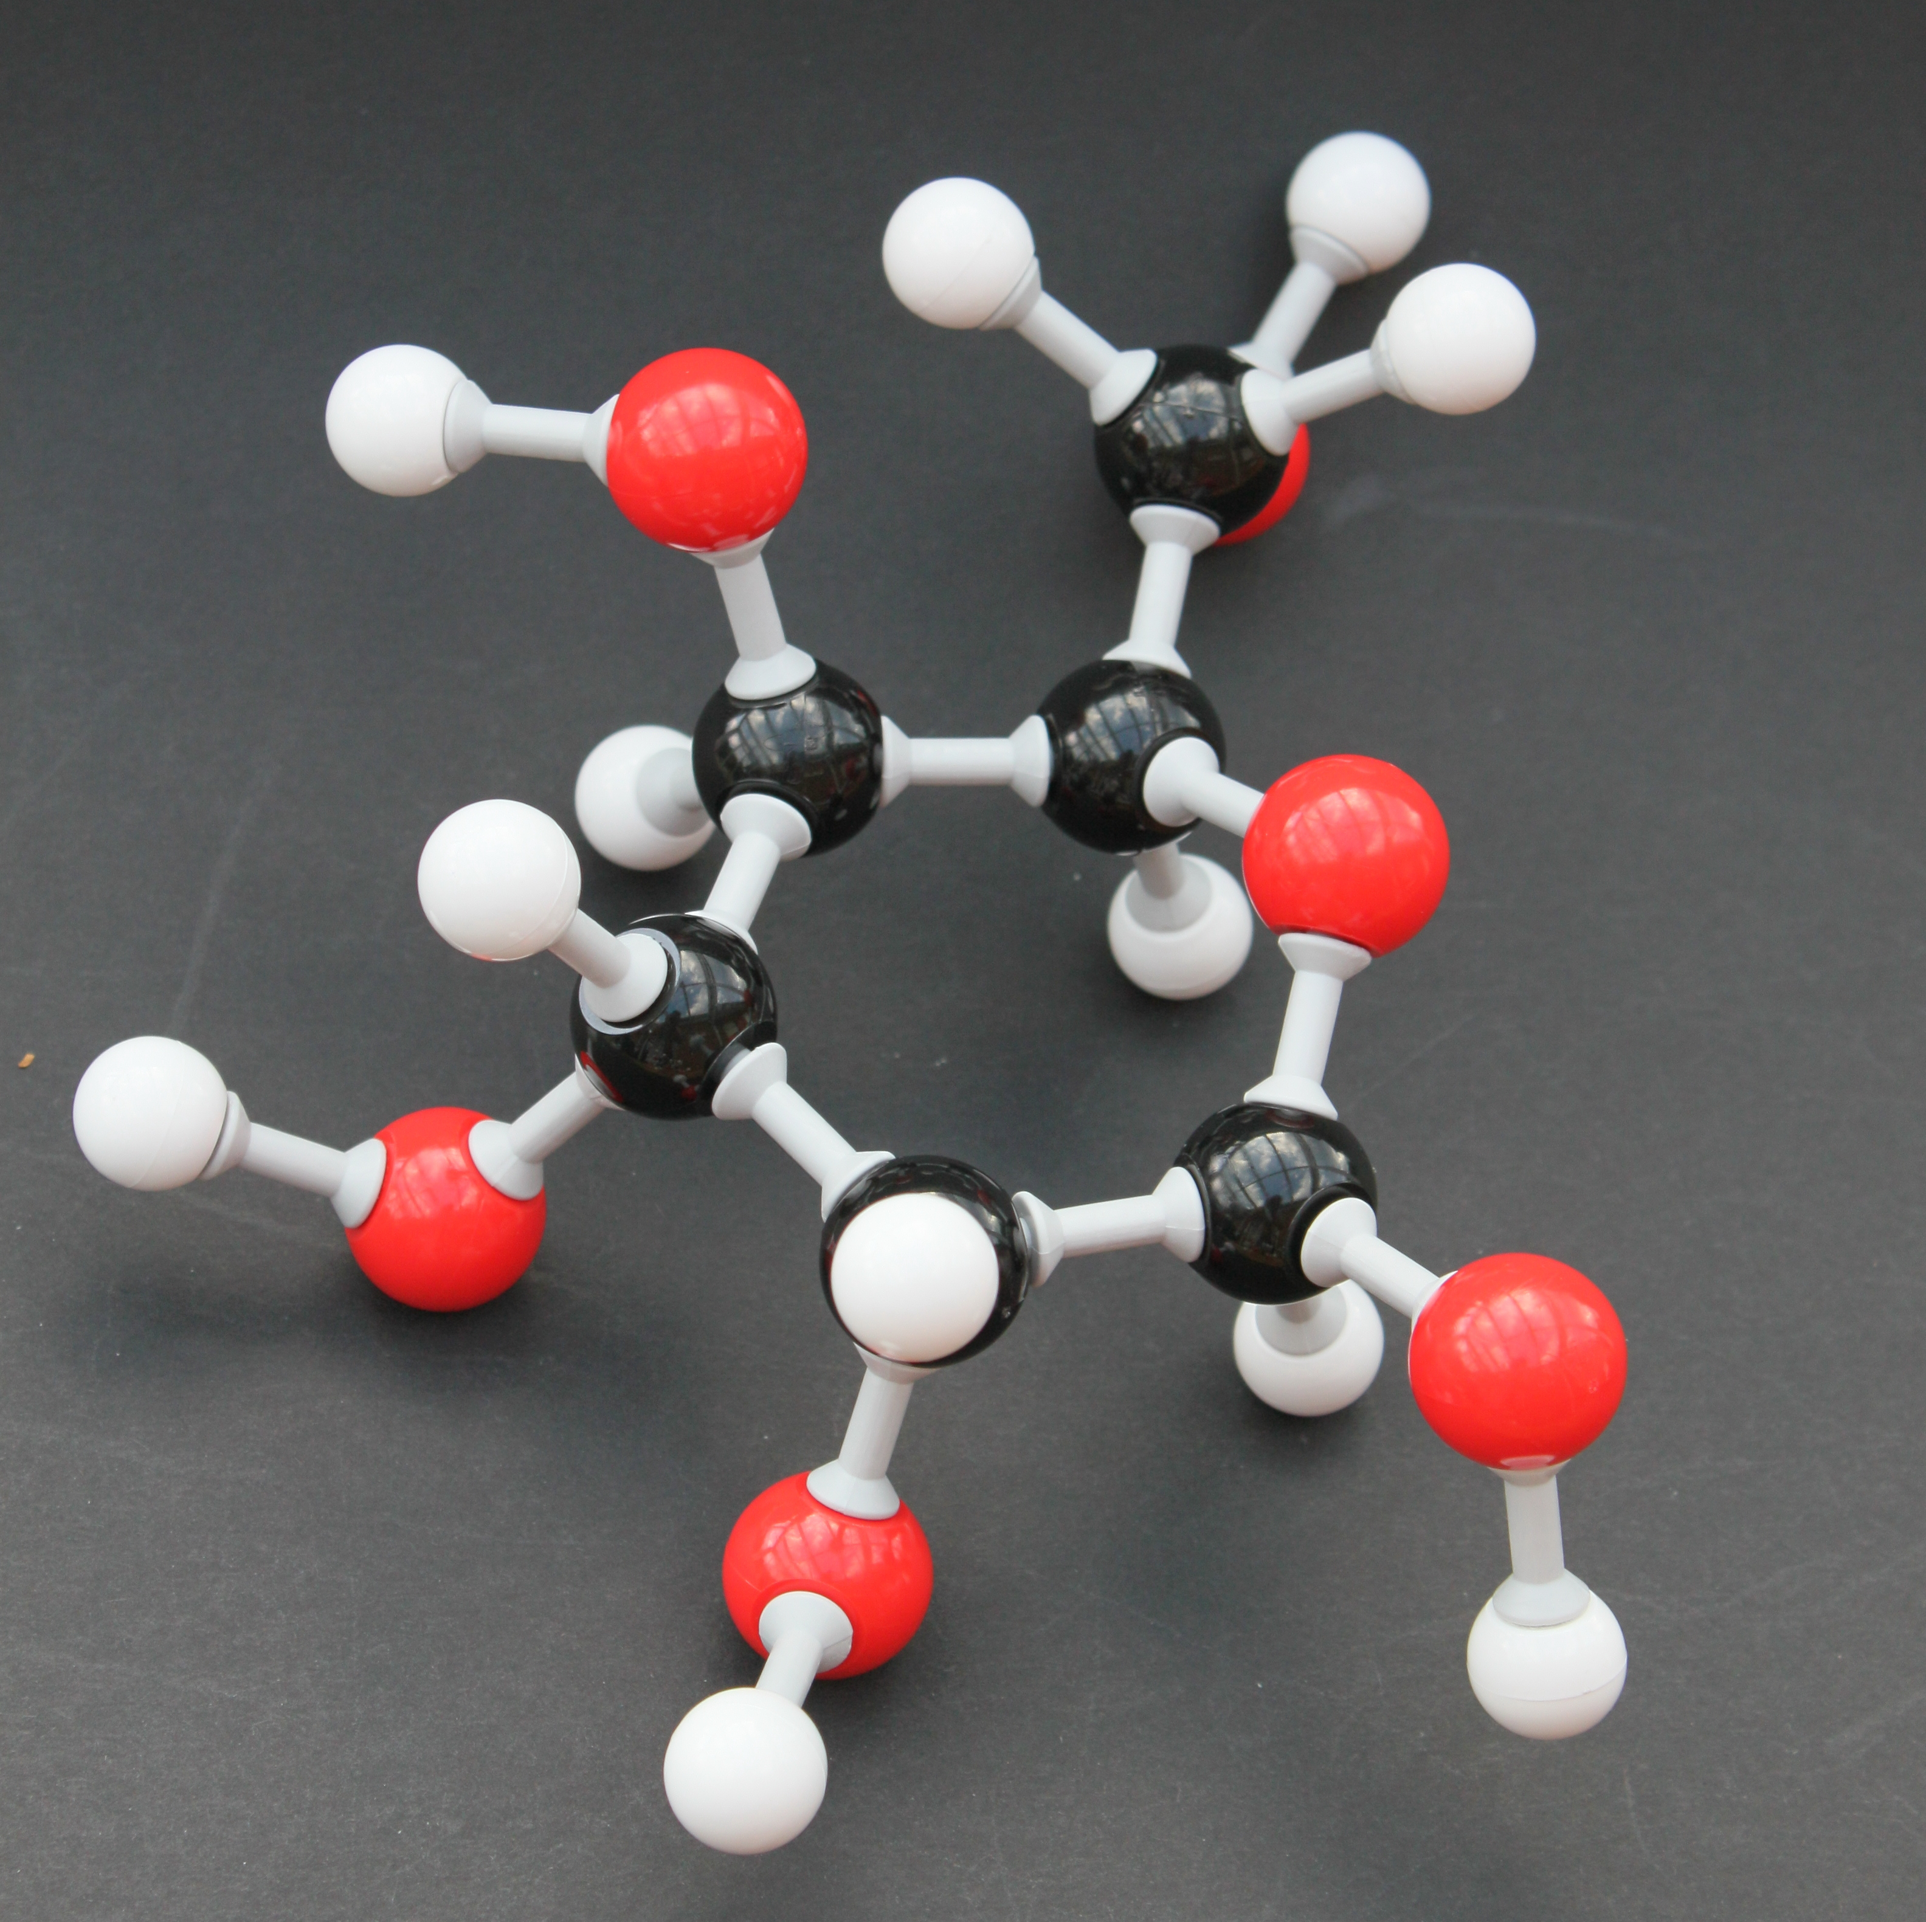
Round 6: Human Factors Models
“All models are wrong, but some are useful”
I’ll give you a picture, you give me the model name and what it models (half credit each)!

Slide 48
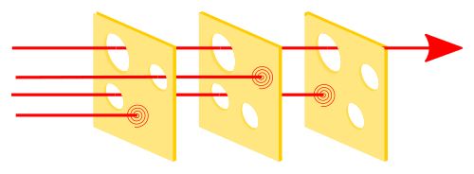

Slide 49
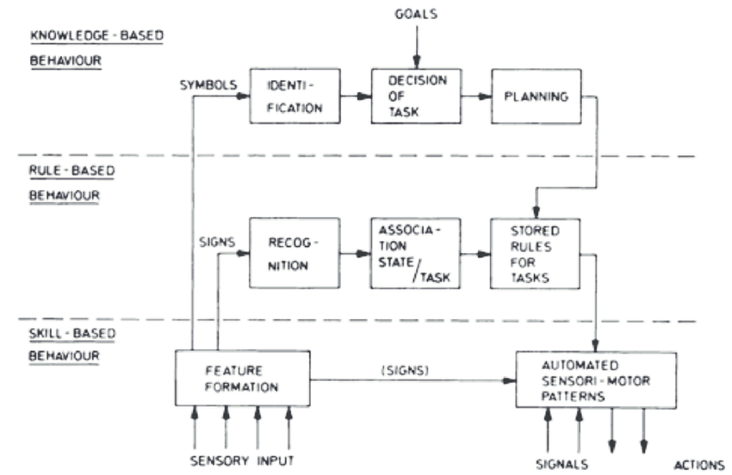

Slide 50
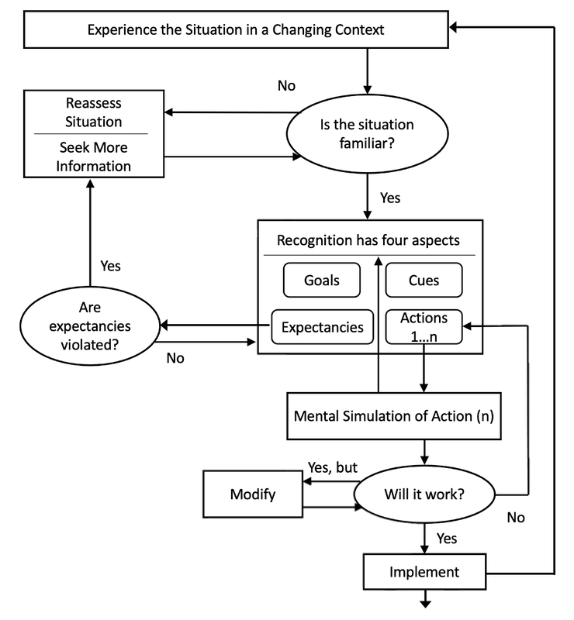

Slide 51
Round 6: Human Factors Models
Write down your answers!
Ready?

Slide 52
Reason’s Swiss Cheese Model (1990)
Errors!
Errors happen when several gaps in protective layers align
Errors can be reduced
  More precautionary layers
  Ensure holes don’t align

Slide 53
Rasmussen’s Skill, Rule, and Knowledge (SRK) Model (1983)
Performance!
Three levels
  Skill (automatic)
  Rule (if-then)
  Knowledge (reason it out)
Different errors in different stages
More automaticity = faster

Slide 54
Klein’s Recognition Primed Decision-Making Model (1993)
Naturalistic Decision Making!
10 items
Subjective assessment
EZ peasy

Slide 55


Add Up Points!
Point from each round
  1/3/5 pts per question for first half, 2/4/6 second half
Bonus round
  2 pts each, 2 pt bonus for all 10
+1 point per unique PhD, Master, Undergrad
Add up total before final question
Totals?

Slide 56

Final Question
7 points
60 seconds
Hand in papers to me when done
Ready??

Slide 57

What 400s BC Greek physician and philosopher described how a surgeon’s workplace should be laid out for safety and efficiency?
Hint: he’s famous for other things in medicine too

Slide 58
Turn in sheets!

Slide 59
What 400s BC Greek physician and philosopher described how a surgeon’s workplace should be laid out for safety and efficiency?
Hippocrates!

Slide 60


