Slide 1

Global Terrorism
DSE 241 Final Project Proposal
Team: Teck Lim, Venu Mamidala, Yogesh Bansal
Notes:
Venu
2 - mins

Slide 2
Definition of Terrorism
The Global Terrorism Database (GTD)™ defines a terrorist attack as the threatened or actual use of illegal force and violence by a non-state actor to attain a political, economic, religious, or social goal through fear, coercion, or intimidation.
The incident must be intentional
The incident must entail some level of violence or immediate threat of violence
The perpetrators of the incidents must be sub-national actors.
Notes:
The incident must be intentional – the result of a conscious calculation on the part of a perpetrator
The incident must entail some level of violence or immediate threat of violence -including property violence, as well as violence against people.
The perpetrators of the incidents must be sub-national actors. The database does not include acts of state terrorism (terrorism committed by a country against another country or against their citizen)

Slide 3
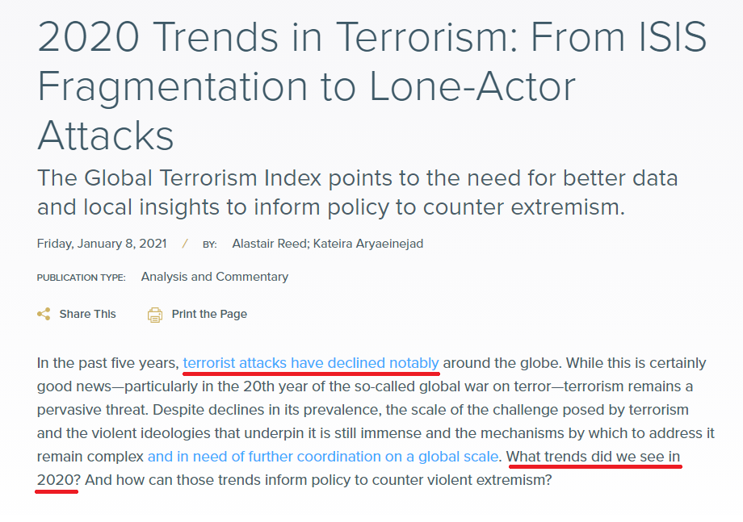
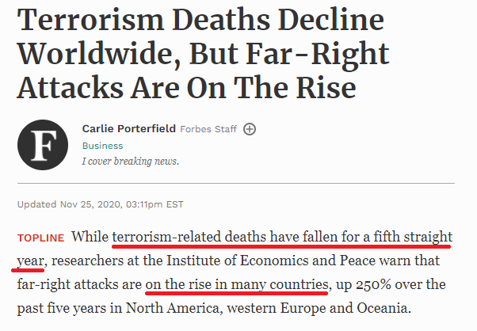
Global Terrorism on the Rise?

Slide 4
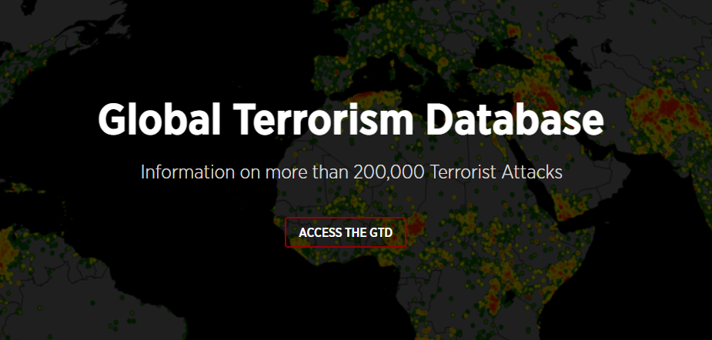
Dataset
Global Terrorism Database (GTD)™
Range from year 1970-2018
135 features
192,212 records
https://start.umd.edu/gtd/
Notes:
Yogesh
3 - mins

Slide 5
Dataset Features
Date (Year, Month, Day, ...)
Incident information (Summary, ...)
Location (Region, Country, State, City, Vicinity, Location, Latitude, Longitude, ...)
Attack information (Attack Type, Successful, Suicide Attack, ...)
Weapon information (Type, Sub-Type, ...)
Target/Victim information (Type , Sub-Type, Nationality, ...)
Perpetrator Information (Group Name, Sub-Group Name, Number of Captured, …)
Casualties and Consequences (Total Fatalities, Total Injured, Property Damage, …)
Notes:
Attack Type Hierarchy: Assassination Hijacking Kidnapping Barricade Incident Bombing/Explosion Armed Assault Unarmed Assault Facility/Infrastructure Attack Unknown

Slide 6
Visualization Tasks
Understand Overall trend of terrorist attacks year-over-year
Understand distribution of attacks across regions & countries
Distribution of casualties from terrorism across time, countries, attack type
Identify deadliest terrorist groups
Look up terrorism prevention factors by understanding failed attempts
Programming dominant

Slide 7
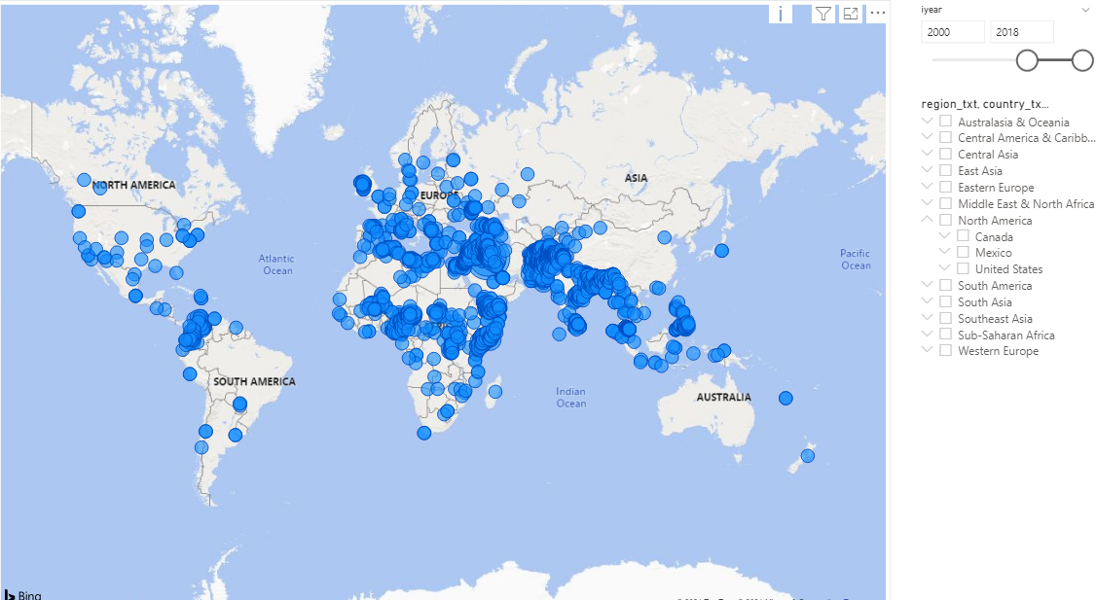
Notes:
Teck - 2 mins
Is visualization meant for data exploration, hypothesis confirmation or presentation?

Slide 8
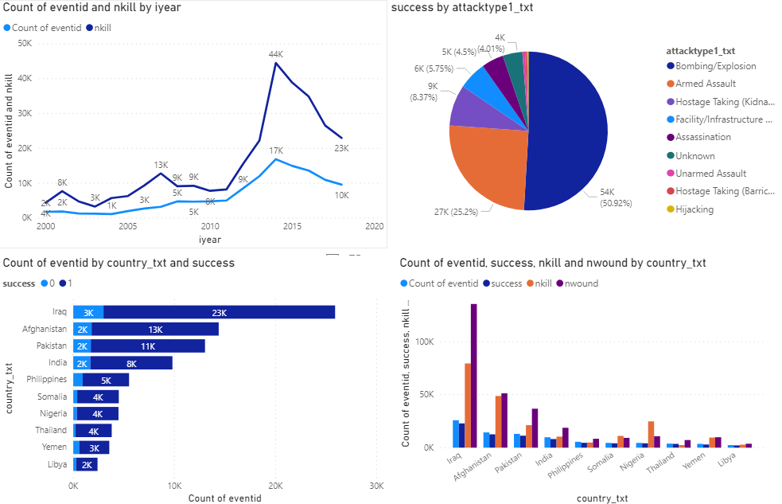

Slide 9
Stakeholders
Primary: Government Agencies (CIA, FBI, …)
Secondary: General Public

Slide 10
Q / A

