Slide 1
Question 2
Reporting Frauds

Slide 2


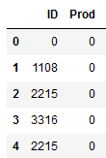
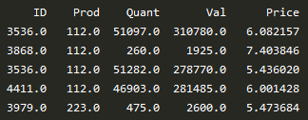
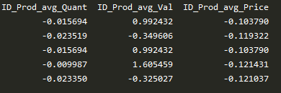
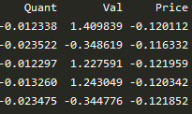
A. Data Cleaning
1. Missing data:
2. Label Encode string data types:
3. Subset ‘Insp’ columns == ‘unkn’:
%
The subset data is known as Test dataset. The ‘unkn’ value will be predicted using models after tuning and evaluation
%
%
%
%
4. Mapping Value in ‘Insp’ Column to binary classification:
Missing value is being imputed using the K-Nearest Neighbour Imputer method. This means that the missing data are being filled up with value with similar ‘ID’ and ‘Prod’ values.
‘ok’
0
‘fraud’
1
B. Feature Engineering
C. Train Validation Splitting
1. Adding a new feature column:
3. Aggregate mean of Quant, Val and Price, through grouping ID and Prod columns :
Training:
80%
Shuffled
Validation:
20%
Shuffled
Price = Val / Quant
4. SMOTE for imbalanced classified datasets:
2. Normalization using standard scaler of Quant, Val and Price :
‘ok’: 14462
‘fraud’: 1270
SMOTE
‘ok’: 14462
‘fraud’: 14462
=
Synthetic data is being created to boost the number of ‘fraud’ subset dataset to have the same number as ‘ok’ subset (** for Training dataset only)

Slide 3
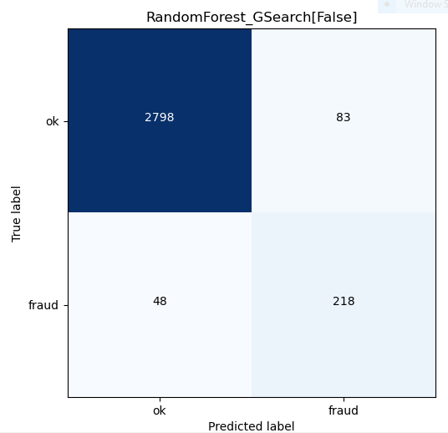

D. Confusion Matrix of Random Forest Model
E. Model Ranking and Evaluation Result
model | auc_train | auc_valid | accuracy train | accuracy valid | matthew_corr_train | matthew_corr_valid | f1_score_train | f1_score_valid | FP | FN | TP | Cost | rank
RandomForest | 0.999957 | 0.90338 | 0.999957 | 0.95742 | 0.999914 | 0.748805 | 0.999957 | 0.768966 | 91 | 43 | 223 | -1174000 | 1
XGBoostOptimized | 0.999957 | 0.904018 | 0.999957 | 0.971084 | 0.999914 | 0.812209 | 0.999957 | 0.827977 | 44 | 47 | 219 | -1203000 | 2
LightGBMOptimized | 0.999914 | 0.902832 | 0.999914 | 0.972037 | 0.999827 | 0.816927 | 0.999914 | 0.832061 | 40 | 48 | 218 | -1218000 | 3
XGBoost | 0.988688 | 0.89644 | 0.988688 | 0.963457 | 0.9774 | 0.770976 | 0.988649 | 0.790528 | 66 | 49 | 217 | -1263000 | 4
CatBoost | 0.972973 | 0.893808 | 0.972973 | 0.955513 | 0.946006 | 0.735218 | 0.97282 | 0.756944 | 92 | 48 | 218 | -1270000 | 5
LightGBM | 0.96205 | 0.891002 | 0.96205 | 0.947251 | 0.924218 | 0.702565 | 0.961744 | 0.725166 | 119 | 47 | 219 | -1278000 | 6
RandomForestOptimized | 0.999957 | 0.893202 | 0.999957 | 0.963775 | 0.999914 | 0.77085 | 0.999957 | 0.790441 | 63 | 51 | 215 | -1298000 | 7
DecisionTree | 0.999957 | 0.846263 | 0.999957 | 0.92469 | 0.999914 | 0.597381 | 0.999957 | 0.627943 | 171 | 66 | 200 | -1691000 | 8
SupportVectorMachine | 0.986141 | 0.733436 | 0.986141 | 0.789959 | 0.97229 | 0.304961 | 0.986168 | 0.348768 | 572 | 89 | 177 | -2529000 | 9
TensorflowMLP | 0.628787 | 0.627484 | 0.573267 | 0.713378 | 0.156431 | 0.075875 | 0.48273 | 0.181488 | 1836 | 52 | 214 | -3090000 | 10
LRegression | 0.939038 | 0.666586 | 0.939038 | 0.848745 | 0.879329 | 0.265241 | 0.940622 | 0.333333 | 329 | 147 | 119 | -3388000 | 11
NaiveBayesClassifier | 0.544081 | 0.552167 | 0.544081 | 0.911026 | 0.178507 | 0.186678 | 0.193401 | 0.186047 | 46 | 234 | 32 | -4758000 | 12
The above table shows total of 12 models being ranked according to their cost (calculation shown on the left side). Since this is an imbalanced dataset, the evaluation matric should not be focusing on Accuracy as it is misleading with the high score as most ‘ok’ category being categorized successfully. Instead, we should look at Matthew Correlation score and F1 score since it penalize False Negatives and False Positives, therefore, a more meaningful gauge for misclassification.
The model which incurred lesser cost to the company will be chosen to predict the datasets which column ‘Insp’ of ‘unkn’. Our team identified that using RandomForest model will incur the least cost and thus it was chosen to predict the Test dataset.
Assumption
Each fraud investigation cost: $1,000
Each undetected fraud loss: $20,000
F. Deployment
Cost Calculation
The model is being saved as a pickle file for reusability. The pickle file is then integrated into a flask RESTful API application, and subsequently being deployed using docker. User Acceptance Test (UAT) should be conducted to test the scalability and reliability of the model through numerous iterations and different combination of datasets.
Cost to check fraud (red rectangular) : (218 + 83) * $1,000 = $301,000
Undetected fraud (blue circle): 48 * $20,000 = $960,000
G. Implementation Issues
a. The model the team chosen will have high false positive rate, meaning it will detect a lot of ‘fraud’ cases even though the cases are ‘ok’. Thus, more time and money will be spend on investigating the fraud cases. Should the cost of undetected fraud decreases, the team may deploy alternate model balancing its lower false positive rate and lower cost.
b. The unlabelled data is more then labelled data. There still a lot of uncertainties in determining the robustness of the data in the long run. The team should labelled more of the datasets to test the model to determine whether the model needs further fine tuning.
Total cost: $301,000 + $960,000 = $1,261,000

Slide 4
Question 3
Labour Force Participation

Slide 5
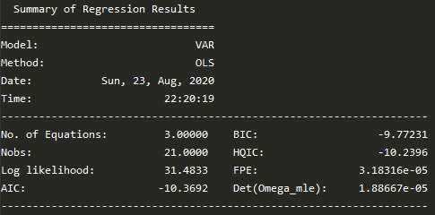
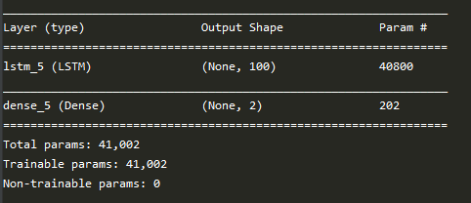
Model Evaluation
country | model | rmse_val | mae_val | mape_val | Rank
China | univariate ARIMA | 0.229056 | 0.170299 | 0.20% | 2
 | vector autoregression | 0.100333 | 0.086517 | 0.09% | 1
 | univariate multistep LSTM | 0.537208 | 0.533162 | 0.57% | 3
 | multivariate multistep LSTM | 1.694371 | 1.682232 | 3.43% | 4
India | univariate ARIMA | 0.147826 | 0.133336 | 0.21% | 1
 | vector autoregression | 0.229457 | 0.160332 | 0.24% | 2
 | univariate multistep LSTM | 0.273243 | 0.243713 | 0.35% | 3
 | multivariate multistep LSTM | 2.356452 | 2.353175 | 1.82% | 4
Singapore | univariate ARIMA | 0.662064 | 0.483331 | 0.90% | 2
 | vector autoregression | 1.251873 | 1.153763 | 1.40% | 3
 | univariate multistep LSTM | 0.504056 | 0.496465 | 0.61% | 1
 | multivariate multistep LSTM | 2.906351 | 2.862995 | 9.08% | 4
Diagram 1: (China) Vector Autoregression lag order 1, AIC parameters
Diagram 2: (India) Stepwise ARIMA lowest AIC parameters
Diagram 3: (Singapore) Tensorflow LSTM model structure
Firstly, the first 80% of dataset in year sequence is split as Training and the remaining 20% of the dataset is split as Validation.
Different models were chosen for different countries according to the lowest RMSE, MAE and MAPE value obtained from the Validation dataset (highlighted in yellow)
A. For China, the team choose vector autoregression as the model. The AIC for this model is -10.3692 (shown in Diagram 1).
B. For India, the team choose univariate ARIMA as the model. The AIC for this model is -13.344 (shown in Diagram 2).
C. For Singapore, the team choose univariate multistep LSTM as the model. The whole inception of the model is trying to use every past 3 years data to predict 2 years ahead of data for each individual country. The model is being trained with a LSTM layer of 100 hidden units, activation function “Relu” and input shape of (3,1) + a Dense output layer of 2 units (shown in Diagram 3) using Training dataset. The model is then compiled using “Adam” as the optimizer and loss function of Mean Square Error (MSE).

Slide 6
Predicted Trends
Model Chosen: vector autoregression

Slide 7
Predicted Trends
Model Chosen: univariate ARIMA

Slide 8
Predicted Trends
Model Chosen: univariate multistep LSTM

