Slide 1
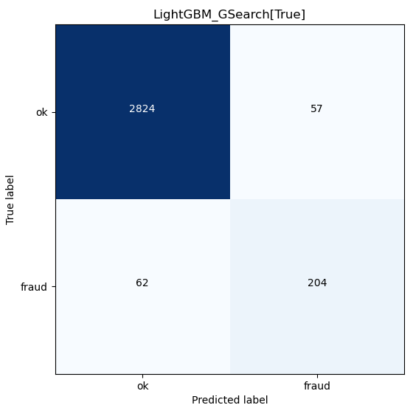
LightGBMGridSearchPolynomial
Description | Cost
investigation per suspect fraud case | 1000
loss per fraud case | 20000
model | auc_train | auc_valid | acc_train | acc_valid | matthew_corr_train | matthew_corr_valid | f1_score_train | f1_score_valid | FP | FN | TP | Cost | rank
RandomForest | 0.999957 | 0.90338 | 0.999957 | 0.95742 | 0.999914 | 0.748805 | 0.999957 | 0.768966 | 91 | 43 | 223 | -1174000 | 1
XGBoost | 0.988688 | 0.89644 | 0.988688 | 0.963457 | 0.9774 | 0.770976 | 0.988649 | 0.790528 | 66 | 49 | 217 | -1263000 | 2
CatBoost | 0.972973 | 0.893808 | 0.972973 | 0.955513 | 0.946006 | 0.735218 | 0.97282 | 0.756944 | 92 | 48 | 218 | -1270000 | 3
LightGBM | 0.96205 | 0.891002 | 0.96205 | 0.947251 | 0.924218 | 0.702565 | 0.961744 | 0.725166 | 119 | 47 | 219 | -1278000 | 4
LightGBMGridSearch | 0.999914 | 0.892537 | 0.999914 | 0.965682 | 0.999827 | 0.779778 | 0.999914 | 0.798507 | 56 | 52 | 214 | -1310000 | 5
RandomForestGridSearch | 0.901822 | 0.866734 | 0.901822 | 0.905942 | 0.804519 | 0.57445 | 0.899478 | 0.595628 | 248 | 48 | 218 | -1426000 | 6
LightGBMGridSearchPolyNomial | 1 | 0.873566 | 1 | 0.962186 | 1 | 0.753601 | 1 | 0.774194 | 57 | 62 | 204 | -1501000 | 7
XGBoostGridSearch | 0.870693 | 0.834718 | 0.870693 | 0.875437 | 0.742191 | 0.492475 | 0.867613 | 0.516049 | 335 | 57 | 209 | -1684000 | 8
DecisionTree | 0.999957 | 0.846263 | 0.999957 | 0.92469 | 0.999914 | 0.597381 | 0.999957 | 0.627943 | 171 | 66 | 200 | -1691000 | 9
SupportVectorMachine | 0.986141 | 0.733436 | 0.986141 | 0.789959 | 0.97229 | 0.304961 | 0.986168 | 0.348768 | 572 | 89 | 177 | -2529000 | 10
TensorflowMLP | 0.628787 | 0.627484 | 0.573267 | 0.713378 | 0.156431 | 0.075875 | 0.48273 | 0.181488 | 1836 | 52 | 214 | -3090000 | 11
LRegression | 0.939038 | 0.666586 | 0.939038 | 0.848745 | 0.879329 | 0.265241 | 0.940622 | 0.333333 | 329 | 147 | 119 | -3388000 | 12
NaiveBayesClassifier | 0.544081 | 0.552167 | 0.544081 | 0.911026 | 0.178507 | 0.186678 | 0.193401 | 0.186047 | 46 | 234 | 32 | -4758000 | 13
Each predicted fraud will go through investigation (red rectangular) : (204 + 57) * $1,000 = $261,000
Total cost: $1,501,000
Unpredicted fraud will incur losses (blue circle): 62 * $20,000 = $1,240,000

Slide 2
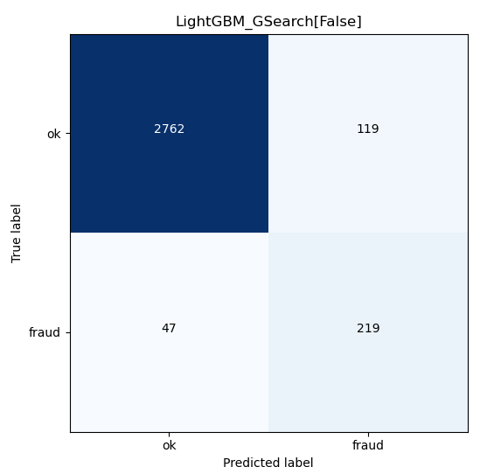


Slide 3

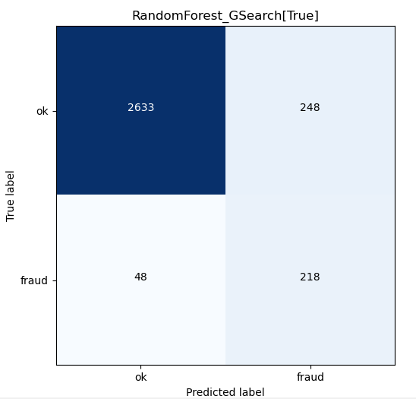

Slide 4
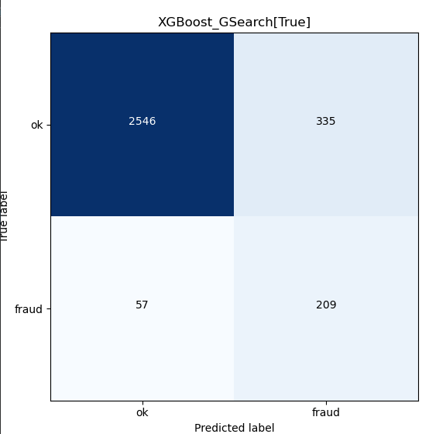


Slide 5
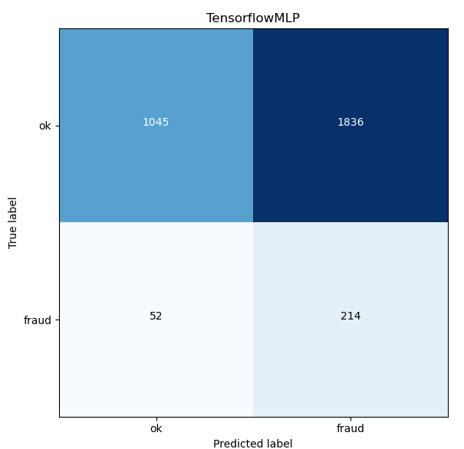
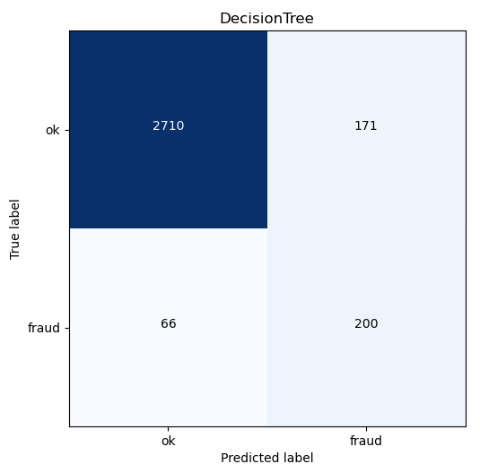

Slide 6
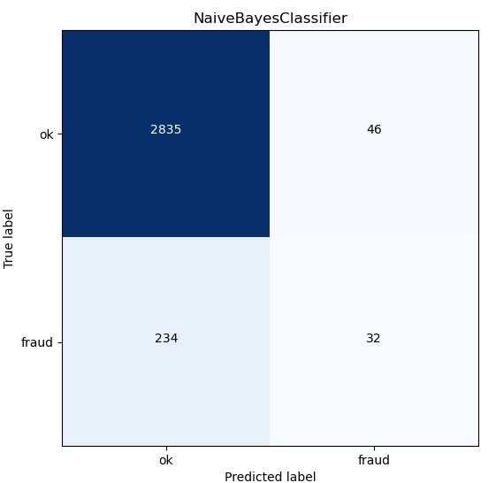


Slide 7
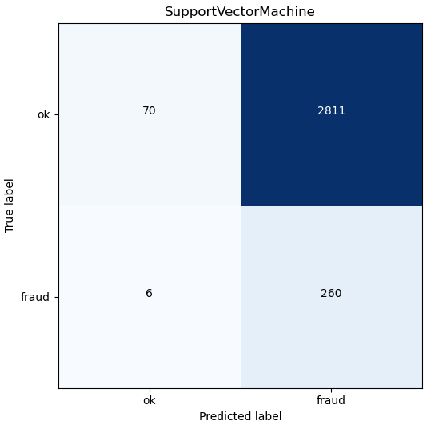
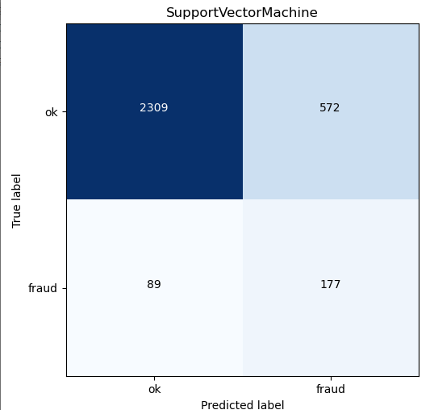
Linear Kernel
RBF Kernel

