Slide 1
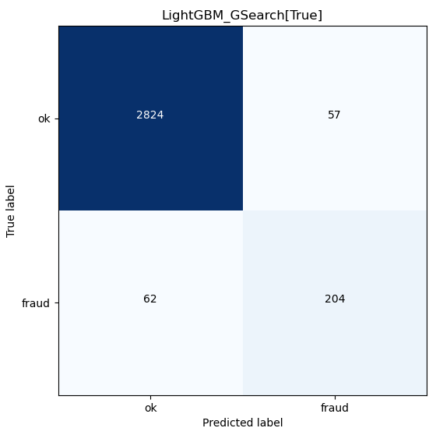
LightGBMGridSearchPolynomial
Description | Cost
investigation per suspect fraud case | 1000
loss per fraud case | 10000
model | auc_train | auc_valid | acc_train | acc_valid | matthew_corr_train | matthew_corr_valid | f1_score_train | f1_score_valid | FP | FN | TP | Cost | rank
RandomForest | 0.999957 | 0.8801 | 0.999957 | 0.949158 | 0.999914 | 0.701633 | 0.999957 | 0.726027 | 106 | 54 | 212 | -1398000 | 1
LightGBMGridSearch | 0.999914 | 0.879956 | 0.999914 | 0.952018 | 0.999827 | 0.712438 | 0.999914 | 0.736475 | 96 | 55 | 211 | -1407000 | 2
LightGBM | 0.944262 | 0.872693 | 0.944262 | 0.923101 | 0.888621 | 0.61726 | 0.943848 | 0.64095 | 192 | 50 | 216 | -1408000 | 3
XGBoost | 0.980701 | 0.874228 | 0.980701 | 0.941532 | 0.961405 | 0.670685 | 0.980724 | 0.69637 | 129 | 55 | 211 | -1440000 | 4
LightGBMGridSearchPolyNomial | 1 | 0.873566 | 1 | 0.962186 | 1 | 0.753601 | 1 | 0.774194 | 57 | 62 | 204 | -1501000 | 5
RandomForestGridSearch | 0.884164 | 0.828008 | 0.884164 | 0.869399 | 0.768405 | 0.477462 | 0.883333 | 0.501818 | 352 | 59 | 207 | -1739000 | 6
DecisionTree | 0.999957 | 0.837991 | 0.999957 | 0.915793 | 0.999914 | 0.567577 | 0.999957 | 0.599092 | 197 | 68 | 198 | -1755000 | 7
XGBoostGridSearch | 0.862879 | 0.823293 | 0.862879 | 0.857642 | 0.725891 | 0.458461 | 0.861552 | 0.481481 | 391 | 58 | 208 | -1759000 | 8
TensorflowMLP | 0.628787 | 0.627484 | 0.573267 | 0.713378 | 0.156431 | 0.075875 | 0.48273 | 0.181488 | 1836 | 52 | 214 | -3090000 | 9
LRegression | 0.5 | 0.5 | 0.5 | 0.084525 | 0 | 0 | 0.666667 | 0.155875 | 2881 | 0 | 266 | -3147000 | 10
NaiveBayesClassifier | 0.513125 | 0.515064 | 0.513125 | 0.902447 | 0.070285 | 0.05806 | 0.091956 | 0.078078 | 54 | 253 | 13 | -5127000 | 11
Each predicted fraud will go through investigation (red rectangular) : (204 + 57) * $1,000 = $261,000
Total cost: $881,000
Unpredicted fraud will incur losses (blue circle): 62 * $10,000 = $620,000

Slide 2
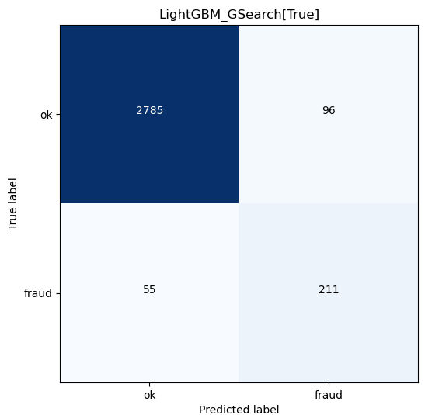
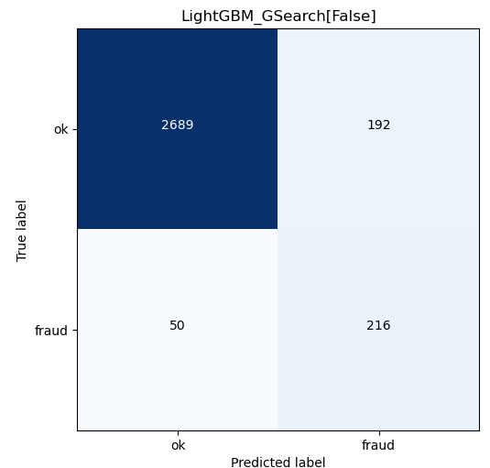

Slide 3



Slide 4
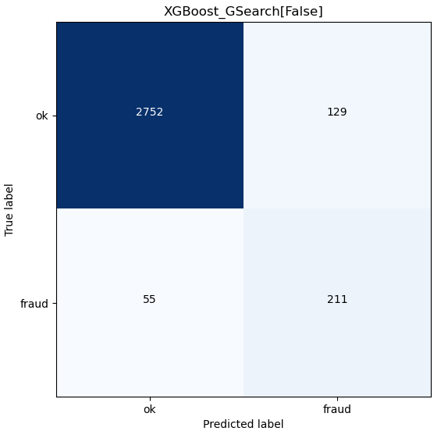
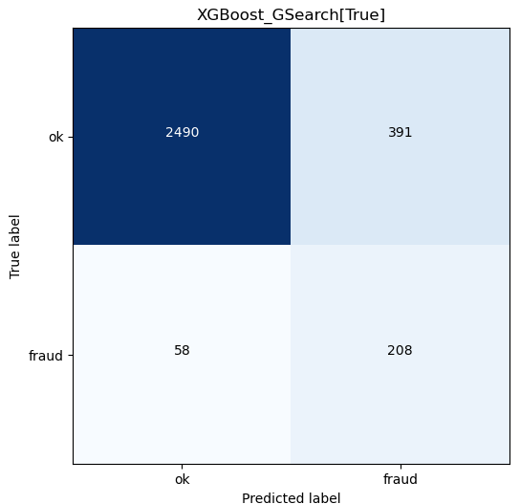

Slide 5
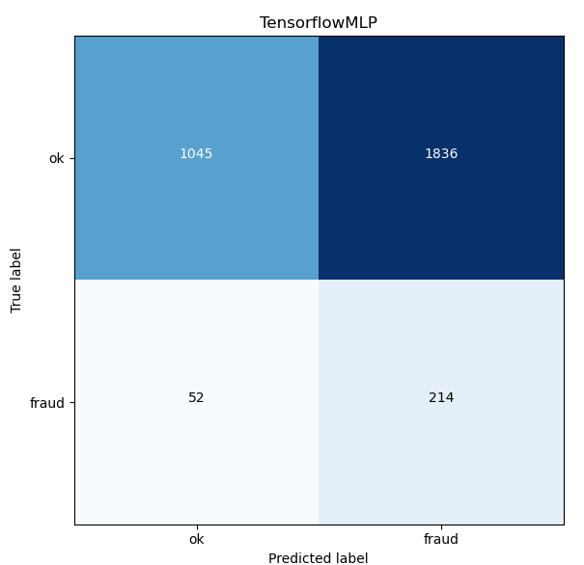


Slide 6
