Slide 1
Virus Game 2.0

Slide 2




1 player is the alien and everyone else is a crewmate
The designated alien starts out carrying the virus
All the other crewmates start out healthy

Slide 3
However, other players can be infected with the virus
Infected players are still on the crewmate team and want to defeat the alien
Crewmates win if they can identify the original alien
Players see no difference between alien/crewmates or healthy/infected

Slide 4
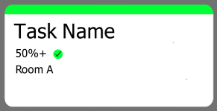
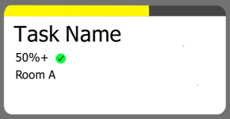
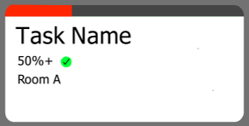
3 Players
3 Players
3 Players
Throughout the game, players will complete tasks
There can be more than one task going at any given time
Tasks can be seen by all players
During a task, a designated number of players will enter a room
The task will state what percentage of players need to be healthy/infected (In the example above, 50% or more of the players must be heathy for the task to succeed)
Players will be given a certain amount of time to get the proper number of players into the room
Players fail the task by putting in an incorrect ratio of healthy/infected (as given by each task) or by failing to get enough players in the room in time
If players fail a task, their spaceship will be damaged
Players can only fail 5 tasks

Slide 5
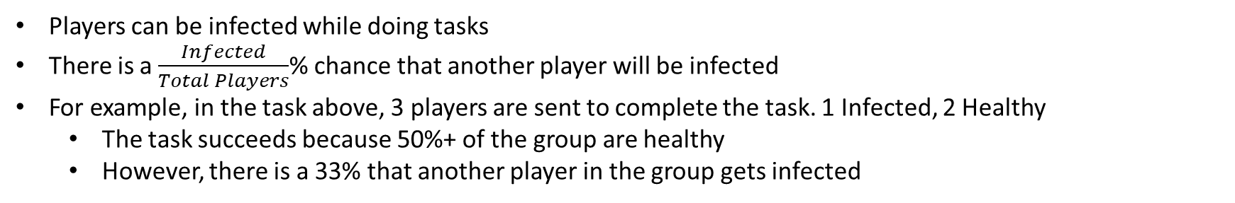
3 Players
Players can be infected while doing tasks
There is a $\frac{Infected}{Total Players}$% chance that another player will be infected
For example, in the task above, 3 players are sent to complete the task. 1 Infected, 2 Healthy
The task succeeds because 50%+ of the group are healthy
However, there is a 33% that another player in the group gets infected

Slide 6
3 Players
When an alien is sent to complete a task, his or her infected status is treated as the opposite status
For example, in the task above, 3 players are sent to complete the task. 2 Infected, 1 Healthy. And one of the Infected is the alien.
The task ordinarily would fail because more than half the group is infected
However, the alien counts as healthy instead. Therefore, the task succeeds instead

Slide 7
When the crewmates believe they know who the alien is or when they fail 5 tasks (and their ship breaks down), they must eject 1 player from their spaceship (to reduce weight).
If the players chose the alien they win, if they do not, they lose and the alien wins

Slide 8
There may be additional roles to make the game more interesting, including:
The Doctor – every 150s pick one player to cure of any infection.
The Scientist – every 100s pick one player to check for infection.
The Pseudodoctor – every 120s pick one player to cure. However, if you are infected, your patient will be infected instead.
The Diseased – additional player that starts out with the virus. Your role is not revealed to other players. If you are infected at the end of the game, you only win if you are the one voted out. (Hidden)
The Captain – you are not the alien, and all other players know this
The Mad scientist – you always know whether or not you are infected
The Mutant – you can change your healthy/infected status at will
Gorb (for large groups) – you know who Borb is. If Borb is voted out, you win. Taken from One Night. (Hidden)
Borb (for large groups) - you know who Gorb is. If Gorb is voted out, you win. Taken from One Night.
(Hidden)
The Psycho – you win if the crewmates fail 5 tasks. Ensure that the players are confused at all times and do not press the button to vote before they fail 5 tasks. (Hidden)
Security Officer - every 150s pick a player. They will not become infected during their next task.
Alien Pawn (for large groups) – you are always infected even after being cured. You know who the alien is and must protect them at all costs.

Slide 9
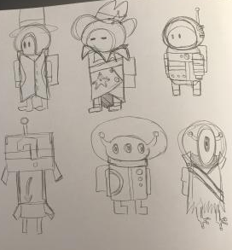
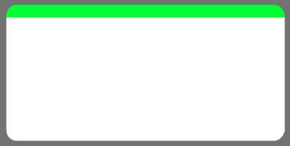


Additional Notes:
The alien can also be given an additional non-hidden role such as the scientist. He/she can use this to their advantage by lying about results
All roles unless specified as “hidden” are known to all players. This means everyone one knows who the doctor is. However, the doctor could still be an alien.
Tasks may require a certain number of infected crewmates. For example, there could be a task requiring 1 healthy and 1 infected:
Doctor’s Visit
1 1
Room B
2 Players
There are multiple rooms because as the game progresses there will be more and more tasks until there are multiple tasks going on in multiple rooms
Players don’t always want to succeed at tasks. Sometimes a fail may give away who the alien is.

Slide 10
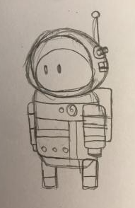
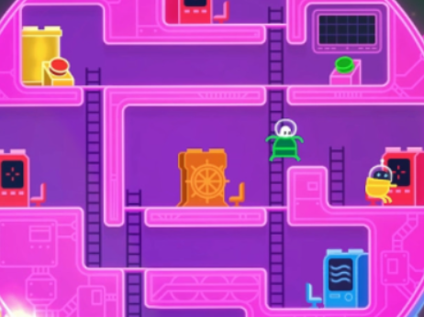
← Current Idea for Player Character (drawn by Lily)
↓ Concept for Spaceship (from Lover’s in a Dangerous Spacetime)

Slide 11
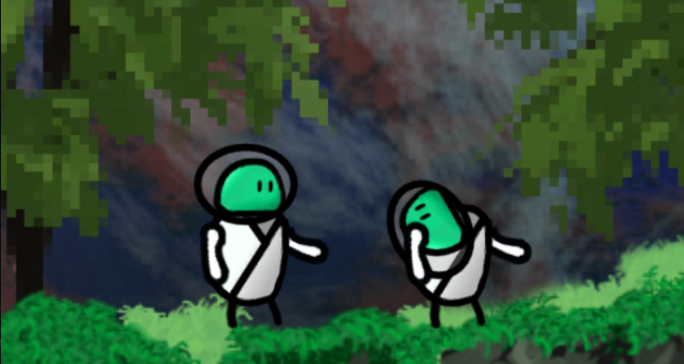
Pros:
Can use pretty much all the code we have already written.
We have already coded the most difficult sections
Can test the game before coding to see if it is fun
Is a fairly simple game to code
Small maps mean less work for art team
Cons:
Basically requires voice chat so no public lobbies
Roles may get pretty complicated to code but we can always scrap those if its too hard
Gameplay may require to much thinking lol

