Slide 1
Virus Game 2.1

Slide 2




Players are divided into 2 teams: Aliens and Crewmates. Crewmates do not know who the aliens are
All players can be either healthy or infected
At the start of the game, half the players are infected at random
Crewmates cannot see whether they or any other players are infected. However, aliens can see who is infected

Slide 3

The game is divided into 3-5 rounds
At the start of each round, you will be randomly assigned a role (Aliens as well) that will allow you to preform a certain action during a task (explained later).

Slide 4
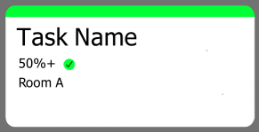



Round 1:
Task Name
Task Name
100%
100%
Room B
Room C
3 Players
1 Player
2 Players
Then, players will be given a handful shared tasks
Players must divide themselves into groups to preform each task
Each task will state what percentage of players need to be healthy/infected in order to the task to succeed
At the end of the game, the number of succeeded/failed tasks will be added up. If there are more successes, crewmates win; if there are more fails, aliens win

Slide 5
Doctor
3 Players
Once players have been divided into groups, players will enter their respective rooms
Any player with a role will now fulfill that role’s action (most roles either change or ascertain a player’s healthy/infected status)
In the example above, a player with the doctor role cures another player.
A Task’s success/failure is calculated AFTER all roles have preformed their actions
Thus, in the example above, the task succeeds because 2 players are healthy at the end.

Slide 6
Roles may include:
Doctor – pick one player to cure of any infection
Scientist – pick one player to check for infection
Diseased – pick one player to infect
Feeble – if there is an infected in your room, you will be infected
Mad scientist – you get to know whether you are infected at the end of a task
Shapeshifter – pick a player, you now have their healthy/infected status
Psycho – All healthy/infected status in your room are flipped
????? - Switch two other players healthy/infected status
Pseudo-Doctor – pick one player to cure of any infection. However, if you are infected, they are infected instead.
????? – You know the total number of infected in your room at the end of the round

Slide 7
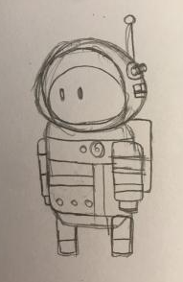
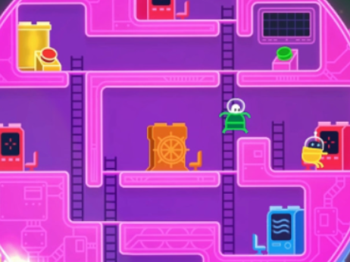
← Current Idea for Player Character (drawn by Lily)
↓ Concept for Spaceship (from Lover’s in a Dangerous Spacetime)

