Slide 1
“A rigorous and robust quantum speed-up in supervised machine learning”
Yunchao Liu, Srinivasan Arunachalam, and Kristan Temme
December 1st, 2020
(David Gayowsky, Mar 9th 2023)
Published in Nature, by IBM (Qiskit): https://research.ibm.com/blog/quantum-kernels

Slide 2
Motivation
One possible application of quantum computing: quantum “speed-ups”.
Essentially, using quantum computing to decrease time of already known problems (particularly NP-hard problems).
This includes machine learning methods: several quantum algorithms for machine learning tasks that promise polynomial and exponential speed-ups.

Slide 3
Motivation
Some proposed quantum algorithms do have speed-ups vs. classical methods: but, rely on encoding data into quantum state amplitudes for use in quantum algorithm, using less bits.
However: in some cases, resulting speed-up comes from data storage, not the algorithm itself… the quantum algorithm isn’t any better than a classical algorithm!

Slide 4
Problem Statement
However: hard to know how effective data storage in quantum amplitudes is (noise, decoherence, number of qubits, etc…).
Problem: find an example of a quantum machine learning algorithm, which given classical access to data can provably outperform all classical learners for some learning problem.
i.e. provide rigorous mathematical proof of a QML algorithm which uses classical data storage, but still provides a speed-up.

Slide 5
Concept
Show that an exponential quantum speed-up in machine learning can be achieved:
Use quantum feature (sample) space, e.g.:
Each classical data point is mapped (non-linearly) to a quantum state,
Points are then classified by linear classifier in quantum space.

Slide 6
Concept
Explicitly, classification is done by:
On training data, obtain the quantum kernel* (similarity function) by measuring pairwise inner product of quantum states,
Pass to a classical optimizer that determines optimal linear classifier for separating data in feature (quantum) space**.
(*As an aside: I myself still need to brush up on kernel methods…)
**I will expand on this later.

Slide 7
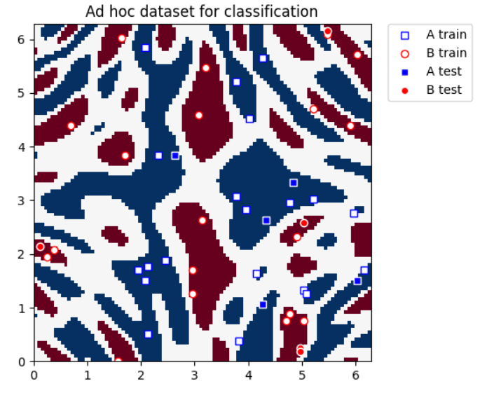
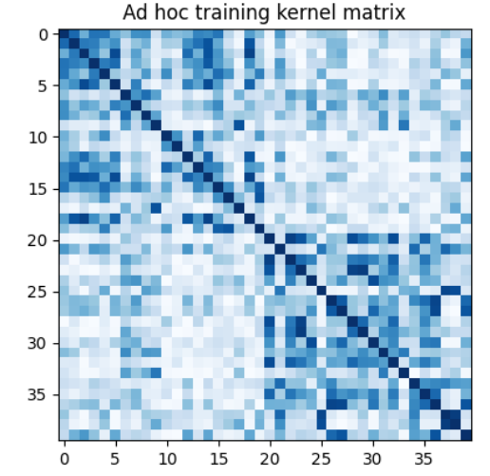




Concept
(Aside: Quantum Kernel Estimation with Support Vector Machines:)
Qiskit Tutorial on QKE: https://qiskit.org/documentation/machine-learning/tutorials/03_quantum_kernel.html
Then send our quantum kernel to whichever classification algorithm we’d like to use (SVM in this tutorial).
Kernel function used to map input x to alternate dimensional function:
Here f is quantum feature map:
Then kernel matrix is written:

Slide 8
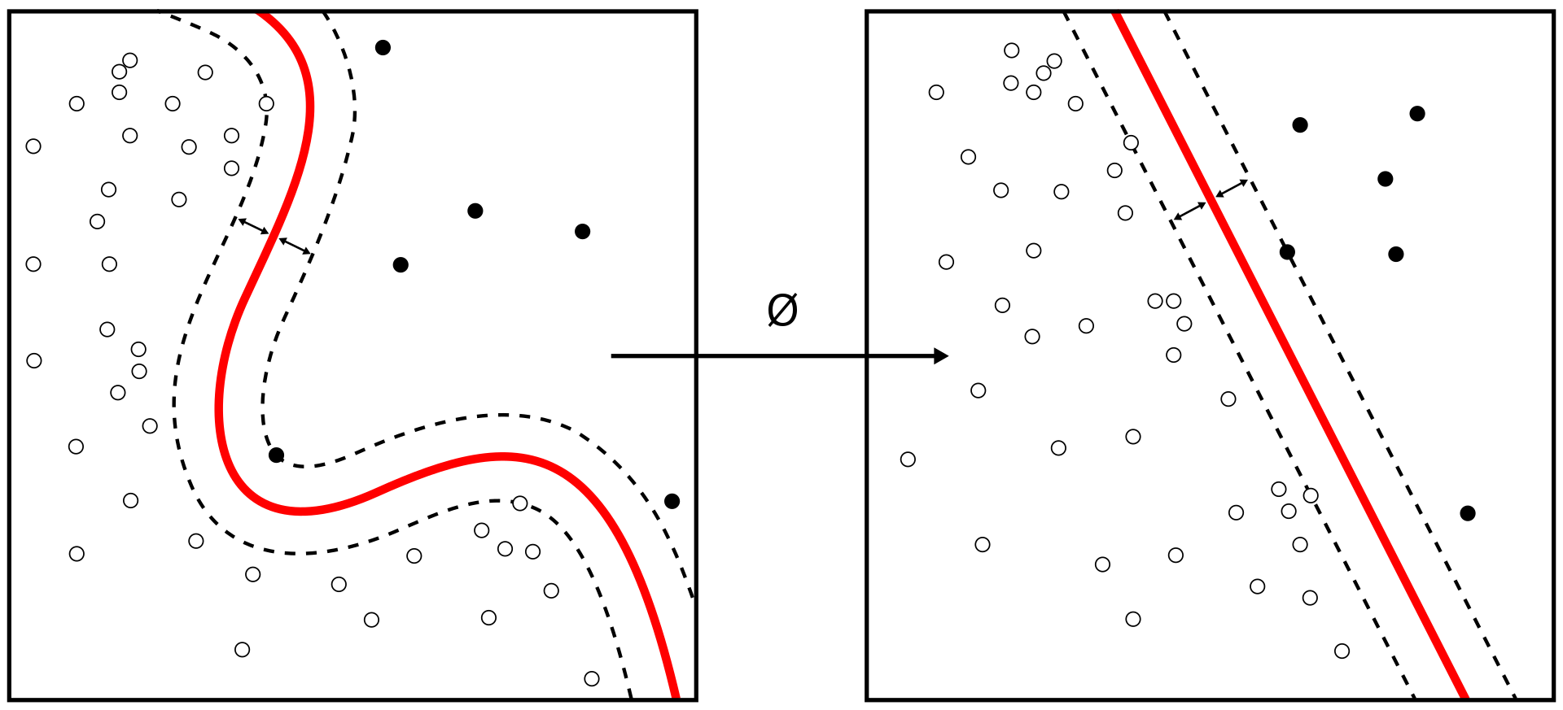
Background
In general: recall task of supervised classification is to assign a label -1 or 1 to data points x based on some unknown decision rule, based on classified training data set.
But: need to compute a classifier in time that is polynomial in the size of the training data set, with the goal of achieving high test accuracy.

Slide 9
Background
Base proof off of (classically “hard”) Discrete Logarithm Problem:
“Given a group G, a generator* g of the group and an element x of G, find log_{g}(x).”
Hardness depends on group G → this paper uses Z_{p}, where p is a large prime number, for this group, problem is classically hard.
By various mathematical tomfoolery**: no classical algorithm can solve this in polynomial time.
*, **We don’t have time for group theory and/or abstract algebra today! Just accept the conjecture.

Slide 10
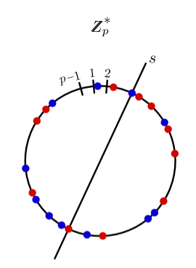
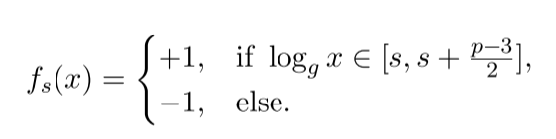
Background
Define a concept (decision rule) class, or set of labelling rules, to be the set of all possible “decisions” (boundaries, sorting rules, etc.), which our target decision rule is a member of.
Base the concept class on DLP, where concept class C = {f_{s}}, such that:
Where each possible f_{s} maps half the elements in Z_{p} to +1, and half to -1.

Slide 11
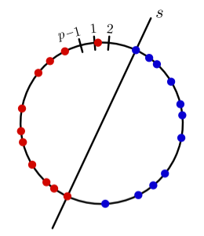
Background
The task here is not to learn the optimal classifier (decision boundary) for some set of points, but to efficiently learn the concept class C.
A concept class C is “efficiently learnable” if for every f_{s} ∈ C, an efficient algorithm can achieve 99% test accuracy by learning from examples labeled according to f_{s}.
As an example, think of each f_{s} as a way to cut a circle of points in two
halves.
We want to make sure our algorithm can figure out each way.
(The two halves problem is, of course, trivial.)

Slide 12
Problem
Main idea: “An efficient quantum learner can pass this challenge, while no efficient classical learner can pass it, assuming the classical hardness of DLP.”
Task: Show that the concept class C can be efficiently learned by our support vector machine algorithm with quantum kernel estimation.

Slide 13

Proof
First step: Establish quantum feature map, i.e. map classical data points to n-qubit quantum state (n = number of bits required to represent prime p).
The quantum feature map is a circuit, where the quantum kernel is calculated via quantum computer.*
*I shan’t go into any more detail on this or we’ll be here until next week.

Slide 14
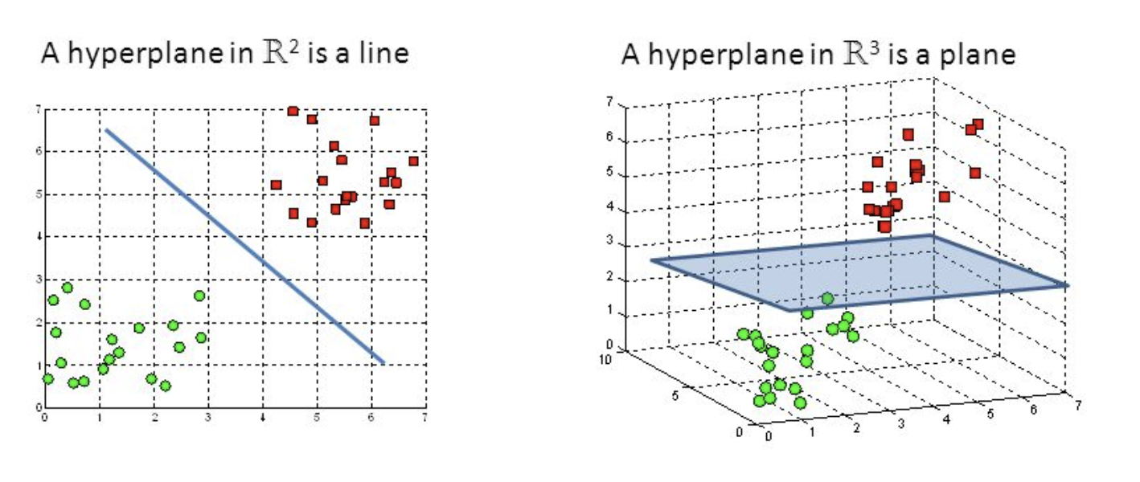
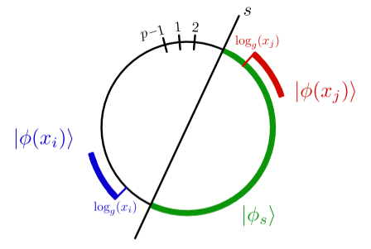
Proof
A good feature (hah!) of feature mapping: patterns (in low-dimensional spaces) become more recognizable in higher-dimensional feature space.
As a result, for our concept class: there is a hyperplane (outer product) which separates -1 and +1 labelled states in each f_{s}, by a large margin (outer vs. inner product).

Slide 15
Proof
Notice: by mapping to exponentially higher-dimensional feature space, we are taking advantage of quantum data, without having to actually store in qubit amplitudes – just using inner products!
Now we can see that in order to
classify data, we need only to find
a good linear classifier in feature
space!
*This idea isn’t new – used in ML algorithms already. But now we see we can do it on a quantum computer!

Slide 16
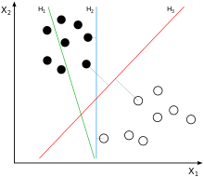
Proof
Now, how do we find the hyperplane?
Once we map to a high-dimensional feature space, it takes exponential time to find the optimal hyperplane.
Thus, use ML methods (in this case, Support Vector
Machines, as they are made to construct hyperplanes).

Slide 17
Proof
Thus, follow the general SVM-QKE algorithm:
Input a set S of m training examples.
Run QKE to obtain m x m kernel matrix K(x_{i}, x_{j}).
Run SVM on a classical computer to obtain hyperplane solution (i.e. parameters of hyperplane).
When we would like to test our algorithm:
Input new data point x.
Compute K(x, x_{i}) for all i = 1, … m.
Pass to linear classifier to classify new point x based on hyperplane solution.

Slide 18
But…
But what about quantum noise? Couldn’t that make our algorithm less effective than classical solutions, even if QKE is reducing our problem time?
I will not show the proof here (as it takes two appendixes), however, it can be shown that:
There exists some hyperplane w* with a large margin on the training set.
SVM program optimizes for the hyperplane with largest margin, thus it is guaranteed to find a good hyperplane w, even if not w*.
Thus, still a margin, and linear classifier still has good accuracy, even with quantum noise*.
*This is also proved, although I will not go through the proof here.

Slide 19
Conclusions
A simple quantum machine learning algorithm has been created, which:
Does not assume we can accurately store qubit amplitudes,
Is robust, i.e. works even with quantum noise (NISQ),
Outperforms purely classical algorithms.

Slide 20
Future Work
This paper is more of a conceptual exercise – although interesting and shows the applicability of quantum computing to machine learning methods (or vise versa), is not practically motivated.
Thus, for future work, it is suggested to:
Construct quantum feature maps that can be applied to practical machine learning problems that are classically challenging,
Continue to work on creating error-mitigated quantum feature maps to mitigate error.

