Slide 1
Sampling & Deep Neural Networks for Ising Models
“Sampling Algorithms for Validation of Supervised Learning Models for Ising-Like Systems”, N. Portman and I. Tamblyn, 2016
“Deep Neural Networks for Direct, Featureless Learning Through Observation: The Case of 2D Spin Models”, K. Mills and I. Tamblyn, 2018
David Gayowsky, September 14th, 2022

Slide 2
Sampling Algorithms
Neural nets used to analyse large-scale systems more efficiently than explicit calculation, e.g. in large scale Ising model.
Purpose: develop an algorithm to create a sample set of Ising spin states such that:
Phase transitions are observed,
Improves on accuracy of calculating (regression) or classifying (classification) Ising spin states and state energies w.r.t. Metropolis-Monte-Carlo sampling.
Set of Ising states used as training set in neural network – training neural net to identify phase transitions in Ising systems.

Slide 3
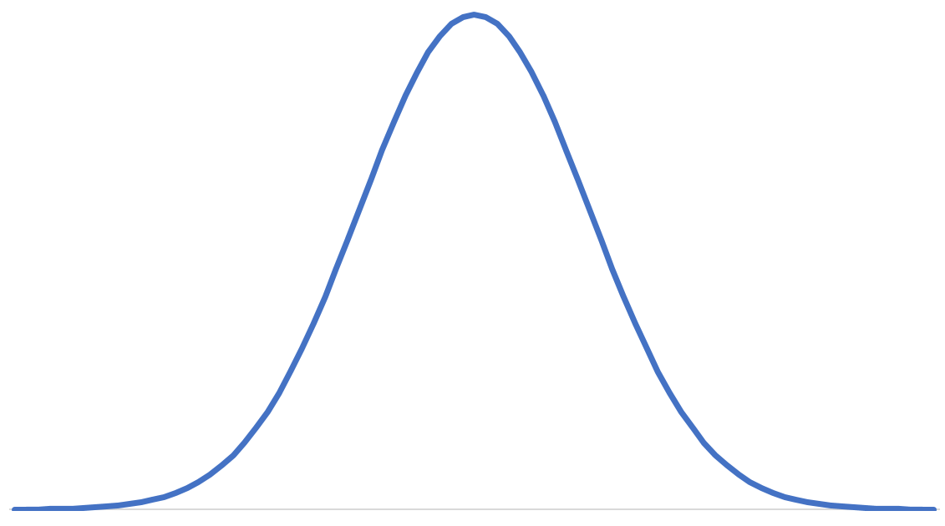
Sampling Algorithms
MMC: sampling algorithm to generate a set of Ising spin states from all possible states of the system, to use as training set of states for our NN.
Lots of sampled states!
Problem: MMC samples according to state distribution across system energies – in Boltzmann (gaussian) distribution of states, uneven sampling from across configuration space.
State Probability
Very few sampled states ☹
State Energy

Slide 4
Sampling Algorithms
Very few sampled states in NN training data set from an energy range can result in:
Biased prediction of energy values, i.e. prediction of energy values by NN inaccurate at edges of state distribution.
Intersecting testing and training data sets – how?
Thus: want to develop sampling method for Ising models which takes (roughly) equivalent number of states across energy spectra.
Class imbalance problem – show up all over the place – accuracy is bad metric for class imbalance problem – need to actively seek examples from underrepresented class to make sure we have enough training examples.
Note: success of NNs depends on “right” training data set!

Slide 5
Sampling Algorithms
New sampling algorithm must:
Display correct Ising model behaviour,
Generates training and testing data sets which do not intersect, includes complete range of energy states in both sets, and have similar probability distributions of states.
Corrects biased MMC sampling,
Applies to large scale 2D Ising model.
Note: interested only in those states which the system is likely to visit at equilibrium.
Also note: need to stop reading mmc as “mixed monte carlo” – picturing physicists in a cage brawl… I don’t even like mma…..

Slide 6
Sampling Algorithms
ID-MH (Metropolis-Hastings) Sampling:
Proposed sampling method, where for an Ising system of allowed configurations C and energies E:
Generate random configuration C_{i} with energy E_{i}.
Generate set of states {Cj}, all with energy Ej.
Draw random configuration Cjk.
Calculate acceptance ratio A.
Calculate random variable u in 0, 1.
If u < A or Ej – Ei < 0, accept Cjk as configuration, otherwise, stay in Ci.
Repeat 2-6 until 1000 configurations accepted in training data set.
Improves upon MMC because MMC only flips single bit, ID-MH takes any poss. configuration.
What does A represent?
Why u < A?
Why Ej – Ei < 0?
Why do these determine acceptable configurations?

Slide 7
Sampling Algorithms
Non-intersection and degenerate-energy states: sample 50% of configuration space, put in training, rest goes in testing.
- Distribute via deck, i.e. in each deck Ci of energy Ei, take half of each deck in training and testing.
Also: only two boundary states, not similar! So put both in training so we can recognize them (or similar states) during testing.
But how do we know if these are states we’re interested in?

Slide 8
Sampling Algorithms
“Seeds” at temperatures:
How are we varying temperature here?
What are we converging to? Varying T to ensure test states will still give phase transitions?
How does this fit into bigger picture of system?
Train NN to find phase transitions? With what algorithm? How? Then apply to testing data set?
“Boundary energy states excluded from testing” – why?

Slide 9
Sampling Algorithms
ID-MH does observe phase transition for 2D lattice of N < 6.
However: Necessitates generating entire configuration space – too big! Not practical.
So, we need to find an alternate algorithm…

Slide 10
Sampling Algorithms
Block-ID Sampling: Sampling algorithm which incorporates ID-MH, but for larger size systems.
Create Ising state Cn consisting of a k x k array of N x N blocks.
Generate NxN ID-MH training & testing data.
Replace one randomly chosen NxN block at (ki,kj) in the k x k array by a configuration generated by ID-MH (creates Cl).
Compute energy difference E(Cl – Cm).
Generate u in range (0,1).
If energy difference =/= 0 and u < min(1, exp(-Beta*DeltaE)), accept Cl. Otherwise repeat.
Why this specific energy difference? What does it represent? Why do we take it?

Slide 11
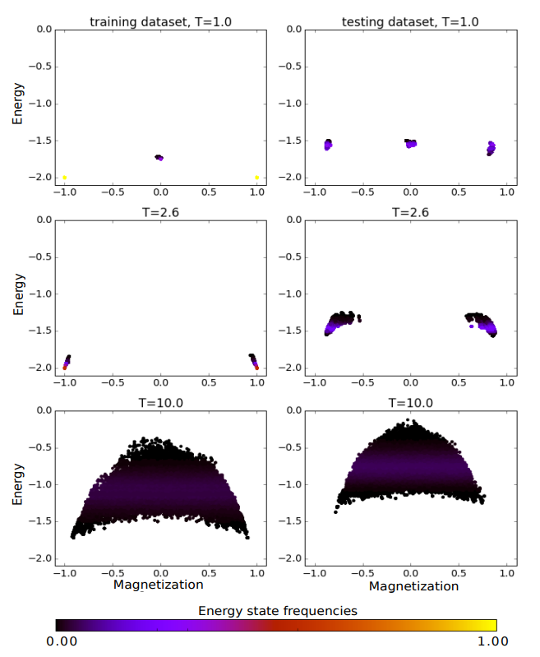
Sampling Algorithms
Block-ID results in testing data set which consists of higher energy states than training – won’t work, can’t make accurate predictions about energy states not learned.
Consequence of excluded boundary states… are these still only excluded from testing? Or excluded from training now too in block-ID?
Also dependant on temperature – why?

Slide 12
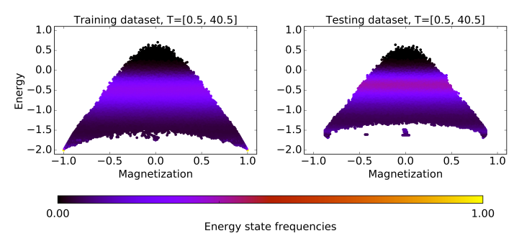
Sampling Algorithms
To fix: combine training data sets across temperature range.
Again – why is this dependant on temperature range? To do with Ising model?
PCA view in general?

Slide 13
Sampling Algorithms
Testing B-ID algorithm:
Generate states via B-ID.
Test using various machine learning methods (decision trees, random forests, k nearest neighbors, artificial neural networks).
Assess performance of each by comparison of predicted and true values of energy, magnetization and median error.

Slide 14
Sampling Algorithms
General observations & conclusions:
B-ID sampling corrects MMC unbalanced range of states.
Regression calculation more accurate than classification in case of B-ID sampling.
However: in all cases, median error for data generated from B-ID sampled data sets is unacceptably high.
(Simultaneous prediction of energy and magnetization increases error.)
Increasing data set size decreased error, however, still too high error to be acceptable.
Equalizing data set size across energy range distributed median error across states, tl;dr; more states in training data set → less error in that energy range when testing.

Slide 15
Metropolis-Hastings Algorithm
Metropolis algorithm: For an Ising system, algorithm randomly changes individual spins such that the probability of a configuration occurring follows the Boltzmann distribution.
(Metropolis algorithm = Metropolis-Hastings? Hastings just explained/generalized?)
Would like to flip spins randomly, have a system that can reach any configuration in a finite number of steps, and E dist. described by Boltzmann distribution.
Recall: E(a) of state a in canonical ensemble not fixed, but distributed with probabilities P(a) according to Boltzmann distribution.

Slide 16
Metropolis-Hastings Algorithm
How we use Metropolis to determine T dependance:
Start with fixed T and initial configuration C_i.
Appy algorithm until equilibrium is reached.
Generate statistical fluctuations about equilibrium.
Change temperature.
Repeat 1-3 in order to determine temperature dependence.
Note this can be a long-running algorithm – although usually only ~10N iterations for N site system will reach equilibrium – 2^N sites – for Ising model. Diff for diff. models.

Slide 17
Metropolis-Hastings Algorithm
Metropolis algorithm, in detail:
Start with arbitrary spin configuration C_i = {s_1, s_2, … s_N} on N sites.
Generate trial configuration C_(i+1), picking some random(?) particle j and flipping its spin.
Calculate energy E(C_(i+1)) of trial configuration. → Calc. differences in E, only flipping one spin → saves computational time!
If E(C_(i+1)) <= E(C_i), accept by setting C_i == C_(i+1)
If E(C_(i+1)) > E(C_i), accept with relative probability P = exp(-DeltaE / kT)
Choose a random x_i in U(0,1)
C_i == C_(i+1) if P => x_i, otherwise reject and keep C_i (!!).
E.g. write down observable again! (e.g. average energy, magnetization, conductivity, etc.)

Slide 18
Metropolis-Hastings Algorithm
Basis of algorithm is generating trial configuration and accepting or rejecting depending on value of Boltzmann factor.
If a trial configuration has lower energy than initial configuration (ie. DeltaE <= 0), the relative probability will be greater than 1 – we are good!
Relative probability: P(i+1)/P_i = exp(-DeltaE / kT)
Note that as E(i+1) → infinity, the probability goes to 0 – hence when DeltaE = E(i+1) – E(i) is greater than 0, probability goes to 0.

Slide 19
Metropolis-Hastings Algorithm
Thus when DeltaE > 0, pick random x_i in U(0,1), and if relative probability is greater than x_i, we accept.
Weight given to trial configuration dependant on how far it is from minimum energy configuration. Configurations away from minimum energy are de-emphasized, but not discarded completely (hence why we choose x_i to allow some through).
Allows program to find global energy minima, instead of getting stuck in local one.

Slide 20
Metropolis-Hastings Algorithm
Not actually trying to minimize energy – not running as an optimization algorithm. Not built to try and find ground state.
Analytically:
T → calculate probabilities → change T → recalculate as we now have new probs. For each state… even if prob is 0!
Instead, Metropolis calculates prob of one state, jumps through states instead of calculating all at once. And when we have stabilized, we see that we will be in a 10% prob state 10% of the time, we visit states according to the probability of those states!
(Prob. Of getting attacked by a bear…)
Each “frame” is state, where for state occurring 10% of time, frame will occur 10% of the time.
We can get stuck in states if they are very highly probable, but will pop out eventually – or maybe starting state is biased. May need to average over time and starting states.

Slide 21
Metropolis-Hastings Algorithm
Constant T (kT ~ 2.5) M-H, take simple example (cold start, all spin up):
Constant T (kT ~ 2.5) M-H, take simple example (hot start, random spins):
Note:
Randomized choice of site each time,
Frame taken every 100 steps (over 10,000)
Periodic BCs
Calc. magnetization and energy, compare to what supposed to look like. Fig. 3 from paper.

Slide 22
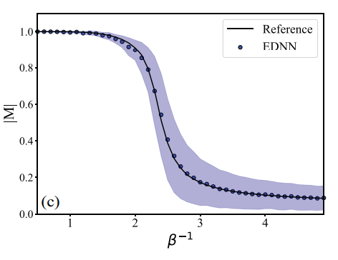
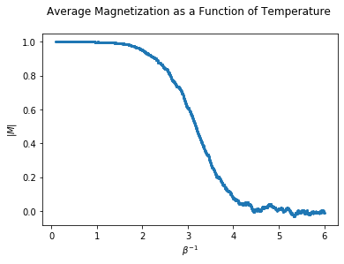
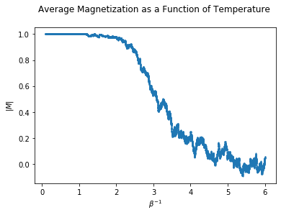
Metropolis-Hastings Algorithm
Mean average temperature for 50 configurations per data point, cold start:
Mean average temperature per 2 configurations per data point, cold start:
Little bit slow compared to ideal… inflection point is a little bit late in my plots.
Just due to stepping over Beta but some configurations aren’t changed?
Plot magnetization as a function of update or step, make sure it actually converges., use uncorrelated snapshots
Lots of numerical trickery, throwing out first 10,000 values, etc.

Slide 23
Deep Neural Network
Neural nets used to analyse large-scale systems more efficiently than explicit calculation, e.g. in large scale Ising model.
Purpose: teach DNN to predict observable value of configuration (e.g. E, mag, etc.) , which can then be expanded to other (more complex) systems, while improving calculation efficiency.
Note: DNN makes predictions about states it has never seen before, based on training data set.

Slide 24
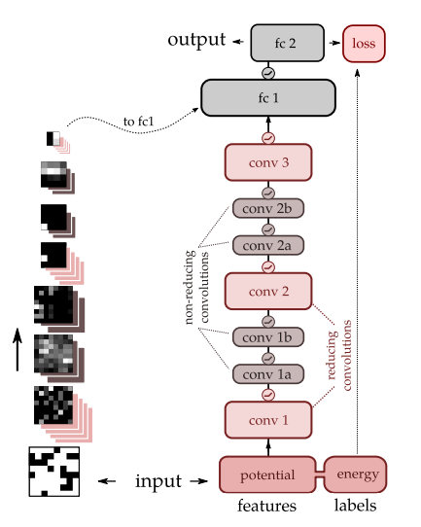
Deep Neural Network
Neural network structure:
Convolutional layers?
Mapping images – what does this have to do with Hamiltonians? (Images like pictures, or images like projections?)
Layers adding trainable parameters to network?
Physically, how does this deep neural network work?
Is this paper talking about THIS DNN in particular? Or DNNs in general?

Slide 25
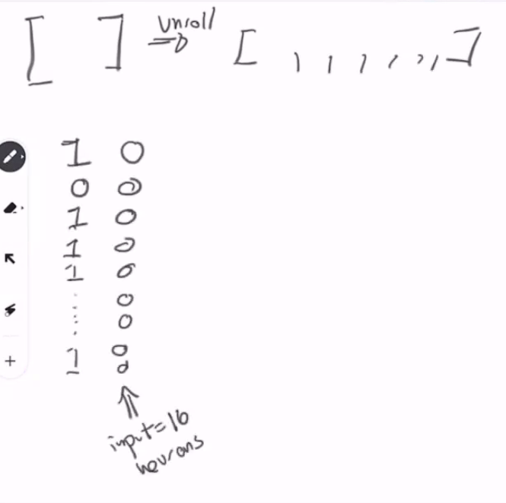
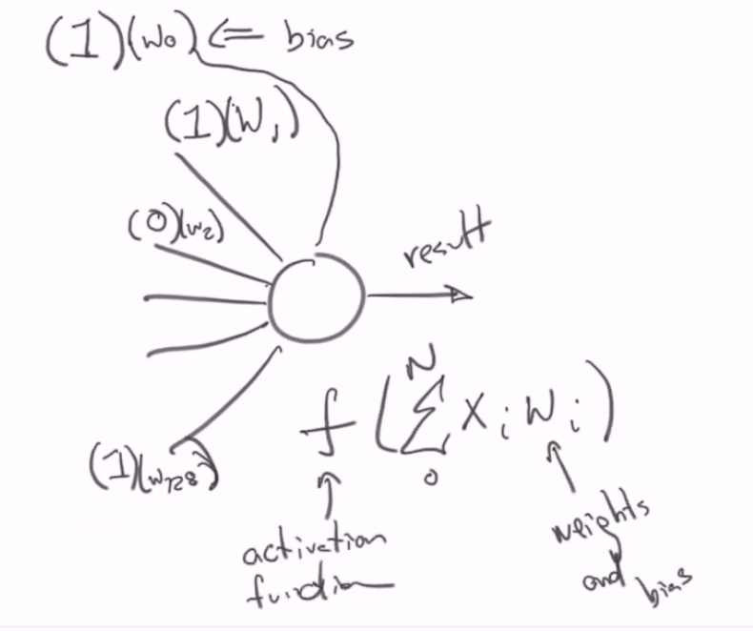
Deep Neural Network
Fully connected NN: unroll, make input,
Hidden layer e.g. 128 neurons
Every hidden neuron getting input from EACH input neuron
Each input has input plus some weight, plus w0 bias input
Sum, pass to special nonlinear activation function f, and pass to next hidden neuron.
Some f work better than others
Non-linear f means f(a) + f(b) =/= f(a+b)

Slide 26
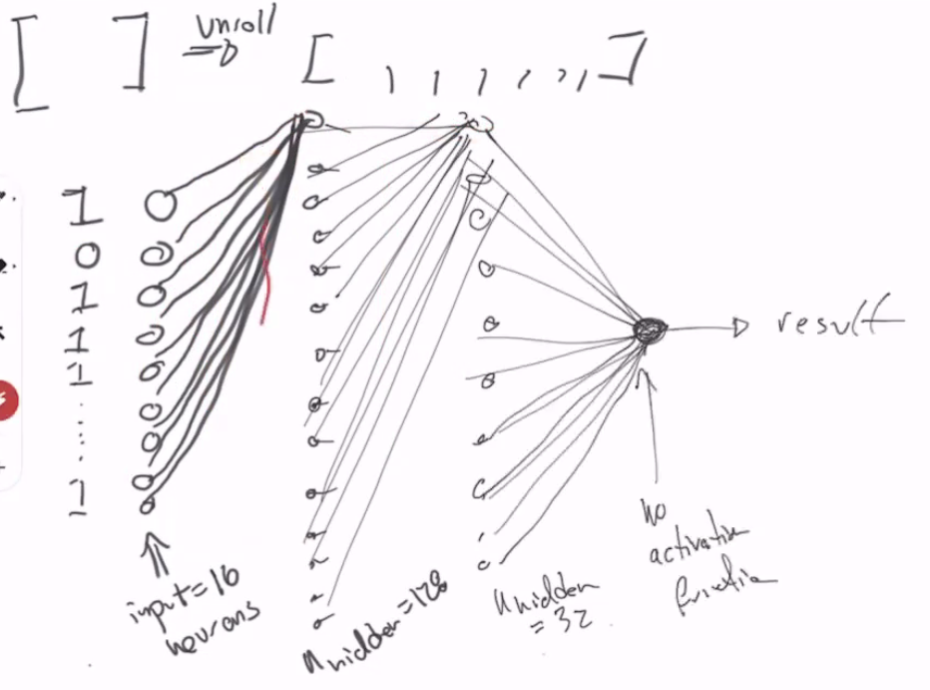
Deep Neural Network
Each hidden neuron will output something
If we randomly initialize weights, output of each is different from the other
Weight initialization is important – changes how easy it is to work with NNs!
Now say we have another hidden layer. Neurons in first hidden layer had 17 things going in (16 inputs + bias). Now these have 128 inputs + bias from first layer!
Now they emit some other number… ad nauseum.
Now, result won’t be the same as our first E from initialized weights – depending on our weights. If we pick correct weights, we can get a nice result. Supervised learning.
Need some mechanism for figuring out what weights are. And we can use gradient descent to do that, update weights, use back propagation to find out what gradients are. How we solve with fully connected NN.

Slide 27
Deep Neural Network
We will do this with fully connected NN first – regression, PyTorch. Trying to match something to a scalar value.
Then look at other NN eventually.
Make use of people in group!

Slide 28
Practice DNN
Tutorial: fitting 3rd order polynomial to sin function
Take input x(-pi to pi), y = sin(x).
Create three layer (for 3rd order) NN with pytorch tensor → tensor will end up being shape of input parameter (x) x three layers.
Compute predicted y value (of polynomial) when passing x_i, ie. Pass input data tensor → produce output data tensor.
Compute loss (given predicted and true values of y) → compute gradient of loss → update weights using gradient descent.
Repeat calculation.

Slide 29
Practice DNN
Questions:
Gradient of loss? Backward pass?
Loss function?
Updating weights with gradients – “learning rate” (not in CLEAN tutorial)?
Linear layer weights? How to “flatten” to one number?

Slide 30
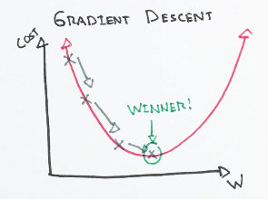
Gradient Descent
“Starting at the top of the mountain, we take our first step downhill in the direction specified by the negative gradient. Next we recalculate the negative gradient (passing in the coordinates of our new point) and take another step in the direction it specifies. We continue this process iteratively until we get to the bottom of our graph, or to a point where we can no longer move downhill–a local minimum.”

Slide 31
Gradient Descent
“The size of these steps is called the learning rate. With a high learning rate we can cover more ground each step, but we risk overshooting the lowest point since the slope of the hill is constantly changing. With a very low learning rate, we can confidently move in the direction of the negative gradient since we are recalculating it so frequently. A low learning rate is more precise, but calculating the gradient is time-consuming, so it will take us a very long time to get to the bottom.”
Why no learning rate in CLEAN tutorial? (Maybe just hidden?)
A Loss Functions tells us “how good” our model is at making predictions for a given set of parameters. The cost function has its own curve and its own gradients. The slope of this curve tells us how to update our parameters to make the model more accurate.
So we are looking for minima of loss to figure out what our weights should be?

Slide 32
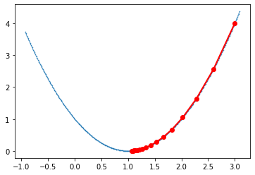
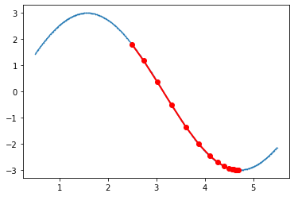
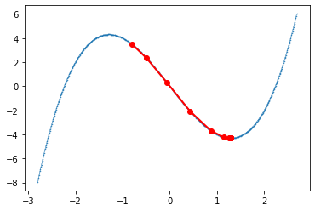
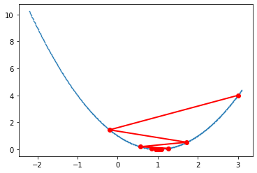
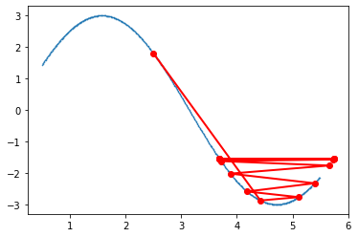
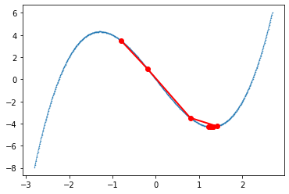
Gradient Descent
Use gradient descent to find minimum of x^2, some other functions:
x^2 – 2x +1, learning rates of 0.1 and 0.8:
3sin(x), learning rates of 0.1 and 0.8:
x^3 – 5x, learning rates of 0.1 and 0.2:

Slide 33
Deep Neural Network
Same issue here we saw in last paper: randomly generating set of spin states generates uneven distribution of states about the center of distribution. (Same soup, different smell, we know why this is bad.)
Implement umbrella sampling, “targeted sampling” which moves towards target energy – not same method as last paper. How?
Initially treat as classification routine.

Slide 34
Deep Neural Network
See that data sets containing less than 20% of configuration space accurately classify almost all possible Ising configurations (ie. Classify states into given energy levels).
Why I mention this: 27,000 training examples used – what is a “good” number of training data points/sets? If an (overall in the field of ML) goal is to get better accuracy without having to generate as much training data, where does current “good” standard sit?
More important than numbers: do you have examples from all classes we wish to do imprints on? Can’t think in terms of total number of examples, we want to have evenly distributed examples. Rule of thumb, NN is 10,000 – xgboost hundreds to thousands – learn what xgboost is.
Note: See that at upper and lower energies, states are repeated in training data set in order to achieve accuracy… did previous algorithm repeat states? Or entirely unique states?

Slide 35
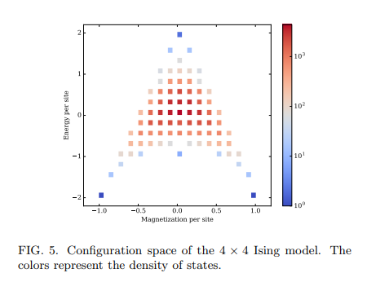
Deep Neural Network
Density of states – plot shows number of ways we can create each state for the given energy and magnetization.
If we randomly sample states, we can see that there’s a high probability we’re going to sample from red (denser) states.
Ultimately we want a ML model which is accurate for most states – so we need to have a way to choose states ahead of time to get the energy.
For small model – we could just go through and calculate all possible energy and magnetization and select the states. But this is crazy for big systems… computationally expensive.
So we want clever sampling strategy where we’re only computing E and M for some states and not others.

Slide 36
Deep Neural Network
Now try this neural net with regression (more useful) – neural network layer of width 1 gives regression instead of classification? How?
NN reads in vector of some fixed length → hidden layer of some other length → then last layer can either be length 1 or greater than 1. Vector of length 1 is just a number.
Last layer more than length 1 → length = number of distinct classes. (ie. Distinguishing between cat, dog, hot dog, last vector is of length 3). → output vector is result of classification (numbers will sum to 1 but not necessarily a probability!), ie. If classified as cat, will have [100], dog [010], etc.
Do note that regression gives good results for Ising model, even in large 8x8 model.

Slide 37
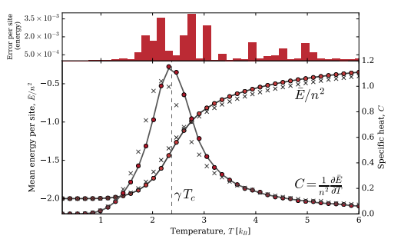
Deep Neural Network
Ising model phase transition (4x4, 8x8):
Use MH sampling to get Ising configuration space.
Calculate mean energy per site.
Vary T.
Repeat until phase transition can be seen in E vs. T plot.
Compare results with exact calculation – for both regression and classification.
Interestingly, classification performs better in this case – opposite to block-ID paper, even though looking for the same phenomena.
(But – both are pretty good!)

Slide 38
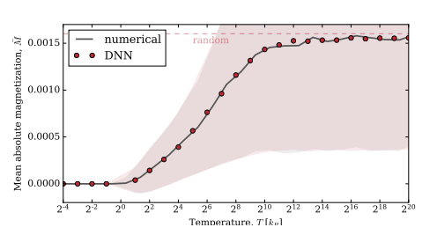
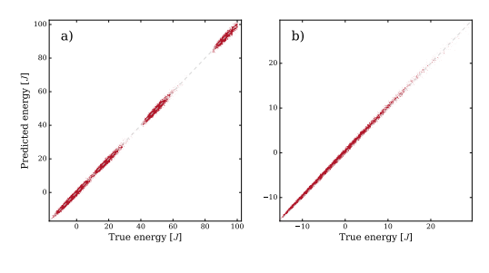
Deep Neural Network
Other arbitrary long range interactions & models:
Once again DNN models associated energies with good accuracy.
“Wide generalizability of DNN approach”
DNN drastically outperforms explicit calculations in terms of speed, including CUDA optimized algorithms (computing on graphics cards).

Slide 39
Deep Neural Network
Other notes on DNN method:
Disordered Hamiltonians cannot be DNN modeled due to spatially-dependant operators, which neural networks ignore – why?
DNN performed better than other DL methods in same trials.
Kernel methods???
NNs ignoring spatially-dependant operators only true for convolutional networks.
Convolution kernel applied to entire image as a “weight”, doesn’t depend on spacing – independent of position because kernel just slides across.
Try and train a neural network – got enough to do it, ask for help ☺

Slide 40
Deep Neural Network
NN Structure/Algorithm:
Take example problem of using DNN with regression, to find some value.
How do we map input parameters to weights and inputs? Essentially: how do we map some problem to a DNN?
Think of Ising model as 2D image.
How can we represent data in the easiest fashion? Auto-encoder: compress and decompress data. Works by forgetting useless data.
Neural net structure influenced by problem structure – and what kind of symmetries we can have in problem. The more symmetries we can encode, the easier time our NN will have.
Here, just want to show that a NN works – don’t need to get too crazy. PyTorch can do lots of things for us – initializing weights, network, etc.
How much computational resource do we have? Some nets are very large to train.
Andre Karpathy - blog post about steps to go through in order to train a neural network. Don’t need every one all the time – but a good guide! E.g. see if network can memorize one data point – if not, some issue.

Slide 41
Deep Neural Network
Training DNN on 4x4 Ising Model: meet with chris, viktor, evan, ask for inner workings
Take example problem:
Use DNN to find energy value of given Ising configuration, within 4x4 lattice model. Use regression.
Framing problem:
Supervised learning
Measure performance by comparing to analytically calculated energy values.
Have analytical solution just from counting spins (essentially).
Data management:
Ising configuration space – how much data do we need?
2^16 = 65536 possible configurations… may need large storage space. Do we have to store all training configurations? Or can we approximate simply by storing number of spin ups and spin downs (if we are only calculating energy)? – can’t just approximate! Insufficient data, just number won’t give us correct energy for this problem.
Need to sample across full range of energies (as we have discussed before).
Need to generate training data set across range of energies. – do this dumb way at first! NN will be the same!

Slide 42
Deep Neural Network
DNN Algorithm & Design:
How do we know what our DNN will look like?
Do we have a generalized algorithm for designing these? Number of layers?
Mapping a problem to a DNN?
Typical Architecture (Regression Model): - start with MNIST (!!), do classification – very similar to doing classification on ising model.
One input neuron per “input feature” – assumedly for 4x4 ising model, 16 input neurons, one per each site? + one for bias, often don’t need to explicitly include bias, included through layers. Might find bias = true in linear layers, ad nauseum.
1-5 hidden layers – depends on model – how do we know how many? Try with one, two, three, four, experiment! Generally trial and error. For simple problems, don’t need complexity – more complex, more depth. Deeper nets take longer to train.
Buy subscription to colab pro, can run NNs on there – use their GPUs. Get started with colab, then consider getting colab pro – can do a lot of this easily from colab. Let Isaac know when we are waiting for code to run…
Neurons per hidden layer – again how do we know how many? Experiment with 32, 64, 128!
Output neuron – just one, as we are looking at regression.

Slide 43
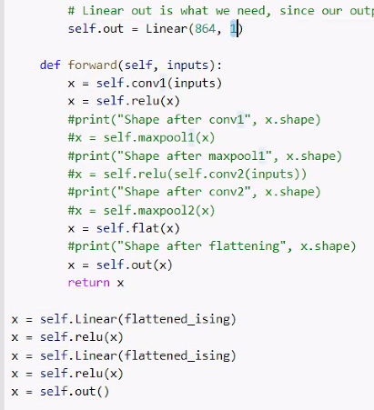
Deep Neural Network
Define some class we use to initialize and do forward pass.
In definition, put in number of layers, input and output sizes, etc.
In class, also include self.layers we want to use, i.e. self.conv (imported layer for NN from pytorch), self.linear (which we will prob need), self.dropout (cuts random connections to prevent NN from just memorizing outputs), self.flat, self.out
Def forward (within class) for forward propagation model, where we take input, and applies the stuff we brought in above.
Standard feed forward/artifial neural net – good!
CNN deals with spatial stuff – but we can usually flatten stuff into 1D vectors to use in FF/ANN which works.

Slide 44
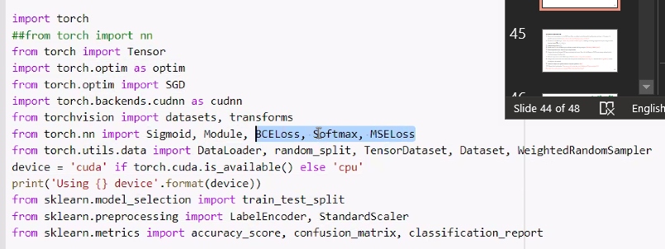
Deep Neural Network
torch.optim has the optimizers we might want ie. SGE, we can import loss functions as well ie MSELoss, BCELoss, mean absolute error loss, etc.
Can define train_batched function outside of nn class, where we define optimizer, incl. learning rate, parameters we use in our optimization, calculating the loss, and we can call loss.backward() to do backward pass.

Slide 45
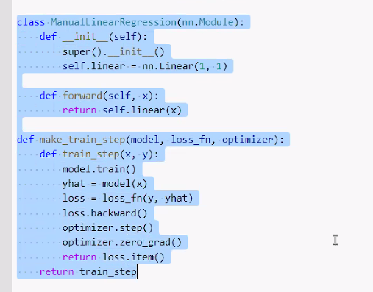
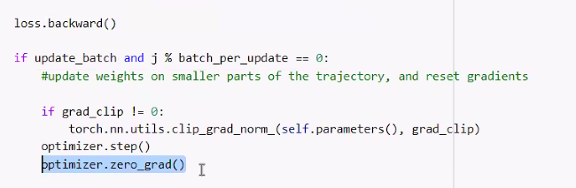
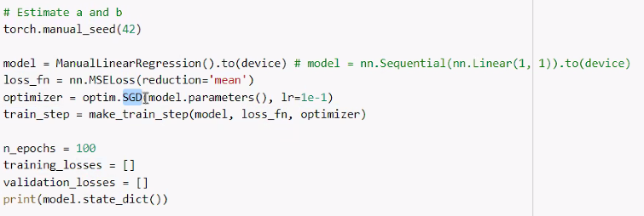
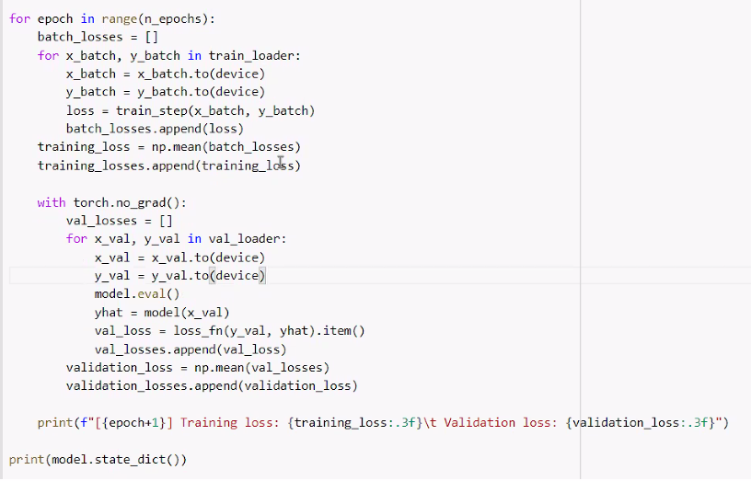
Deep Neural Network
Not sure why we have optimizer zero grad, but there is a reason somewhere…
IMPORTANT: Here’s a structure, but make sure we are in train mode in train,
And eval when we’re doing our forward propagation – and never the
Two shall meet!

Slide 46
Backpropagation Algorithm:
Pass a set of training data {t_i} to DNN input. Here, set of data is spins for one 4x4 configuration, and input is 17 neurons, 16 possible spins plus one bias (what is bias in this case? Flipping a spin up or down?)
Pass data set to hidden layer 1. (How many neurons in hidden layers?), randomly initializing weights on first pass, using activation function f(sum 0→16, S_1i*W_1i).
Compute output for all {t_i}.
Repeat steps 2-3 for all hidden layers, and keep a record of all layer outputs. (How many hidden layers?)
Record regression output from last layer (single neuron).
Compute loss (error) between DNN output and analytical output. Here, this is difference in DNN output energy and analytically calculated energy of configuration.
Measure output error at each hidden layer, of each neuron(?) – using chain rule (how?).
Compute how much of this error comes from each previous connection (neuron or layer?) – measures the error gradient(?) across all weights in the network.
Update all weights with gradient descent using error gradients – how?
Repeat for all training data. Then can test with testing data just by feeding to NN given weights? Or?
How does this actually compute our energy? What is function of each layer?

Slide 47










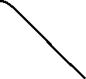
Deep Neural Network

Slide 48
Deep Neural Network
Input training data:
Each input data set t^(i) is set of “feature values” – i.e. set of spins, t^(i) = [t_i1, t_i2, … t_i16]
Has corresponding y^(i), “label”, in this case, energy value E_i
Total data set of matrix X, where X = [t_1^T, t_2^T, … t_p^T] for total training data sets p.
Sampling training data:
Need distribution from across all energy levels.
Use sampling methods from papers? Or perhaps simpler sampling method…
Ideally we don’t want to generate all our configurations. But perhaps we can generate a list of possible energy states (combinatorial maths) and simply generate random configurations with the required energy.
Weights etc. at each layer help train NN, when we train the NN learns which neuron to “light up” to get the desired output.

Slide 49











Slide 50
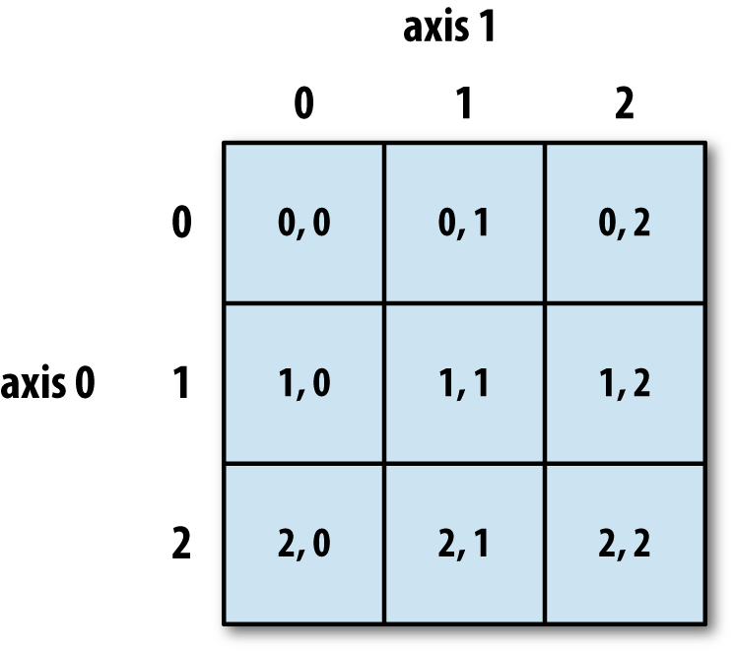
Deep Neural Network
Have set of 16 possible sites, each of which may be spin up or spin down.
Simply take set of combinations without repetition for which ones will be spin up.
i.e. sites = {0, 1, … 15}
sites_0 = []
sites_1 = [[0], [1], [2], … [15]]
sites_2 = [[0,1],[0,2]…]
Ad nauseum.
Then keep track of which 1-16 index corresponds to each place in the grid:
0 = [0,0]
1 = [0,1]
2 = [0,2]
3 = [0,3]
4 = [1,0]
Ad nauseum.

Slide 51
Windows linux subsystem
Launch linux docker type thing locally on computer
And then for coding use vscode
That way if we need to ssh etc., then that’s already just there.
Wsl → ubuntu free → in store app
Install conda into wsl
In terminal wget paste link
Wsl extension in vscode will allow us to connect to this environment
Microsoft store → terminal → can use linux/windows/etc. terminal tabs

