Slide 1
Ising DNN (Test Project)
David Gayowsky
Jan. 2nd 2022

Slide 2
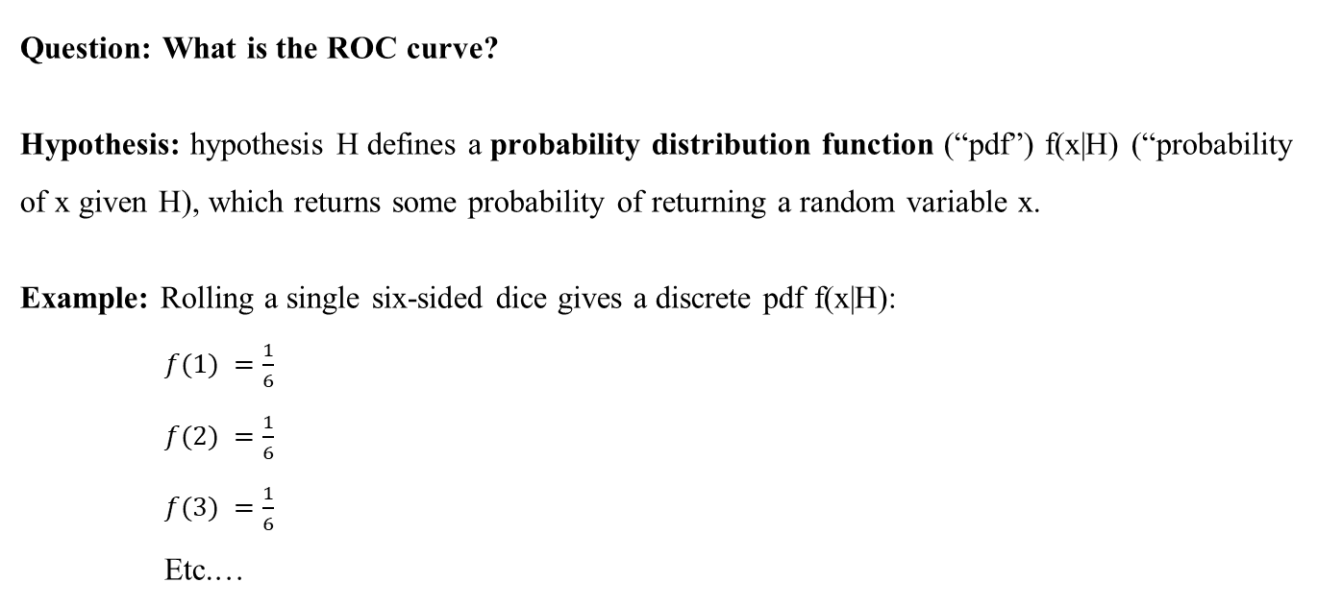
Answered Question: ROC Curves
Question: What is the ROC curve?
Hypothesis: hypothesis H defines a probability distribution function (“pdf”) f(x|H) (“probability of x given H), which returns some probability of returning a random variable x.
Example: Rolling a single six-sided dice gives a discrete pdf f(x|H):
$f(1) =\frac{1}{6}$
$f(2) =\frac{1}{6}$
$f(3) =\frac{1}{6}$
Etc.…
Where we consider that f(x|H) represents the probability to return:
x = a certain dice roll, under the hypothesis
H = that the dice is not weighted

Slide 3
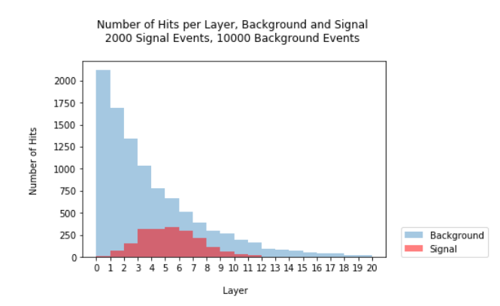
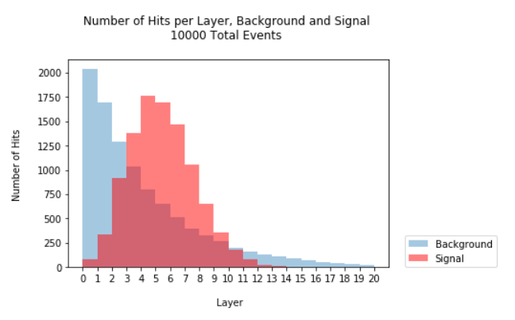
Answered Question: ROC Curves
Question: What is the ROC curve?
Firstly, need to consider a scenario in which we have a hypothesis we would like to test (“signal”) for validity by comparing against some already-assumed idea (“background”), defined by two pdfs.
AKA Null Hypothesis or H₀
AKA Test Hypothesis or H₁

Slide 4
Answered Question: ROC Curves
We can evaluate whether we would like to accept our signal hypothesis via statistical tests, which tell us the significance of our results.
Critical region: region or range of x in which we assume signal hypothesis H₁ is correct, and background hypothesis H₀ is incorrect.
P-value: probability, under assumption of a signal hypothesis H₁, to observe data with equal or lesser compatibility with H₁ relative to the data we got.
Or: Probability of rejecting H₀ when it is true.
Lower p-value → H₀ is less likely to be true → more significant results!*
P-value of 0.05 or 5% is generally considered sufficient for significance.

Slide 5
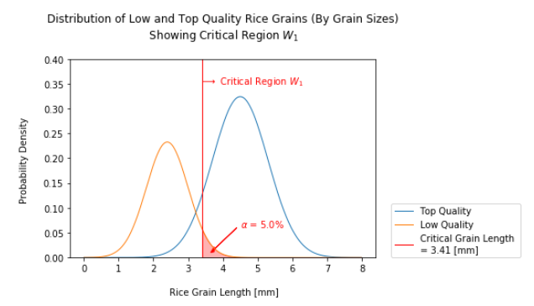
Answered Question: ROC Curves
Example: High and low quality rice grains.
Critical region in which we assume our signal is correct, defined by x greater than the critical value.
Background pdf.
P-value, or probability of background being true under signal assumption.
Signal pdf.

Slide 6
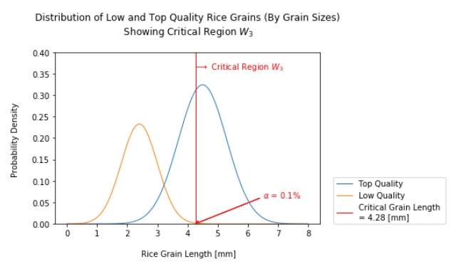
Answered Question: ROC Curves
Example: High and low quality rice grains.
We can shift the critical region and critical value to change our p-value.
Can call this “choosing our cut”.
P-value decreases as we shift our critical region – less chance of selecting lower quality grains, in this example.

Slide 7
Answered Question: ROC Curves
Need a few more definitions…
Background Efficiency: the same as our p-value, also called “probability to fall into the critical region assuming H₀ is true”.
How much of our background is leaking through our cut?
Area under background curve in critical region.
Signal Efficiency: also known as “power” of a statistical test, or “probability of rejecting H₀ when H₀ is false”. Fraction of desired events we actually get!
How much of our signal is in the cut?
Area under signal curve in critical region.

Slide 8
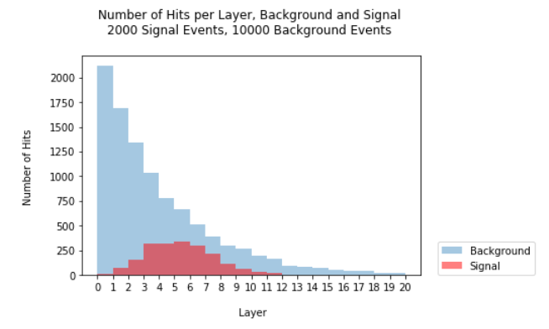
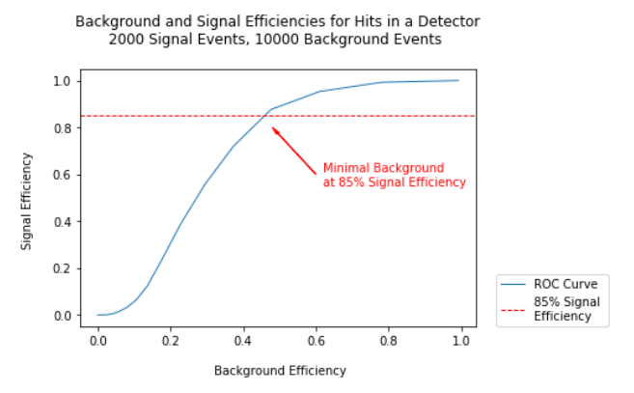
Answered Question: ROC Curves
ROC Curve: “receiver operating characteristic curve”, or graph of signal efficiency versus background efficiency for different cut values.
Example: Layer hits in a detector – where is our optimal cut, where we remove enough background, but keep enough signal, to give us meaningful results?

Slide 9
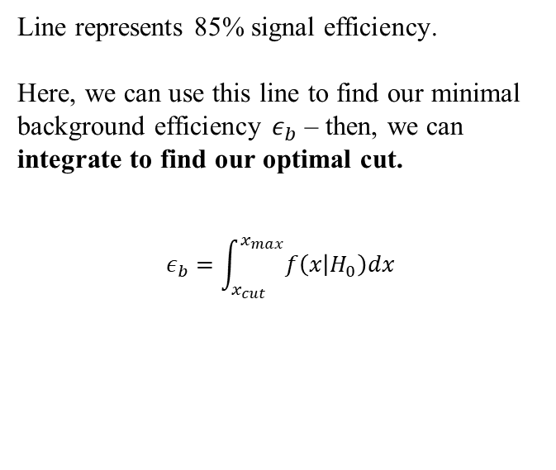
Answered Question: ROC Curves
Example: Layer hits in a detector.
Line represents 85% signal efficiency.
Here, we can use this line to find our minimal background efficiency $ε_{b}$ – then, we can integrate to find our optimal cut.
$$ε_{b}=\int_{x_{cut}}^{x_{max}}{f\left(x | H_{0}\right)dx}$$
But what about ROC curves in machine learning?

Slide 10
Answered Question: ROC Curves
In classification algorithms, consider:
True Positive Rate: signal efficiency, or fraction of desired events (class matches) we actually get.
False Positive Rate: background efficiency, or false classifications.
Classification Threshold: Given a probability of some “object” to belong to a certain class, what do we say that probability needs to be before we declare it part of the class?
i.e. if the probability of an email to be spam is 0.99, we classify it as spam.
What about if the probability is 0.51? Is it spam?

Slide 11
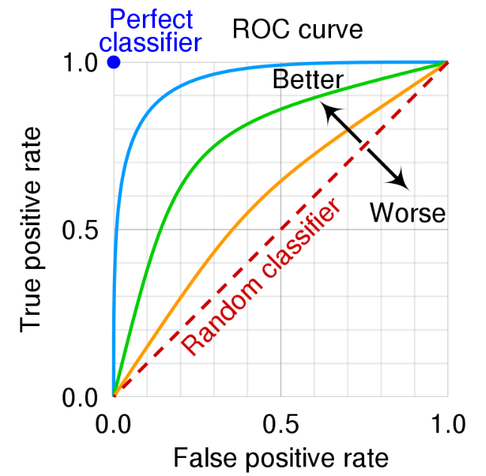
Answered Question: ROC Curves
Here, we can use an ROC curve to evaluate:
The performance of a classifier at different classification thresholds.
The overall performance of the classifier.
More true positives, less false positives – better classifier!
Can use this to determine classification threshold – i.e. choose a minimum true positive rate, and integrate as we did previously.

Slide 12
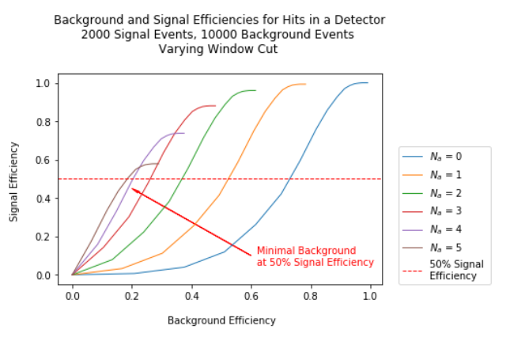
Answered Question: ROC Curves
Bonus: What happens if we define the critical region with two bounds, a minimum and maximum?
Window Cut: Critical region bounded at the top and bottom with two critical values.
Can repeat the same procedure as with a single ROC curve.
However, a window cut can increase the signal to background ratio so we can see more of the signal data.
Multiple ROC curves, one for each minimum cut value.

Slide 13
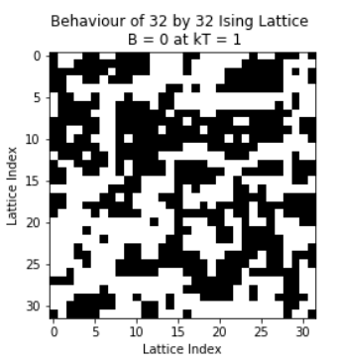
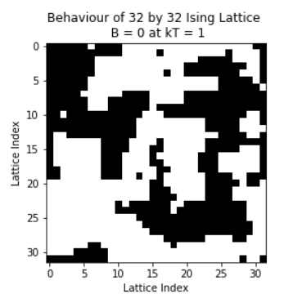
Ising DNN
Goal: Build a sample DNN which evaluates the energy of a given Ising model configuration.
Background: Simple Ising model: 2D lattice of spins, consisting of spin up and spin down. Can calculate thermodynamic properties, such as average magnetization, internal energy, etc.
Metropolis MC gives results:

Slide 14
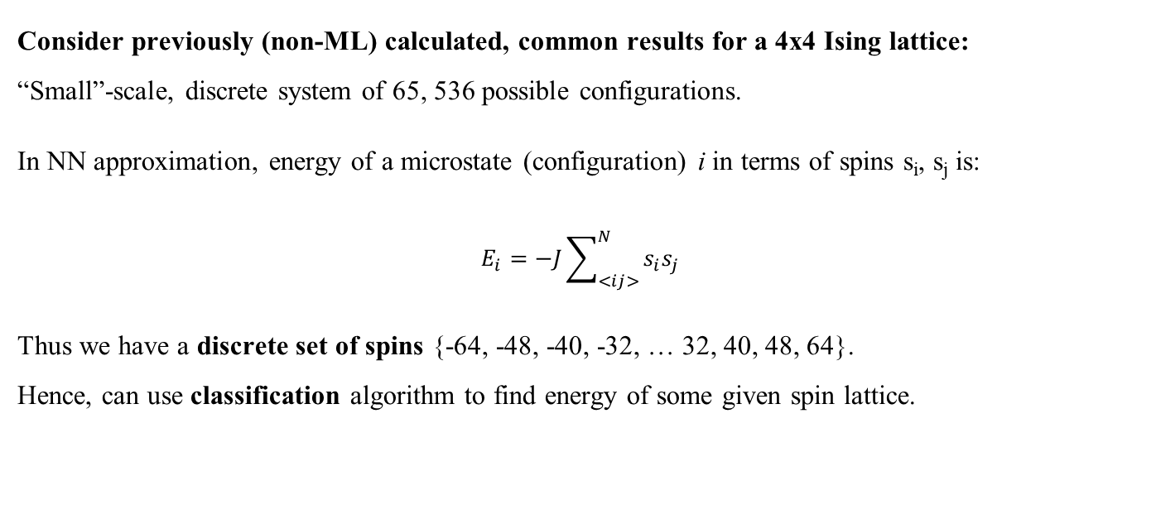
Ising DNN
Consider previously (non-ML) calculated, common results for a 4x4 Ising lattice:
“Small”-scale, discrete system of 65, 536 possible configurations.
In NN approximation, energy of a microstate (configuration) i in terms of spins s_{i}, s_{j} is:
$$E_{i}=−J\sum_{<ij>}^{N}{s_{i}s_{j}}$$
Thus we have a discrete set of spins {-64, -48, -40, -32, … 32, 40, 48, 64}.
Hence, can use classification algorithm to find energy of some given spin lattice.

Slide 15
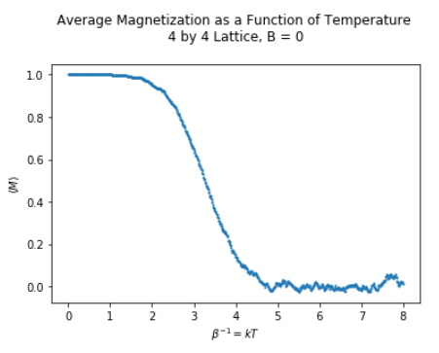
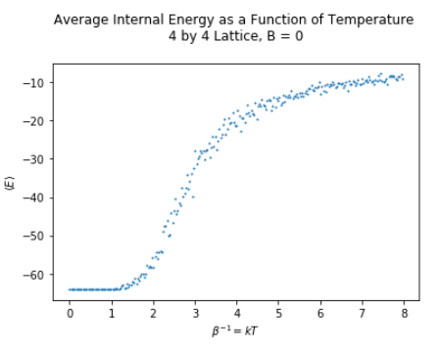
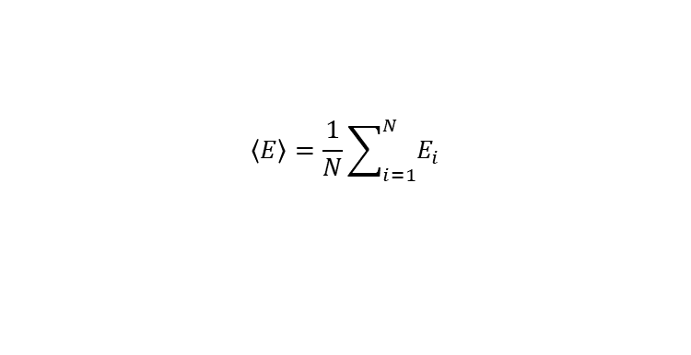
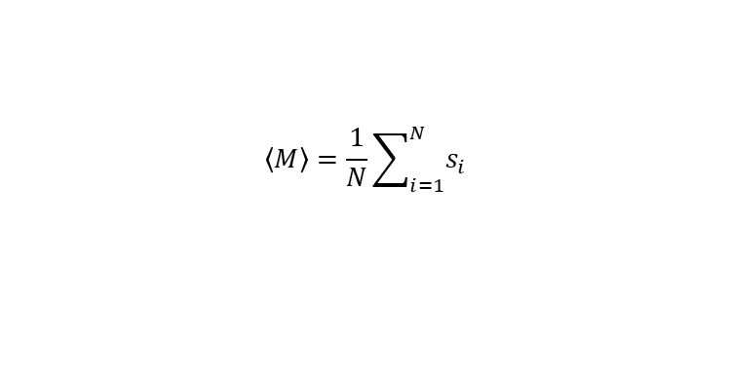
Ising DNN
Consider previously (non-ML) calculated, common results for a 4x4 Ising lattice:
$$\left\langle M\right\rangle =\frac{1}{N}\sum_{i=1}^{N}{s_{i}}$$
$$\left\langle E\right\rangle =\frac{1}{N}\sum_{i=1}^{N}{E_{i}}$$
For each site i in lattice, given a total number of sites N.

Slide 16
Ising DNN
Wish to recreate these results with DNN.
Structure algorithm, for small-scale Ising:
Create a full set of all 65, 536 possible configurations and energies.
Create training and testing data sets by shuffling configurations and energies, and selecting half of them randomly for each data set.
Feed training data to train neural net.
Feed testing data to neural net.
Evaluate what fraction of our results are correctly predicted by the DNN.

Slide 17
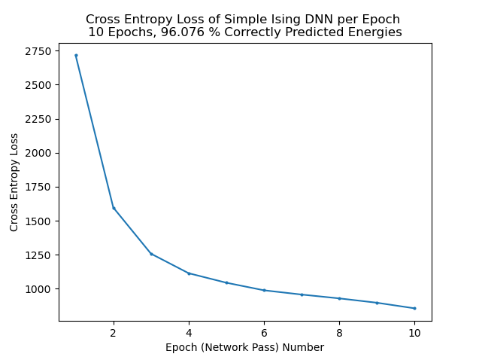
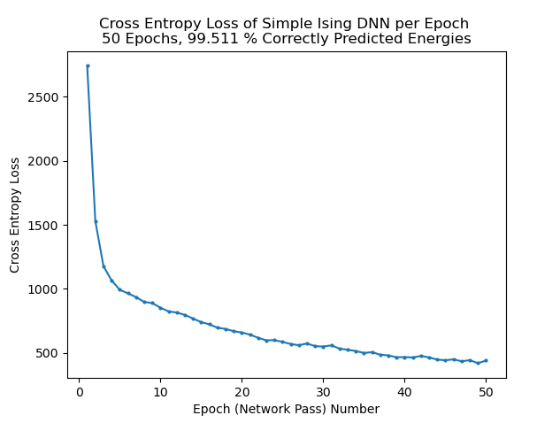
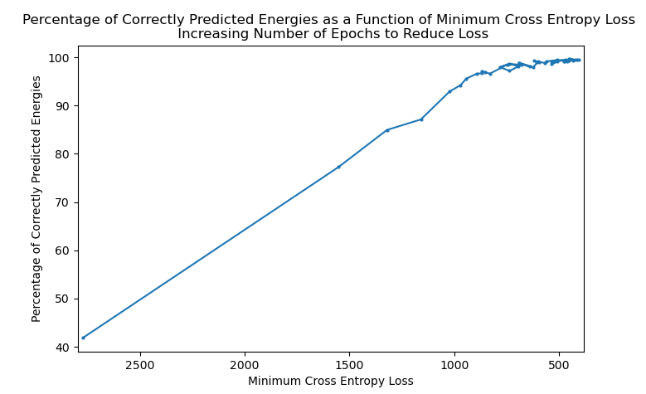
Ising DNN
Loss function: (Categorical) Cross Entropy Loss – compare actual energy value with probability that input aligns with that category.
Smaller loss → Better model!
Decrease in loss → Implies our model is learning.

Slide 18
Ising DNN
Consideration: Here we see that even with random sampling, 50 epochs is enough to obtain a 99.5% accuracy rate for predicted energies of given configurations - thus, we say for now we do not consider a targeted sampling algorithm.

Slide 19
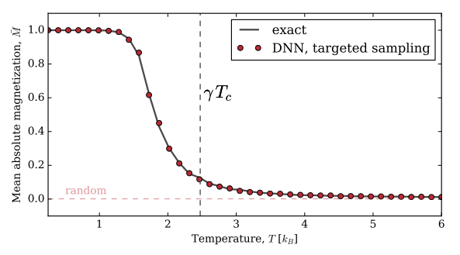
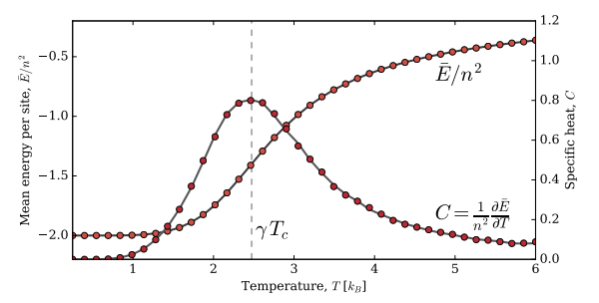
Ising DNN
Recreating plots from Kyle’s paper (“Deep Neural Networks for Direct, Featureless Learning Through Observation: The Case of 2D Spin Models”, K. Mills and I. Tamblyn, 2018):
How do we do this?

Slide 20
Ising DNN
Here, want to find the average magnetization and internal energy as a function of temperature.
Use standard Metropolis MC algorithm, except instead of explicitly calculating the energy of a given configuration, use DNN to predict the energy of our configuration.
→ Can do this over multiple trials to come up with an average, hopefully get some nicer plots.

Slide 21
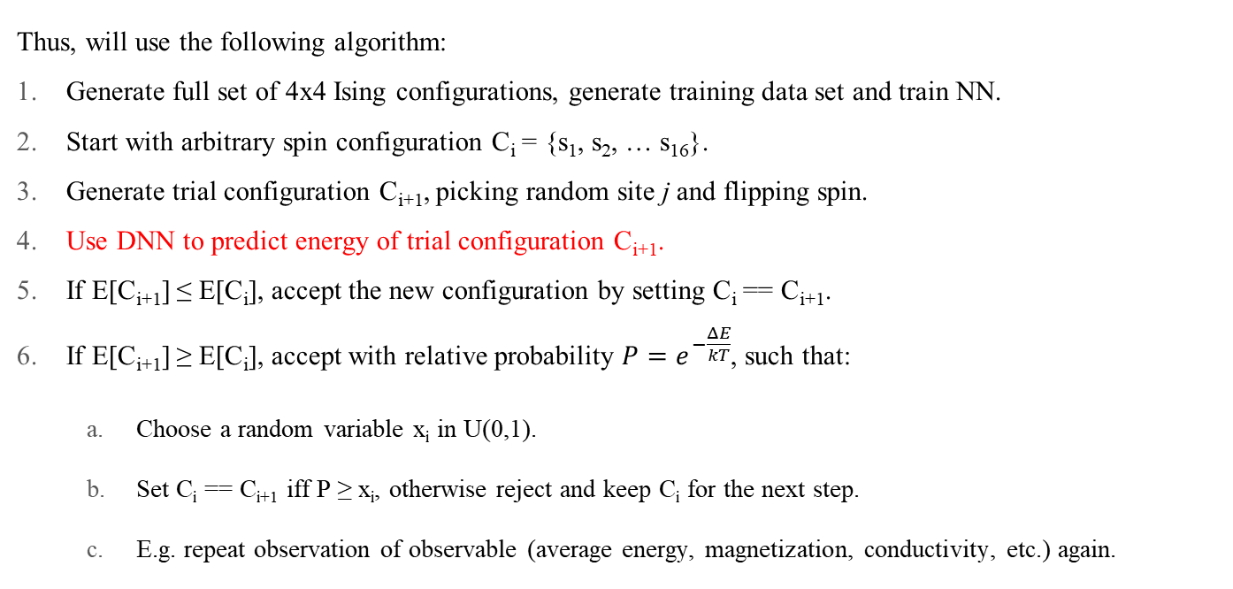
Ising DNN
Thus, will use the following algorithm:
Generate full set of 4x4 Ising configurations, generate training data set and train NN.
Start with arbitrary spin configuration C_{i} = {s₁, s₂, … s₁₆}.
Generate trial configuration C_{i+1}, picking random site j and flipping spin.
Use DNN to predict energy of trial configuration C_{i+1}.
If E[C_{i+1}] ≤ E[C_{i}], accept the new configuration by setting C_{i} == C_{i+1}.
If E[C_{i+1}] ≥ E[C_{i}], accept with relative probability $P=e^{−\frac{ΔE}{kT}}$, such that:
Choose a random variable x_{i} in U(0,1).
Set C_{i} == C_{i+1} iff P ≥ x_{i}, otherwise reject and keep C_{i} for the next step.
E.g. repeat observation of observable (average energy, magnetization, conductivity, etc.) again.

Slide 22
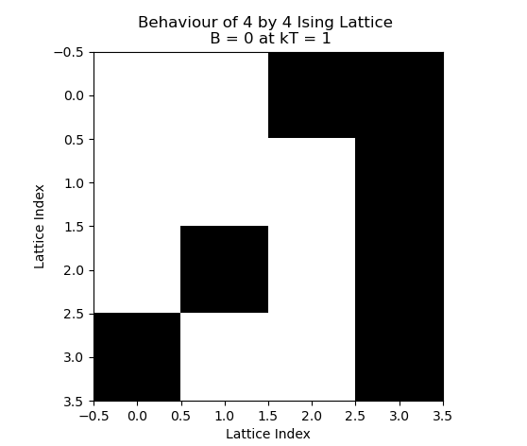
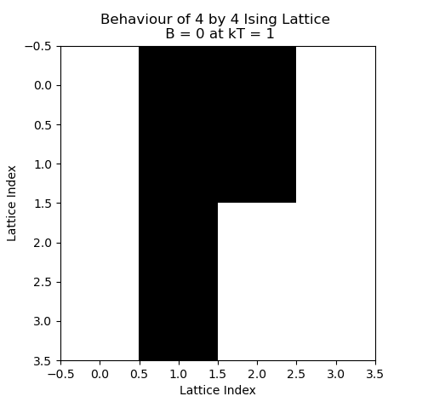
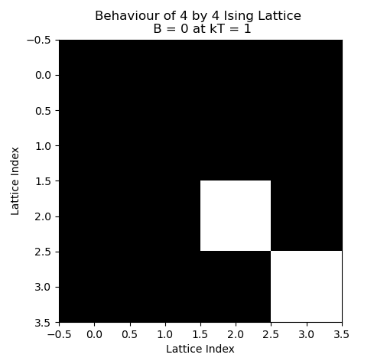
Ising DNN
Firstly, make sure Metropolis MC with DNN is working. Look at configuration plots of 4x4 Ising lattice, for B = 0, kT = 1, to ensure behavior is observed.
DNN Generated Configurations: (At 10, 15, 20 Steps – Different Runs)
These don’t look too bad – I’m willing to say this is working, so far.

Slide 23
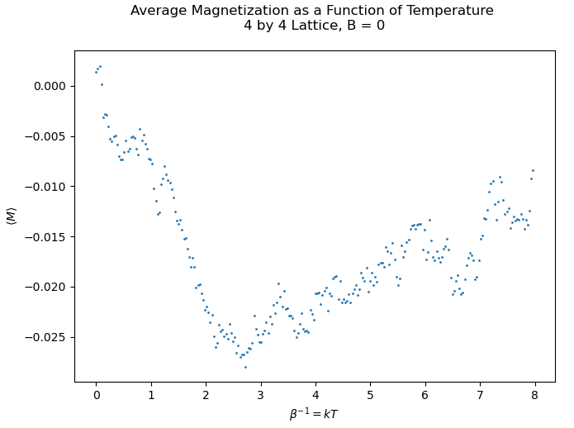
Ising DNN
Consider previously (non-ML) calculated, common results for a 4x4 Ising lattice, and compare with DNN result: (25 Epochs, LR = 0.0003, 250 steps & 5000 samples.)
Okay, so it needs some work… may not even be ML related errors, I may just have goofed a line in my code.
But it’s on its way…
Previous (Non-ML) Result
ML Result

Slide 24
Ising DNN
Bad plot is due to bad energy state sampling…
Need to change training data sampling method, couple of options:
Write algorithm to explicitly sample from the tails of the energy distribution,
Re-weight the outlying energy states (losses?) such that they carry greater importance in the training data set.
Here, we only have a few states at the edges of our energy distribution – we can’t sample them more if we don’t have them. (Can we repeat these in training data set?)
Thus: we’ll try re-weighting them and seeing what we get.

Slide 25
Ising DNN
Next Steps:
Correct errors in average magnetization, match results.
Compute and match results for average internal energy.
Eventual Considerations:
Expand to larger Ising systems.
(May require more involved sampling method. Consider questions e.g. how few samples can we take to still obtain accurate thermodynamic results?)
How large of an Ising system can we consider and still get accurate results?
Ad nauseum…

