Slide 1
One login, extra proof only when it matters
Single sign-on and step-up MFA across three apps, with a live demo
Acme Bank (fictional) | Proof of concept | Tested with Keycloak only
Notes:
Welcome. 45 minutes: about 12 of them a live demo. For managers: the one-line takeaway under each slide title is for you. For developers: details are in the appendix and in the repo docs. Everything shown is fake data; only Keycloak was ever run.

Slide 2
The problem: many logins, some risky actions
For managers: staff and customers want one easy login, but a stolen password must not be enough to move money.
Many apps, many logins
One password is a weak gate
MFA on every click does not work
Every app asks again. People reuse passwords or write them down.
A phished password could change contact details or approve a transfer.
Constant prompts annoy users. Better: extra proof only for risky actions.
Notes:
Three pains. Many apps means many passwords. A password alone is a weak gate for risky actions. But asking for a second factor on every click makes people hate security. We want both: easy by default, strict when it matters.

Slide 3
Today in 45 minutes
For managers: a short concept part, a live demo in the middle, then trade-offs and honesty about what was tested.
5 min
The problem and single sign-on basics
8 min
Architecture, tokens and step-up MFA
12 min
Live demo: Acme Bank
5 min
Connecting any identity provider
5 min
Security decisions and what was verified
10 min
Questions and buffer
Notes:
Timing: about 5 min problem and SSO basics, 8 min architecture, tokens and step-up concepts, 12 min live demo, 5 min IdP flexibility, 5 min security and what was verified, 10 min questions and buffer.

Slide 4
Single sign-on: log in once, use many apps
For managers: one trusted login page, many apps. Fewer passwords, one place to add stronger checks.
1. First app sends you to the login page
Identity provider (Keycloak)
the only place a password is typed
2. Other apps find your IdP session: no prompt
Customer Portal
Payments and Transfers
Back Office
Notes:
Analogy: the reception desk of a building checks your ID once and gives you a badge; every office door then trusts the badge. The identity provider (IdP) is the reception desk. Apps never see your password, only a signed proof.

Slide 5
The demo: three parts of one fictional bank
For managers: one story to follow: a customer, a payment, and a back-office approval.
Customer Portal
Payments and Transfers
Back Office
React app, port 5300
Accounts, balances, profile
Sensitive: change e-mail address
Angular app, port 5400
Send money, add payee
Sensitive: add payee, send over 1000
ASP.NET Core MVC, port 5200
Limits, approvals, users
Sensitive: change limit, approve transfer
Notes:
Acme Bank is fictional, with fake data. Each app is built differently on purpose: React and Angular run in the browser, MVC runs on a server. Same look, same nav bar, same session panel.

Slide 6
Architecture: three apps, one API, one IdP
For developers: the API validates every token itself; apps only carry it.
Customer Portal (React)
Apps log in via the IdP (redirect, code + PKCE)
Payments (Angular)
Shared API
enforces step-up
Keycloak
login + TOTP
public keys (JWKS)
Back Office (MVC)
access token
Notes:
The apps log users in through Keycloak using the Authorization Code flow with PKCE. They call one shared API with an access token. The API is the only place that decides about step-up. The API fetches Keycloak public keys (JWKS) to check signatures.

Slide 7
The token journey
For managers: short-lived passes limit the damage if one leaks.
ID token
Access token
Where they live
Read by the app
Who logged in and how
Never sent to the API
Sent to the API
Lives 5 minutes (setting)
Carries level (acr), login time (auth_time), audience
React, Angular: browser memory only
MVC: on the server, browser has only an HttpOnly cookie
A refresh keeps the original login time, so it can never replace a step-up (verified against Keycloak).
Notes:
Three tokens. The ID token tells the app who logged in and how. The access token goes to the API and is short lived: 5 minutes here. The refresh token is not used by the apps in this PoC; when the access token ends the apps go through single sign-on again. A refresh would keep the old login time, which we verified.

Slide 8
Step-up MFA: prove it is really you, right now
For managers: being logged in is not the same as being sure. Risky actions need fresh proof.
LoA1: password
LoA2: password + authenticator code
Enough to look at accounts and balances.
Token says acr = 1
Needed to change e-mail, add payee, send over 1000, change limits, approve transfers.
Token says acr = 2
And it must be recent: the login time (auth_time) must be within 60 seconds.
Notes:
LoA1 means a password only. LoA2 means a password plus a code from an authenticator app (TOTP). The token says what level was reached (acr) and when (auth_time). For risky actions the API asks for LoA2 and a recent login.

Slide 9
The step-up flow in six steps
For developers: this is RFC 9470 (OAuth step-up authentication challenge).
1 Click a sensitive action
2 API says 401: stronger or newer login needed
3 App explains why (popup)
4 Keycloak asks for the authenticator code
5 App gets a new token (acr 2, new login time)
6 Retry: API checks again, then performs it
Notes:
User clicks a sensitive action. The app calls the API. The API sees the level is too low or too old and answers 401 with a challenge that says which level and how recent. The app shows a clear popup, sends the user to Keycloak for the authenticator code, comes back, and retries. The API checks again; nothing is trusted from the client.

Slide 10
The API decides, not the app
For managers: the security rule cannot be bypassed by tampering with the website.
What the API checks
HTTP 401 Unauthorized
WWW-Authenticate: Bearer
error="insufficient_
user_authentication",
acr_values="2",
max_age="60"
Signature, issuer, audience, expiry
Level (acr) at least LoA2
Login time within 60 seconds
Only then: perform the action
Notes:
If the browser app decided, anyone could edit it in dev tools. So the app just sends the token. The API reads the level and login time from the signed token. Not enough: it refuses and does not perform the action. We ran this: a password-only token and an old token are both refused.

Slide 11
One shared window for all three apps
For managers: one proof, valid in all apps, for a short time. The length is a setting.
Inside the window: Payments and Back Office open with no prompt
Login (password)
Window: 60 s (up to 65 s with clock leeway)
Authenticator code: window starts
Window over: the next sensitive action asks again
Refreshing a token does not extend the window: it keeps the old login time.
Notes:
Because all apps share one identity provider session and the API judges the login time, proving yourself in one app counts for the others for about a minute. In the demo you do the authenticator code once and then use Payments and Back Office with no new prompt, until the countdown ends. The effective window is up to 65 seconds because of a 5 second clock leeway.

Slide 12
Live demo
Acme Bank: one login, three apps, extra proof when it matters (about 12 minutes)
Notes:
Before this slide: the checklist in demo/run-demo.md is done, private browser window open at the Customer Portal, authenticator app visible, backup screenshots ready. Remember: the window is about a minute (up to 65 s), and a TOTP code cannot be reused, so wait for the next code between step-ups.

Slide 13
Demo script: what you will see
1
Sign in to the Customer Portal (password): LoA1
6
Back Office: approve a transfer, no prompt
2
Change e-mail: popup asks for extra proof
7
Wait for the countdown to reach zero
3
Authenticator code: LoA2, countdown starts
8
Send 2500 again: asked again. "Not now" cancels
4
Click Payments in the nav: no login prompt
9
API refuses a tampered call (optional)
5
Send 2500 inside the minute: no second prompt
10
Sign out: other apps ask for a login
Login: alice / alice-dev-only (fake). Tips: wait for the next authenticator code between step-ups; clocks in sync.
Notes:
Walk through the ten steps. Step 7 is the wait: use it to talk. If anything breaks, switch to the numbered screenshots 01 to 14 in demo/screenshots and narrate. Tip: after one step-up wait for the next authenticator code before the next one.

Slide 14
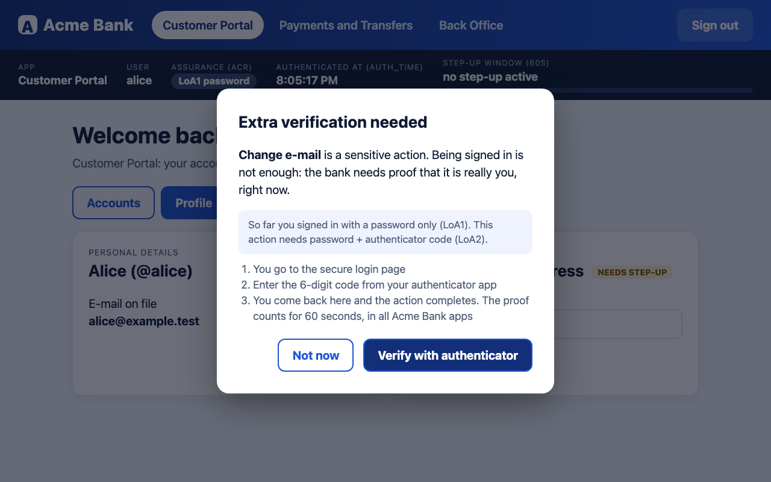
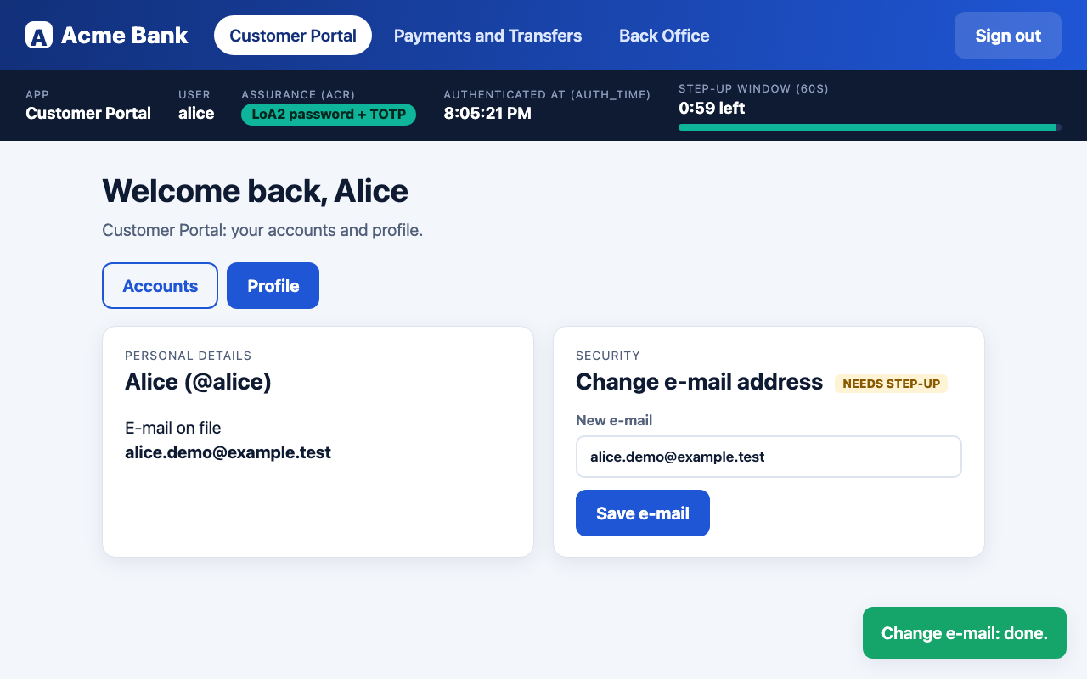
What the demo looks like (backup screenshots)
Step 3: a clear popup explains why extra proof is needed
Step 5: the session panel shows LoA2 and the 60 s countdown
All 14 numbered screenshots are in demo/screenshots
Notes:
These are real screenshots from a run against live Keycloak. If the live demo fails, narrate from these. Left: the step-up popup that explains why. Right: after the authenticator code, the session panel shows LoA2 and the countdown.

Slide 15
Any identity provider: a profile file, not new code
For managers: switching provider is configuration work and testing, not a rewrite. We only proved Keycloak.
Keycloak
Tested: login, SSO, step-up, expiry, logout
Microsoft Entra ID
Template, untested. Uses authentication contexts; no documented login-time claim
Okta
Template, untested
Amazon Cognito
Template, untested. Needs managed login and a paid feature plan
Other OIDC
Generic profile, untested elsewhere
Notes:
IdPs differ in how you ask for stronger authentication and which claims carry the level and the login time. Those differences live in a small JSON profile. Only Keycloak was tested. Entra, Okta and Cognito profiles are templates built from the providers documentation and have never been run against a real tenant. The API even refuses to start with the Entra template when a time limit is configured, because Entra does not document a login-time claim.

Slide 16
Security decisions and honest trade-offs
For managers: strong where it matters, and we list where it is not production grade.
Chosen on purpose
Known weaknesses
Authorization Code + PKCE everywhere
Step-up enforced in the API
Tokens in memory; MVC keeps them on the server
One shared window, set by configuration
Browser memory is exposed to XSS (a BFF is the production pattern)
Small transfers avoid step-up (no cumulative limits)
No front/back-channel logout
Dev setup: http, fake TOTP seed is public
Notes:
PKCE and the code flow keep tokens out of URLs. Enforcement on the API makes browser tampering useless. Tokens in browser memory are weaker than a backend-for-frontend; we chose simplicity and say so. Known weaknesses: the window is really up to 65 seconds, many small transfers avoid the over 1000 rule, no back-channel logout, everything runs on plain http on localhost.

Slide 17
What was actually run, and what was only reviewed
For managers: we separate what we proved from what we only believe.
Run, with evidence
Only reviewed, or not run
Login, step-up, shared window, expiry, cancel, sign-out across all three apps
IdP error and ignored step-up request
Evaluator with shifted clock
API refuses weak, stale and tampered tokens
Windows laptop: nothing run
Entra, Okta, Cognito: templates only
Angular with an ignored request (same code pattern)
Real clock skew between machines
Notes:
Be precise. Run against live Keycloak with a headless browser: 13 end to end checks all passed, 7 negative-path checks all passed (IdP error on return, IdP ignoring the stronger-login request), 9 evaluator cases with shifted clock passed, API checks with curl. Only reviewed or not run: Windows, real tenants of other IdPs, Angular for the ignored-request case, real clock skew between two machines.

Slide 18
Limits and next steps
For managers: it works end to end in the lab; production needs the items below.
Try next
Harden
Extend
Run on the Windows laptop
Test a real Entra or Okta tenant
Backend-for-frontend for SPAs
HTTPS everywhere
Cumulative transfer limits
Back-channel logout
Passkeys (WebAuthn)
Per-action window lengths
Notes:
This is a proof of concept. Next steps if we continue: try it on the Windows laptop, test one real IdP tenant, move SPA tokens behind a backend-for-frontend, add cumulative limits, add back-channel logout, and consider WebAuthn passkeys.

Slide 19
Questions
Everything is in the repo: README, docs/, demo/, and the security review checklist
Notes:
Use docs/presentation/rehearsal-guide.md for the ten likely questions and short answers.

Slide 20
Appendix: glossary
SSO Log in once, use many apps
acr Token field: how strong the login was
IdP The login service (Keycloak here)
auth_time Token field: when the user really logged in
OIDC The standard apps use to talk to the IdP
TOTP 6-digit code from an authenticator app
PKCE Protects the login code from theft
Step-up Extra proof only for risky actions
Access token Short-lived pass shown to the API
JWKS The IdP public keys used to check tokens
Notes:
Reference only. Not part of the 45 minute flow.

Slide 21
Appendix: FAQ
Why not just MFA at login?
Where is the rule enforced?
It annoys users on every login; step-up asks only for risky actions.
In the API, from signed token claims.
What if the IdP ignores the request?
Is refresh used?
Client and API both check the returned level; the action is not performed.
No. A refresh would keep the old login time anyway.
Does it work with Entra or Okta?
Why 60 seconds?
Templates exist; only Keycloak was tested.
So expiry is visible in a live demo; it is a setting.
Notes:
Short answers. The rehearsal guide has more.

Slide 22
Appendix: repo map and ports
Folder | Purpose | Port
apps/react | Customer Portal | 5300
apps/angular | Payments and Transfers | 5400
apps/mvc | Back Office | 5200
api/ | Shared API, enforces step-up | 5100
idp/ | Keycloak realm and IdP profiles | 8180
packages/ | Shared profile loaders and look | -
tools/ , demo/ , docs/ | Probes, demo script, all documentation | -
Notes:
Reference.

