Slide 1
Engineering Graphics Portfolio
Garrett Yeakley & Andrew Januszko

Slide 2
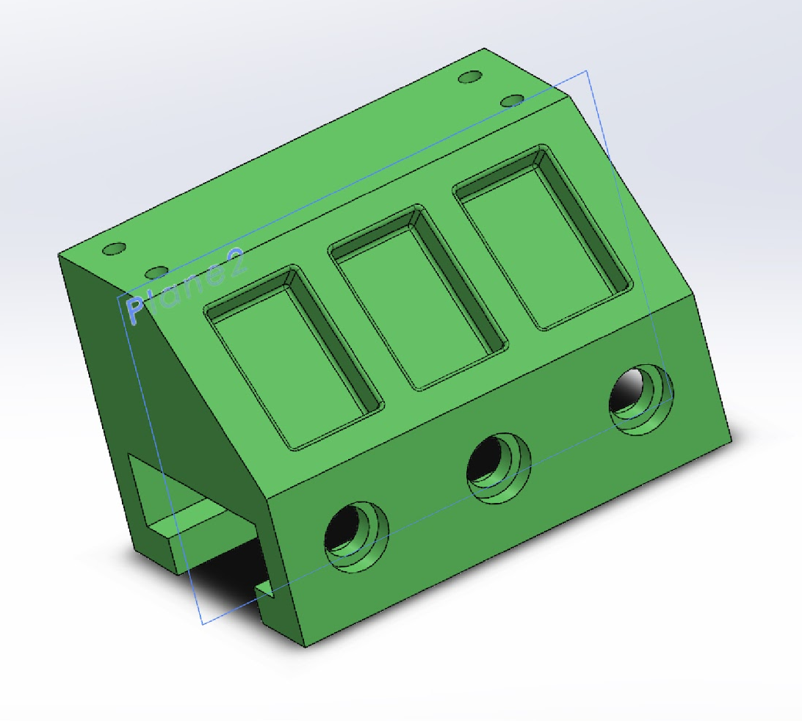
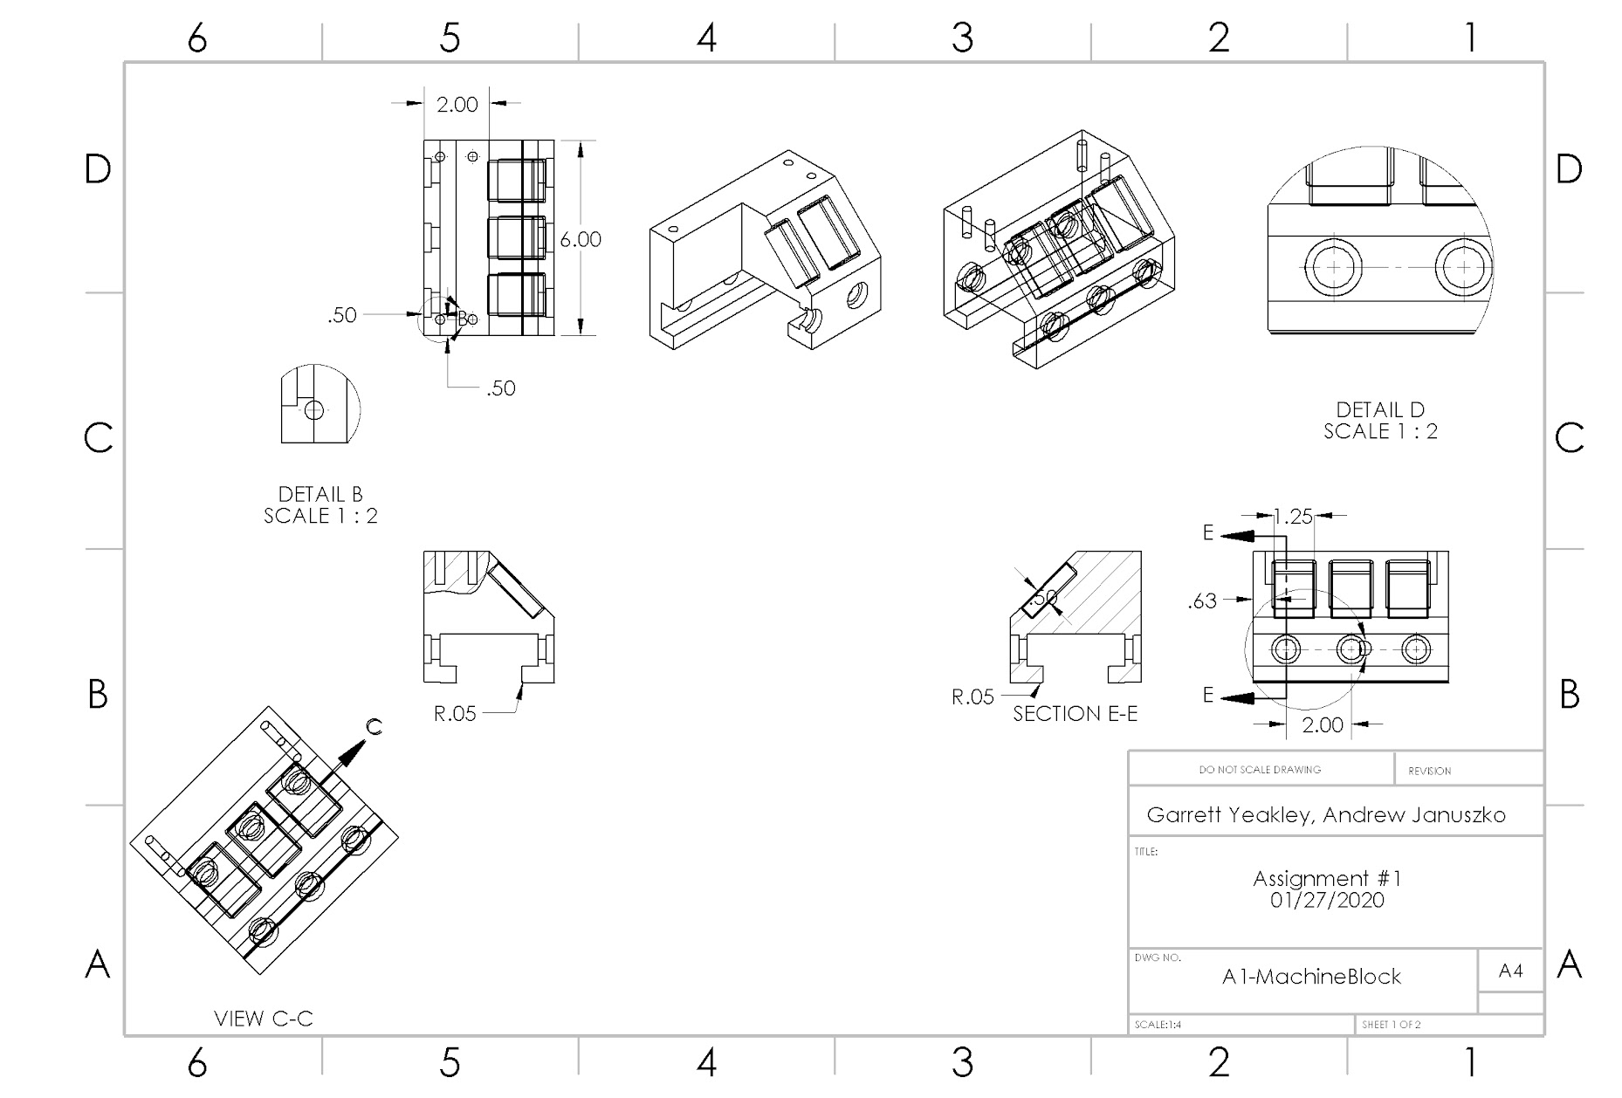

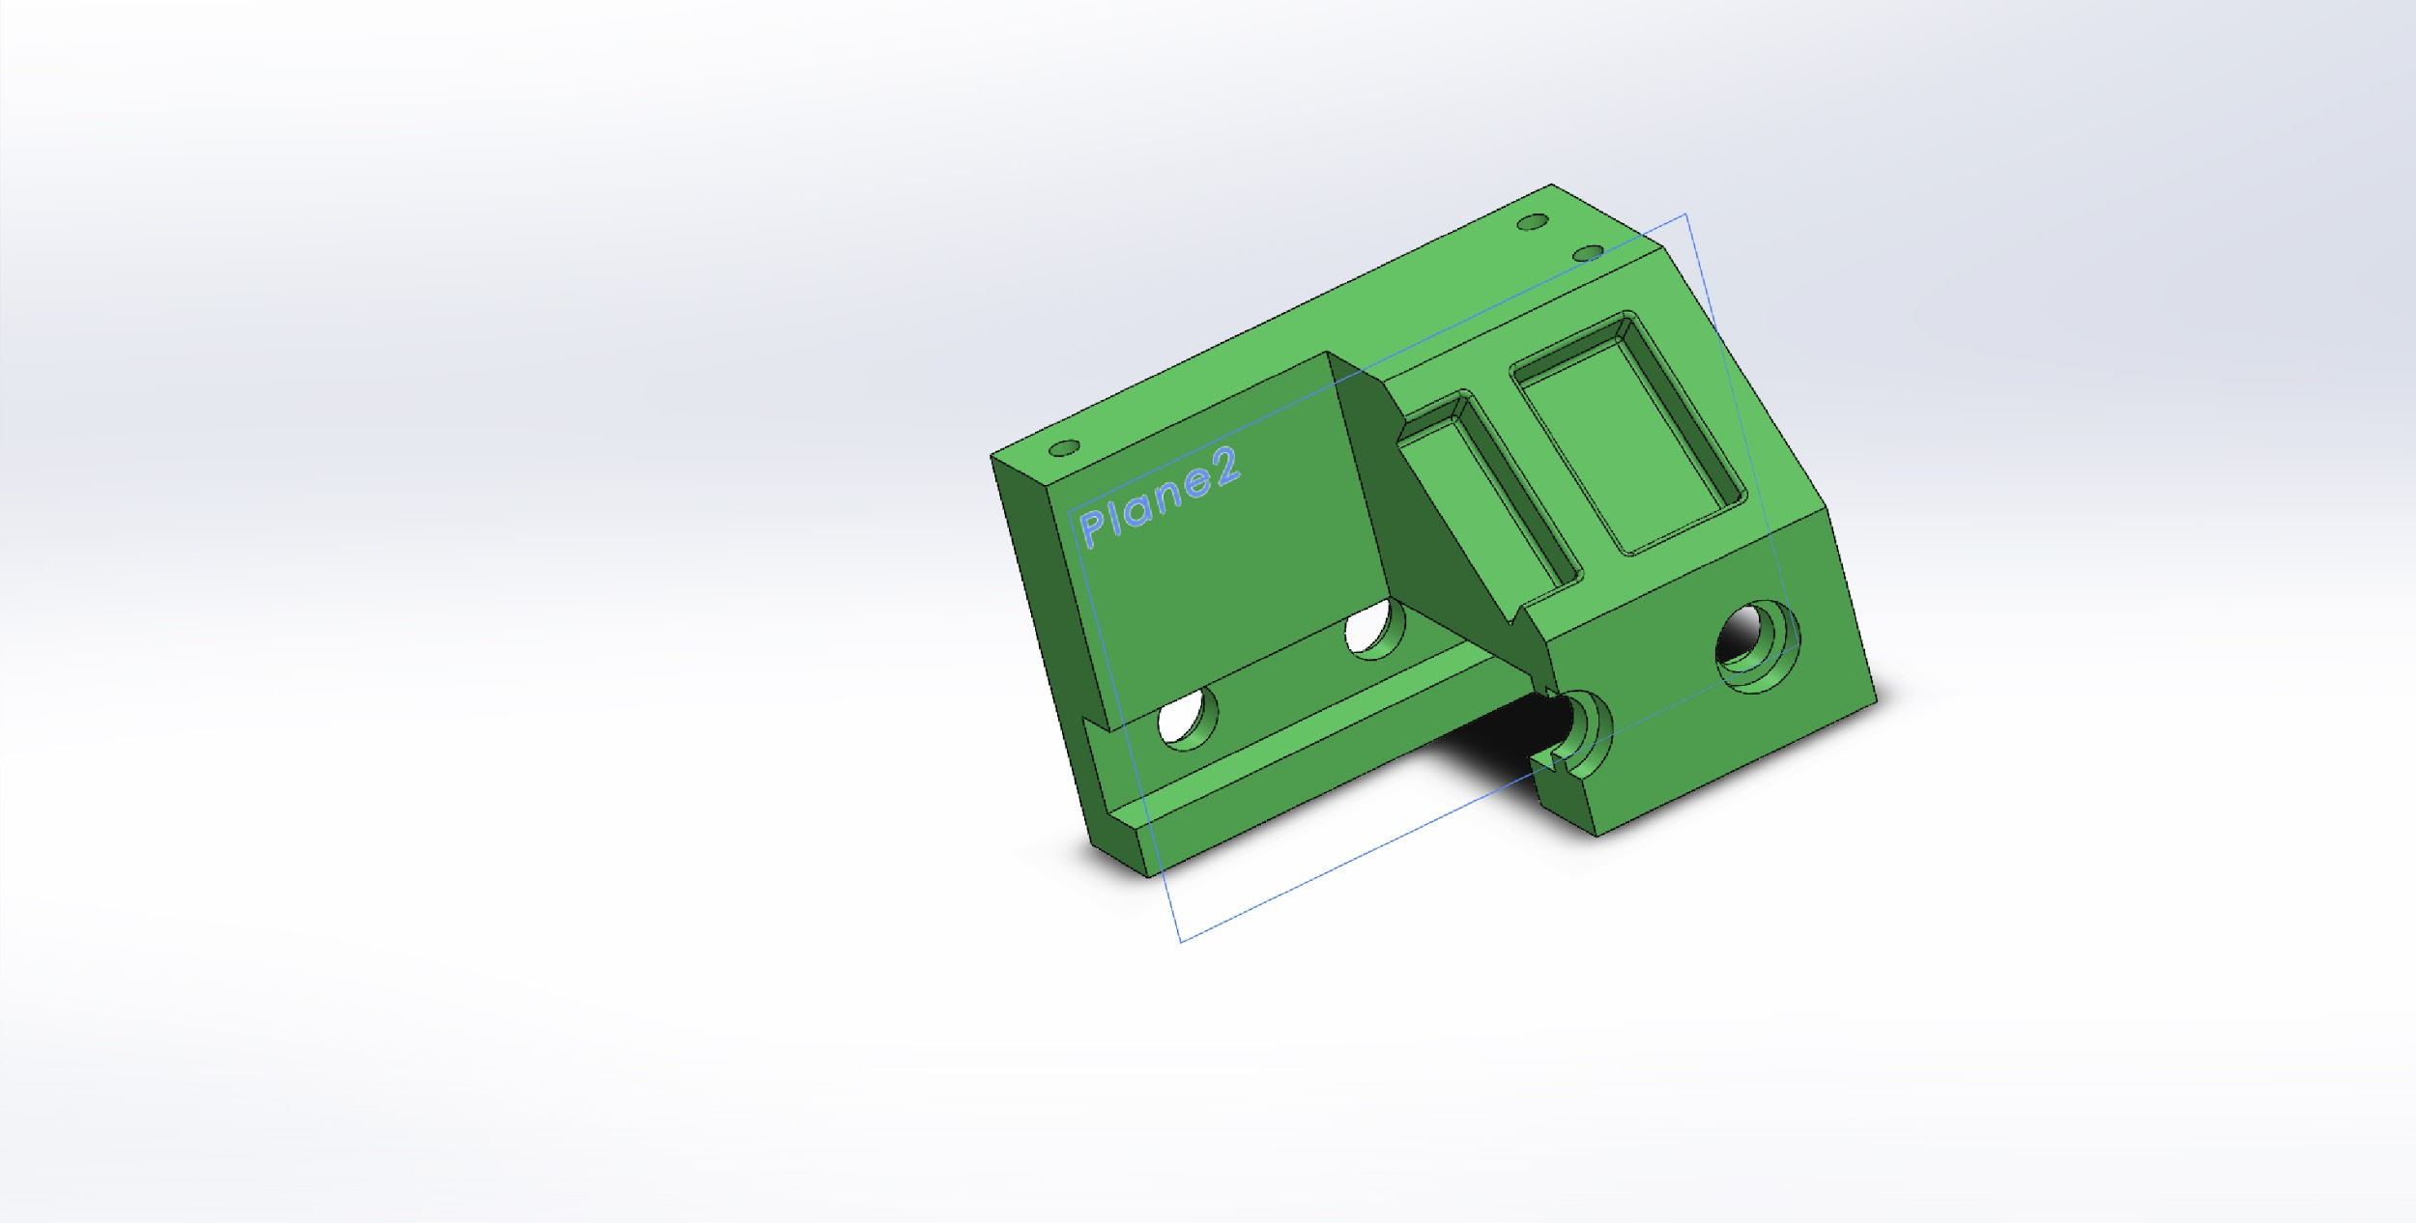
Assignment 1 (Photos)

Slide 3
Assignment 1 (Description)
For this assignment, we drew a sketch, extruded it, and added bore holes and fillets. We also created different configurations of the part. After doing so, we created a drawing file with multiple viewpoints of the part that labels the dimensions. This assignment served as an brief introduction to many of the SolidWorks tools and features.

Slide 4
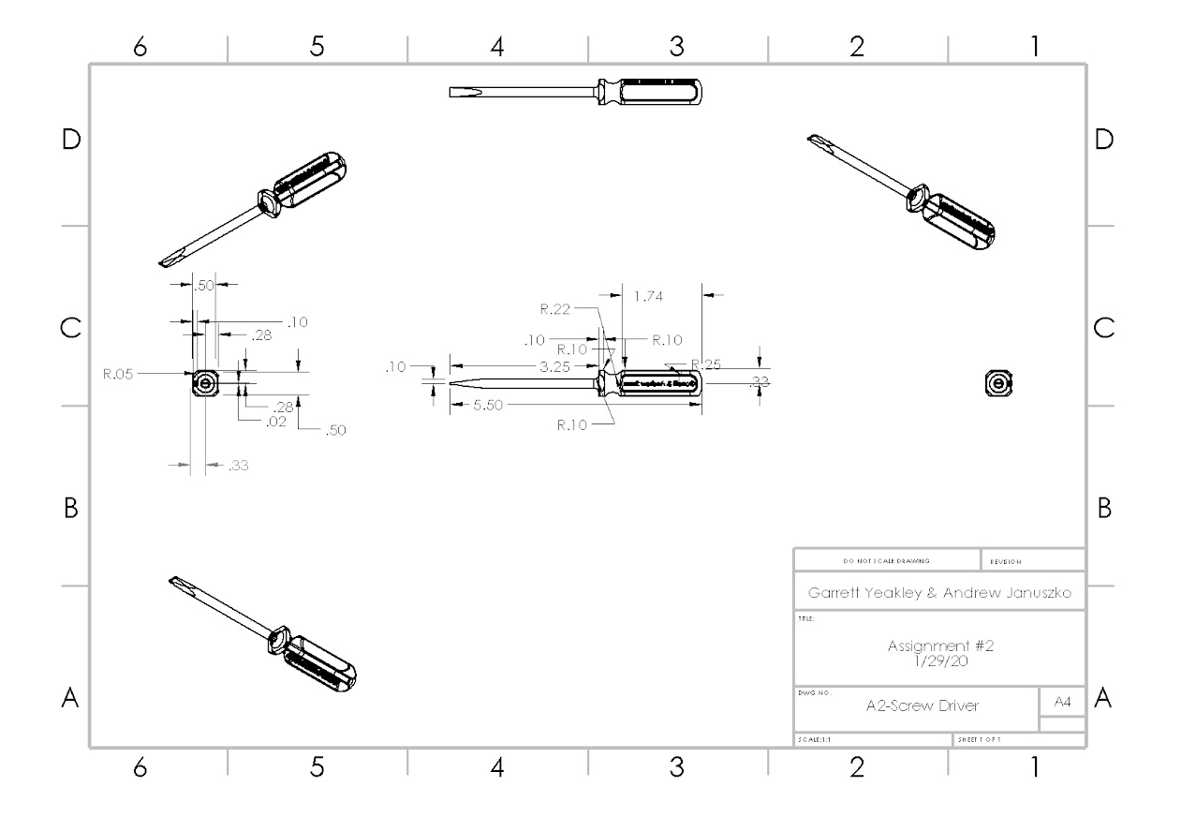
Assignment 2 (Photos)

Slide 5
Assignment 2 (Description)
.

Slide 6
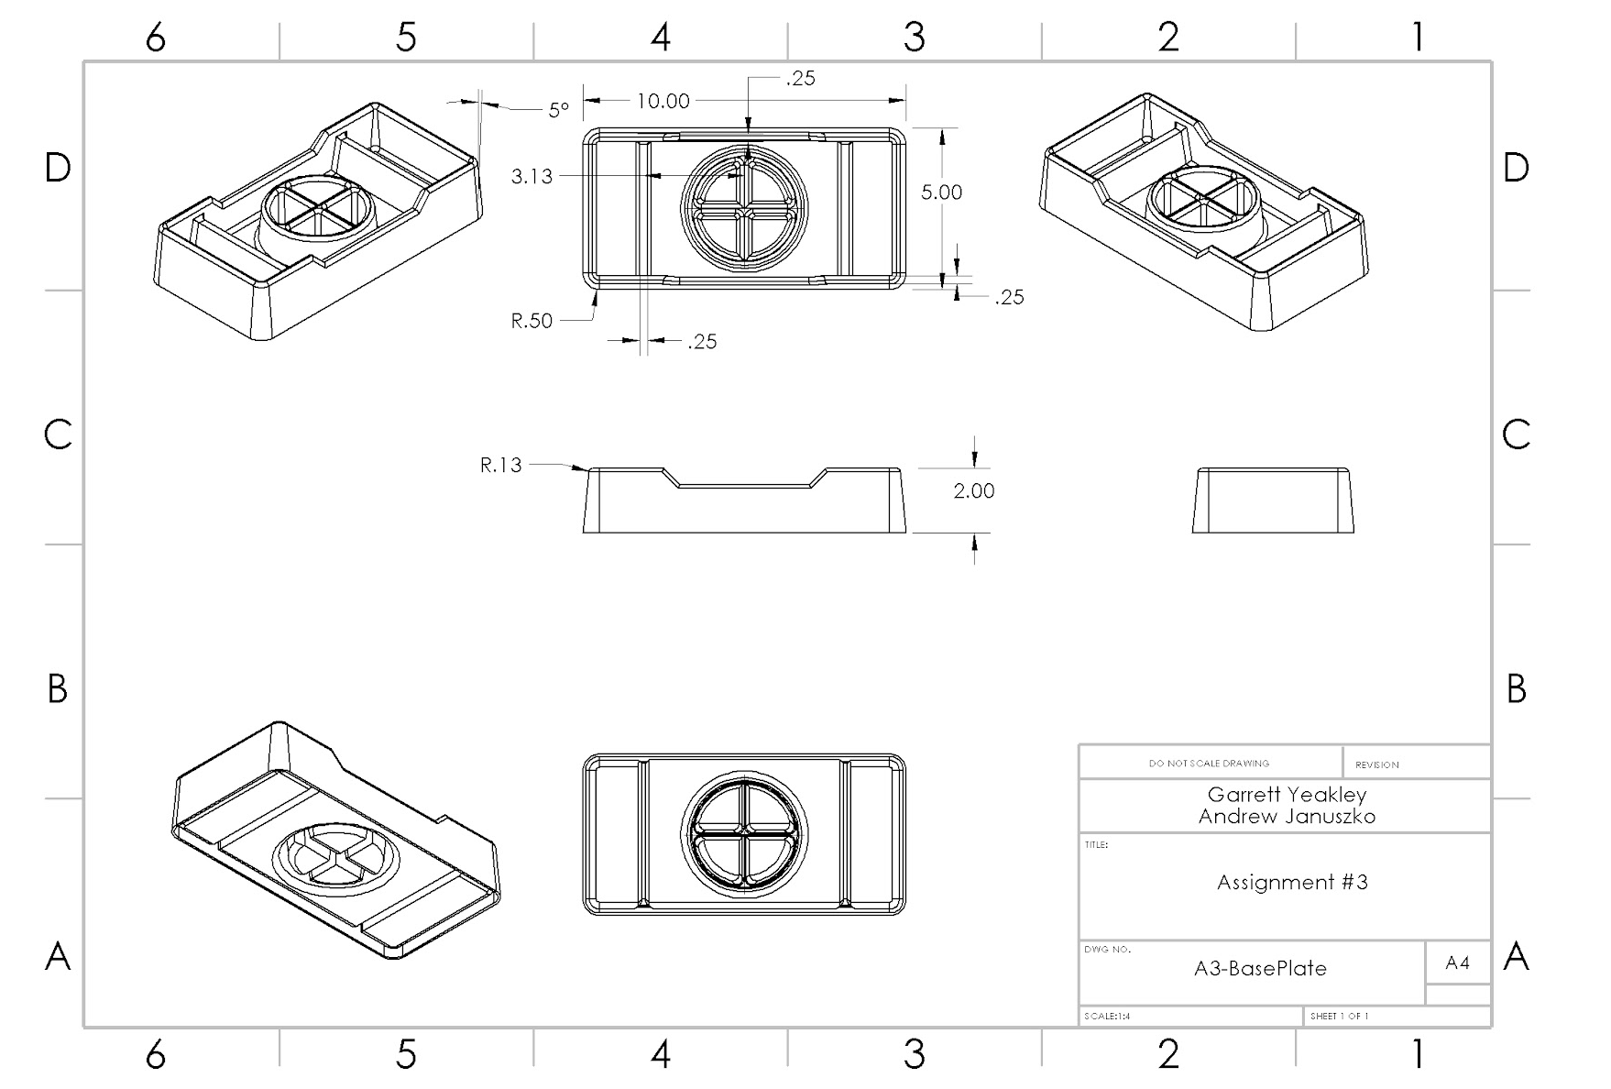
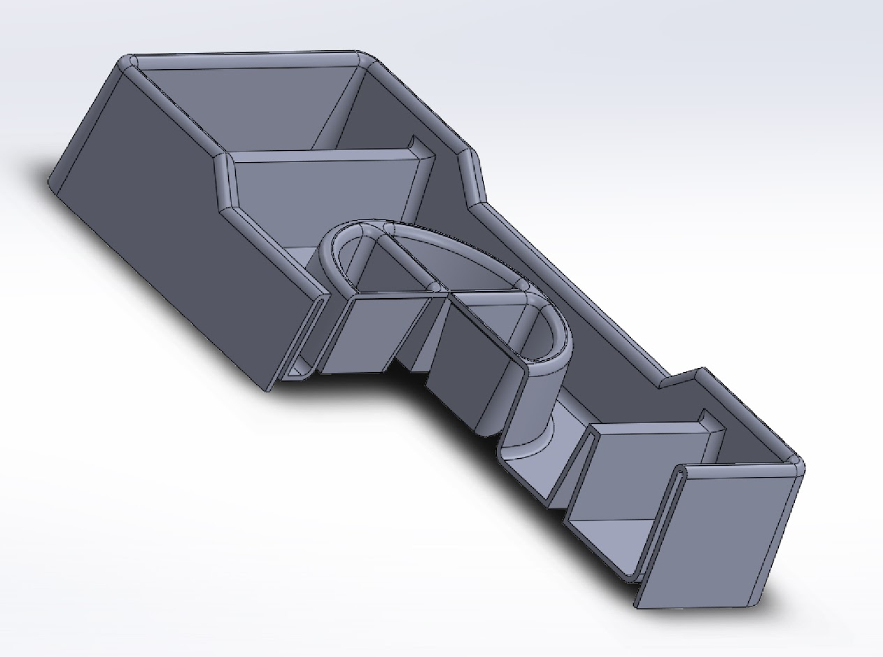
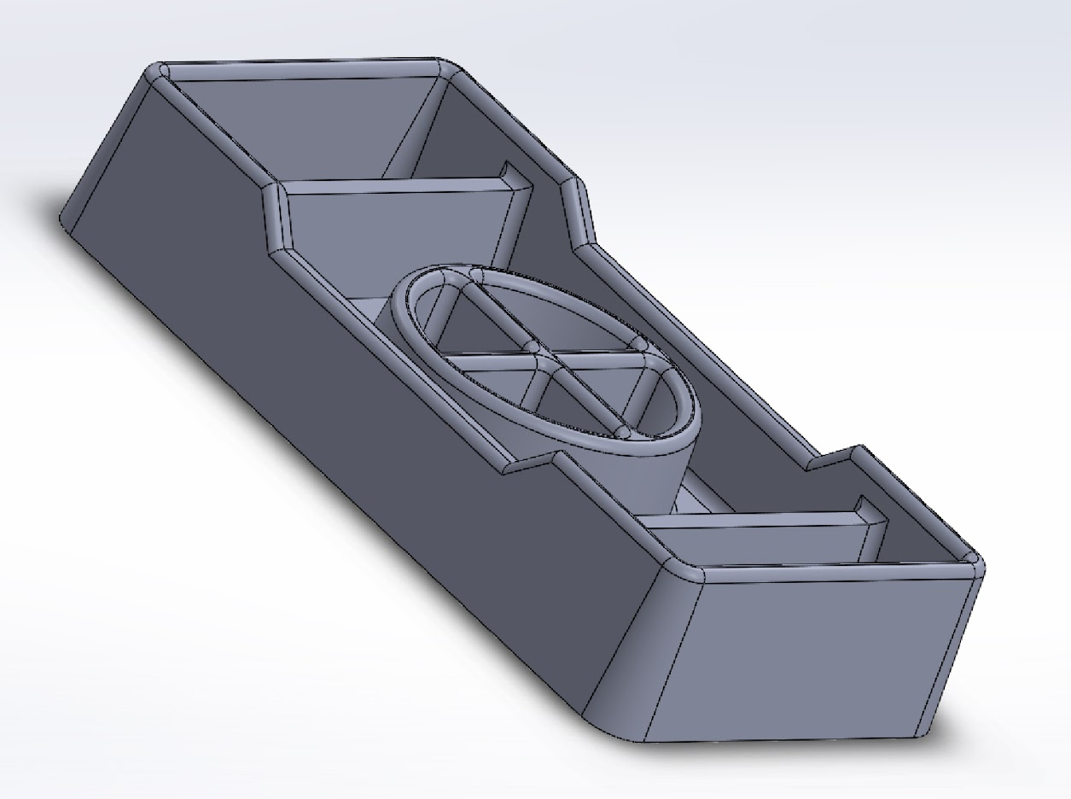
Assignment 3 (Photos)

Slide 7
Assignment 3 (Description)
.

Slide 8
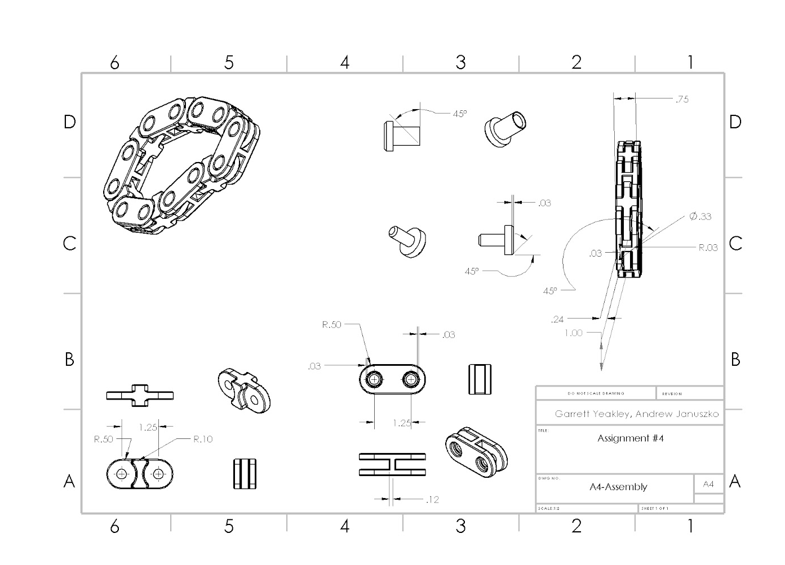
Assignment 4 (Photos)

Slide 9
Assignment 4 (Description)
.

Slide 10
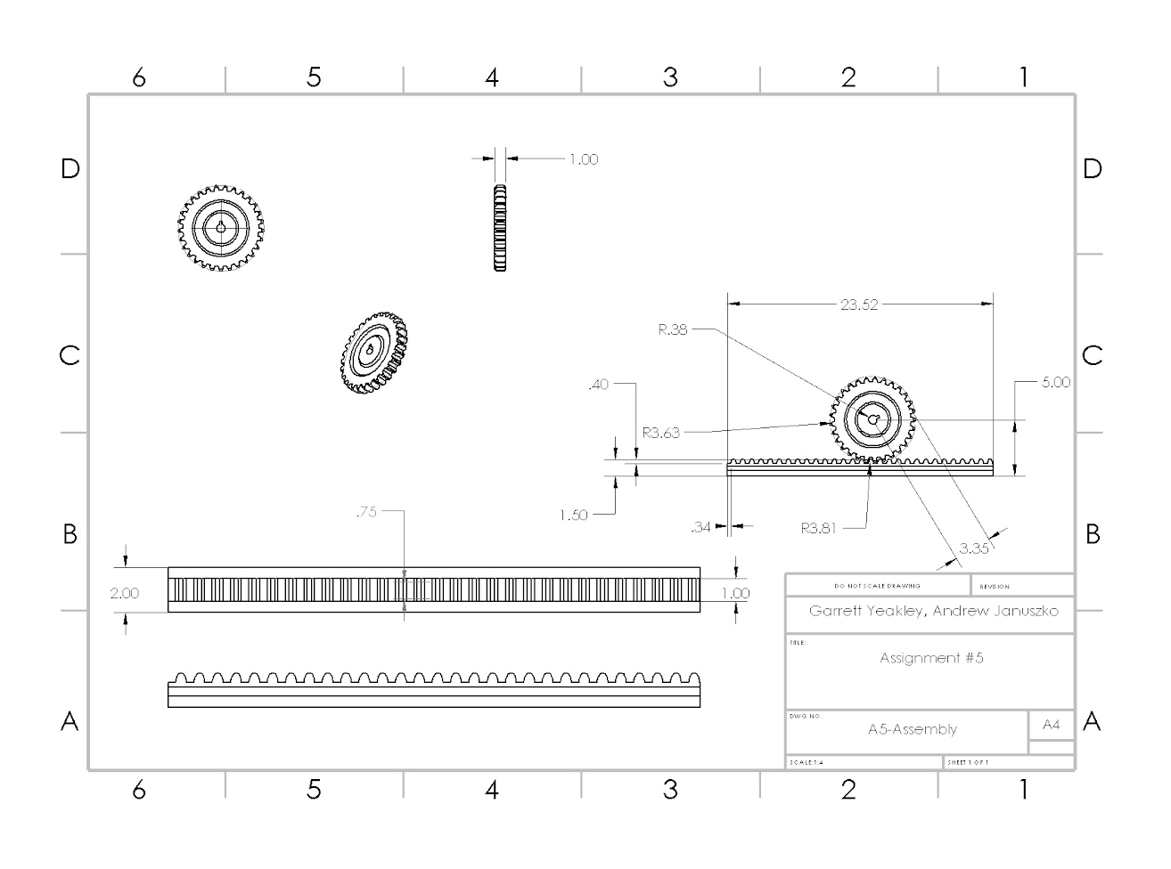
Assignment 5 (Photos)

Slide 11
Assignment 5 (Description)
.

Slide 12
Assignment 6 (Photos)

Slide 13
Assignment 6 (Description)
.

Slide 14
Assignment 7 (Photos)

Slide 15
Assignment 7 (Description)
.

Slide 16
Assignment 8 (Photos)

Slide 17
Assignment 8 (Description)
.

Slide 18
Assignment 9 (Photos)

Slide 19
Assignment 9 (Description)
.

Slide 20
Assignment 10 (Photos)

Slide 21
Assignment 10 (Description)
.

Slide 22
Assignment 11 (Photos)

Slide 23
Assignment 11 (Description)
.

Slide 24
Assignment 12 (Photos)

Slide 25
Assignment 12 (Description)
.

Slide 26
Assignment 13 (Photos)

Slide 27
Assignment 13 (Description)
.

Slide 28
Assignment 14 (Photos)

Slide 29
Assignment 14 (Description)
.

Slide 30
Assignment 15 (Photos)

Slide 31
Assignment 15 (Description)
.

Slide 32
Assignment 16 (Photos)

Slide 33
Assignment 16 (Description)
.

Slide 34
Assignment 17 (Photos)

Slide 35
Assignment 17 (Description)
.

Slide 36
Assignment 18 (Photos)

Slide 37
Assignment 18 (Description)
.

Slide 38
Assignment 19 (Photos)

Slide 39
Assignment 19 (Description)
.

